Slide 1
INTEGRATED MANAGEMENT OF RAILWAY CYBERSECURITY
PROTECTING CRITICAL RAILWAY INFRASTRUCTURE, THROUGH STRATEGIC CYBERSECURITY MANAGEMENT
CURRENT AND FUTURE CHALLENGES
JORGE MARTÍN
OT CYBERSECURITY ENGINEER
SERGIO ALEJO
OT CYBERSECURITY MANAGER
27 NOV 2025

Slide 2
/ CAF strategy
Governance Model
Design and Architecture
Market Solutions Selection
Cross-Cutting Management
Installation Phase
Testing & Validation

Slide 3
Governance Model
/
Local CISO team
Leads project cybersecurity strategy, interacts with clients, defines management plans, and validates all designs
Project Manager team
Develops detailed design and ensures proposed solutions integrate effectively into the global system
Centralised cybersecurity management with local presence across international business consortiums

Slide 4
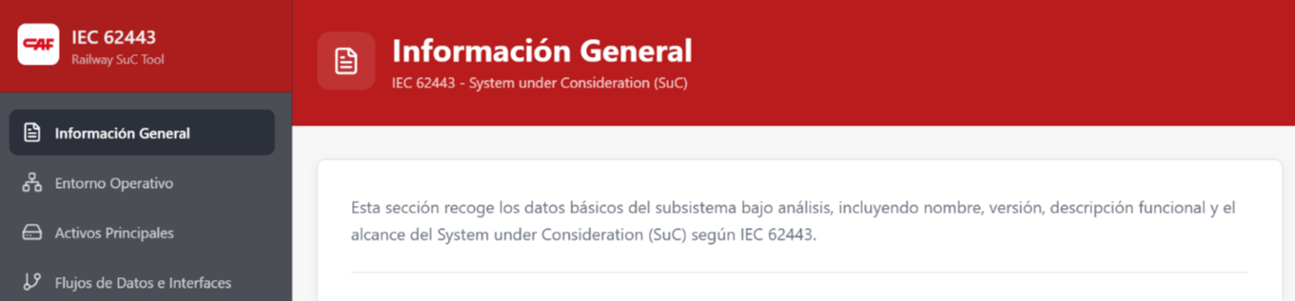
/
Design and Architecture
01
ASSET INVENTORY
Gather information about digital assets, systems, functions, and technologies
02
RISK ANALYSIS
Identify potential threats and assess their impact on critical assets
03
ARCHITECTURE
Develop zones and conduits diagrams for network segmentation and communication flows
04
SOLUTION PROPOSAL
Design firewalls, intrusion detection, authentication, and encryption systems

Slide 5
/
Market Solutions Selection
VENDOR EVALUATION
Compatibility with existing systems
Level of protection offered
Ease of integration
Cost and maintenance
Regulatory compliance
Selecting the most suitable cybersecurity solutions based on comprehensive evaluation criteria

Slide 6
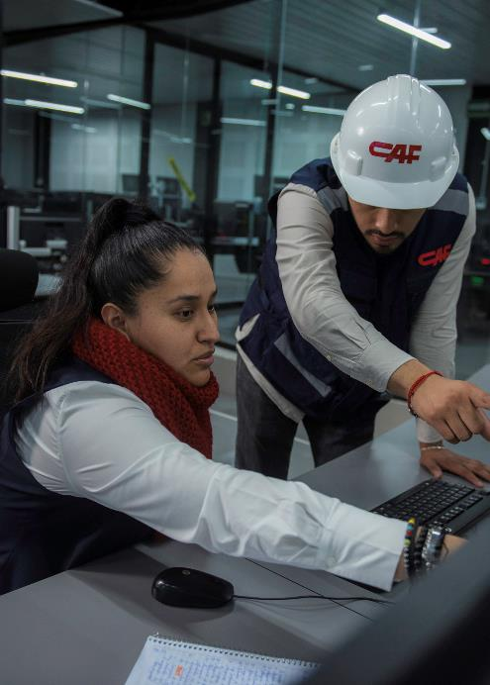
Cross-Cutting Management
/
01
DESIGN VALIDATION
Conduct cybersecurity evaluations per subsystem, analyzing architecture, vulnerabilities, and exposure levels
  Authentication
  Secure protocols
  Updated firmware
  Network segmentation
02
RISK ANALYSIS
Assess effectiveness of measures and determine residual risk for informed decision-making

Slide 7
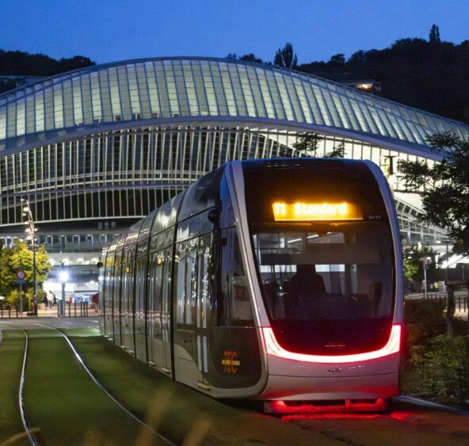
Installation Phase
/
Configuration verification
Connectivity testing
Log and alert review
Operator training
Ensuring smooth integration across engineering, operations and supplier teams through controlled implementation

Slide 8
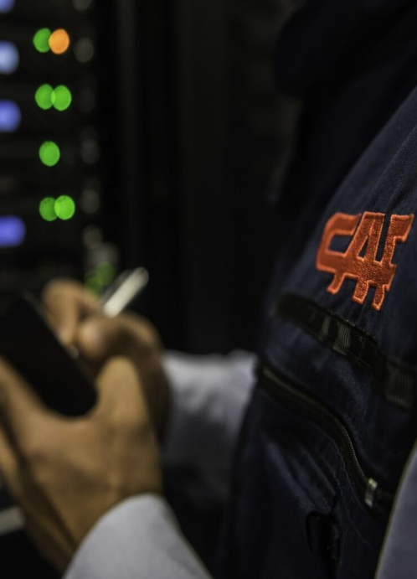
/
Testing & Validation
SOLUTION TESTING
Verify each cybersecurity solution functions correctly
INTEGRATION TESTING
Ensure seamless operation between subsystems
PENETRATION TESTING
Assess resilience against attacks before going live

Slide 9

Conclusion
/
Clear and effective governance
Rigorous and tailored design
Cross-cutting management that ensures coherence
Critical evaluation of solutions
Controlled installation
Exhaustive validation

Slide 10
THE FUTURE OF RAILWAY CYBERSECURITY
EXPLORING TOMORROW’S CHALLENGES IN RAILWAYS SYSTEM:
Artificial Intelligence
Quantum Computing
New Regulatory Frameworks

Slide 11

Artificial Intelligence: Ally and Threat
/
New Attack Techniques
AI automates attacks, identifies vulnerabilities in real time, evades traditional detection
Detection Capabilities
  Real-time monitoring of rolling stock, signalling, telecommunications—detecting anomalous patterns
Response Automation
  Automated incident response under human supervision—every second counts in critical systems

Slide 12
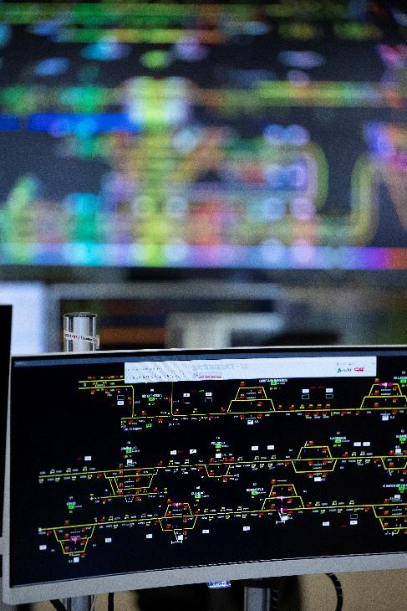
Quantum Computing:
New challenges vs. Innovative solutions
THE THREAT
Shor's algorithm breaks RSA/ECC in seconds
Digital signatures compromised
Identity spoofing risk in signalling systems
THE SOLUTION
Post-quantum cryptography development
NIST standardising quantum-resistant algorithms
CAF laboratory testing emerging technologies
Quantum-safe transition: Inventory current systems, assess risks, plan orderly migration to post-quantum algorithms

Slide 13
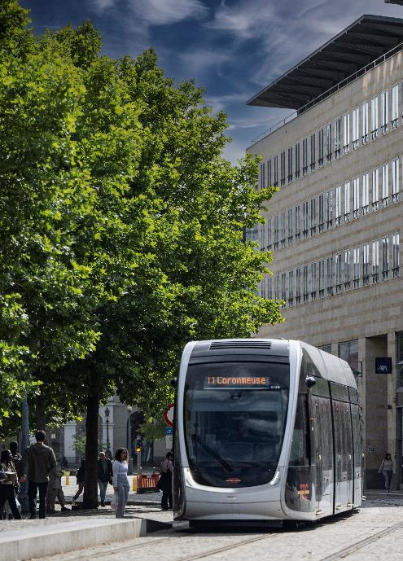
The New Regulatory Framework:
Problem or Solution?
/
NIS2 DIRECTIVE
Cyber risk management systems
Rapid incident reporting
Supply chain monitoring
Executive-level responsability
IEC 63452 STANDARD
First International railway cybersecurity standard
Full lifecycle coverage
Integrates with functional safety (RAMS)
Defines roles for all stakeholders
CYBER RESILIENCE ACT
Security by design mandatory
Lifecycle security updates
CE marking for digital products
Transparency requirements

Slide 14
/
A Secure Future Starts Today
Cybersecurity is not technical – it’s strategic
CAF CYBERSECURITY LABORATORY: Our pillars
/ AI & Post-Quantum Cryptography Evaluation
/ Testing & Simulation
/ Collaboration
/ Team Training
Evaluating AI and post-quantum cryptography
Penetration testing, cyberattack simulations, proprietary tools
Working with regulatory bodies and universities
Integrating cybersecurity from design to operation
The future of rail is digital – but it must also be secure

