Slide 1




Taking a partnership approach to reduce risk and maximise outcomes: The results are in!
Danielle Harrison – Head of Mobility Outcomes, Arjo UK
Andrea Commander-Twell – Clinical Manager, Arjo UK
Marta Venerus – Sister, Critical Care, North West Anglia NHS FT

Slide 2
The burden of pressure ulcers at NWAFT in 2023
£11m
to treat¹
1785 reported HAPU’s in 2023
59%
(national average = 41%¹)
1055 reported as Cat 2
Notes:
DH – To update audience on reason Arjo were asked to help within the Trust
Question to Marta - What she thought when she saw these numbers? What is impact on patients she cares for and herself as a caregiver?

Slide 3

Arjo MOVE Pressure Ulcer Prevention Programme
For stage methodology
1. Define and Measure
2. Analysis and Design
Understand performance goals and identify metrics for success
Anchor project with decision-makers
Define product gaps
Sign contract with defined outcomes
Map and design processes
Refine Key Performance Indicators (KPI)
Critical part to ensure all root causes are fully mitigated by the solution
4. Consult and Sustain
3. Implement and Go-live
Provide continued support to help sustain a culture of improvement
Quickly identify hotspots and address issues
Reassess annually to identify new issues
Implement solutions and equipment
Appoint MOVE Coaches
Initiate peer to peer coaching, supporting new ways of working according to updated processes
Notes:
DH – Overview of MOVE 4 stage methodology and importance of the structure

Slide 4
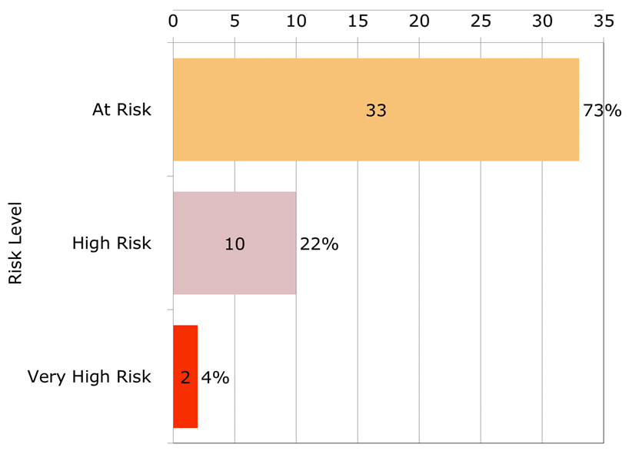
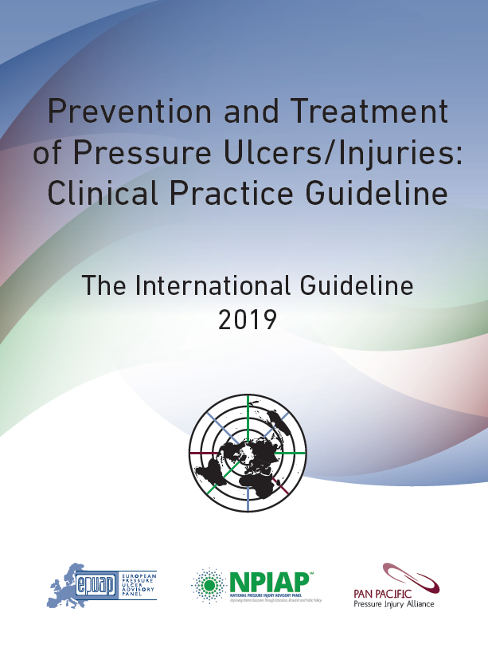
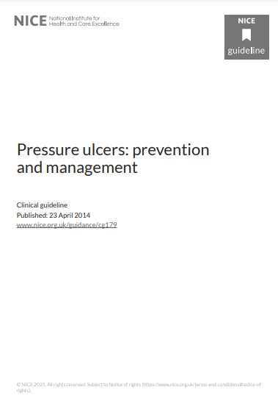
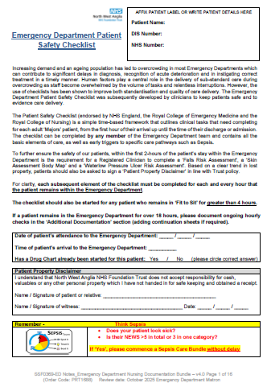
Define and Measure
Clinical prevalence - Quality of preventative care
45 patients assessed in ED
100% of patients had sufficient risk factors to be vulnerable to developing a pressure ulcer.
26 (58%) of patients in ED were identified as never risk assessed on admission
Notes:
DH – Update on why ED was chosen as initial focus area. Overview of measurements taken and some of queries raised by team – 2 hour KPI, No MUST etc. to hi-light all patients at risk based on adapted WL risk assessment also frequency of reassessment and ‘setting up to fail’
Question to Andrea – This was Arjos first Clinical prevalence in an ED and we have completed a couple since then – why was it so important to drill down to this level within this environment? Answers around – changes in ED in recent years, risk to patients and caregivers, some areas more like wards due to LOS, importance of keeping patient flow moving, etc

Slide 5
Define and Measure
Clinical prevalence - Seating and mattresses
Notes:
Will possibly update slides to later Clinical prev results – this is the original but most impactful
DH – Chairs in ED – no pressure relief – addressed immediately. ALOS @ 15.5 hours shows importance of correct seating. Access to matts and observations around provision and relative to existing contract
Question to Marta – Can you explain to us why the correct surfaces (both seating and mattresses) is so importance for patients?

Slide 6

Analysis and Design
Process Mapping - Emergency Care
Assessment
Consider introduction of Purpose-T risk assessment –
  Allows screening of patients and define those in need of full risk assessment
Review audit process for all quality of preventative care measures
Prevention Management
Review –
  Current mattress ordering process
  Process for sitting patients in a chair both in Majors and Fit 2 Sit
  Process for transferring patients from a trolley to a bed at “hour 6”.
  Frequency of repositioning and transfer activities, ensuring the use of appropriate patient handling equipment, such as slide sheets, and active and passive hoists
Notes:
DH to explain Process Mapping and why needed
Andrea to explain restrictions of current RA and benefits of using Purpose-T

Slide 7
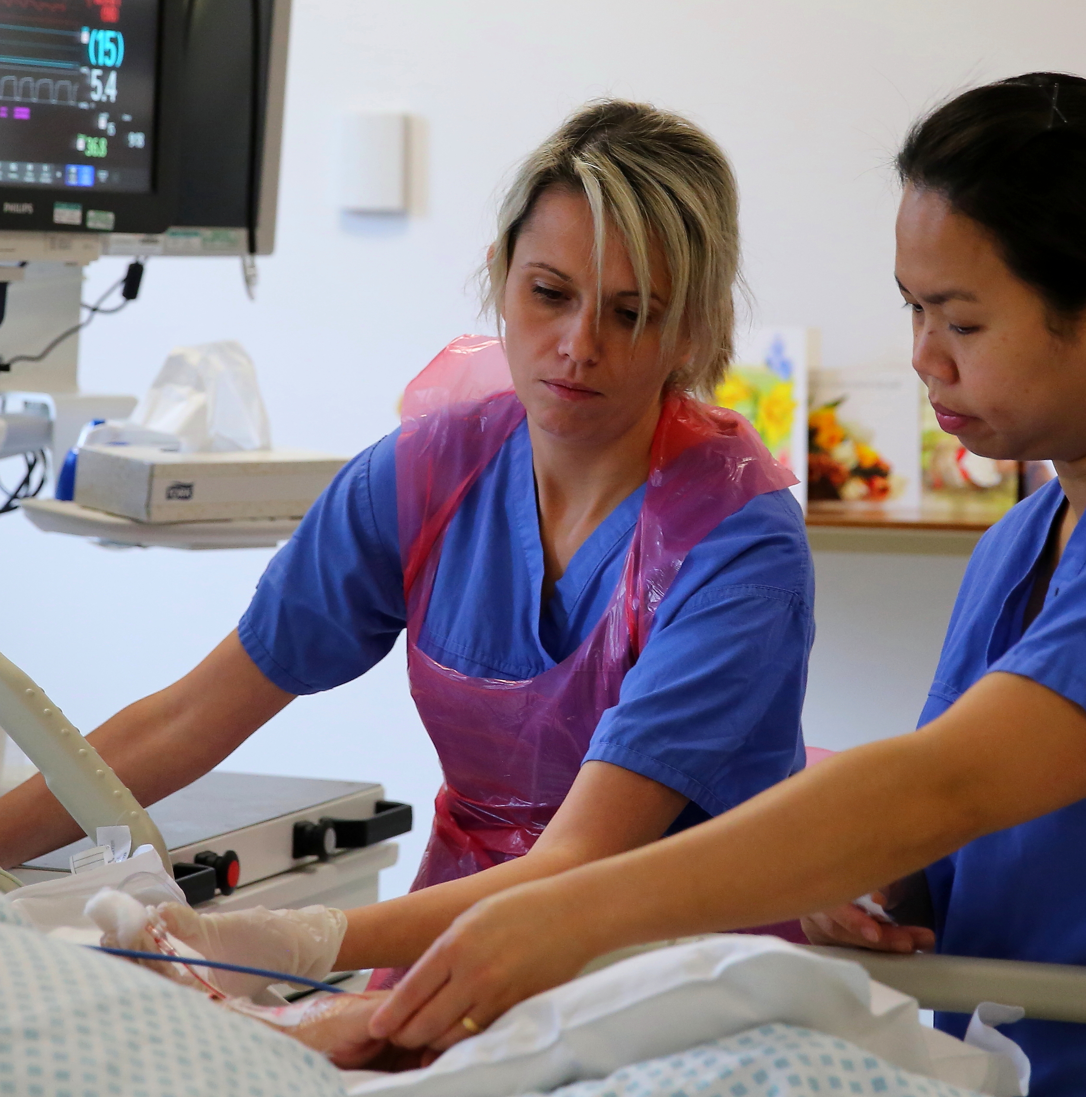
Analysis and Design
Process Mapping - Critical Care
Prevention Management
Consider limiting sitting time for high-risk patients to under 2 hours.
Review –
  Positioning of patient’s medical devices
  Early mobilisation and rehabilitation strategy
Monitoring and Evaluation
Implement an audit process and KPI’s for monitoring quality of preventative care measures
Review step-up / step-down process for patients as clinical condition determines
Discharge
Review and update VSA and PU risk assessment as part of discharge process using the SBAR handover
Notes:
Marta to expand on importance of a robust early mobilisation and rehabilitation strategy

Slide 8
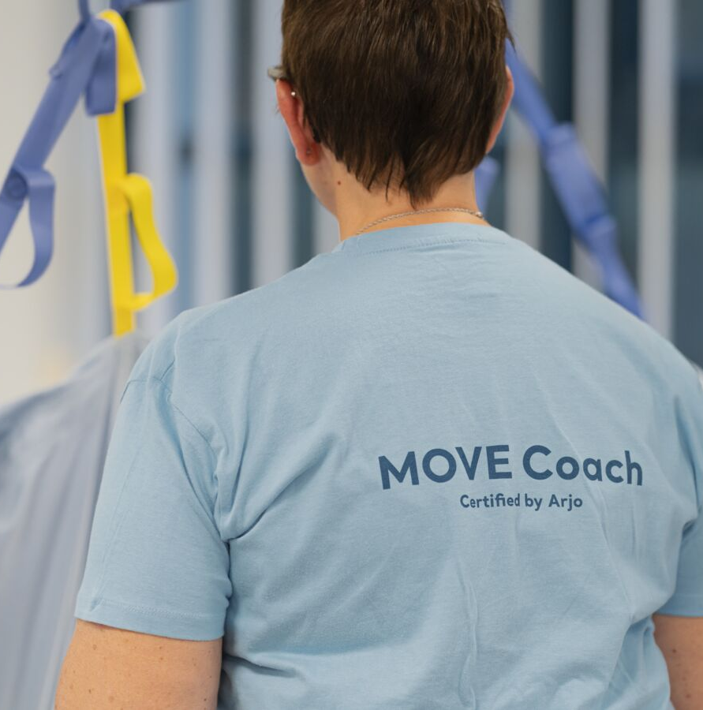
Implement and Go Live
MOVE Coach CPD Accredited Training
Day 1: Principles of pressure ulcer prevention
Day 2: Pressure redistribution surfaces and clinical decision making
Day 3: Mobility assessment, repositioning & transfer activities, and clinical decision making
Day 4: Repositioning & transfer activities and clinical decision making
Day 5: Workplace coaching and embedding a cultural change in clinical practice
Notes:
DH will introduce the MOVE Coach model (peer to peer support, workplace coaching)
Question to Andrea – What challenges did you find during the training? (environment, management of staff availability, engagement, etc
Question to Marta – What were your initial expectations of the training? How did this change during the course? What key takeaways did you have from the MOVE course experience?

Slide 9
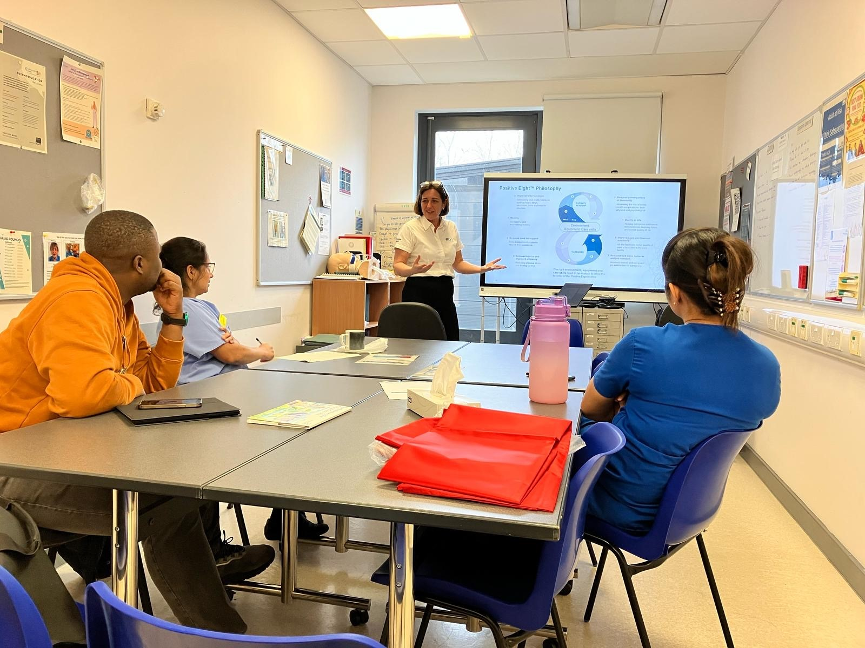
Feedback from ward staff
“I loved the course and would definitely encourage others to attend”
“A very informative and practica course”
“Knowledgeable, non-judgemental and supportive consultants”
“What I like the most are the practical sessions where we can apply or practice our skills”
“I like the blended learning of presentations, discussions and practical sessions”

Slide 10

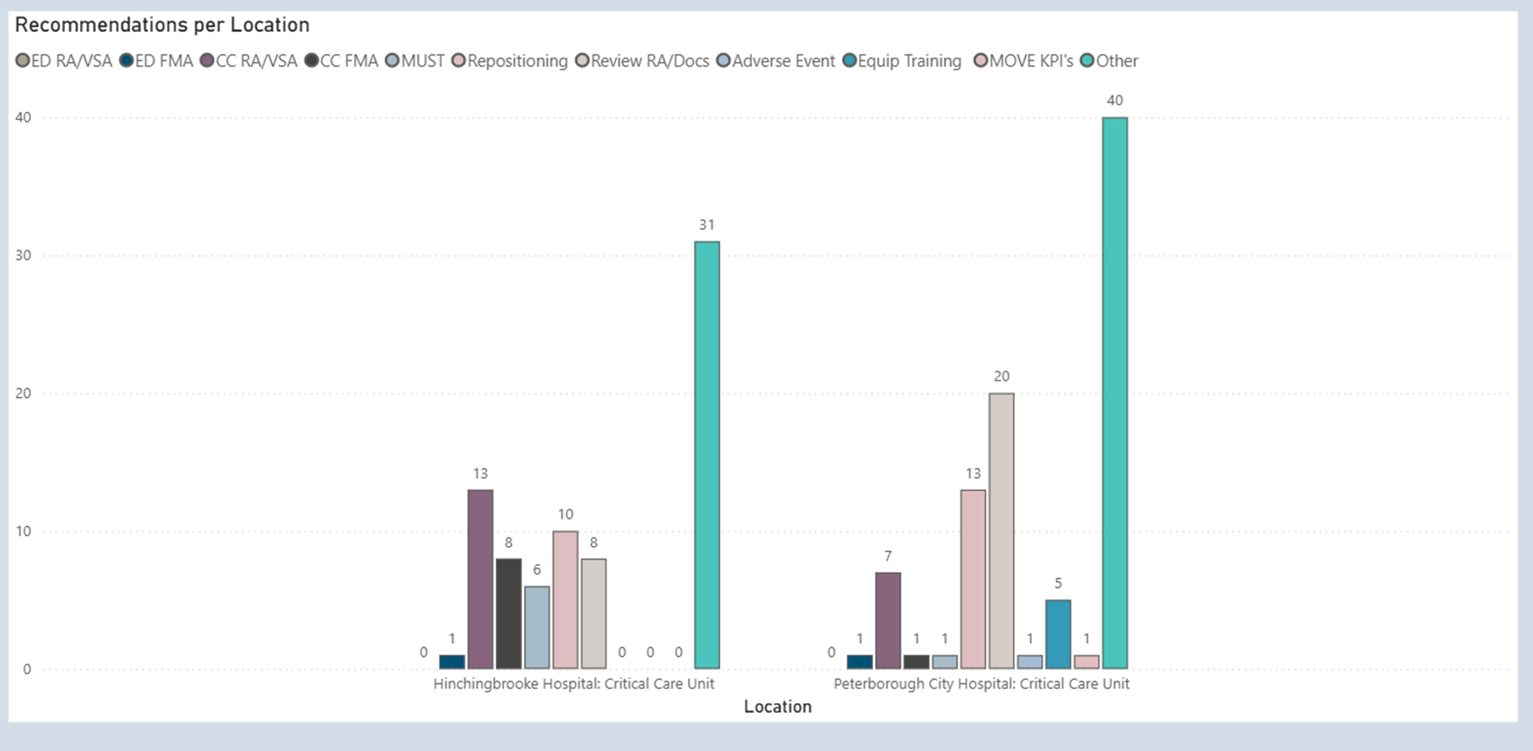
Consult and Sustain - On site visits
Notes:
DH to provide overview of Arjo Clinical Consultancy Teams activity during this phase and explain about app developed
Question to Andrea – How helpful has the app been during this phase?
Question for Marta – How did you and the CCU team find the presence of the Arjo team during this time? Could explain that the Arjo team members felt part of the team and the benefits of having the Arjo team on site whilst the MOVE Coach was embedded

Slide 11
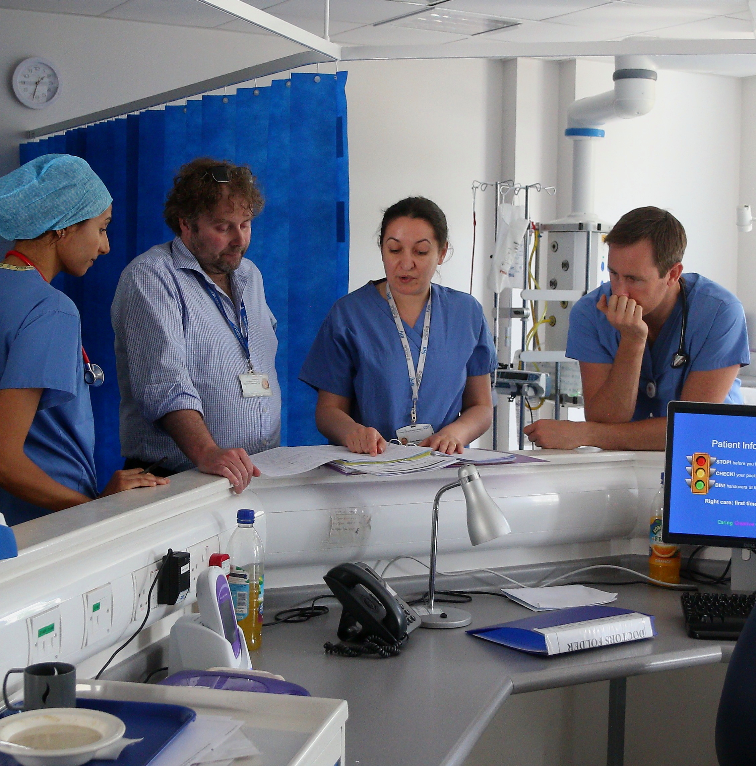
Consult and Sustain
Move Coach Projects – Critical Care
Adapted Waterlow Risk Assessment:
  Update the ICCA system and supporting evidence to reduce inconsistencies in assessment documentation
  Adjustments to ICCA system within the next two weeks.
  MOVE coach will start supportive training
Mattress Selection Guide:
  Develop and implement a step-up/step-down process to ensure patients' clinical needs are met effectively.
Seating:
  Collaborate with the therapy team to review current specialist seating, promoting early mobilisation and rehabilitation.
Notes:
Marta to talk about projects identified, the processes involved in implementing changes and benefits to caregivers and patients

Slide 12
Consult and Sustain
Quality of preventative care improvements- ED
Notes:
DH to introduce results for ED – explain new baseline created before Go Live and update on ED lead response.
Questions to Andrea – how did it make you feel when you saw these results?

Slide 13
Consult and Sustain
Quality of preventative care improvements - PCH CCU
Notes:
DH to introduce results for PCH CCU
Question to Marta – why are these improvements so important? Ideas – reducing risk to patient, acuity of patients in CCU high so must ensure all assessments completed, etc

Slide 14
The burden of pressure ulcers
Cost efficiencies created in CCU – estimated 1 year
53%
reduction
116
reported HAPU’s (12 month period)
55
Reported HAPU’s (second 6 week comparison)
£440k
cost avoidance
£715k
to treat
£275k
to treat
(second 6 week comparison)
Note count of Datix lines not multiples of Pus. Healed and Mucosal not used in Burden of pressure ulcers
All data based on NHS productivity Calculator
Notes:
DH to introduce slide and results
Question to Marta – what were your first thoughts when you saw these numbers?
Question to Andrea – Why is this data so important for the work we ahave been doing within the trust?

Slide 15
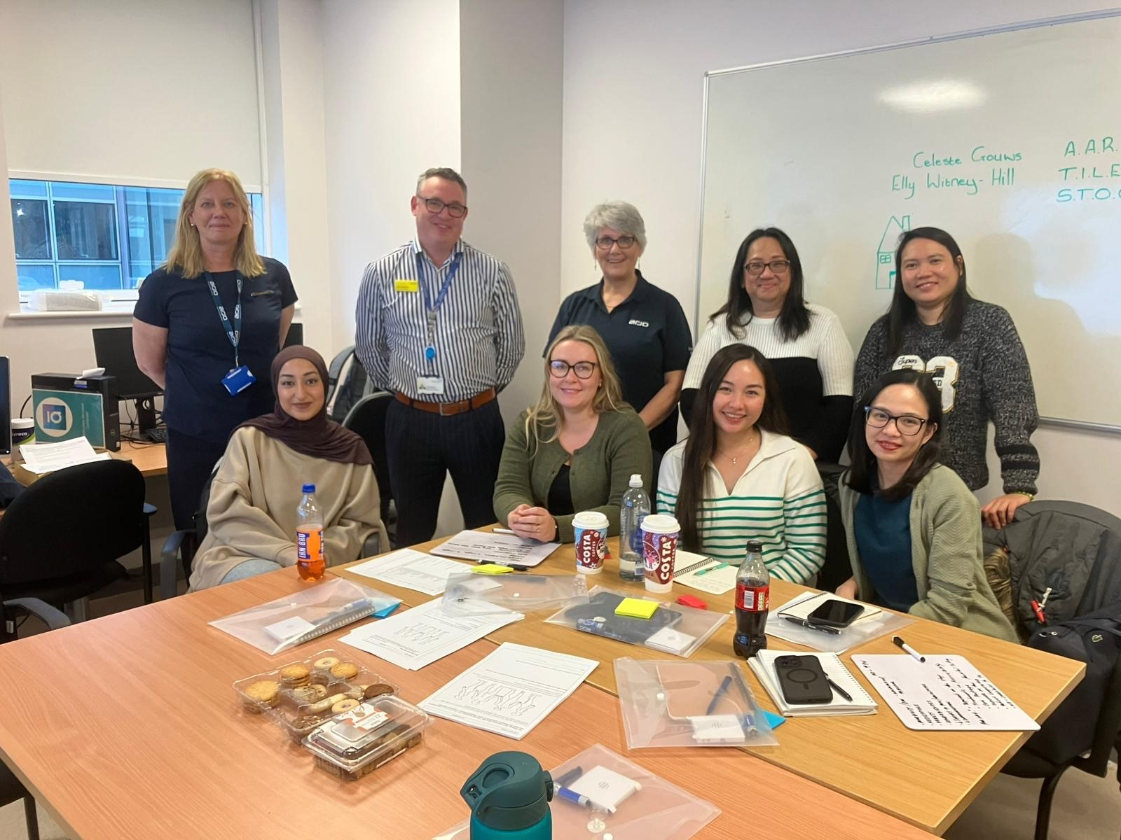
The importance of taking a partnership approach to reduce risk and maximise outcomes
Understanding the problem
Data to evidence the impact of the problem
Agreed measurable outcomes
Accountability and responsibility
Bespoke training and education
Clinical consultancy
Culture change and sustained model
Long standing trusted partnership
Notes:
Summary – Problem statement, why NWA with Arjo, this is how Arjo NWA will partner, mutually agreed measurable outcomesPartnership approach, 2 organisations can come together to improve patient experience and improve employee development and retention. Facility owns the program – Arjo are support. Accountability and responsibility -

Slide 16

Q & A
Notes:
All

