Slide 1
A Future Fit Workforce?
Prof. James Buchan
james_buchan@hotmail.com

Slide 2
A Future Fit Workforce?
Begin with a cliché……
Looking back
Workforce and the Ten Year Plan snapshots:
  Reliance on international staff
  Next gen
  Tech
Looking forward: Sustainability, not a shopping list

Slide 3
A cliché…Healthcare workforce planning/ policy
The cliché:
Healthcare workforce planning/ policy is : “The right numbers in the right place…”
The reality:
“The right staff in the right place, at the right time, with the right skills, in the right teams, in decent work, in supportive organisational cultures and effective management, with the right resources, connected to their communities…….”

Slide 4
Looking back: Over-specialisation:
Which country and date….?
“The practice of medicine is highly specialized. Individual doctors will treat individual ailments, rather than the whole gamut of diseases. As a result CountryXXX positively teems with doctors; some specialize in treating eyes and others heads; some are dentists and others tend to the stomach; some specialize in obscure illnesses”.
Year xxxx

Slide 5
Looking back: Over-specialisation
“The practice of medicine is highly specialized. Individual doctors will treat individual ailments, rather than the whole gamut of diseases. As a result Egypt positively teems with doctors; some specialize in treating eyes and others heads; some are dentists and others tend to the stomach; some specialize in obscure illnesses”.
Herodotus: year: c 450 B.C.
(The Histories. Book Two, para 84;translation by Tom Holland, 2013)

Slide 6
Looking back: National health workforce “solutions”
National report proposing solutions to nursing shortages:
Skill mix change: use of support workers to “free up” nurses to deliver care
Retention: examine pay and incentives , pension, workload
“Returners” : implement measures to enable non practicing nurses to come back to the workforce
Which Country/ Year?

Slide 7
Looking back: National health workforce “solutions”
National report proposing solutions to nursing shortages e.g.:
Skill mix change: use of support workers to “free up” nurses to deliver care
Retention: examine pay and incentives , pension, workload
“Returners” : implement measures to enable “married” nurses to come back to the workforce
UK, 1945: Ministry of Health 'Staffing the hospitals: An urgent national need’.

Slide 8
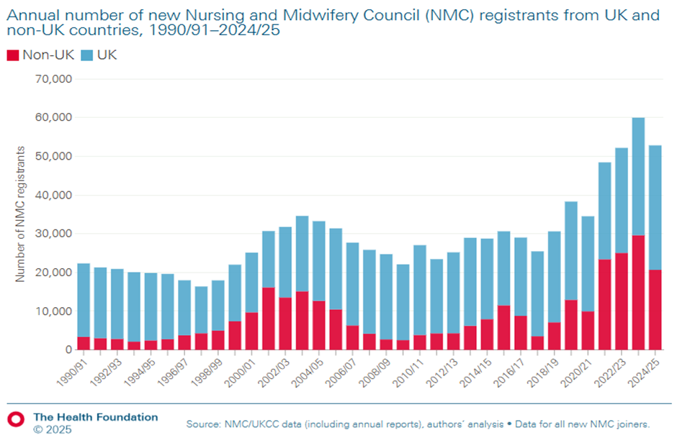
A 10% international staff threshold?: Annual number of new NMC registrants from UK [blue] and non- UK countries [red] 1990-2025

Slide 9
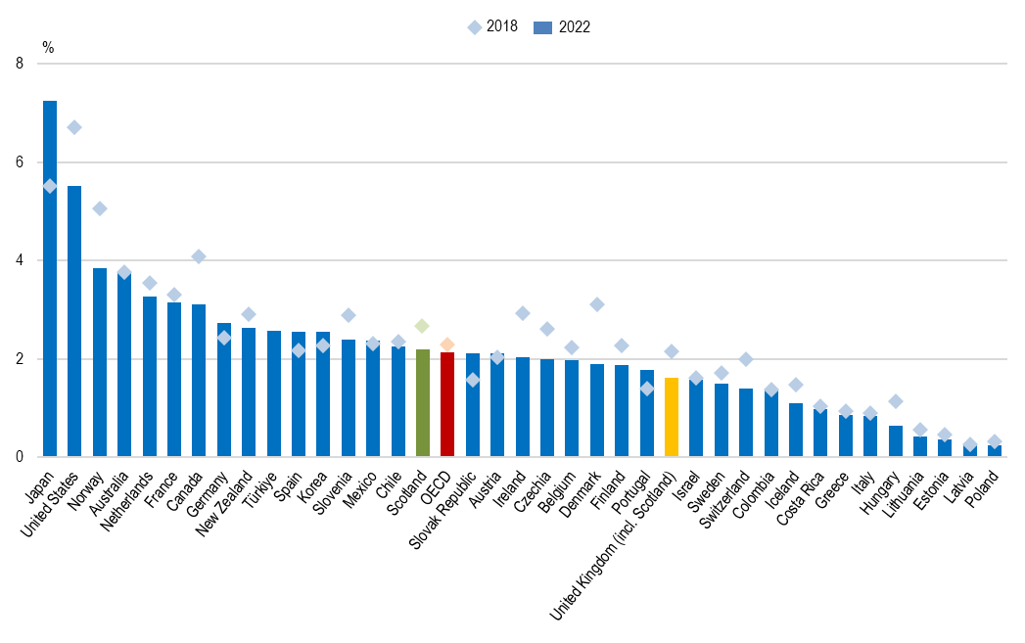
Next gen?: Nursing interest among 15-year-olds, OECD countries, 2018 and 2022 (OECD,2024)

Slide 10
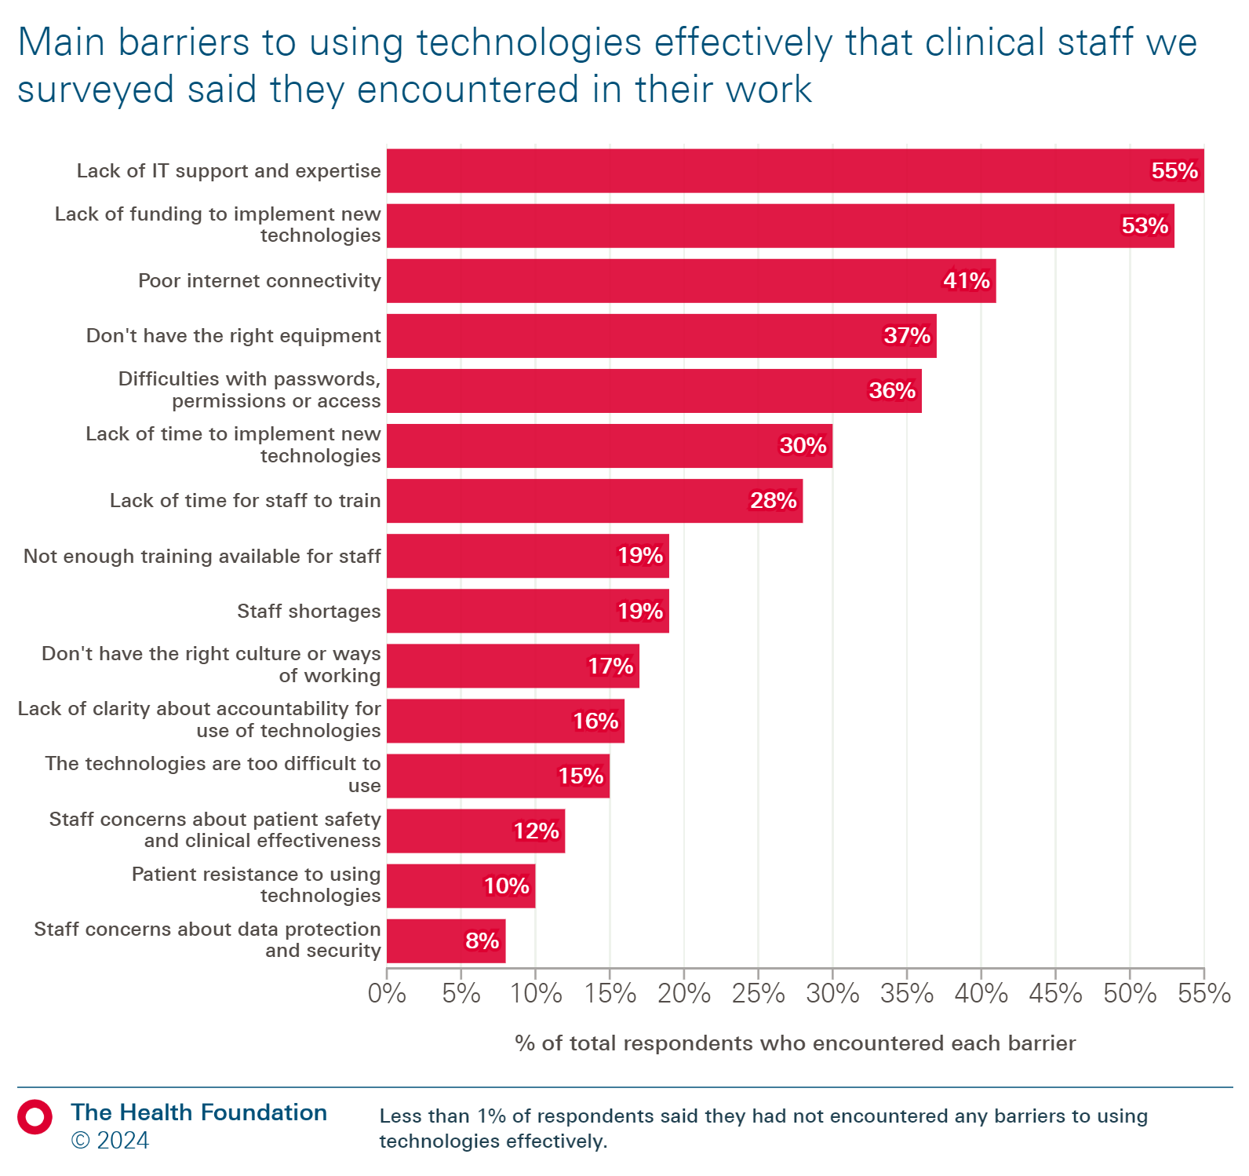
Tech Challenges

Slide 11
A sustainable approach..(not a “shopping list”)
Know the workforce: profile, dynamics, motivations, needs, impact…(An inclusive definition of “workforce”…..not just nurses/ doctors; not just professionals; teams not individuals)
Focus on investment: Build supply; Retain and Recruit; Optimize performance: Advanced roles;
Not just new supply/ “more of the same” from training: prioritise effective use of the current workforce: retention/ re-skill / additional training/ distribution
Adaptive, aligned workforce planning, not a fixed plan.
Innovate- Harness new technology
Pay and careers: A pay determination process that can reflect both external labour market trends and internal career structure priorities, and can enable pay to be an effective workforce policy tool, linked to overall workforce strategy. (Multi year, local flexibilities)

Slide 12
Key References
Moulds A, Horton T (2024) Which technologies offer the biggest opportunities to save time in the NHS? Health Foundation https://www.health.org.uk/publications/long-reads/which-technologies-offer-the-biggest-opportunities-to-save-time-in-the-nhs
OECD (2024) Fewer young people want to become nurses in half of OECD countries.
OECD (2023) Health at a Glance 2023. https://www.oecd-ilibrary.org/social-issues-migration-health/health-at-a-glance-2023_7a7afb35-en
WHO (2023) Framework for action on the health and care workforce in the WHO European Region 2023–2030 https://www.who.int/europe/about-us/governance/regional-committee/73rd-session-of-the-who-regional-committee-for-europe/rc73-spotlights/health-and-care-workforce

