Slide 1
Empowerment in Action being Brave
Why supporting staff is the key to safer patient care​
Kelly McGovern
Chief Nurse and Director of Infection Prevention

Slide 2

Courage in care we are not working with tins of beans

Slide 3
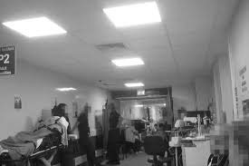
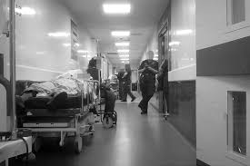
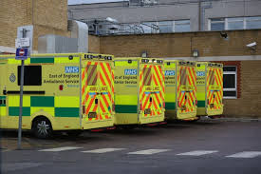
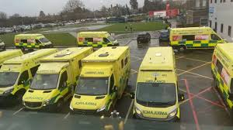

What I walked into

Slide 4
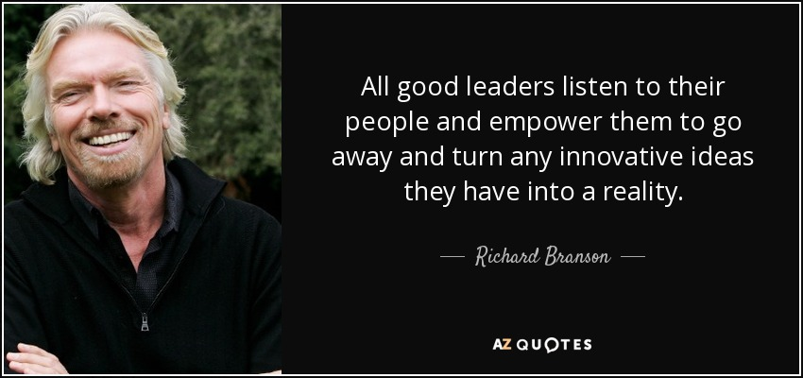
What did I do: Empowerment

Slide 5
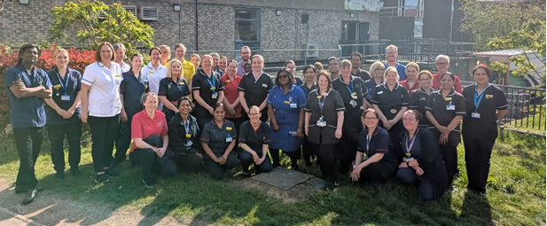
Lead from the Front: Visibility

Slide 6

Become one super team: Find the Hummers

Slide 7


“Breaking the Rules” (Useless and Obstructive ones)

Slide 8
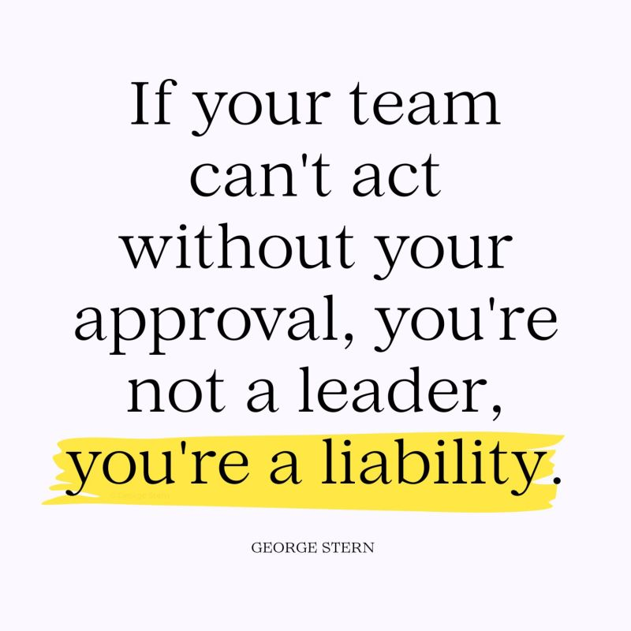
Allow them to make their own decision and Mistakes.

Slide 9
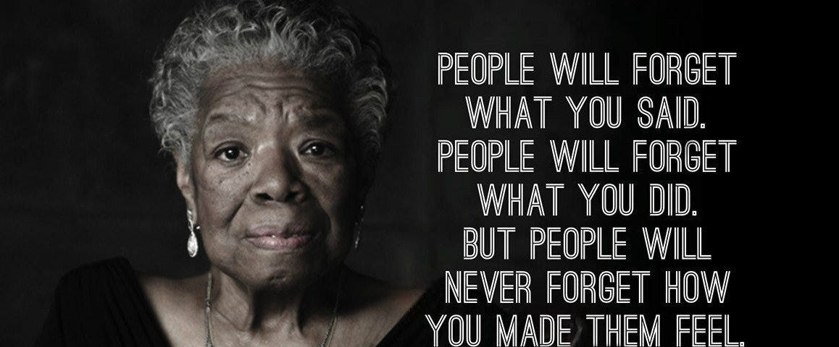
Make everyone believe and make it everyone's business : Empower

