Slide 1


Your essential connectivity guide to seamless ATM
Joel Klooster
SVP Flight Safety, Viasat

Slide 2


What is Iris?
Iris enables next-generation air traffic management, and more:
Relieves pressure on congested VHF links
By using satcom as primary for ATS
Improves the coordination of operations
Through enhanced AOC communications
Helps manage increased
flight volumes
By providing increased data link capacity to compliment VDL
Initial 4D Trajectory Based Operations
Supports ATN/OSI and the sharing of ADS-C Extended Projected Profile
Iris is the Viasat implementation of FANS 3/C, enabled by the SwiftBroadband-Safety service

Slide 3






Iris is flying high across Europe
Iris has already achieved impressive milestones:
Supported by 19 European ANSPs
Appointed ESSP as an Iris service provider
First communication service provider to achieve EASA certification
Airlines already using Iris
Iris is built on Viasat SB-S
Airlines about to start

Slide 4

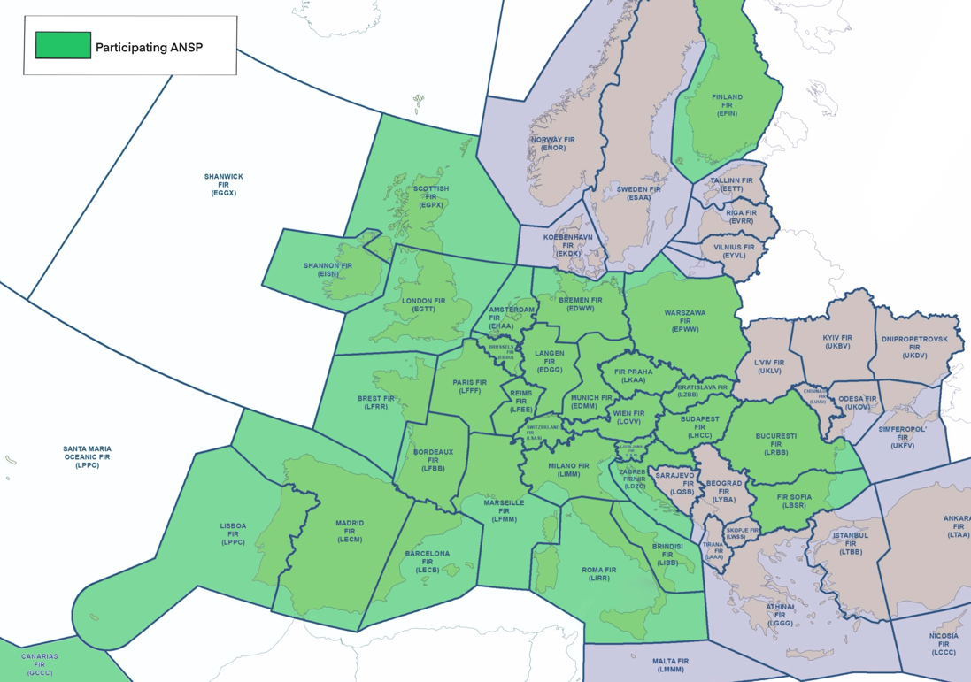
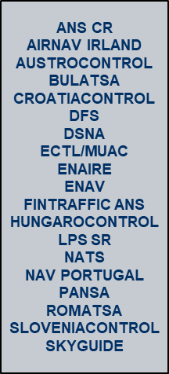
Early ANSP adopters

Slide 5

The Iris ATS B2 service has completed
5,000+ flights with easyJet in Europe

Slide 6

Total operational flexibility
Choose a future proof solution today to avoid costly retrofit in the future
ATS
Meet current and future ATN requirements
AOC
Advanced Flight Operations
ACARS - ATN/OSI - ATN/IPS
Enhanced AOC comms & weather
TBO / ADS-C EPP
Connected EFB for real time apps
End-to-end PKI encryption
Connected QAR for Flight Data Monitoring
Multi-link ready
ACARS, ACARS over IP, & IP
Aircraft conditioning and monitoring data offloading
“On an A320 the drag value is negligible based on our internal experts (<0.1%)”
Airbus FANS, Datalink, & Satellite Communications team

Slide 7




A world of opportunity from
connected EFB
Flight Profile Optimization
Reduce fuel burn by 1% - 3%, and avoid turbulence
Enhanced AOC Comms
Chat apps, IP voice, connected crew apps
SWIM
& FF-ICE
Future TBO concepts may rely on connected EFB

Slide 8

Development and deployment are accelerating
Operational in Europe with easyJet
Iris Global
Iris service evolution
Iris IOC
Iris IOC implementation | Iris FOC design
2014 | 2015 | 2016 | 2017 | 2018 | 2019 | 2020 | 2021 | 2022 | 2023 | 2024 | 2025 | 2026 | 2027 | 2028+
Flight trials
Iris Operational in Europe
Complementing VDLm2, Initial 4D
Iris precursor
Design, development, integration, validation
ISP certified
ATN/IPS
ATN/OSI

Slide 9
A data link ready for the future
Continental
Oceanic & Remote
2023
ATN/OSI
2027
ATN/IPS
Oceanic & Remote
Oceanic & Remote
Cockpit IP services
FANS ACARS
Cockpit IP services
FANS ACARS
Capability
FANS ACARS
Cockpit IP services
FANS ACARS
Dual Voice
ACARS
Dual Voice
ACARS
Dual Voice
ACARS
Dual Voice
ACARS
Enhanced Security
Enhanced Security
Viasat
Classic Aero
SB-S
Available today
SB-S
Available today
SB-S Iris Available today
FANS ACARS applications
ATS data link for oceanic/remote airspace
CPDLC meeting RCP240
ADS-C meeting RSP180
ATN B2 applications
ATS data link
for continental airspace
CPDLC meeting RCP130
ADS-C meeting RSP160
ATS B2 capabilities
Extended CPDLC message set for trajectory negotiation
ADS-C Extended Projected Profile (EPP)
Supporting

Slide 10
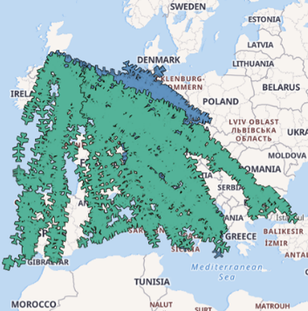
Iris – supporting the move to TBO
“
FANS-C / Trajectory-Based Operations (TBO) can deliver significant efficiencies for airlines. We already see this in the limited airspace that operates these services.
CPT David Morgan, COO, easyJet
”
Notes:
TT = Transit Time
ET = Expiration Time
DT = Delivery Time
OT = Overdue Time (successful delivery of surveillance data)
Air to ground message delivery time (seconds).
C(9)
C(10)
C(17)
C(18)
C(24)

Slide 11


Air travel is changing fast — stay ahead with Viasat
Speak to a Viasat representative today!
Booth #K18

