Slide 1
Effectiveness of Hail Stow in PV Systems
Forensic investigation into March 2024 hailstorms in Fort Bend County, TX
May 2025
Jon Previtali, VP & Senior Principal Engineer
Thanks to Array Technologies for sponsoring this study
5/8/2025
© VDE Americas

Slide 2
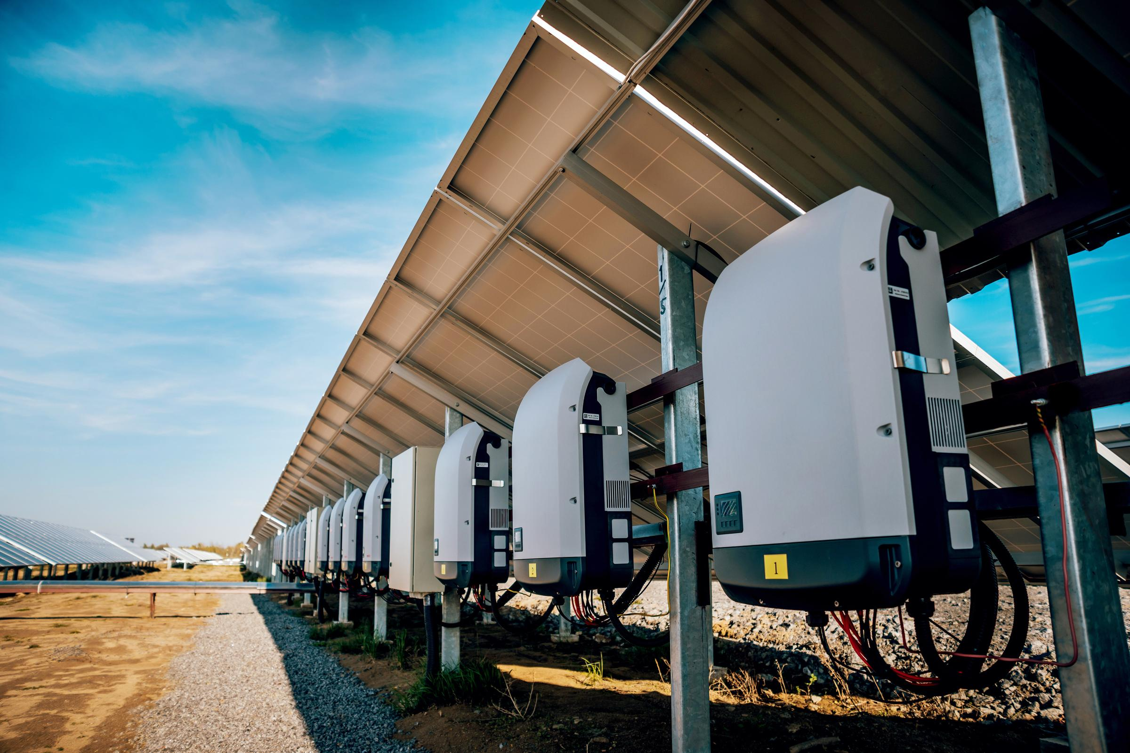
VDE Americas identifies and mitigates technical risk for solar and storage project stakeholders
Providing technical advisory services in the US since 2013
>$15+ billion in financed assets (>250 projects)
Owners and Independent Engineer
Industry-leading Hail Risk Intelligence
Technology Reviews

Slide 3
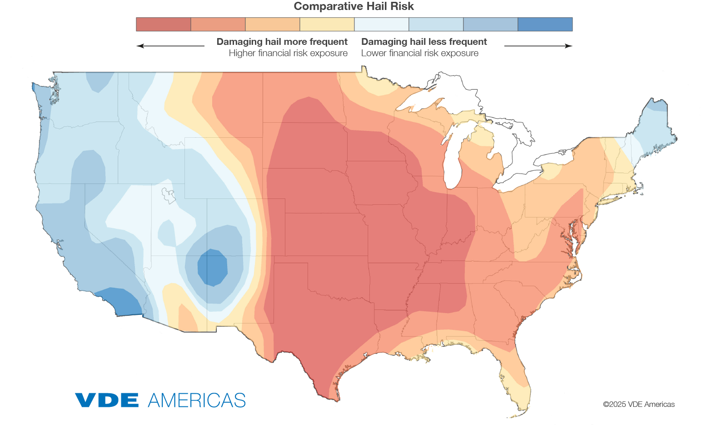

We are the leading provider of Hail Risk Intelligence for Solar
Probable Maximum Loss (PML) reports
Proforma Risk Exposure analysis
Hail Risk Atlas™ ArcGIS maps
Insurance optimization advisory
Portfolio risk management
Hail monitoring and stow protocols, tests, and 3rd party validation services
PV module Hail Resiliency Curves
© VDE Americas

Slide 4
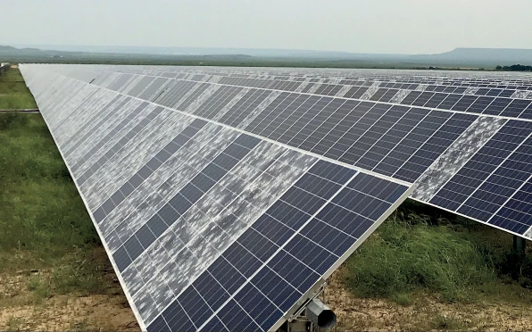
Recent history shows that small numbers of hail loss events cause oversized losses
Midway solar farm
Near Midland, Texas
May 2019 severe hail event
  >400,000 damaged modules
  >$70M insured losses
(Source: Insurance Insider, “Texas hailstorm set to generate $70mn-$80mn solar loss,” October 2019.)

Slide 5
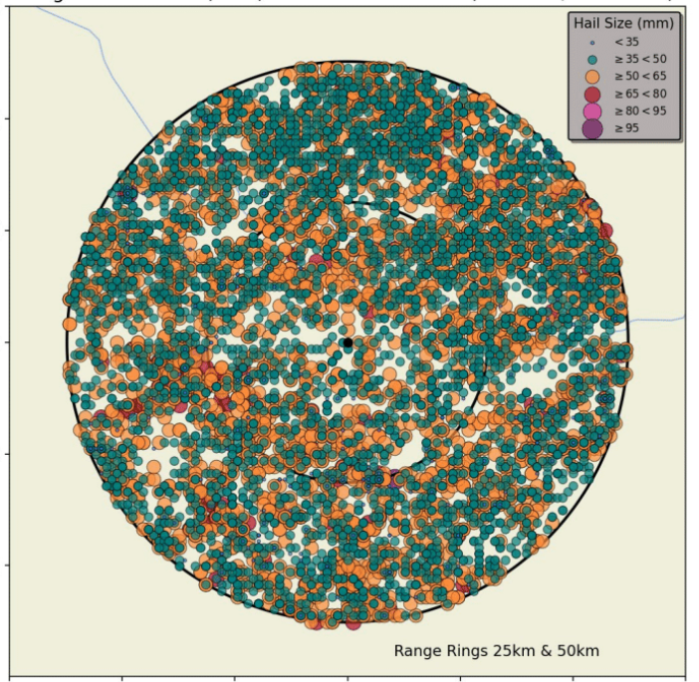
About VDE Americas hail risk model
Hail size observations in region
Coupled Hail Meteorology & Impact Physics
    Calibrated radar & ground-observed
    hail data
    Storm hailstone size & spatial distribution
    Storm swath
    Hailstone density
    Wind speed
    PV module hail resiliency
    Tracker stow capabilities
Validated through forensic analyses
All-in module replacement cost
Project location
© VDE Americas

Slide 6
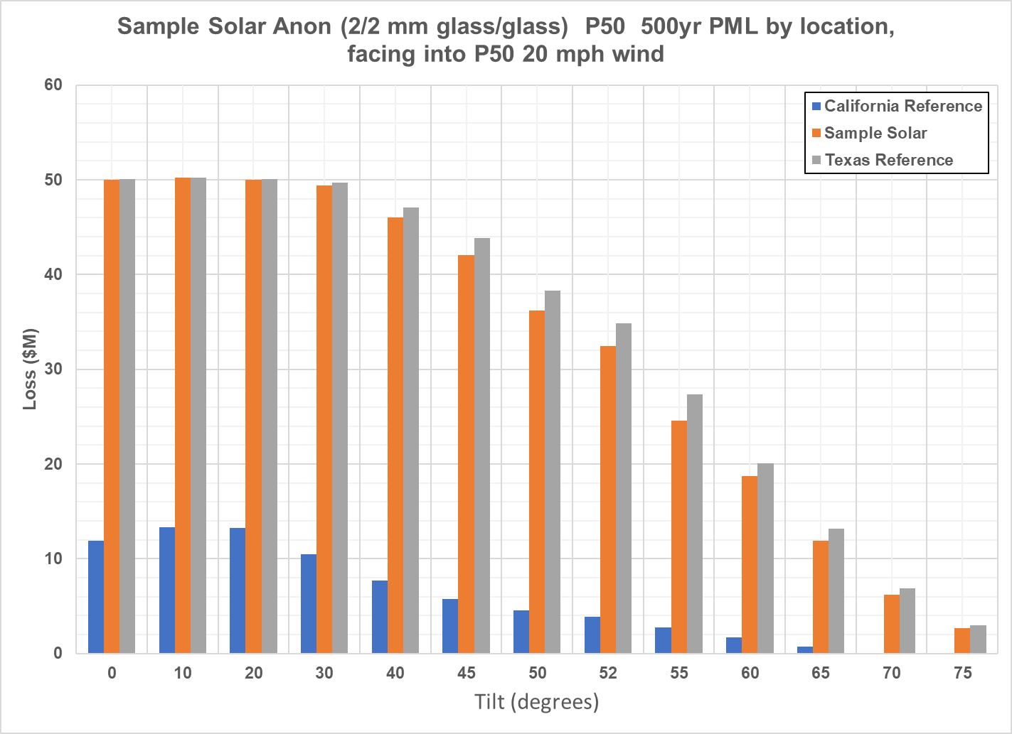
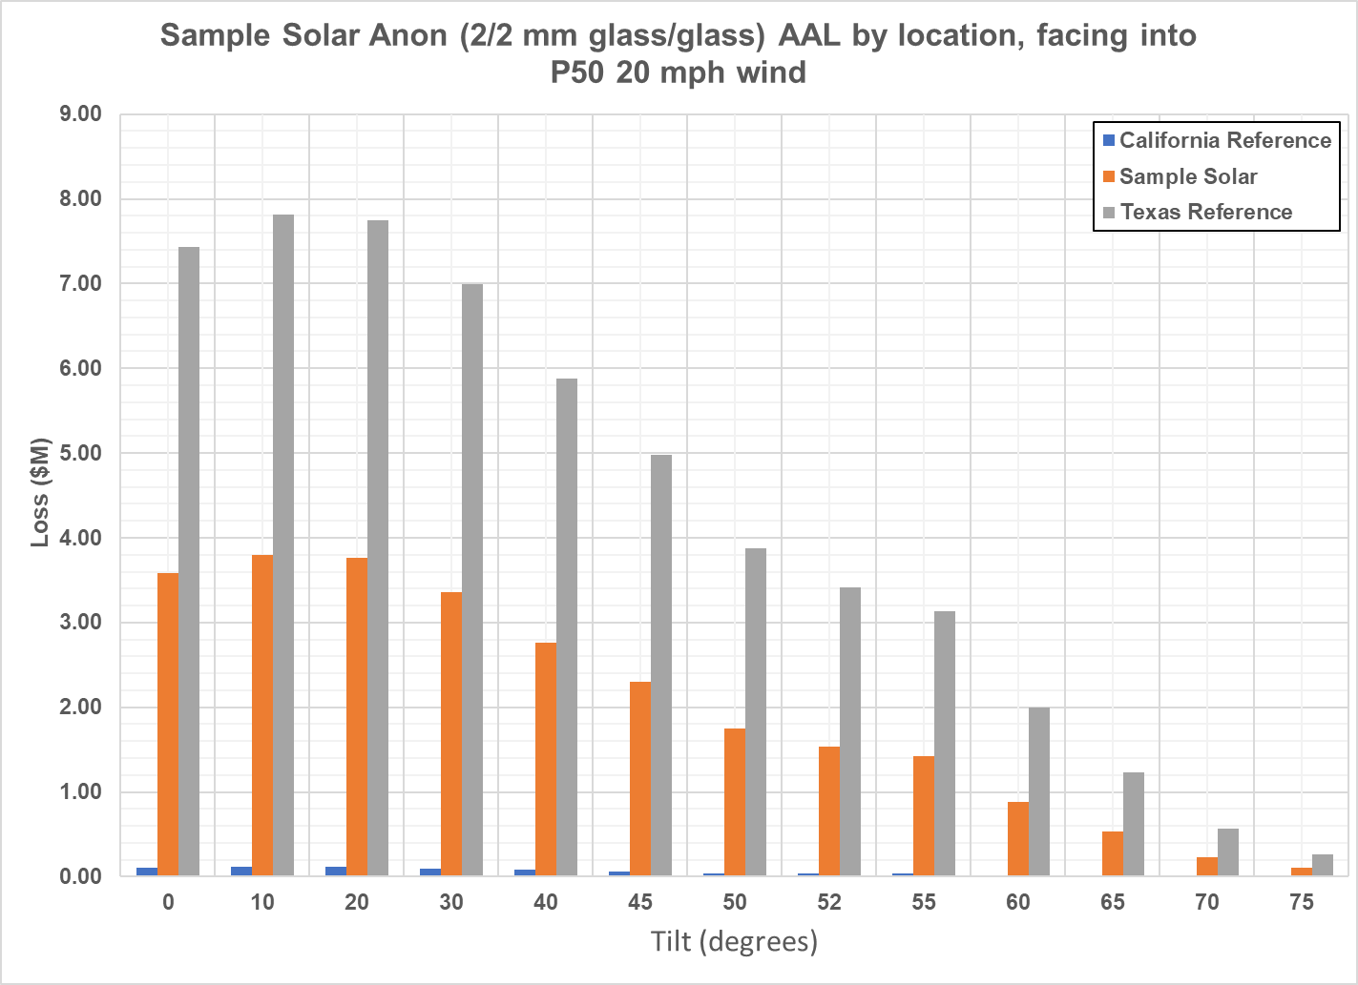

VDE Hail Risk Model Sample Results
Risk of loss at varying tilts for 2-2 mm dual glass Sample location v. CA and TX references
500-yr Probable Maximum Loss (PML)
Average Annual Loss (AAL)
© VDE Americas

Slide 7
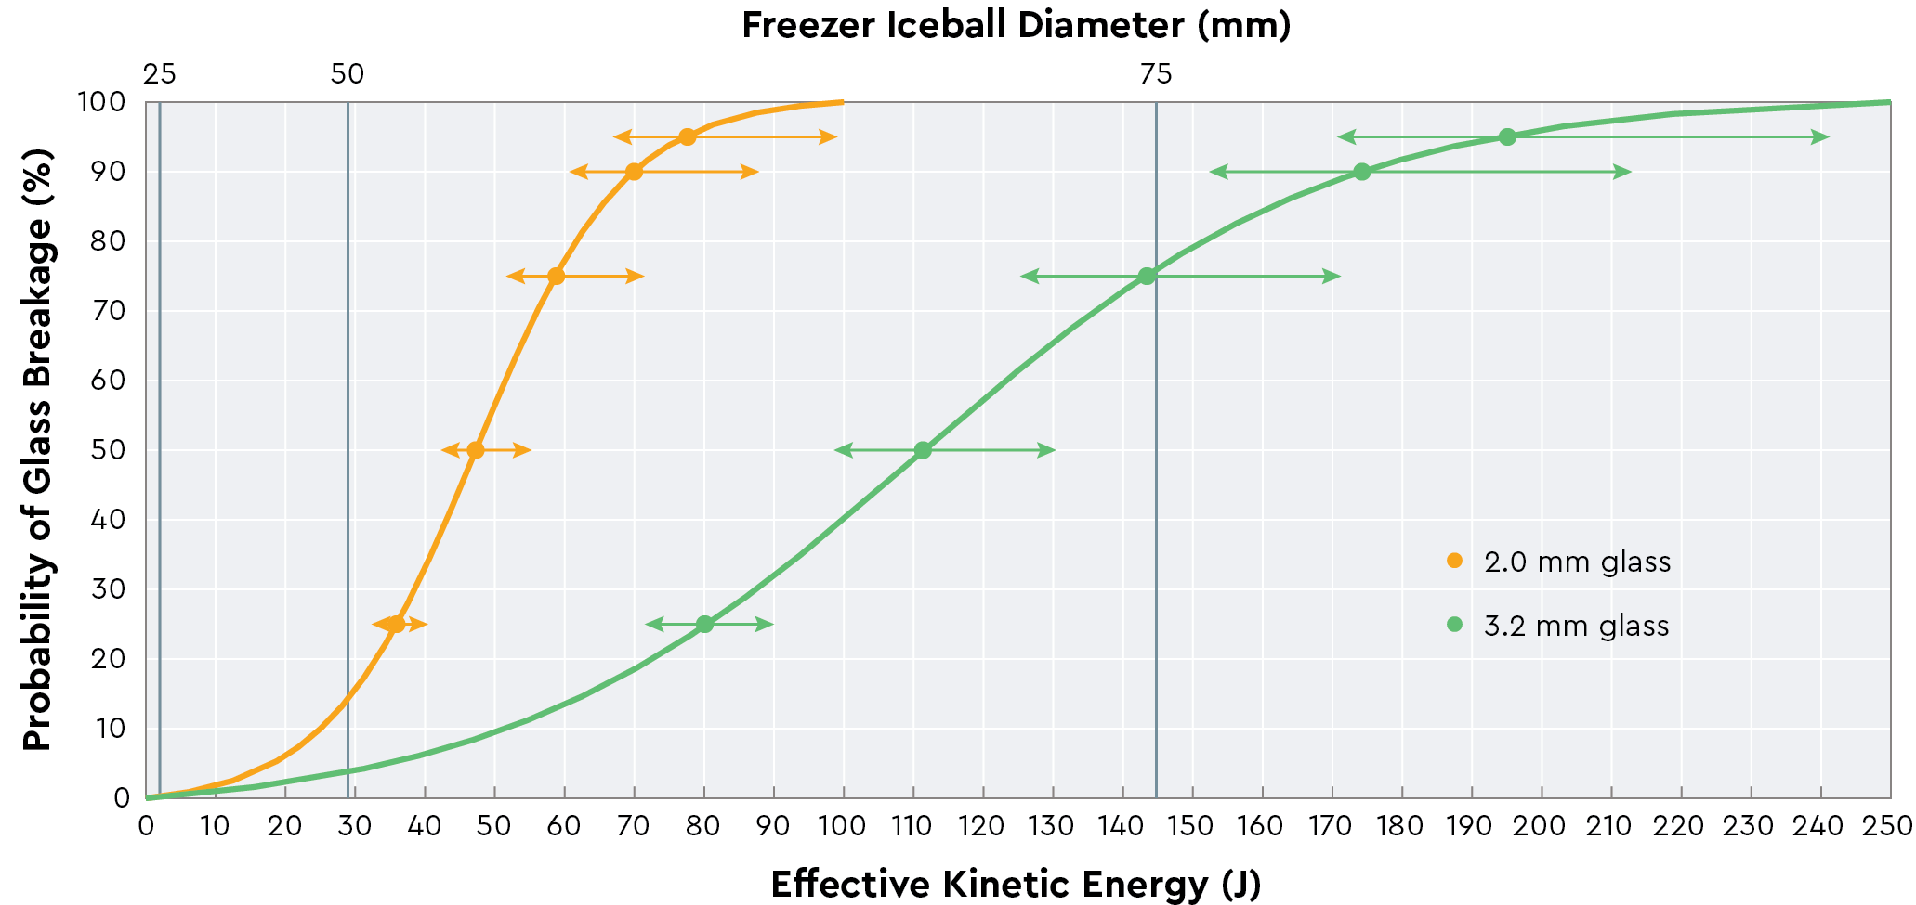

3.2 front glass PV modules are on average 2X more hail resilient than 2/2 mm dual glass modules

Slide 8
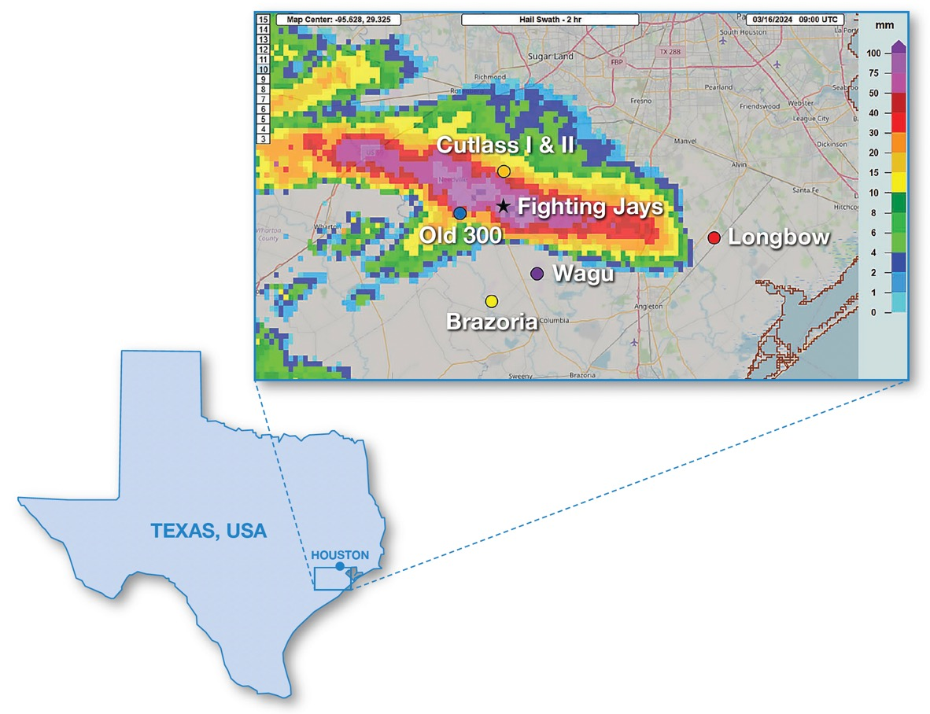
Severe weather event analysis in Fort Bend County area
Three utility PV projects with trackers and 2/2 mm dual glass PV modules located within 15 km (9.3 mi) of Fighting Jays solar farm:
Cutlass 1 [108 MWp]
Cutlass 2 [272 MWp]
Old 300 [270 MWp]
NOAA National Severe Storms Laboratory (NOAA NSSL), 2024
Area of interest is roughly 30 miles south-by-southwest of Houston

Slide 9
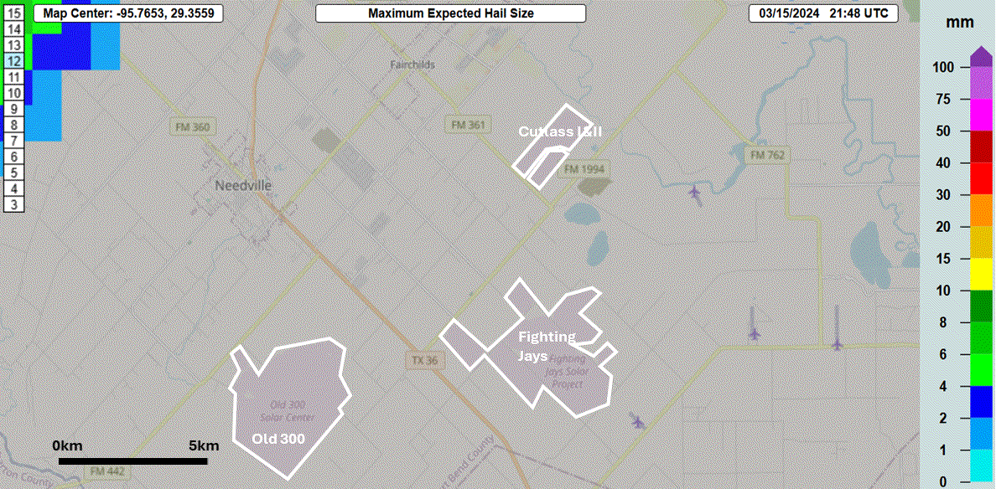
76-minute hail event time lapse for Storm on March 15, 2024
NOAA NSSL, 2024

Slide 10
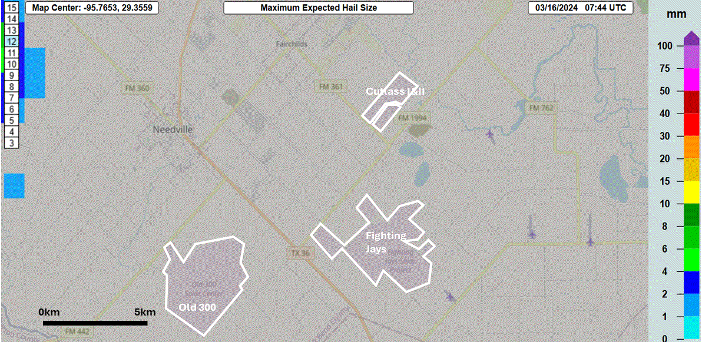
56-minute hail event time lapse for on March 16, 2024
NOAA NSSL, 2024

Slide 11
March 15 & 16 Hailstorms
 |  | Old 300 | Cutlass I | Cutlass II | Fighting Jays
3/15/2024 Storm (5:00–6:30 p.m. CDT) | Max hail size (per radar) | 30–40 mm | 40–50 mm | 50–75 mm | 50–75 mm
 | Max wind speed at site | 51 mph
 | Storm speed | 23 mph
3/16/2024 Storm (2:30–3:30 a.m. CDT) | Max hail size (per radar) | 75–100 mm | 50–75 mm | 30–40 mm | >100 mm
 | Max wind speed at site | 31 mph | 23 mph max gust (in vicinity)
 | Storm speed | 30 mph

Slide 12


Synopsis of hail event impacts
Fighting Jays
Severe hail damage (no public details available)
Old 300
Stowed per protocol to nearest extreme angle
Hail damage limited to ~40 modules on a non-stowed tracker (motor fault predated storm)
<10 modules damaged due to wind-blown objects
Oil gauge damaged on one MVT [medium-voltage transformer], causing inverter skid shutdown
Tracker stow direction relative to wind direction unknown
Cutlass I
No hail damage reported
Stowed per protocol to nearest extreme angle
Tracker stow direction relative to wind direction unknown
Cutlass II
No hail damage reported
Project under construction
Trackers in hail stow per protocol
Tracker stow direction relative to wind direction unknown

Slide 13
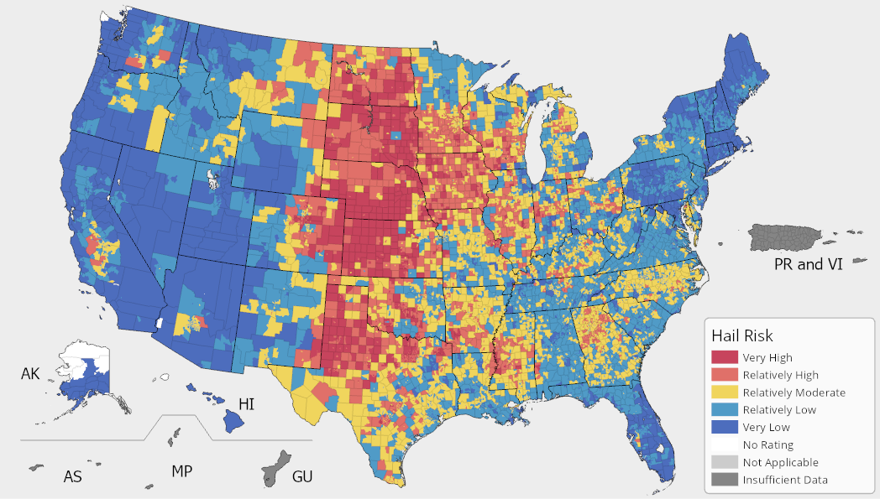

Population bias is a pervasive issue in traditional hail risk maps & data
In this FEMA map, Fort Bend County, TX—the location of the Fighting Jays solar farm—is characterized as “relatively low risk”
13

Slide 14
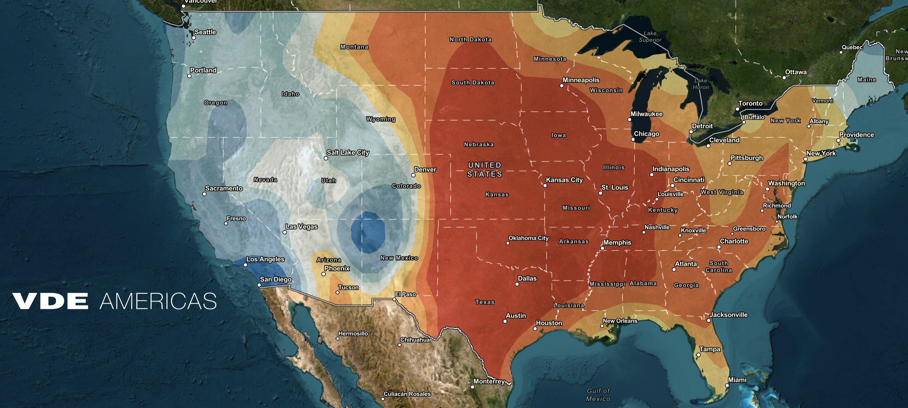
VDE Americas’ hail return interval contour maps eliminate population bias
In this map from VDE, the return interval for 45-mm (1.8-in.) hail in Fort Bend County, TX—the location of the Fighting Jays solar farm—is 25–50 years.
© VDE Americas
14

Slide 15
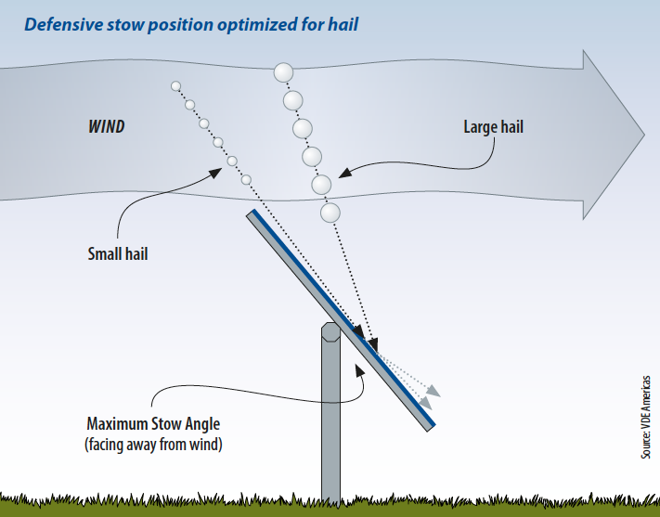
Key findings from Fort Bend County forensic investigation
Hail stow prevented module damage at multiple projects exposed to >1-in-500-year hail.
At Old 300 or Cutlass I & II, there was no hail damage to modules in a defensive stow position.
Reliable weather forecasting and quick response times are critical to success.
Stow at night as hailstorms can occur overnight.
Stow during construction!
Defensive hail stow protocols are effective for the prevention of physical damage to PV modules

Slide 16
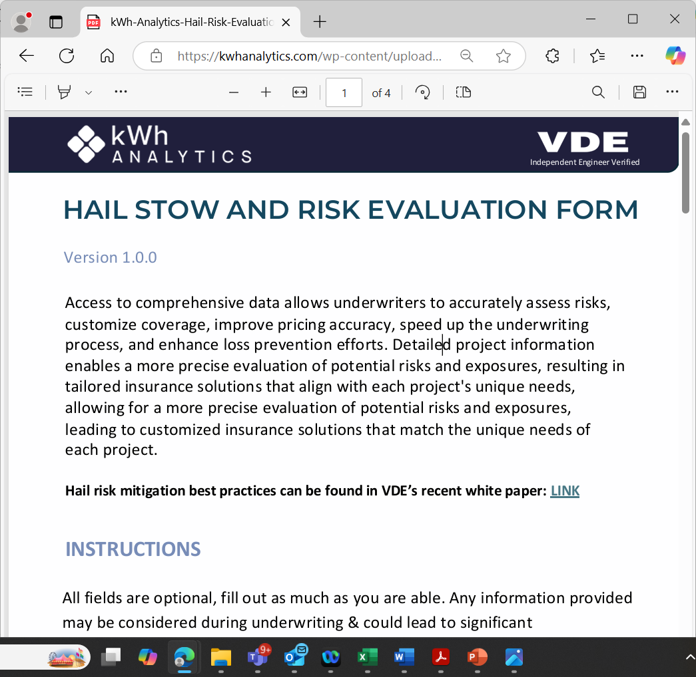
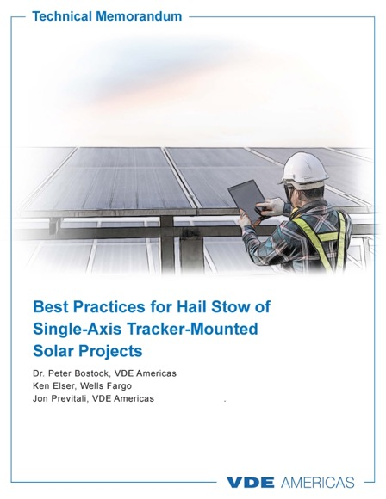
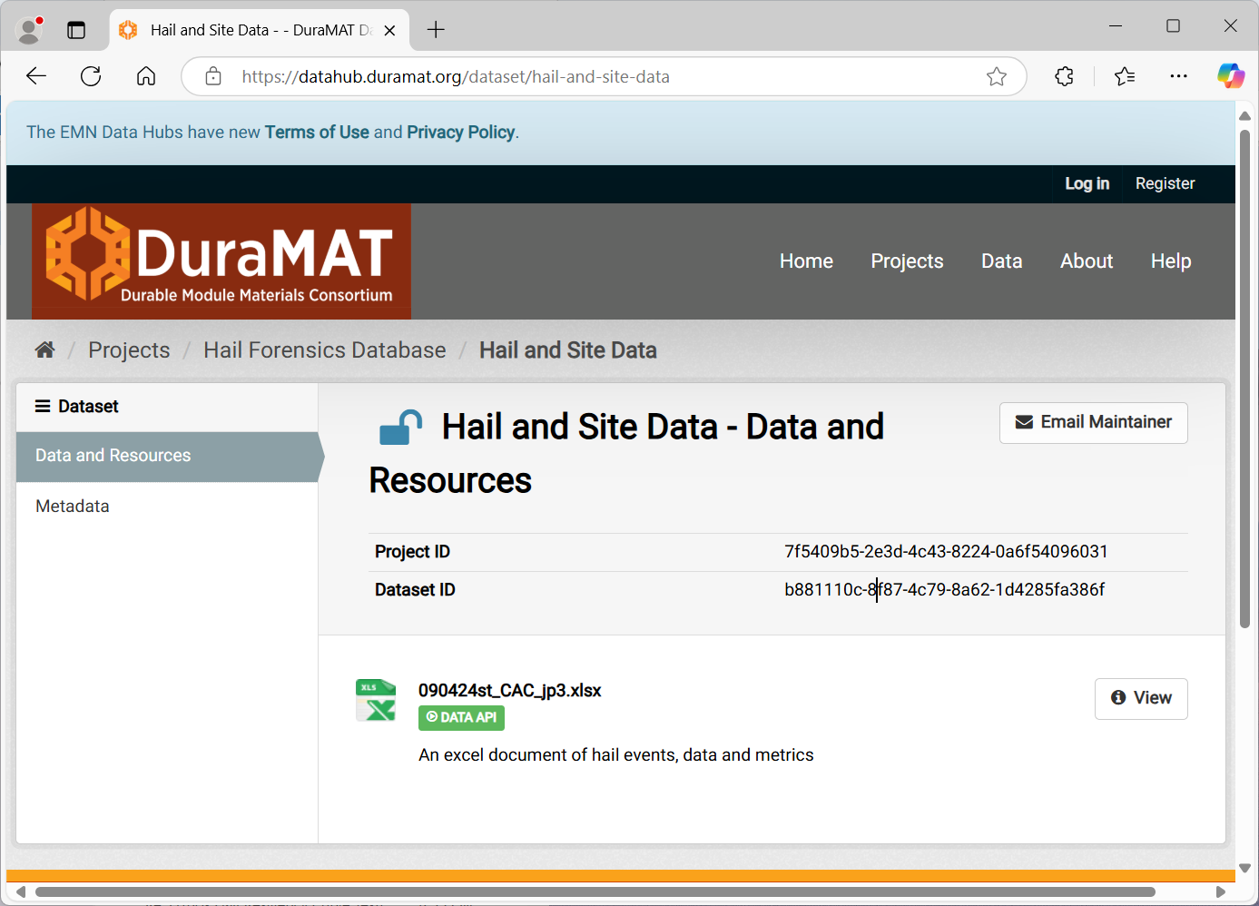
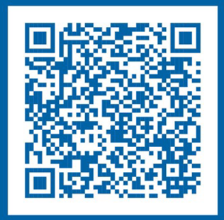
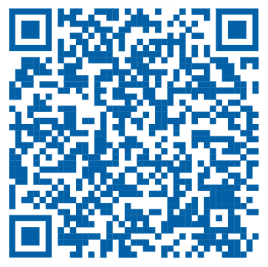
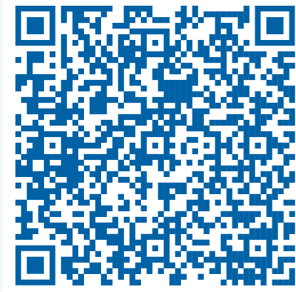
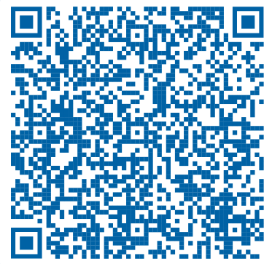
Download VDE’s best practices memo for operational hail defenses
Upload or Download Data on the DuraMAT Hail Forensics Database (NREL)
Confirm hail stow using the new Hail Stow & Risk Evaluation Form

Slide 17
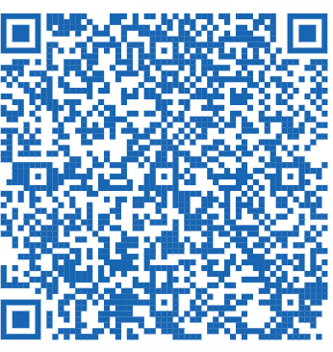
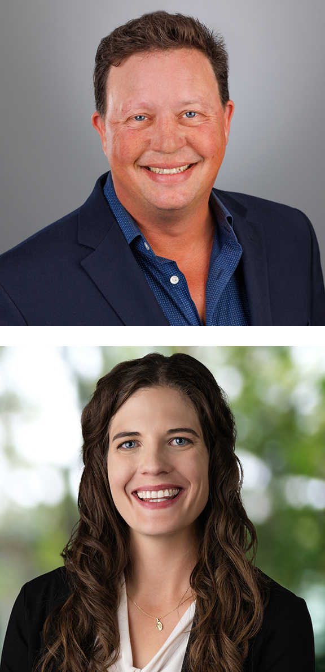
Join us for our next tech talk, Thursday, May 15
“Hail season survival strategies for tracker-mounted solar projects”
Nicole Thompson
Senior Manager of Data Science, kWh Analytics
Jon Previtali
VP & Senior Principal Engineer, VDE Americas
17

Slide 18
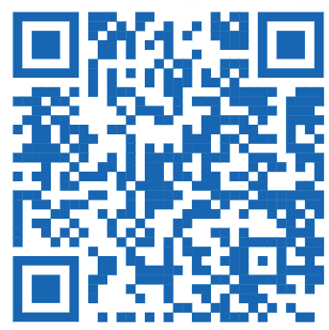
Thank you for your attention!
We are building the e-dialistic future.
Please join us.
Your contact person:
Jon Previtali
VP & Senior Principal Engineer
Phone +1 415 694 0935
jon.previtali@vde.com
5/8/2025
© VDE Americas
18

