Slide 1
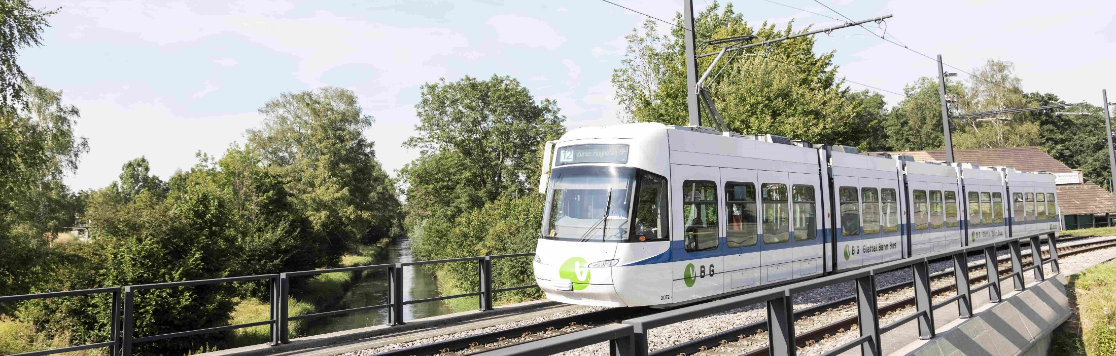
Boosting Urban Development. Public funding for Zurich's outer suburbs light rail.
RailLive, 27.11.2024, Claudio Büchel

Slide 2
Glattal Light Rail

Slide 3
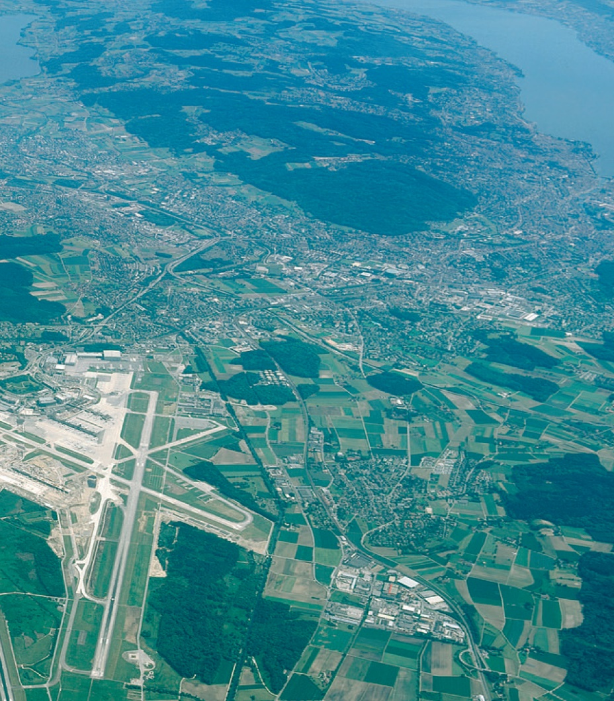
A new backbone for a dynamic region.
Light Rail system
Almost 100% right-of-way
Desserves suburban towns
Connections to the airport and downtown Zurich

Slide 4
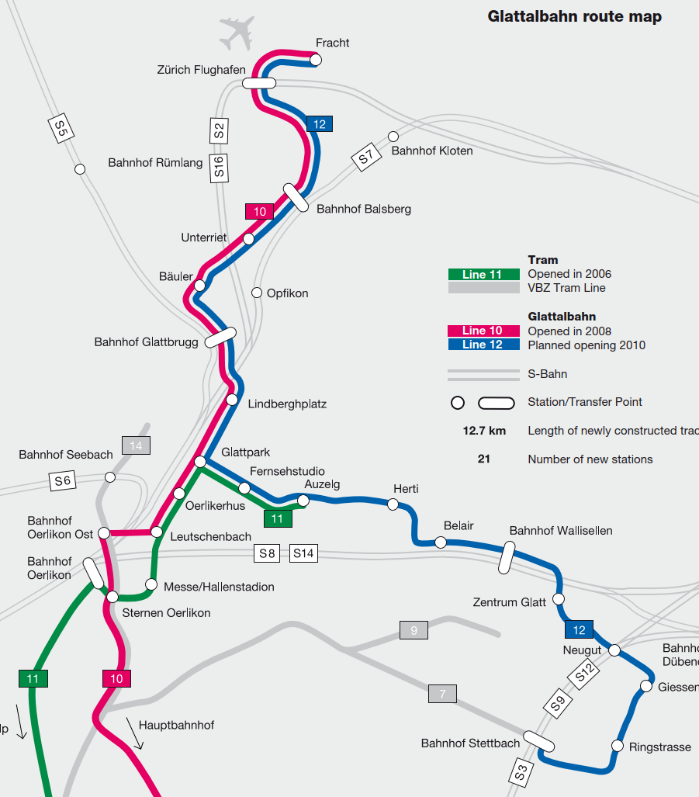
Transport for a vibrant network city.
High frequency (intervals between 15 min and 5 min)
Operation hours from 5am to midnight
6 transfer hubs (connection to suburban railway)
9 Mio riders per year
Construction costs: 590 Mio EUR

Slide 5
28x

Slide 6
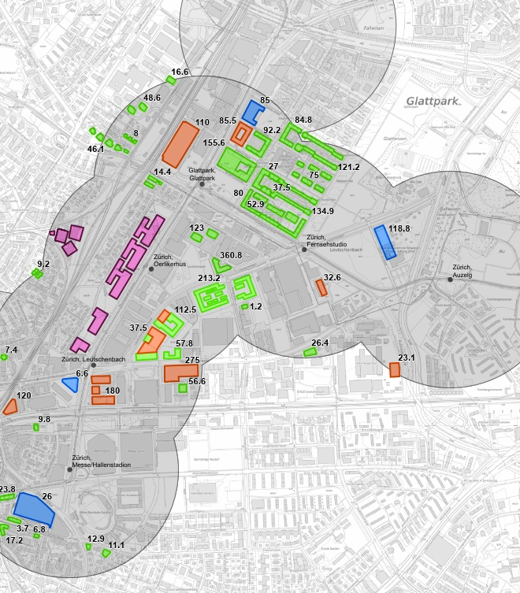


Construction cost x 28 = Investments in real estate
Over 16 billion EUR has been invested in building construction in the service area of the light rail system since its opening.
Residential buildings
Office/Commercial buildings
Special buildings
Not realized yet

Slide 7
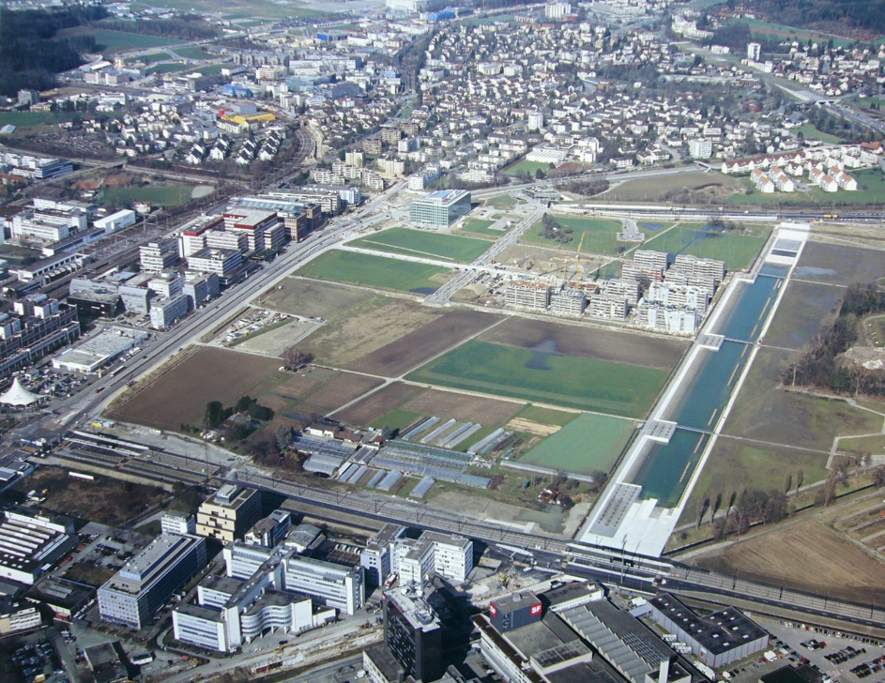
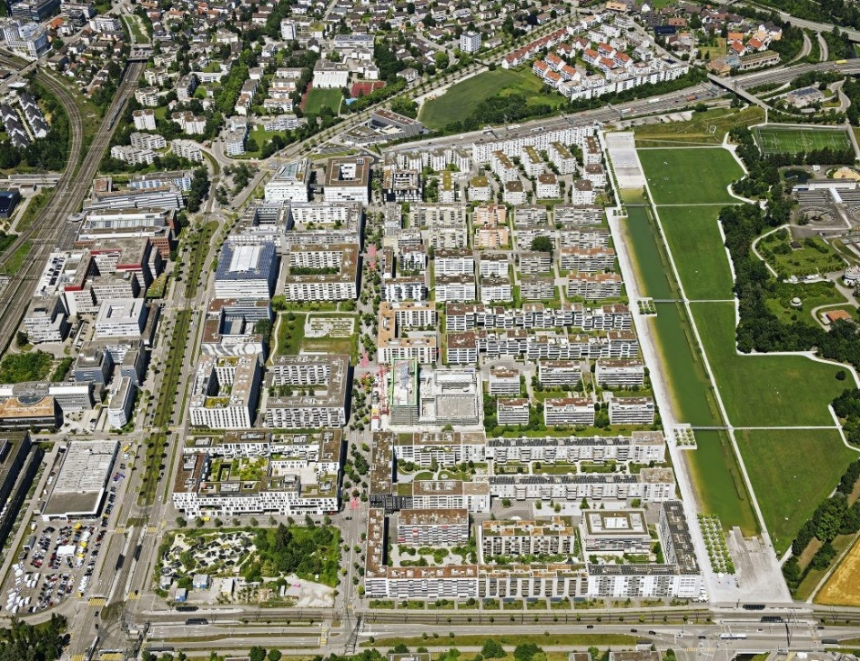
A pasture becomes a city.
2005
2020
vonballmoospartner.ch

Slide 8
More residents and workplaces. Less congestion.
Example of the Municipality of Opfikon (2008 – 2023)
40% more residents
50% more workplaces
3x more riders on the light rail system
Car ownership decreased by 20%

Slide 9
Transit-oriented development

Slide 10
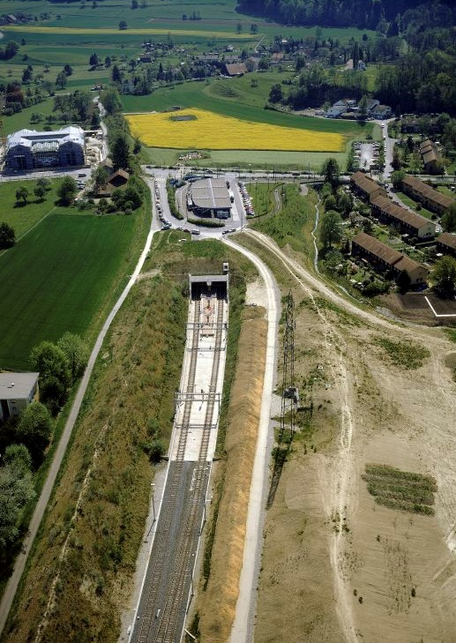
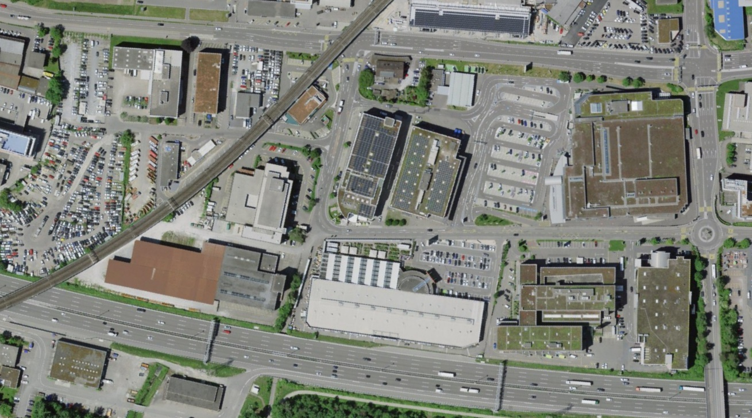
The opposite of transit-oriented development…
Commercial district Dietlikon 2023
Stettbach Transit Hub 1990
ETH-Bibliothek Zürich, Bildarchiv / Com_FC24-8012-0005

Slide 11
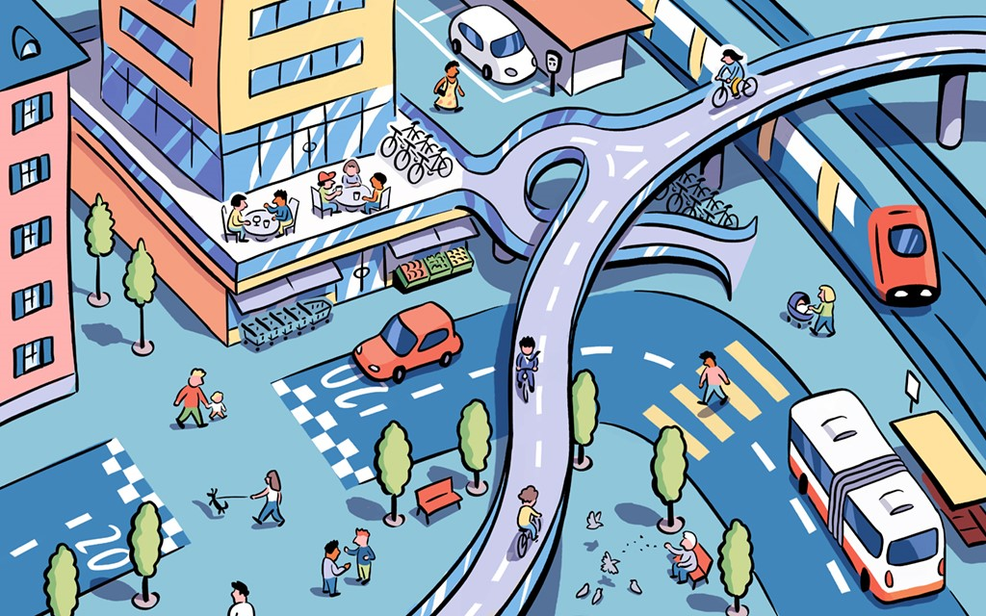
The Swiss way of funding transit infrastructure projects in agglomerations.
There has been strong growth in the suburbs since the 80s.
The downside of the growth was increasing congestion on the road network.
The municipalities recognized the need for coordinated action and began developing a light rail concept.
The project was too expensive for local and regional authorities.
The federal state introduced the agglomeration fund, which made it possible for the state to finance up to 40% of infrastructure projects in the suburbs.

Slide 12
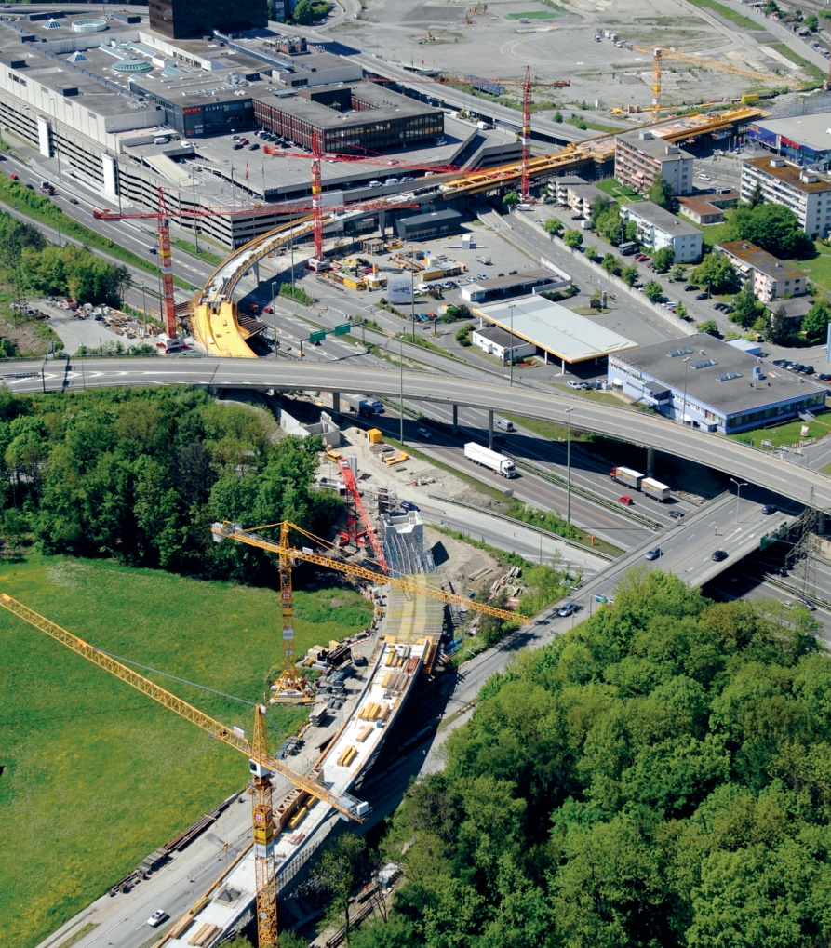
How to get money from the national fund?
The agglomerations must prove that they coordinate urbanism and transport planning.
The aim is to avoid urban sprawl and to achieve a shift towards sustainable mobility.
The better the coordination, the higher the federal contribution. Max. 40%.

Slide 13
Caution! Wrong incentives, wrong systems

Slide 14
Funding of Light Rails vs. Funding of Heavy Rails.
Highway &
Agglo- meration
Fund
«NAF»
Railway
Infrastructure
Fund
«BIF»
operations and maintenance
National highways
federal taxes
operations and maintenance
railways
fuel tax
value added tax
construction of new national highways
highway toll
fuel tax
construction of new railways
vehicle import tax
heavy vehicle charge
100%
projects in agglomerations
(bike, tram, streets)
research
cantonal contribution
max. 40%
Swiss agglomerations tend to propose heavy rail projects even if light rail would be more adequat.

Slide 15
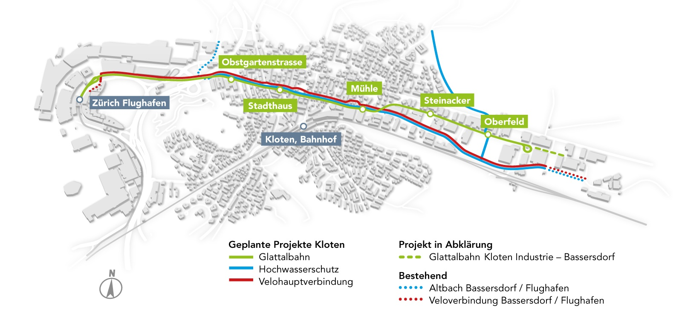
Glattal Light Rail Extension Project
AIRPORT
Project
Light Rail Linie
Flood Protection
Bike Highway

Slide 16
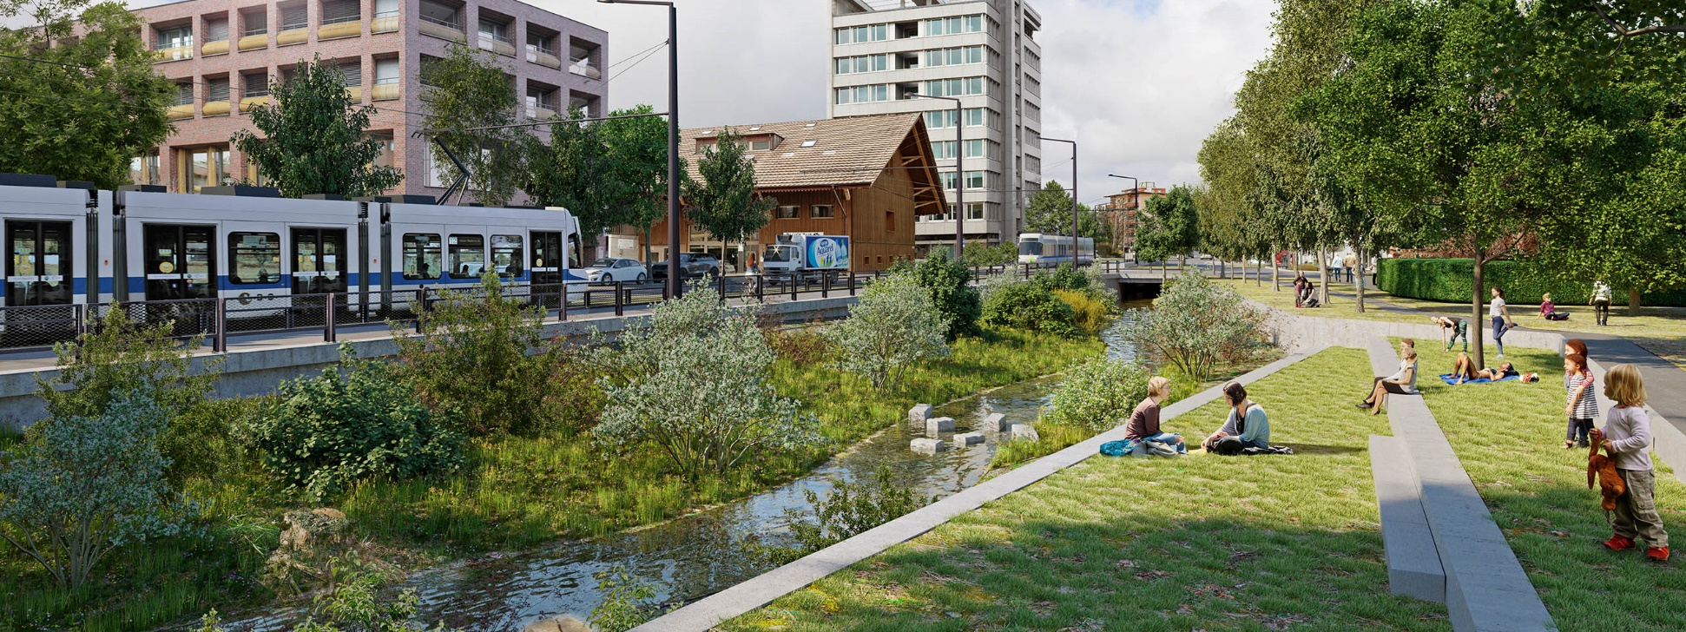
The next urban development

Slide 17
The Light Rail story continues!

Slide 18
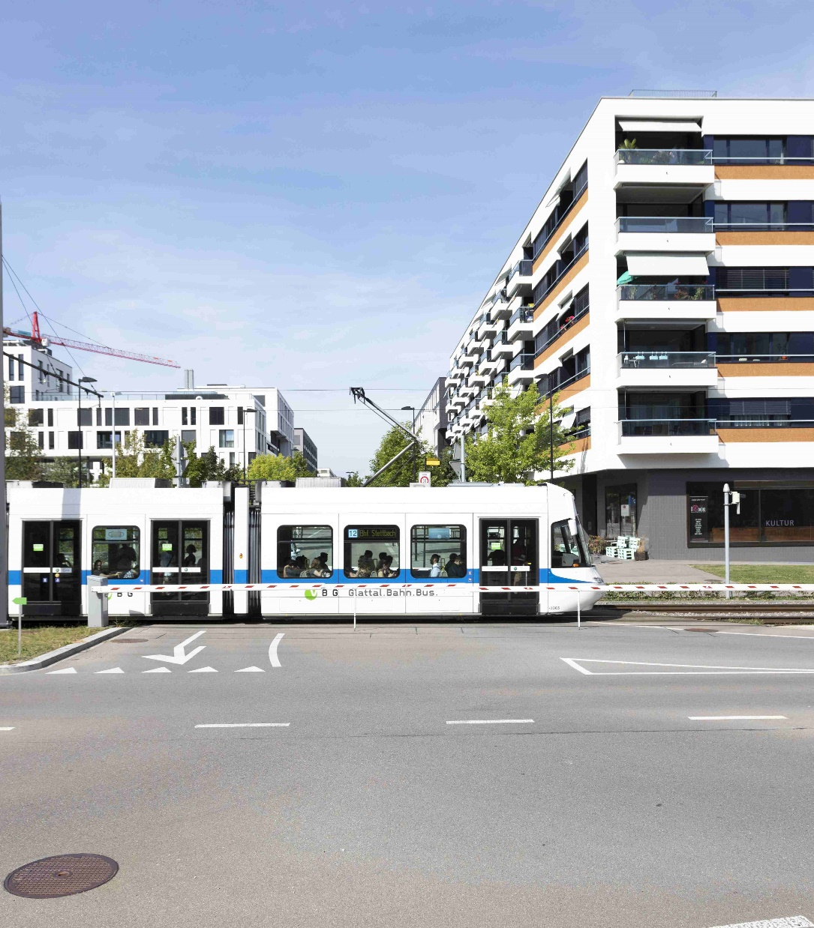

¡Gracias! claudio.buechel@vbg.ch www.linkedin.com/in/claudiobuechel
Claudio Büchel
Head of Offer
Notes:
Der Inhalt der Bildobjekte kann per rechtem Mausklick und mit dem Befehl BILD ÄNDERN ausgetauscht werden.
→ Wichtig: Das einzufügende Porträtfoto muss die Grösse von 2,2 cm x 2,2 cm haben, da es ansonsten verzogen wird.

