Slide 1
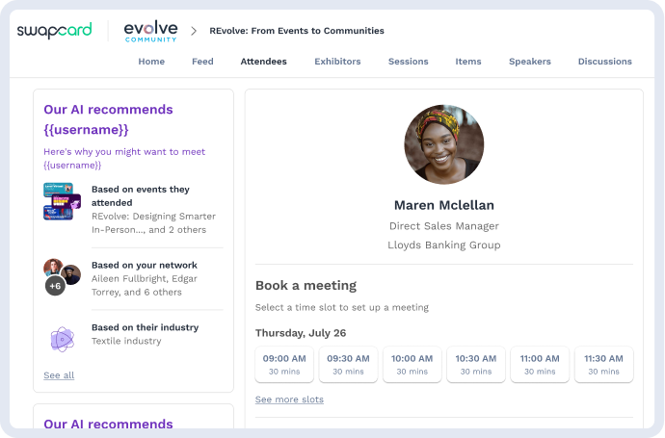

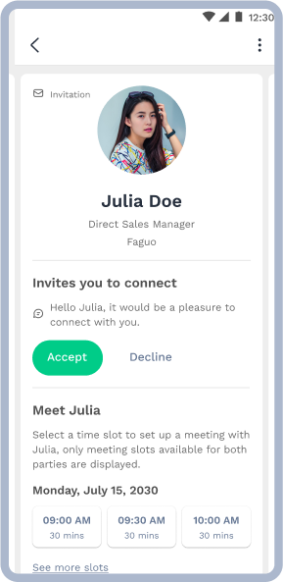
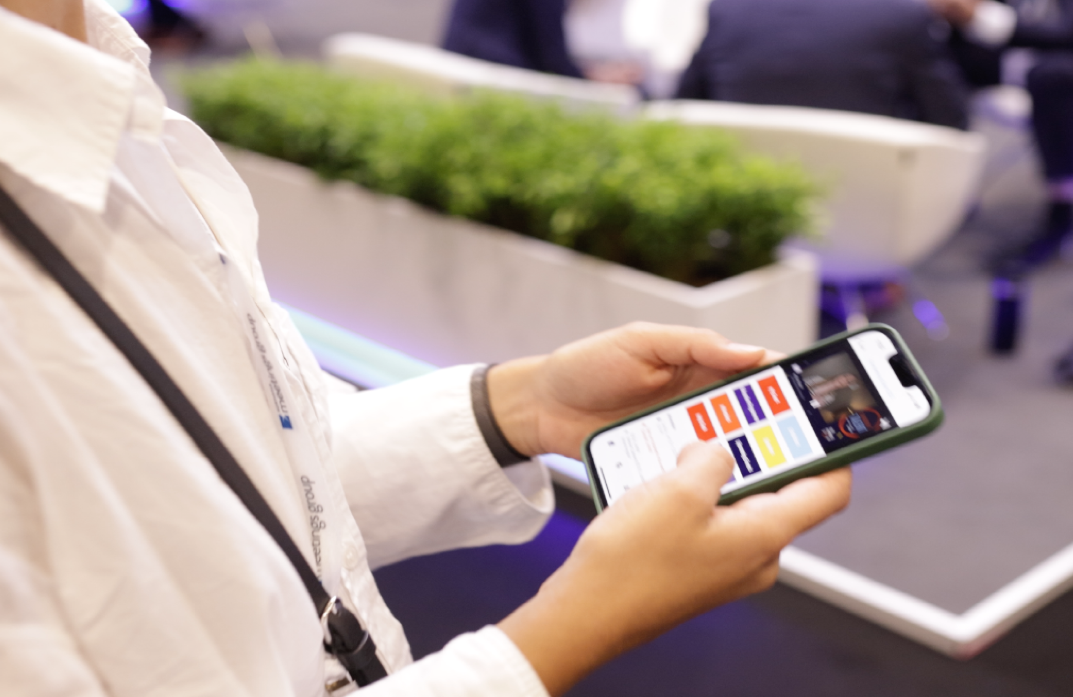
User’s Guide
General guide

Slide 2
Access the app
Login

Slide 3

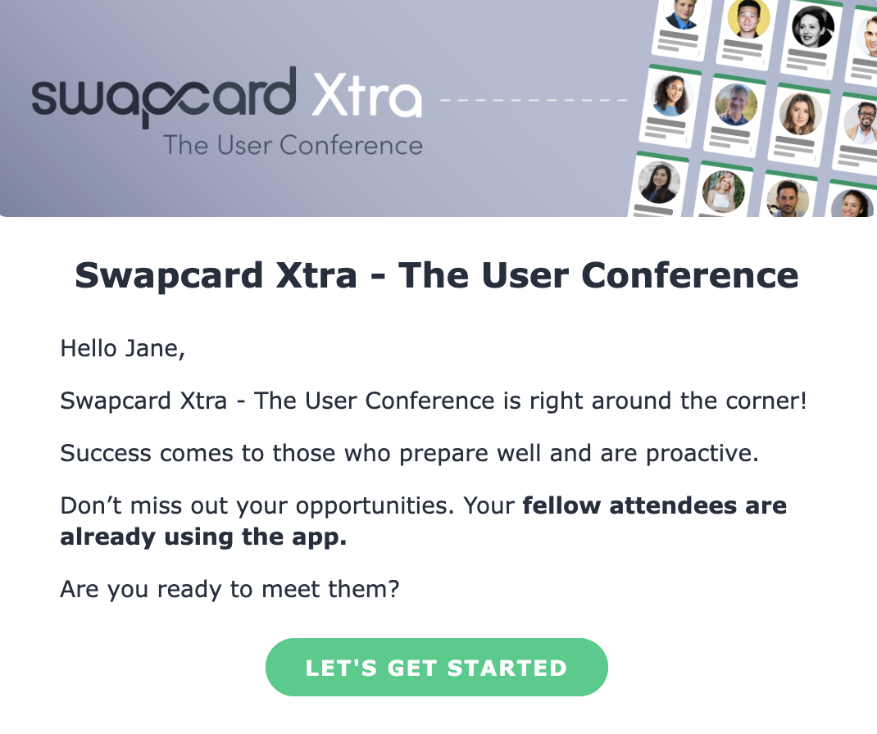
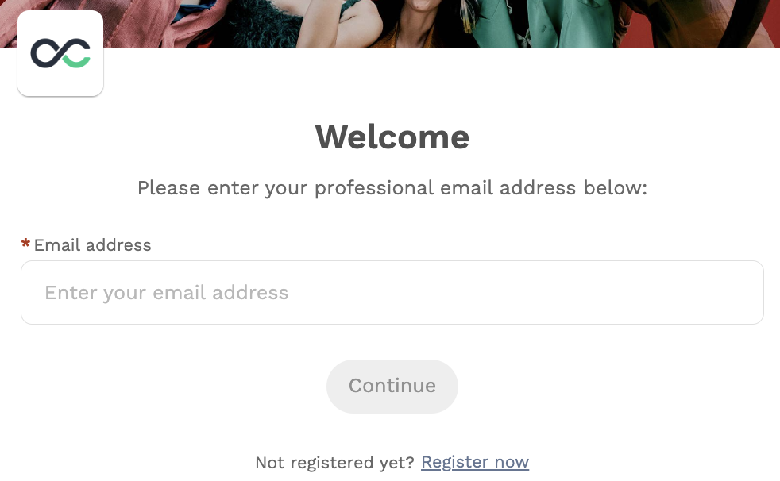

How to login for the first time?
You will receive an email similar to this ones with a button redirecting you to a login page. Your account is automatically created by the platform after you have registered. A window will then prompt you to create a password for your account:
1
You can also access the event from your phone by downloading the OPS Event app (iOS/Android) or the event branded app.
2
Note: If you don’t see this email in your mailbox, please check your spam folder. Most of our emails are sent from noreply@swapcard.com

Slide 4
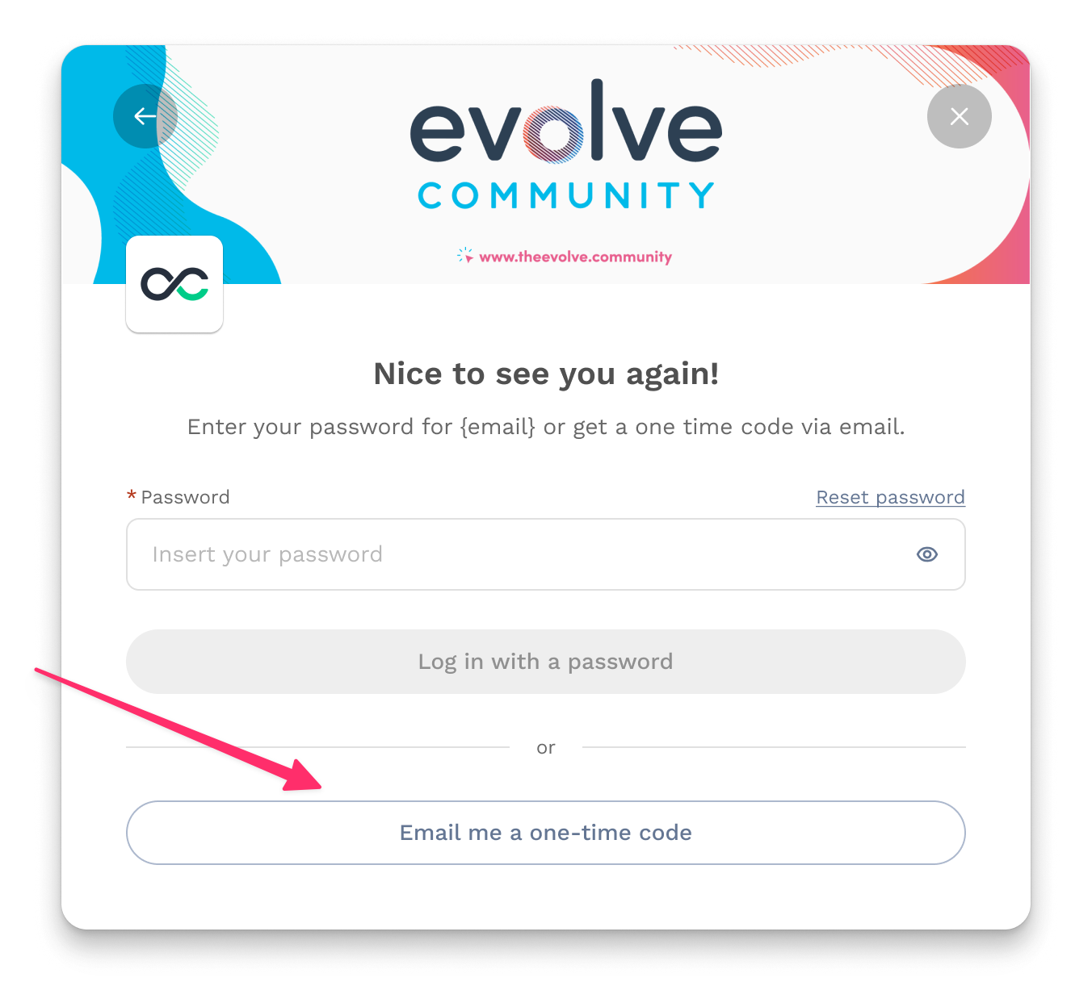
How to login when I have an account?
1
Access your account on app.swapcard.com
2
Enter the email you used to register for your event
3
You will then be prompted to enter your password (if previously set) or notified that a one-time code has been sent to your email. If unsure of your password, you can request a one-time code. You'll promptly receive an email with a code that you can enter into the designated box.
If you need any help, please contact our Support Team.
4

Slide 5
Available Features
Content

Slide 6
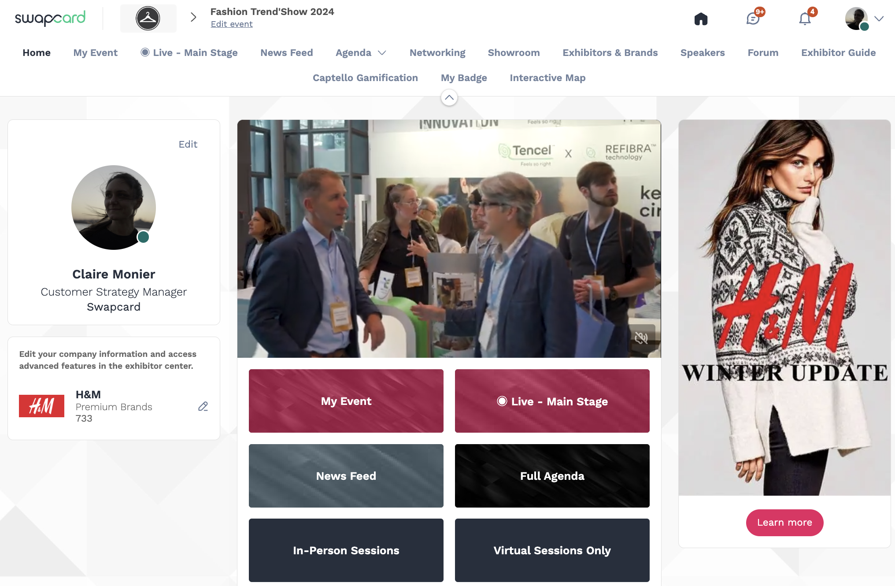
How to edit your profile (1/3)
1
2
There are two ways of accessing your profile:
From the drop-down on the upper-right corner of your screen, click “My profile”
On the left side of your screen
next to your photo, click “Edit”
You’ll be redirected to your profile where you can edit your information.

Slide 7
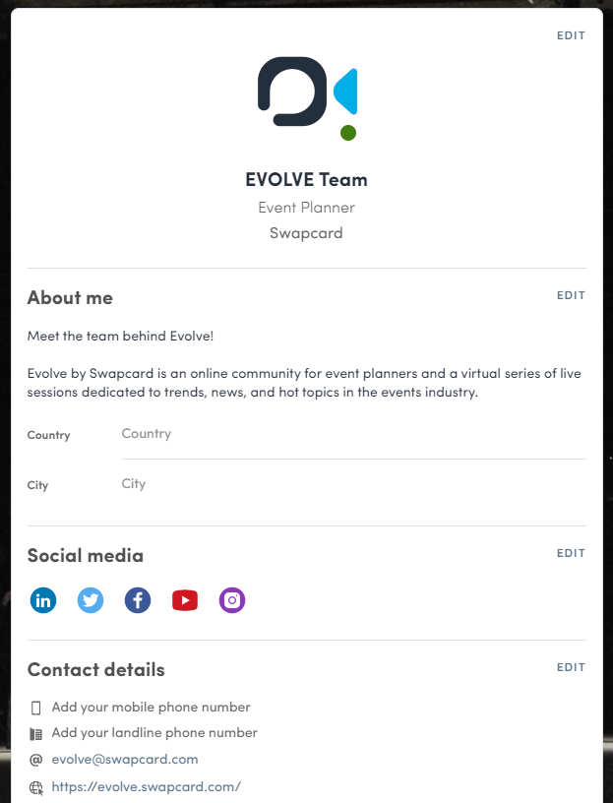
How to edit your profile (2/3)
To edit your profile, click “Edit” or “Add” next to
the information section you want to edit.
Here is the information you can edit:
Personal information
Biography
Social Media
Contact details
Company
Additional fields added by the organizer

Slide 8
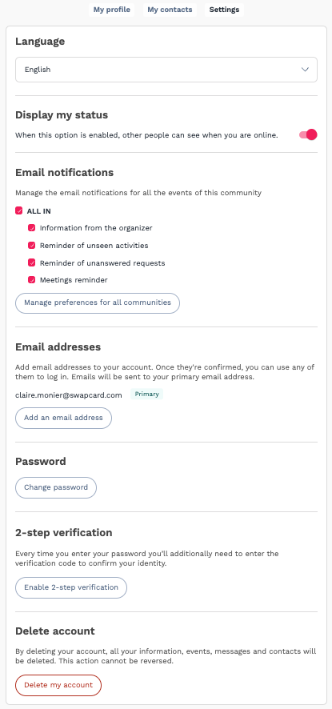
How to edit your profile (3/3)
From the “My Settings” tab, you can update your account preferences:
Language
Display my status
Email notifications
Email addresses (add secondary email) details
Update my password
2-steps verification
Delete my account

Slide 9
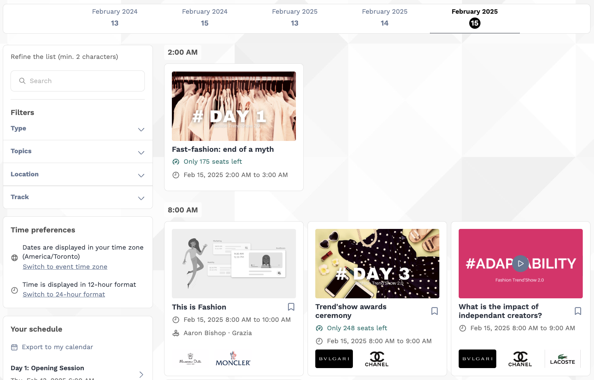
How the schedule works
The schedule/agenda button gives you an overview of the event sessions. You can register for sessions by clicking on this bookmarking icon.
You can find sessions by using the search bar and filters located on the left side of the screen.

Slide 10
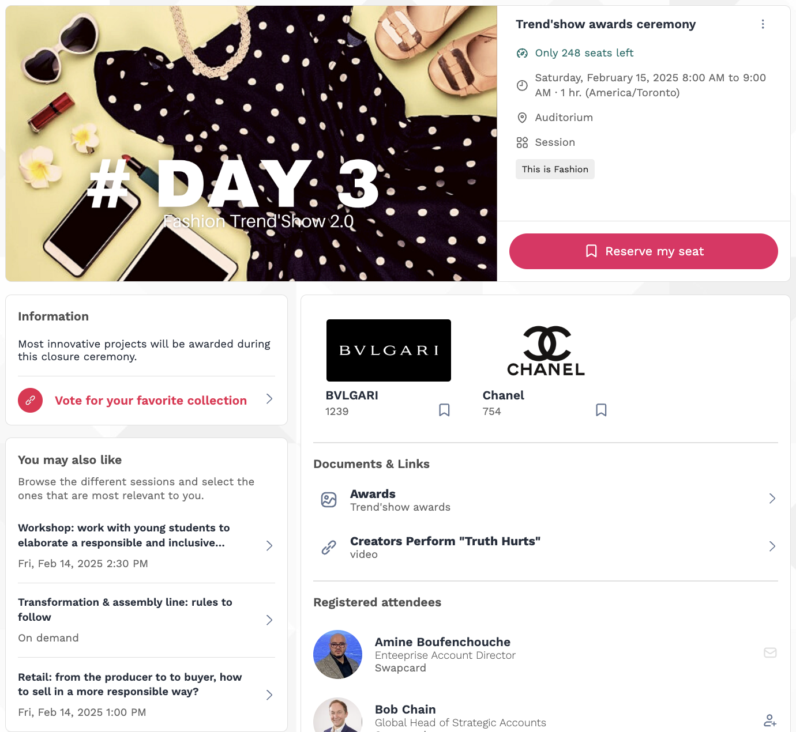
How the schedule works
By selecting a particular session, you'll uncover comprehensive details tailored to your interests: session capacity (if applicable), dates, times, and location; featured speakers and exhibitors; pertinent documents and links; and a roster of registered attendees (where applicable).

Slide 11
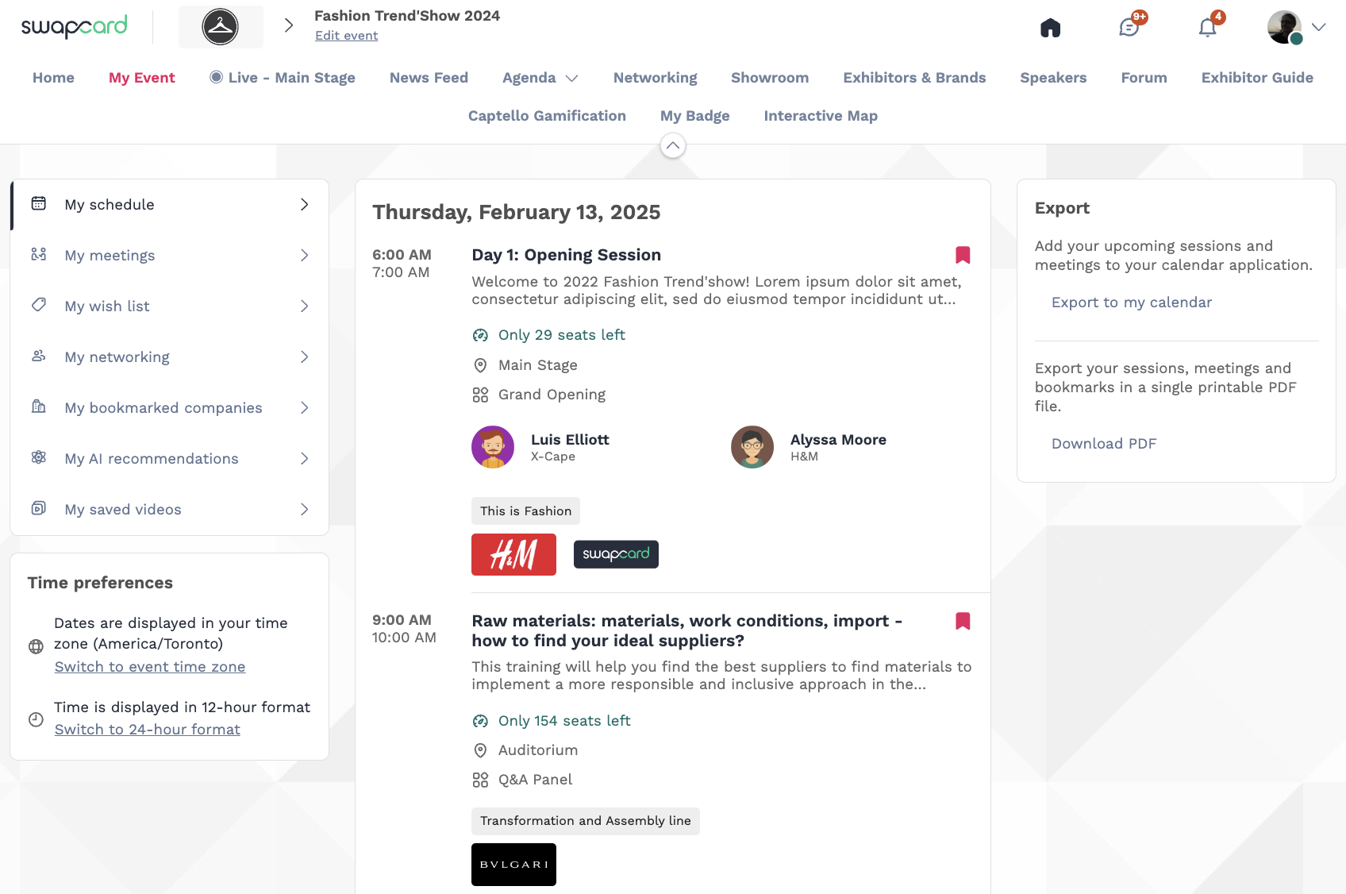
How the schedule works | My Event
The tab “My Event” (if available) allows you to see your own schedule. Here you can find the sessions, sponsors and partners you bookmarked, your confirmed meetings and more.
You can export your schedule by clicking “Export to my calendar” or “Download PDF.”

Slide 12
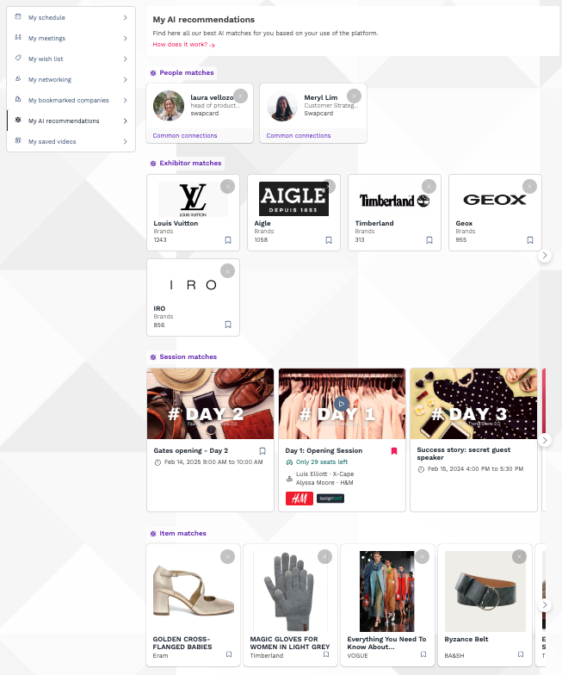
How the schedule works | My AI Recommendations
The "My AI Recommendations" tab, if enabled, curates a personalized list of People, Exhibitors, Sessions, and Items based on our advanced AI matching system.
The completeness of your profile significantly enhances the quality of recommendations, while your platform activity further refines the results.

Slide 13
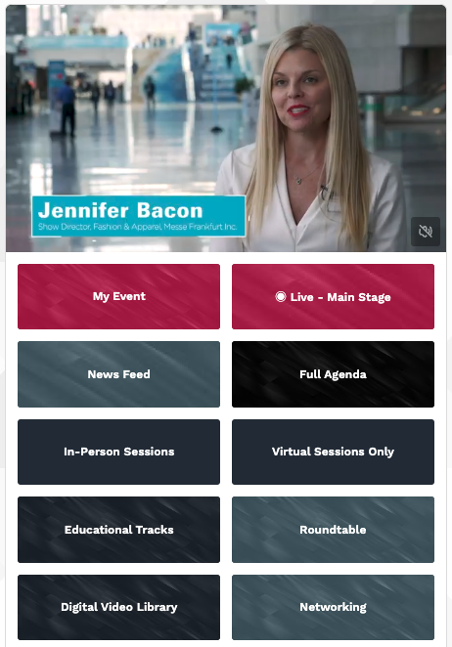
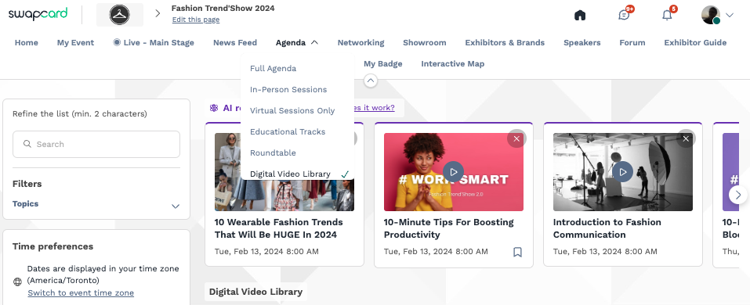
How to watch session on-demand?
The event organizer can make sessions available to watch on-demand.
You can access on-demand sessions through the schedule by clicking on past sessions.
There may be an On-demand, Replay or Digital Video Library button added by the organizer on the homepage. This is where content is available to watch after the event has ended.

Slide 14
Available Features
Networking

Slide 15
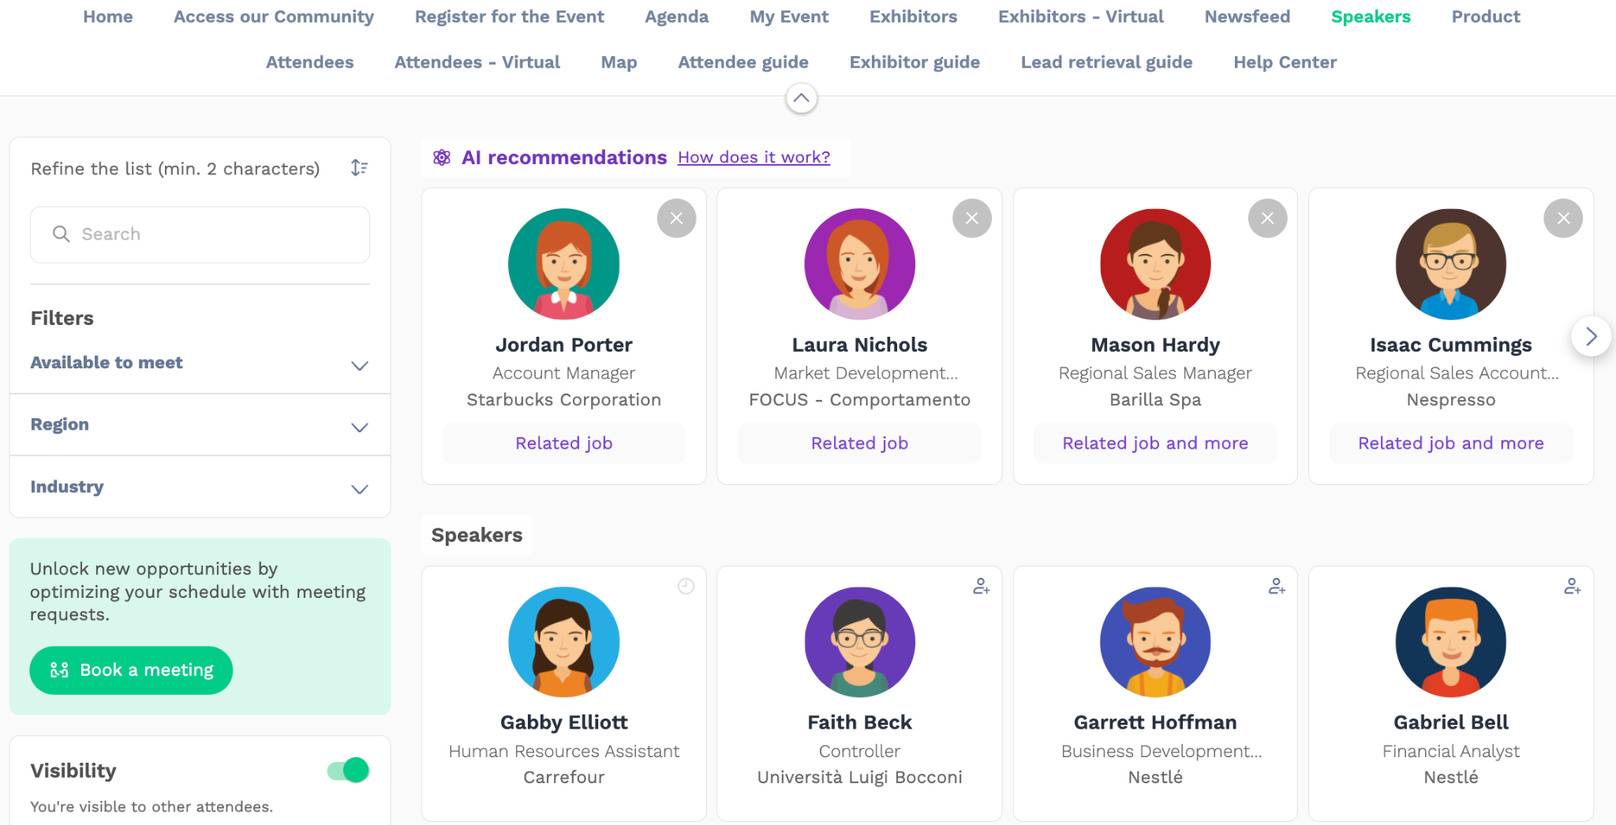
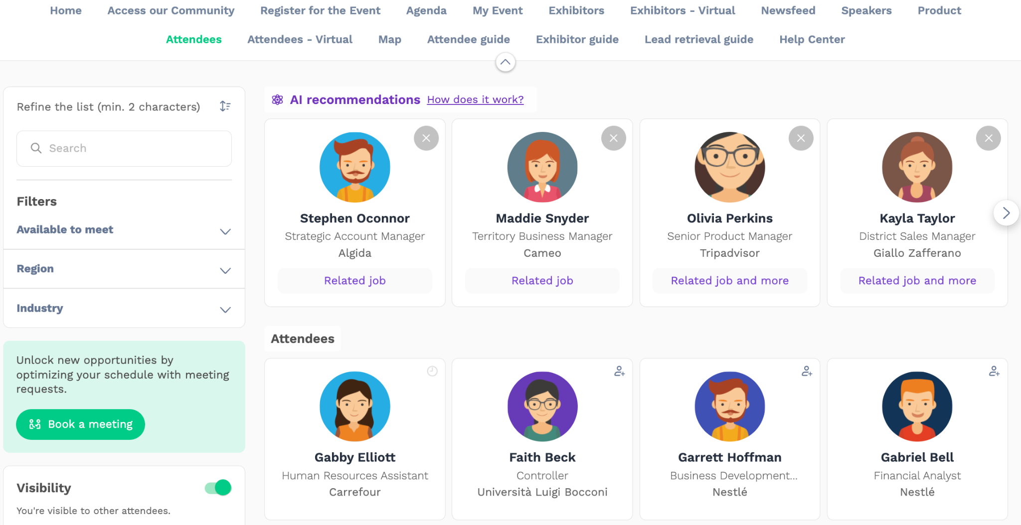
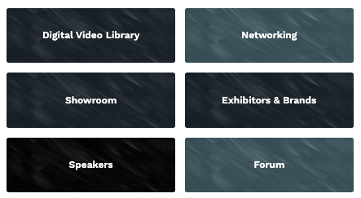
Networking
From the home page or the top navigation bar
you can access the Speaker and Attendee lists (these sections can have different names depending on the event).
Here you can search and find people to connect with. You can chat, have video calls, and book meetings. You can meet virtually or face-to-face depending on how the event is organized.

Slide 16
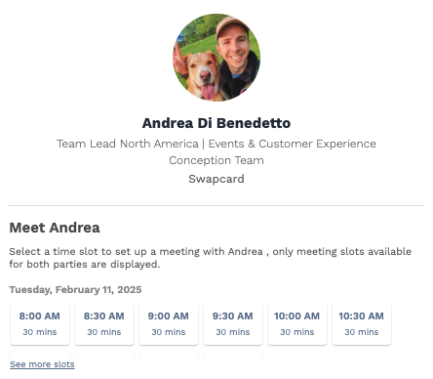
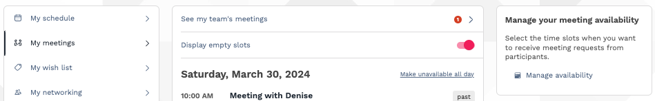
Networking
If you see time slots appearing on people's profiles, it means that the organizer has made it possible for you to book meetings with them. Slots disappear once booked.
You can manage your availability for meetings by going to the My meetings tab in My Event. Making yourself unavailable all day or at specific times will remove meeting slots.

Slide 17
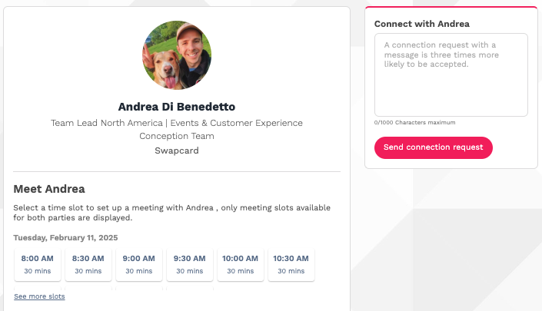
How to send a connection request
To send a connection request, go to their profile (via the list of participants, speakers or a company profile) and click the Send connection request button.
Tip: Add a note to your connection request to introduce yourself and explain the reason for your request.
You will be able to find a full list of your connections in “My Event” under “My Networking”.
Note: Accepting a meeting will automatically make the person who requested the meeting one of your connections with access to your complete profile.

Slide 18
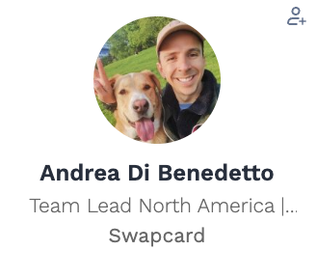

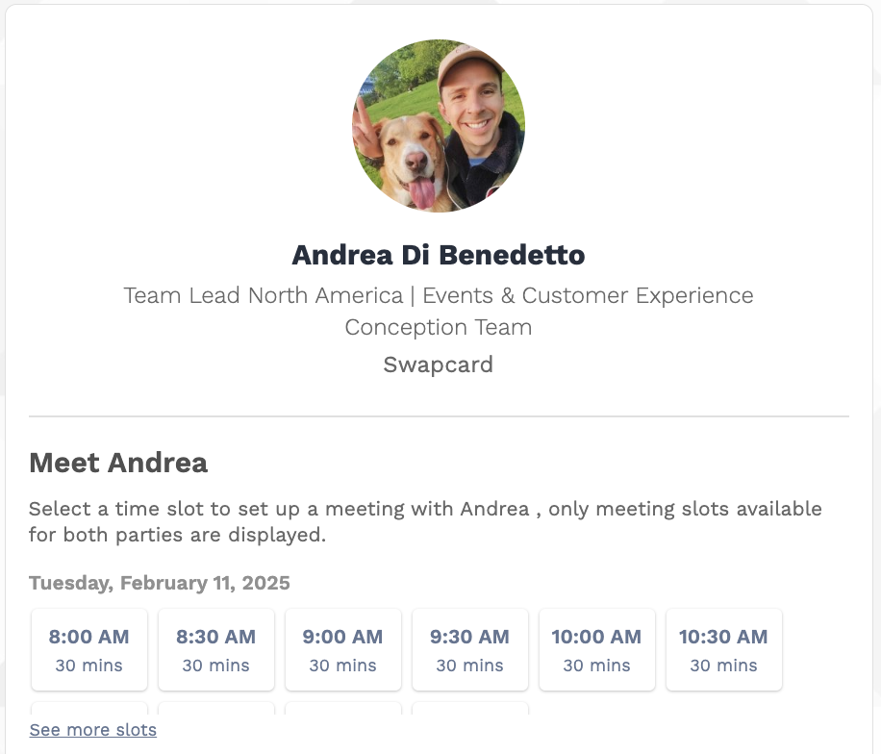

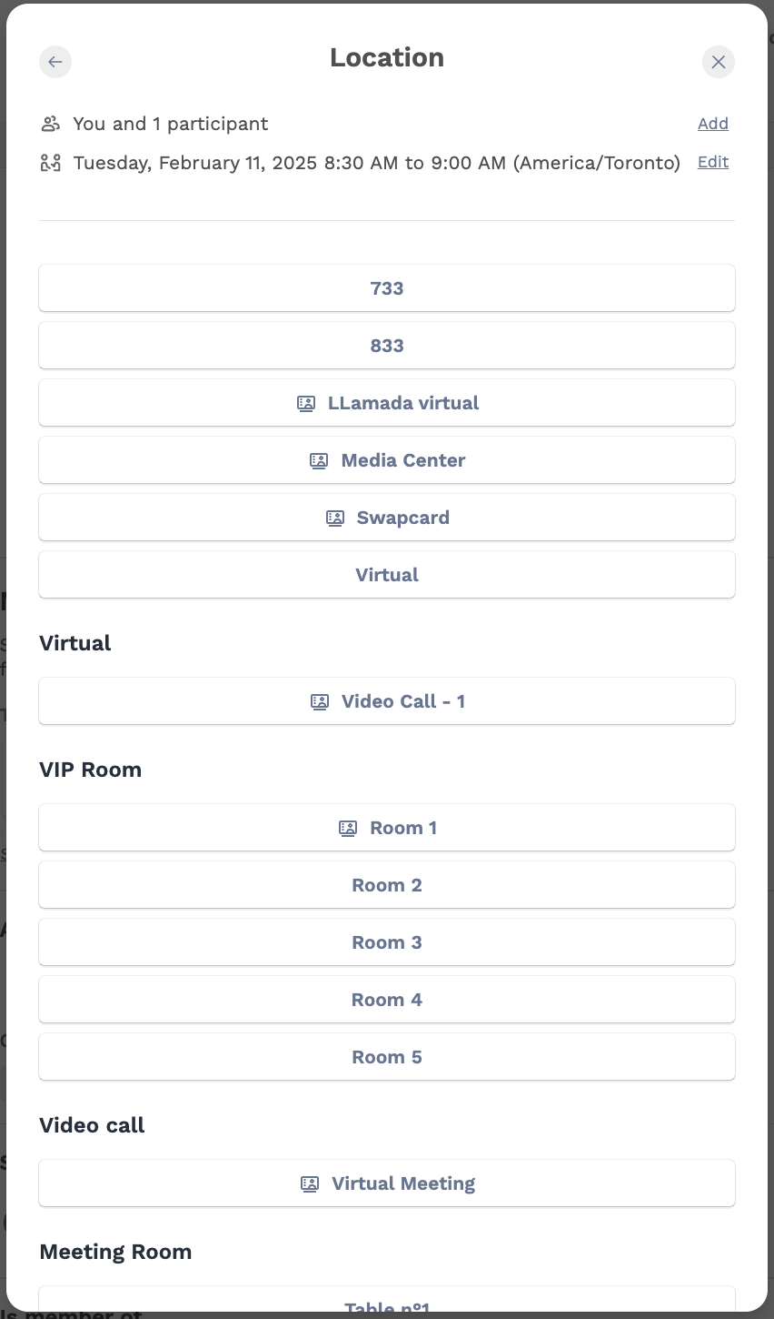
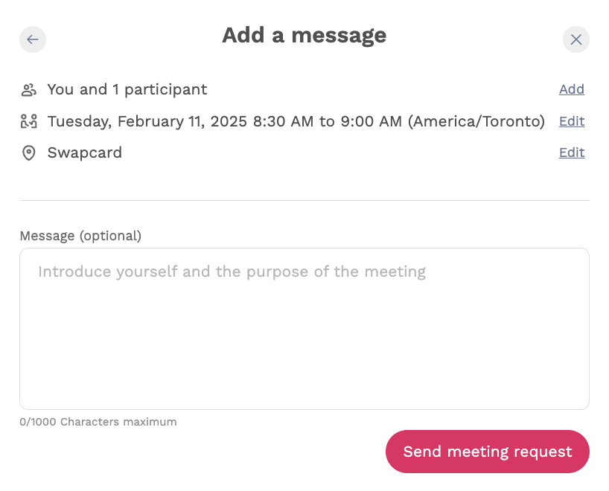
How to request a meeting
Access a person's profile (i.e.: from the Attendees button)
Click on one of the suggested meeting slots. For more slots click “see more slots”
After selecting a slot and choosing a location for the meeting, write a note to the person you would like to meet.
Once done, click “Send meeting request”. At both stages 3 and 4, you can add more people to the meeting and change the meeting’s date/time.
1
1
2
2
3
3
4
4
3

Slide 19
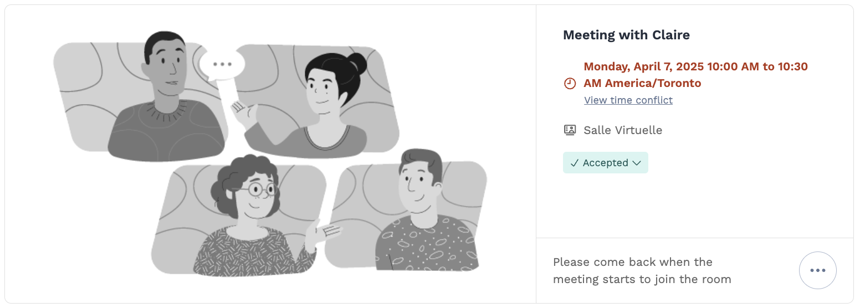
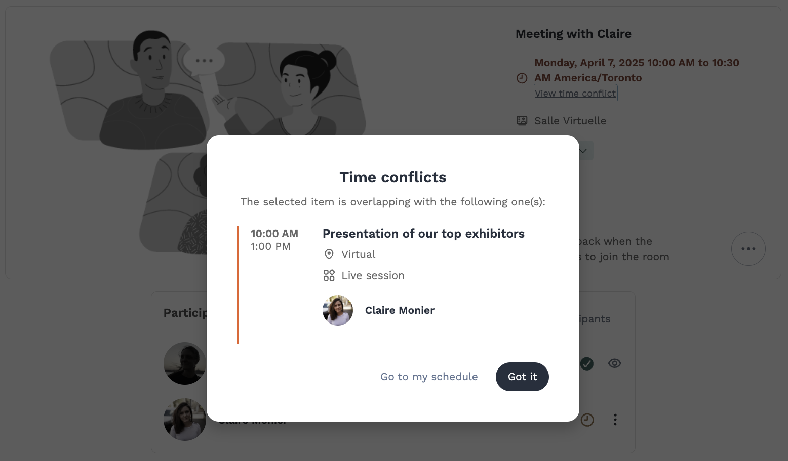

How to have a virtual meeting?
5 minutes before a virtual meeting and 15 minutes before a face-to-face meeting you will receive a reminder email
from which you can click to access the meeting.
If you are already on the platform you can start the meeting by going to the profile of the person you have a meeting with, and click the “Meeting call” button.
This will launch the video call. This button is only available
if the meeting is confirmed.
If you are already committed for another event (session or meeting), you will be notified by a red text on the meeting's page and in the 'My Event' tab to indicate the time conflict.
Note: You can also access a meeting directly from the meeting notification.

Slide 20
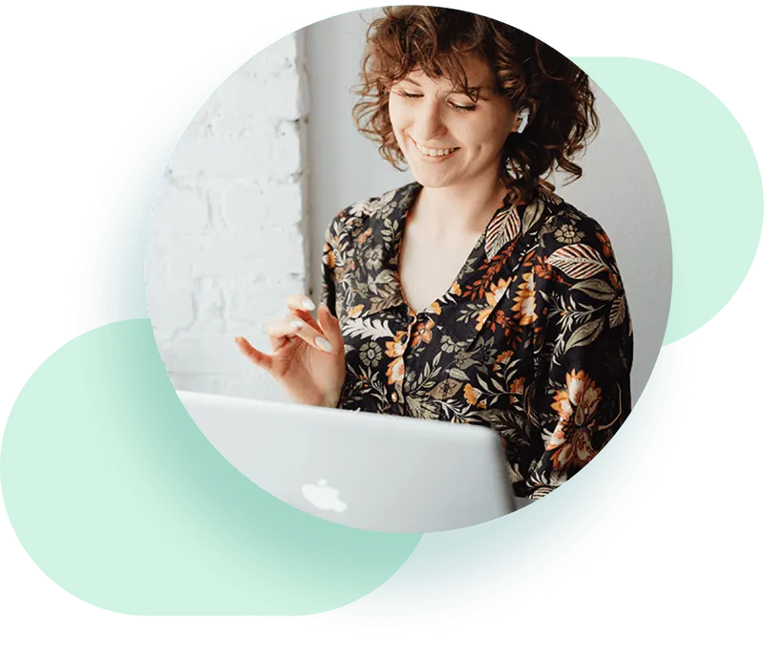

Thank you for taking the time to read this presentation.
Feel free to contact our Support Team if you need assistance.

