Slide 1

A Safer Surgery:
Shorter stay, better recovery!
Michele Millard
National Quality Improvement Lead
Spire Healthcare

Slide 2
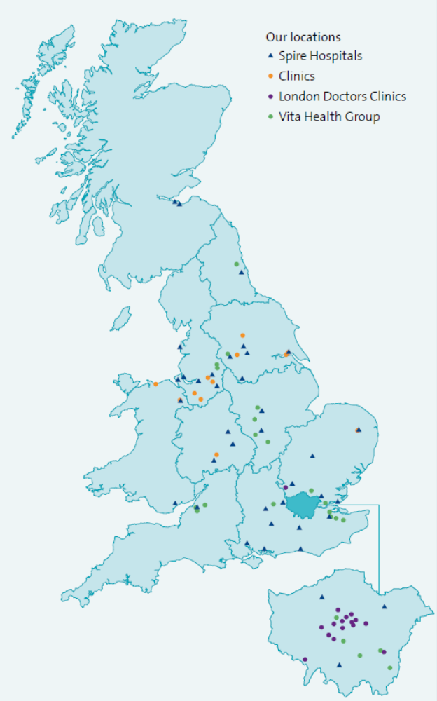

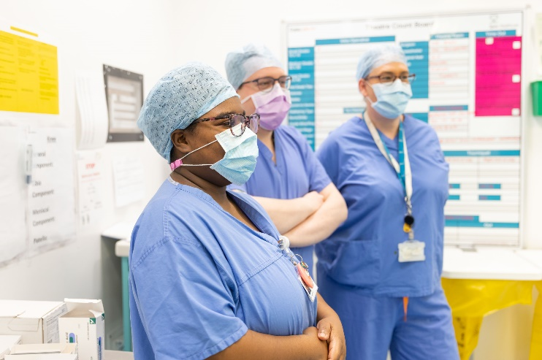

Spire Healthcare
Britain’s largest independent integrated healthcare company by turnover, operating across England, Wales and Scotland
What we do:
Treatment and surgery: from orthopaedics to cancer and complex care
Diagnostics
Primary care: nationwide network of independent GPs
Occupational health and employee assistance programmes
Physiotherapy, recovery and rehabilitation
NHS talking therapies and corporate and private mental health
38
Hospitals
3 Nations
40 ICBs
50+ Clinics, consulting rooms and medical centres
1m+
People cared for annually – NHS, self-pay, insured, corporate
17,400 Colleagues
230
FTSU Guardians/
Ambassadors
98%
Good or Outstanding inspected locations (or equivalent)

Slide 3
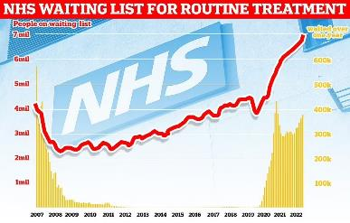
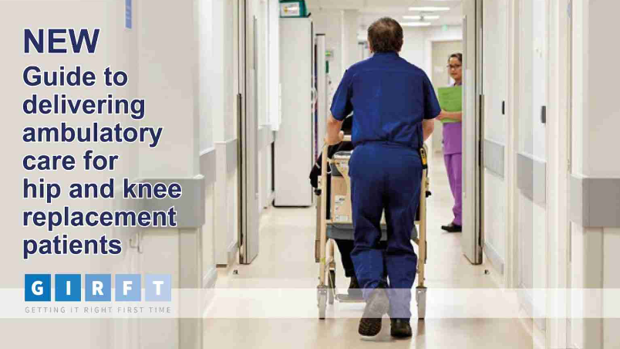
Reducing patient average length of stay (AvLOS) - orthopaedics
NHS waits in England over 7.3 million people
Hips and knees – largest group and many waiting 12 months+
Decreasing LOS using ‘enhanced recovery pathways’ reduces recovery time and improves outcomes
Reduce AvLOS for primary hip and knee replacement surgeries across Spire
Increase capacity to reduce NHS waiting lists
Keys to success:
  Managing patient expectations
  Whole team approach
  Consistent message and standardised pathway
Notes:
Michele

Slide 4
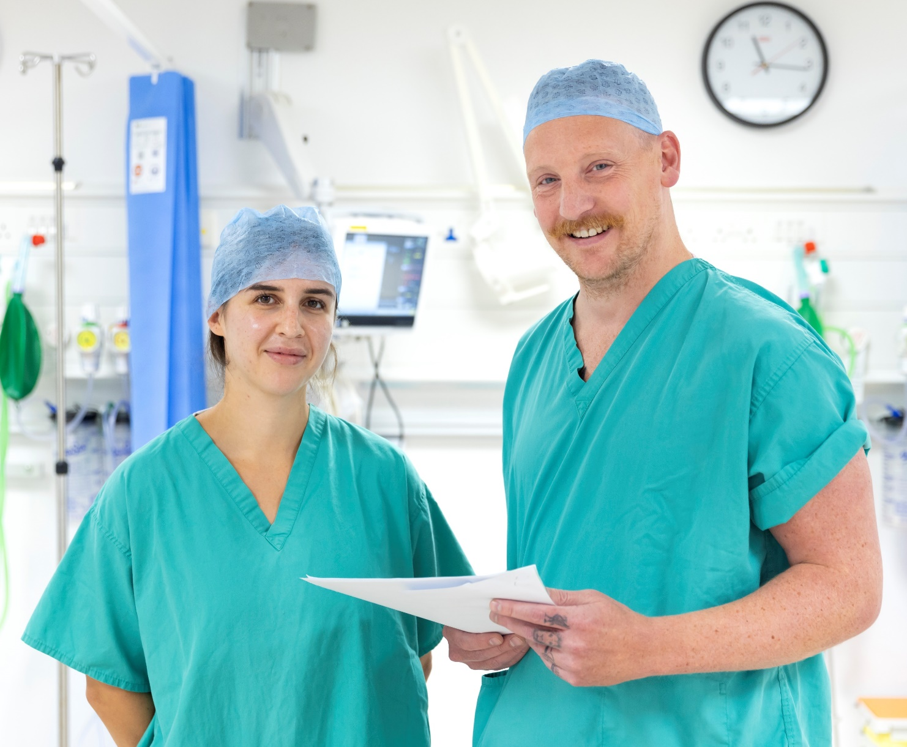
What we have achieved
Standardised pathway
AvLOS 2 days or lower
Successful 23-hour pathway
Improved patient safety and outcomes
Upholding the 6 domains of health care
Positive patient experience
Increased capacity
      24% over two years
      3,400+ NHS patients treated nationwide
Work translated to NHS hospitals
Notes:
Sarah 6 domains safe, effective, patient-centred, timely, efficient and equitable.

Slide 5
How? Sharing best practice and consistent message keys to success
AvLOS group established November 2022
Practice across Spire was reviewed, guidelines and research studied
Shared best practice, 23-hour pathway developed in Hull at regular meetings
New pathways developed, adopting best practice, and trialled
Audits ensured pathway met 6 domains of quality healthcare
Detailed data collected for the 23-hour pathway
Rolled out in 38 hospitals with support from all members of the hospital team
Notes:
A framework was developed including all aspects of the patient journey and the 23 hour pathway sits within this framework. This was agreed by all stakeholders at numerous meetings before being rolled out in March 2022
We did a gap analysis on each service involved to see what additional support / training we may need to achieve the objectives of the pathway. From this staffing & training needs were identified and addressed, and work was done around managing patient expectations & communication.
We started with a strict inclusion criteria, list
We built in safety nets along the process at POA/ MDT/ Therapy classes – at any of these points the patient could revert back to the standard pathway.
We ensured a consistent message throughout the patient journey to manage the patient’s expectations
Pre op therapy sessions ensured patients were screened for suitability, well informed about the pathway and they received their exercises, gait analysis and all relevant equipment
Patient were identified as blue on the theatre diaries and were scheduled in the first 2 slots unless insured. This was checked at bed capacity meetings. Mention insurance
The patients were identified on the ward board using a green magnet so that these patients were prioritized for physio, bloods and x ray

Slide 6
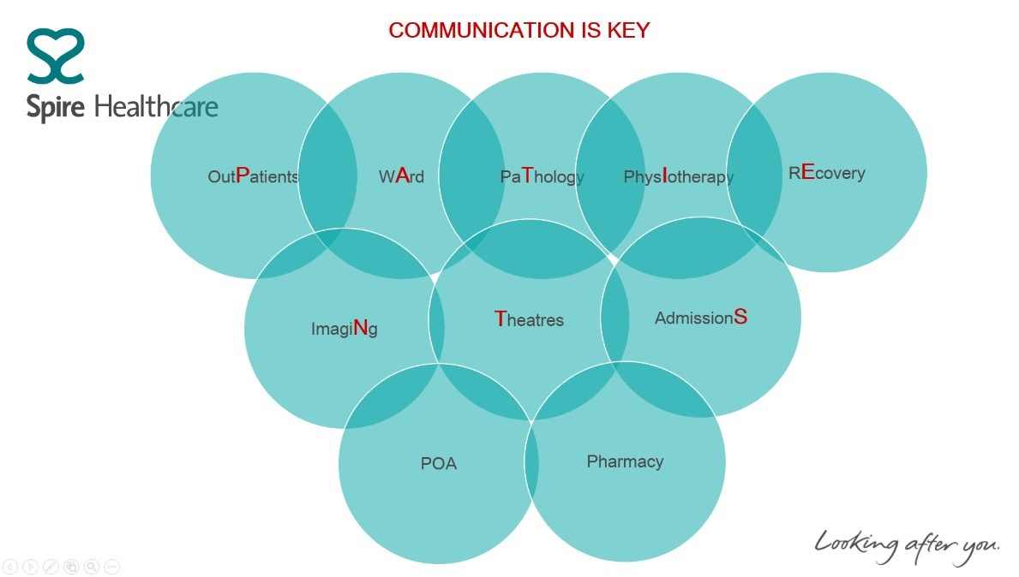
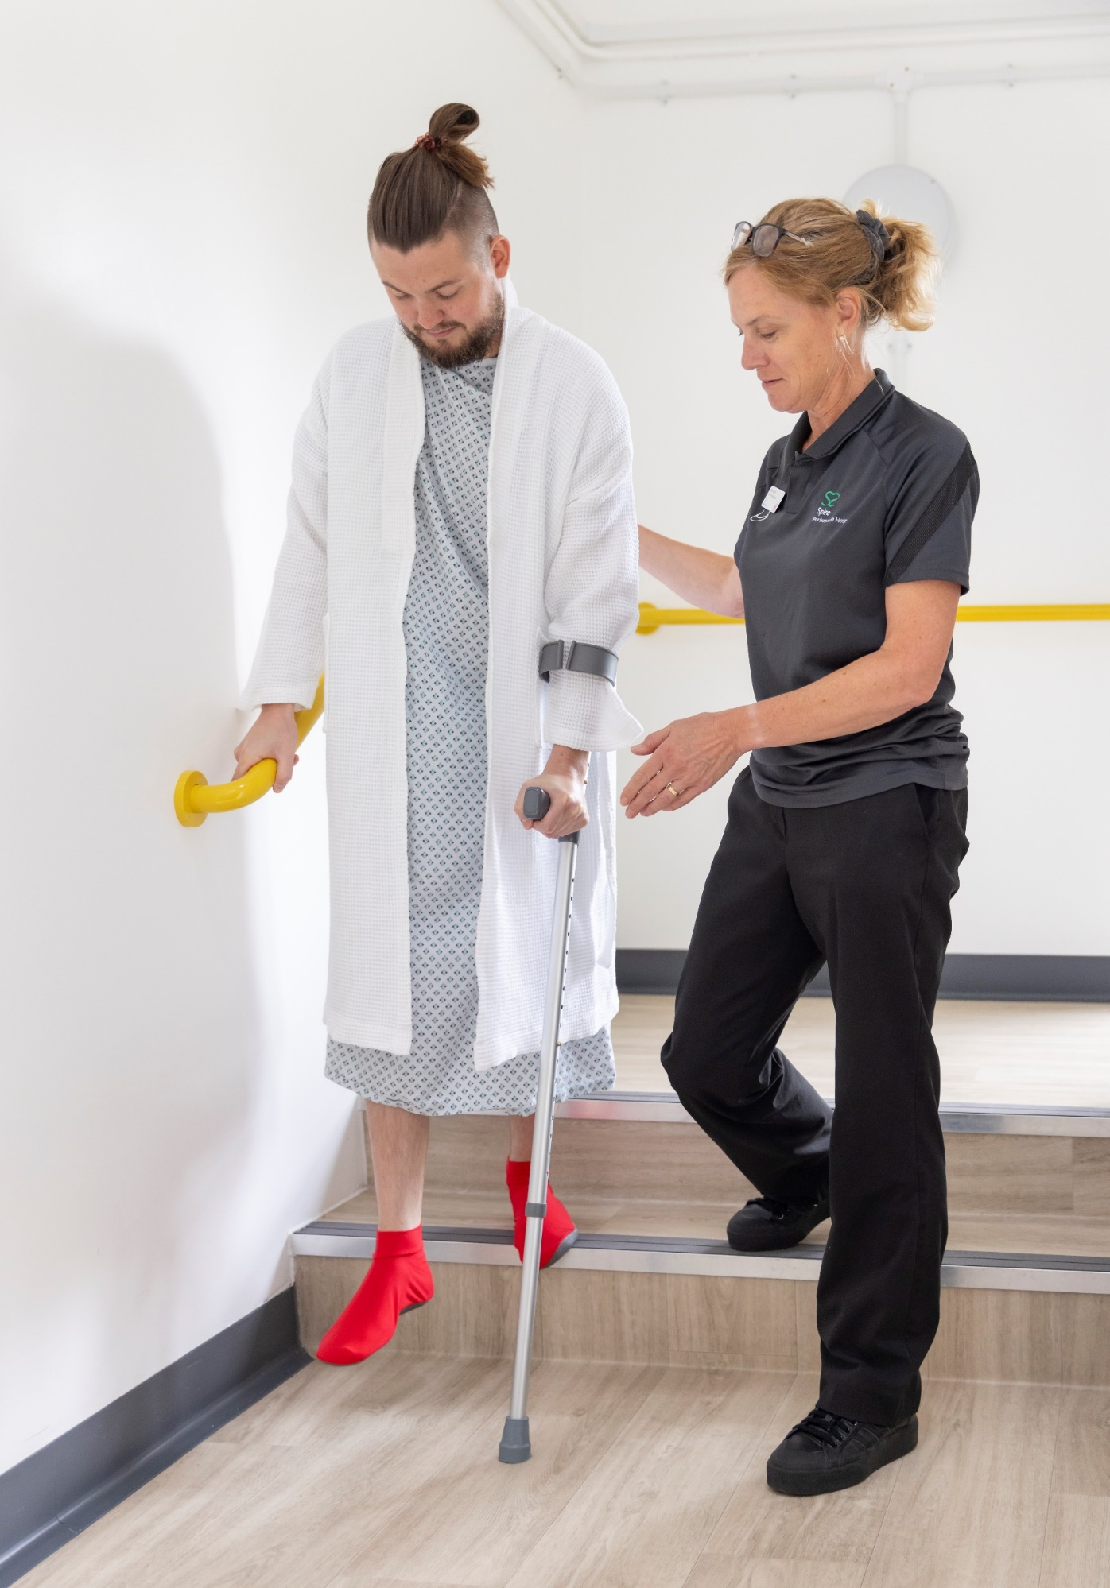


Involvement - patients, hospital team, partners and regulators

Slide 7
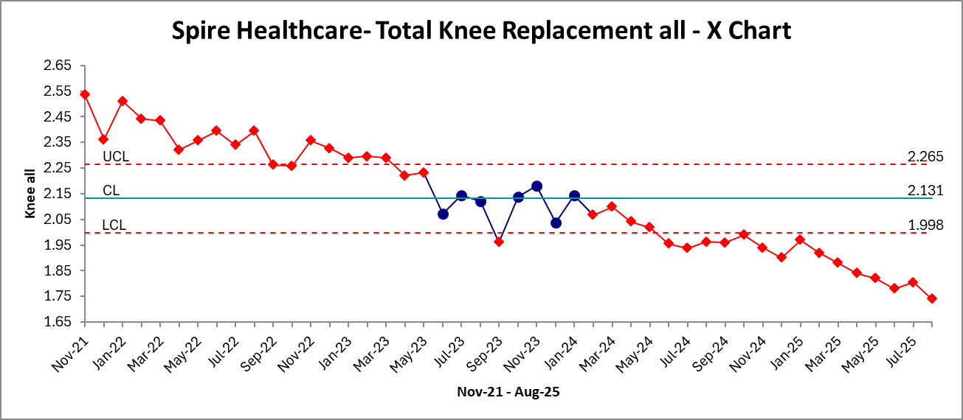
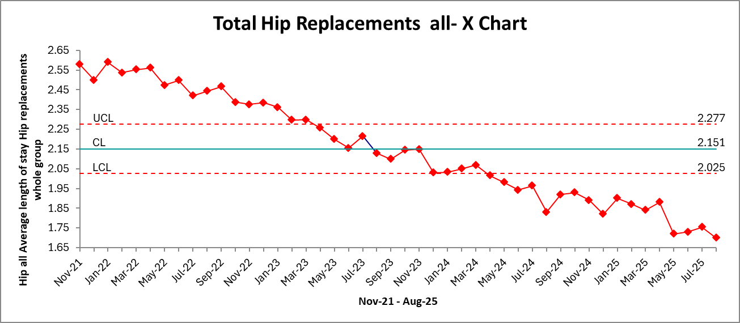
Results - all patients

Slide 8

Other positive outcomes
PROMS 2024
DOWN
Health gains in:
Complaints
20% during the study period
97.5%
94.1%
DOWN
Surgical site infection rate 15%
of hip replacement
patients.
of knee replacement
patients.
STABLE
readmission rate
60%
reduction in avoidable blood clots
97%
of patients rated their experience as
or
GOOD
VERY GOOD
These are
SIGNIFICANT
reductions in harm

Slide 9
Outcomes from Spire Hull audit
100 patients (NHS and private) went through 23-hour pathway at Spire Hull and East Riding Hospital
  No blood clots
  No readmissions
  No returns to theatre
  No infections within the study group during this period
  No complaints and that the patients had been very positive about their experience
Many patient positive comments:
  ‘This has transformed my life. I was back working in the garden within the week and going for walks’
  ‘I have 100% improved quality of life. I am self-employed so have no help. I was working until the day before the surgery, which the consultant was surprised by, as it was bone on bone. This was such a relief.’
  ‘Recovery was 10 weeks, but I felt ready to go back to work and I was only waiting nine months, and I know of people waiting longer!’

Slide 10
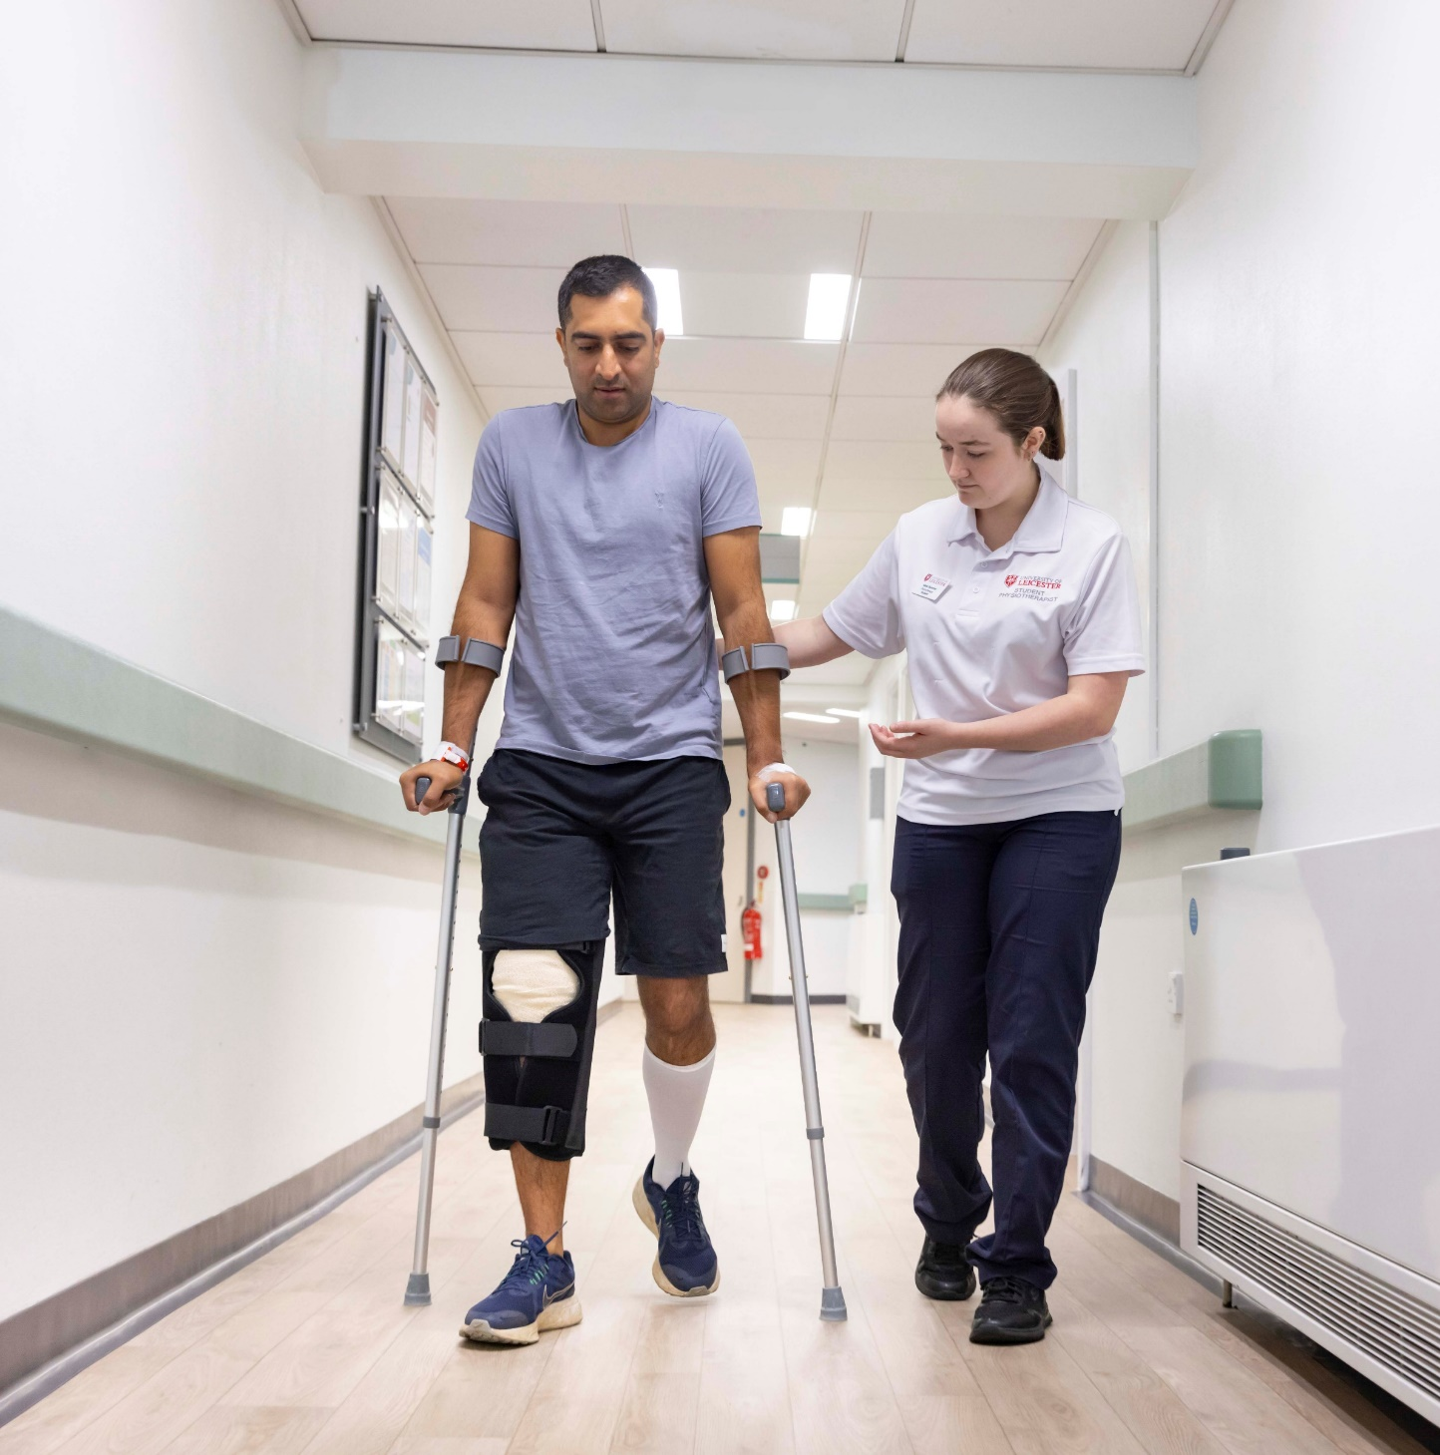
Sharing safer learnings
Work shared and embedded across 38 Spire hospitals
Project shared with primary care GPs in NHS and independent sector
Learning has been implemented in local NHS hospitals and replicated
Shared internationally at shared learning conference

Slide 11
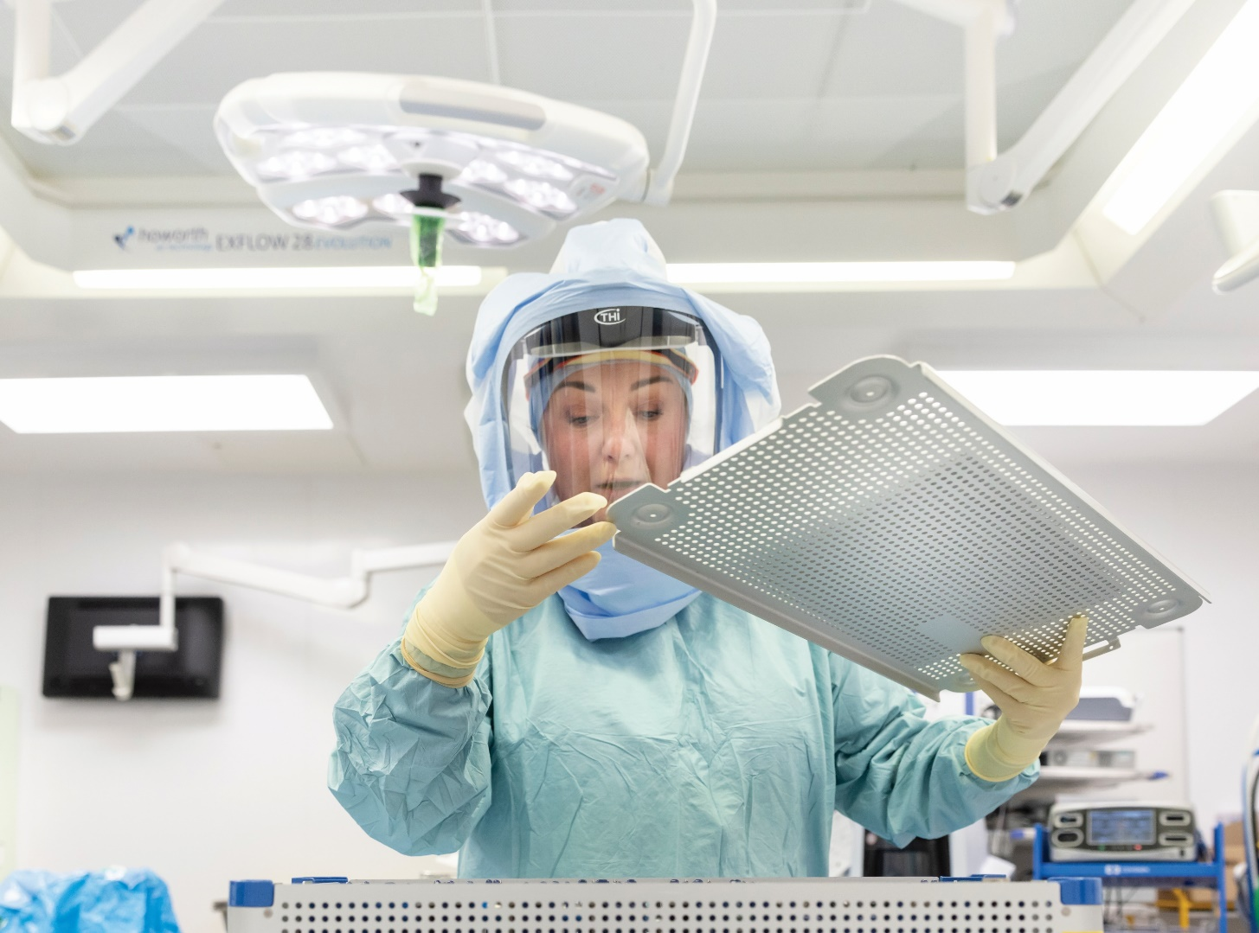
NHS learning or adoption
23-hour pathway developed at Spire Hull now rolled out at local NHS hospitals in the Humber region
Leading to significant reduction in LOS
  Goole
    Q1 2023 - 2.4 days
    Q1 2024 - 1.7 days
  Castle Hill Hospital
    Q1 2021 - 6.5 days
    Q2 2024 - 4.5 days
Demonstrates the translational value of this work
Lessons learnt during the Spire pathway used in development of NHS pathways

Slide 12

How could this be replicated?
A whole team approach – surgeon, anaesthetist, preoperative assessment nurses, physiotherapist, radiographers and most importantly the patients!
Use a QI approach with solutions coming from the team
Build confidence in the process with the team
Supportive and encouraging communication with the patient from the very beginning
Talk about discharge being milestone-led rather than X days in hospital
Review analgesic regimes, reduce opiate use
Early mobilisation, set a target for on-the-day mobilisation
Discharge safety netting, have a system for support
Notes:
Tom

Slide 13
Contact us
michele.millard@spirehealthcare.com

