Slide 1
United Natural Products Alliance
China Regulatory Overview
Non-tariff Trade Barriers
Cross-border E-commerce
Free Trade Zones
China’s National Single Window and Decree 248

Slide 2
United Natural Products Alliance - Background
Founded in 1992, based in Utah, a center of the US dietary supplement industry
100 + Members
Original Mission - create a new legal framework for dietary supplements
Success - the Dietary Supplement Health and Education Act of 1994
Baseline of $6 billion in 1994
30 + years of service to the $67 + billion US dietary supplement industry
U.S. Commerce program to help align standards and support e-commerce sales in China
Supply chain is now a top priority

Slide 3






















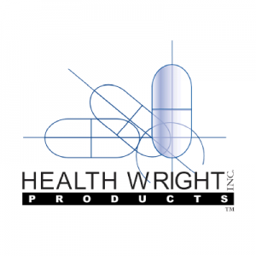




























Selected UNPA Members
Notes:
Some are brands, contract manufacturers, 3rd party laboratories, MOU partnerships with many industry organizations and Universities

Slide 4
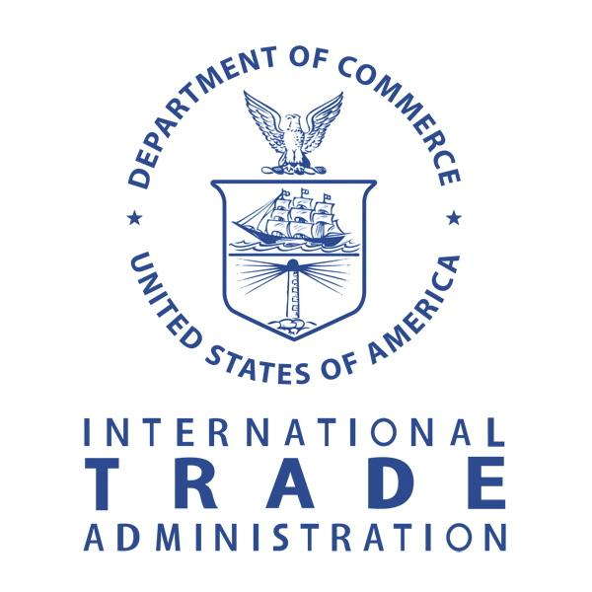

U.S. Department of Commerce - MDCP Grant
UNPA’s MDCP award established a partnership with the U.S. Department of Commerce’s International Trade Administration (ITA).
Address regulatory and market access issues.
Work with e-commerce accelerators to increase exports.
Educate consumers about product ingredient labels, claims, and third-party certifications.
Assure products meet DSHEA standards.

Slide 5
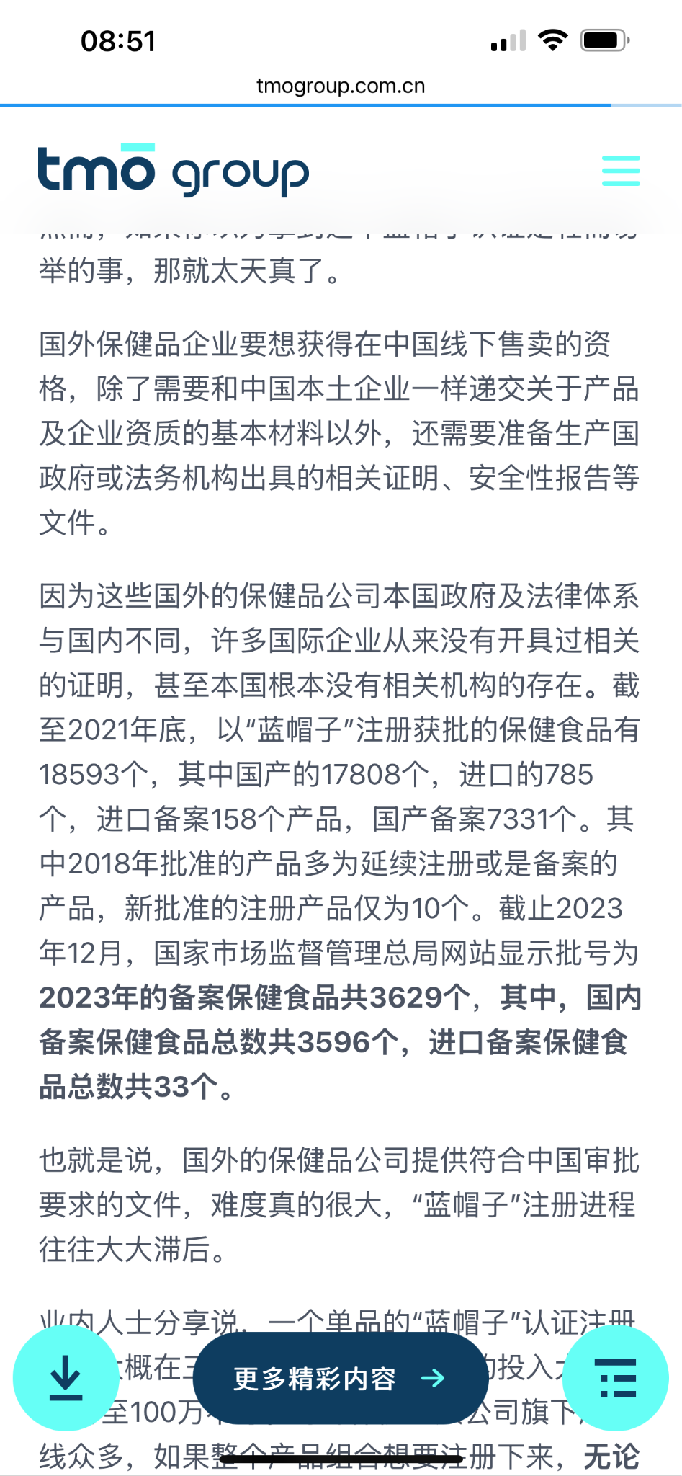

China: Market Approval
General trade of dietary supplements in China requires Blue Hat filing.
2023 Blue Hat Filing Approvals
3596 approvals went to Chinese domestic companies.
33 approvals went to foreign companies.

Slide 6
Cross-Border E-Commerce (CBEC) & Free Trade Zones (FTZ)
CBEC Simplifies Market Entry: Allows US dietary supplement brands to sell directly to consumers, bypassing traditional regulatory hurdles.
FTZs as E-Commerce Hubs: Free Trade Zones store products tax-free until sold (in-bond), speeding up customs clearance and reducing costs.
Logistics Advantage: FTZs and bonded warehouse to facilitate fast delivery for products sold through platforms like Tmall Global and Douyin (TikTok).
Throttled Market: China imposes an annual 26,000 RMB ($3,583) individual consumer quota; each purchase may not exceed 5,000 RMB ($689).

Slide 7
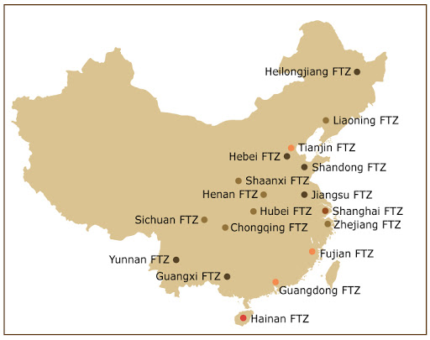
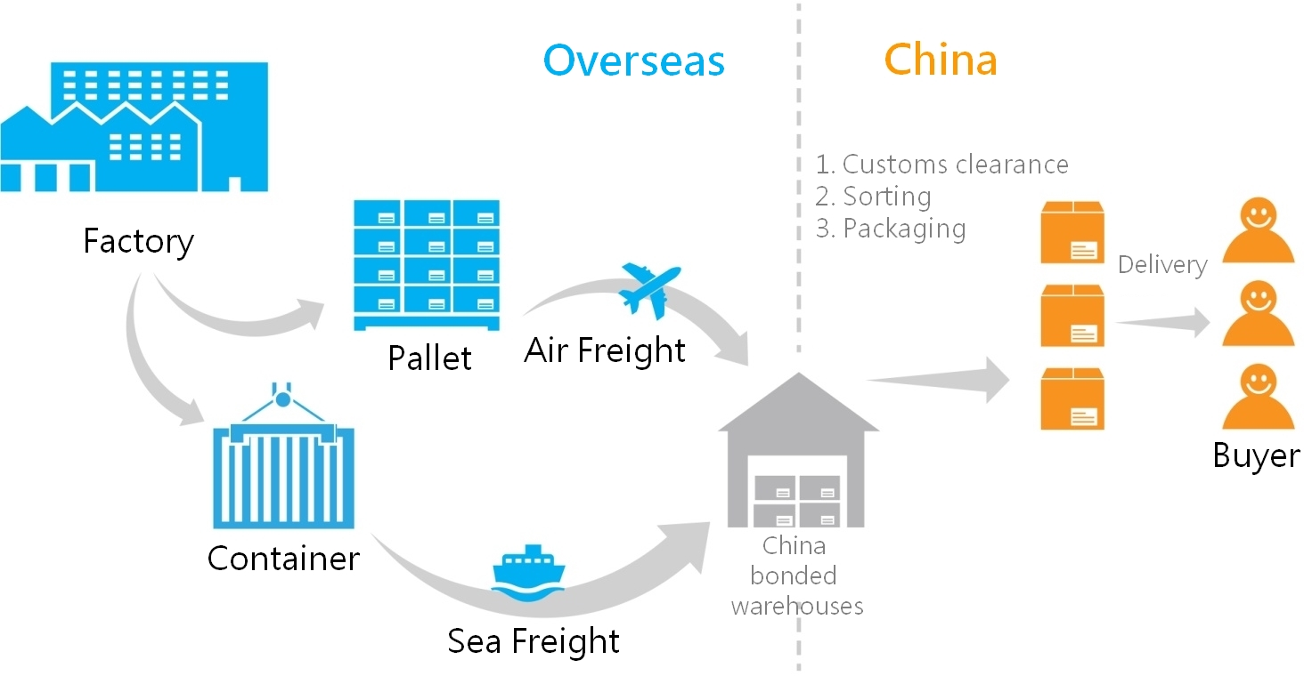
Cross-Border E-Commerce (CBEC) & Free Trade Zones (FTZ) in China

Slide 8

China GACC Registration Single Window
The Regulation and Administration of Overseas Manufacturers of Imported Food (“Decree 248”) took effect on January 1, 2022.
The regulation states that overseas food manufacturing, processing, and storage facilities are required to register with the General Administration of Customs of China (GACC) to export food products to China.
DS Industry: Method 1 - Competent Authority Registration Process

Slide 9
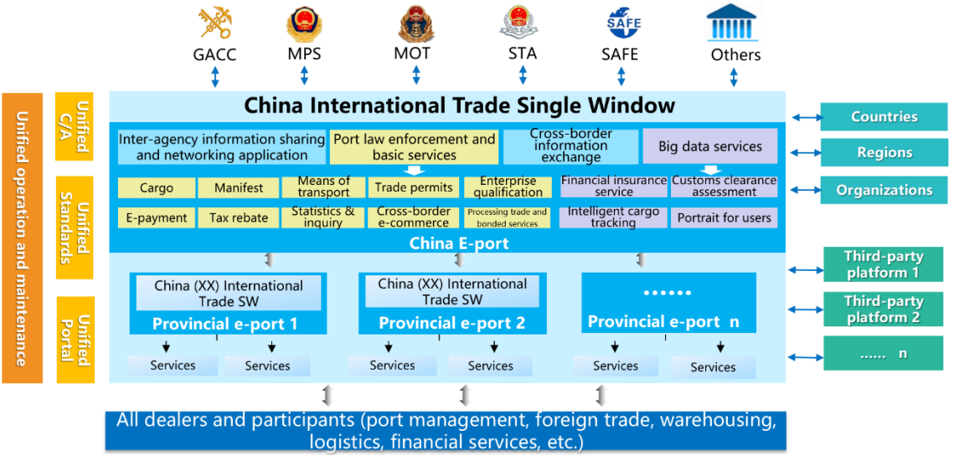
Navigating China’s National Single Windows (NSWs)
CBEC Simplifies Entry but Requires Compliance: Products on China's CBEC Positive List bypass traditional registration but must adhere to customs declarations and GACC manufacturer registration.
NSW Documentation & Labeling: Importers must submit accurate ingredient details, labeling compliance, and product information via China’s National Single Window (NSW).

Slide 10
China GACC Registration Single Window
Step One: Complete FDA's Export Listing Module (ELM). ELM will give you the number needed to complete the China GACC Registration.
https://www.fda.gov/food/food-export-lists/online-applications-export-lists
Step Two: Create an account with China GACC after completing the FDA ELM.
https://app.singlewindow.cn/userserver/user/abroad/index?backUrl=https%3A%2F%2Fapp.singlewindow.cn%2Fcas%2Flogin%3Fservice%3Dhttps%253A%252F%252Fcifer.singlewindow.cn%252Fdeskserver%252Fj_spring_cas_security_check&loginLanguage=
Step Three: Login to your China GACC account here and complete registration.
https://app.singlewindow.cn/cas/login?service=https%3A%2F%2Fcifer.singlewindow.cn%2Fdeskserver%2Fj_spring_cas_security_check
Registration Guides
Search: “Introduction to Facility Registration Under Decree 248”
8-page summary prepared by USDA Foreign Agricultural Service
Search: “Decree 248 Unofficial Self-Registration Guide for Overseas Food Facilities”
17-page summary prepared by USDA Foreign Agricultural Service
Notes:
Step 1: look up FDA Establishment Identifier (FEI); ensure that their establishment has a current and valid ’s Food Facility Registration, when submitting product information, establishments should provide the product name and Schedule B/HTS (Harmonized Tariff Schedule) number to the 8- or 10-digit level.

Slide 11
Key Takeaways for U.S. Brandholders
CBEC Offers Strategic Market Entry: Leverage cross-border e-commerce to navigate complex regulatory requirements.
FTZs Facilitate Efficient Distribution: Utilize Free Trade Zones to optimize logistics and reduce customs-related delays and costs.
E-Commerce Accelerators as Critical Partners: Working with e-commerce accelerators simplifies regulatory processes, ensuring faster access to consumer markets.

Slide 12
Thank You
Loren Israelsen, President and Founder
loren@unpa.com
Daniel Mabey, Asia President & Director of Strategic Markets
daniel@unpa.com

