Slide 1



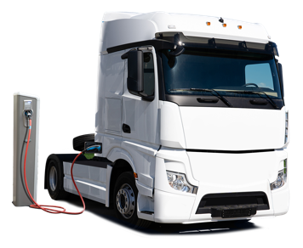
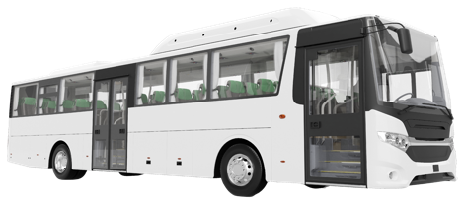
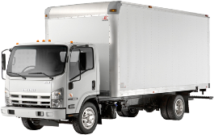
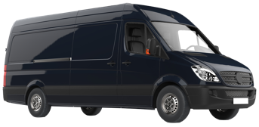
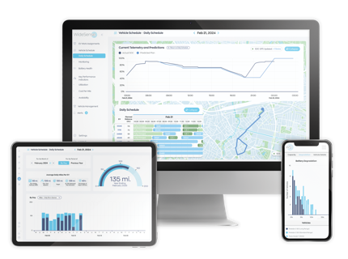

Berkeley, California, USA
Transforming Public Transport with AI:
Planning, Scheduling, and Operations
Heikki LAINE
VP | Product

Slide 2
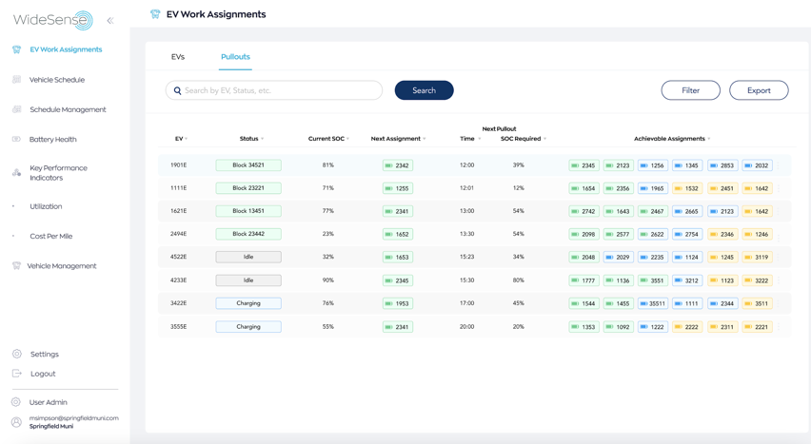

About WideSense
Make the shift to electric and increase the profitability of your transportation work.
Our full lifecycle fleet electrification solutions increase revenue-generating utilization, while lowering operating & capital costs.
| 2

Slide 3




Fleet Electrification Challenges
Electrifying fleets efficiently is complex
    High variance in
    fuel consumption
    Fuel tank capacity
    shrinkage
    Long
    refueling times
    Fuel price
    complexity
    Operating an electric vehicle fleet is
    significantly more complex than an ICE fleet.
This document is proprietary & confidential. No part of this document may be disclosed to any Third Party without the express written consent of WideSense.
| 3

Slide 4

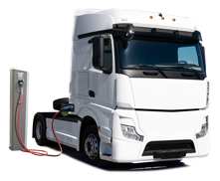

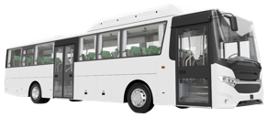
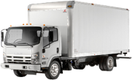

Today’s Typical Electrification Approach
EVs are introduced without adapting procedures to optimize performance
INTRODUCE
EVs
FOLLOW ICE
SOPs
Vehicle by Vehicle Replacement | → | LOW Utilization
Route by Route Electrification | → | HIGH Cost / mile
Overbuilt infrastructure + fleets | → | HIGH CAPEX
    but with AI optimization, EV TCO OUTPERFORMS ICE
| 4

Slide 5
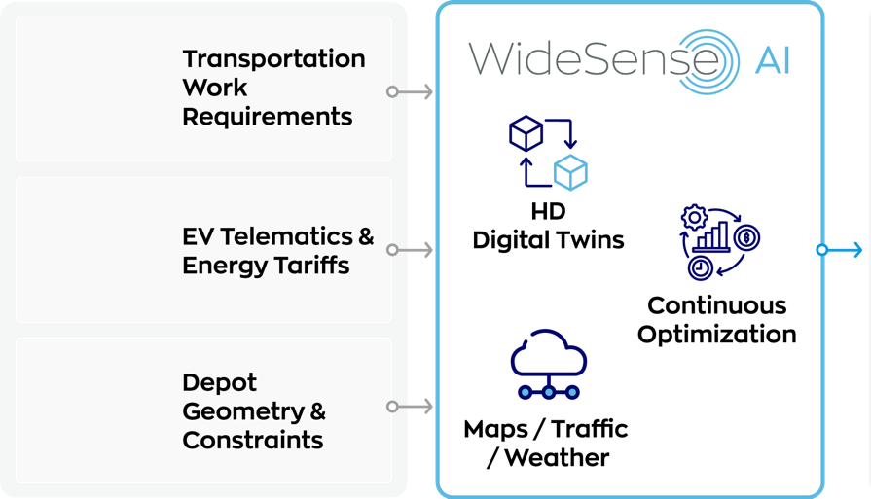
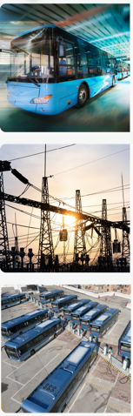




Platform for Optimized Transport Electrification
PLANNING
SCHEDULING
OPERATIONAL GUIDANCE
MONITORING
| 5

Slide 6
Where is Public Transport using WideSense AI?
PLANNING
SCHEDULING
OPERATIONAL GUIDANCE
MONITORING
Real-time contextual warnings and alerts
Component health with degradation forecasts
Event prediction based on your schedules - less noise and more time to act before disruptions
Dashboards for your financial, operational, and sustainability KPIs
AI-powered plan generation, optimized for your KPIs
Bottom-up modeling of your EVs, chargers, depot dynamics, and depot power limits
Dynamically simulated as a system at scale
Optimized trip organization, EV assignment, and charging schedules
Real-time EV SoC, energy tariffs, and load-balancing algorithms
Built on fleet, depot, and charging feasibility assessments
Easy-to-follow decision support for daily trip and charge operations
Yard and charge management integration for accuracy
Improved schedule adherence for better operational and financial performance
| 6

Slide 7
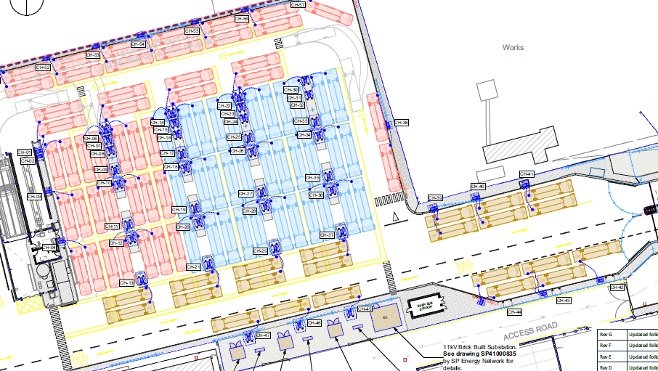
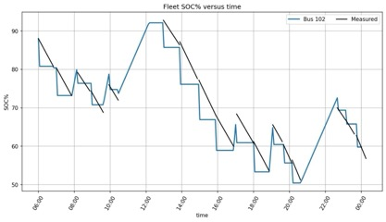
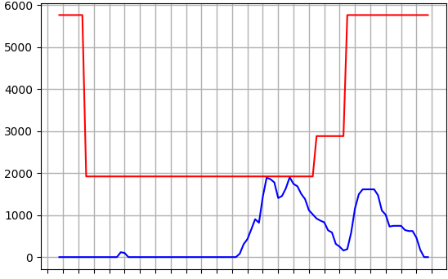
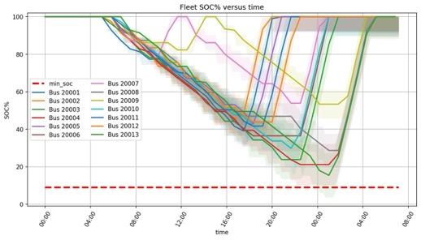

Examples : Planning
Bottom-Up Modeling
Energy Optimization
Instead of using fixed values for eBus energy consumption, battery capacity, and charging behavior we learn digital twins from real eBus and charger behavioral data over time.
Real-time charge optimization based on tariff structure and load-balancing algorithms create charge strategies that reduces energy costs without compromising service.
WS Model
depot and charger max
low-SoC events
| 7

Slide 8
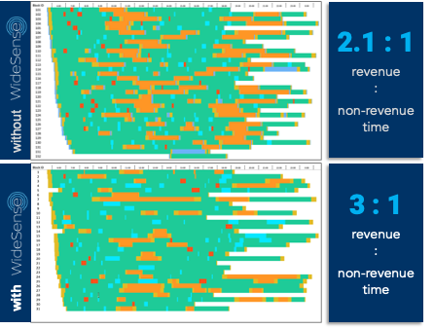
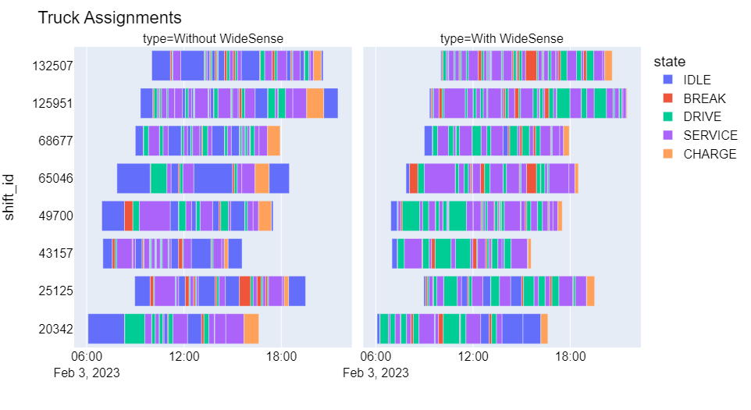
Examples : Scheduling
Block Schedule Optimization
Create efficient block combinations that optimize work and charging, and minimize the number of eBuses, while respecting constraints in schedule requirements and service levels.
Labor Optimization
Streamline runcutting by optimizing operator assignments from vehicle blocks to reduce the number of runs while adhering to work rules and ensuring efficient use of operator time.
46% more driver productivity
| 8

Slide 9
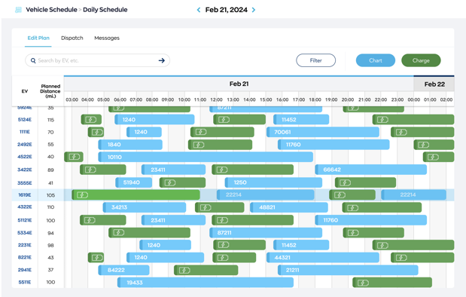
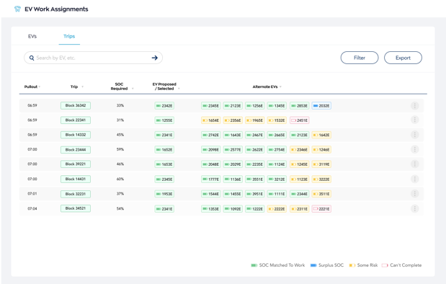
Examples : Daily Operations
Continuous Optimization
eBus-level Work Assignment
Dynamic adjustment and alignment of eBus assignments to meet real-time demands considering current vehicle, work, and environmental conditions.
Precise eBus-level work assignments including real-time handing of exceptions to ensure state of charge and operational requirements are managed to maintain service reliability.
| 9

Slide 10
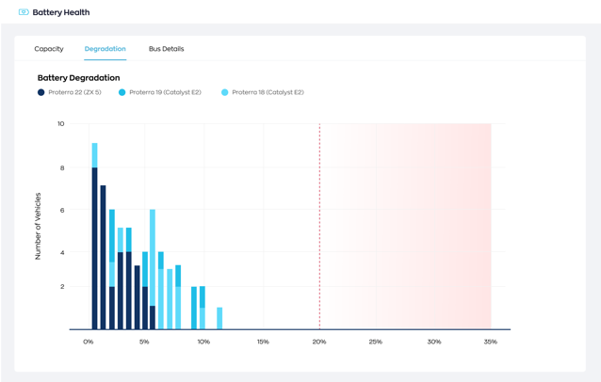
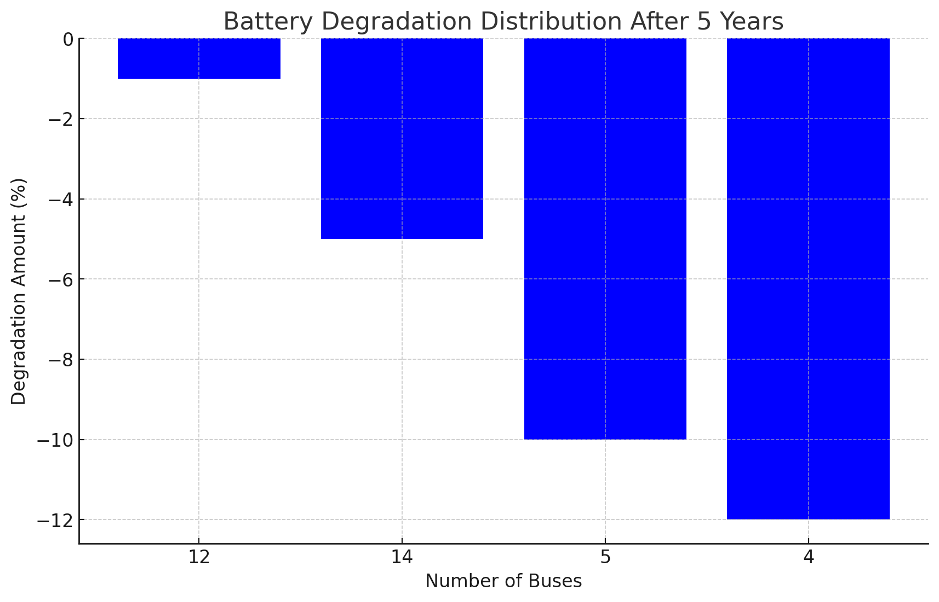
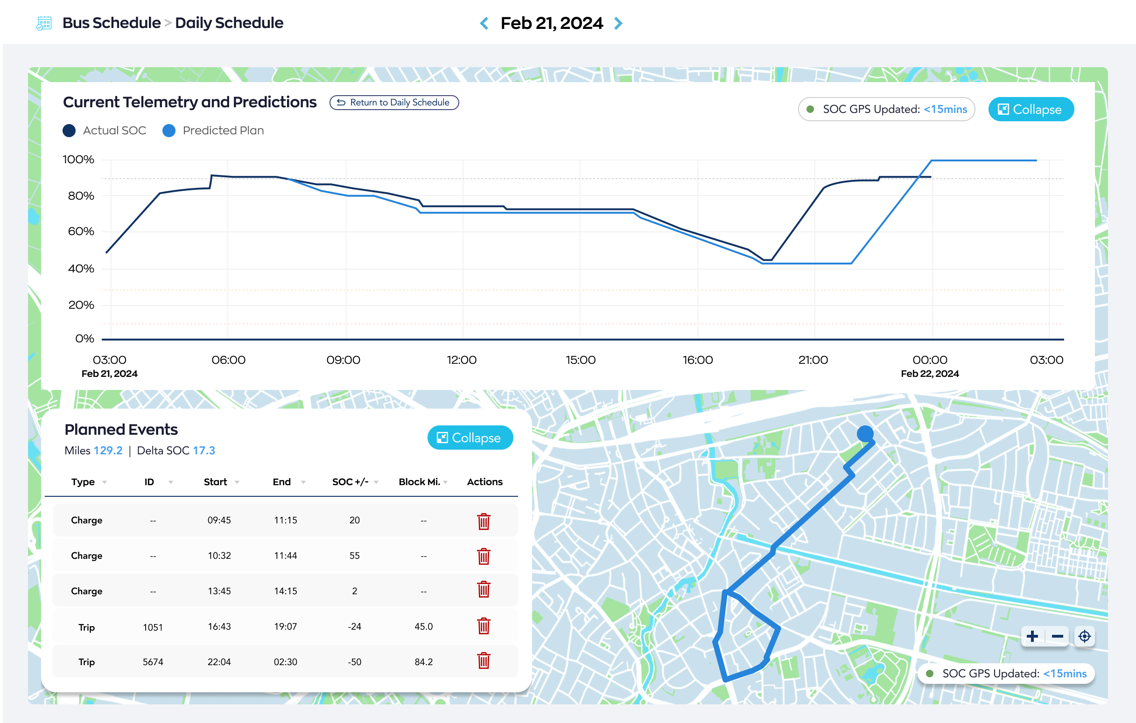
Examples : Monitoring
Anomaly Detection
Forecasting
Monitor and detect eBus battery issues in real time to ensure reliable daily operations by identifying and addressing potential problems before they affect service.
Forecasts battery health and degradation to enable proactive adjustments to schedules and eBus requirements, to maintain optimal performance and service reliability.
| 10

Slide 11
How can WideSense AI help PTOs, today?
TENDER RESPONSE
Improve confidence, eliminate padding
Deliver more competitive responses, faster
PLANNING AND SCHEDULING
Right-size fleet, charger, and labor requirements
Maximize revenue miles and minimize fuel costs
REAL-TIME OPERATIONS & ADHERENCE
Augment decision making and awareness
Maximize asset revenue utilization and service reliability
| 11

Slide 12


Thank You
heikki.laine@widesense.net

