Slide 1
JTP Conference: 5th Anniversary of the Just Transition Platform
21-23 October 2025, Brussels

Slide 2

Clean technologies accelerating competitiveness in JTF regions
Wolfgang Munch, Senior Expert, European Commission
#JustTransitionPlatform

Slide 3
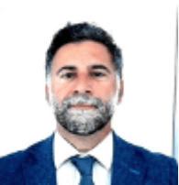
Keynote presentation
Ruben Maximiano
Senior Policy Analyst and Competition Expert, Organisation for Economic Co-operation and Development (OECD)
#JustTransitionPlatform

Slide 4
The OECD Diagnostic Tool and the Role of Regions in the Energy Transition
Ruben Maximiano, Senior Expert, OECD
21 October 2025

Slide 5

A Diagnostic Tool for Policymakers for Screening Regulations
Solar Energy
Wind Energy
Including utility scale and innovative solar solutions
Onshore and offshore wind technologies
Demand Response
Pumped Hydro Storage
Prosumers, Energy Communities and Aggregators
Water batteries for energy storage
Grid Infrastructure
Spatial planning and permitting
Investing in transmission and distribution networks
Land use policies and approval for renewable energy sites
Our Unique Approach
A
B
C
Self-Assessment Screening Tool for all levels of government (national, regional, local)
Regulatory barriers across 10 different markets
Evidence-based scores and good practice examples

Slide 6
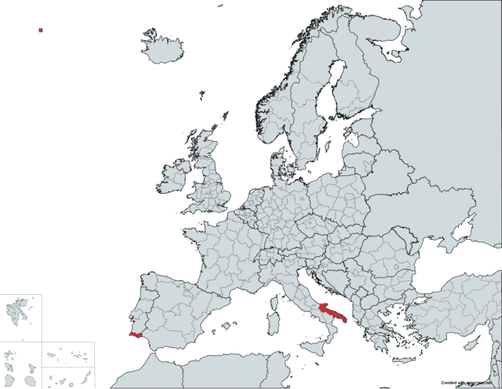
Why Sub-National Action Matters
EU targets depend on regional & local delivery
Permits, zoning, and grid approvals mostly sub-national competences
Apulia (Italy): Overlapping competences cause delays
Algarve (Portugal): Outdated spatial plan (2007) stalls projects
Transition success will be decided in town halls and regions

Slide 7

Spatial Planning Bottlenecks
Outdated or silent local plans block renewable projects
Few regions designate suitable areas for wind/solar
Misalignment with grid expansion and national targets
Example: Algarve regional plan prioritised tourism, nothing on energy
If the map is wrong, the journey will be slow and expensive

Slide 8

Permitting Challenges
Fragmented, sequential approvals across authorities
Lack of Spatial planning means more resources, lack of single contact points; weak or unenforced timelines
Municipalities often lack capacity/expertise
Uncertainty is what deters investors

Slide 9

How the Tool and the OECD can help
MS and Regions
🎓 Capacity building: train national, regional & local officials
📝 Assessment: MS and regions can map their own barriers or ask OECD
📊 Benchmarking: compare similar MS or regions for peer learning
🚀 In-depth reviews: design reform roadmaps (permitting, planning, grid)
Practical instrument for faster projects & stronger regional voice

Slide 10
In a Nutshell
The acceleration of renewables and meeting targets in Europe depends on how regions and municipalities handle spatial planning, permitting, and grid connection rules
The OECD Diagnostic Tool gives us a way to systematically identify and fix these bottlenecks, modernising rules to a decentralised system made of many small generation plants
Regions can use it to self-assess their frameworks, benchmark against peers, and even design practical reform roadmaps
In short, it’s a practical instrument to adapt rules to the new renewable technologies, speed up projects, and strengthen the regions’ voice in the energy transition

Slide 11

Looking forward to putting the Diagnostic Tool to work!
Published on 22 October 2025
Ruben Maximiano
Senior Expert
Project Leader, OECD

Slide 12
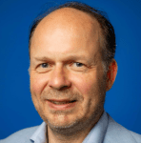

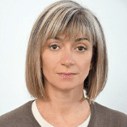

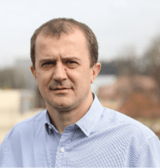
Clean technologies accelerating competitiveness in JTF regions
#JustTransitionPlatform
Moderator
Wolfgang Munch
Senior Expert, European Commission
Albert van Pabst
CEO of SDS Separation Technology B.V
Katarzyna Faruga
Head of Network Management CEE,
HZwo Hydrogen Innovation Cluster
Rumyana Grozeva
Executive Director,
Regional Economic Development Agency of Stara Zagora
Ruben Maximiano
Senior Policy Analyst and Competition Expert, OECD
Lisa Grasser
Program Director,
Mecaware
Robert Dominko
Head,
Centre for Demonstration and Training in Carbon-Free Technologies

Slide 13

SDS Separation –
The Compact
Powerhouse for
Carbon Capture
Albert van Pabst
21 October 2025

Slide 14

Urgent decarbonisation gap for mid-scale industry
EU climate goals demand rapid CCS adoption — but mid-scale emitters lack viable solutions
>2,200 sites emit 55 Mt CO₂ yearly in EU + UK.
Mostly from burning fuels for heat.
Many emissions are unavoidable in production.
Electrification often isn’t an option.
14

Slide 15
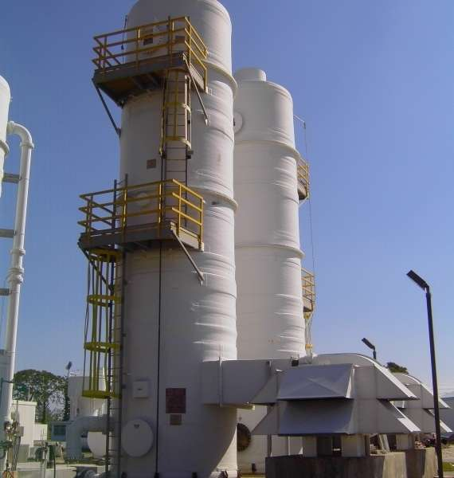
Why conventional ccs fails for mid-scale emitters…
conventional ccs: too big, too costly for mid-scale industry
30 - 40 m height
Oversized scrubbing towers
High CAPEX barrier
High OPEX burden
Inflexible & immobile
Stranded asset risk
15

Slide 16


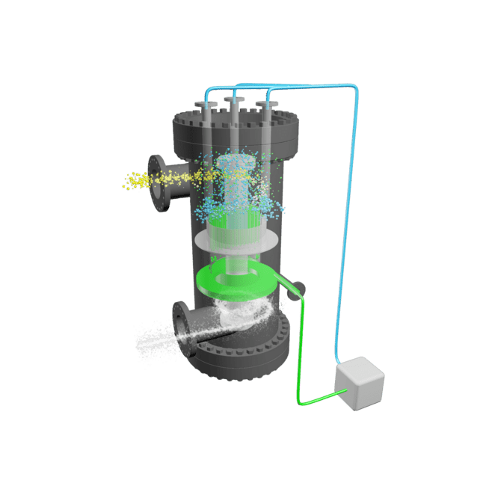
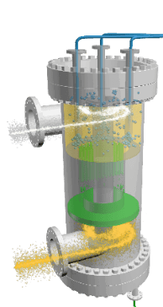
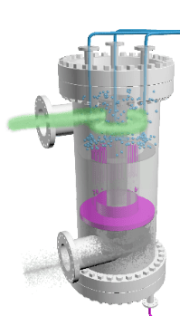
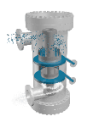


SDS applications in the Carbon Capture chain
backed by JTF, SDS unlocks new value across the cc supply chain
Liquified CO₂ transport by truck
Pre-washing
Carbon Capture
CO₂ Conditioning
RotaQuench
RotaScrub
RotaStrip
RotaSep
Clean gas
Lean Amine
CO₂
CO₂ Rich Amine
Cooled Flue gas with
CO₂
Stripped Amine
Washing of emissions
Carbon Capture
Separation
+ Heat Recovery
Gasesous CO2 transport by pipeline
With JTF support, SDS expands its impact:
• From CO₂ capture to pre/post-treatment & heat recovery.
• Building a local carbon-capture workforce with technical schools.
16

Slide 17
SDS Separation Technology B.V.
Scheepmakersstraat 3
3334 KG ZWIJNDRECHT
The Netherlands
T +31 (0)85 004 9232
E info@sds-separation.com
W www.sds-separation.com

Slide 18
Clean technologies accelerating competitiveness in JTF regions
#JustTransitionPlatform
Moderator
Wolfgang Munch
Senior Expert, European Commission
Albert van Pabst
CEO of SDS Separation Technology B.V
Katarzyna Faruga
Head of Network Management CEE,
HZwo Hydrogen Innovation Cluster
Rumyana Grozeva
Executive Director,
Regional Economic Development Agency of Stara Zagora
Ruben Maximiano
Senior Policy Analyst and Competition Expert, OECD
Lisa Grasser
Program Director,
Mecaware
Robert Dominko
Head,
Centre for Demonstration and Training in Carbon-Free Technologies

Slide 19

Mecaware: battery recycling made clean, scalable and for Europe
Lisa Grasser
21 October 2025

Slide 20
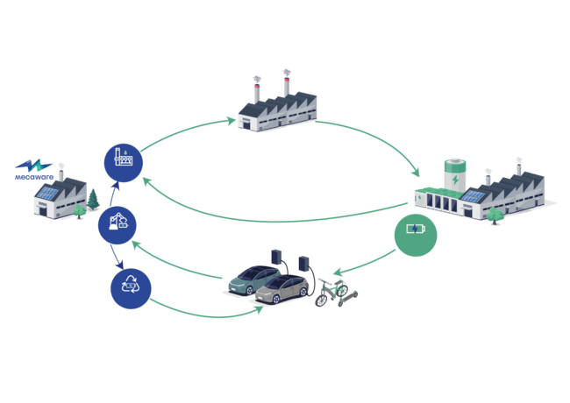
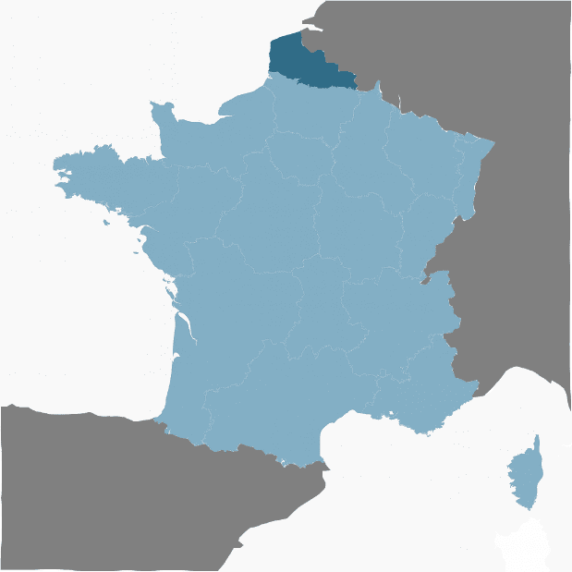

From batteries to strategic metals : recycling made clean, scalable and for Europe
Cathode Active Material manufacturing
Gigafactory
recycling
upstream prep.
scraps
battery
manufacturing
Integrated Recycling
Hub
end-of-life batteries
second
life
remanufactured batteries
OEMs
From Sulphate-Free Recycling to a fully Integrated Recycling Business Model

Slide 21
Clean technologies accelerating competitiveness in JTF regions
#JustTransitionPlatform
Moderator
Wolfgang Munch
Senior Expert, European Commission
Albert van Pabst
CEO of SDS Separation Technology B.V
Katarzyna Faruga
Head of Network Management CEE,
Hydrogen Innovation Cluster
Rumyana Grozeva
Executive Director,
Regional Economic Development Agency of Stara Zagora
Ruben Maximiano
Senior Policy Analyst and Competition Expert, OECD
Lisa Grasser
Program Director,
Mecaware
Robert Dominko
Head,
Centre for Demonstration and Training in Carbon-Free Technologies

Slide 22
Clean technologies accelerating competitiveness in JTF regions
Katarzyna Faruga
Head of Network Management CEE,
HZwo Hydrogen Innovation Cluster
#JustTransitionPlatform

Slide 23


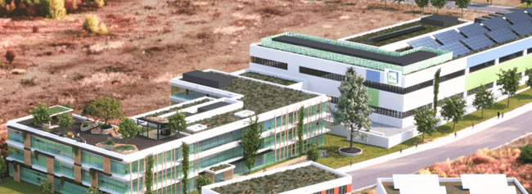




Hydrogen Technology Cluster
European network of hydrogen experts
            National Hydrogen Innovation Center
Competence Centre for Hydrogen Technologies
#JustTransitionPlatform

Slide 24
Clean technologies accelerating competitiveness in JTF regions
#JustTransitionPlatform
Moderator
Wolfgang Munch
Senior Expert, European Commission
Albert van Pabst
CEO of SDS Separation Technology B.V
Katarzyna Faruga
Head of Network Management CEE,
HZwo Hydrogen Innovation Cluster
Rumyana Grozeva
Executive Director,
Regional Economic Development Agency of Stara Zagora
Ruben Maximiano
Senior Policy Analyst and Competition Expert, OECD
Lisa Grasser
Program Director,
Mecaware
Robert Dominko
Head,
Centre for Demonstration and Training in Carbon-Free Technologies

Slide 25


Center for Development, Demonstrations and Training for Carbon-Free Technologies
National institute of chemistry, Slovenia
Prof.dr. Robert Dominko
21/10/2025

Slide 26
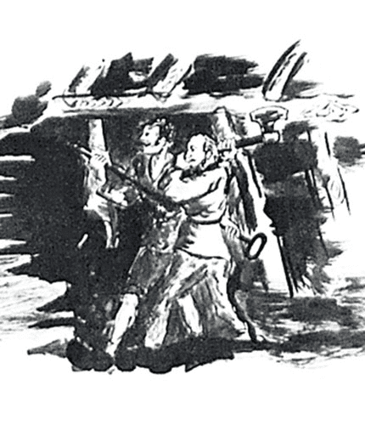
Vision
To create conditions for the development of modern technologies for energy conversion and storage
To contribute to the development of the region and beyond in the field of green transition technologies
To become a globally recognized center as a technology transfer bridge
Source: Museum Zagorje

Slide 27
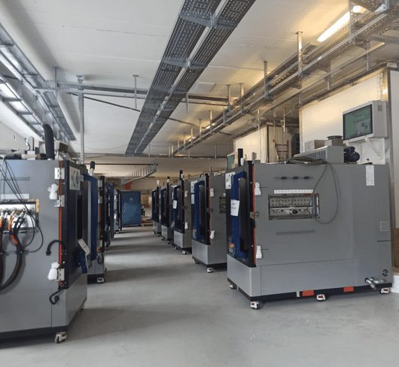
What
More than
2.000 m² advanced research infrastructure linked to the research environment of the National Institute of Chemistry
Modern and top tier research center, part of the National Institute of Chemistry
Two independent labs will operate within the center.

Slide 28
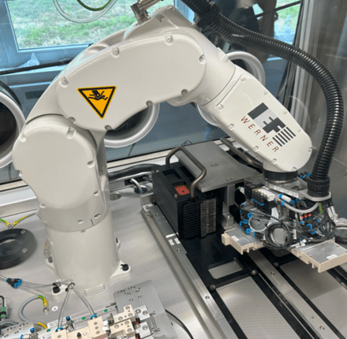
Goals
Pilot testing for industrial innovation
Education and training on zero carbon technologies
Linking with international research communities
Linking with the economy
Setting up novel research infrastructure in Slovenia and the wider region
Accelerating transfer of knowledge from research units into industry and commercial use

Slide 29
Clean technologies accelerating competitiveness in JTF regions
#JustTransitionPlatform
Moderator
Wolfgang Munch
Senior Expert, European Commission
Albert van Pabst
CEO of SDS Separation Technology B.V
Katarzyna Faruga
Head of Network Management CEE,
HZwo Hydrogen Innovation Cluster
Rumyana Grozeva
Executive Director,
Regional Economic Development Agency of Stara Zagora
Ruben Maximiano
Senior Policy Analyst and Competition Expert, OECD
Lisa Grasser
Program Director,
Mecaware
Robert Dominko
Head,
Centre for Demonstration and Training in Carbon-Free Technologies

Slide 30


EUROPEAN DIGITAL
INNOVATION HUB ZAGORE – H2 TRAINING AND TBI ENVIRONMENT
Dr Rumyana Grozeva
21 October 2025

Slide 31
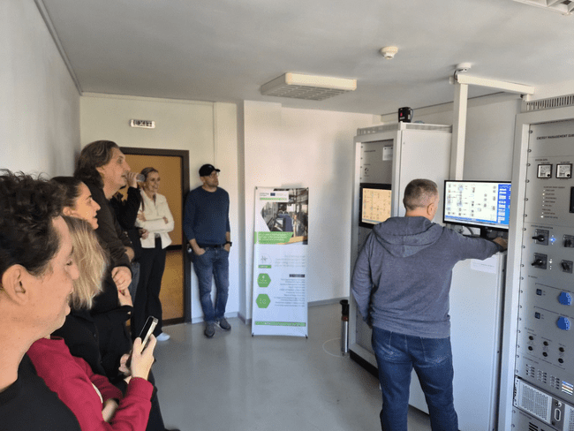
H2 in different dimension of reality: physical and virtual
In the largest coal region in the Balkans, competitiveness means transformation.
Through EDIH Zagore — 50:50 co-funded by DG REGIO and Digital Europe Programme — we turn the legacy of carbon into an opportunity for innovation.
Supporting SMEs to test, train, and invest in clean technologies.
Building the regional hydrogen and digital innovation ecosystem.
Linking JTF priorities with Digital Europe capabilities to accelerate the twin transition.

Slide 32
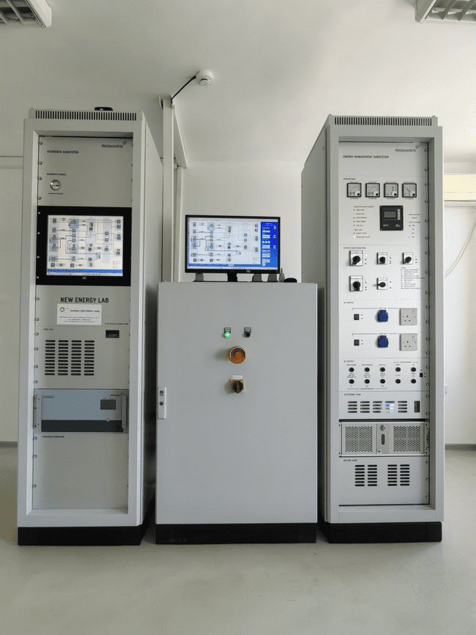
H2 in different dimension of reality: physical and virtual
Hydrogen is the most abundant molecule in the universe, and if we shall call it just a molecule, then it have to be called the molecule of sustainability.
At EDIH Zagore, we connect the physical testing of hydrogen systems with their virtual simulation through digital twins and immersive technologies — transforming knowledge into competitiveness.
Physical dimension: Hydrogen Testing System (H₂TC) — real infrastructure for SMEs and research.
Virtual dimension: Immersive Multiwall VR Lab — simulating hydrogen processes, safety, and efficiency.
Together they help industries reduce risk, cut emissions, and build new skills for the clean economy.

Slide 33
Stara Zagora Regional Economic Development Agency
127 Stoletov str
6000 Stara Zagora,
BULGARIA
T +359 (0) 42 605007
E office@szeda.eu
W www.szeda.eu
EUROPEAN DIGITAL INNOVATION HUB ZAGORE
127 Stoletov str
6000 Stara Zagora,
BULGARIA
T +359 (0) 42 605007
E office@edih-zagore.eu
W www.edih-zagore.eu

Slide 34
Clean technologies accelerating competitiveness in JTF regions
#JustTransitionPlatform
Moderator
Wolfgang Munch
Senior Expert, European Commission
Albert van Pabst
CEO of SDS Separation Technology B.V
Katarzyna Faruga
Head of Network Management CEE,
HZwo Hydrogen Innovation Cluster
Rumyana Grozeva
Executive Director,
Regional Economic Development Agency of Stara Zagora
Ruben Maximiano
Senior Policy Analyst and Competition Expert, OECD
Lisa Grasser
Program Director,
Mecaware
Robert Dominko
Head,
Centre for Demonstration and Training in Carbon-Free Technologies

