Slide 1
Okanjande Namibia Mine Project
The global battery industry faces a supply risk: over 70% of graphite supply is concentrated in China.

Slide 2
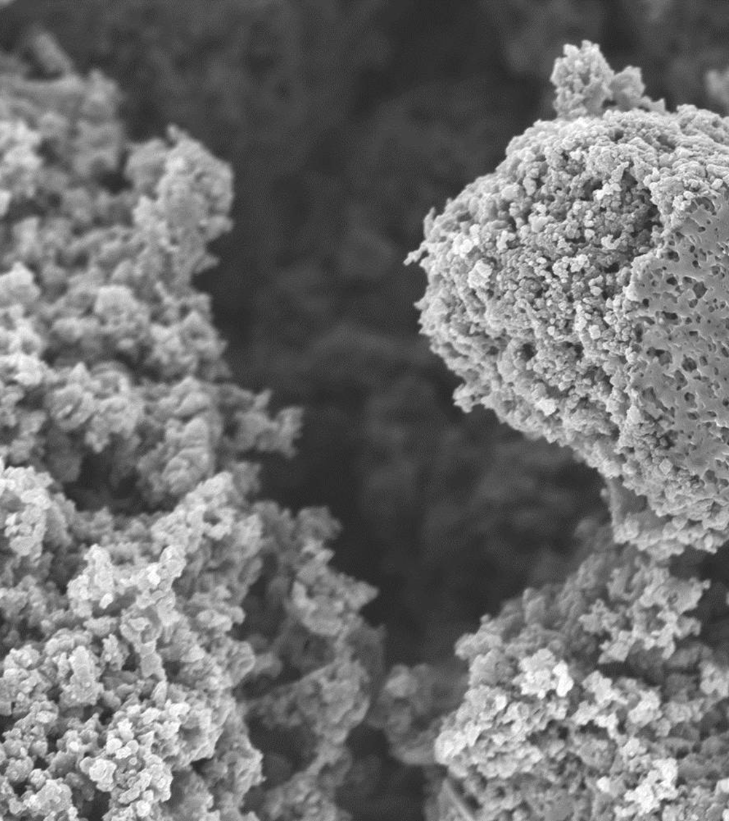
Okanjande Mine in Namibia
A fully permitted, near-term graphite restart delivering battery-grade supply to ex-China markets
  Low CAPEX, open-pit mine with proven graphite ore deposit, reducing execution risk and accelerating time to cashflows
  Battery-first commercial strategy with in-house testing and qualification, prioritising higher margin anode markets
  Ex-China, mine-to-anode pathway that meets OEM¹ traceability, security, and qualification requirements
      3 yrs
      ~47%
      ~$120Mn
      Total CAPEX required
      $35Mn
      Project economics²
      Payback period
      Pre-tax IRR
      Pre-tax NPV (@ 8%)
1. Original equipment manufacturer; 2. As per 2023 Preliminary Economic Assessment

Slide 3
Okanjande | Namibian, near-term, restart opportunity
Project overview
Financial profile
Project description:
Restart of a fully permitted, formerly-producing graphite mine (production occurred 2017-2018)
Current plan is a restart with production planned for 2027, having been under care and maintenance since Q3 2022
Supply and offtake agreements
60% of Phase 1 production expected to be processed through JV with Obeikan
40% commercial optionality to existing customers
Ongoing OEM and cell platform qualification processes
Mineral(s):
Natural flake graphite concentrate, optimised for battery-grade spherical graphite conversion
Investment needs:
~$35M
10%
Processing:
Mining & concentration (graphite concentrate) in Namibia
Downstream BAM processing via JV with Obeikan pathway
Intended use of capital:
Processing plant relocation to mine and mine restart
Includes tailing and waste management upgrades of existing facilities
Production capacity:
Graphite concentrate: ~31kt pa expected (Phase 1)
Resource base supports future expansion (Phase 2)
Projected returns and timelines
Pre-tax IRR: 47% with Pre-Tax NPV @8% of ~$120M
Payback period: 3 years
Numbers from 2023 Prelim Economic Assessment (PEA) and subject to price, exchange rates, and execution
Development stage:
Pre-feasibility
Feasibility
Construction
Production
Key dates
Restart target of H1 2027 – dependent on finalising financing
Production expected within a year of construction
Commercial advantage
Secured demand
Namibian mine forms part of a broader strategy to be a vertically integrated ex-China battery anode material producer, with 60% of mine output into our own facilities
Key ESG initiatives
20MW on-site solar power installation
New grid water connection for stable mine ops, and improving access for local communities
Reduced local community risk and transport emissions through relocation of processing facility
Rapid cash flow
Former producer therefore reduced permitting and resources risks (~12 month timeline from financing to production)

Slide 4

Okanjande offers a battery-aligned product, de-risked production, with commercial optionality and near-term cash flow potential
Battery-first commercial strategy
Proven BAM processing technology capturing natural flake demand, aligned with OEM EV performance standards
De-risked near-term production
Fully permitted, low-CAPEX, restart with proven graphite resource and accelerated time to cash flows
Established supporting infrastructure
Logistics access to Walvis Bay port and further investments into solar power and low-cost water supply
Bankable commercial pathways
100% offtake with JV with Obeikan, with optionality via upcoming French BAM facility¹ and global third-party sales
1. Northern Graphite processing facility in development. Designated as a "Strategic Project" under the EU Critical Raw Materials Act in 2025 - feasibility studies expected to begin in 2027

Slide 5
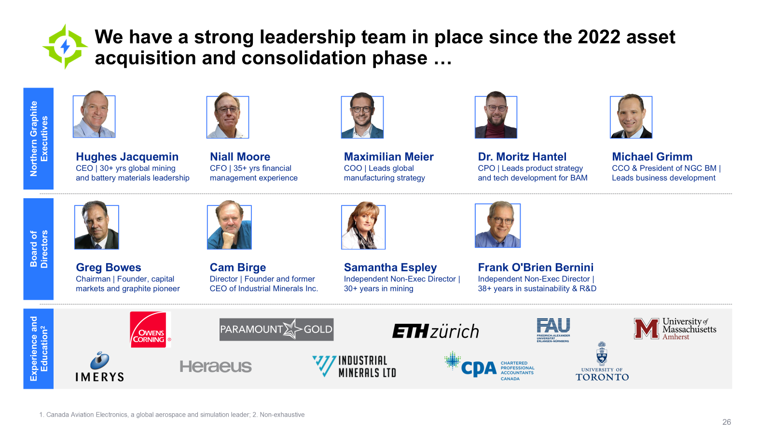

Slide 6
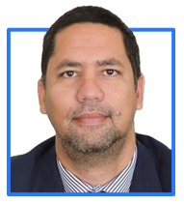


… Alongside a delivery team in Namibia, and end-to-end expertise in Germany and Saudi Arabia
Namibian expertise
Downstream execution expertise
NGC Battery Materials
JV with Obeikan
Sam Januarie
Country Director | 27+ years experience in multi-national companies
Accelerating customer approval and time-to-revenue
De-risking scale up and anchoring premium end markets
Leads Northern Graphite's Namibian operations and in-country execution
Deep on-the-ground experience in Namibia’s mining and regulatory environment
Rapid material validation against customer product specifications
Tight feedback loop between testing, processing and mine output
Downstream execution capability in a regulated industrial environment
Improves demand visibility, project bankability, and financing confidence

Slide 7



Contact us for more information
Sam Januarie
Country Executive Director Namibia
sjanuarie@northerngraphite.com
Northern Graphite
@TSXV_NGC
Northerngraphite.com

