Slide 1
Defensive Responses to Critical Feedback
Prof. Alex Gillespie
Culture & Risk Research Unit
London School of Economics
a.t.gillespie@lse.ac.uk

Slide 2
The Problem: Learning form Patients
Healthcare needs to listen to patients:
  Bristol Royal Infirmary (1995)
  Mid-Staffordshire (Francis, 2013)
  ‘First Do No Harm’ (2020): ‘unresponsive and defensive’
Minimal evidence of learning from patients (Liu et al., 2020; Martin et al., 2021)
______________________________________________________________________________
Martin, G. P., Chew, S., & Dixon-Woods, M. (2021). Why do systems for responding to concerns and complaints so often fail patients, families and healthcare staff? A qualitative study. Social Science & Medicine, 287, 114375.
Liu, J. J., Rotteau, L., Bell, C. M., & Shojania, K. G. (2019). Putting out fires: A qualitative study exploring the use of patient complaints to drive improvement at three academic hospitals. BMJ Quality & Safety, 28(11), 894–900.

Slide 3
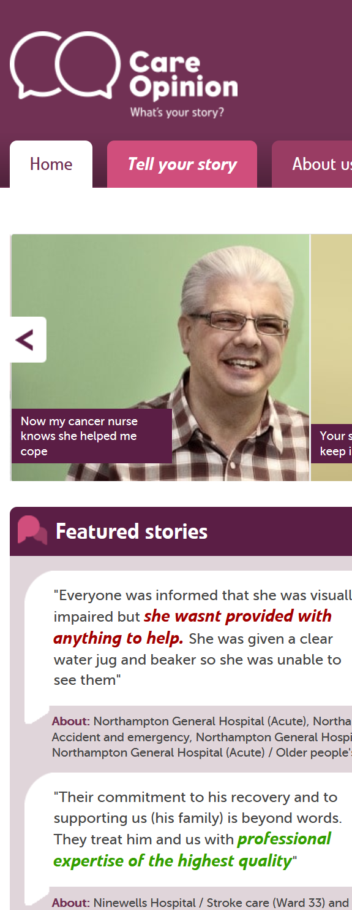
Empirical Study
What actually happens when patients voice concerns online?
Care Opinion: facilitate dialogue between patients & staff
‘Stories’ are posted; staff post ‘Responses’
Analysed 2,500 responses
___________________________________________________
Gillespie, A., & Reader, T. (2025). The complaint handler’s bind: How organisational constraints lead to defensive responses to criticism. PLoS One, 20(6), e0325185.

Slide 4
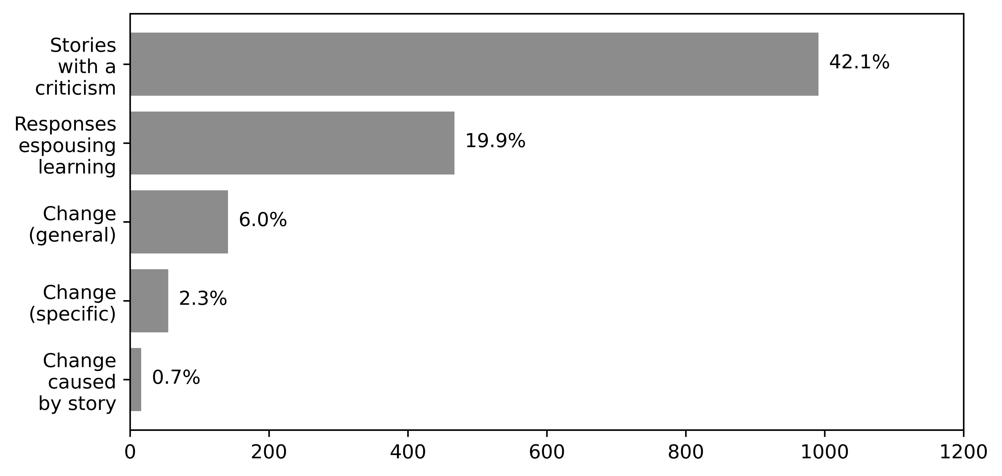
Finding
_________________________________________________________________________________________________________
Gillespie, A., & Reader, T. (2025). The complaint handler’s bind: How organisational constraints lead to defensive responses to criticism. PLoS One, 20(6), e0325185.

Slide 5
Contradictory Response
Story: reported waiting in discomfort and delays
Response: “We would like to assure you that we take all comments seriously and act on them as part of our ongoing commitment to improving patient experience. If you would like us to look into your concerns more fully, please contact PALS”.

Slide 6
Contradictory Response
Story: reported waiting in discomfort and delays
Response: “We would like to assure you that we take all comments seriously and act on them as part of our ongoing commitment to improving patient experience. If you would like us to look into your concerns more fully, please contact PALS”.

Slide 7
Contradictory Response
Story: reported waiting in discomfort and delays
Response: “We would like to assure you that we take all comments seriously and act on them as part of our ongoing commitment to improving patient experience. If you would like us to look into your concerns more fully, please contact PALS”.

Slide 8
The Puzzle:
How can staff simultaneously espouse learning from feedback whilst ignoring it?

Slide 9
The Complaint Handler’s Bind
Staff are told to address complaints
But the don’t have the power to create organisational learning
Staff can’t admit this to patients (and maybe their organisation)
So they espouse learning, while resisting initiating changes
_________________________________________________________________________________________________________
Gillespie, A., & Reader, T. (2025). The complaint handler’s bind: How organisational constraints lead to defensive responses to criticism. PLoS One, 20(6), e0325185.

Slide 10


Conclusion
Defensiveness is pervasive in responses to patient voice
Rather than blaming staff, do staff have the capacity to institute changes?
Defensiveness might be a symptom rather than a cause

