Slide 1
February 3, 2026 | Boston, MA
ISO New England’s Interconnection Process Improvements
RE+ Northeast
Graham Jesmer
Senior Regulatory Counsel

Slide 2

The ISO’s Interconnection Process is in Transition
The ISO’s Order No. 2023 compliant Interconnection Procedures include several major changes to its previous “first-come, first-served” serial study-based interconnection process
  Adopts a “first ready, first-served” cluster study process
  Increased financial/site control requirements for those entering the ISO’s interconnection process, and the application of withdrawal penalties for projects that exit the queue under certain circumstances
  A penalty structure applied to the ISO and transmission owners for delays in study completion beyond established deadlines
Oct. 11, 2025, ISO-NE started the Transitional Cluster
Study (TCS), which must be complete by Aug. 6, 2026
State-jurisdictional interconnection studies will continue
to closely coordinate with ISO Interconnection Studies
Learn more about the TCS

Slide 3
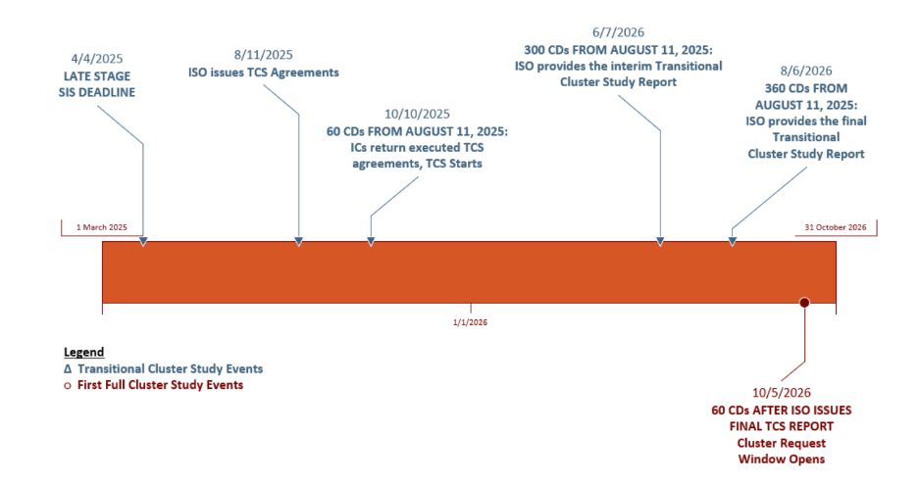
Transitional Cluster Study Timeline

Slide 4
Today’s Queue Reflects the Changing Interconnection Process
36,821 MW
13,966 MW
April 2025
January 2026
Source: ISO Generator Interconnection Queue, FERC Jurisdictional Proposals; Nameplate Capacity Ratings.
Notes:
The October 2025 queue includes the ~5,000MW in the TCS and ~10,000 MW of projects that already had completed studies and are allowed to remain in the queue to work towards their interconnection

Slide 5

Transitional Cluster Study
2
2
5,225 MW*
1
19
Transitional Cluster Study
Oct. 2025
2
0
Source: ISO Generator Interconnection Queue, FERC Jurisdictional Proposals; Nameplate Capacity Ratings. *MW total only includes Interconnection Requests that did not complete a system impact study prior to April 4, 2025, and so will need to be studied according to the Network Capability Interconnection Standard. Totals for each fuel type represents all Interconnection Requests Participating in the Transitional Cluster Study (including those being only studied according to the Capacity Capability Interconnection Standard).

Slide 6

Interconnection Process – Basic Flow
Interconnection Request
Basic information: size, location, fuel type
Cluster Study
  Exact list of upgrades required for the cluster
Construction
  Generator begins commercial operation once construction is complete
Interconnection Agreement
  Three-party agreement between generator, ISO, and transmission owner
For more information about this process, visit Participate > Applications and Status Changes > New or Modified Interconnections
Changes to the Interconnection Process are in development to comply with FERC Order 2023. For more information, visit Committees and Groups > Key Projects > Order No. 2023 Key Project

Slide 7
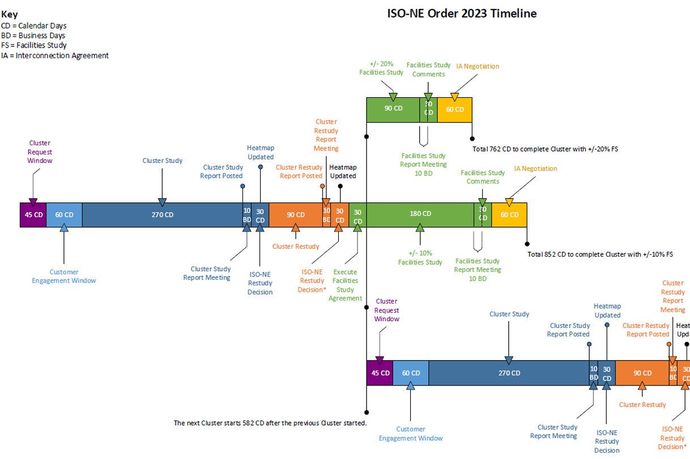
General Cluster Study Timeline
Additional details available in Planning Procedure 5-6

Slide 8

Economic Planning for the Clean Energy Transition
Key Findings for the New England Grid
Increased variability will require vastly different supply levels from year to year
  Peak demand could vary by up to 50% between mild and severe winters by 2050
Emissions reductions will be seasonal
  Spring will be mostly decarbonized by 2040, but a small portion of winter days will still produce significant emissions in 2050
Renewable-only build-outs may be vast
  If the 2050 resource build-out is almost entirely wind, solar, and batteries, the region will need a power system that is 4x its current capacity to
  achieve state emissions goals and maintain reliability
Firm, dispatchable, zero-carbon generation
could help address challenges
  May support reliability and reduce build-out costs
Learn More!
Dec. 2024 EPCET Public Webinar Presentation & Recording
Source: Economic Planning for the Clean Energy Transition: Illuminating the Challenges of Tomorrow’s Grid

Slide 9




Average Annual Buildout Necessary to Achieve State Goals by 2050
1,293 MW
per year of offshore wind
955 MW
per year of solar
268 MW
per year of
land-based wind
952 MW
per year of batteries
Source: Economic Planning for the Clean Energy Transition: Illuminating the Challenges of Tomorrow’s Grid

Slide 10
Coordination with State Level Studies
Pursuant to Section I.3.9 of the ISO New England Transmission, Markets, and Services Tariff, Market Participants are required to submit notice to the ISO for additions or changes to any generating resource at least 60 days prior to the project’s planned in-service date
  Projects that are individually, or in aggregate, greater than or equal to 5 MW are automatically required to submit a Proposed Plan Application, supported by Level III analysis, pursuant to section 2.1 of Planning Procedure 5-1
  Projects that are greater than 1 MW but less than 5 MW are subject to further determination by the ISO on whether or not a Generator Notification Form is sufficient, or if further analysis is required – The ISO will perform a screening to make this determination
The ISO serves as the affected party to Distributed Energy Resource (DER)-ASO studies, and helps to coordinate these projects approval through section I.3.9 of the Tariff
Additional details regarding this coordination relative to the Transitional Cluster Study and future Cluster Studies can be found here.

Slide 12

About the Presenter
Graham Jesmer
Sr. Regulatory Counsel, Operations and Planning
ISO New England

Slide 13

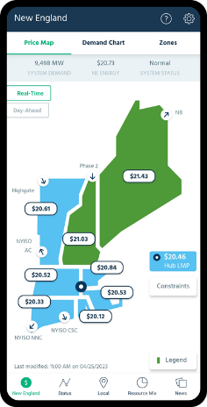
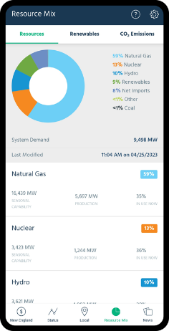





For More Information
Download the ISO to Go App
ISO to Go is a free mobile application that puts real-time wholesale electricity pricing and power grid information in the palm of your hand
Subscribe to ISO Newswire
ISO Newswire is your source for regular news about ISO New England and the wholesale electricity industry within the six-state region
Log on to ISO Express
ISO Express provides real-time data on New England’s wholesale electricity markets and power system operations
Follow the ISO on Social Media
www.iso-ne.com/social

