Slide 1



Beyond the rail journey
How to increase revenue offering
additional services to travelers
World Passenger Festival

Slide 2

Today’s agenda
Who we are
Survey results
Multimodal services
Multimodal challenges
Snowfall solutions

Slide 3
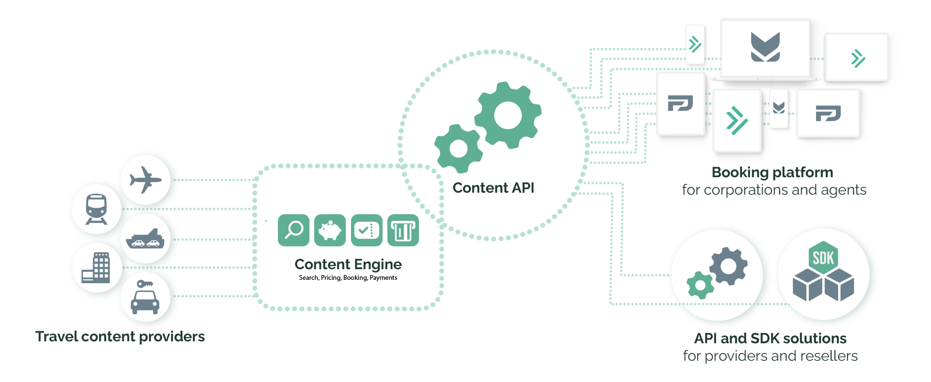
We are Snowfall: Next Generation Tools and Technologies that simplify the world of travel
Notes:
Anthony?

Slide 4

The survey
Which services beyond the train journey are offered by rail operators
Reason for offering multimodality
What are your biggest challenges in offering multimodal travel options?

Slide 5


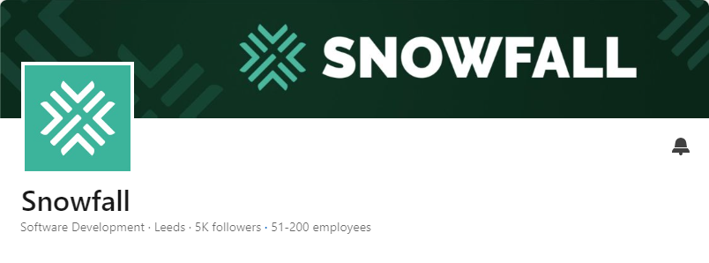

Do you want to see the overall research? Follow Snowfall on LinkedIn

Slide 6
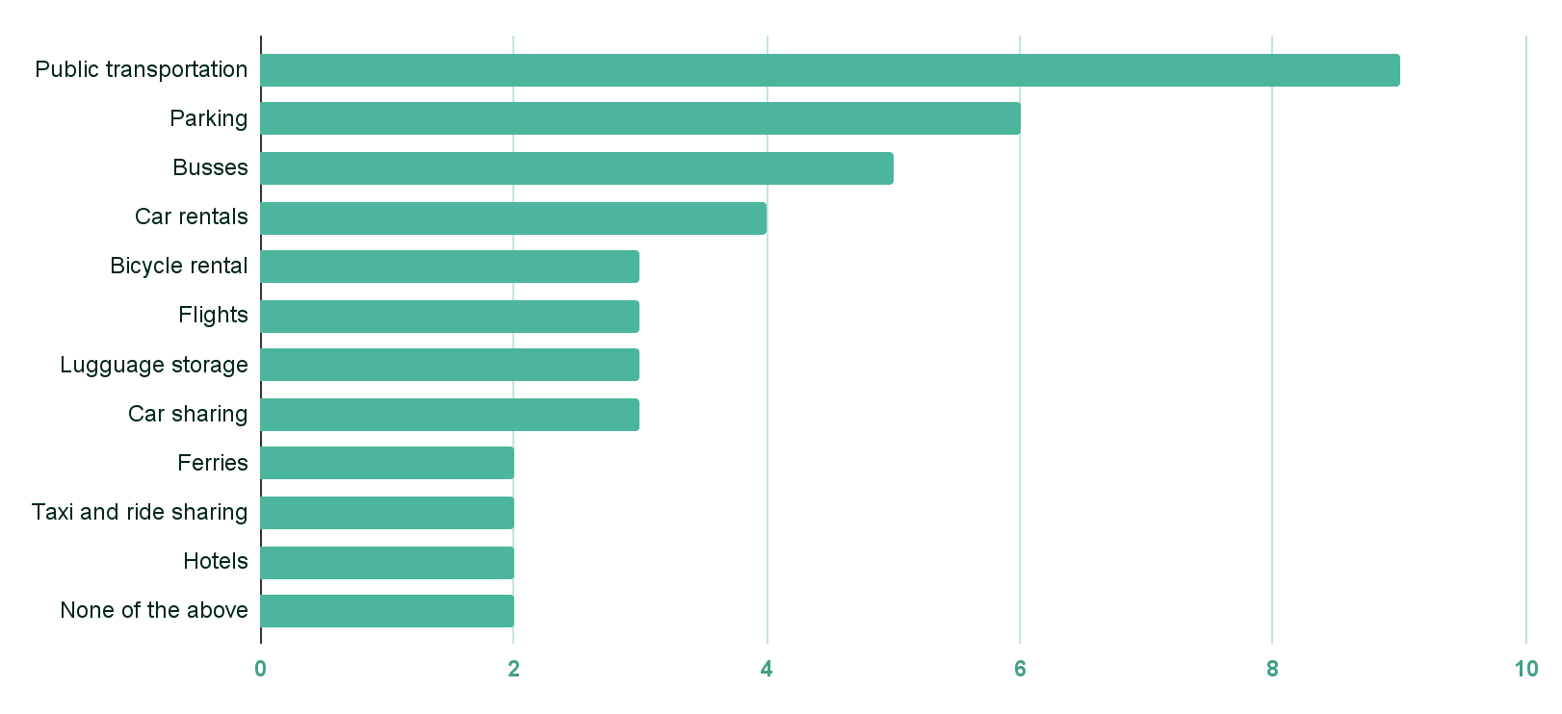
Extended services
Outside of the train journey itself, which of these services (that provide a more integrated travel experience) do you currently offer your customers
Source: Snowfall survey to rail operators, May 2024

Slide 7
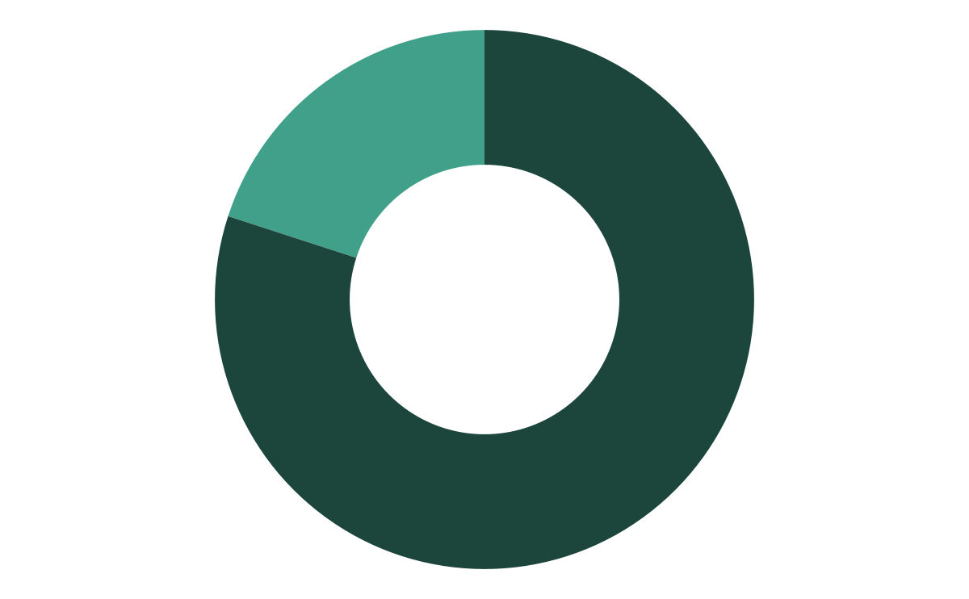
What is your main reason for offering multimodality?
Improve customer experience
Stay competitive in the market
Source: Snowfall survey to rail operators, May 2024

Slide 8
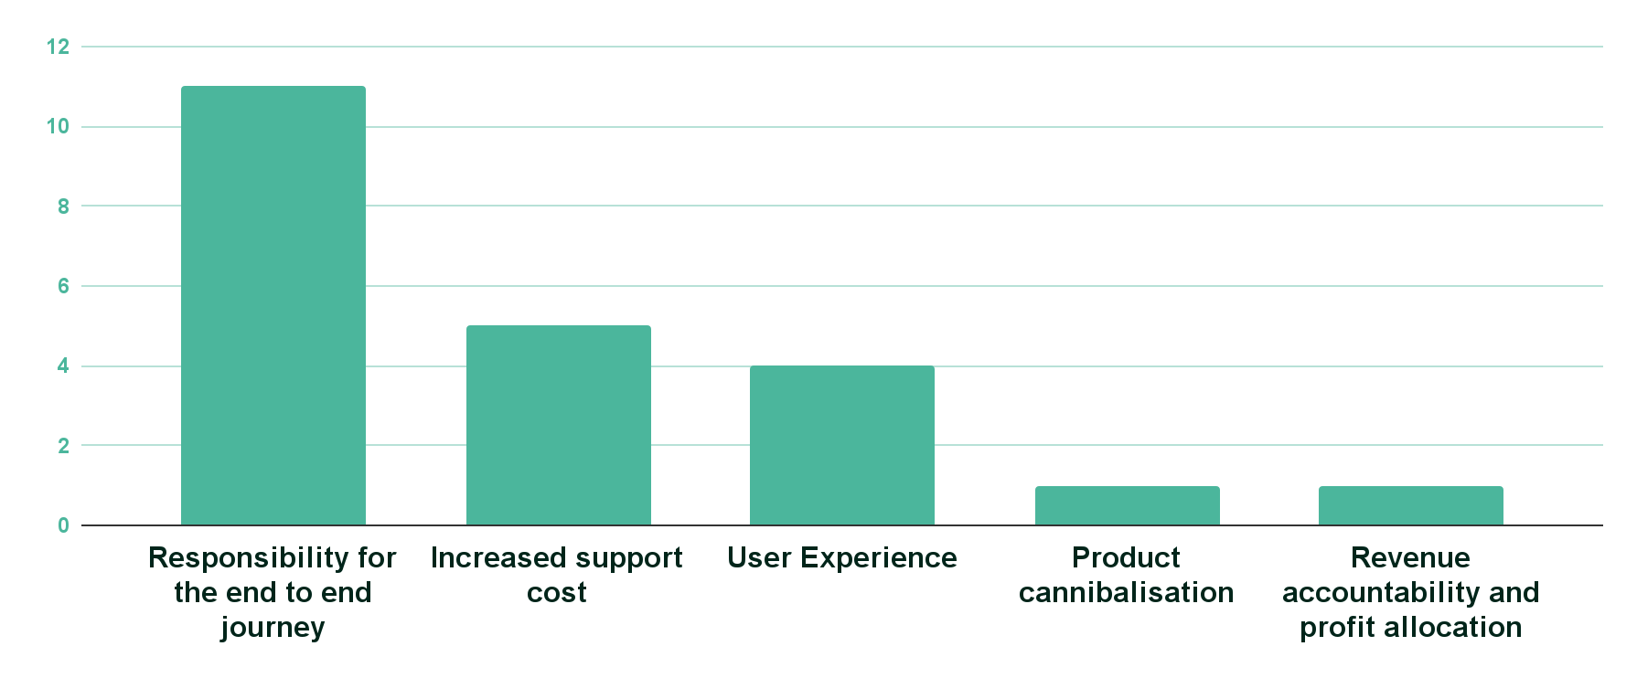
What are your biggest challenges in offering multimodal travel options?
Source: Snowfall survey to rail operators, May 2024

Slide 9
Snowfall solutions
Be part of the Snowfall ecosystem, the world’s largest booking inventory
SDK

