Slide 1

Revolutionising passenger experience with DiLoc:
Making information Instant, Seamless, Accessible, Consistent
World Passenger Festival 2024 | Vienna
Stefan Gähwiler
ICT Solution Manager
Zurich/Switzerland, 25th June 2024

Slide 2

Agenda
Introduction SZU
Current Situation
Challenges
Future Strategy

Slide 3
Introduction SZU

Slide 4
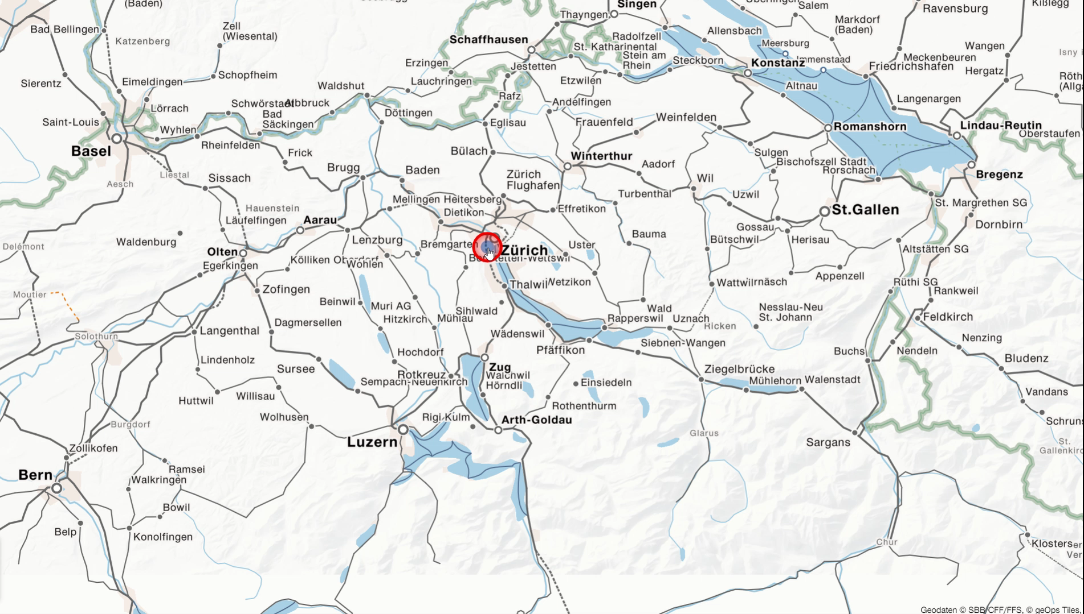
Where to find us

Slide 5



Facts & Figures
25 million
Transported Passengers
3.5 kilometres
Average Travel Distance
231
Number of Employees
Train | 14 017 000
Bus | 10 755 000
Cable Car | 280 000
Total | 25 052 000
Train | 4.41
Bus | 2.21
Average | 3.42
Employees | 231
FTE | 208
Notes:
Einwohnerzahl Schweiz und Österreich 9 Mio,

Slide 6
Current Situation

Slide 7
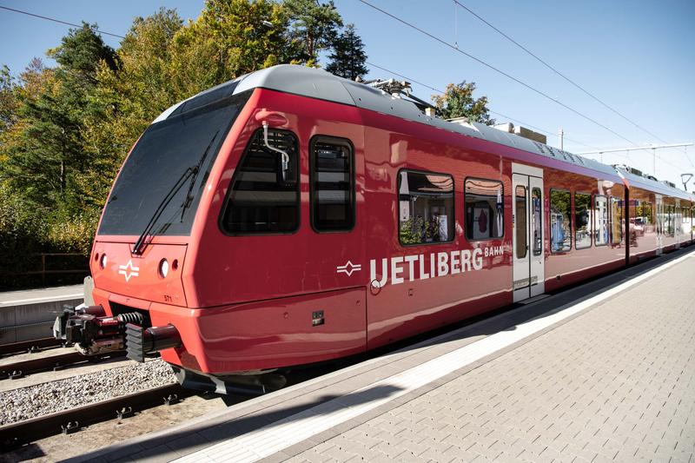

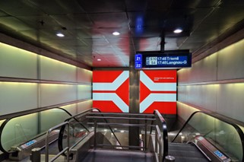
Assets
Rolling Stock
Separate system
No connection for live announcements
No short-term timetable updates
Mobile
Public transport apps
Push-messages
Station
Few screens
Outdated hardware
Specified content
Notes:
Rolling Stock:
isolated customer information system, no connection to Diloc on the land side. No possibility for live announcements from the operation center, and no realtime information.
Mobile:
We send the necessary information to those apps, but we don’t interact with them. We just do the bare minimum.
Station:
As you can see, we do not really have screens at the stations and the possibility to provide informations are very limited. We cannot really be compliant with the laws and standards.
For both mobile and Station we have implemented DiLoc. So the “software side” is up to date and ready for the future.

Slide 8
Challenges

Slide 9

Instant & Seamless
Realtime communication
Know what to communicate, before you have to
Guidance
Notes:
Fast decision making and quick implementation in systems
We need to communicate via different channels at the same time and the quality has to be sufficient, so customer are still able to act > usage of prepared concepts, which are programmable in DiLoc|Motion
Customer guidance via information at the right time and adequate content

Slide 10
Accessible & Consistent
Language
Visualization and content
Consistent across entire public transport
Notes:
In which language is information available, which languages do our customer understand, how much information is appropriate and when is it too much?
Which information do you see and hear and where is these information? When and where do differently abled people get their information? Which way is disrupted or how to get from A to B?
We are one part of a big public transport system in Zurich; therefore, we do not want the customer to have to adjust when travelling with us. Thus, the national industry standard exists, which we want to realise.

Slide 11
Future Strategy

Slide 12
Focus on Customer Journey
What are the Customer’s needs
Where do customers first get in contact with SZU?
      → Anywhere via app, websites, customer-/travel centre
What do customers want to know when they are at our stations?
      → Which platform, delayed or on time, where is my car?
What do customers want to know while travelling with us?
      → When do I have to get off, delayed or on time, where am I at the moment?
What do customers want to know when getting off the train?
      → Which side do I have to get off, where do I need to go?
Notes:
Getting information to take the train from SZU to get somewhere. They know the date, time, S-service and destination where to get off. How does the travelcenter know these things? Long time ahead, we have announced our timetable, no realtime information at this point. Shortterm information are already provided by DiLoc|Motion.
Where does my train leave (referred to time, S-service and destination, is it on time, where’s my car (bicycle, trolley, luggage, etc.) Providing these information via different channels with DiLoc|Motion.
Where am I currently, where do I have to get off, how many stops until then? All information can Diloc provide in realtime.

Slide 13
Focus on Workflows
How we should adjust our Workflows, Processes and Systems
1 input system to distribute information = seamless, consistent, accessible
1 user interface to work with = instant, seamless, consistent
Pre-prepared information concepts = instant, consistent
Standardised equipment of the stations = seamless, accessible, consistent
Standardised equipment of the rolling stock = seamless, accessible, consistent
Notes:
Our goal is to have 1 input system, which is DiLoc, to provide customer information on all channels. In that system we want to have one interface where the operators can work with and by making sure, that the information there are up to date, then information on all channels are consistent and instantly accessible.
Our small railway network allows us to work with a small number of prepared concepts, these are all preprogrammed and available in DiLoc. Currently we are preparing a data interface to the national data hub. By realizing that, we are able to provide event information, such as construction works or disruptions, at stations and mobile channels with 5 mouse clicks, and this is no exaggeration.
At last we want to have standardised equipment. Standardised equipment gives you a recognition value and for customers it doesn’t matter with who they travel (SBB, SZU, VBZ, FB), the information are always found in the same place. Standardised doesn’t only mean hardwareish standard but also the same amount of hardware.

Slide 14
Focus on Mobile
How to support Mobile Channels with stationary Customer Information
Public transport focused site maps
Location on platform in relation to train, substitute transport
QR-codes on screens for substitute routes, disruption overview
Notes:
Stationary means, at the station and in rolling stock
Public transport focused site maps, like the one I presented you in the beginning:
In rolling stock, site map of the next station: stations of other public transport, which direction you have to go, which platform you arrive, etc. especially handy at bigger stations, so customer know where to go and you get the people of the platform faster
At stations, site map of other public transport, way to substitute transport with link e.g. google maps

Slide 15
Assets
Rolling Stock
Integrated system
Live announcements
Realtime timetable updates
Mobile
Public transport and
non-public transport apps
Websites
Supported by stationary hardware
Station
Different sized and positioned screens
Customer guidance
Specified and customisable content
Notes:
This slide is more like a recap of the previous 3.
We want an integrated system, which we will realise with DiLoc|OnBoard. This gives us also the possibility to do live announcements in the rolling stock. Also do we have realtime Timetable updates. The operators' dispositions are sent immediately to the car and shows and tells, whatever update he has made (Change of platform, delay, etc.)
We interact with different apps, use maps to guide customers, give them the information on stationary hardware which they can take with them (QR-Codes, etc.)
At the stations we want have screens for two main purposes. The first is to be compliant with regulations and laws, the second group is the one we are innovative and support the mobile channel, try new things out.

Slide 16
Questions

