Slide 1


Unlocking
Dynamic
Inventory
Juan Pablo Lafosse (CEO)
February 2025
Singapore

Slide 2


A turning point..
STATIC
INVENTORY MANAGEMENT
DYNAMIC
INVENTORY MANAGEMENT

Slide 3







Today: Static Inventory Management
2 high demand flights spill high yield passengers
New Demand
3 flights with lower demand depart with spoilage
New Demand
Flight 1
Flight 2
Flight 3
Flight 4
Flight 5
High demand
Mid demand
Low demand
Mid demand
High demand
High fares
Mid fares
Low fares

Slide 4


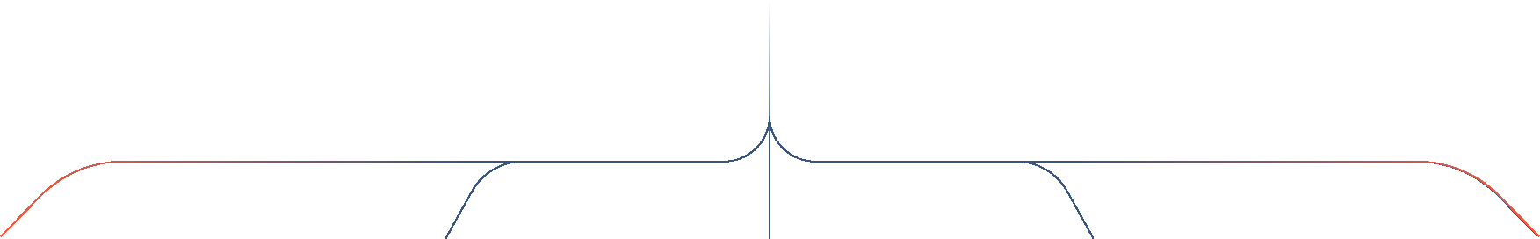
Automated seat buyback and flight swap offers to free up space
for last minute, high yield passengers

Slide 5
Dynamic Inventory Management
Example: SIN-KUL, multiple daily frequencies
New Demand
New Demand
Flight 1
Flight 2
Flight 3
Flight 4
Flight 5
High demand
Mid demand
Low demand
Mid demand
High demand
High fares
Mid fares
Low fares

Slide 6
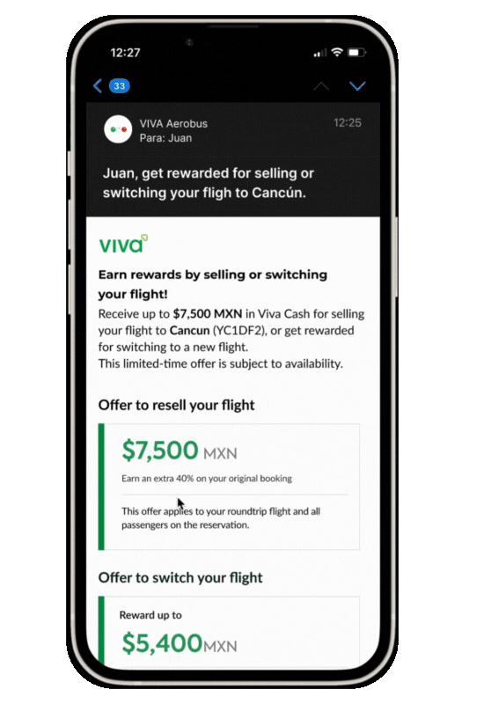
Customized Customer
Experience

Slide 7

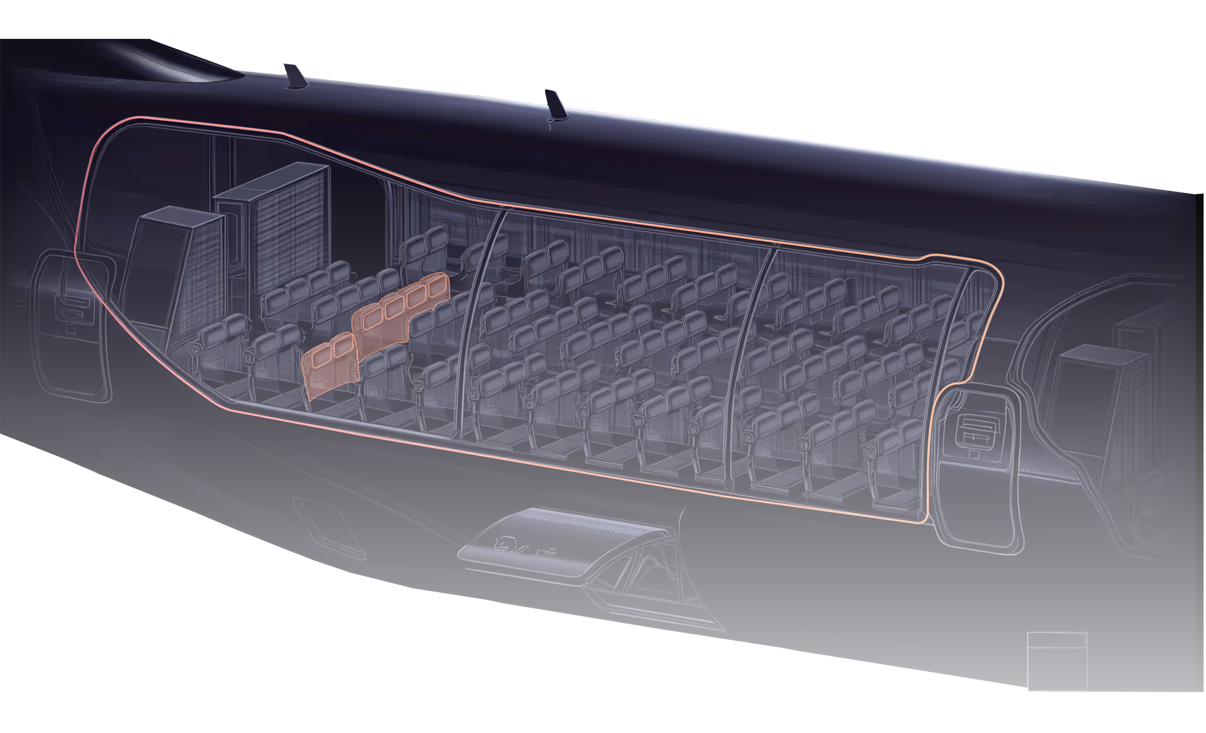
Outstanding Results
4 to 6
Repurchased & resold
seats per
managed flight

Slide 8

Results | Economics of an average buyback/swap transaction
3X
$294
$136
$158
Swap: Alternative Flight + Voucher
OR
Buyback: Voucher
$94
Original fare paid by passenger
Passenger Incentive
Resale
price
Profit Generated

Slide 9
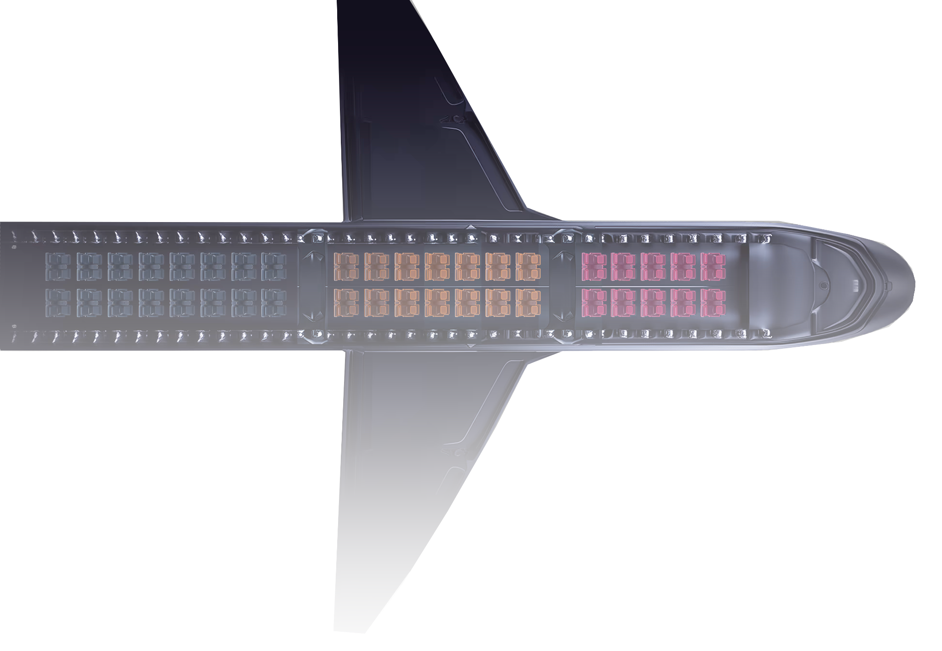
Outstanding Results
3 to 4%
Incremental revenue
per managed flight

Slide 10




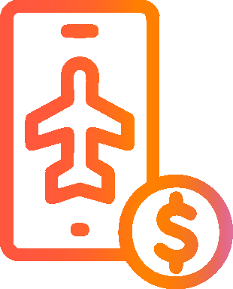


How it works
1
Flight identification
4
Transaction on White Label
2
Passenger
Offer
5
Flight Credits Issued
3
Passenger
Notification
6
Seat
Resale

Slide 11
Seamless Integration
Pre-built PSS connector
and customizable white label
minimize integration effort.
1
Install connector into airline infrastructure
Parametrize PSS credentials
Configure RmX Back-Office
2
3

Slide 12

Everyone WINS!
High-Yield passengers
WIN
Low-Yield passengers
WIN
Airlines
WIN

Slide 13

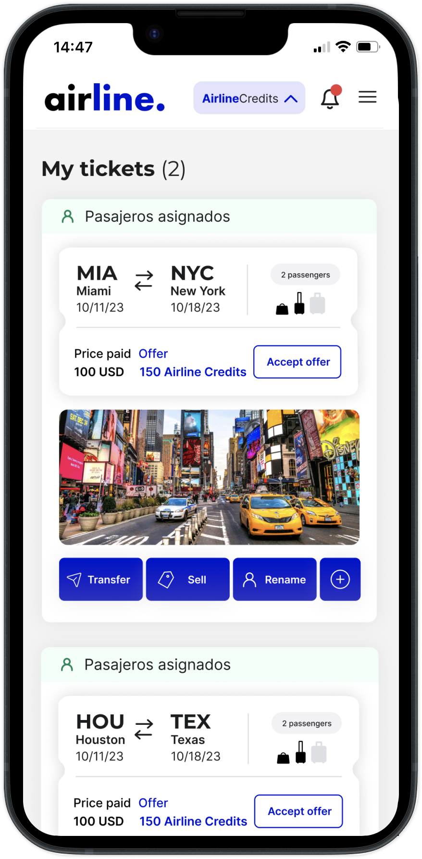

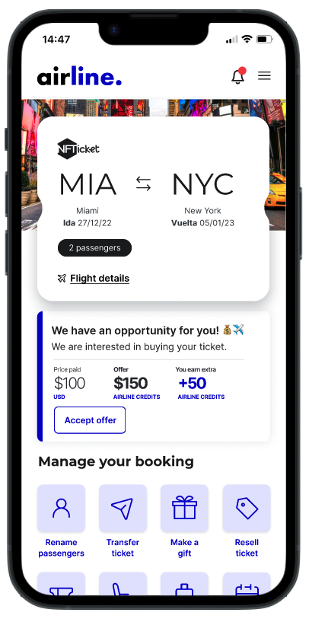


Real impact | Revenue & profit uplift from virtual inventory expansion
No complexity | White label solution with fast and easy implementation
Zero risk | Our fees are 100% variable with no upfront costs or dedicated resources

Slide 14


Visit us at F01!

