Slide 1


School Bus Fleet Electrification: Unlocking the Decarbonization Potential of K-12 School Transportation
A Fleet Electrification Plan (FEP) provides school districts with a clear roadmap for transitioning to electric buses
Michael Brinkman, Senior Associate
Email: mbrinkman@cannondesign.com
Phone: 312.960.8327

Slide 2






Decarbonization potential of K-12 school transportation and the role of electrification
Large School Transportation Fleet
K-12 school districts operate the largest transportation fleet in the U.S., offering significant decarbonization opportunities.
GHG Emissions Reduction Strategy
Decoupling greenhouse gas emissions from energy use through clean electrification is a key strategy to achieve climate goals.
Electrification for Decarbonization
Electrification helps reduce greenhouse gas emissions by shifting from fossil fuels to cleaner energy sources.

Slide 3



Transportation
Stakeholders
Facilities
Sustainability

Slide 4
Clean Energy Vehicle Procurement
Identify and acquire clean energy vehicles compatible with existing infrastructure for sustainable transit.
Procurement of Charging Equipment
Selecting and procuring reliable electric vehicle chargers to maintain continuous school bus service is essential.
Environmental Impact Analysis
Conduct rigorous analyses of energy consumption and greenhouse gas emissions to inform sustainability efforts.
Shared Vision

Slide 5

Fleet Electrification Plan (FEP) as a roadmap for transition and stakeholder alignment
Clear Transition Roadmap
FEP provides a strategic roadmap guiding school districts' transition to electric school buses (ESBs) and infrastructure deployment.
Stakeholder Collaboration
FEP involves transportation, facilities, and sustainability teams to align vehicle acquisitions with infrastructure needs.
Complex Decarbonization Management
Fleet decarbonization requires robust project management to handle its inherent complexity effectively.

Slide 6
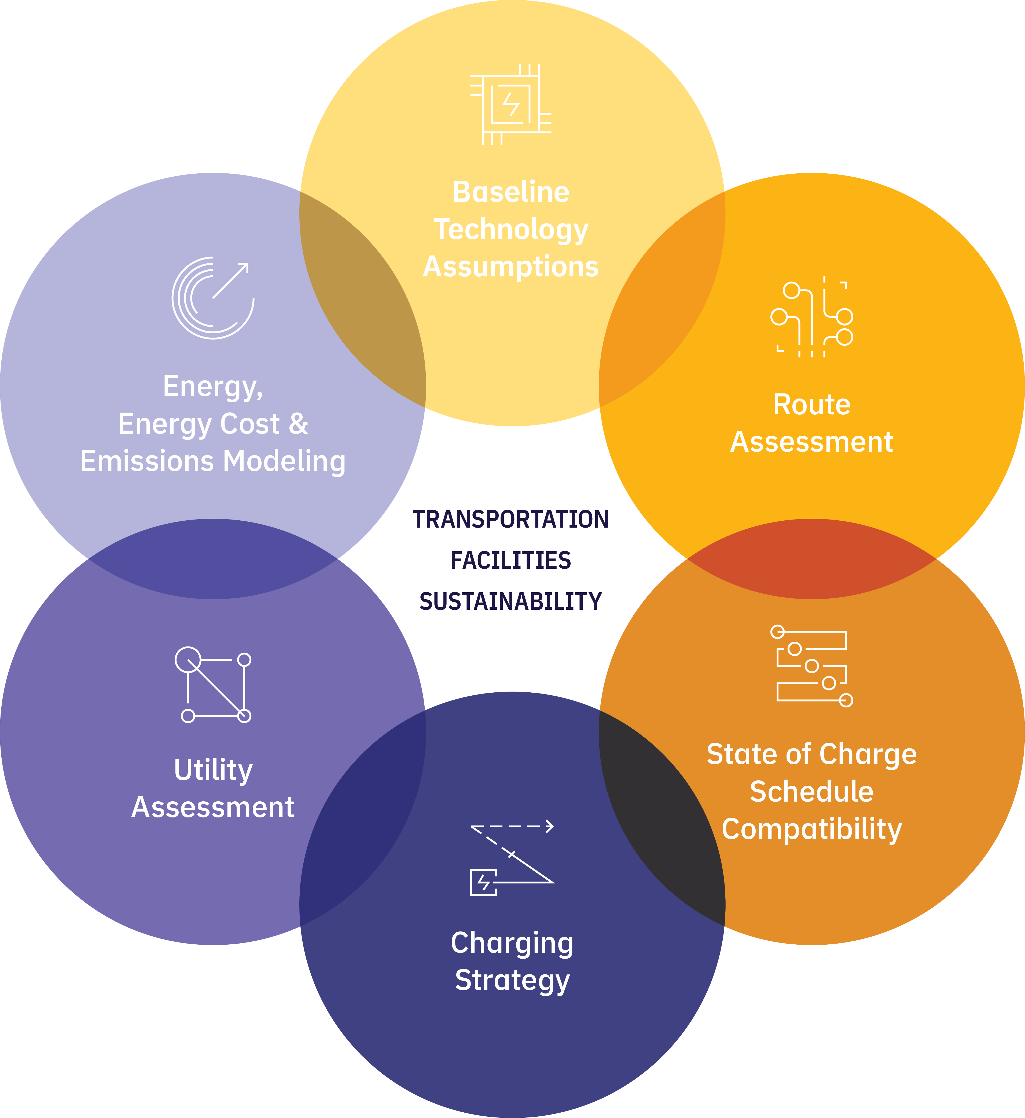
Fleet Electrification Plan (FEP) Process
Importance of Early Planning
Developing a FEP early ensures investments align with district goals for efficient electrification.
An Essential Commissioning Tool
Provides a detailed record that explains the reasoning, concepts, calculations, decisions, and product selections used to meet operational requirements.
Used throughout Project Lifecycle
Serves as a reference for the entire project lifecycle, including future renovations, vehicles purchases, and infrastructure upgrades.

Slide 7

Baseline Technology Assumptions

Slide 8

Defining technology assumptions for vehicles and charging infrastructure
Vehicle Type and Configuration
Defining vehicle types and configurations is crucial for meeting transportation service requirements effectively.
Performance Differences
Zero-emissions vehicles operate differently than traditional fossil fuel vehicles, requiring unique service strategies.
Impact of Cold Temperatures
Cold weather significantly affects zero-emission vehicle efficiency and battery life.
Charger Configurations and Impact
Charger placement, whether front or rear, significantly affects site layout and operational efficiency.
Operational Considerations
Heating systems and vehicle preconditioning are operational factors influencing charging and vehicle readiness.

Slide 9

Route Assessment

Slide 10
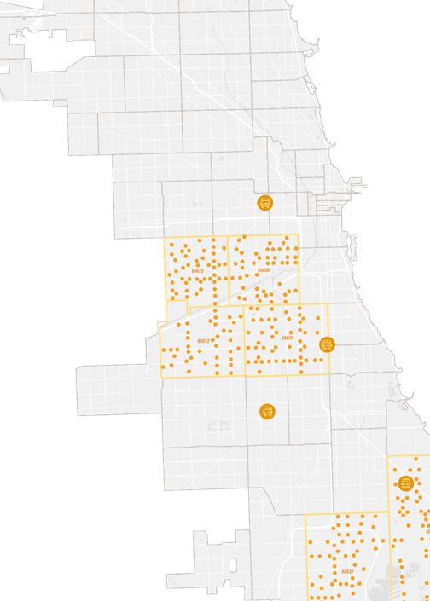
Route assessment and battery performance under operational scenarios
Route Optimization for ESBs
Optimal route assignments are determined using geospatial, schedule, and stop data to meet operational needs effectively.
Battery Performance Evaluation
Battery capacity and ambient factors, like temperature and terrain, critically impact electric school bus range under worst case scenarios.
Service Reliability and Risk Areas
Simulations identify risk areas where electric school bus service performance might be compromised under current schedules.
Range Extension Strategies
Midday charging and range buffers are recommended strategies to extend electric school bus operational range beyond single charges.

Slide 11
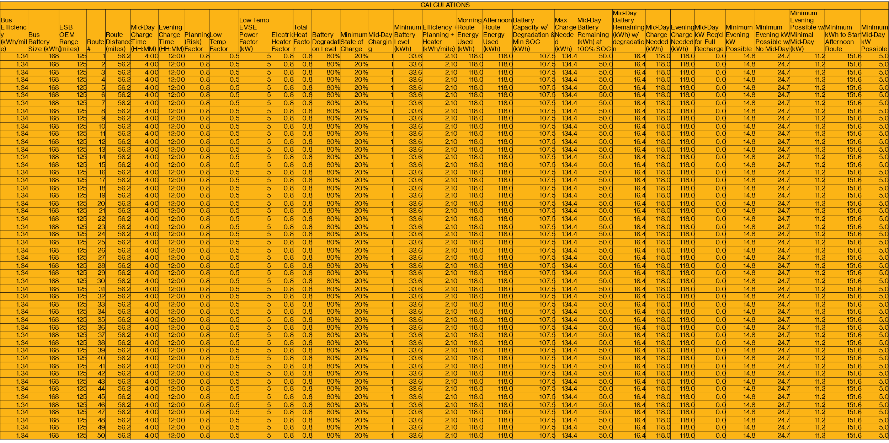
Route assessment determines State of Charge (kWh remaining) on a stop-by-stop basis
Vehicle Type and Configuration
Average Speed / Duty Cycle
Passenger Capacity / Weight
Battery Chemistry and Capacity
Usable Battery Capacity
Battery Degradation
Climate
Weather
Temperature
Topography / Regenerative Braking
Heaters / Other Auxiliary Loads
Other
Preconditioning
Dwell Time / Idling
Driver Behavior / Regenerative Braking

Slide 12

State of Charge Schedule Compatibility

Slide 13
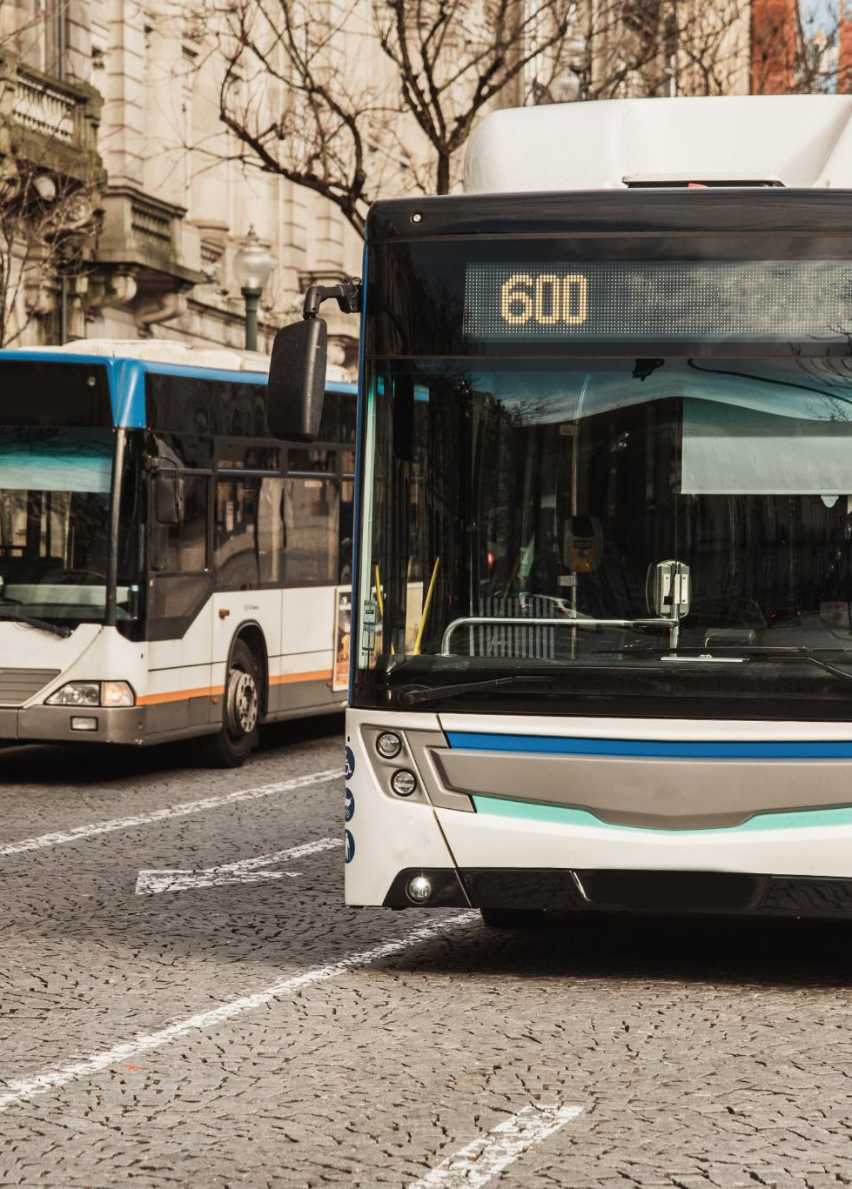
State of Charge (SOC) modeling and compatibility with operational schedules
SOC Modeling Purpose
The FEP uses SOC modeling to assess electric bus schedule compatibility with battery charge levels.
Operational Schedule Review
Operational schedules are reviewed with route analysis to ensure battery SOC supports service needs.
Impact of Climate and Activities
Climate and operational activities influence charging duration and the bus’s charging profile.

Slide 14
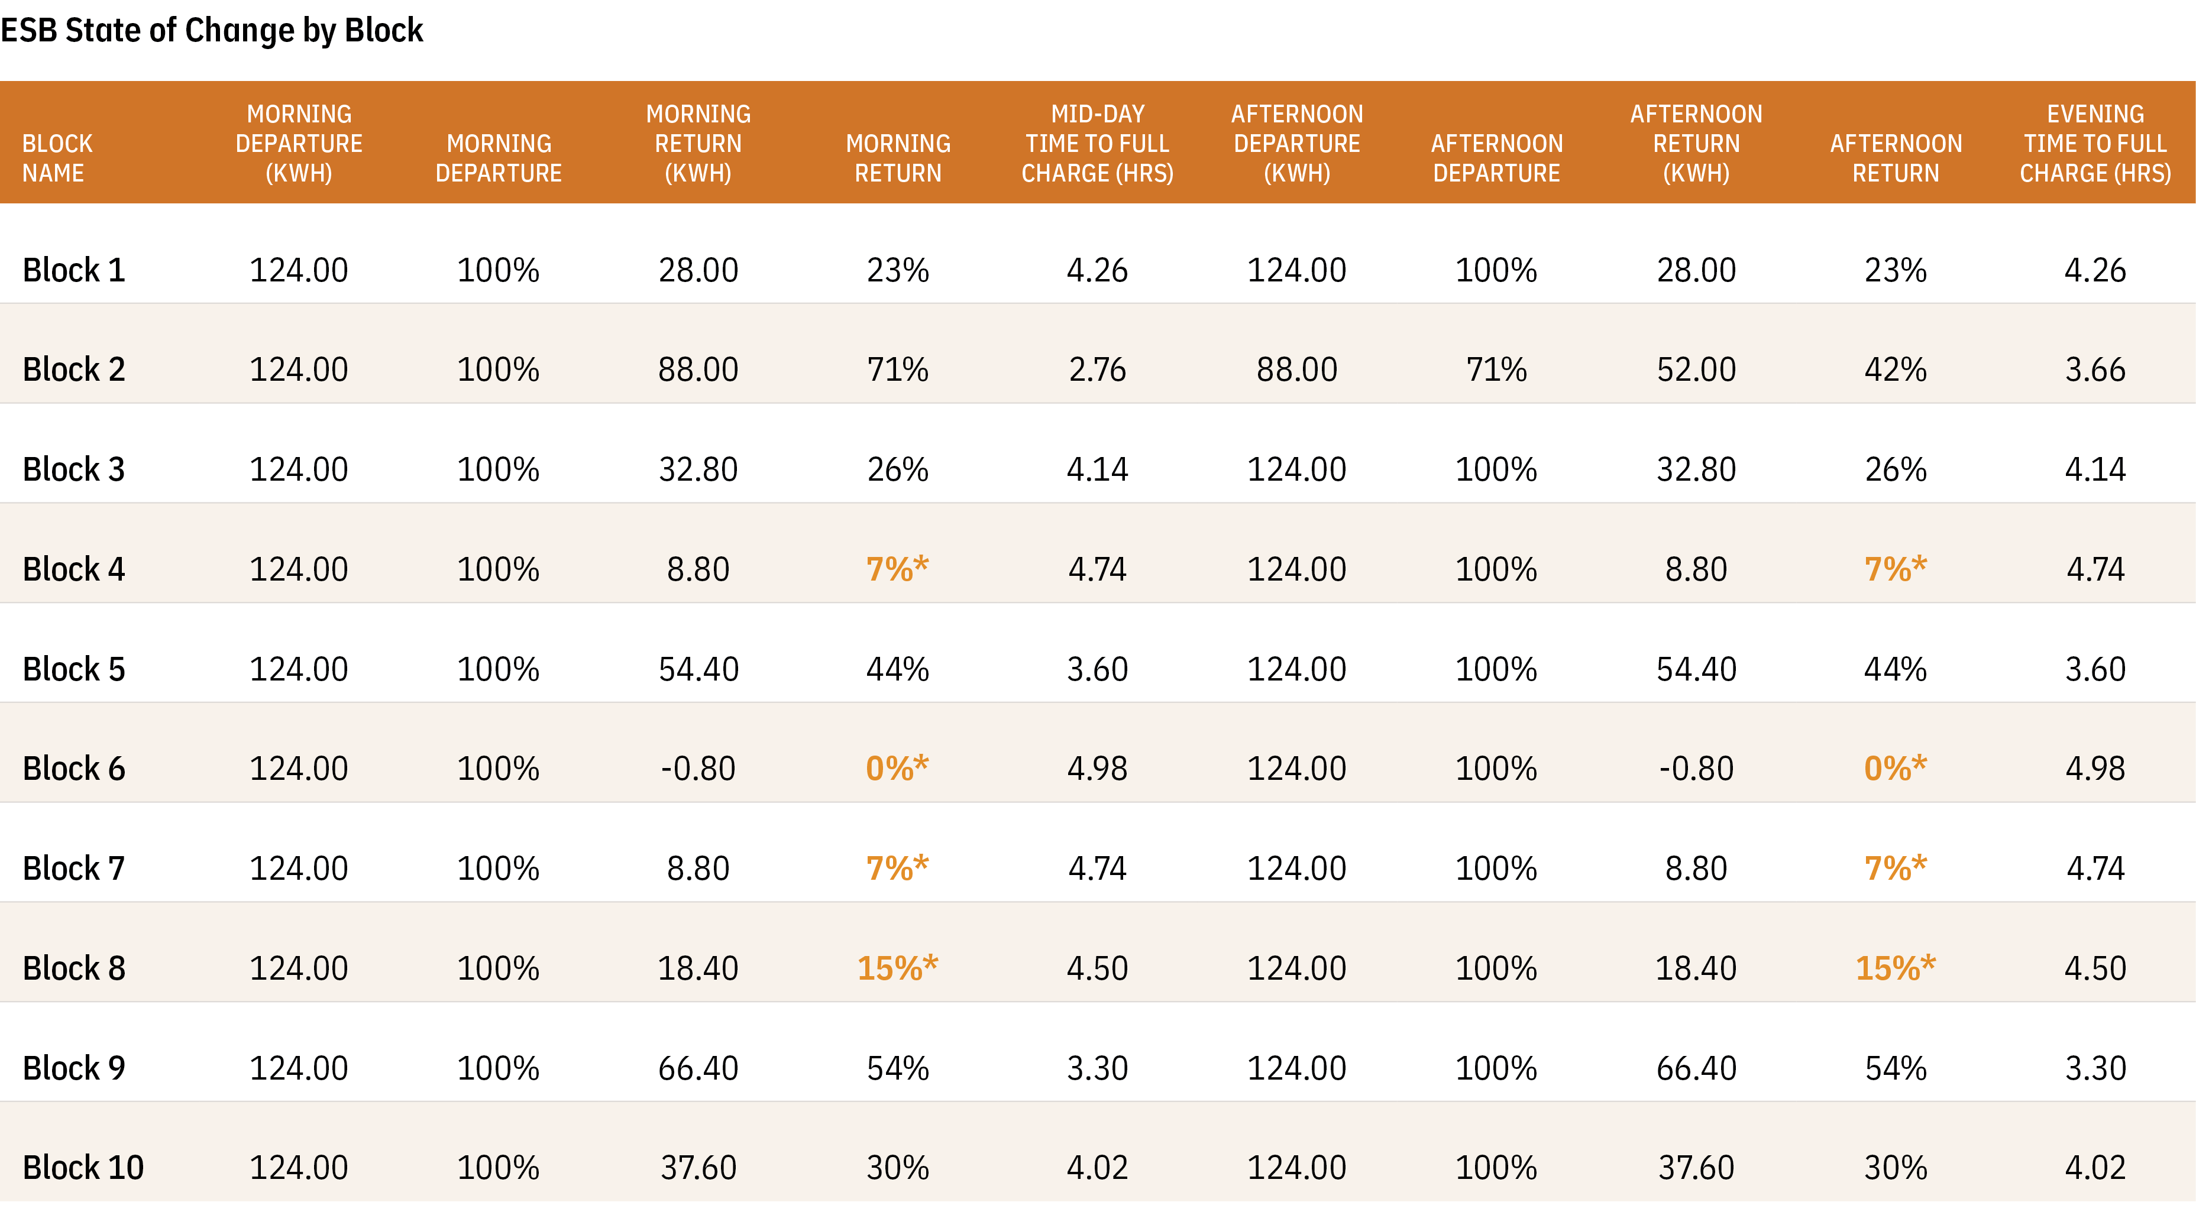

Slide 15

Charging Strategy

Slide 16

Effective charging strategies ensure optimal performance and reliability
Overnight Charging
Overnight charging uses off-peak electricity rates to fully charge fleets with predictable schedules for next-day use.
Mid-Day Charging
Mid-day charging during operational breaks extends vehicle range and keeps fleets ready for the rest of the day.
On-Route Charging
On-route charging provides power during scheduled stops, reducing downtime and maintaining continuous vehicle service.

Slide 17
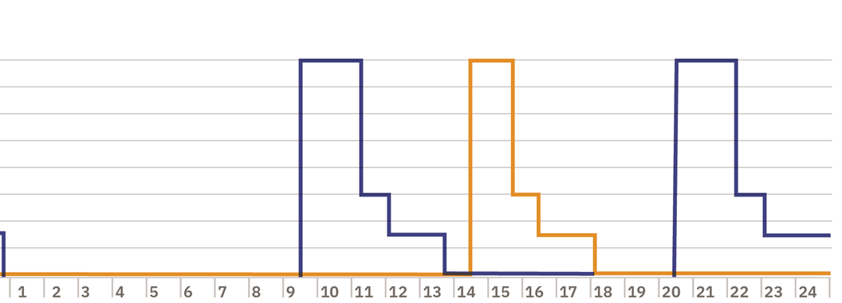
Impact of charging strategies on operational efficiency and sustainability goals
Level 2 Charging
Level 2 charging supports fleets with predictable schedules by replenishing batteries with minimal operational disruption.
All-in-One Level 3 Charging
All-in-one Level 3 chargers combine power electronics and dispensers to deliver the highest charging speeds efficiently.
Split Dispenser Level 3 Charging
Split dispenser chargers separate power electronics from dispensers, providing flexibility and scalability for large operations.
Choosing the Right Charger
Charger choice depends on fleet size, operational needs, and cost constraints, often requiring a mixed approach.

Slide 18

Utility Assessment

Slide 19
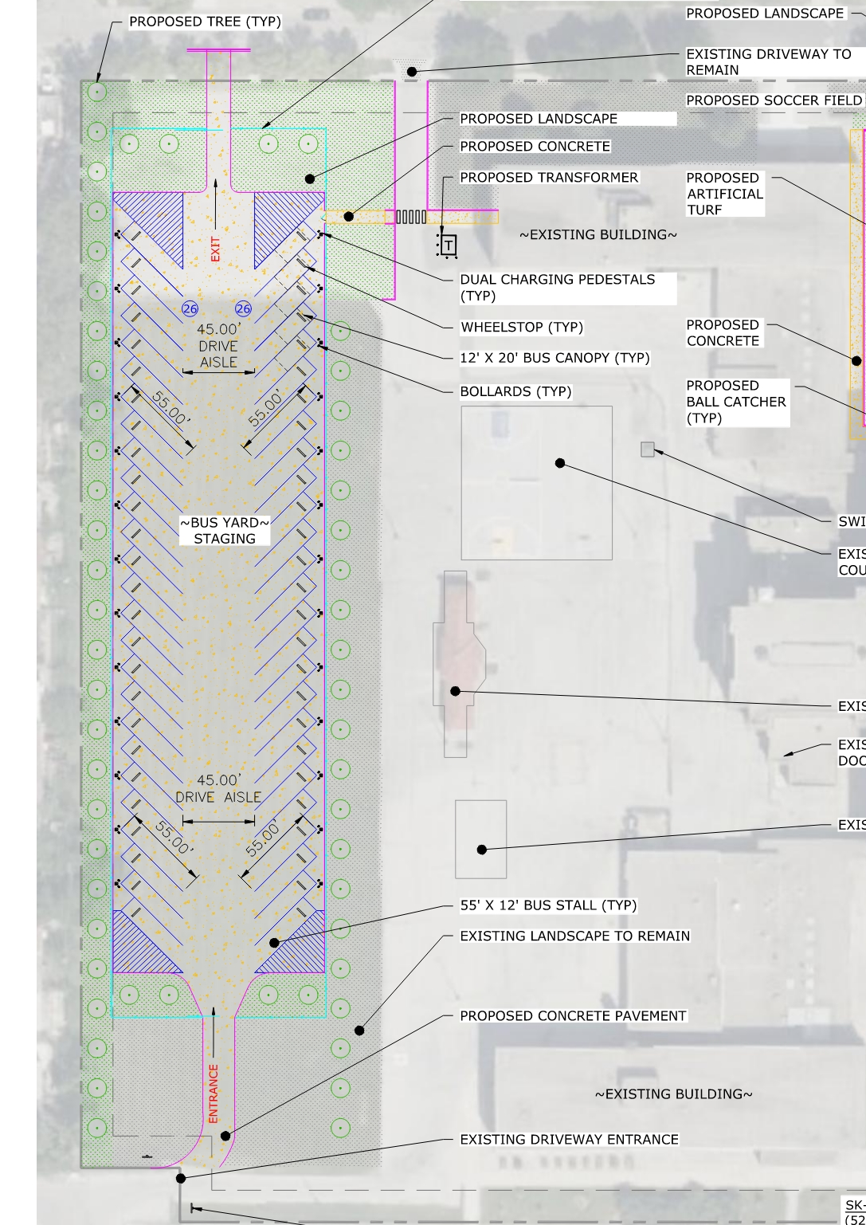
Facility infrastructure
Current Facility Limitations
Many existing facilities lack infrastructure to support electric vehicle charging, presenting spatial and functional challenges.
Renovation vs Replacement
Deciding whether to renovate or replace facilities requires careful evaluation of costs and future infrastructure needs.
Investment Requirements
Understanding investment needs is key to upgrading facilities for zero-emissions technology adoption.

Slide 20
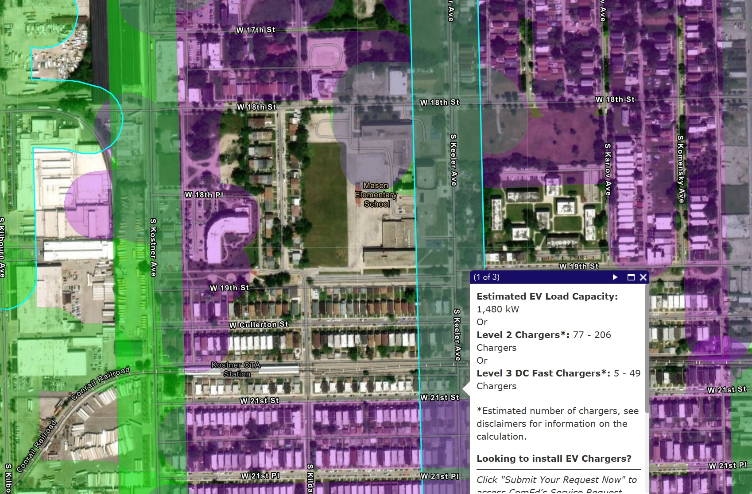
Engaging utilities and assessing electrical capacity for charging demand
Utility Engagement Importance
Engaging utilities is crucial to assess available electrical capacity for electric vehicle charging demands.
Electrical Load Analysis
Analyzing one year of metering data helps determine peak demand and informs site power requirements for EV chargers.
Infrastructure Upgrades
Utility may require upgrades like new transformers or circuits to support increased electrical service capacity.
Project Timeline Considerations
Utility upgrades can take several months to years depending on project size and complexity of charging infrastructure.

Slide 21

Energy, Cost, and Emissions Modeling

Slide 22
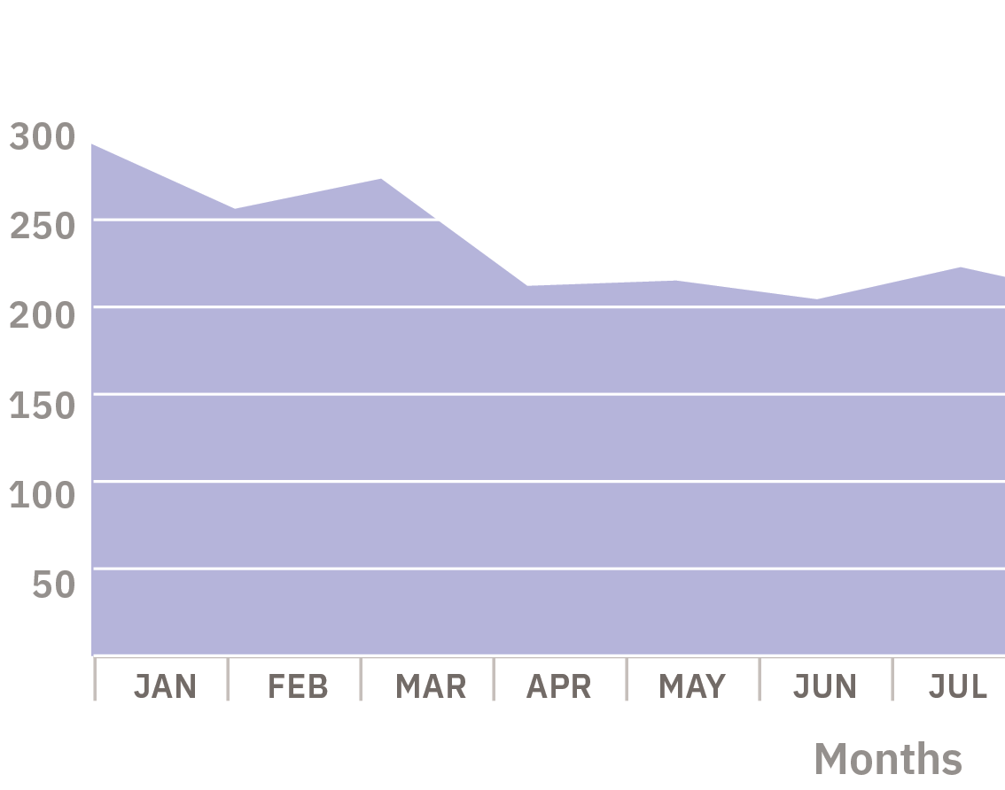
Developing baseline energy profiles and modeling operational impacts
Baseline Energy Profile
Develop baseline energy profile using SOC schedule and charging strategy for operational impact analysis.
Unmanaged vs Managed Demand
Evaluate unmanaged power demand during peak times and explore managed scenarios affecting cost and emissions.
Control Strategy Recommendations
Compare control strategies to recommend optimal energy cost savings while meeting operational needs.

Slide 23
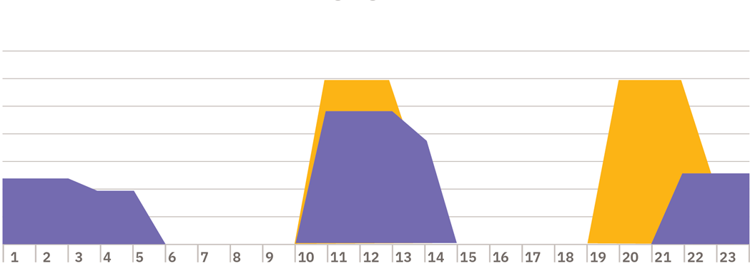
Alternatives to Utility Infrastructure Improvements
Dynamic Power Sharing
Load management software distributes existing power across multiple EV chargers without new electrical capacity.
Phased Infrastructure Upgrades
Incremental purchasing of EV charging stations aligns power capacity with growing demand in phases.
Alternative Site Selection
Considering multiple locations helps overcome feasibility challenges in infrastructure upgrades for EV charging.
Energy Consumption Management
Understanding charger power output profiles aids in predicting and managing operational energy costs.

Slide 24
Conclusion
Decarbonizing Transportation
Electrifying school bus fleets reduces carbon emissions and promotes environmental sustainability in K-12 transportation.
Strategic Planning
Effective planning ensures smooth transition to electric buses with optimized routes and infrastructure.
Collaboration and Communication
Strong collaboration among stakeholders and clear communication help in successful implementation.

Slide 25
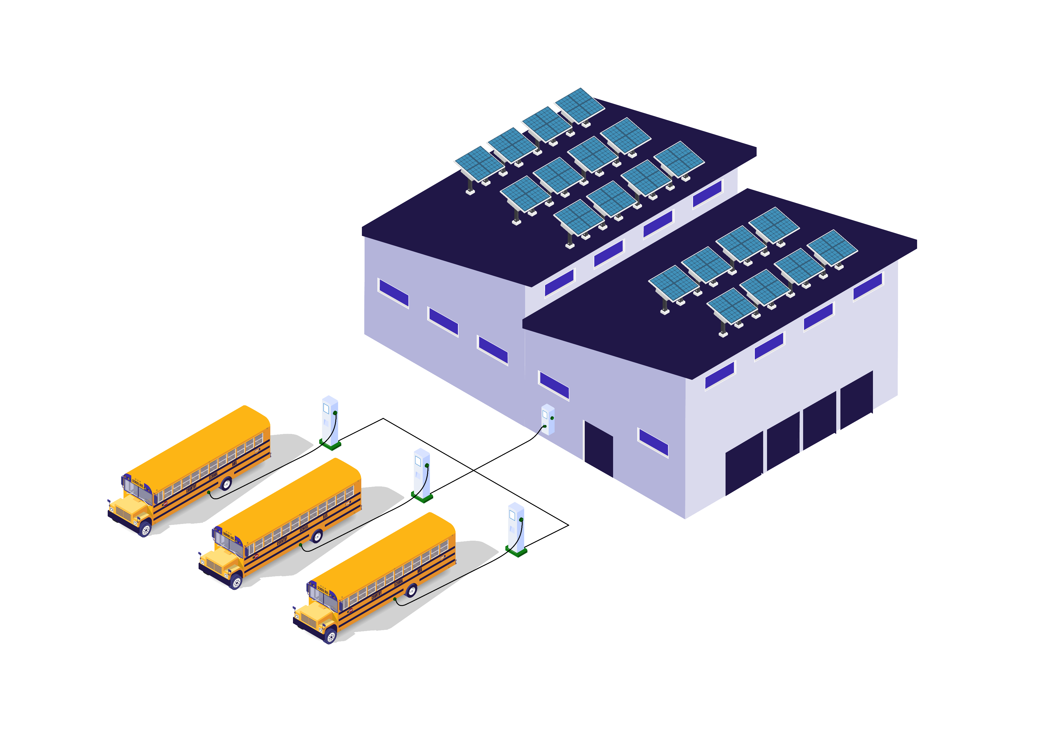


Michael Brinkman, Senior Associate
mbrinkman@cannondesign.com T 312.960.8327
225 North Michigan Ave, Suite 1100,
Chicago, IL 60601

