Slide 1
Overcoming Challenges to Certifying
Multicore Avionics
Brian Riley <bjriley@ghs.com>

Slide 2
Agenda
Our Multicore Certification Credentials
AMC 20-193: Use of Multi-Core Processors
Robust Partitioning
Bandwidth Allocation
Cache Partitioning

Slide 3

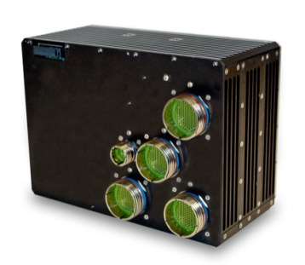
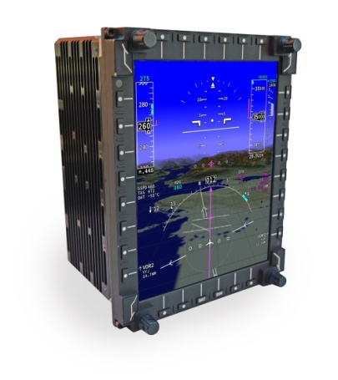
Our Key Credential: World’s First Multicore TSOs
PU-3000 Multicore Avionics Computer |  | March 2021 TSO-C198 (AFGCS Equipment) Authorized as a Flight Director
MFD-3068 Multicore Smart Display |  | May 2021 3 Separate TSO Authorizations: TSO-C113, TSO-C165, TSO-C209 Drives up to 4 displays, incl. PFD Multiple apps of mixed criticality
All TSOs included DO-178C DAL A and CAST-32A objectives
Both systems run the INTEGRITY®-178 tuMP™ RTOS
Notes:
It wasn’t until late last year that another company got a multicore TSO, and that was 5 years later than they originally claimed would happen.

Slide 4
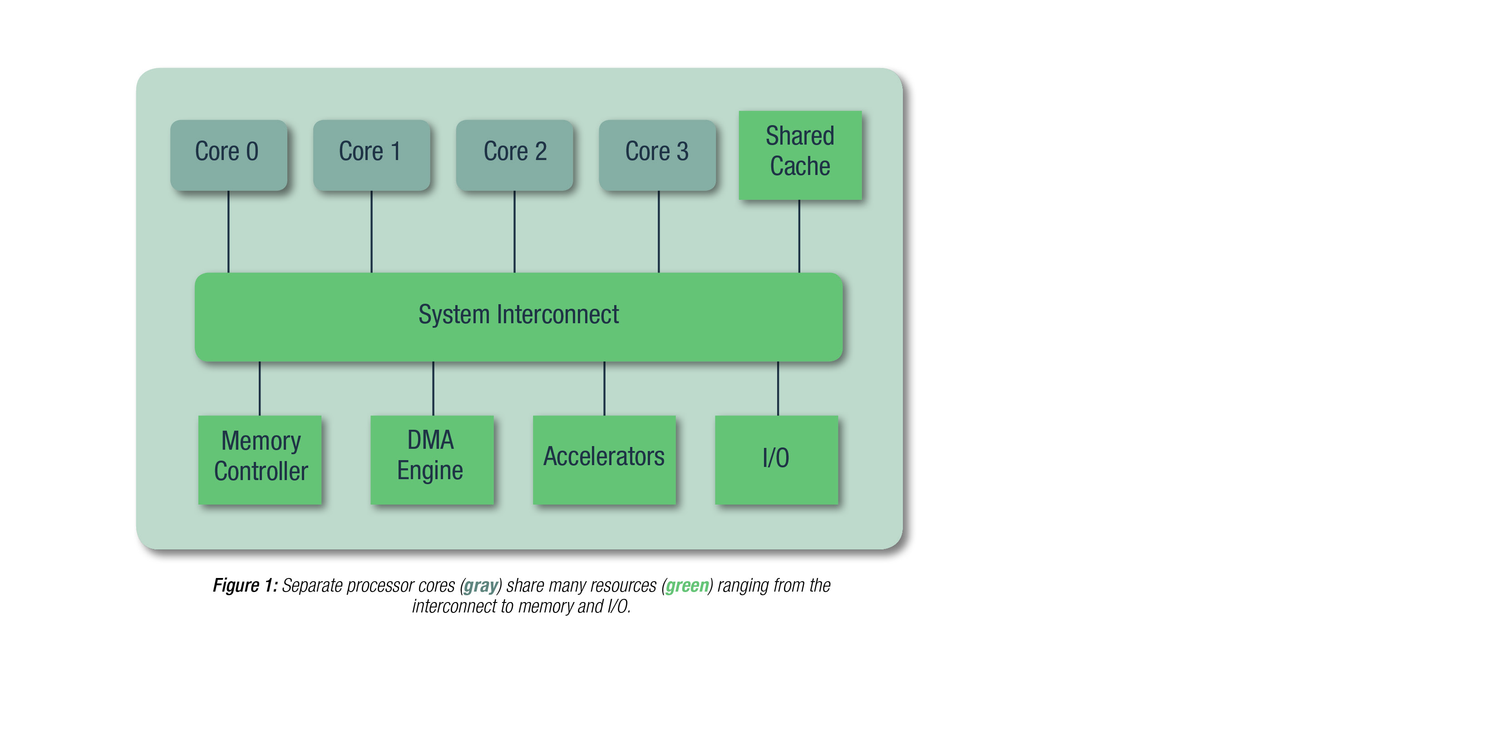
AMC 20-193: Use of Multi-Core Processors
Main topic is contention for shared resources
  Memory, cache, on-chip interconnect, and external interfaces
9 Objectives
  Very little change from CAST-32A
New Definition of Integrated Modular Avionics (IMA), which requires
  Robust resource partitioning
  Robust time partitioning
Example Shared Resource Contention:
Attempt to access DRAM while it is in use
X

Slide 5
Robust Partitioning in AMC 20-193
Multicore Robust Resource Partitioning is Manageable
  Using the memory management unit (MMU) and other well-established techniques
Multicore Robust Time Partitioning is Very Challenging
→ Need a way to mitigate all or almost all sources of interference
“No software partition consumes more than its allocation of execution time on the core(s) on which it executes, irrespective of whether partitions are executing on none of the other active cores or on all of the other active cores.”

Slide 6
Benefits of Meeting IMA Robust Partitioning
Significantly Less Software Verification per AMC 20-193:
Verify software applications separately
Determine their WCETs separately
Results:
Incremental module design and acceptance
Applications are independently modifiable
Platform behavior may be verified independently of specific applications
App 3
App 5
App 1
App 2
App 4
Operating System or Hypervisor
with Robust Partitioning
An application can be modified or replaced without testing and reverifying the entire system.

Slide 7
Achieving Robust Time Partitioning
General Solution: Bandwidth Allocation
Allocate and enforce bandwidth
from cores to shared resources
  Although some CPUs have a HW implementation, it is immature, complex, and not in CPUs used for avionics
INTEGRITY®-178 tuMP RTOS Implementation
  Bandwidth Allocation and Monitoring (BAM)
Bandwidth Allocation

Slide 8
Example: Multicore DRAM Interference

Slide 9
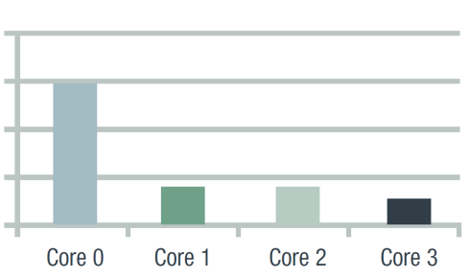
Example Bandwidth Allocations
Software architect allocates the shared bandwidth on a per core basis
Max bandwidth is enforced by the RTOS continuously over a very small quantum of time
80%
60%
40%
20%
0%

Slide 10
Results with BAM in INTEGRITY-178 tuMP

Slide 11
Shared Cache Interference is Different
Problem is Inter-Core Cache Line Eviction
  Task on Core 0 goes to read its data, but a task on Core 2 caused new data to be loaded instead
Contention for Access in Not an Issue
Shared Cache Supports Simultaneous Access


Slide 12
Multiple Memory Locations Map to Same Cache Line/Set
Physical
Memory
4-Way Set-Associative Cache
Cache Line
Cache Sets
Challenge:
Deconflicting the virtual-to-physical memory mapping so that different cores do not use the same cache line

Slide 13
Hardware-Based Cache Partitioning to the Rescue!
Allocate a Cache Way to a Core
Physical
Memory
Core 1
Core 2
Core 3
Core 4
Cache Line
Cache Sets
Example: Intel® Cache Allocation Technology
* Tasks are assigned to a Class of Service (CLOS)
* Each CLOS is mapped to one or more cache ways

Slide 14

Overcoming Multicore Certification Challenges
Goal: Robust Partitioning
eases development and verification
01
Solution:
Bandwidth Allocation
mitigates most sources of multicore interference
Implementation:
INTEGRITY-178 tuMP
has both bandwidth allocation and cache partitioning thus
enabling robust partitioning
02
04
03
Cache Partitioning
mitigates non-contention interference
www.free-powerpoint-templates-design.com

