Slide 1


Turning Disruption
into Loyalty
WAF 2025
Loyalty / Track 3 / Pavilion 1
Personalization in the moments that matter

Slide 2
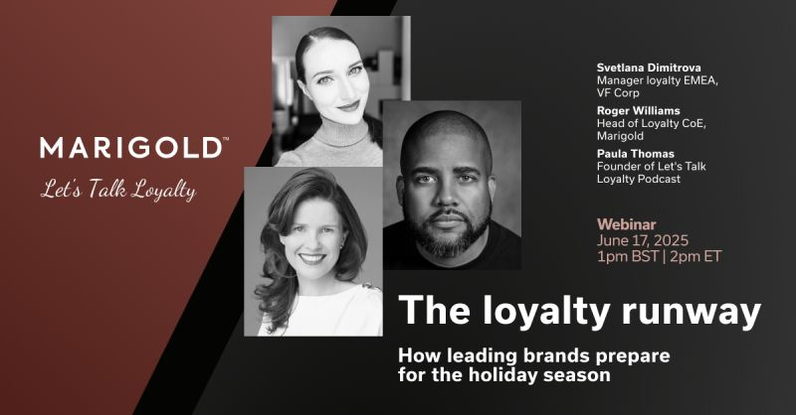

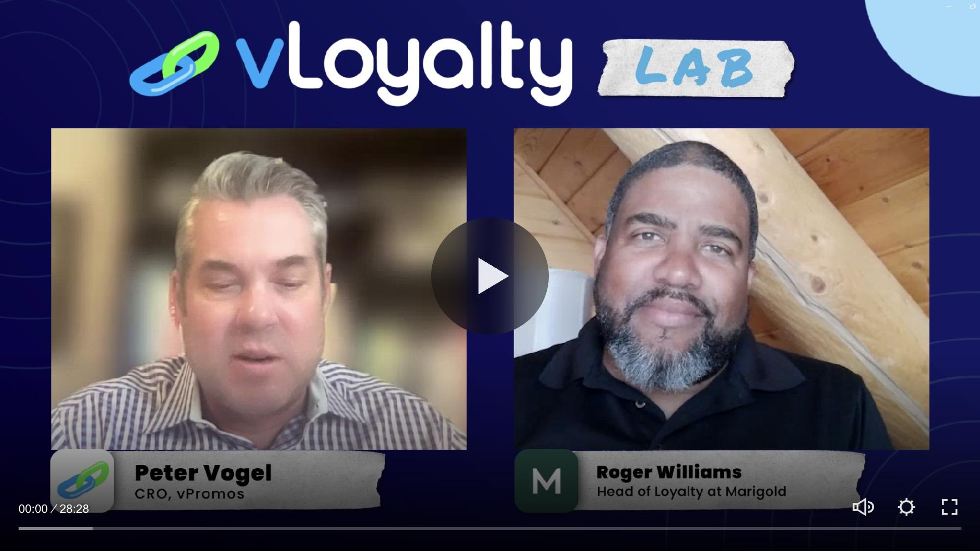
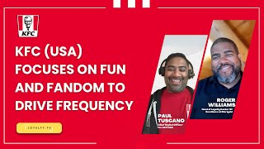
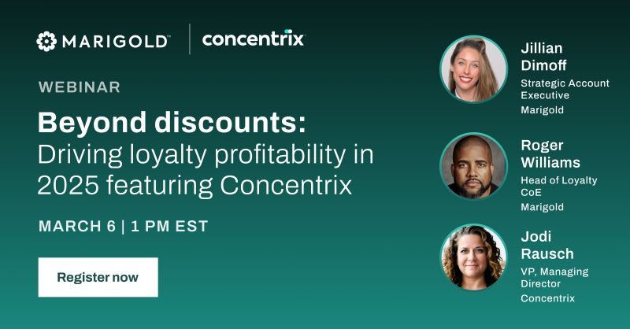

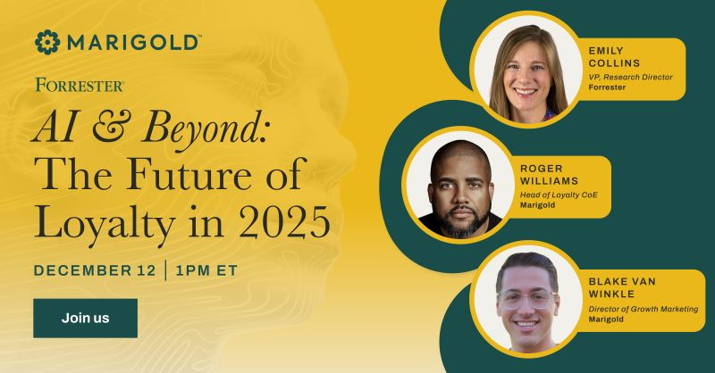
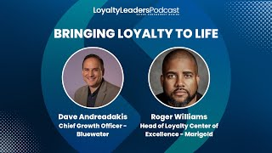
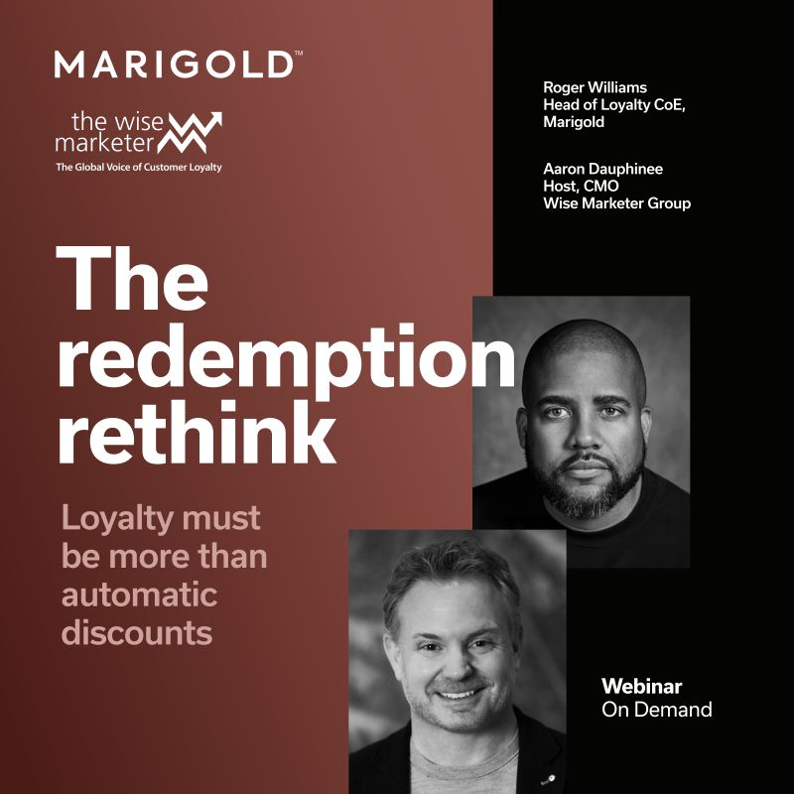
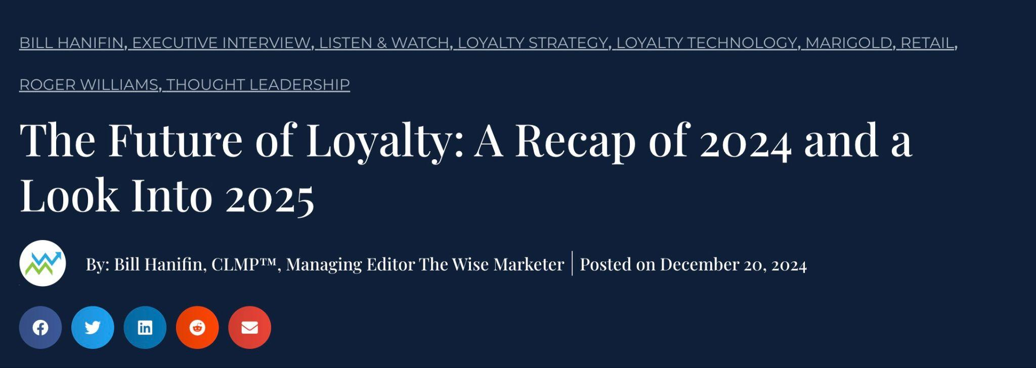
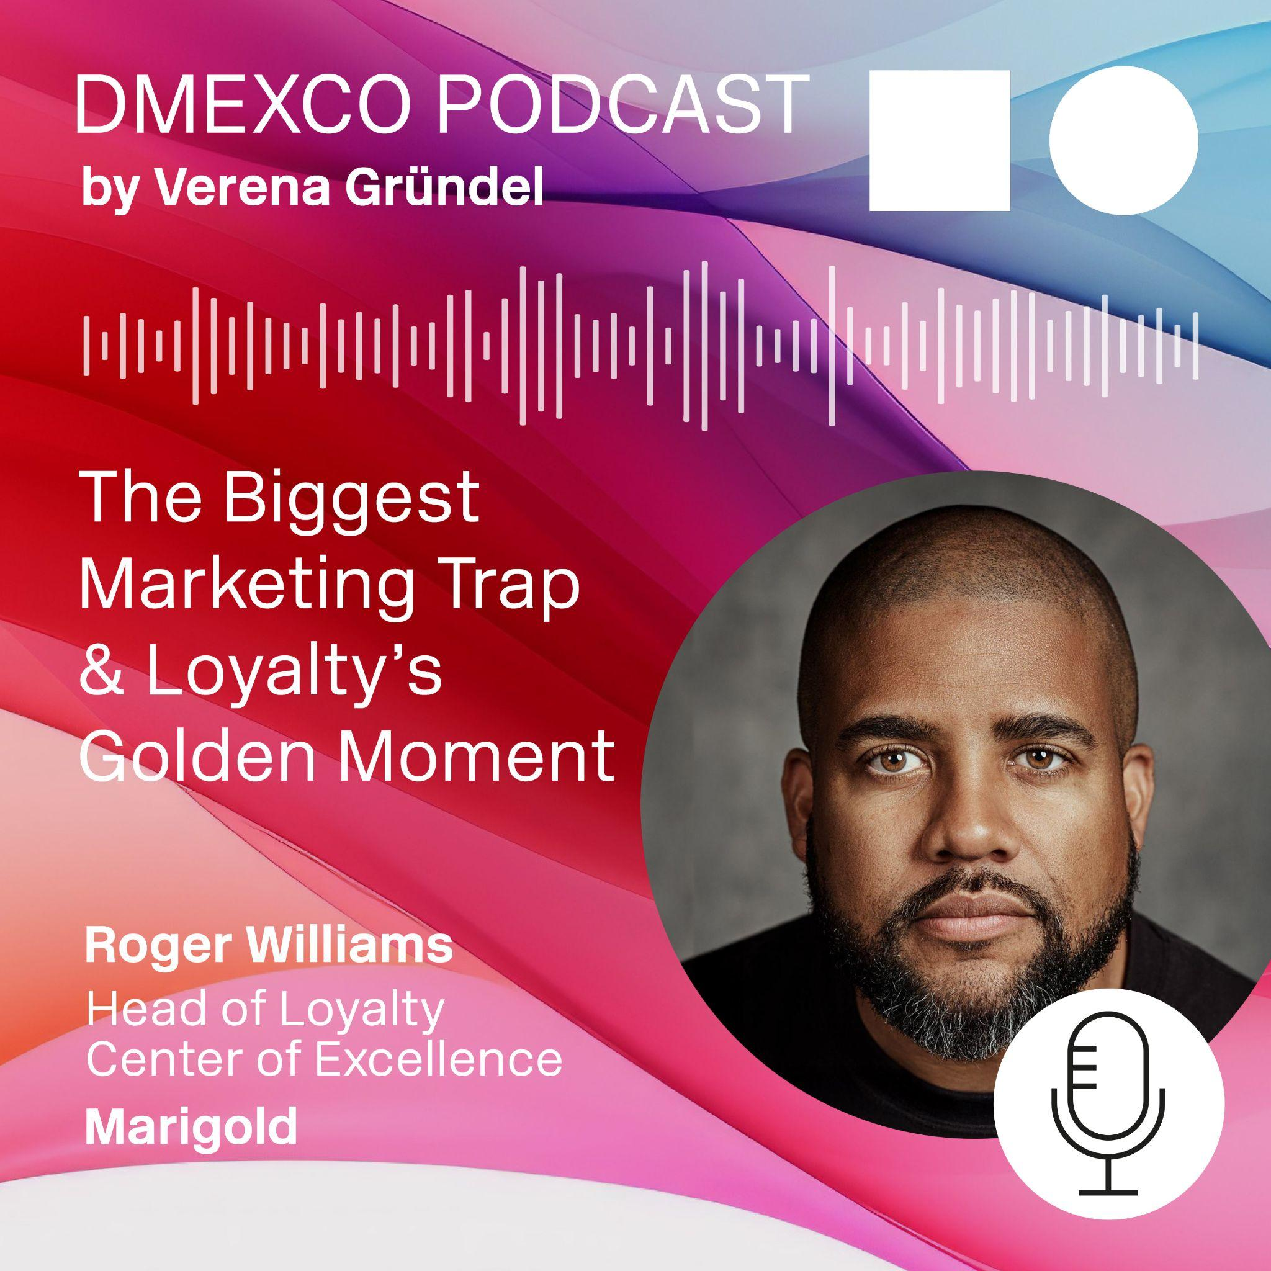
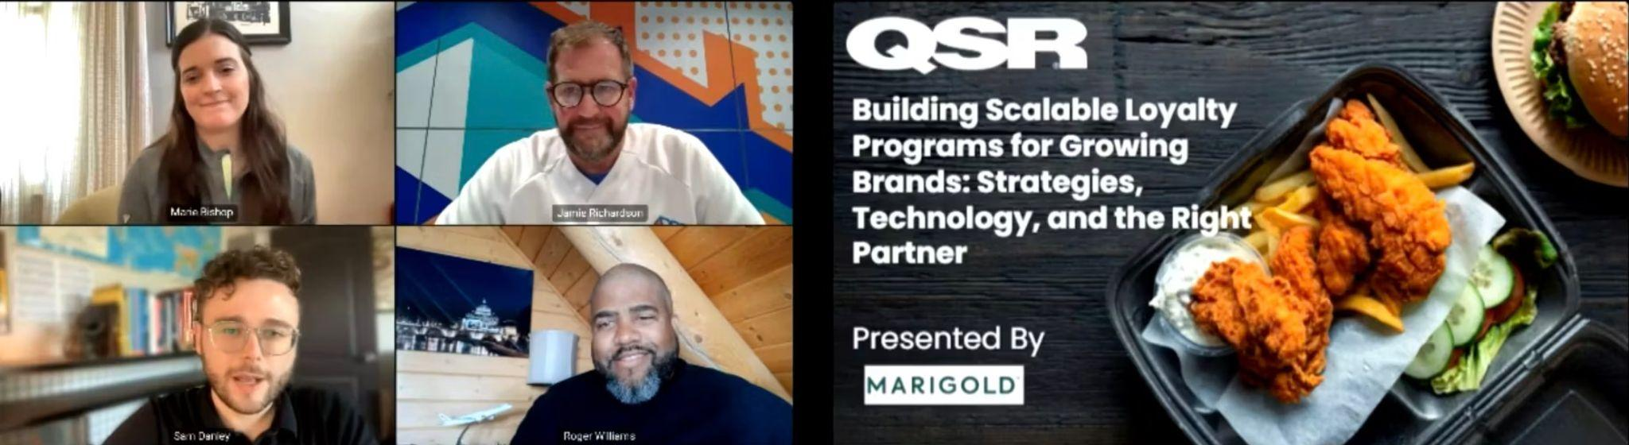
Your presenter
World Aviation Festival 2025
Roger Williams
Head of Loyalty CoE
5 years with Marigold
Sabre
Airline Information
Caribbean Airlines

Slide 3
Turning disruption into loyalty
01
Who is to blame?
02
The issue with post-flight surveys
03
How we re-invented travel recommendation
04
Trip Experience Optimization

Slide 4
The psychology of disruption.
Notes:
Let’s jump in and start with the essentials.

Slide 5


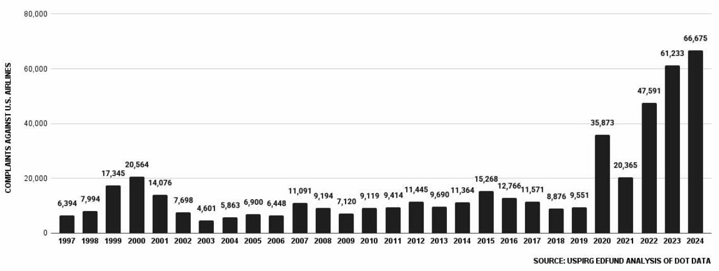
Airline’s fault?
Yes, but not in the way they’re saying
Root cause
Extreme weather - 5.2%.
NAS - 18.1%
Late aircraft - 40%
Maintenance or crew - 36.4%
All influenced by non-airline factors. Weather or NAS.
Complaints against U.S. airlines soar… rising by nearly 9%
Teresa Murray, Director, US PIRG
Force majeure, more credible?
Clear-air turbulence (CAT) frequency increased by 55% from 1979 to 2020, and projections suggest it could double or triple globally by the end of the century.
True cause: Lack of communication
57% of pax want more information and 56% want more frequent communication. About 36% of pax dissatisfied with communication will file for compensation.*
Notes:
Teresa Murray
Director of Consumer Watchdog, U.S. PIRG Education Fund
Murray told Newsweek: "Complaints about refunds and delays from 2020 through 2022 caused Congress last year in the FAA [Federal Aviation Administration] Reauthorization bill to spell out that airlines must issue fast, no-hassle refunds if flights are canceled for any reason—bad weather, staffing or a zombie apocalypse, whatever the reason." "Congress also spelled out what counts as a 'significant delay.' It's defined as three hours or more," she added. "That's now the law."
The director was also surprised by the rise in cancellations and delays last year, noting that about 22 percent of flights were delayed or canceled, which amounts to 1.7 million flights delayed or canceled in 2024. The cancellation figures include flights canceled within seven days before the planned departure date, while delays include flights that arrive 15 minutes or more later than their scheduled time. Murry told Newsweek: "We're going in the wrong direction and I fear those could get worse in 2025 because of the shortage of air traffic controllers."
*25 July 2025
New research reveals only one in ten passengers feel fully informed of their rights when flight is disrupted
https://www.caa.co.uk/newsroom/news/new-research-reveals-only-one-in-ten-passengers-feel-fully-informed-of-their-rights-when-flight-is-disrupted/

Slide 6
The issue with post-flight surveys.
Notes:
Let’s jump in and start with the essentials.

Slide 7
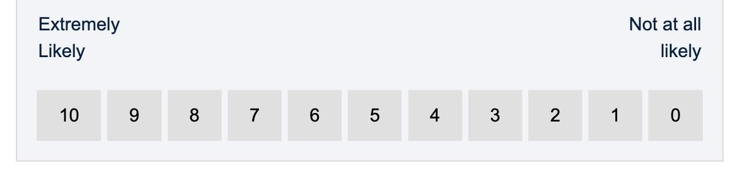
Anyone listening?
Critical
1-8% response rate because pax don’t feel heard.
Catalyst
Pax skepticism: Airlines respond on social media but lacks scale as pax with large followers are prioritized.
Marigold Confidential Information Enclosed
“Without an incentive (either monetary/points) or an exceedingly positive or negative experience that needs mentioning I am not going to waste my time beyond clicking delete.” - notquiteaff, FlyerTalk Evangelist
Origin
NPS is often biased in how questions are phrased. Not great performance metrics.

Slide 8
We started by re-inventing the recommendation engine for airlines and travel.
Notes:
Let’s jump in and start with the essentials.

Slide 9
But first, loyalty is backwards
Marigold Confidential Information Enclosed
Purchase
Earn Points
Most brands invest 100% of incentives
to occur after the transaction
Notes:
Presenter: Roger
Most brands invest 100% of incentives to occur after the transaction

Slide 10
Front load incentives to drive engagement and ROI
Marigold Confidential Information Enclosed
Earn Points
Purchase
Earn Points
Invest in smaller incremental incentives
before the sale:
Completing challenges
Providing zero party data
Clicking on an Email or accepting an offer
Notes:
Presenter: Roger
Continue to invest in points after the transaction, but now you have better attribution!

Slide 11
Zero party data also solves for loyalty revenue attribution
Loyalty’s burden of proof
Proven: Ancillary revenues from loyalty partnerships
Debatable: Incremental purchasing behavior
Wide migration proximity
Narrow migration proximity
Stable
Grower
Decliner
Communication-driven habituation
Loyalty incentives drive two-way pax communication
Build loyalty currency accrual habits
We deliver it in the form of journeys
Minority
Majority
Evaluate
LOYALTY STRATEGY
Front load transactions with engagement accruals.
Build habituation reinforced by journeys
Golden Moments: Upsell redeemers. Offer bonus miles.
Notes:
Let’s dive into our ROI framework, which is built around a simple customer lifecycle methodology.
We categorize members into three groups:
Grower – those who are increasing spend and frequency
Stable – those who are maintaining their behavior but not growing
Decliner – customers whose engagement or spend is tapering off
You can see this lifecycle visualized on the left side of the slide. It’s straightforward—but highly effective for guiding loyalty strategy.
Tailored Strategies by Lifecycle Stage
Our loyalty strategy is built around targeting each group differently:
Growers
This is a small but powerful segment. These customers are already showing growth behavior, so we don’t want to derail that by offering discounts. Instead, we use upsell tactics, premium offers, and post-redemption bonus points to reinforce their engagement.
Stables & Decliners
These groups are more appropriate for discount-based incentives—but those discounts should be purposeful and conditional. For example, we can trigger a discount only after a set behavior, like visiting twice in a week or trying a new category.
Key Principles to Maximize ROI
On the right side of the slide, we outline the most important takeaways:
Small is powerful – Growers are few, but they drive outsized returns.
Discount with purpose – Use discounts to activate stagnation, not as a default tool.
Make it conditional – Challenge-based or behavior-driven offers protect your margins.
Redeemers = Revenue – Focus heavily on post-redemption engagement, when members are most likely to spend more. This is the time to offer bonus points, not more discounts.
Ultimately, this ROI framework ensures your loyalty program isn’t just rewarding behavior—it’s driving measurable growth while protecting your margin.

Slide 12
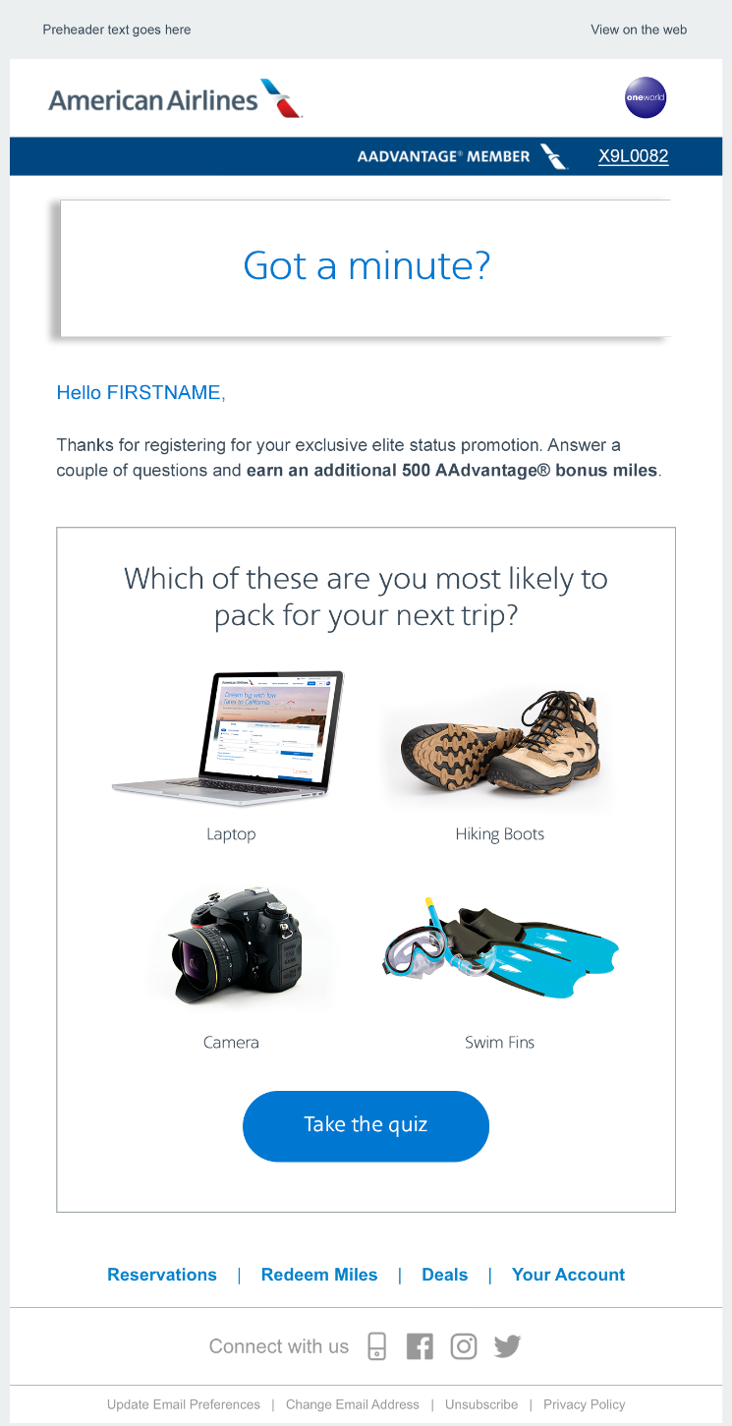
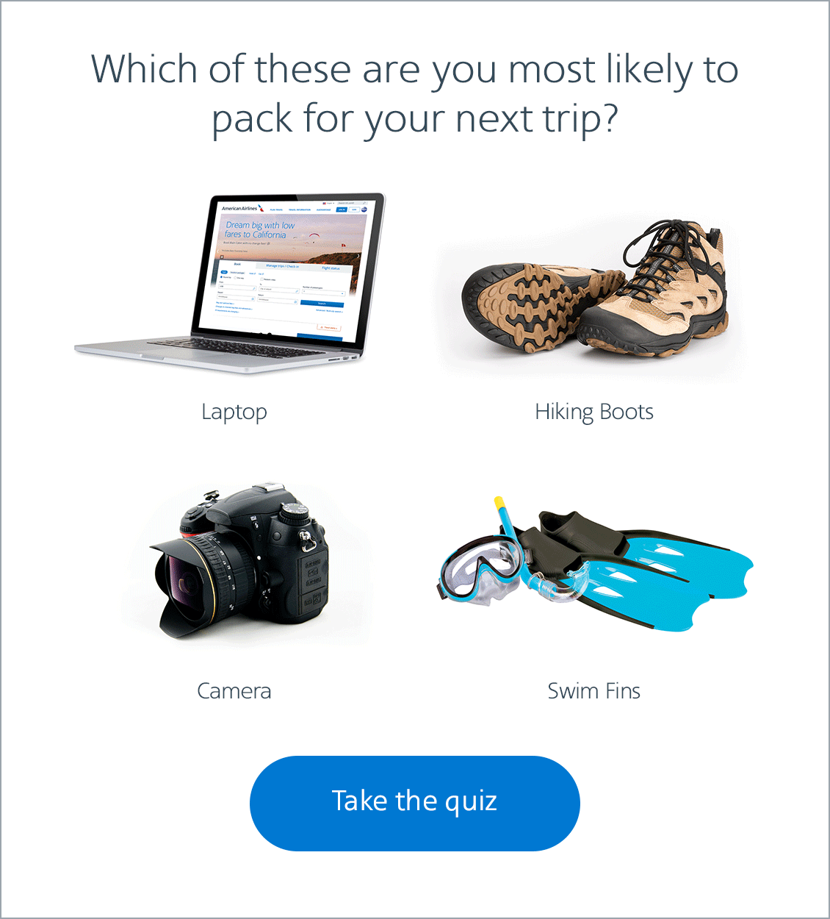
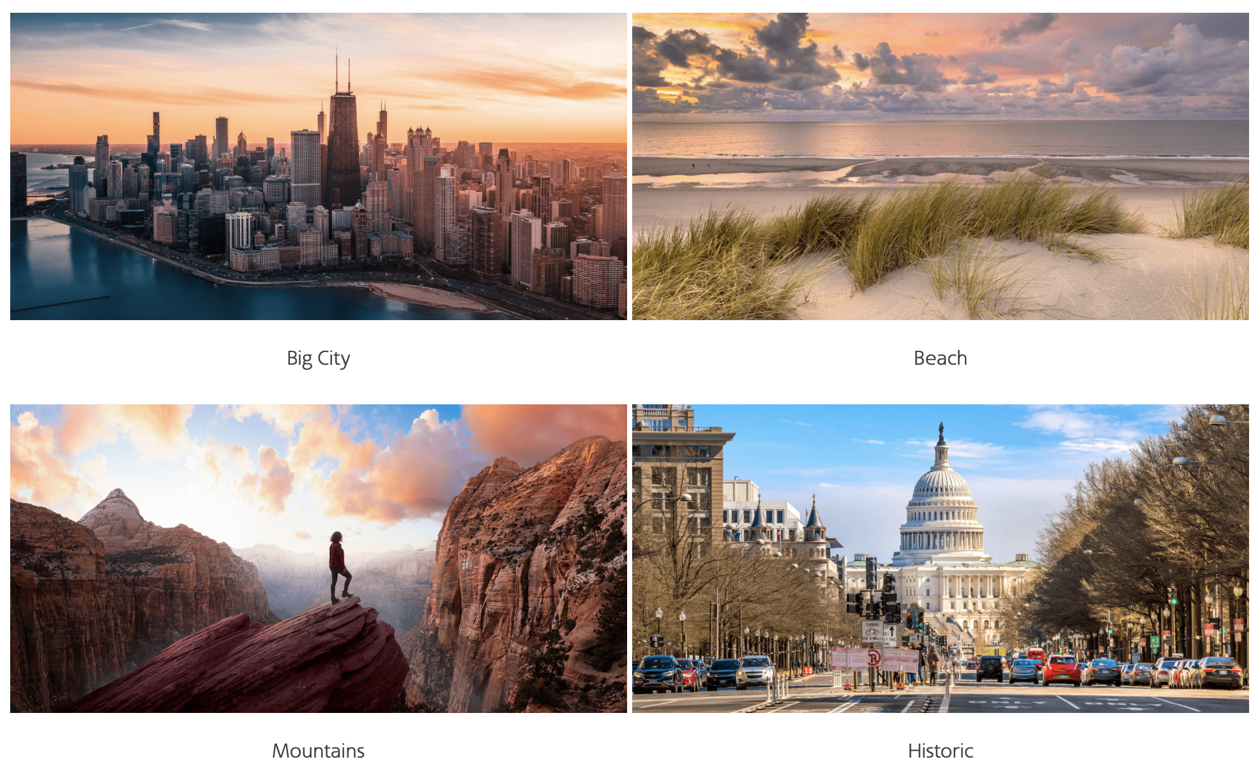
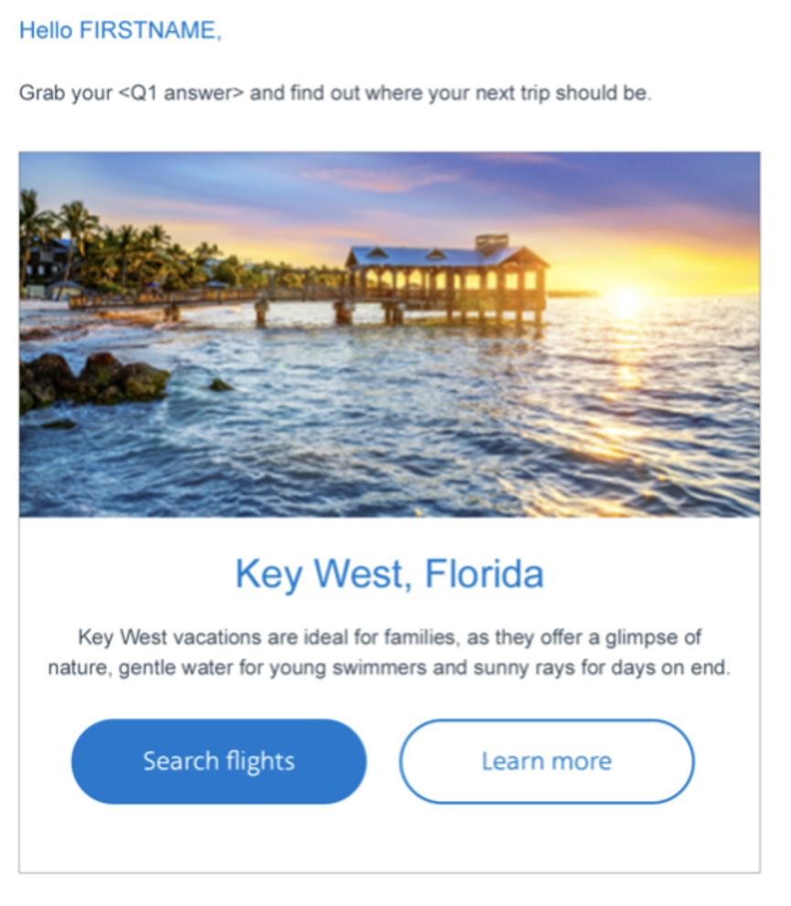
Two questions changed the world for frequent travellers
What do you plan on packing?
Which view would you rather wake up to?

Slide 13
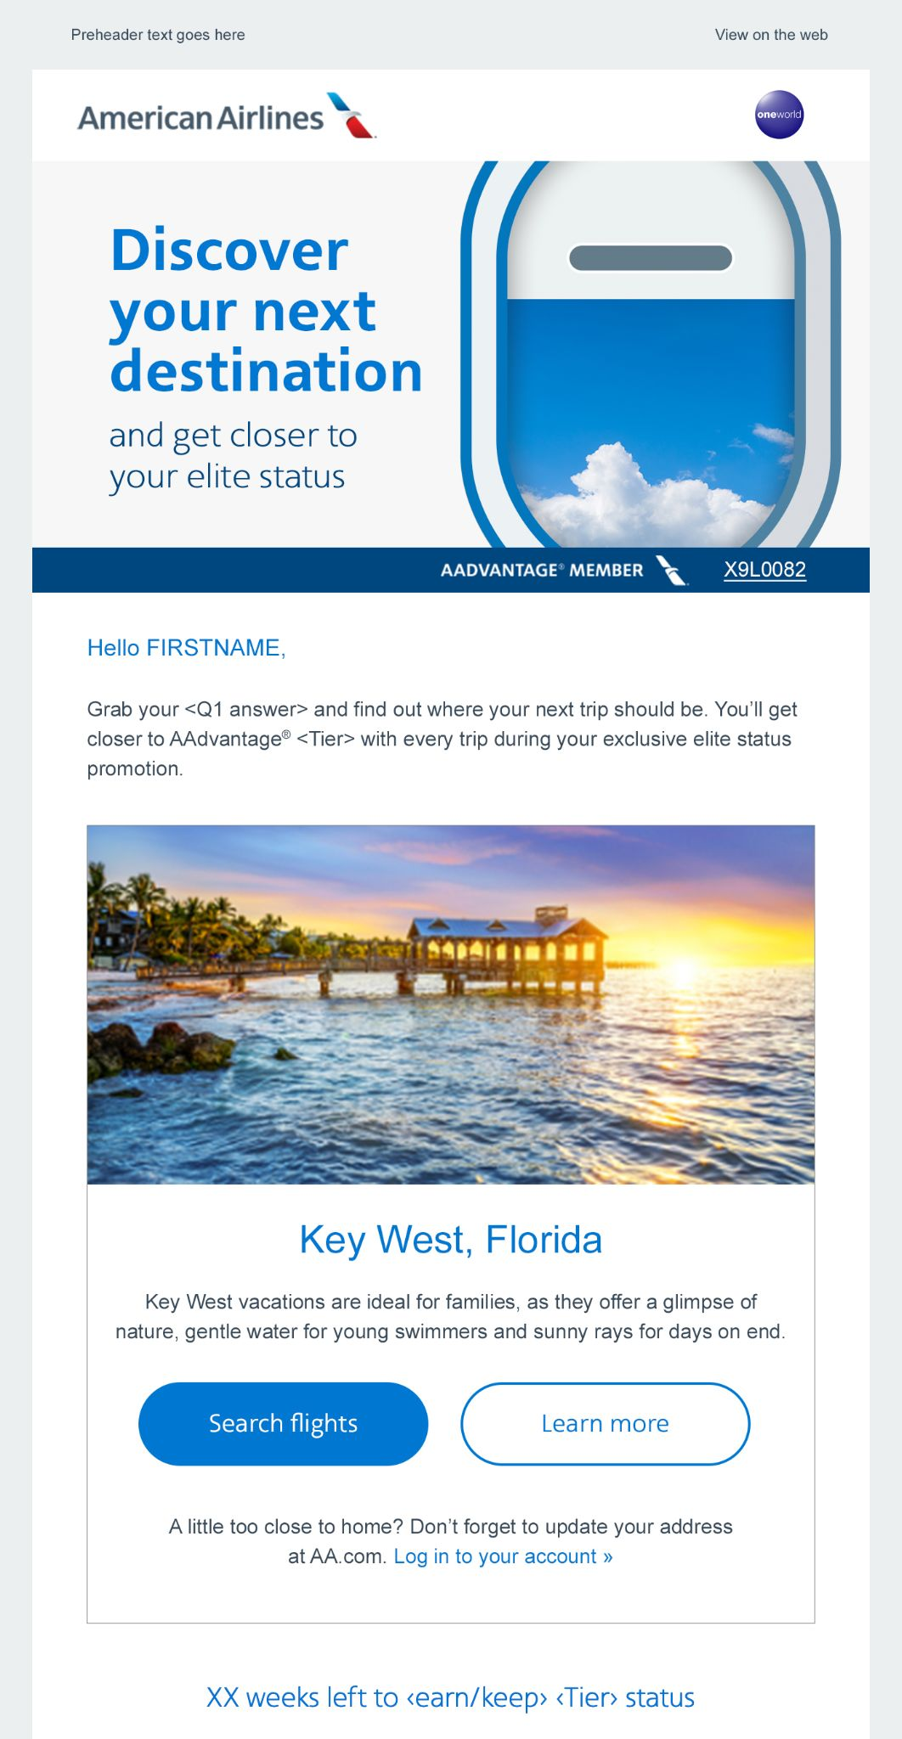
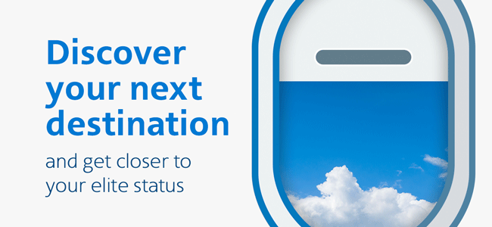
Interactivity pairs well with ZPD personalization
Interactive Email elements and incentivizing customers
with 500 miles per click further increased engagement.

Slide 14

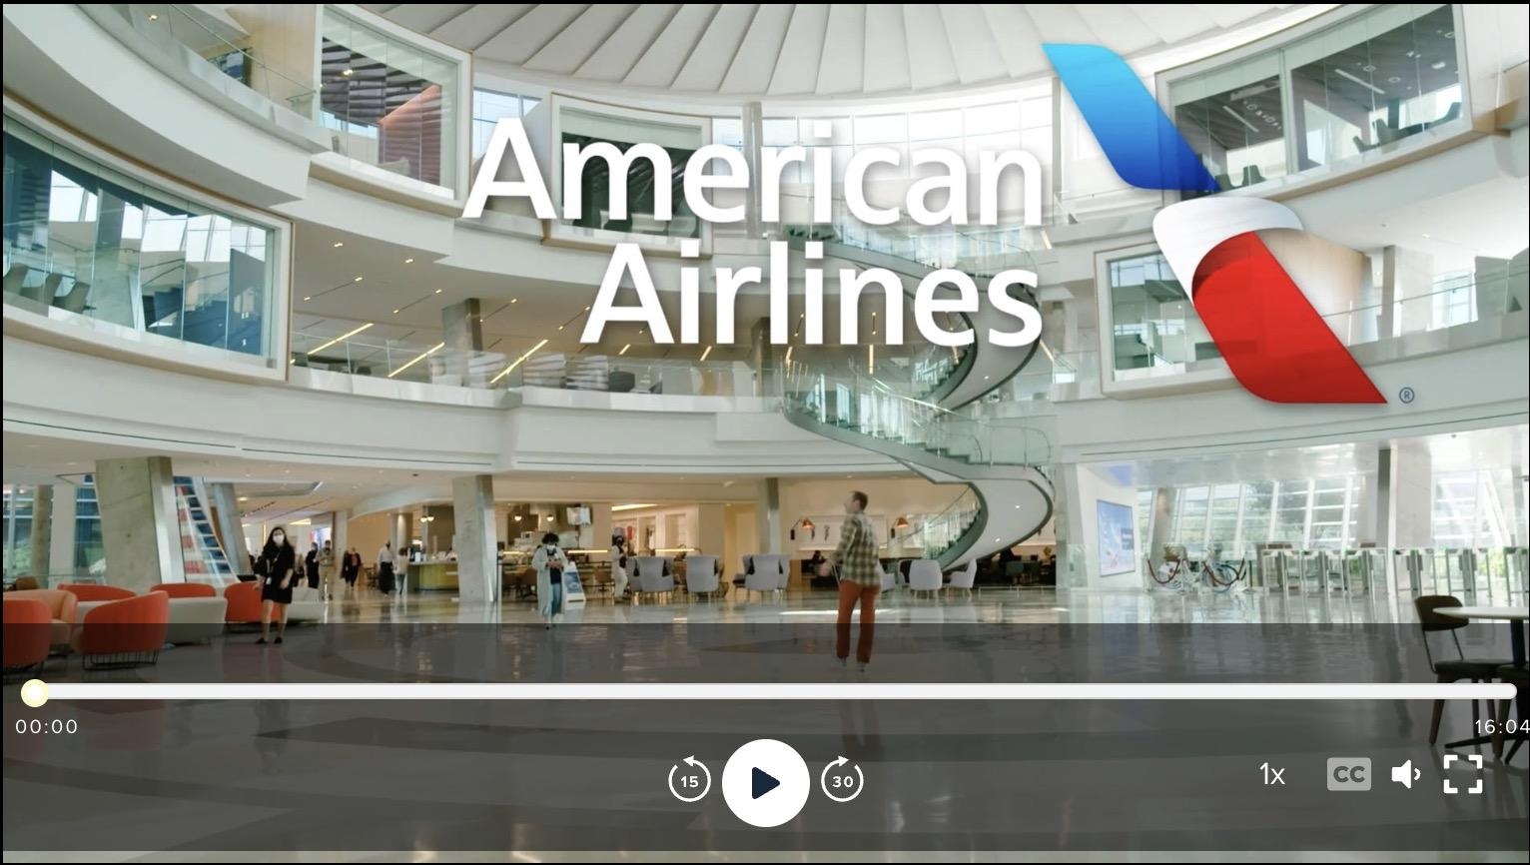
“the results were amazing. Of those who began the survey, 84% finished. The emails sent afterward had over 54% open rates. All this resulted in a lift in revenue as well—to the tune of an average increase of $20 per user.”

Slide 15
Trip Experience Optimization from a loyalty strategy perspective.
Notes:
Let’s jump in and start with the essentials.

Slide 16

TEO framework
Hi Emily. Looks like you’re close to arriving at Heathrow. Security is busy and you have less than an hour to board. Interested in securing Fast Track?
Preemptive
1
Real time
2
Disruption management
ZPD: Needs/pref, get work done, relax, vegetarian, halal.
Offer: customized vouchers and services upsell.
Yes, I don’t want to miss my flight..
Geolocation triggers
Pax is 5 miles from airport and security is congested.
Offer: Notification to buy fast track or Clear in the US.
Great. Here are some options to purchase Fast Track and skip the line
Midway
3
Post
4
CSAT touch point
ZPD: Empathetic touch point:
- No sales pitch
- Genuine how are you?
- Orient pax on TEO process (build anticipation)
Recommendation
ZPD: Next steps
- Recc survey
- Targeted Email recc
- Miles accrual to click
- Agentic AI flow
Hi Emily. Lake Tahoe - a great choice! Let’s find the best options. Any budget in mind?
Something for two adults around $3 to 3.5K total.
Great. I see you’ve been on adventure trips with us. Shall I focus on adventure options?
Travel journey
Notes:
The recovery experience is a sales opportunity

Slide 17




Post trip: Inspiration and initial engagement
Summer adventures
tailored to you.
Hi Emily. Lake Tahoe - a great choice! Let’s find the best options. Any budget in mind?
Booking Confirmation:
Lake Tahoe awaits!
Something for two adults around $3 to 3.5K total.
Great. I see you’ve been on adventure trips with us. Shall I focus on adventure options?
PLAN MY TRIP
PLAN MY TRIP
ADD EXTRAS
Recommendation email offer
AI Trip discovery & planning
Seamless conversion
This interactive approach boosts engagement significantly: Emily spends 10+ minutes chatting (versus ~1 minute on a standard webpage), and the travel brand sees a 3x higher click-through rate on their interactive CTA.

Slide 18


Post trip: Conversion & upsell opportunity
How to make the most of Lake Tahoe.
Hi Emily. As a Silver member, you get triple points on all Spa packages. Want the menu?
Updated Itinerary:
Lake Tahoe awaits!
Does the Spa offer hot stone massages?
It does. For 45 minutes or 75 minutes. I can offer a special…
EXPLORE ADD-ONS
ADD MORE
Re-engagement offer
AI-powered cross-sell
One-click frictionless purchase
By leveraging AI chat for cross-selling, the travel brand achieves a significant boost in average order value. Emily's additional purchases raised her trip's value by 20%, contributing to an average 15% revenue increase per booking across similar customer journeys.

Slide 19

Post trip: TEO and ongoing engagement
Emily, get ready for Lake Tahoe!
Hi Emily. Let me know how I can help you get the most out of your trip.
Welcome back home, Emily!
Are there any boat excursions nearby?
76º
There are many options around the lake. Near your hotel, you can rent small boats from…
ASK US ANYTHING
RATE YOUR TRIP
Pre-trip assistance
AI On-trip support
Post-trip follow-up
Overall lifecycle engagement feels consistent and personalized at every touchpoint, increasing Emily's loyalty to the travel brand. She's likely to book future vacations with them because the experience was convenient and tailored to her specific needs and interests.

Slide 20
Measurable business impact
The AI-powered approach delivers concrete business results across the customer journey. From initial engagement to post-purchase interaction, every metric shows significant improvement over traditional methods. A 20% increase in 6-month repeat purchase rate among AI-engaged customers demonstrates the long-term value of this approach.
Higher CTR
Time Engaged
Booking Value
Uptake Rate
3x
10 minutes
+20%
+30%
Interactive CTAs outperform standard email actions by 3x, offering highly-personalized offers and recommendations.
Engagement metrics are boosted significantly with the average interactive conversation lasting 10 minutes.
Average booking size can be boosted by 20% through awareness and bundling of add-ons and upgrades.
Assisted booking options with highly-personalized offers can increase conversion rates for upsell packages by 30%.

Slide 21
Wait, there is more.
Notes:
Let’s jump in and start with the essentials.

Slide 22
Loyalty is an excellent predictor of customer behavior
Having a loyalty program is a huge data advantage
We ran a test using ML to determine which data model would yield the best results for determining customer propensity to purchase. The pure loyalty model based on redemption signals far outperformed.
AdTech companion
Imagine if you could predict, within the accuracy of a week, when a customer would make a purchase. How valuable would that be for advertisers?
CDP + LOY Model
Accuracy: 93%
ROC AUC: 0.97
CDP Model
Accuracy: 95%
ROC AUC: 0.98
Better targeting
Knowing when loyalty members will likely make their next booking allows us to optimize experience matching with zero party data.
Loyalty Model - Winner
Accuracy: 96%
ROC AUC: 0.99

Slide 23
The future of service recovery and loyalty is already here
Marigold Confidential Information Enclosed
Augmented reality is here. Xreal recently launched Project Aura glasses, running Google Android XR to compete with AR glasses from Meta and Apple.
We want to deliver TEO and service recovery offers in the most immersive way possible.

Slide 24
www.meetmarigold.com

Slide 25
Appendix

Slide 26
Roger Williams
Head of Loyalty CoE
Author
Version 1.1
External distribution
Version 1.1
30 Sep - Initial draft for WAF 25 presentation.
Version 1.2
TBD.
Version 1.3
TBD.
Version 1.4
TBD.
Version 1.5
TBD.
Version 1.6
TBD.

Slide 27
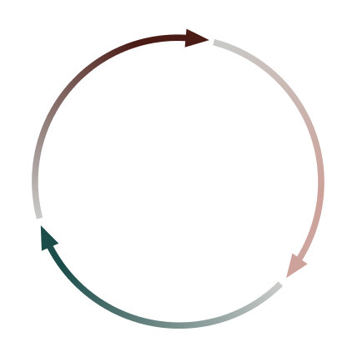

Decision intelligence loop: anticipate, act, adapt
AI that adapts, learns, and delivers better outcomes
Predictive AI
1
Anticipates outcomes with behavioral signals
and benchmarks
2
GenAI, Agentic AI
Converts insights into optimized actions
3
Adaptive Experimentation
Refines tactics dynamically, even with incomplete data

Slide 28

Smarter customer lifecycles powered by conversations and context
Context-driven dialog
Right timing and bigger flow of ZPD
2
1
Start the conversation
Email marketing
3
Marigold Confidential Information Enclosed
Confident conversion
Clear, AI-guidance, one-click purchases
5
4
Deeper personalization
Profile enrichment
Preference collection
Goldmine of data shared in conversation

