Slide 1


Shifting Care from Hospital to Community with Ready-to-Administer & Ready-to-Use Medicines
HSJ Forum, 16th October 2025
Notes:
Good morning everyone, and thank you for joining us today.
I’m Sam Hodgson, the Ready-to-Use Product Manager at B. Braun and I’m joined by my colleague Matt Greening who is a Business Development Manager specialising in Aseptic Transformation.
Today, we’ll be exploring how ready-to-administer and ready-to-use medicines can help shift more care safely from hospital into the community - improving patient outcomes, easing pressure on acute services, and creating more sustainable models of care.
During today’s session, we’d really value your input. If you could take a moment to scan the QR code on screen, it’ll take you straight to our Slido where you can share your thoughts and respond to a few quick polls throughout the presentation.

Slide 2




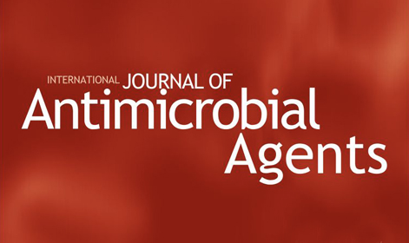

Shifting Care from Hospital to Community
The NHS must shift to homecare to relieve hospitals and improve long-term patient outcomes¹.
Community care has a 92% success rate with low adverse events (6.4%) and just 3.1% hospital readmissions³.
Up to 1 in 3 patients face delays due to homecare availability²
Community care costs 20% to 50% of traditional inpatient care⁴.
Notes:
So, let’s start with the big picture.
The new NHS 10-year plan highlighted the immense pressure on inpatient beds, and made it clear that shifting care into the community is no longer optional - it’s essential.
But access is still a challenge. Up to one in three patients face discharge delays due to limited homecare availability.
So, the opportunity is clear - but we need to scale access safely and sustainably.

Slide 3


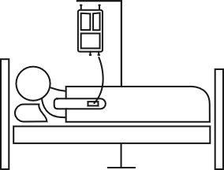


Current Pathways – Antimicrobial Therapy
Patient stays in hospital
Patient travels to an infusion centre
Access to OPAT services varies both geographically and by patient population.
Less equitable access for housebound patients, children and young people.
Notes:
Let’s look at how things currently work for antimicrobial therapy.
Right now, patients often stay in hospital, or they travel back and forth to infusion centres, which isn’t ideal - especially for the elderly, those living in rural areas, or patients with disabilities or chronic illnesses.
This is where ready-to-administer and ready-to-use medicines can make a real difference - by enabling care closer to home.

Slide 4


Slido
Do you currently use ready-to-use or ready-to-administer medicines in community settings to provide outpatient antimicrobial therapy?
Notes:
Before we move on, I’d like to get your input – If I could ask you to please take a moment to respond via Slido to the question you can see on screen here.
Do you currently use ready-to-administer or ready-to-use medicines in community settings for outpatient antimicrobial therapy?

Slide 5
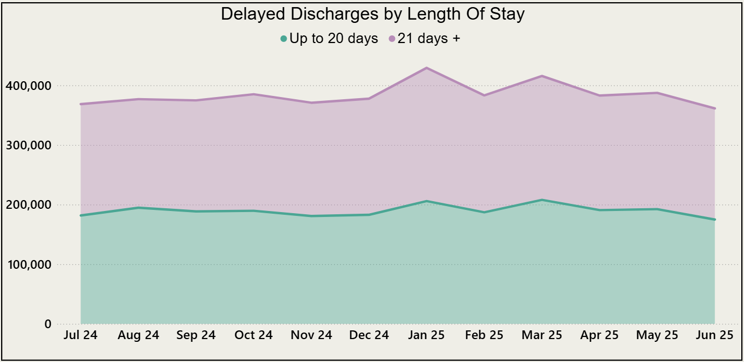

The Scale of the Problem: A Growing Crisis
4.6 Million bed days lost over the last 12 months​
(equivalent to £1.5 billion)^{2,5}​
Notes:
We all recognise the scale of this challenge.
Over the last year alone, we’ve lost 4.6 million bed days due to delayed discharges - that’s equivalent to £1.5 billion.
That’s capacity that could be used for elective recovery, urgent care, or reducing waiting lists.
By expanding community care access, we can enable recovery at home with excellent outcomes.

Slide 6





Enabling Recovery at Home:
Expanding Community Care Access
Clinical Outcome (cured or improved)
92%³​
Adverse Event Rate
6.4%, with only 3.1% requiring hospital readmission³.​
Mortality Rate
0.2%.
Reduces risks of hospital-acquired infections (HCAIs), deconditioning, venous thromboembolism, psychological morbidity³.
BSAC National Outcomes Registry System (NORS) - based on 57 organizations, covering 27,841 patient episodes and 442,280 OPAT treatment days.
Notes:
Clinically, it’s safe—92% success rate, 6.4% adverse events, and just 3.1% readmissions. Mortality is incredibly low at 0.2%.
But beyond the numbers, it’s also important to consider patient wellbeing.
Patients can maintain routines, stay connected with family, and avoid the psychological stress of hospitalisation.
At this point, I’m going to hand over to my colleague Matt, who’ll take us through the next section focusing on how we can support scalable community care models.

Slide 7
Slido
What are the key enablers your trust needs to scale community care safely and sustainably?

Slide 8

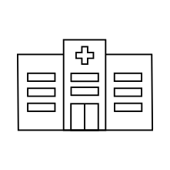
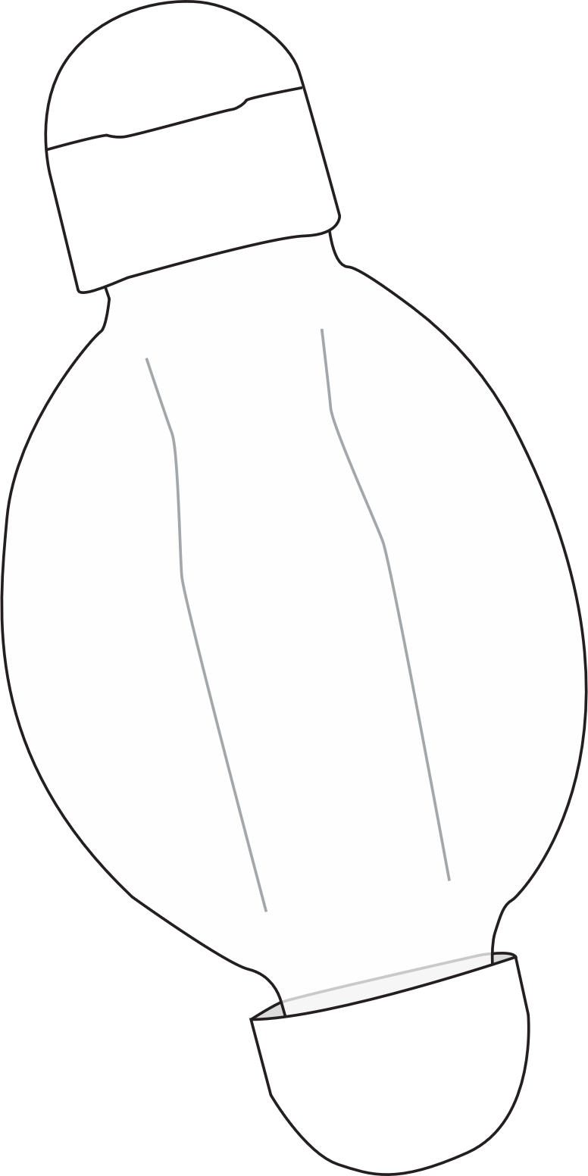
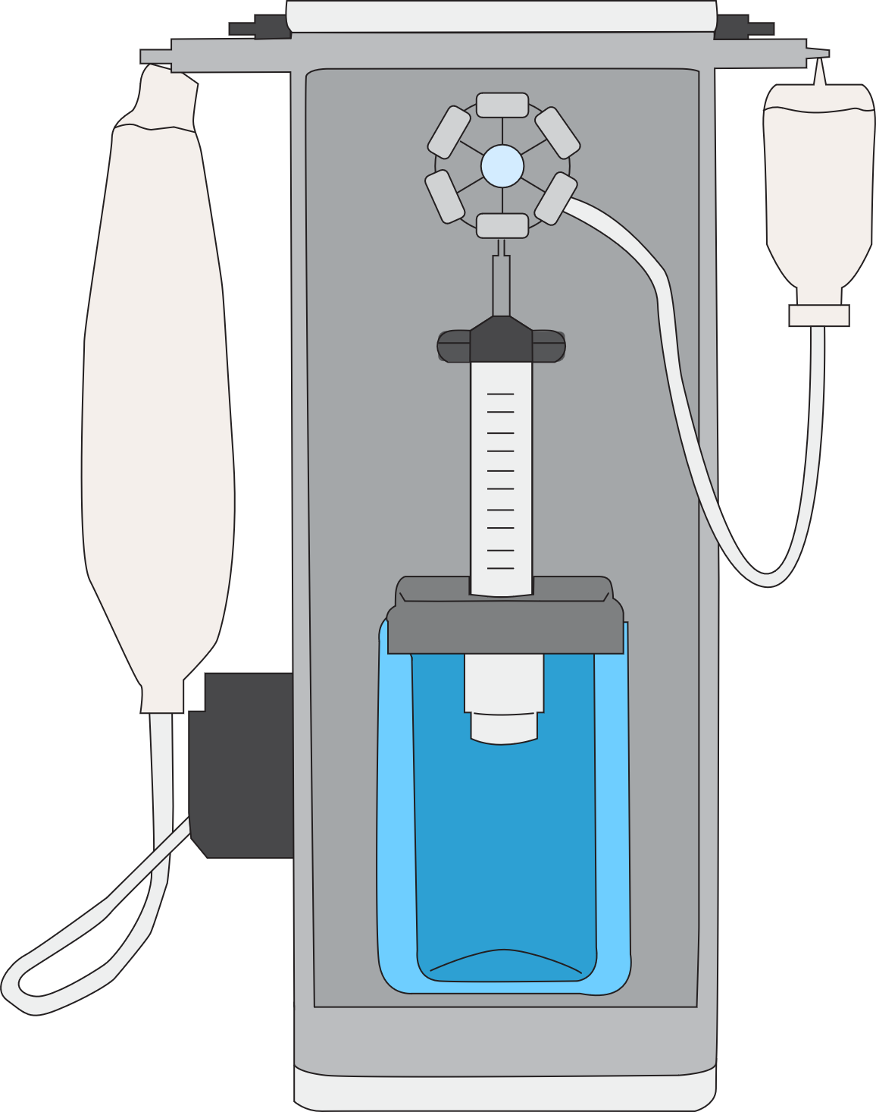
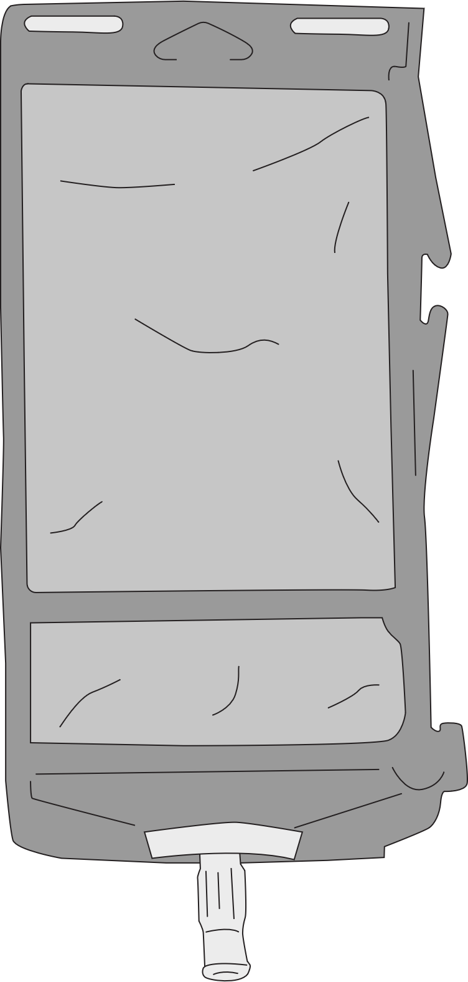

New Pathways Ready-to-Administer/Ready-to-Use
Patient receives antibiotics at home via nurse visit
Patient self administers at home
Notes:
Let’s explore how new pathways are enabling scalable, patient-centred OPAT delivery. Traditionally, patients either remain in hospital or travel to infusion centres. But with ready-to-administer and ready-to-use formats, there is an opportunity now to enable care at home—either via nurse visits or self-administration.
The first model involves the integration of semi-automated in-house compounding using the Gri-Fill system allows aseptic preparation of elastomeric devices on-site, enabling same-day discharge even in rural or underserved areas, by empowering organisations to take compounding into their own hands.
The second model is structured around initiation of IV therapy in hospital, covering days 0-2, while outsourced elastomeric devices are ordered to enable care in the patient’s home from day 3 onwards, these devices have extended shelf lives allowing inventory to be maintained without wastage for the full course of treatment.
The final model enables immediate discharge using ready-to-use products to streamline preparation by nursing staff in, or near to, the patients home. These RTU products have significantly extended shelf lives, enabling organisations to keep them on hand ready to deploy.
These models also support self-administration pathways, empowering patients to manage their therapy at home with nurse-led training. This is especially impactful in rural areas, where daily travel to hospital is a major barrier.
These innovations reduce inpatient burden, improve patient flow, and expand access to OPAT—without requiring additional workforce. It’s a modular, scalable solution that supports NHS England’s shift from hospital to community care.

Slide 9
Worked Example
Example: For a Trust serving 500,000 people:
Estimated OPAT Patients
Bed Days Avoided
Cost Savings
500
(based on 100 patients per 100,000 population)⁶.
500 patients × 28
(beds days avoided on average per patient)⁶
= 14,000
beds days avoided per annum
14,000 × £317 (average cost of an inpatient bed day⁵)
= £4,438,000 saving per annum
Notes:
To illustrate the impact, let’s take a Trust serving 500,000 people.
Based on national OPAT estimates, around 500 patients annually could be eligible for outpatient IV therapy.
If each patient avoids 28 inpatient bed days, that’s 14,000 bed days saved. At an average cost of £317 per bed day, this equates to over £4.4 million in annual savings.

Slide 10
Worked Example
Operational Example: 5.5-hour working day with Gri-Fill system:
20
devices filled per hour⁷
110
total devices filled
(20 x 5.5 hours)
Gri-Fill Rate
30
minutes required per device⁸
Manual Filling Rate
11
total devices filled
(330 mins ÷ 30 mins)
Efficiency Gain: Gri-Fill enables 10x more devices to be filled in the same operational timeframe
Notes:
Operational efficiency is key to scaling OPAT, so let’s compare manual filling with the semi-automated compounding system, ideal for organisations with clean room space.
Manually, a nurse can fill around 11 devices in a 5.5-hour shift. With the system in place, that jumps to 110 devices—a 10-fold increase in productivity.
This isn’t just about speed. The system reduces contamination risk through closed-system compounding and frees up nursing time for complex care. It also supports same-day discharge by enabling in-house preparation, removing reliance on external suppliers.
It’s a game-changer for trusts looking to expand OPAT without increasing workforce burden.

Slide 11

How can you help?
Contacts us to find out how we can help model and strengthen your out of hospital model.

Slide 12
References
Department of Health and Social Care & Prime Minister's Office. (2025) Fit for the future: 10 Year Health Plan for England – executive summary. London: GOV.UK. Available at: https://www.gov.uk/government/publications/10-year-health-plan-for-england-fit-for-the-future/fit-for-the-future-10-year-health-plan-for-england-executive-summary (Accessed: 2 October 2025).
Nuffield Trust (2025) Delayed discharges from hospital. Available at: https://www.nuffieldtrust.org.uk/resource/delayed-discharges-from-hospital (Accessed: 7 October 2025).
British Society for Antimicrobial Chemotherapy (BSAC). (2017) National Outcomes Registry System (NORS) – Terms andConditions. Available at: https://bsac.org.uk/wp-content/uploads/2017/12/BSAC-NORS-TCs.pdf (Accessed: 2 October 2025).
Gilchrist, M., Wade, P., Ashiru-Oredope, D., Avornyo, P., Beech, E., Freeman, R., et al. (2021) ‘Outpatient parenteral antimicrobialtherapy (OPAT) in the UK: findings from the BSAC National Outcomes Registry’, International Journal of Antimicrobial Agents, 58(5), p.106416. https://doi.org/10.1016/j.ijantimicag.2021.106416 (Accessed: 2 October 2025).
Scottish Health Technologies Group (SHTG). (2021) Cost calculator for UK outpatient parenteral antimicrobial therapy (OPAT) services. Available at: https://shtg.scot/our-advice/cost-calculator-for-uk-outpatient-parenteral-antimicrobial-therapy-opat-services/ (Accessed: 2 October 2025).
NHS England (2025) Business case template for developing or expanding outpatient parenteral antimicrobial therapy (OPAT) services. Available at: https://www.england.nhs.uk/long-read/business-case-template-for-developing-or-expanding-outpatient-parenteral-antimicrobial-therapy-opat-services/ (Accessed: 7 October 2025).

