Slide 1
Our Approach to Locality and Neighbourhood Health and Care
26th June 2025

Slide 2
Principles and Approach
Prevention and Early Intervention
  Public Health – Area profiles, health inequalities and wider determinants.
  Our fantastic Birmingham Voluntary and Community Sector - NNS
Technology and Innovation
  Digital Customer Journey
  Predicative analytics
Personalised Care
  3 Conversations Social Work Model – Strength based approach.
Workforce development
  Equipping our workforce to deliver the best outcomes for the Localities and Neighbourhoods they serve.
Integrated Care
  Colocation
  Shared care record and single systems
  Iterative change – Progress not perfection

Slide 3
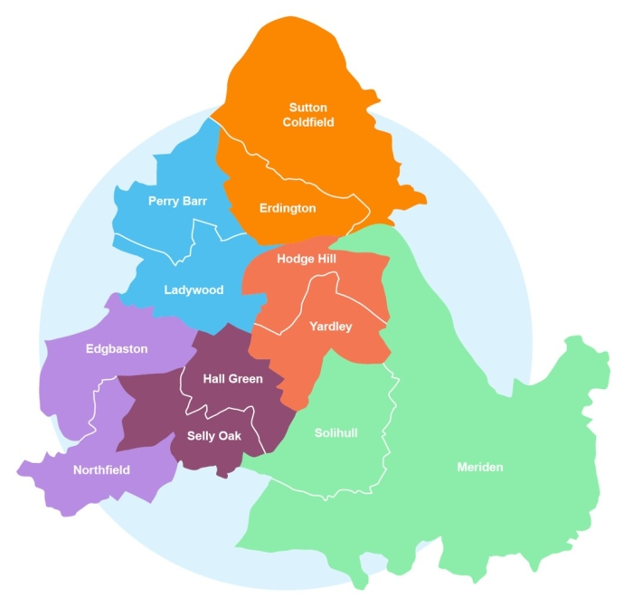
Places, Localities and Neighbourhoods
Places
2 local authorities – Birmingham and Solihull
Localities
Population of c. 300,000 people;
Locality Partnerships
Community and voluntary sector partners
Neighbourhoods
Population of c. 50,000 people
Aiming to be geographically coherent and aligned to Primary Care Networks
Integrated teams with colleagues co-located across 2-3 neighbourhoods.

Slide 4
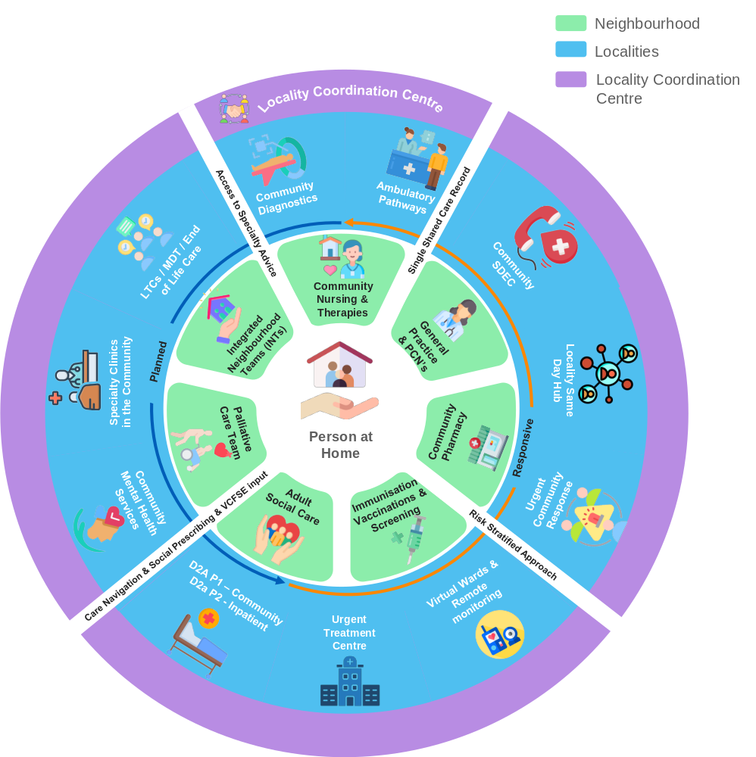
Our Neighbourhood Health Model
Developed over c. 18 months of testing and learning.
Will continue to evolve.
Aims to keep people healthy and independent at home
Integrated neighbourhood teams: local MDTs expanding to wider team
Locality hubs: care co-ordination and support and specialist expertise.
Practical things that make this easier: co-location, shared records, organisational development, co-ordination.

Slide 5
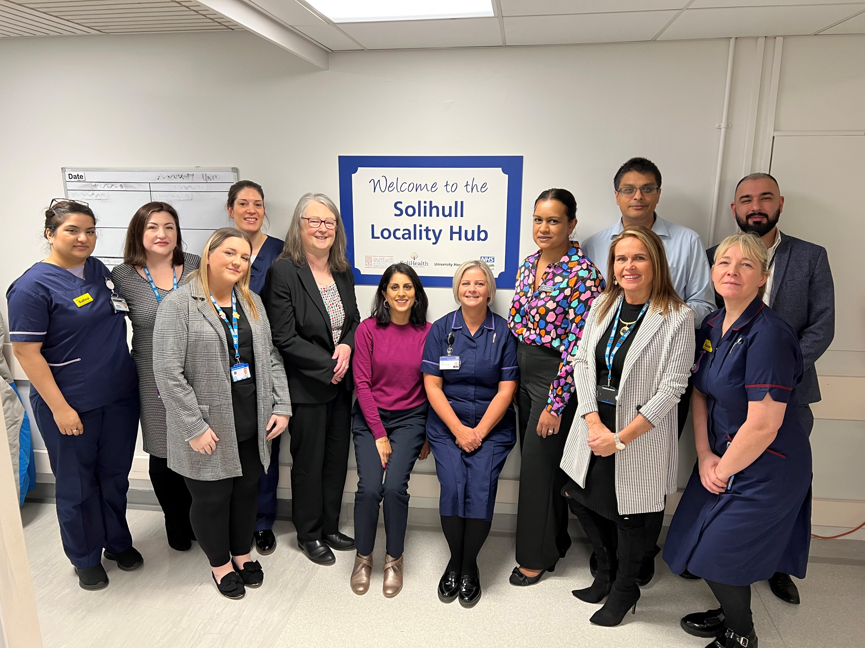
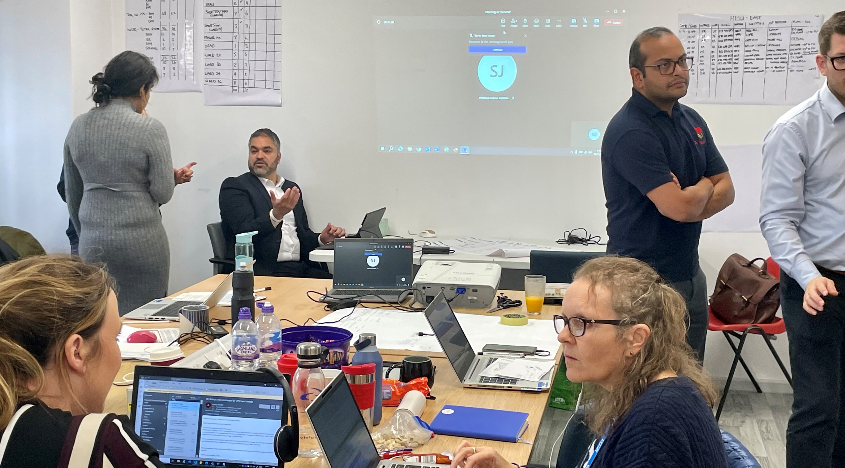
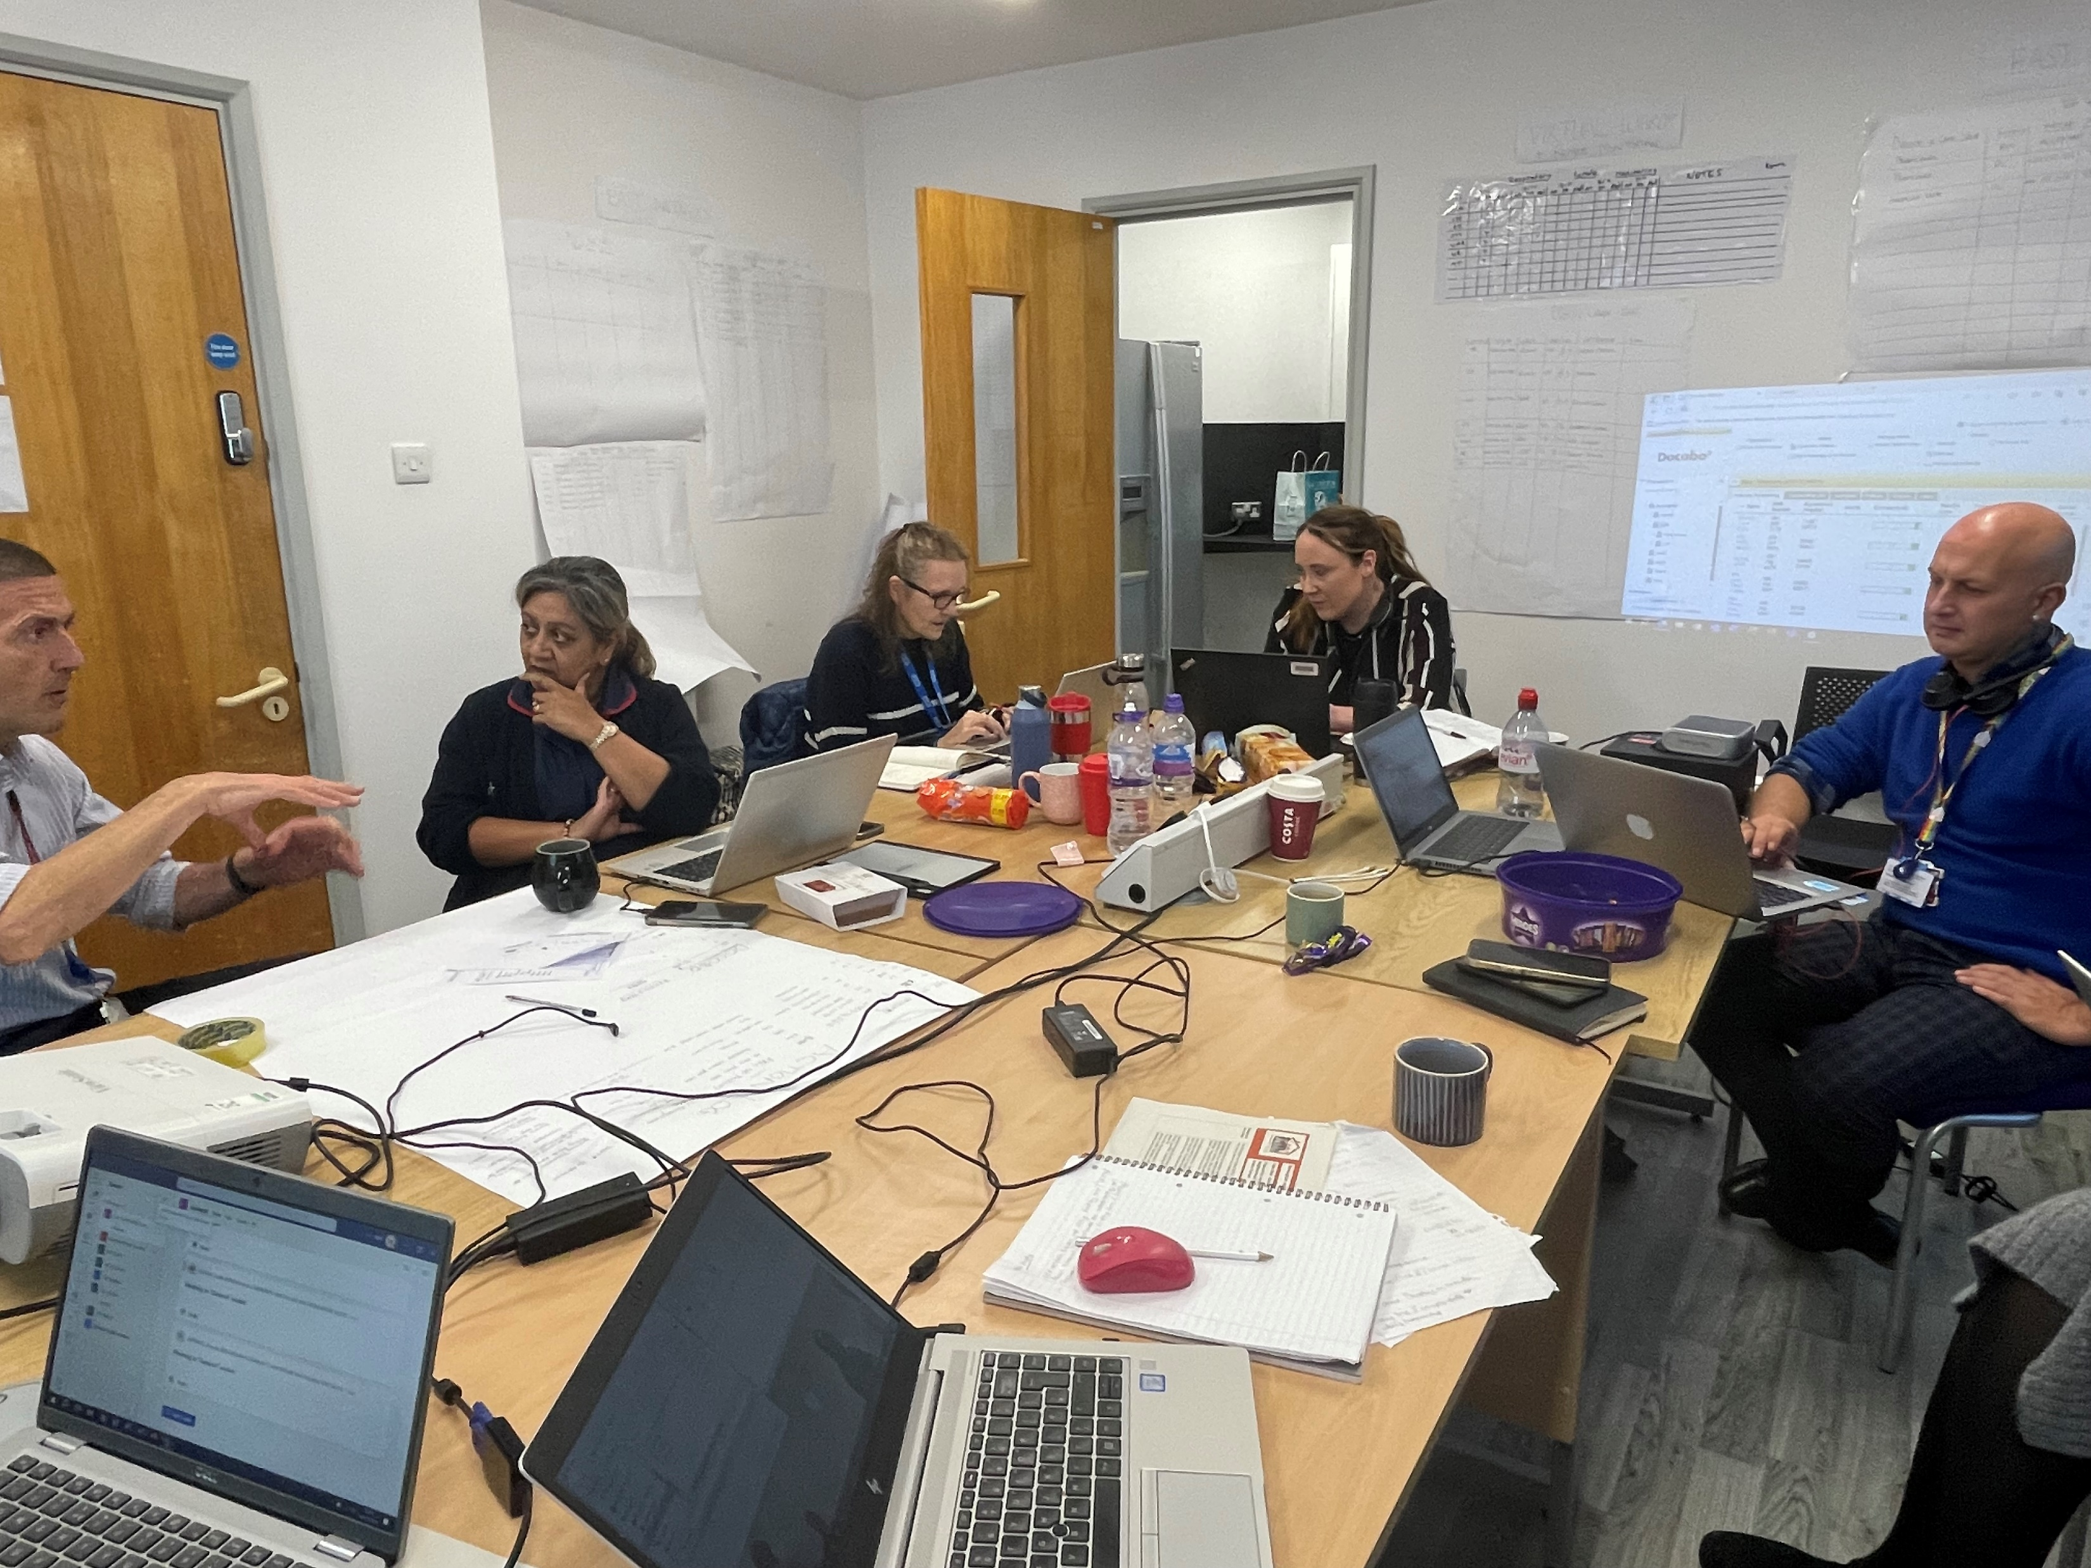
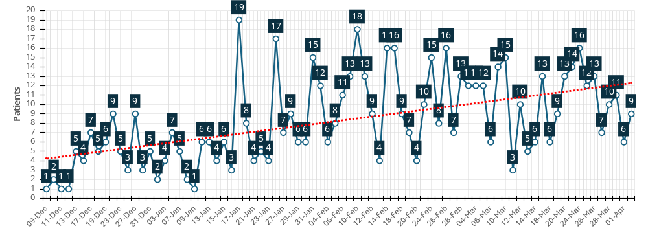
Locality & Neighbourhood working – the Impact on Citizens & Workforce
Integrated Neighbourhood Teams
GP attendances – down 31%
A&E attendances – down 20%
Inpatient spells – down 21%
Outpatient spells – down 25%
Community contacts – down 15%
Mental health – up 47%
Social care packages – down 77%
Respiratory SDEC / ARI Hub
“Sense of ownership and responsibility for heath and care for all patients in the East, its rewarding being able to put the right support around people”
>500 patients seen in a Community setting helping avoid hospital presentation
Increasing ambulance presentations conveyed to Hub , with 8-minute handover time
“Great to have the data that means we can identify when local high intensity service users need a different approach and can make that happen”
Notes:
“Levels of clinical and ops collaboration means all the expert knowledge you need is available”
“Loved seeing the collaborative working – not at a distance but having people together in real time”
“I feel like I’ve really got to know the residents of the East”

