Slide 1
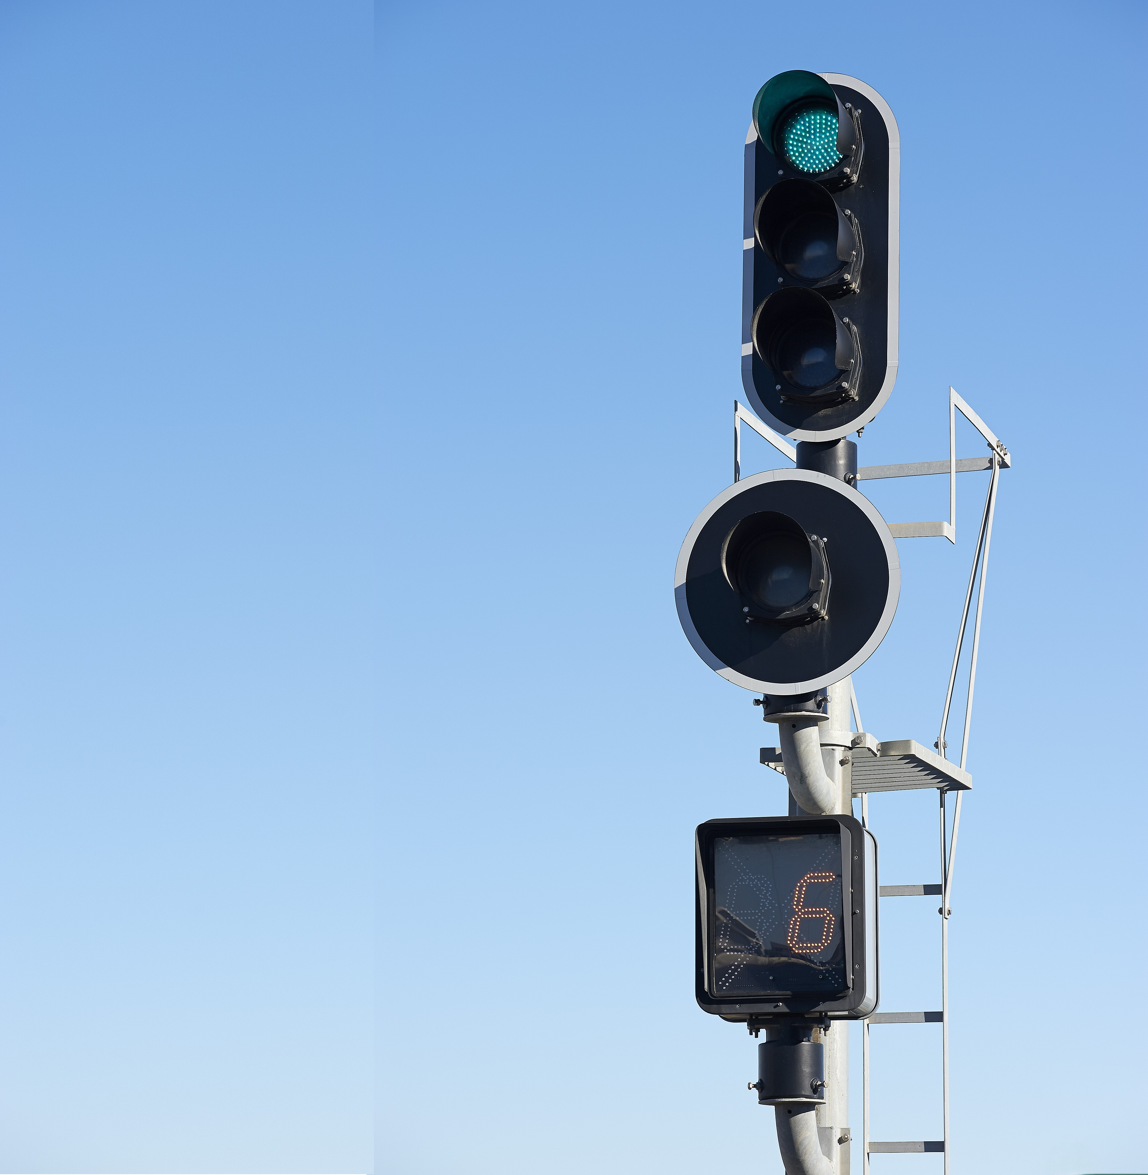


EwOC LS
Wayside Object Controller for LED Signals
Technology to boost rail Safety

Slide 2



Context: Who we are
Founded in 1977 in Barcelona, ELECTRANS has become a trusted name in railway signalling.
Global supplier in the railway signalling industry.
Pioneers in Spain in level crossing systems and LED signals technology.
Complete lifecycle control: Ensuring compatibility with technological advances and minimizing the impact of obsolescence.
Agile and customer-focused: Quick, flexible responses and high adaptability, including the development of customized solutions tailored to specific client requirements.
ADAPTATION
SUSTAINABILITY
INNOVATION
CUSTOMER DRIVEN
COMMITMENT
Technology To Boost Rail Safety
Notes:
2

Slide 3
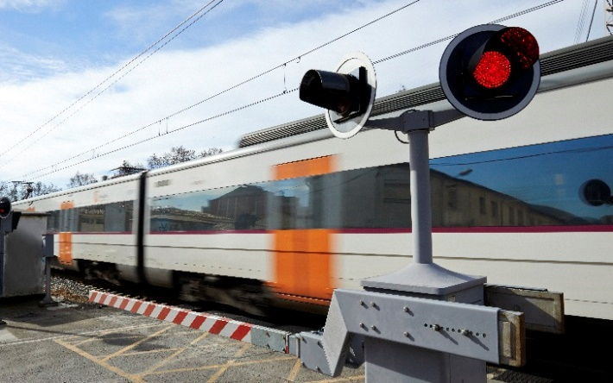
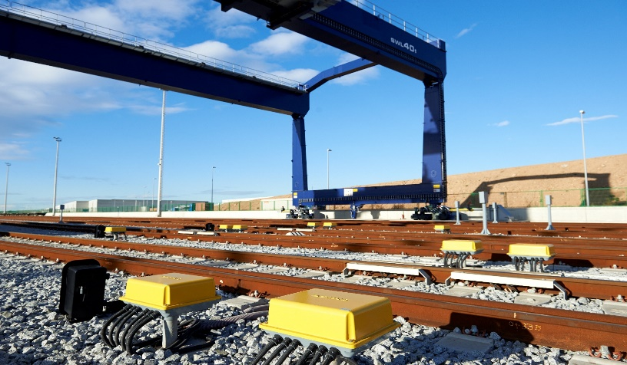
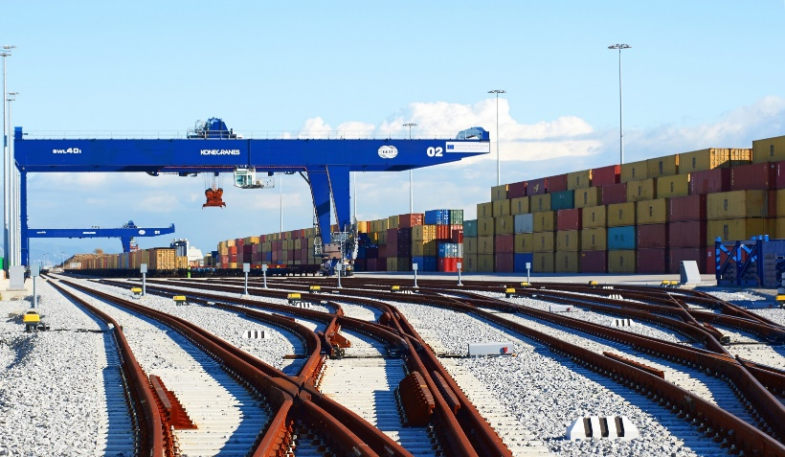
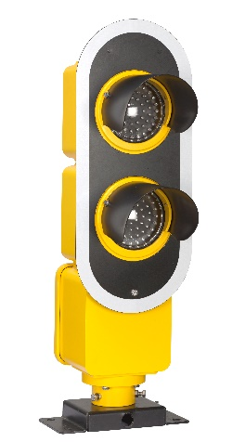
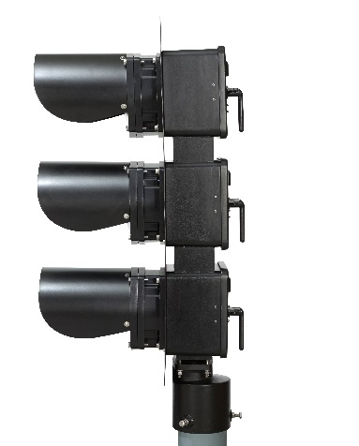
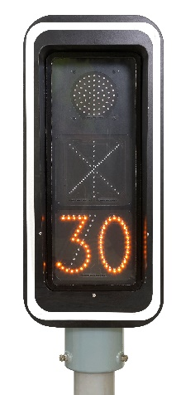
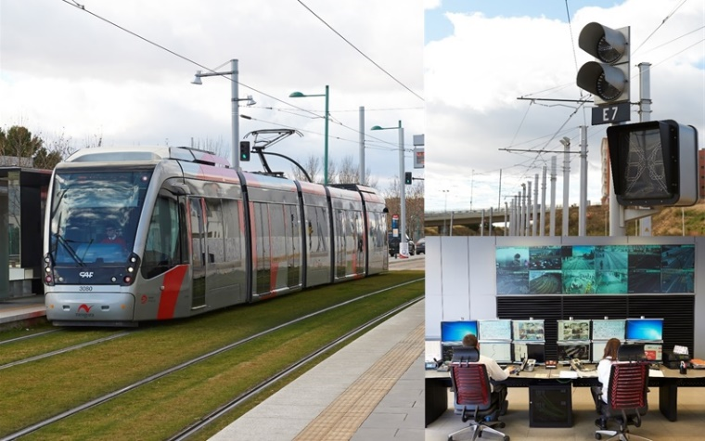
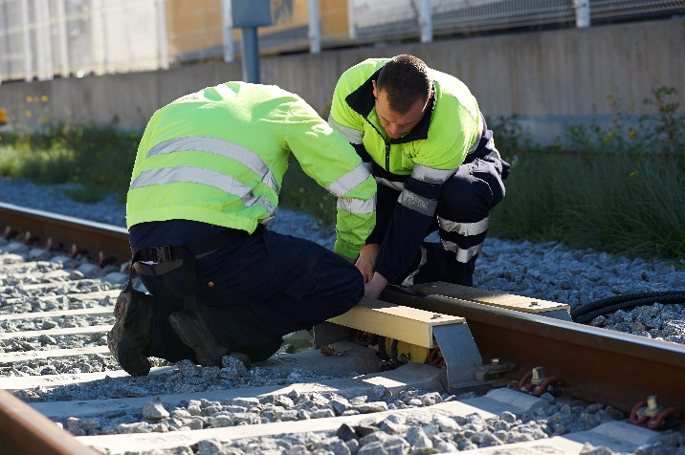

Solutions & Services
Level crossing protection solutions
Axle Counters
Rail signalling systems
Signals and Lights
LRT signalling systems
Aftersales
Technology To Boost Rail Safety

Slide 4
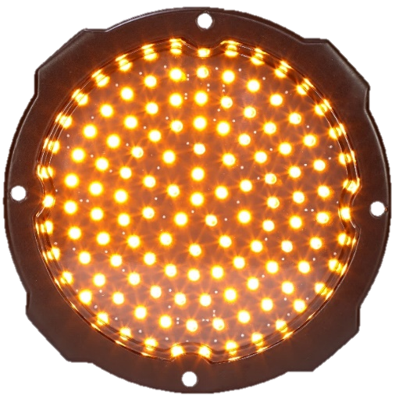
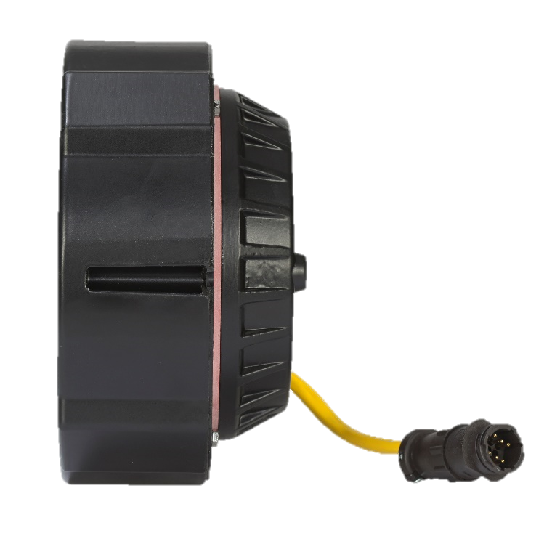
Signals & Lights
In 2005, ELECTRANS pioneered innovation by introducing the LD-160-AV a SIL-4 certified LED signal light for high-speed rail lines in Spain.
Global impact: More than 35,000 units supplied worldwide, ensuring reliability and safety across diverse railway networks.
Strong market presence: Our solutions are widely implemented across metro systems in major cities and key railway lines.
Metros:
Barcelona, Madrid, Bilbao, Paris, Milan, Singapore, Riyadh, Sydney, Medellín, Bogotá, Lille, Lyon, Torino, Ho Chi Minh, Bucharest, Sao Paolo, Argel, Mumbai, Lima, Quito, Santiago de Chile.
Railway Lines:
Spain, Brazil, Mexico, Saudi Arabia, Romania, Turkey, Azerbaijan, Egypt, Venezuela,
Technology To Boost Rail Safety
Notes:
4

Slide 5
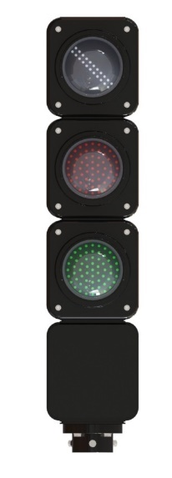
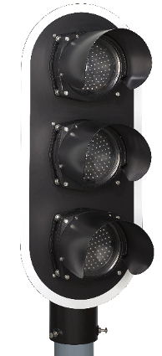
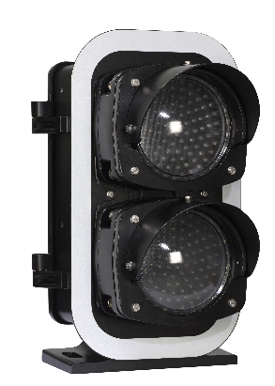
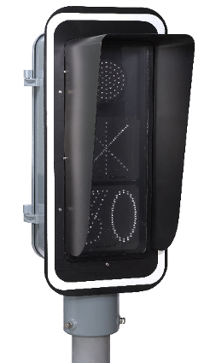
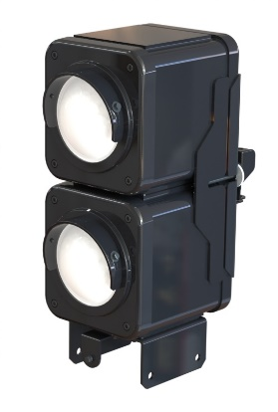
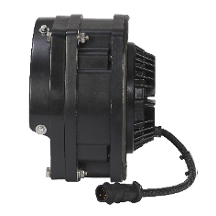
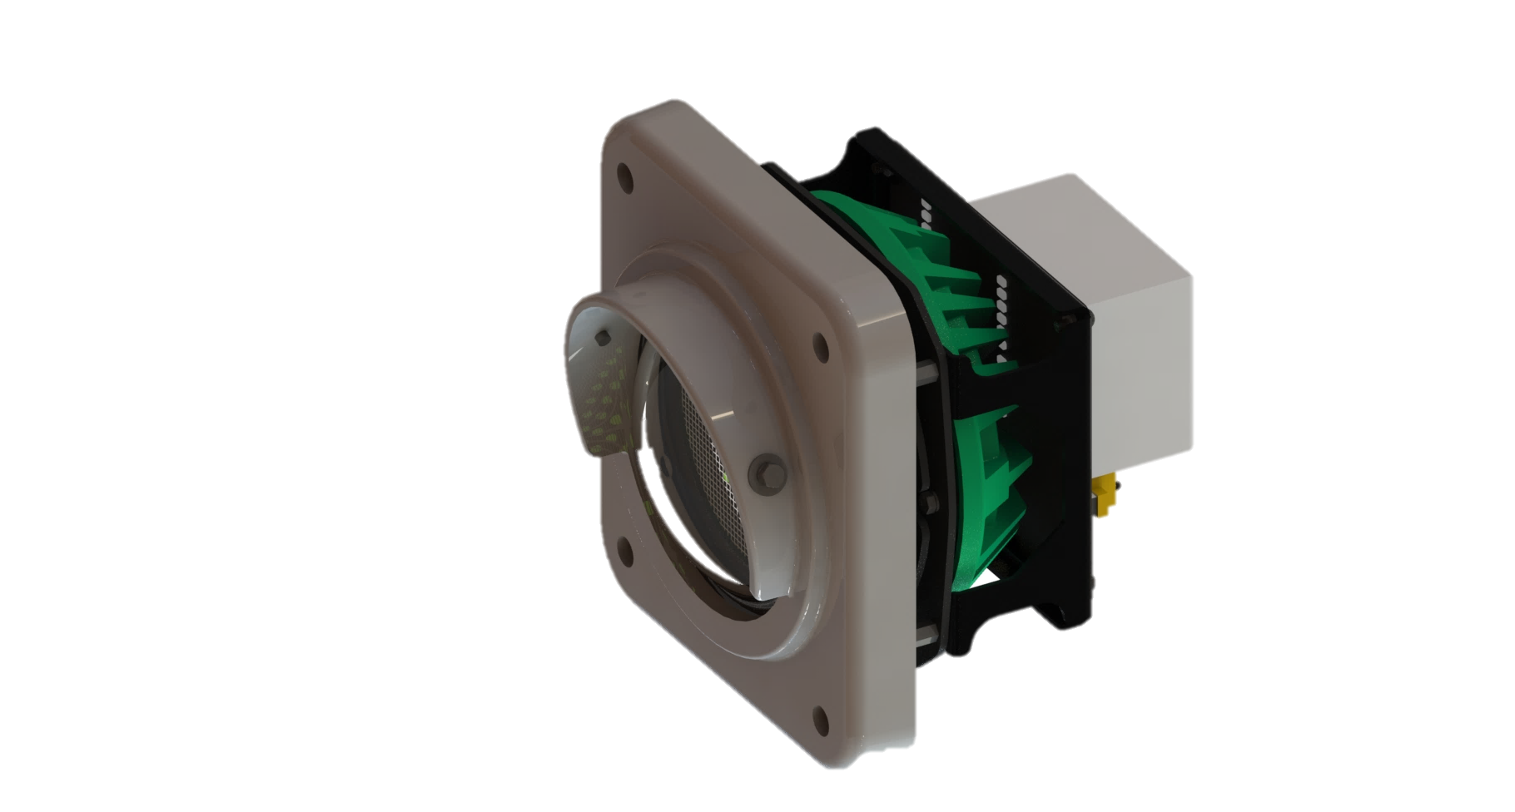
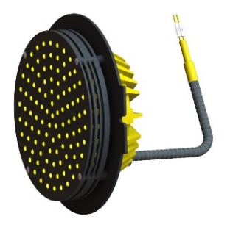
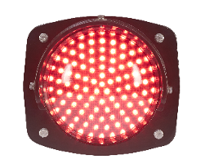
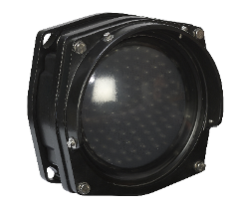
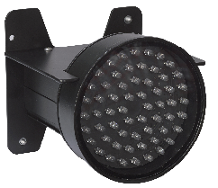
Signals & Lights
AL-200 (High signal) | FC-140 (Dwarf signal) | FOVAR/LEDVAR | MD120/MD120S
LED LIGHTS
Technology To Boost Rail Safety

Slide 6

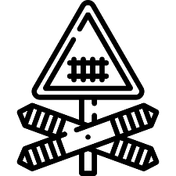
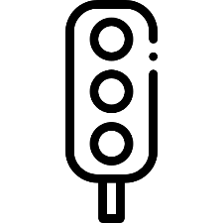
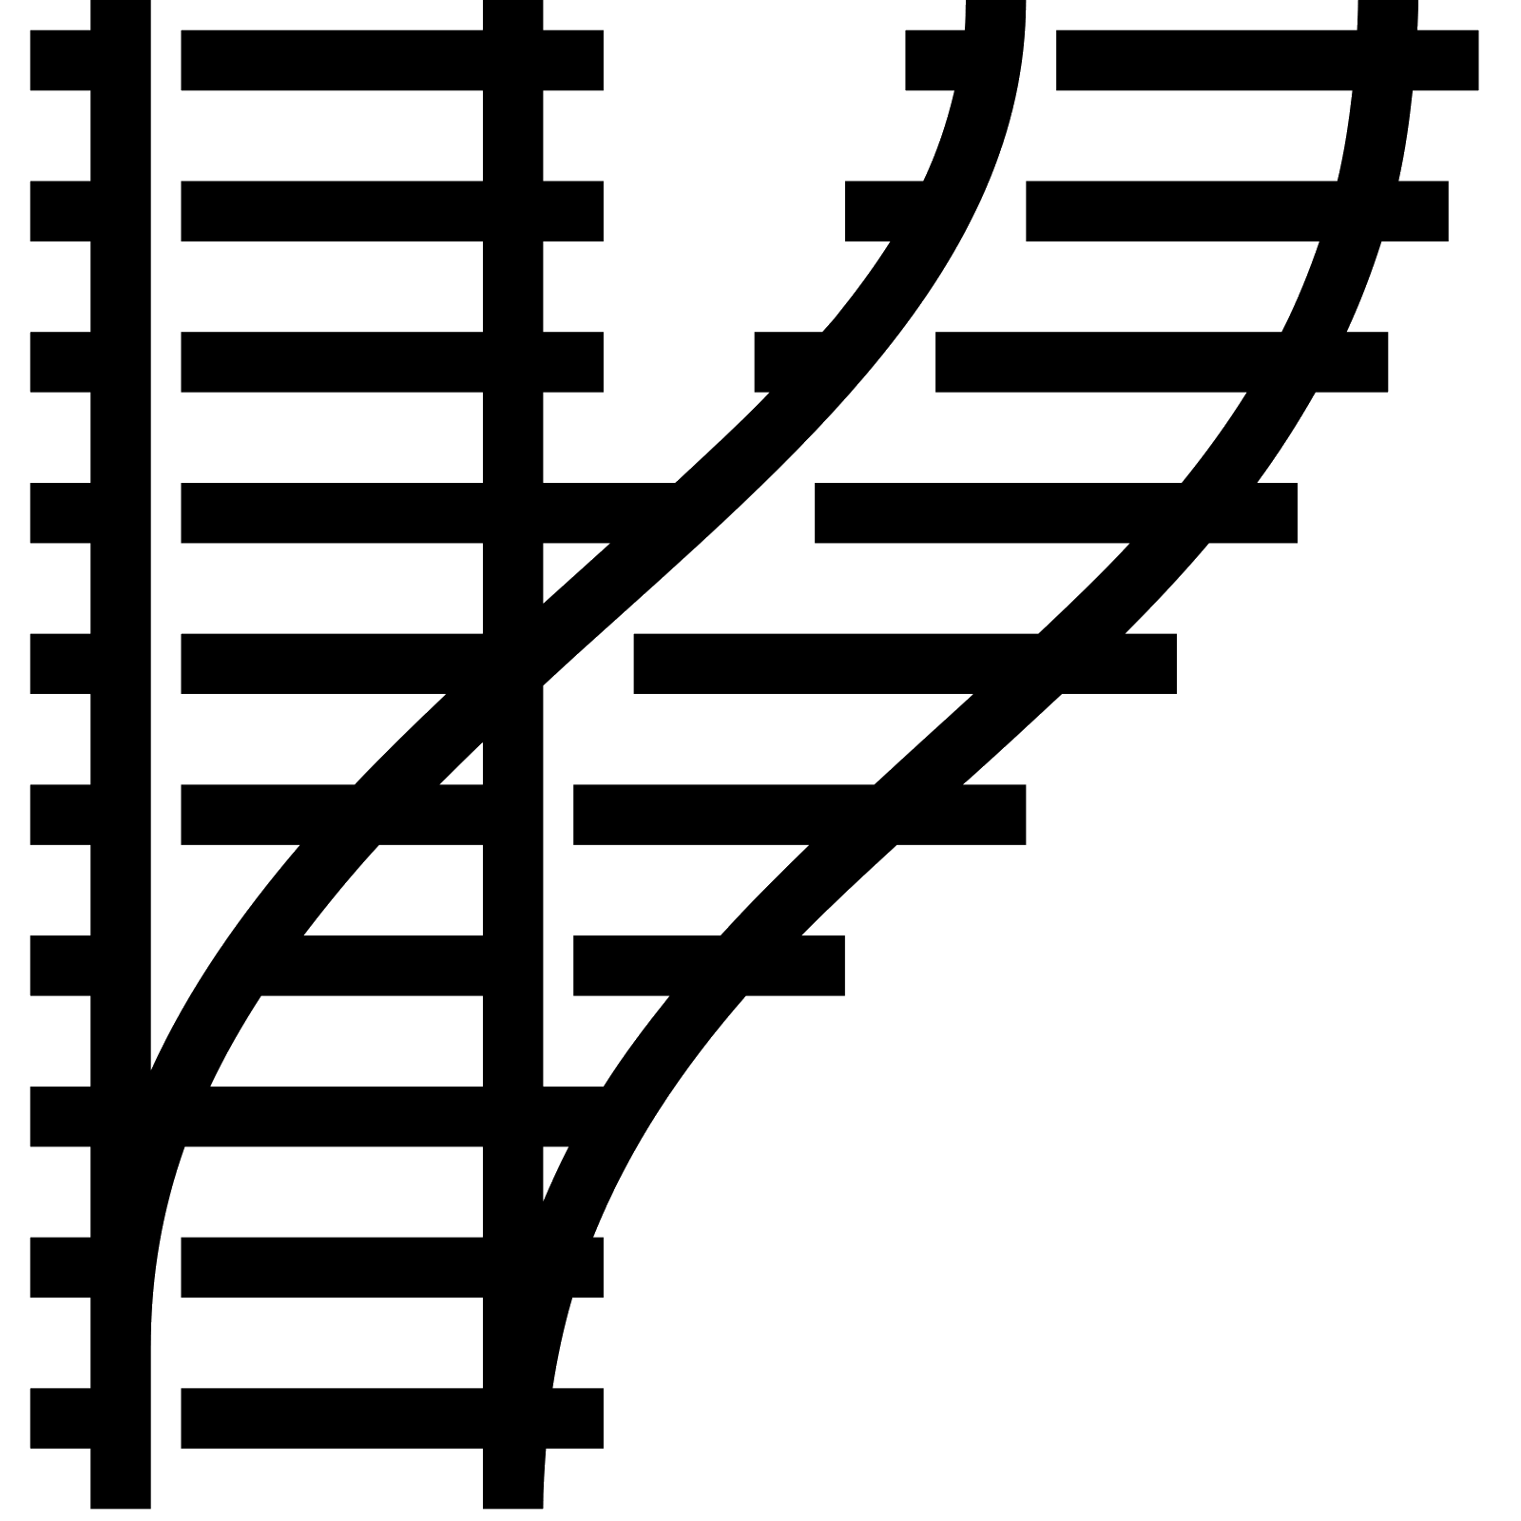
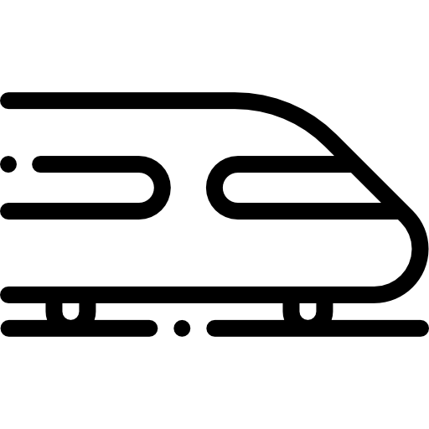

A road towards digitalization & standardization
INTERLOCKING
INTERLOCKING
COOPER CABLING
IP NETWORK
Wayside Equipment
Wayside Equipment
Technology To Boost Rail Safety

Slide 7
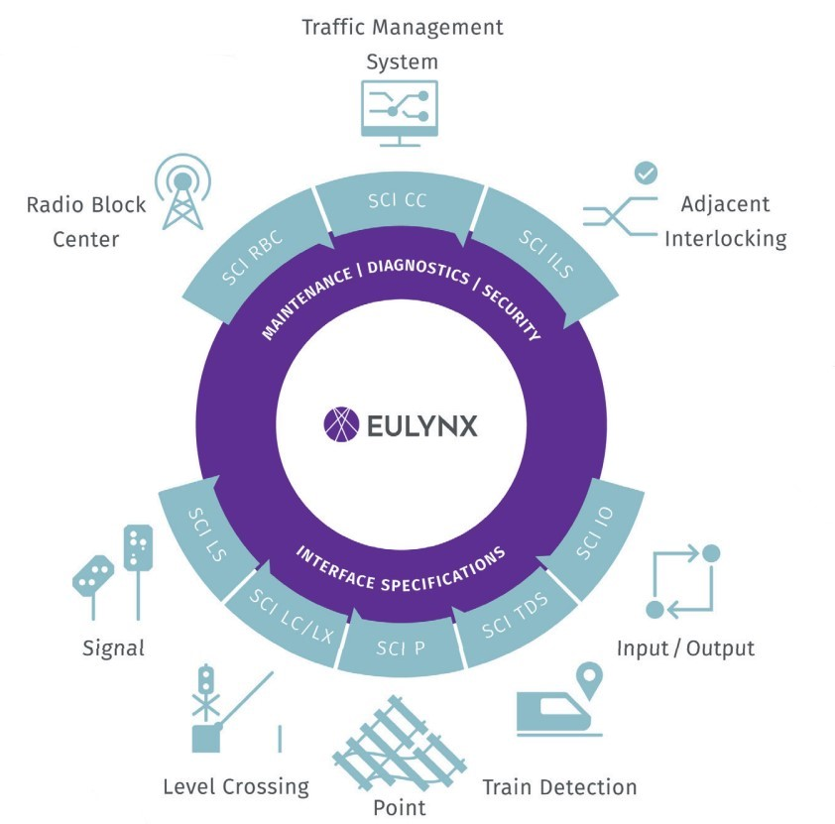
A road towards digitalization & standardization
Interoperability: Standardized interfaces enable multi-vendor integration.
Open Ecosystem: Eliminates vendor lock-in, fostering innovation.
Modularity: Decouples interlocking from field elements for flexible upgrades.
Cost Efficiency: Reduces engineering and cabling costs; lowers lifecycle expenses.
Future-Proof: Supports ETCS and digital signalling migration.
Safety & Reliability: Maintains SIL-4
Technology To Boost Rail Safety

Slide 8
A road towards digitalization & standardization
ELECTRANS Goals
Contribute to standardization and modularity in a open environment
Embrace the adoption of the EULYNX standard across its entire product line.
Full implementation in all product categories by end of 2027.
Technology To Boost Rail Safety

Slide 9
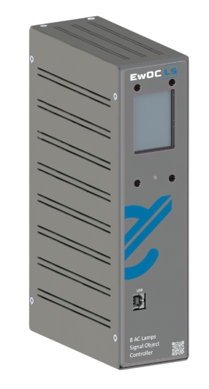
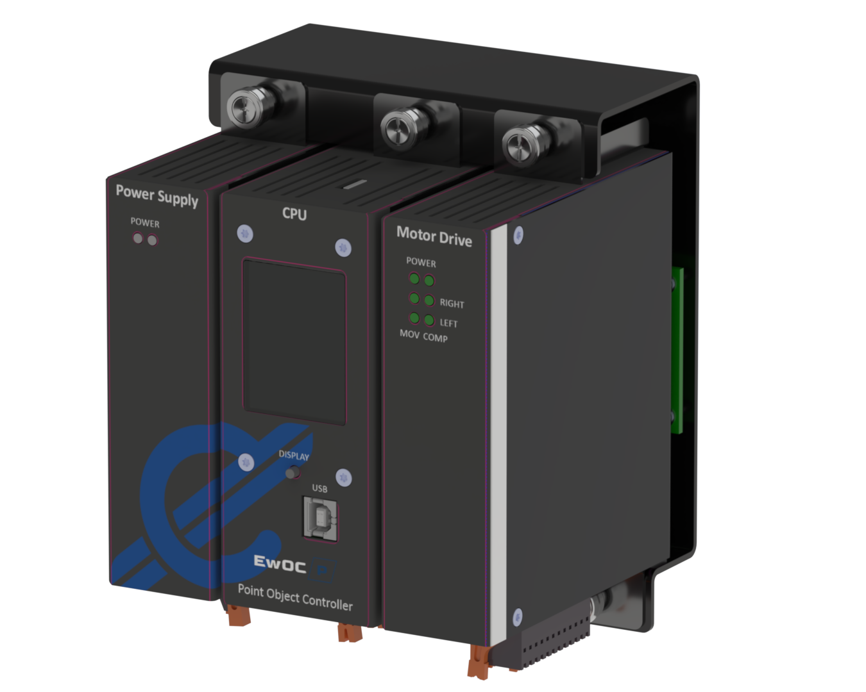
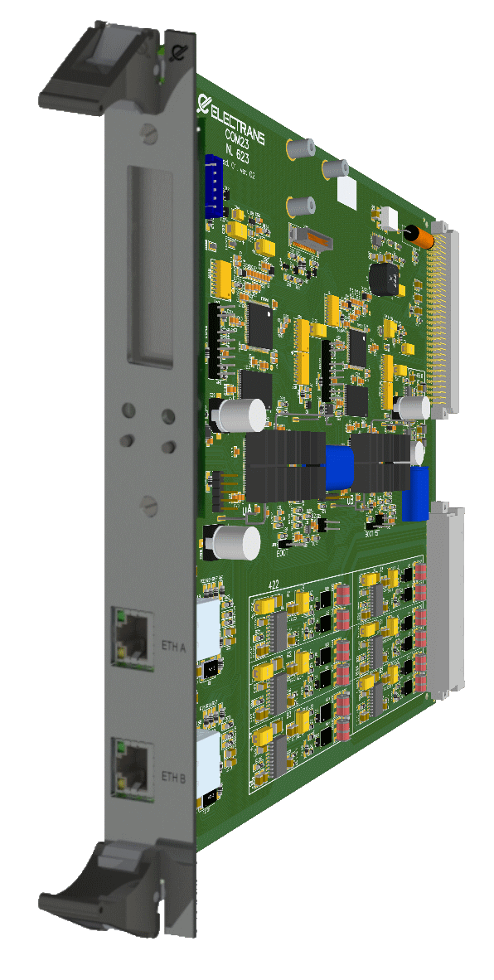
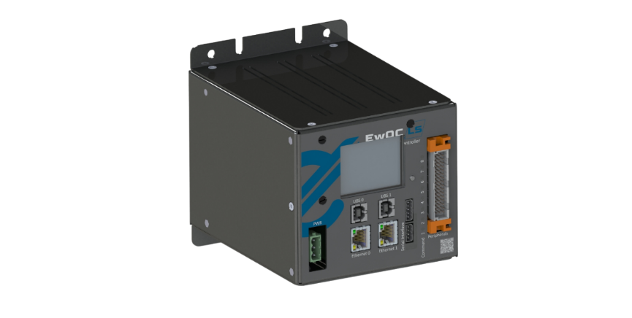
EULYNX Product Line
EwOC LS
EwOC P
COM23
Safety Communication Board
  SIL-4 Wayside Object Controller designed for LED signal control, compliant with EULYNX SCI LS Baseline 4.4.”
  SIL-4 Wayside Object Controller designed for Point Machines control, compliant with EULYNX SCI P Baseline 4.4.”
  SIL-4 Safety Communication Board with 2oo2 redundant architecture for secure integration within the E-CONTROLLER platform.
    Level Crossing: SCI LC/LX
    Interlocking: SCI CC, SCI ILS
    Axle Counter: SCI TDS
    Safety Controller: SCI IO
Technology To Boost Rail Safety

Slide 10
EULYNX Product Line
EwOC LS
First ELECTRANS Wayside Object Controller using EULYNX SCI_LS secure interface, supporting European standardization.
Designed for Railway, Metro, and LRT applications.
2oo2 Architecture
Safety Integrity Level SIL-4
Lifetime > 20 years
High Availability 99,9997%
MTTR < 30 minutes
Operating Temp. Equipment: - 40ºC to 75ºC
Available in two mechanical formats.
Compatible with both existing and new signals.
Technology To Boost Rail Safety

Slide 11
EULYNX Product Line
EwOC LS
EwOC for DC LED signal
Flexible installation: On signal mast or nearby cabinet.
Direct DC control of LED units (up to 8) without the need of transformer
High brightness: Up to 3,000 cd with dedicated LED modules.
Energy-efficient: Very low power consumption per aspect.
Advanced configurability: Software-based settings.
Integrated alarms: Aspect failure, Internal temperature and humidity supervision
Ideal for new installations with significant wiring savings.
EwOC for AC LED signal
Designed for compatibility with existing LED signal modules in infrastructure.
Ideal for long-distance aspect control (Centralized WOC).
Management up to 8 LED units
Advanced configurability: Software-based settings.
Integrated alarms: Aspect failure, brightness level monitoring.
Cybersecurity and Encryption: In both solutions, communication between the interlocking system and the object controller will be secured by external third-party modules, ensuring point-to-point secure communication.
Technology To Boost Rail Safety

Slide 12
Key Takeaways
Interoperability: Standardized interfaces enable multi-vendor integration.
Open Ecosystem: Eliminates vendor lock-in
Modularity: Decouples interlocking from field elements for flexible upgrades.
Cost Efficiency: Reduces cabling costs; lowers lifecycle expenses.
Future-Proof: Supports ETCS and digital signalling migration.
Legacy Compatibility: Ensures integration with existing systems, minimizing initial investment.
Enhanced Maintenance Data: Provides richer diagnostics for predictive and corrective maintenance.
Technology To Boost Rail Safety

Slide 13
www.electrans.es
José Manuel Yera
jmyera@electrans.es
Thank You
Technology To Boost Rail Safety

