Slide 1



ANGOLA – EU LOBITO CORRIDOR BUSINESS FORUM
One Forum, Two Phases
“Adjusting skills development to workforce demand”
#TeamEurope
Opportunity-driven Skills and VET in Africa

Slide 2




Why Opportunity-driven Vocational Education
and Training (OP-VET) ? ​
ANGOLA – EU LOBITO CORRIDOR
BUSINESS FORUM
2026
A PARADIGM SHIFT
Employment as the leading perspective​​
Reverse-engineered VET and Skills development starting from concrete employment opportunities​
Engaging the private sector to create a win-win for learners & business​​
One Forum, Two Phases

Slide 3





One Forum, Two Phases
One Programme - Three Workstreams
ANGOLA – EU LOBITO CORRIDOR
BUSINESS FORUM
2026
Team Europe Initiative to support Opportunity-driven skills and vocational education
and training (VET) in Sub-Saharan Africa
Co-funded by the European Union and the German Government (BMZ)
75 million (EU) + 1.050.000 (BMZ)
March 2024 - February 2029
Overall management by
Request-based
Technical Assistance Facility
Support VET ​(re-)orient towards employment opportunities​
Regional exchange and
Public-Private Partnerships
Facilitating partnerships and promoting OP-VET
Innovative skills development pilot projects
Funding and implementing
OP-VET pilot projects ​(call closed)
#TeamEurope
Led by
Led by
Led by

Slide 4
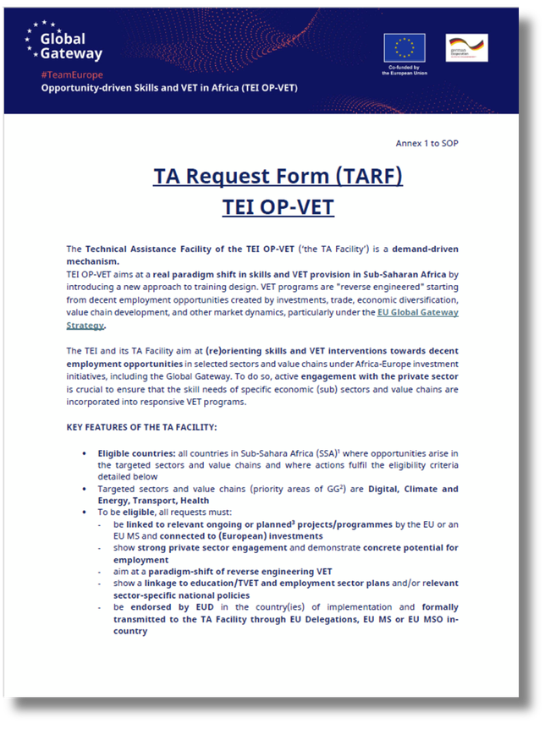
One Forum, Two Phases
Key facts on the TA Facility
ANGOLA – EU LOBITO CORRIDOR
BUSINESS FORUM
2026
Technical assistance = provision of tailored expertise to respond to the needs​
Geographical scope: all Sub-Saharan Africa (49 countries)​
Available expertise: up to 180 working days over 12 months​​
Support by one or more implementing agencies (EF, EDUFI, Enabel, GIZ)​​
TA Requests processed on a “first come first serve” basis​
Application through the dedicated TA Request Form ​
Estimated time between reception of TA Request and start: ​2,5 - 3 months​
Single contact point: TA_FACILITY@TEI-OPVET.EU

Slide 5

One Forum, Two Phases
What can be covered by the TA Facility ?
ANGOLA – EU LOBITO CORRIDOR
BUSINESS FORUM
2026
The TA Facility of the TEI OP-VET covers
The TA Facility does not cover
Expertise costs (remote and in-country) for a maximum of 180 experts days over 12 months​
  Technical expertise on VET/skills development and labour market​
  Sectoral expertise on priority areas​
  Local and international expertise​
Implementation of actions resulting from the TA support​
​
Direct funding for stakeholders (equipment, consumables, grants, …

Slide 6
One Forum, Two Phases
What concrete support can the TA Facility offer ? ​
ANGOLA – EU LOBITO CORRIDOR
BUSINESS FORUM
2026
Some examples​
Identification of concrete employment opportunities and required skills needs​​
Reorientation of interventions to include an OP-VET approach​​
Support for implementation of OP-VET interventions​​
Monitoring and Evaluation of OP-VET actions​​
Concrete example
​
Develop standard criteria and methods to identify employment opportunities and conduct mappings of key sub-sectors and value chains aligned with Global Gateway priorities.​
Concrete example ​​
Provide advice to VET centers and private sector companies in order to reorient them towards OP-VET approaches.​
Concrete example ​​
Provide support to establish partnerships between private and public stakeholders aiming to develop and implement specific opportunity-driven VET interventions. ​
Concrete example ​​
Develop tools and methods to assess the impact of opportunity-driven VET & Skills Development approaches on employment and value chain growth.​​

Slide 7
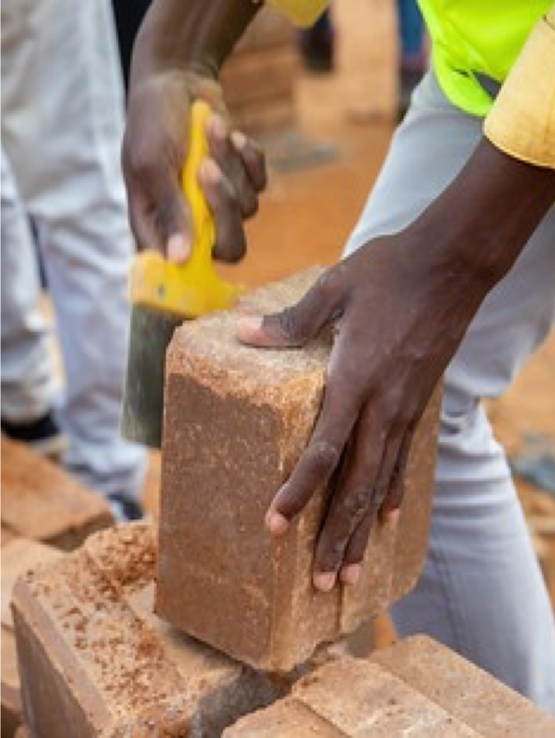
One Forum, Two Phases
Eligibility criteria for the TA Facility​
ANGOLA – EU LOBITO CORRIDOR
BUSINESS FORUM
2026
To be eligible, all TA support requests must fulfil a number of eligibility criteria (8).
Support the paradigm-shift of reverse-engineering skills development​​
Aligned with EU or EU MS strategy in-country​
Be connected to (European) investments in the GG priority areas​
Show strong private sector engagement and demonstrate concrete potential for employment ​
Be backed by available funding for implementation of actions post-TA​​
Be endorsed by the respective EUD (= in country of implementation) before being submitted​
All criteria are specified in the TA Request Form ​
(specific information requested)

Slide 8
One Forum, Two Phases
What concrete support can the TA Facility offer ? ​
ANGOLA – EU LOBITO CORRIDOR
BUSINESS FORUM
2026
Who can apply?... ​
Eligible main requesters - linked to ongoing and/or planned interventions in sub-sectors linked to Global Gateway priority areas: ​
Possible associated requesters:
National VET/skills development institutions; intergovernmental organisations working on skills development/value chain development/employment promotion,…
EU Delegations, EU Member States (MS) and EU MS organisations (incl. EIB/EBRD as Team Europe members)
Local and European private sector organisations and representatives operating in Sub-Saharan Africa (e.g. Chambers of Commerce, Business Federations, Branch representative organisations, …)​
Local or European organisations involved in value chain development and/or skills development and/or employment promotion working in Sub-Saharan Africa (e.g. non-for-profit/NGOs, agencies for employment promotion, …)
We encourage joint TA requests involving all relevant stakeholders from the start​
Important note: single companies alone cannot apply, as we are working in the public benefit ​
And how?
Using the TA Request Form template (in French, English or Portuguese) ​
With endorsement by the in-country EUD
All requests should be submitted via email:
TA_FACILITY@TEI-OPVET.EU

Slide 9
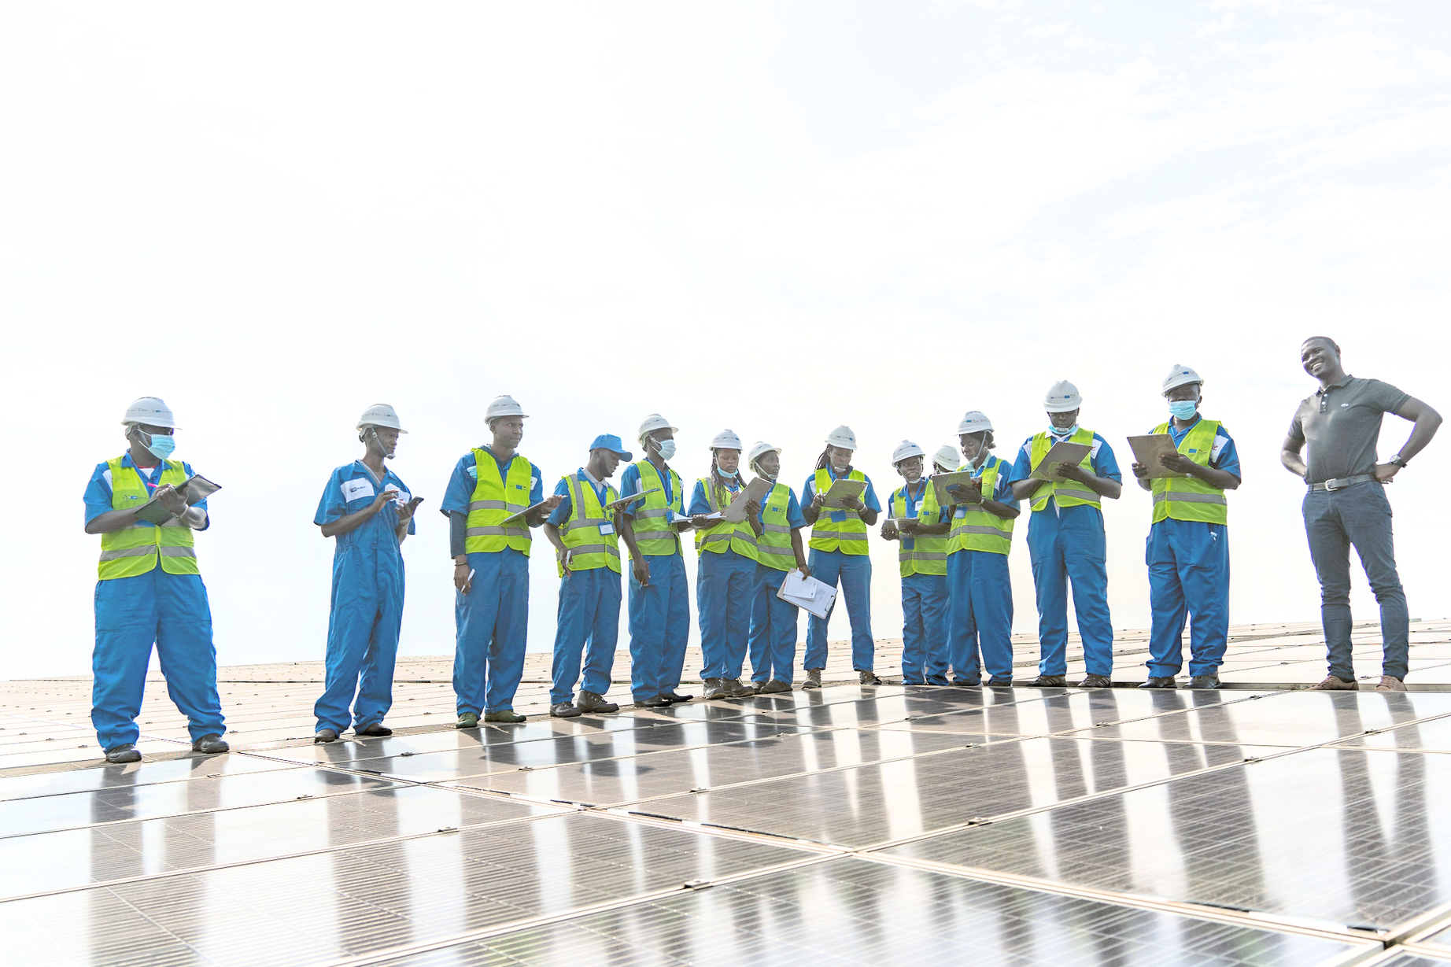

One Forum, Two Phases
#YourGatewayToSkillsAndJobs
Join us
ANGOLA – EU LOBITO CORRIDOR
BUSINESS FORUM
2026
Support this transformative initiative and help shape Africa's future.
Let's bridge skills with opportunities for sustainable development!
#TeamEurope
Opportunity-driven Skills and VET in Africa (TEI OP-VET)

