Slide 1
Community Microgrids: Smart, Residential, and EV Charging
Moderator:
Brian Patterson – Co-Founder & Chairman, EMerge Alliance
Speakers:
Wissam Balshe – Senior Director of Channel Partnerships, Mainspring Energy
Julia Masters – Microgrids for Community Resilience Program Manager, Colorado Department of Local Affairs, Colorado Resiliency Office
Justine Sanchez – Technical Sales Engineer, Microgrid Solutions, Generac
Rubin York – Project Research Engineer, Emerging Technologies,
Orlando Utilities Commission

Slide 2
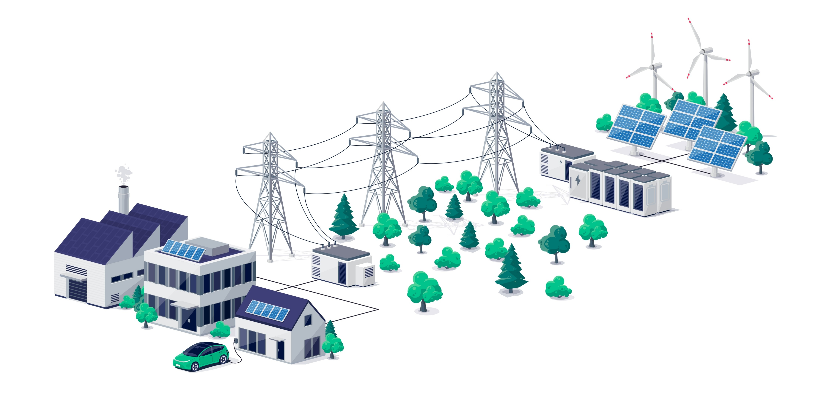
Community Microgrid
A localized energy system that can operate independently or in conjunction with the main electrical grid.
Serves the needs of a specific community or neighborhood
Provides electricity through local generation sources, including:
  Solar panels & wind turbines
  Fuel cells, CHP & small-scale natural gas generators
Typically includes energy storage systems
Provides main grid with frequency, voltage, or VAR support
Uses stored energy when renewable or grid sources are unavailable

Slide 3

Critical Facility Prioritization Guidance
A process for communities and utilities to partner in identifying, understanding, and prioritizing the critical infrastructure and facilities in their communities to focus resilience planning
Step 1:
Develop a Committee and Process
Step 2:
Research Background Info
Step 3:
Inventory Critical Infrastructure & Facilities
Step 4:
Prioritization of Critical Infrastructure & Facilities
Step 5:
Energy Resilience Solutions Investigation
See more at the Process Overview

