Slide 1


Leveraging dynamic pricing
How Eurostar creates value through Sqills’ Pricing Engine
November 2025
Notes:
General storyline:
Eurostar and Sqills have been partners for quite some time. First considerations for an alternative reservation system in 2017, resulting in a go live with S3 Passenger in 2020. Ever since a successful partnership/story;
What is S3 Passenger? Slide containing the short but concrete description of S3 Passenger, followed up by the slide with the “journey search” where I can shortly go over what reservations entail (different modules, capabilities of S3 Passenger);
The essence of the all-in-one solution S3 Passenger is: Inventory -, fare and revenue management (key takeaways we want to bring across for this presentation);
Building the storyline from inventory management, to fare and ultimately revenue management by means of the storyline Eurostar has followed ever since the partnership with Sqills;
Go-live of 2020 we started with the effective inventory management of only the Eurostar trains;
High demands (potentially refer also to the often unavailable trains we see daily on their websites between London - Amsterdam);
Need for optimal inventory management, where needs and wants from the operator are considered just as important as the passenger preferences;
Resulted in 99% peak fill rates for Eurostar in the last year;
Optimal usage of inventory management considered the foundation for the next step …
Merger between Eurostar and Thalys, which resulted in the addition of all the Thalys trains and offers to the Eurostar S3 Passenger environment;
Pre-existing inventory management made the addition of Thalys to the Eurostar environment a smooth process;
However not solely about the network, running trains and thus capacity;
Thalys commercial offer to be included in the same environment in which the Eurostar commercial offer already existed - living next to one another;
Different commercial offers required - enabled through S3 Passenger because of the wide extent of possibilities to distinguish within different elements of your offer:
Individual product offer;
Individual pricing strategies;
All maintained alongside each other within the S3 Passenger environment;
Strength of S3 Passenger - allowing them to live within the same instance, but keeping the separation where needed;
Optimal? Probably not. Especially the maintenance of different commercial offers could bring complexity. Desire to revenue manage these different offers as one. Unnecessary level of complexity, especially in the fare domain;
Therefore, bringing this together in a New Customer Offer (NCO) - combining the commercial offers of Eurostar and Thalys, and strengthening the possibilities for a simpler maintenance and more effective revenue management;
Nonetheless, having ‘wildgroei’ of especially tariffs within your commercial offer is simple to achieve, commercial offer wants customization to tailor revenue management needs;
Variety of different conditions on when you want which product and corresponding tariff to be offered to a specific passenger at a specific moment in time, for a specific train, and so on.
Great variety in different variables that you want to be affecting what commercial offer you return to the passenger;
S3 Passenger can manage - Fare 1.0 tariff configurations with accompanying prices;
What happens if your commercial offer is extremely tailor made to match your revenue management strategy, basically including large number of variables in your considerations - potentially thousands of tariffs;
We (Sqills) can accommodate, but understand also the downsides to that;
Simple changes can require substantial work;
Commercial offer thus becomes static in terms of allowing frequent changes to be made to accommodate for potential changes in your strategy
Introduction of S3 Pricing Engine - offering the right product, with the right price, to the right passenger at the right moment in time;
Essence lies within the abilities to distinguish your pricing strategy, based on a wide variety of different variables based on your overarching strategy;
Key lies within the pricing part, which we want to change based on the inclusion or exclusion of variables - price calculation we want to be dynamic;
S3 Pricing Engine
What is the S3 Pricing Engine? What does it do? And how does it work?
Moving Eurostar to the Pricing Engine;
Phased approach - main aim at reducing the number of tariffs;
Using capabilities of inventory mapping rules (IMR) to ‘remove’ the required need for a one-on-one relationship between booking limits and different price points. Pricing Engine can do this dynamically;
Pricing Engine has more to offer - overview of some local predicates, but also extensions through external variables like contracts, CRM levels, loyalty (in the future);
Moving over to Eurostar - what value does the Pricing Engine add on the short term? And what are the plans for the long term?

Slide 2


Introduction
Sanne ter Braak
Business Consultant

Slide 3


Introduction
Christos Roussakis
Senior Pricing Manager

Slide 4
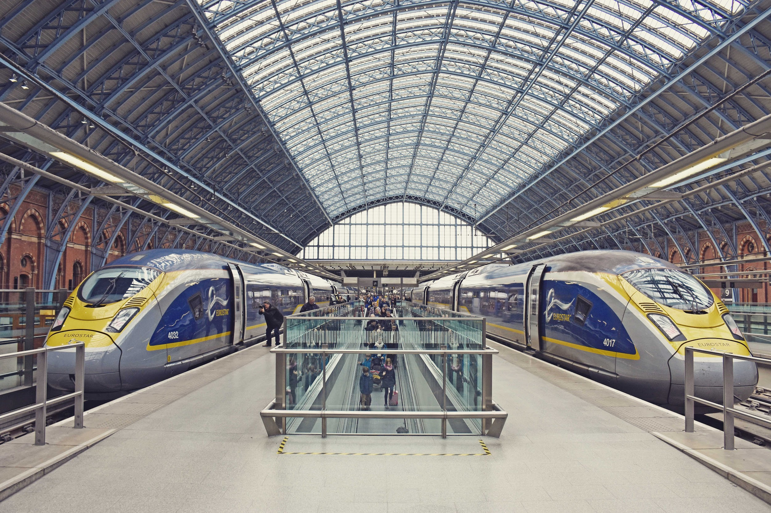

Successful
&
partnership since 2018

Slide 5























Today 55 rail/bus operators chose Sqills S3 Passenger as their core platform for dynamic pricing, inventory management and reservations
“As Eurostar grows beyond 10M transported passengers/year and we expand our reach further into Europe, having a flexible reservation system is critical. With its combination of agility, stability and responsiveness [...] Sqills has proven to be the perfect partner”
Laurent Bellan | Chief Information Officer Eurostar

Slide 6











Offering best-in-class | Dynamic pricing, inventory management, reservation, and self-service capabilities
Manage timetables
and routes.
Manage fares & prices,
products, tariffs and discounts.
Enable payments, various PSP’s.
Distribute tickets in
several shapes and forms.
Manage disruptions easily: (Automatic) Re-accommodation, Self-service rebooking, Refunding, etc.
Integrated Journey
Search API
Customer journey
Manage inventory
availability, equipment scheduling, seating.
Create a booking, customer records and related data.
Facilitate ticket
validation procedures.
Feed financial
back-office systems with transactions.
Notes:
Our system - we believe - brings numerous benefits from driving revenue through dynamic prices, yield management & flexible ancillaries - to reducing cost as the central system of record, using self service & automation and having a very transparent business model.
Seat reservation: Increase seat occupancy
Tickets sold in advance: Better planning, better yielding strategies
Tariff and pricing logic: allows for customer segmentation and price differentiation
Multi-channel distribution: visibility and increased sales with full control of prices per sales channel
After-sales: Increase passenger self-service to reduce operational costs (e.g. call centers) and drive upsell strategies (e.g. add-ons)
Volumes: S3P is 100% horizontally scalable, ready for any kind of peak traffic scenarios (e.g special sales campaigns).

Slide 7



All-in-one inventory, dynamic pricing and reservation system
S3 Passenger
Inventory management
Dedicated capacity control and yield optimisation
Fare management
Offering the right product at the right time to the right customer at the right price
Revenue management
Actionable data insights to enhance intelligent forecasting and optimisation
Dynamic Pricing

Slide 8



Optimising inventory management for ultimate value creation
Rail operator
Re-utilisation of seats to increase allocation efficiency
Passenger
Individual travel preferences affecting desires
Seating Algorithm
Maximum fill rates through maintaining operator - and passenger objectives
Notes:
High occupancy rates = desire for efficient seat allocation and thus maximising load factor and revenue.
Considering operator interests of optimal seat allocation, but at the same time also considering customer preferences.
S3 Seating algorithm, considering broad range of variables that could affect allocation of seats:
Seat position;
Service;
Marketing;
Other

Slide 9
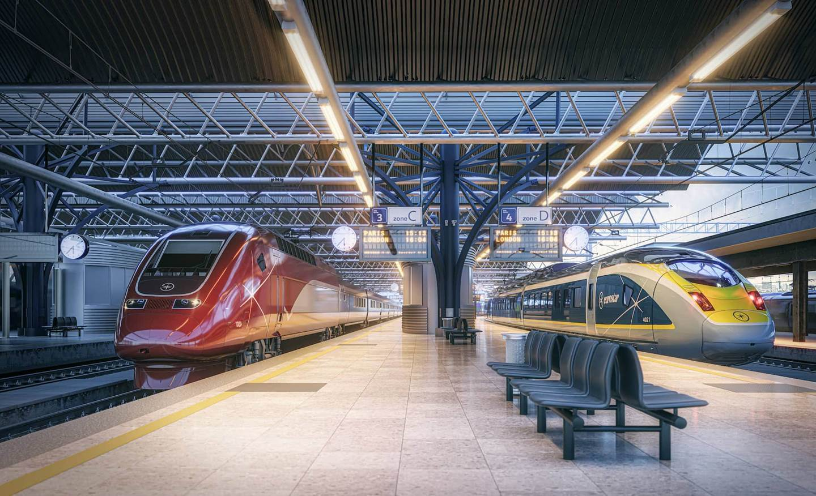
> 99% peak fill rates

Slide 10



One system, two commercial identities
Merger 2024
S3 Passenger
S3 Passenger

Slide 11
From inputs to fares | One-to-one relation
Standard Product
Fare 1
Fare 2
Fare 3
Fare 4
Fare 5
Adult
Young Adult
Youth
Child
Senior

Slide 12

S3 Pricing Engine
Pricing is the output of input variables, calculating prices dynamically.

Slide 13


S3 Pricing Engine | One engine, infinite possibilities
Input Variables
Timing to departure
Passenger Type
Day of Week
Discount
S3 Pricing Engine
Dynamic price
Origin, Destination
Class of Service
Train Occupancy
B2B Agreement
Desired Price Level
…

Slide 14

Building your pricing strategy
Input:
- Fare Code;
- Origin;
- Destination;
- Passenger Type;
- Disability Type;
- Bucket;
- Inventory Class;
- Sales Date;
- Travel Date;
- etc.
Pricing System
Components
Calculations
Data
Output:
Dynamically calculated prices

Slide 15
S3 Pricing Engine | Empowering strategy through customizable pricing
Pricing System
floor(BASE_PRICE * PASSENGER_FACTOR, 1) * DISCOUNT_FACTOR
Round the final price down
Round final price to the nearest value of 1 euro
Check the discount percentage or amount for the given Discount Code
Check the “Passenger Factor” Component to find the impact of the passenger type in the booking
Retrieve the base price per Origin and Destination

Slide 16


Eurostar and S3 Pricing Engine | Moving forward
Migrating to S3 Pricing Engine
Enhance inventory and fare management collaborations.
Adding even more value…
Commercial strategy changes to leverage new capabilities.
Continued
partnership

Slide 17
Leveraging dynamic pricing:
How Eurostar is creating value through Sqills' pricing engine
Rail Live 2025
26 November

Slide 18

Since Eurostar started using S3 passenger in 2020, the number of active fares has reached record levels
Move to S3 Passenger
Stable structure during and just after the Covid Pandemic
Thalys & Eurostar merger
New Customer Offer
Clean-up of inactive fares

Slide 19




…limiting our productivity and posing an efficiency risk.
Time consuming manual inputs
Inconsistencies in our fare structure
Long time to market
Complexity

Slide 20



We decided to introduce a new way of managing fares to fully leverage the capabilities offered by S3 Passenger
Fare Module 1.0
Fare Module 2.0
Static
prices
Dynamic prices using the
Pricing Engine

Slide 21
A change of this scale requires cross-functional collaboration
Pricing
Revenue Management
Digital
Business Planning
IS
Finance
Distribution

Slide 22
A change of this scale requires cross-functional collaboration
Pricing
Revenue Management
Digital
Business Planning
IS
Finance
Distribution

Slide 23





We approached this as a 12-month cross-functional project
Impact analysis
Definition of new structure
Inventory configuration
Front-end & back-end developments
End-to-end testing
Expected go-live
Q3 2026

Slide 24
Thanks to the Price Engine the number of fares will decrease drastically
70% reduction
Move to S3 Passenger
Stable structure during and just after the Covid Pandemic
Thalys & Eurostar merger
New Customer Offer
Clean-up of inactive fares
Pricing
Engine Implementation

Slide 25



The Pricing Engine sets the foundations for a more customer centric product offering
Provide an even more personalised customer experience
Address specific business needs
More tailored offer
Reduce time to market for new offers
Improve resource management
Better efficiency
Reduce number of different fares
Reduce risk of incorrect data input
Better fare management

