Slide 1
Patient Safety risks and concerns in London: a data mining exercise
Patient Safety Congress 2025:
Staff wellbeing as a proxy and prerequisite for patient safety – caring for our workforce
Jess Peck RN, MSc
Senior Clinical Quality Manager – Patient Safety
London Quality & Safety Team
NHS England, London
jess.peck@nhs.net
Notes:
Hello, intros, and thank you for the opportunity to take part in today’s session.

Slide 2
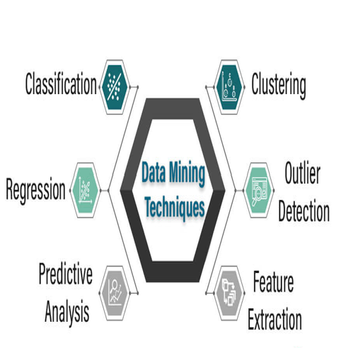
The challenge: what did patient safety data tell us that we didn’t already know?
The Patient Safety Leadership Forum, NHS England (formerly NHS England and NHS Improvement, London) commissioned the National Institute for Health Care Research (NIHR) Imperial Patient Safety Translational Research Centre (PSTRC) and Imperial College Big Data and Analytical Unit (BDAU) to review patient safety in London through data mining techniques and identify unknown / unseen risks and novel insights from publicly available data.
Two cohorts of NHS trust were identified according to their CQC safety rating: ‘GOOD’ or (Good & Outstanding*) and RI (Requires Improvement or Inadequate)
The project was a ‘co-production’ with regular meetings to interpret results and steer the analysis in a direction most useful to inform decision-making in applied healthcare.
Two phases of work ‘sprints’ were commissioned:
  Phase 1: April-June 2020. The goal of the project was to analyse a combined dataset of publicly available variables related to patient safety across London. The research team used machine learning algorithms to analyse a combined dataset of 1000+ variables and used natural language processing (NLP) to analyse the free text contained in CQC reports.
  Phase 2: April-June 2021. This phase built on Phase 1 to explore how the data variables analysed changed over time. To this effect the research team enhanced their existing dataset with historical data where available (2016-2019) and analysed differences over time across London NHS trusts rated as being consistently ‘safe’ or not by the CQC. Univariate and multivariate analyses were conducted to understand differences across individual variables and across the full dataset
Data mining: 'the process of using machine learning and statistical analysis to uncover patterns and valuable information from large data sets' also known as knowledge discovery in databases (KDD), has rapidly evolved with advancements in machine learning, data warehousing, and the growth of big data’.
* No NHS trust had an outstanding rating in the CQC SAFE domain
Notes:
8 mins is challenging to bring to life a translational research project I co-commissioned in 2020-21 when London was implementing the NHS PS Strategy
Our advisory group of safety leaders / advisors across the healthcare system (providers, commissioners, arms length bodies (NHSR) AHSNs etc – PSLF) recognised gathering insights and identifying potential safety risks and concerns from big datasets using data mining was an important part of journey
Data mining uses machine learning and statistical analysis to identify and analyse patterns in big data (too large or complex to be dealt with by traditional data-processing software.
The project leads (me) partnered with NIHR, Imperial Patient Safety Translational Research Centre and Imperial College Big Data & Analytical unit (BDAU) London who had the analytical and research expertise – and co production with applied health care (us) -
Identified 2 cohorts of NHS Trusts based on CQC safety rating (safety domain rating) considered the most consistent, reliable, and comprehensive indicator of safety in England
(Good/ Outstanding) and Requires Improvement (RI) (RI, Inadequate)
- Important framework for identifying significant data variables and their strength of effect.
- The data team used 3-month data sprints driven by ££ but which enabled focussed work and regroup to review / critique findings
Pioneering work not done before and since

Slide 3
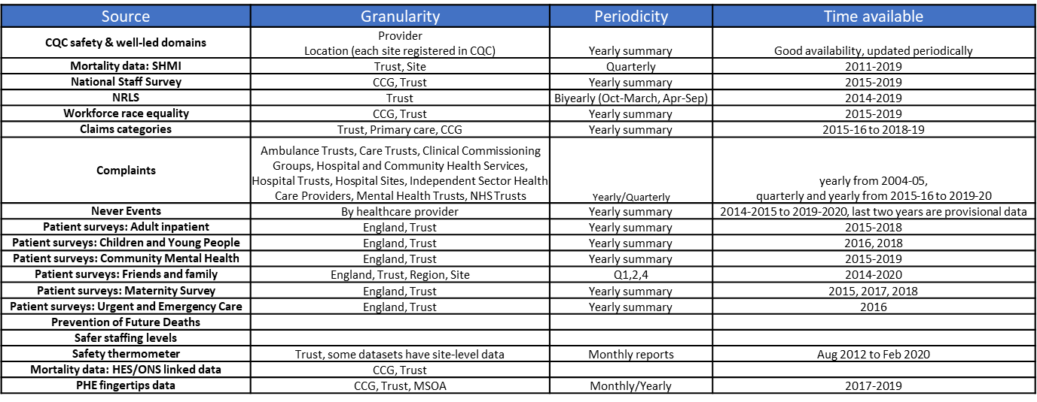
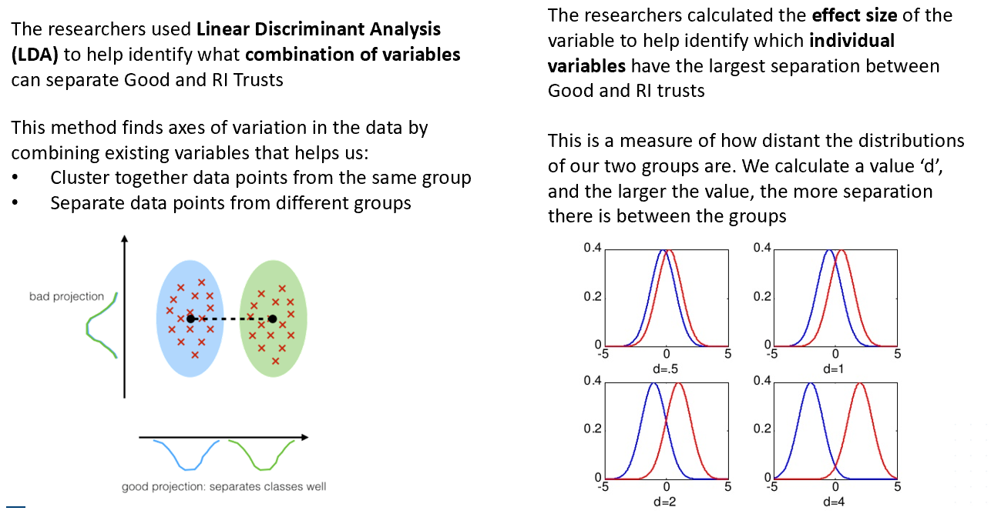
Patient safety datasets of interest and machine learning methodology
10 datasets identified based on data availability, usability and relevance: CQC Safe rating; NHS Staff Survey, Workforce Race Equality Survey (WRES), Mortality Data (Summary Hospital Mortality Index (SHMI), National Reporting and Learning System (NRLS), Claims (Clinical Negligence Scheme for Trusts (CNST), Public Health England (PHE) Public Health Outcomes Framework: Care Hours/ Patient Day, Patient Survey programme data, Data on written complaints to the NHS.
Notes:
- Multiple NHS data sources available in the public domain all important in gaining a rounded view of safety in the table above 19 datasets were analysed by the research team including the NHS staff survey, Workforce Race and Equality Survey (WRES), Mortality data (SHMI), NRLS – safety incident data (20m records), complaints, claims, CQC regulatory framework reports – SAFE domain
10 datasets were finally ‘selected’ based on data availability, usability and relevance (see text box at bottom of the slide)
Quickly on methodology (not my area expertise) for analysis geeks research team – used Linear discriminant analysis (data mining process)

Slide 4
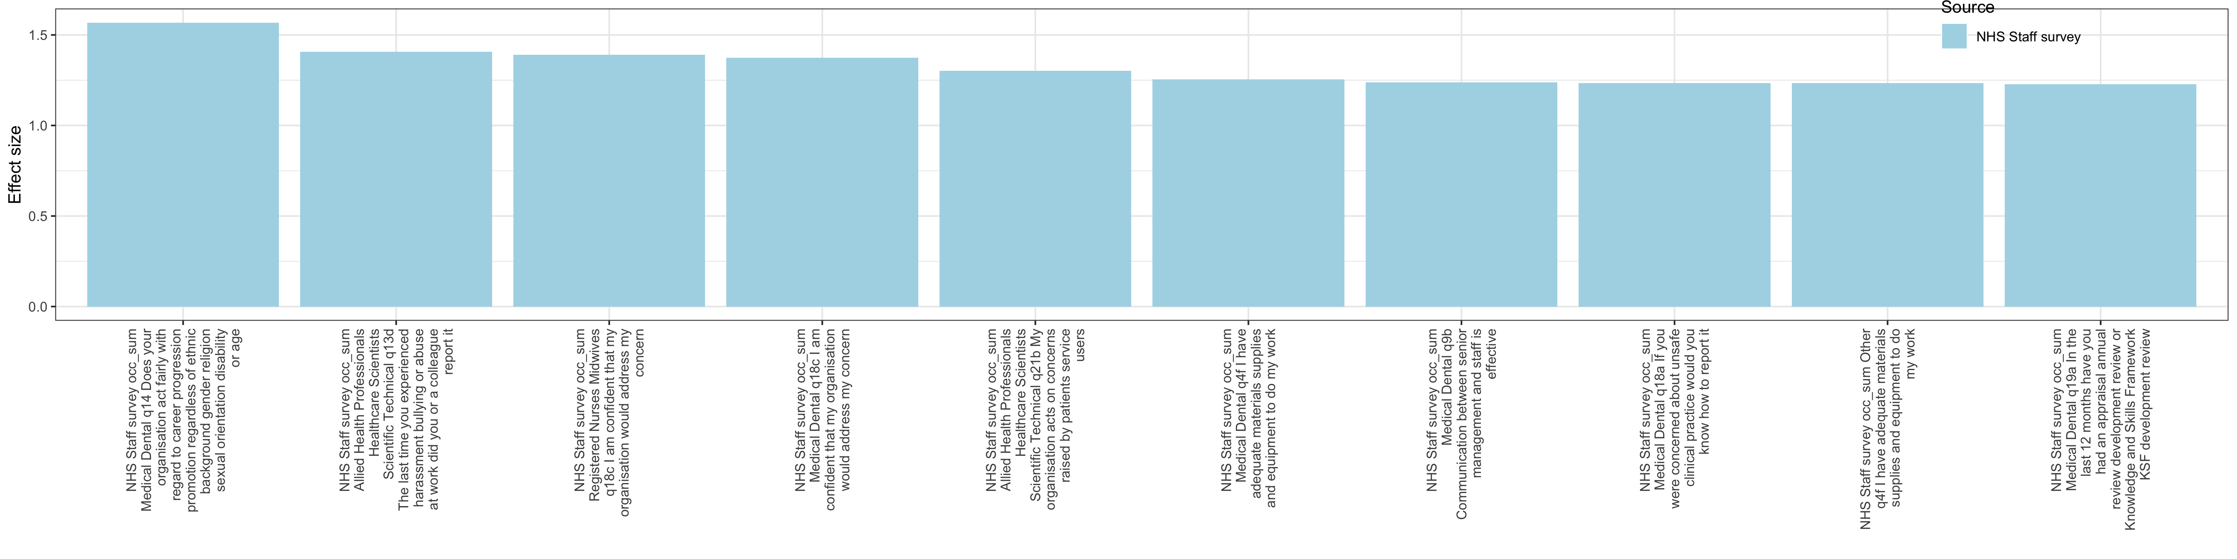
Of all variables included (1,000+), the most relevant in identifying Good organisations relate to staff feeling supported and appreciated at work
Top variables that contribute to identifying Good trusts
My organisation acts fairly with regard to career progression (medical and dental)
I or a colleague reported bullying or harassment the last time I experienced it (health professionals and scientists)
I am confident that my organisation would address my concern (nurses and midwives)
I am confident that my organisation would address my concern (medical and dental)
My organisation acts on concerns raised by patients (health professionals and scientists)
I have adequate materials and supplies to do my work (medical and dental)
Communication between senior management and staff is effective (medical and dental)
If I were concerned about unsafe clinical practice, I would know how to report it (medical and dental)
I have adequate materials and supplies to do my work (other)
I have had an appraisal or development review in the last 12 months (medical and dental)
The higher the value of these variables, the higher the likelihood that the organisation is Good
Notes:
The NHS Staff Survey was the most influential datasets in this study, contributing all top 10 variables associated with trusts rated “Good” or “Outstanding”.
- It provided insights into staff engagement, fair treatment with regards to career progression, management and feedback mechanisms, appraisals, and organisational responsiveness (systems and processes to report concerns and confidence these are addressed, resources to undertake / execute work, effective communication between senior management & staff
- all of which were strongly correlated with better safety ratings.
- The data variables from the survey had high effect sizes, indicating strong predictive power for positive safety outcomes.

Slide 5
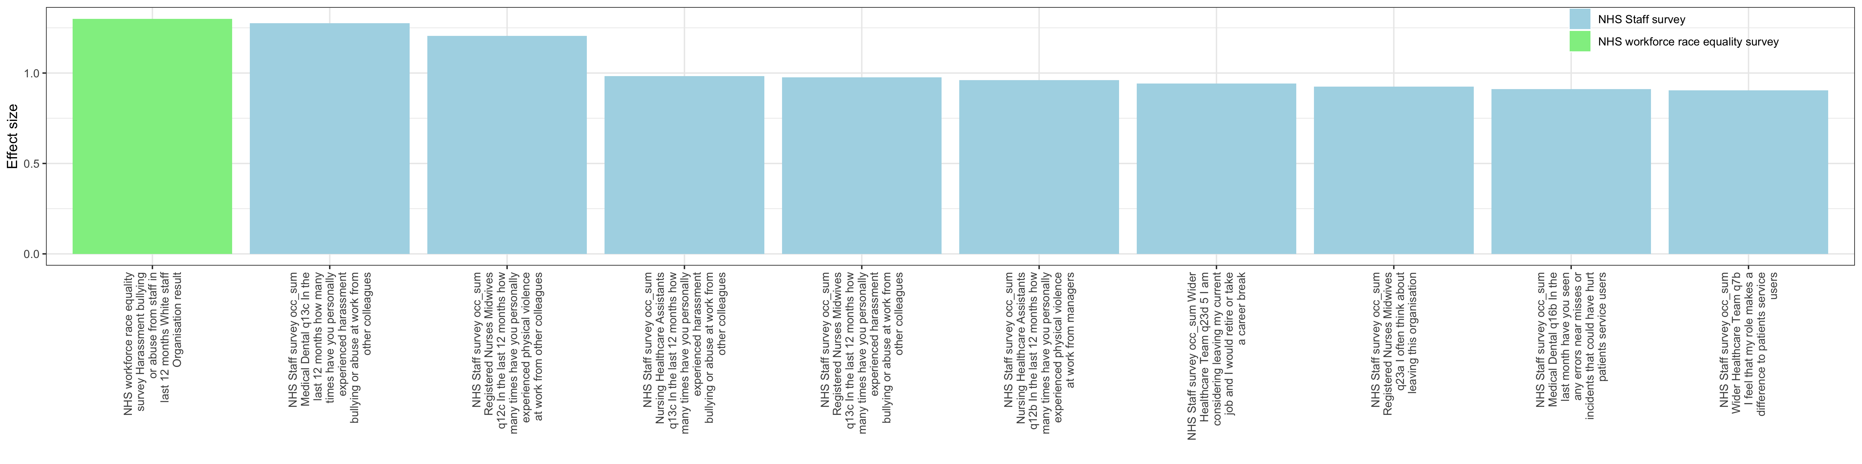
The top 6 variables that contribute the most / are relevant in identifying RI organisations are related to bullying, harassment, abuse and violence at work
Top variables that contribute significantly to identifying RI trusts
Harassment/
bullying or abuse from staff (reported by white staff)
Number of times I experienced bullying or abuse at work from colleagues in last 12 months (medical and dental)
Number of times I experienced physical violence at work from other colleagues in last 12 months (nurses and midwives)
Number of times I experienced bullying or abuse at work from colleagues in last 12 months (nursing assistants)
Number of times I experienced bullying or abuse at work from colleagues in last 12 months (nurses and midwives)
Number of times I experienced physical violence at work from managers in last 12 months (nursing assistants)
I am considering leaving my current job and I would retire or take a break (wider healthcare team)
I often think about leaving this organisation (nurses and midwives)
In the last month I have seen errors or incidents that could have hurt patients (medical and dental)
I feel that my role makes a difference to patients (wider healthcare team)
The higher the value of these variables, the higher the likelihood that the organisation is RI
Notes:
- Whereas, in the RI group the data variable with the highest effect size was from the WRES dataset (shown in green) on the graph and then the NHS staff survey contributing remaining variables of 10 with highest effect sizes related to harassment and bullying / abuse from staff and violence at work.
- Variables from the WRES and NHS Survey had high effect sizes, indicating strong predictive power for less positive safety outcomes.

Slide 6
Research insights: Staff wellbeing has a direct and measurable impact on patient safety
3. Organisational Support is Key
2. Poor Staff Experience Correlates with Safety Risks
1.Staff engagement improves safety outcomes
4. Psychological Safety Encourages Reporting
5. Well-being as a Systemic Indicator
Notes:
How the research insights – show us that staff wellbeing has a direct and measurable impact on patient safety 5 key themes
SS highlights ‘Work as done’ (influence of human factors and system thinking) – how staff feel (different cohorts) , the culture etc in the work system.
1. staff engagement improves safety outcomes: Engaged staff who feel valued, supported and fairly treated are more likely to report safety concerns, follow protocols, collaborate effectively,
2. Poor staff experience correlates with safety risks: looking at the RI group – higher rates of bullying & discrimination, more staff considering leaving their roles (Retention issue), increased reports of physical violence, negative experiences leading to low morale, burnout, reduced vigilance - all compromising patient care.
3.Org support: staff confidence in the organisation’s ability to address concerns was a strong predictor of safety ratings and improves safety outcomes.
4. Psychological safety – we know so much about this now - encourages reporting cultures [near misses & incidents], optimises participation in learning & improvement efforts, a culture of openness essential for proactive management.
5. This study reinforces the importance of viewing staff well-being is not just a workforce issue—but as a patient safety issue.

Slide 7
Summary
This study drove out novel insights and demonstrates NHS Patient safety strategy recommendations to use and employ data linkage techniques.
The NHS Staff Survey was one of the most influential datasets in this study,
This study suggests staff perceptions, as captured by the NHS Staff Survey, are critical indicators of organisational safety and that optimised staff engagement is strongly correlated with better safety ratings.
The study results confirms that improving staff experience is not just a workforce issue – it is a patient safety imperative
Partnership between applied healthcare and academic research organisations ensures that an academics’ technical expertise is used to address practical considerations in patient safety resulting in truly translational work.
Notes:
- This research approach generated novel insights and exemplifies the recommendations of the NHS patient safety strategy (2019) to use / employ data linkage techniques.
Reinforces the need for ongoing resource into staff wellbeing.
This work exemplifies how a partnership between applied healthcare and academic research organisations (combing dual expertise) can be used to address practical considerations in patient safety resulting in a translational piece of work.

Slide 8


The future organisation of health as set out by the 10-year plan vision is driving us further toward a data driven approach, and for patient safety we must continually harness the potential of established data sources within the public domain to drive insights and recognise the benefits of collaborative translation research.
Patient Safety Research Collaborations continue to exists across England offering opportunities for joint funding and collaboration.
Big Data and Analytical Unit, Imperial College London
NIHR Imperial Patient Safety Translational Research Centre
Institute of Global Health Innovation, Imperial College London
Regional Patient Safety Team, NHS England London
Notes:
A key takeaway is …..
I must give my thanks to my organisation for commissioning this work and to the very able research team partners.

Slide 9
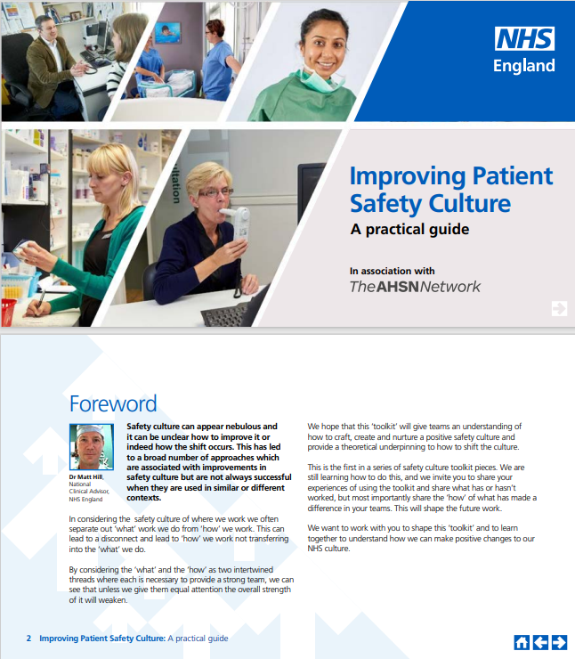
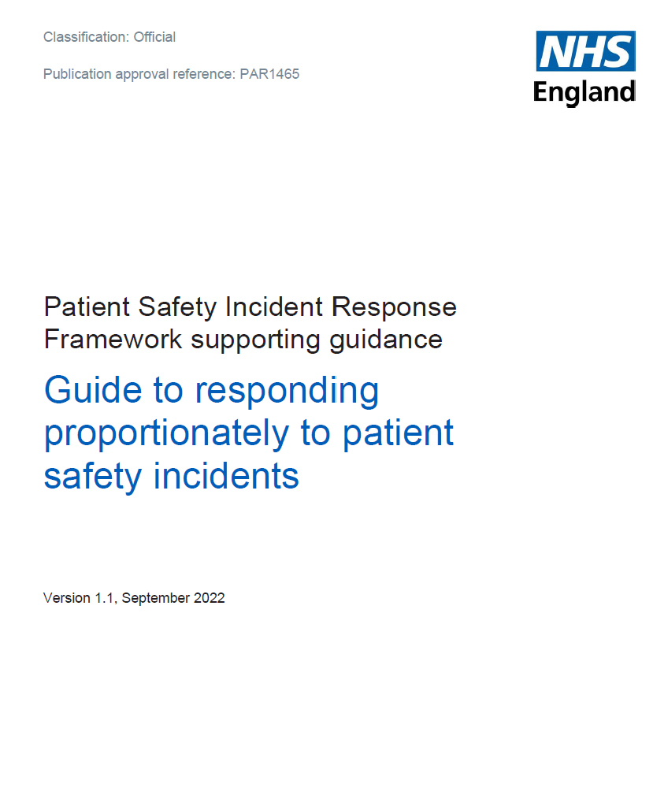
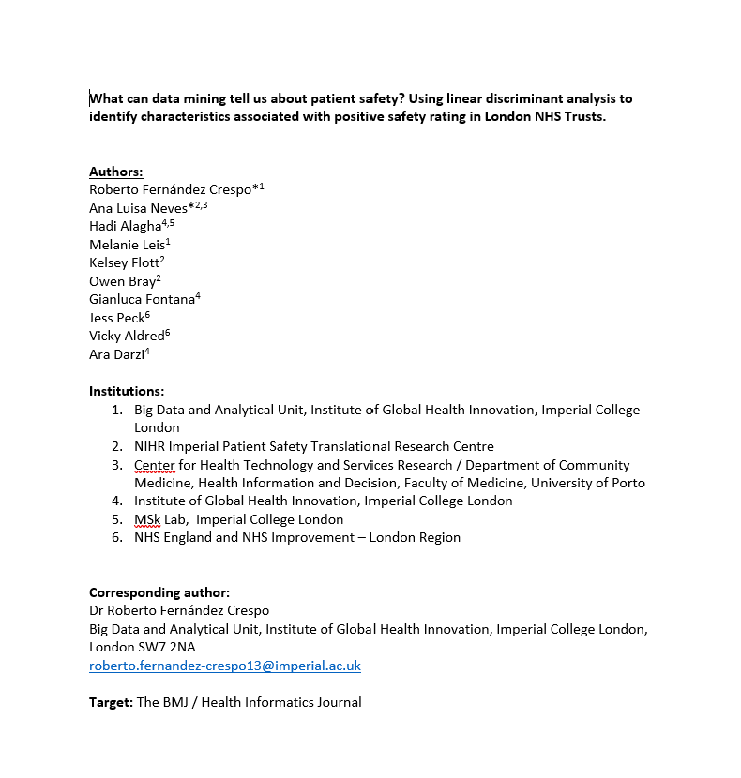
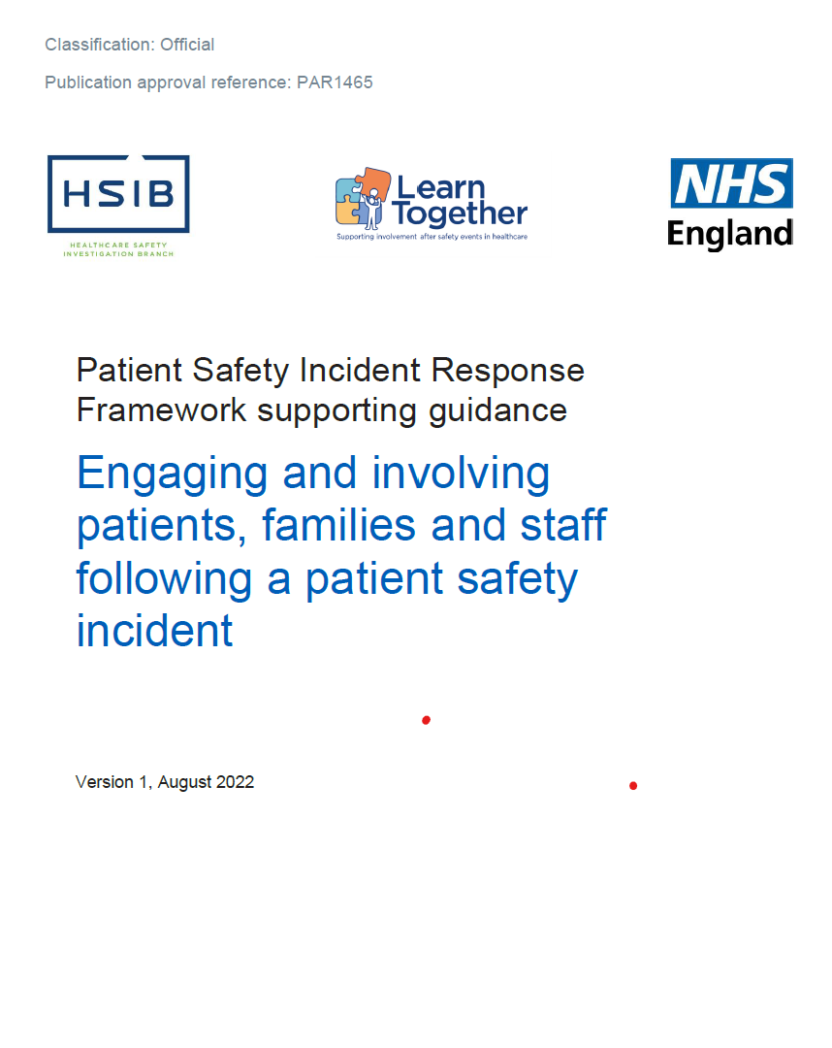
What work has happened since this
Notes:
Spare slide – unlikely to use

