Slide 1

Improving healthcare through family engagement

Slide 2
A journey from campaigning and listening - to collaboration , cultural and practice change

Slide 3
Our Mission, Vision, Purpose and Values
Improving healthcare through family engagement
Our vision is that healthcare is improved by working well with families, learning from them, and supporting them when things go wrong.
Our purpose is to work in partnership with health and care agencies to support the development of safer, more compassionate care by improving collaboration with families.
Our mission is to improve engagement between services and families, learning from families when things go wrong and using this learning to improve care and reduce harm.
Our underpinning values
Collaboration: working in partnership with families and with professionals
Authentic: sharing our lived experiences
Compassionate: understanding distress, bereavement and subjectivity
Power dynamics: understanding and acknowledging the power dynamic in co-production
Notes:
The values we developed at the Away Day

Slide 4

A Framework for a Partnership
In our experience, engaging with families is not simply a task; it’s a journey that creates stronger bonds, enriches experiences and it leads to lasting improvements in care.

Slide 5
What does this look like ?
A senior team with a deep understanding and commitment to family engagement.
A partnership with organisations and local families that enables collaboration, review, scoping and agreement of strategic plans that will ensure families feel confident to express their experiences and ideas.
An understanding of the culture of confidentiality and duty of candour in the organisation as experienced by families.
Systems and structures that embed listening and responding to the voices and experiences of families in the leadership and governance structure of the organisation.
Systems in place that enable families to fully participate.

Slide 6
The Foundations
Build understanding and commitment – Leadership level
“Empower” – existing structures
Family Feedback loops
Support skills building
Build family networks – Families as safety advocates, Safety buddies
Interactive safety workshops
Supporting families to contribute to Quality Improvement
Develop story telling initiatives

Slide 7
What this looks like in practice
A Family’s Experience

Slide 8

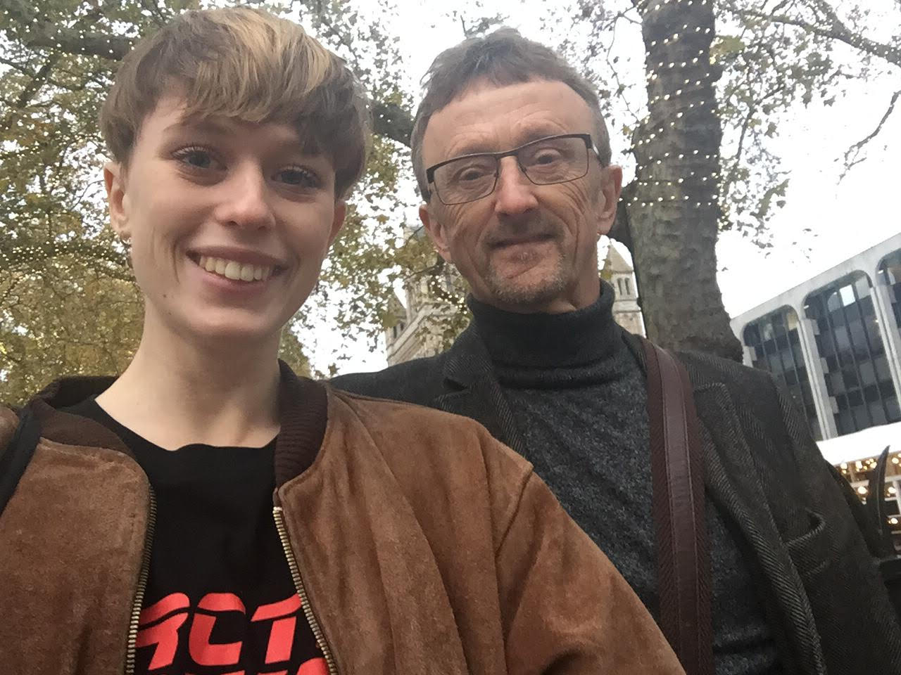
Tobi
What NSFT did
My involvement
What’s changed

Slide 9
Why our work is so important
Rosi Reed – Development and Training Coordinator, Making Families Count
Notes:
Jan general introduction and welcome

Slide 10
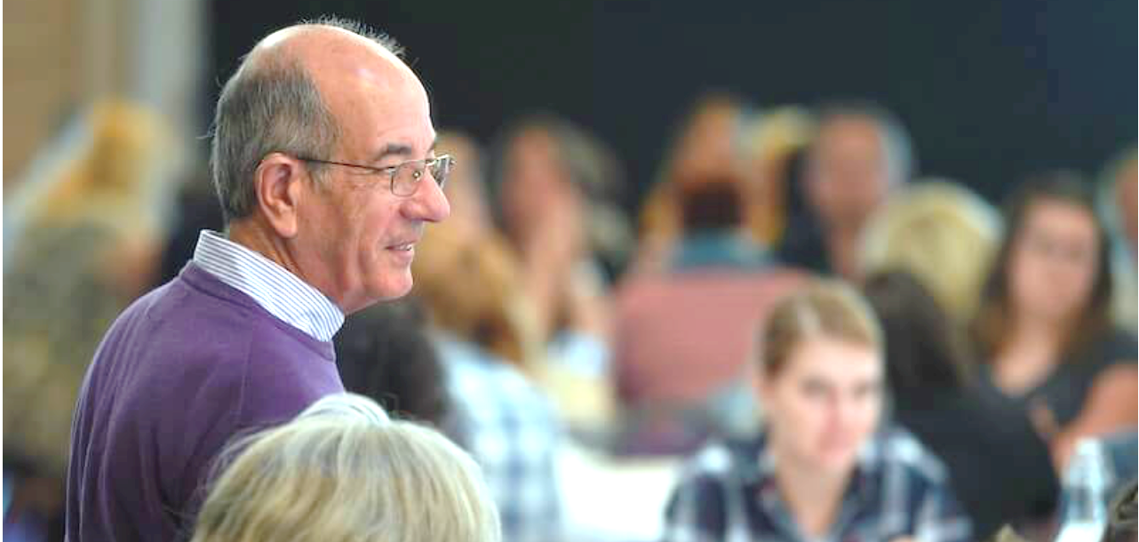
10 years of Making Families Count
Unique - We use the lived experience of family members together senior healthcare professionals to deliver our training.
Experienced – We have worked with hundreds of organisations, written a high regarded patient safety handbook and been involved in many high-profile projects.
Together – We are working with healthcare organisations to deliver high quality, impactful partnership and collaboration work.
Notes:
brief intro

Slide 11
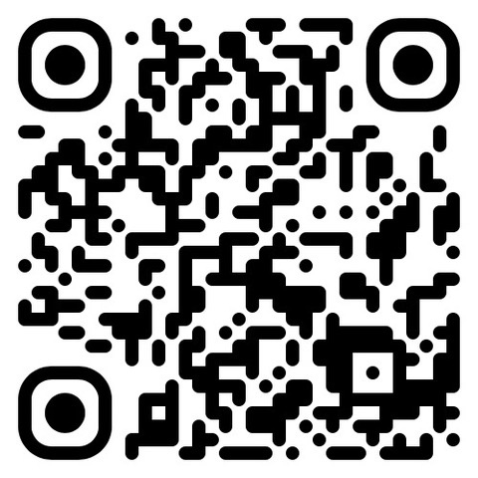
We are at STAND 33 - come and talk to us about how we can work with you to improve your organisations family engagement and patient safety
https://www.makingfamiliescount.org.uk/

