Slide 1
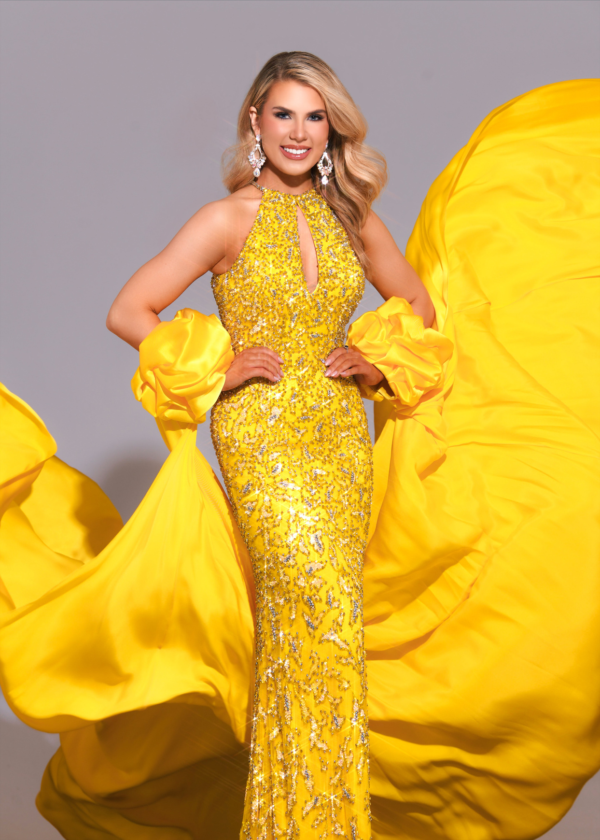

Vanessa Munson

Slide 2

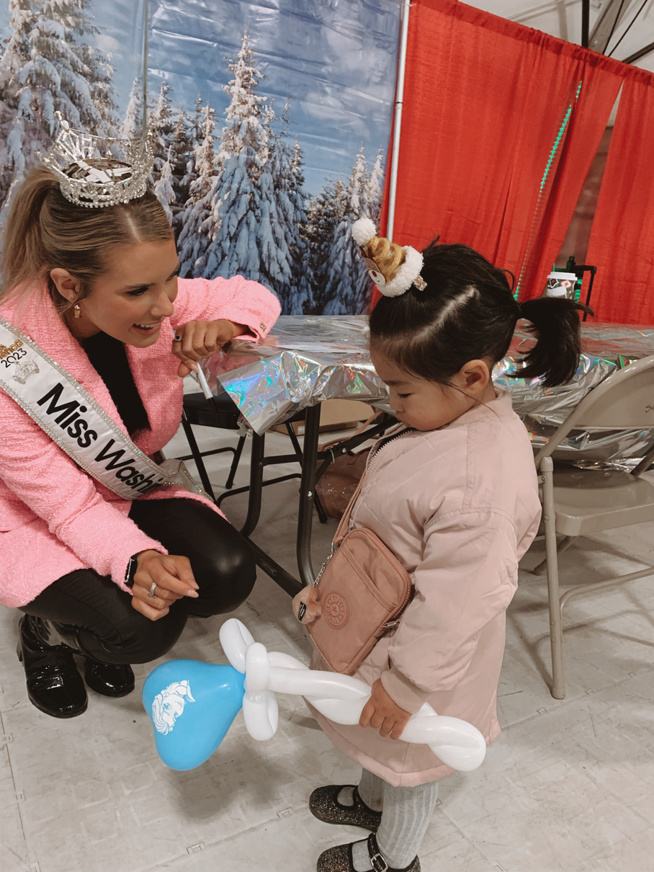
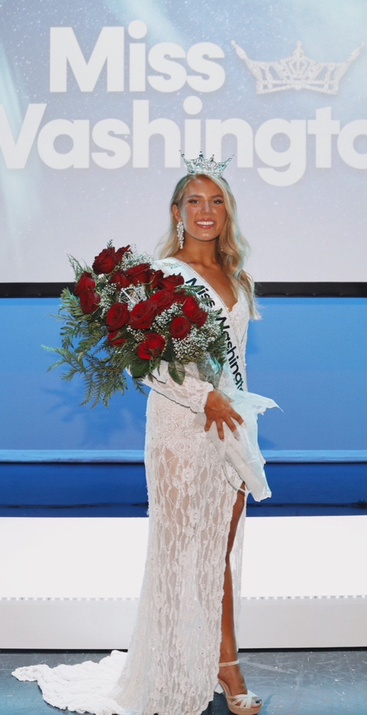
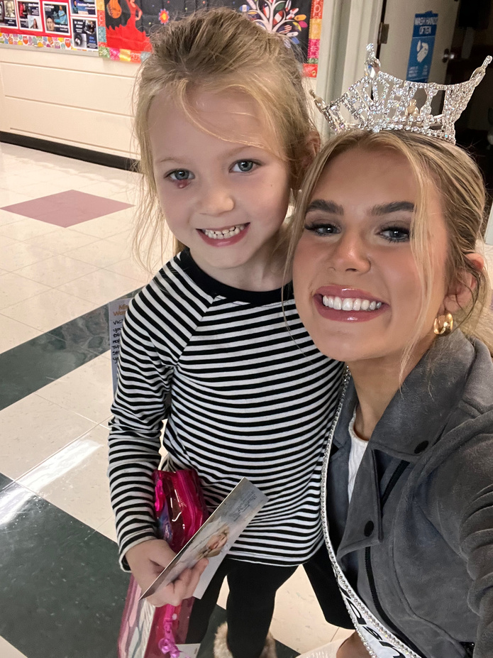
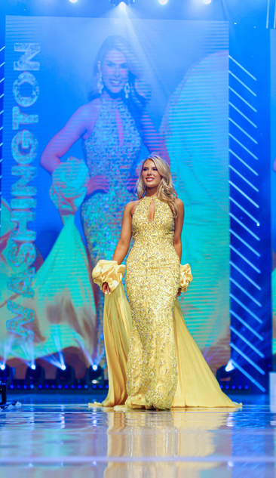



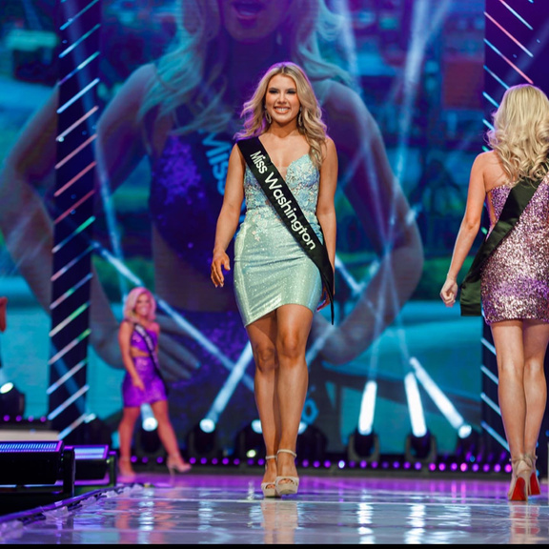
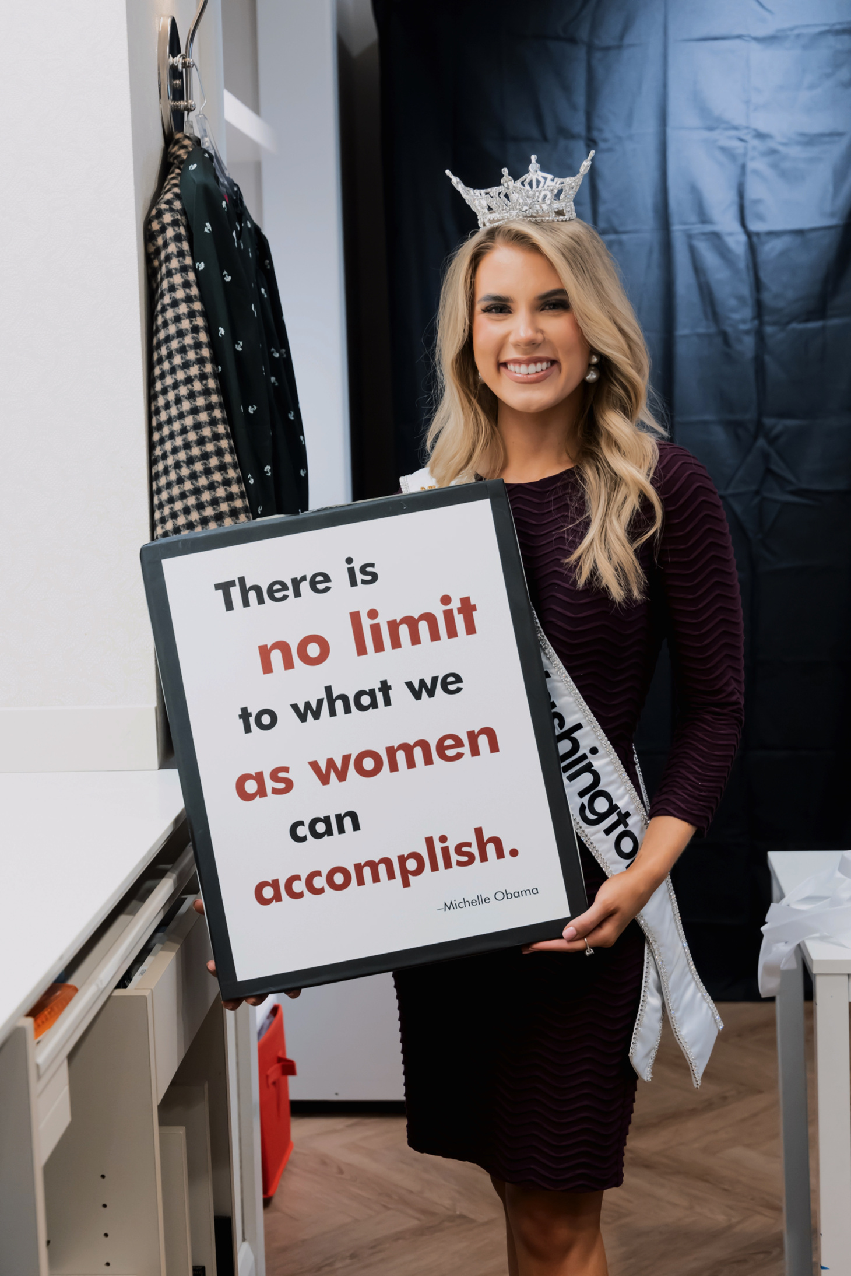
Who I Am

Slide 3

The Miss America Opportunity!
The Miss America Opportunity is the largest scholarship provider for women in the United States today. This is an organization that prides itself on service, style, scholarship, and success. The women that compete in this organization are change makers, leaders, and advocates for a number of different causes.

Slide 4

Reducing Barriers
As a woman who has faced many challenges to include affording education, physical circumstances, and in the work force. I know first hand what it means to be an advocate for yourself and well being.
  Paving a way for education
  Physical and Mental well being
  Becoming your biggest advocate

Slide 5
Practical Applications
Advocacy: Remaining strong in your convictions and what you bring to the table
Affirmations: Reminding yourself of your worth and your capabilities
Resilience: When you lose you learn, get knocked down ten times get up eleven

Slide 6

Practical Applications Cont..
Belief in Yourself: Go with your gut
Take the Leap: Don’t be afraid to take risks
Network: Connect with anyone and EVERYONE

Slide 7
YOU ARE YOUR OWN BEST THING. OWN IT!

