Slide 1
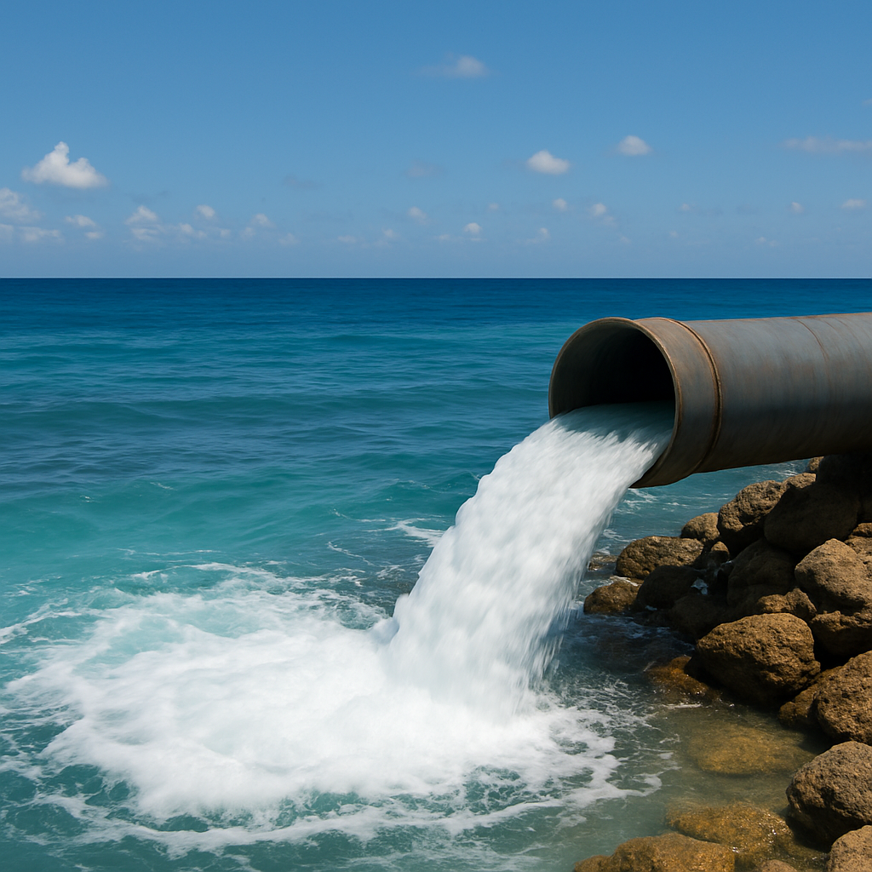

Turning high saline wastewater into valuable resources for a circular, sustainable future

Slide 2
Namibia’s industrial development depends on importing chemicals it currently dumps into the ocean as waste. We want to solve this.

Slide 3
The Problem
Namibia’s industrial development comes with growing environmental and economic risks
Desalination is crucial to Namibia meeting its growing industrial & domestic water demand but brings major environmental challenges
2.6 million m³
+67%
Volume of brine pumped into ocean monthly
Salinity of brine compared to ocean water
2x
20 km²
Increase in sulfur plumes due to brine deposition
Marine habitat threatened by one desalination plant
Source: Erongo Desalination Plant 2023 Data
Namibia depends on imports of key chemicals present in desalination waste
2140
US$28m
Trucks of imported chlor-alkali chemicals (annually)¹
Spent importing chlor-alkali chemicals (annually)²
Source: (1) Namibian Statistics Agency (NSA); (2) GCIP Impact Report Tool

Slide 4
The Opportunity
Chlor-alkali chemicals are key inputs for industries like mining, desalination & manufacturing
Size of Caustic Soda market
01
SOM
Namibia has a growing demand for chlor-alkali chemicals & no local manufacturing
02
SAM
SSA has growing demand but contributes only ~3% of global production
03
TAM
The wider market beyond SSA is not currently a priority
Source: World Bank (2023). Namibia trade statistics: Imports of product 281512 (Sodium hydroxide in aqueous solution); Coherent Market Insights 2021 report

Slide 5
The Solution: Brine Valorization
Utilizing desalination waste for local, sustainable chlor-alkali chemicals production
Treat desalination brine waste stream
Concentrate brine waste stream to reach sodium chloride purity level for chlor-alkali process. Potential to stockpile & sell by-products
60
tons/day
Produce chlor-alkali chemicals from treated brine
  Use chlor-alkali process to produce caustic soda, chlorine, hydrogen & derivatives from brine for industry (mining, desalination, manufacturing)
Caustic soda production capacity plant to be built in Wlotzkabaken in the Erongo region of Namibia
Reduce environmental impact & import dependency
  Aiming for capacity to utilize all Namibia’s desalination waste & supply all Namibia’s industrial demand for chlor-alkali chemicals

Slide 6
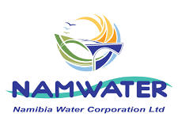

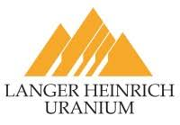

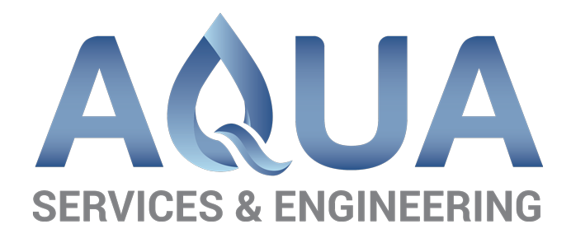
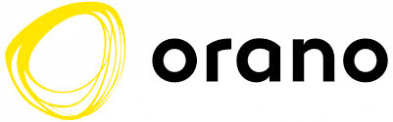

Our Business Model
We are engaging partners up- & downstream of us and have secured commitments
Suppliers
Manufacturer
Distributors
End users
Our facility will be located near existing desalination facilities with waste brine supplied via pipeline
We will concentrate the brine and utilize the chlor-alkali process to produce industrial reagents
We will sell our products to local chemical distributors who currently supply the market
End users purchase our locally produced chemicals with no need to alter existing supply agreements

Slide 7
Our Strategic Advantage
We are well-positioned to displace incumbent chlor-alkali chemical suppliers
Most of Namibia’s chlor-alkali chemicals are supplied by South Africa based producers like Protea Chemicals, Strata Chemicals, Mondi Group & Sasol Polymers.
Green Brine has significant competitive advantage over the current suppliers
Local production
Producing near end users cuts costs, risks & time associated with delivery logistics
Trade protection
Access to infant industry protection from Namibian Ministry of Trade & Industry as a local producer
Sustainability certification
Using waste stream as input & clean power enables cost-competitive, sustainability certified products

Slide 8
Our Impact
Our project is a boon for the environment, the economy and local communities
2.6 million m³
Providing a scalable solution to reduce environmental impact of growing desalination industry and protect aquatic life
Brine disposal mitigated monthly¹
60 tons/day
Reducing Namibia’s chemicals import dependency and forex exposure and increasing supply chain resilience
Production of chlor-alkali chemicals
>8000tCO₂
Supporting Namibia’s industrialization and providing local communities with employment and upskilling opportunities
Emissions mitigated annually²
Source: (1) Erongo Desalination Plant 2023 Data; (2) GCIP Impact Report Tool

Slide 9


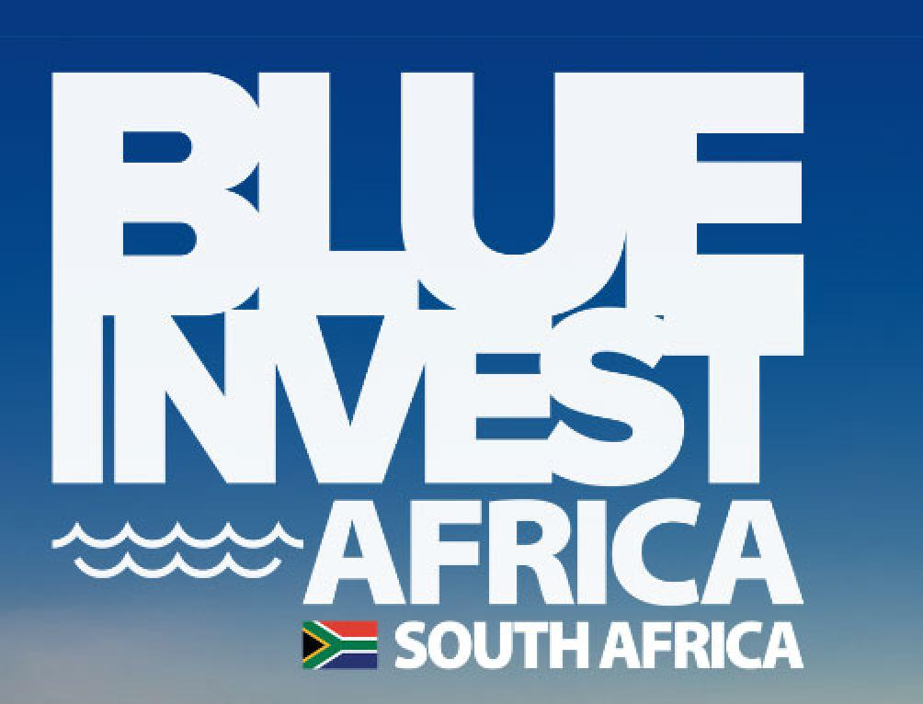



Our Traction
Our project is still being developed but has received national & international recognition
US$13.4m
Value of Letters of Intent (LOIs) signed with industrial offtakers in the Erongo region
Selected as eligible for concessional capital in Namibia–CIF Industrial Decarbonisation Programme
Finalist in BlueInvest Africa Summit organised by European Commission Global Gateway (Nov 2026)
Listed on the investment catalog of Namibia Investment Promotion & Development Board (NIPDB)
Accepted into the Ocean Hub Africa Accelerator for promising Blue Economy startups
Finalist in UNIDO-sponsored Global Cleantech Innovation Programme (May 2026)

Slide 10
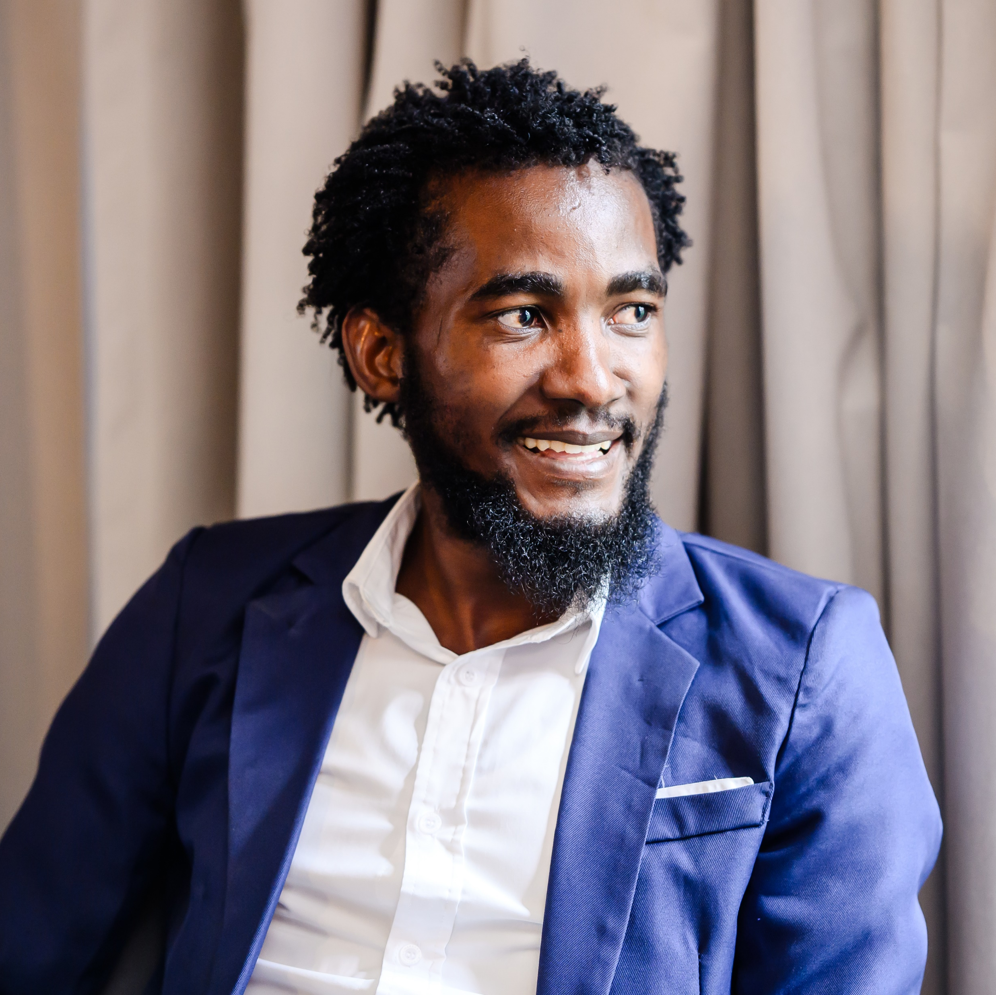
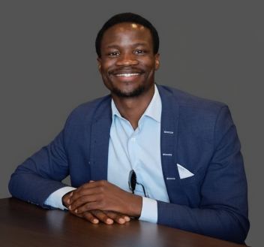
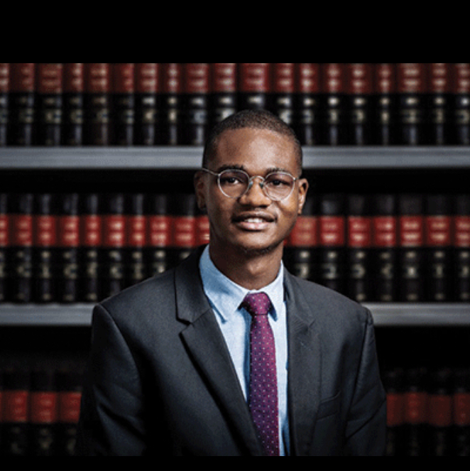
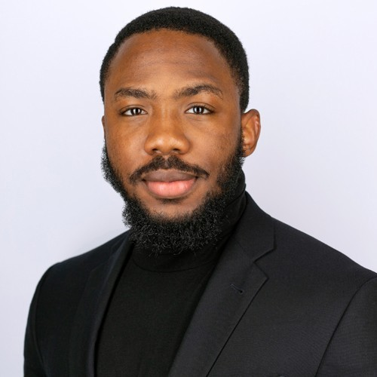
The Team (1/2)
We have a high caliber team primarily consisting of local Namibian talent
Essley Kalola
Project Director
3 years leading technology & infrastructure design, R&D and project development
BSc Chemistry, MSc Renewable Energy University of Namibia (UNAM)
Martin Itamalo
Project Manager
3 years of business dev, project management & stakeholder engagement
BSc Chemistry UNAM
Wayne Rukero
Head of Legal
5+ years in corporate law at top Southern African law firms (Bowmans, ENS)
LLB UNAM, LLM Loyola University New Orleans
Daniel Ogbonna
Strategy & Investment Lead
5+ years in climate strategy & investment at Accenture UK & Macquarie Group UK
MEng Chemical Engineering Imperial College London

Slide 11
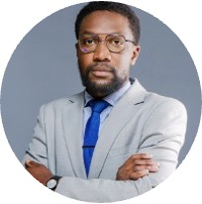

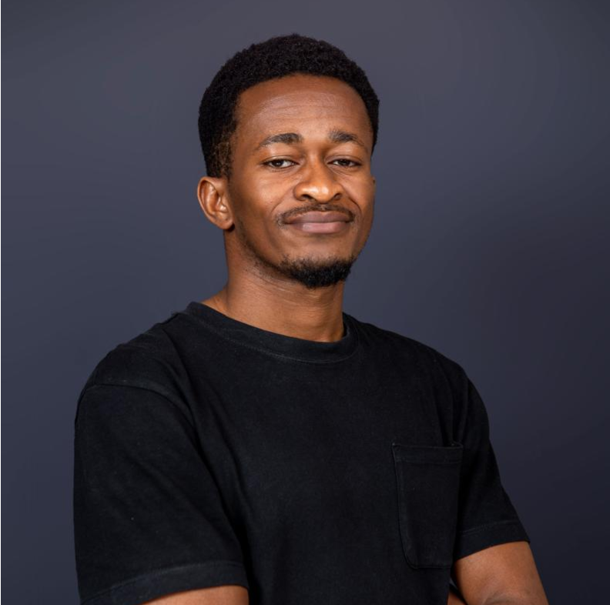
The Team (2/2)
We have a high caliber team primarily consisting of local Namibian talent
Leonard Shihepo
Lead Accountant
BMC Certified Accountant leading financial modelling, analysis & optimisation
BSc Hons, Accounting & Finance Namibia University of Science & Technology (NUST)
Fadzai Nyamarebvu
Legal Advisor
3 years of international law & project management in Southern Africa & Europe
LLB UNAM
Benita Strauss
Tax & Regulatory Advisor
Specialist in Namibian Revenue Agency compliance (VAT, PAYE, tax registration)
BSc Accounting UNAM
Werner Muzanima
Financial Administrator
Manages financial operations (recording, filing, regulatory compliance)
BSc Accounting NUST

Slide 12
The Ask
We are asking for a funds to enable further project development & breaking ground by Q3 2027
Provisional financial projections*
EUR 835k
Currently in discussion with OEMs & EPCs
Project development funds, with estimated total cost of EUR 53m
EUR 68.5m
EUR 10.4m
Land sale sub-division & rezoning applications | 5,900
Environmental Impact Assessment (EIA) | 7,100
Basic & detailed plant engineering design | 450,000
Site establishment (clearing & access, roadworks, fencing) | 272,000
9 months working capital (rentals, salary, IT, partner site visits) | 110,000
Total | 835,000
Net Present Value
(11.95% discount rate)
Net profit in fifth year of operation
Year 4
EUR 53m
Estimated project break even timeline
Total project cost
Open to blended structures with debt, grants & equity
Note: Financial projections are subject to change following the outcome of discussions with technology partners on lowest cost process option

Slide 13
info@greenbrinetechnologies.com
www.greenbrinetechnologies.com
+264817465885
+264813813396

