Slide 1





BREATHING LIFE INTO AIRLINE RETAILING

Slide 2


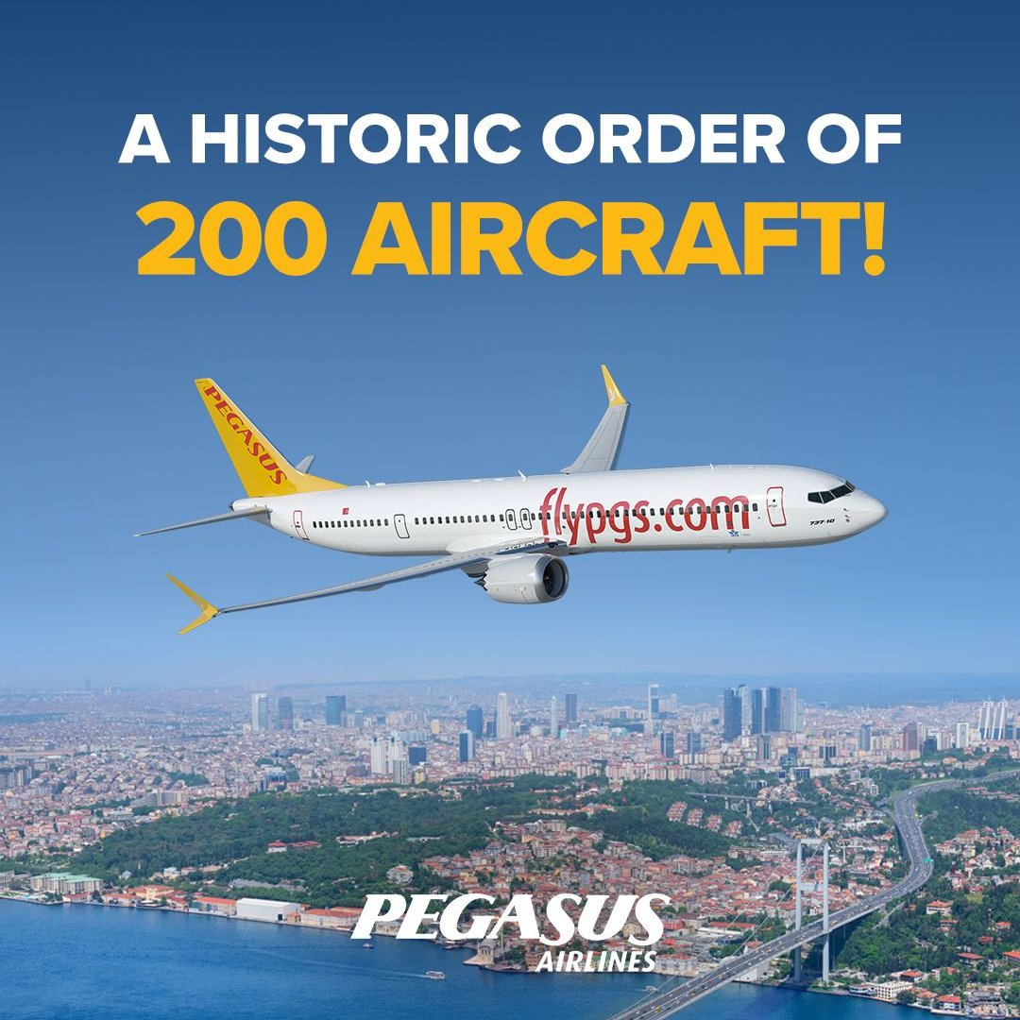



ABOUT PEGASUS
World’s 2nd Youngest Fleet…
Historic Aircraft Order…
For 20 years, more to come…

Slide 3



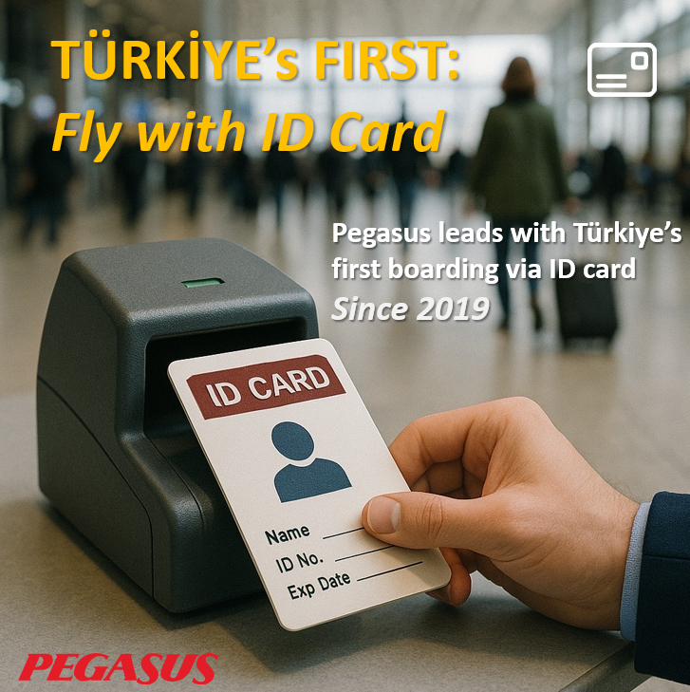
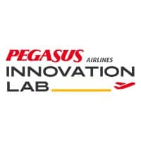


ABOUT PEGASUS
Fast Track Integration
with Plaza Premium
Innovation Lab
A Presence in Silicon Valley
AI Assistant PEGGY
Türkiye’s First Boarding with ID

Slide 4






HITIT AT A GLANCE
Hitit (IATA: 1T, BIST: HTTBT) is a leading global provider of airline and travel IT solutions, with 72+ customers from 50 countries.
Hitit’s solutions cover the entire airline business lifecycle, from planning to reservations to settlement and reporting.
Solutions are fully configurable and serve airlines of all types and sizes,
ranging from FSCs to Hybrids and ULCCs, including multiple Tier 1 airlines.
Crane PSS is 2nd largest in Europe and 3rd largest globally, serving a network of
100+ million passengers, 30.000 agents and 850 airports in 160 countries.
Based on independent market research, Hitit is the fastest growing PSS provider in the industry as well as the top choice for startup airlines in 2024.

Slide 5

WHAT ABOUT AIRLINE RETAILING?
For over 2 years Hitit is the #1 ranked IT Provider in IATA’s Airline Retailing Maturity (ARM) Index.
Recognized by IATA Airline Retailing Consortium as one of the six IT providers in the world with end-to-end OOSD capabilities.
In June at the IATA Offers & Orders Forum 2025, together with Pegasus Airlines we have launched Hitit Oxygen - and immediately became the industry’s largest airline retailing implementation.

Slide 6





TRANSITION TO OFFERS & ORDERS - PROGRESS OVERVIEW
24
1 BILLION
AVR DAILY OFFER
TEST
LIVE
MIGRATION
Q1
Q2
Q3
Q4
NDC 24.1 test environment was set up.
Tests started.
NDC 24.1 went live.
45% of the current volume has gone live.
Migration continues with OTAs and aggregators.
Gradual Transition is adopted.
Our future plan is to transition our GDS volume to Offers and Orders in 2026.
We will be keeping a strategic eye on enhancing third party collaborations via Hitit Oxygen.
PNR & ORDER
TOGETHER
HALF YEAR NDC VOLUME
TOTAL PAX
DAILY AVR. TRX.
ACTIVE # of SELLER
5,7 M
105 M
207

Slide 7






PEGASUS JOURNEY TO INDUSTRY LEADERSHIP
ALL-IN PROJECT SCOPE COVERING
146 DESTINATIONS IN 53 COUNTRIES
1 BILLION OFFERS / DAY
24 DIFFERENT ANCILLARIES
12 MILLION ANNUAL PAX VOLUME
VIA OFFERS & ORDERS BY EOY
ALREADY LIVE. RIGHT NOW.

Slide 8








PEGASUS JOURNEY TO INDUSTRY LEADERSHIP
PHASE 1: THE FUNDAMENTALS
PHASE 2: PLANNING
Refining Awareness into Actionable Insights
Prioritizing Short-to-Mid Term Outcomes
Envisioning a ‘‘No-Holds-Barred’’ End State
Deciding on ‘‘Blue Ocean’’ vs ‘‘Greenfield’’
Mapping from the End State Back to Today
Prerequisites, Dependencies, Steps, Goals
Aligning Across Silos and Key Stakeholders
Integrated Action and Communication Plan

Slide 9
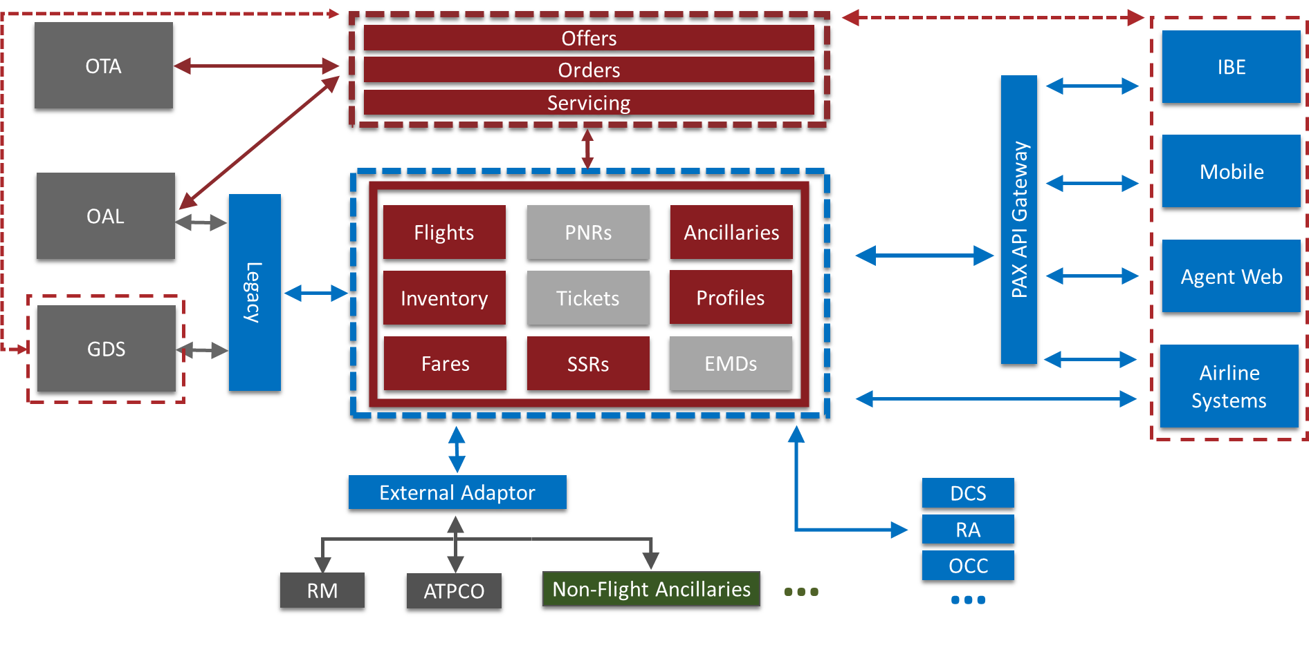

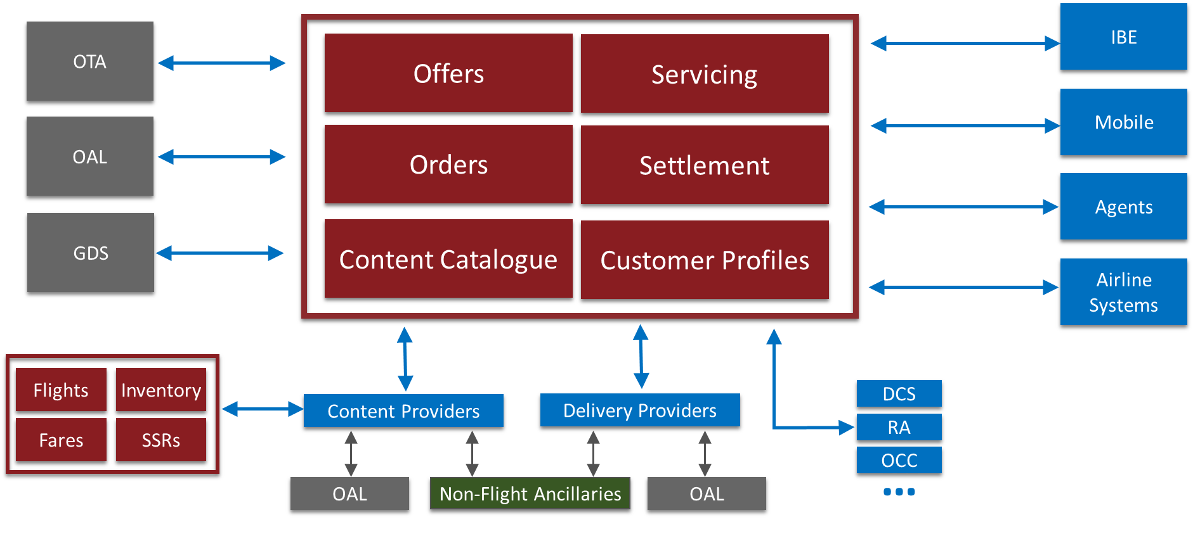

PEGASUS JOURNEY TO INDUSTRY LEADERSHIP
PHASE 3: TECHNICAL DESIGN
PHASE 4: EXECUTE & LAUNCH!

Slide 10
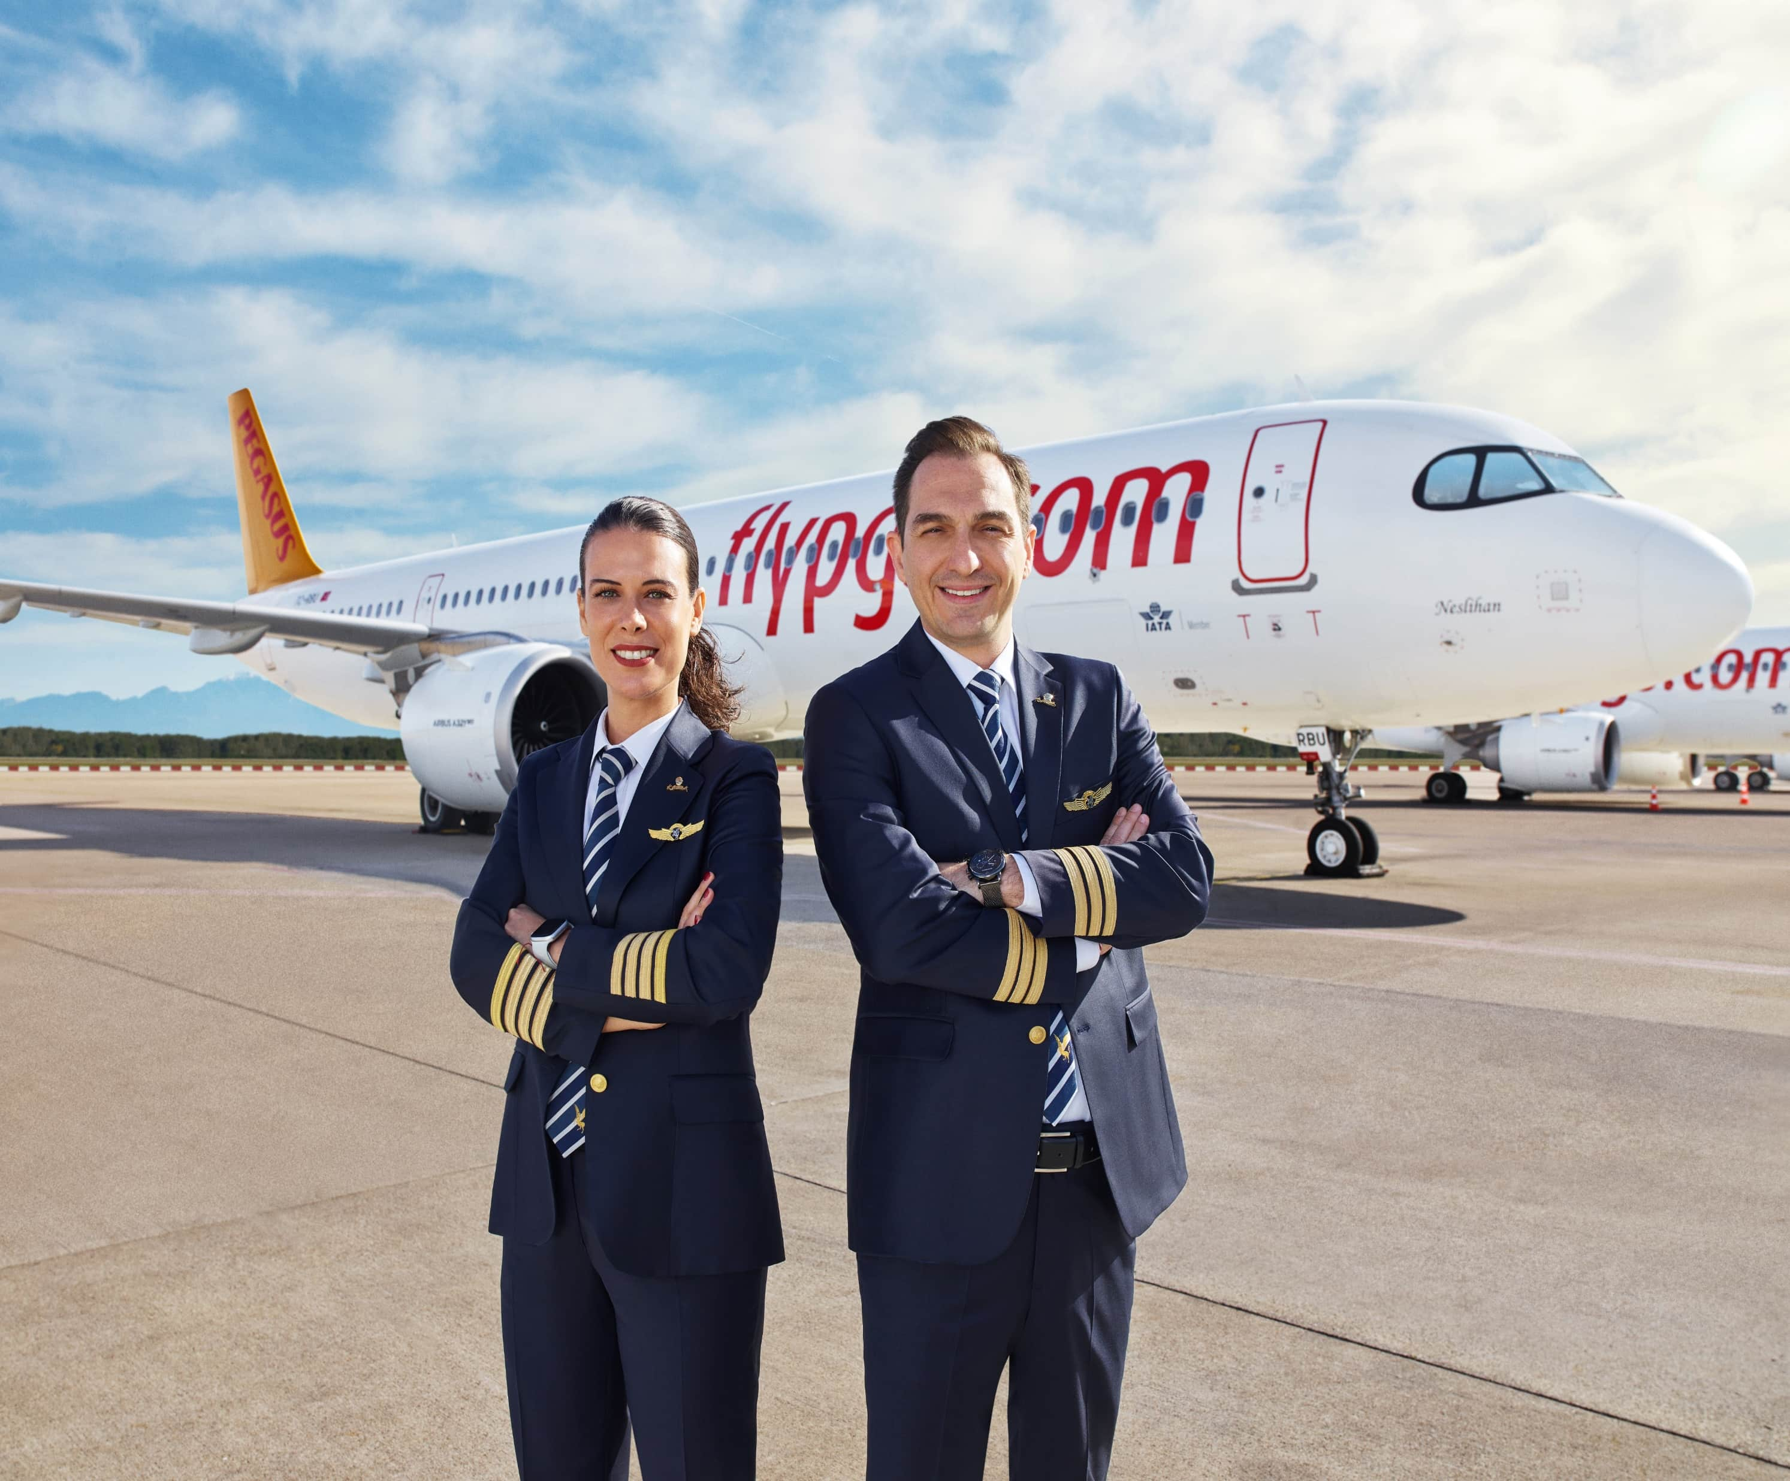
THANK YOU.

