Slide 1


China Natural Products Market Briefing
eCommerce & Digital Growth
Peter McMath
Chief Revenue Officer

Slide 2

ABOUT WPIC
WPIC Marketing + Technologies is the world's leading e-commerce and digital consultancy, driving market growth for organisations in China, Japan, South Korea, and Southeast Asia.
400
HEADCOUNT
9
650 19
^{CLIENTS} EXP^{YEA}RE^{R}IENCE^{S OF}
GLOBAL
OFFICES

Slide 3


























CLIENT PORTFOLIO

Slide 4










END-TO-END SOLUTIONS FOR APAC MARKET GROWTH
Data
Marketing
Commerce
Technology
Operations
Market & Competitor Analytics
Search & Social Metrics
E-commerce
Insights
Data Collection
Market Updates
Targeted Social Media Strategies
Content Creation, Localisation & Design
Livestreaming &
Video Production
Influencer
Partnerships
Digital Advertising
Optimised Media
Spending
Platform Activation
Regional E-
commerce
Store Optimization
Store Operations
Logistics
Management
Merchandising
MOR & IOR
Customer Service Training & Management
Integrated Analytics
Single Source Inventory Management
ERP Integration
Payment integration
App Localization
Cloud hosting
Inbound Freight
Management
Free Trade Zone Operations
Cross Border Fulfillment
Forecasting
Compliance &
Certifications
3PL
Warehousing
Custom Printing & Packaging

Slide 5
₂nd
US$488.5B HEALTH SUPPLEMENTS MARKET
Channel Distribution in China’s
Supplements Market
28%
42%
60%
Largest in the world after USA
8.20%
CAGR (2025-2029)
US$76.4 Billion
CBEC imports 2024
2016
Supermarkets Direct Sales
2020
2024
Pharmacies E-commerce

Slide 6


ECOMMERCE LEADS NATURAL PRODUCT SALES, ESPECIALLY ON TMALL AND DOUYIN.
Overseas Supplements
E-commerce Market Share
Sales Revenue & YoY Growth Rates by Platform
$9.63B
$8.27B
2023
2024
+16.5%
49%
$3.46B
21%
$2.68B
$2.22B
30%
$1.48B
+20.8%
+133.6%
Tmall JD Douyin
Tmall
JD
Douyin

Slide 7
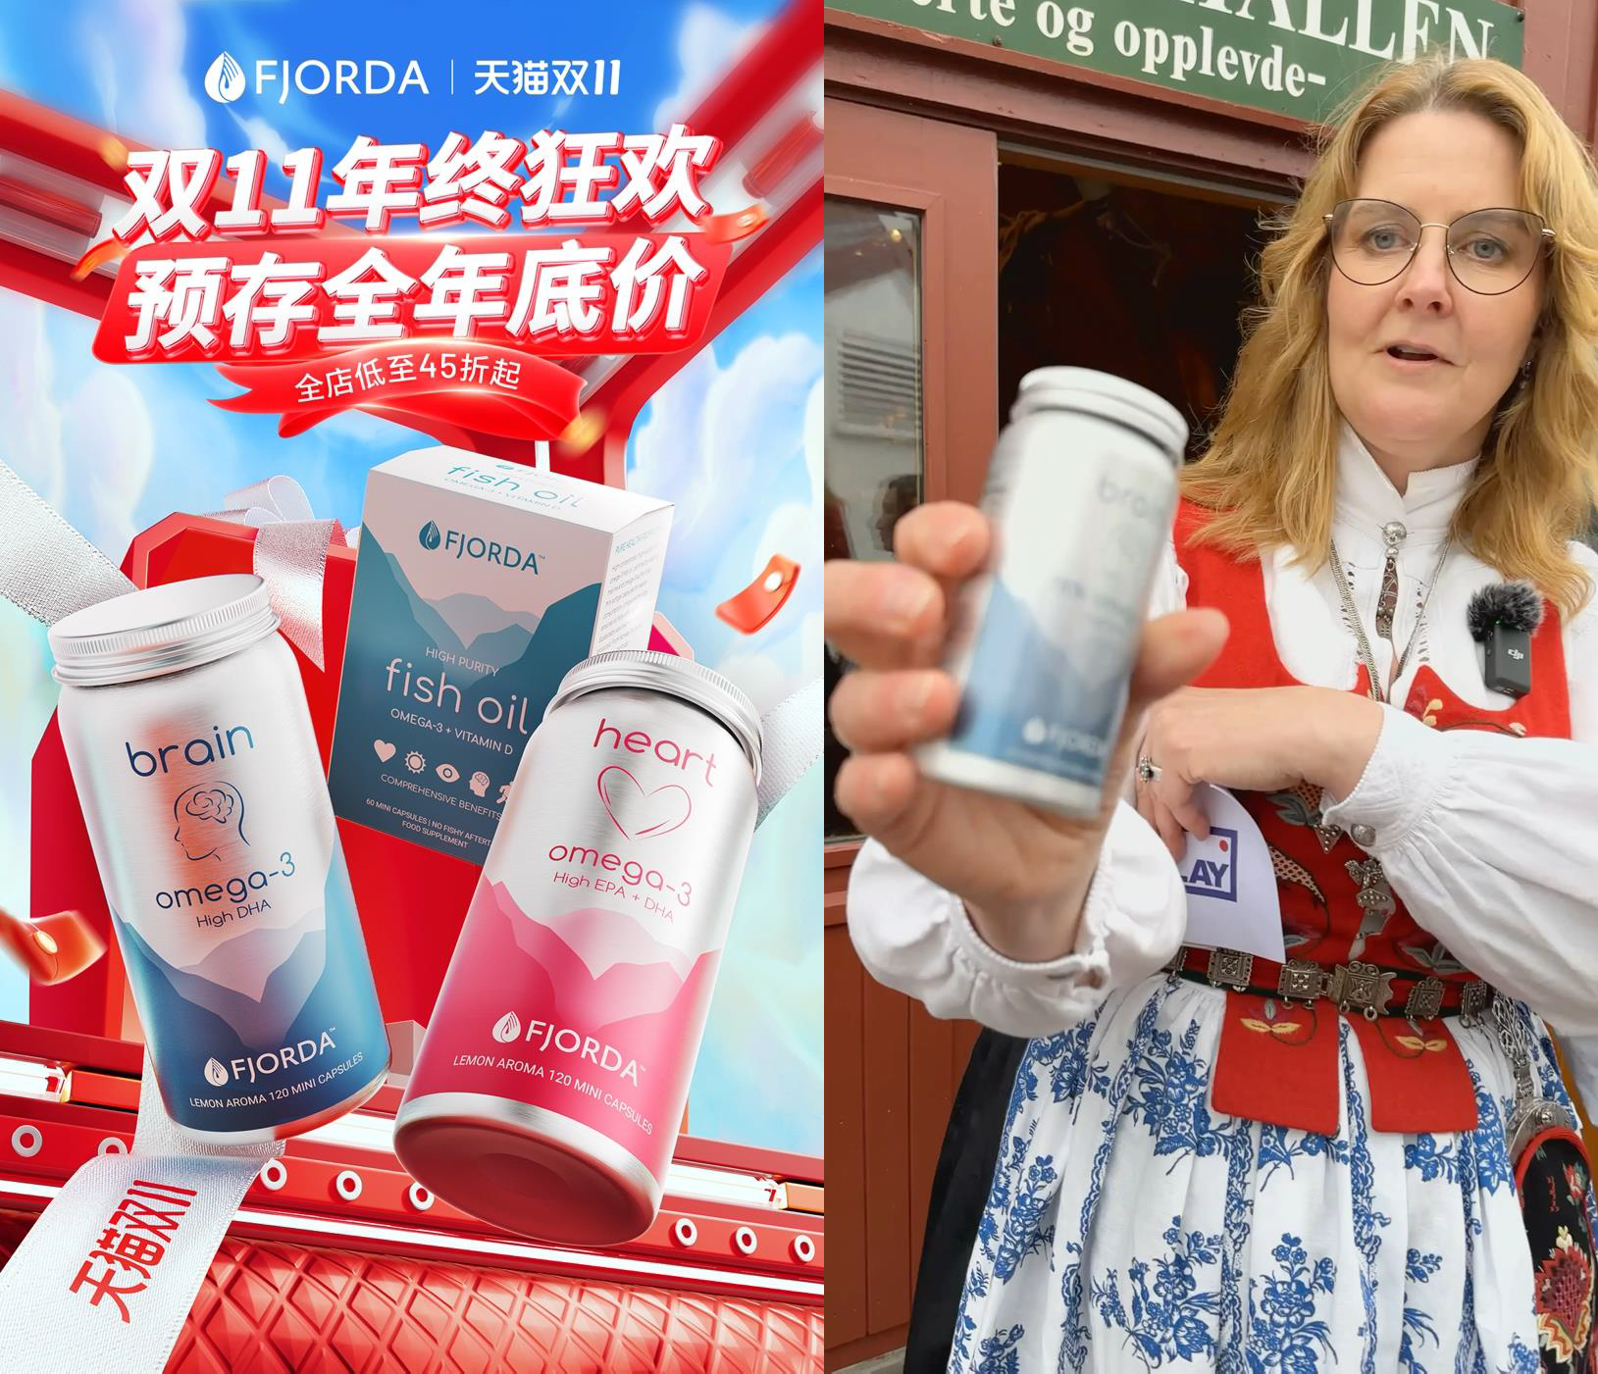
$2.3 Billion on Tmall
SINGLES’
DAY 2024
+11% growth YOY

Slide 8

$695.5 Million on Douyin
SINGLES’
DAY 2024
+78% growth YOY

Slide 9


TMALL & DOUYIN GROWTH IN SUPPLEMENTS SUB-CATEGORIES
Tmall Douyin
384%
Sport Nutrition
+55%
Douyin
Vitamins / Minerals category is booming
Tmall
+21%
Douyin
174%
152%
132%
65%
55%
9%
43%
11%
Calcium
6%
8%
2%
Beauty
+39%
Beauty
+152%
Douyin
Vit. D Magnesium
Protein
Fish Oils
Bone & Joint
+65%
Tmall
Powder

Slide 10


PREFERRED WAYS TO IMPROVE HEALTH IN CHINA 2025
Take Supplements
Exercise Rest & Recreation Food Therapy
Buying Fitness Equipment
Massage Therapy Smoking & Alcohol Cessation Psychological Counseling
64%
61%
57%
57%
55%
34%
25%
12%

Slide 11

CONNECTING WITH CHINESE CONSUMERS

Slide 12









2025 CHINESE CONSUMER JOURNEY
Awareness Consideration Decision
Retention Loyalty
Brands must now guide customers through a streamlined, one-step journey using an integrated omnichannel strategy.
Social commerce is transforming e-commerce in China, moving from traditional sales tactics to enriching the customer journey.

Slide 13

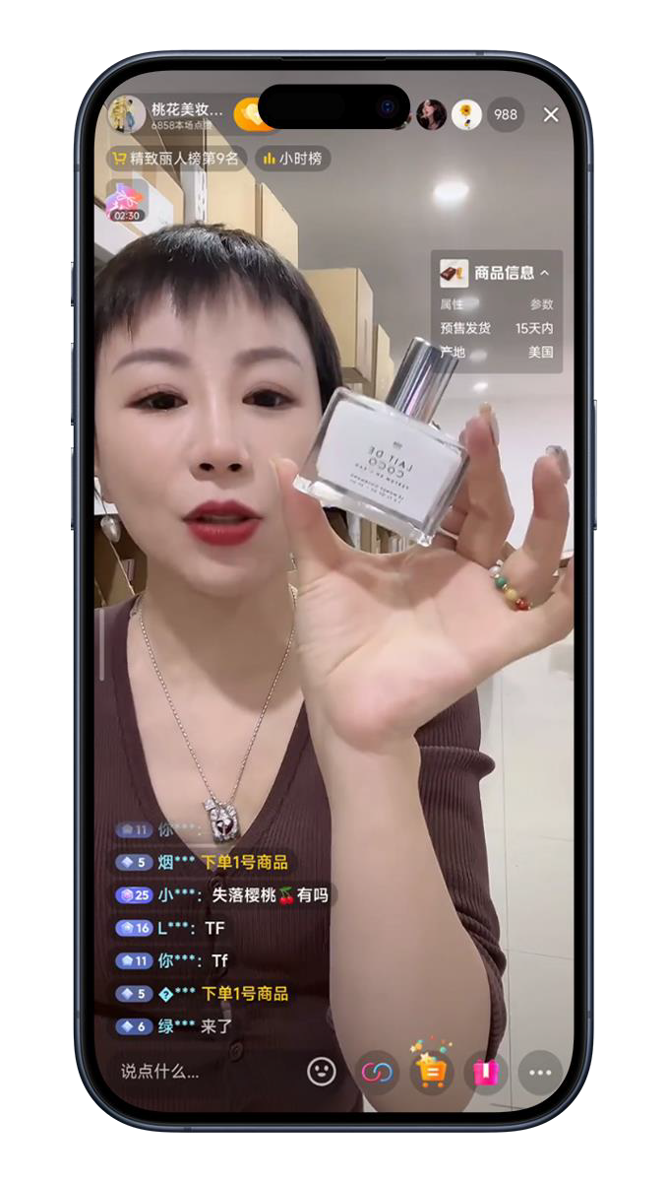

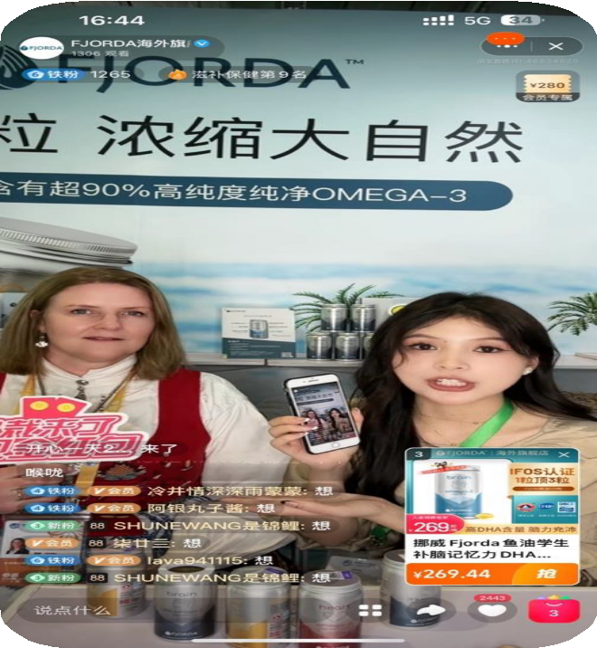
LIVESTREAMING ON DOUYIN
Product sold 19 times more when livestreamed over 6+ days, than when livestreamed 1x day per week.
63%
Share of Douyin’s 2024 total
sales from livestreams
19x
Order placed / account
68%
Share of Douyin’s 2024 health supplements GMV generated from expert-led livestreams
1+
2+
3+ 4+
Days livestreamed / week
5+
6+

Slide 14









Content-to-Commerce
High levels of attention
Quick conversion of attention
Tactical driven initiatives
Ad-to-Commerce
Conventional funnel strategy
Advertise to create awareness
Drive traffic volume to store
Community-to-Commerce
Word of mouth driven
Focus of CRM & repeat sales
Community cultivation
CONVERSION & BRAND DEVELOPMENT

Slide 15

OPPORTUNITY FOR FJORDA

Slide 16
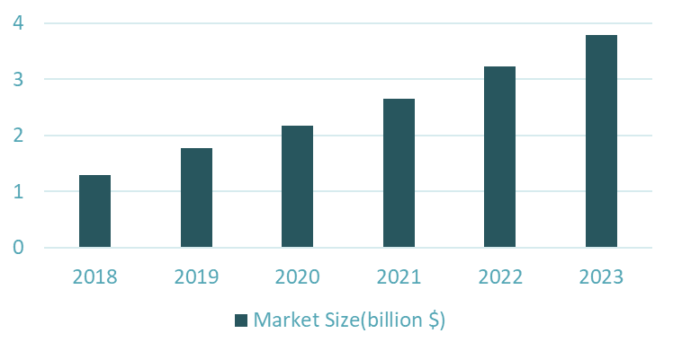
MARKET SIZE & OPPORTUNITY
Chinese & American Consumers' Cognition On Omega-3
51%
38%
23%
_{25%} 28%
China's Omega-3 market soared from $770 million in 2016 to $2.18 billion in 2020. That's an impressive CAGR of over 30% – eclipsing the 5%–10% growth in Europe and America.
Key Growth Drivers:
An ageing demographic pursuing brain- health solutions.
Young adults facing academic and work- related pressures and escalating obesity trends.
Significant potential as fish oil awareness in China remains untapped.
14%
19%
2%
Know a little bit of
benefit
Never heard
Know it well
China US
Just heard but don't
know much
2018–2023 China Omega-3 Market Size

Slide 17

FJORDA MARKET DYNAMICS
Chinese consumers are increasingly seeking high-quality Omega-3 supplements. Key concerns include capsule size, Omega-3 concentration, and aftertaste.
Launched in October 2022, Fjorda is a premium fish oil supplement brand from Norway made for Chinese consumers. It delivered a solution with compact, high- concentration, odorless capsules.

Slide 18





WPIC TAILORED SOLUTION FOR FJORDA
Data Insights
Deepened understanding of the Chinese market.
Brand Localization
Tailored branded creative assets for the Chinese audience.
E-commerce
Launched on Tmall Global, China’s top
crossborder e-commerce platform.
Digital Marketing
Elevated online presence and engagement.

Slide 19

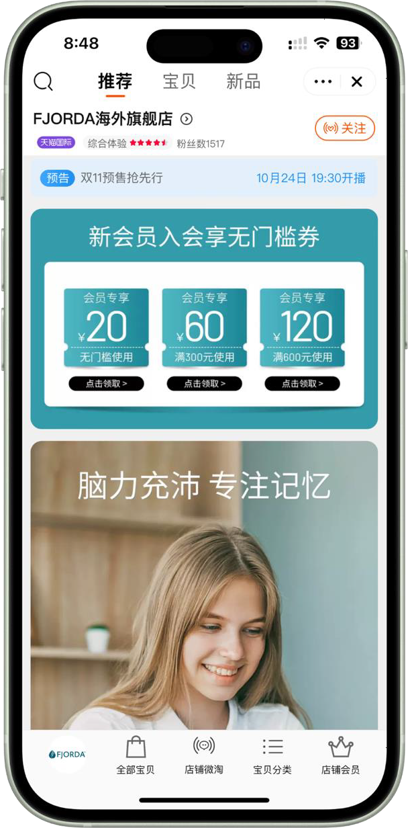
STORE ACTIVATION
WPIC launched Fjorda on Tmall Global —
from concept to live stores.
Product Presentation: We shaped the brand voice – every product page speaks Fjorda messaging and positioning.
User Experience: Our optimizations made the store user experience easy and seamless.
Pricing Strategy: Leveraging Discripto® insights, every SKU was optimally priced.

Slide 20



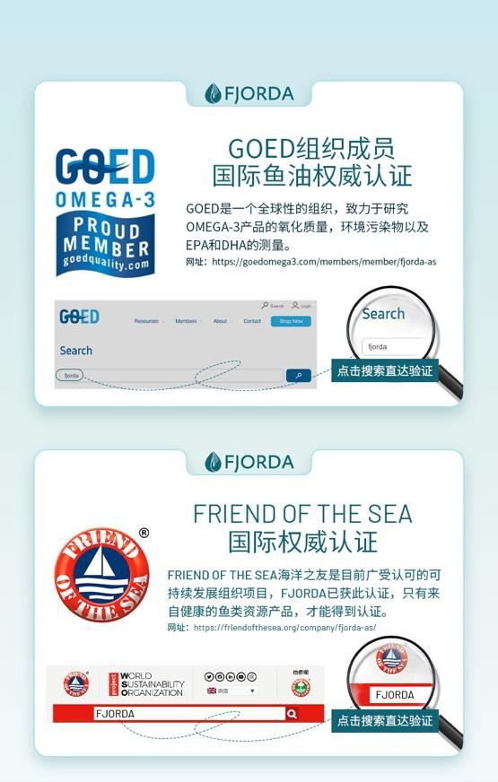

STORE LAYOUT OPTIMIZATION
Showcasing premium raw materials
Certifications that speak volumes
Influencer seal of approval to boost recognition

Slide 21
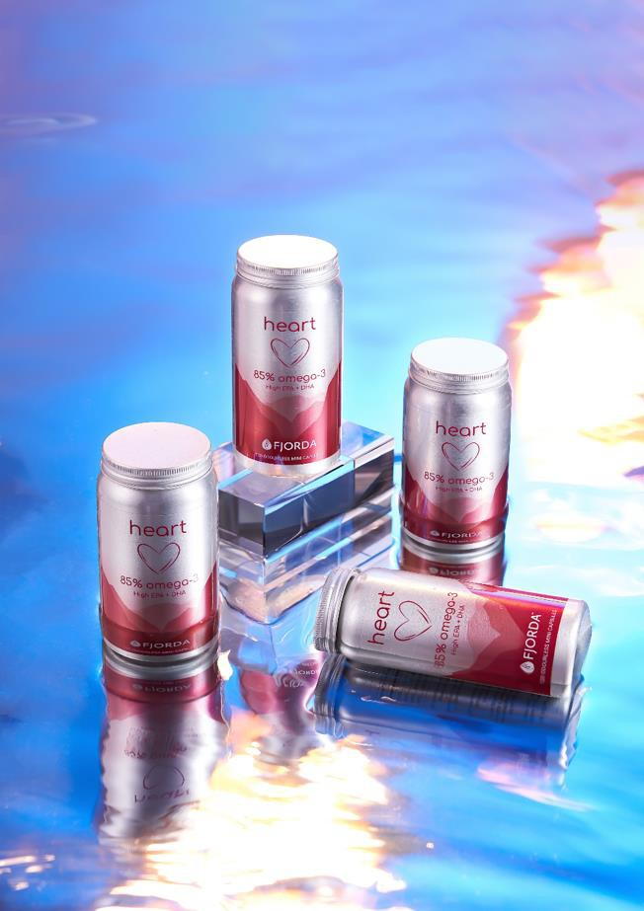
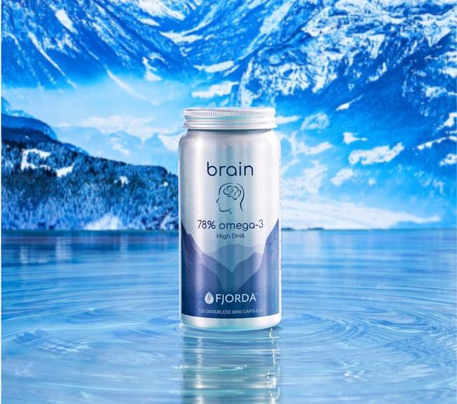


CREATIVE CONTENT
Fjorda’s fish oil meets Norway's natural wonders — fjords, ocean, glaciers, and auroras, showcasing brand purity and natural wonder sophistication.
Elevating Fjorda's youthful and creative image was supported by vibrant colors and connections to fluid lifestyles.

Slide 22
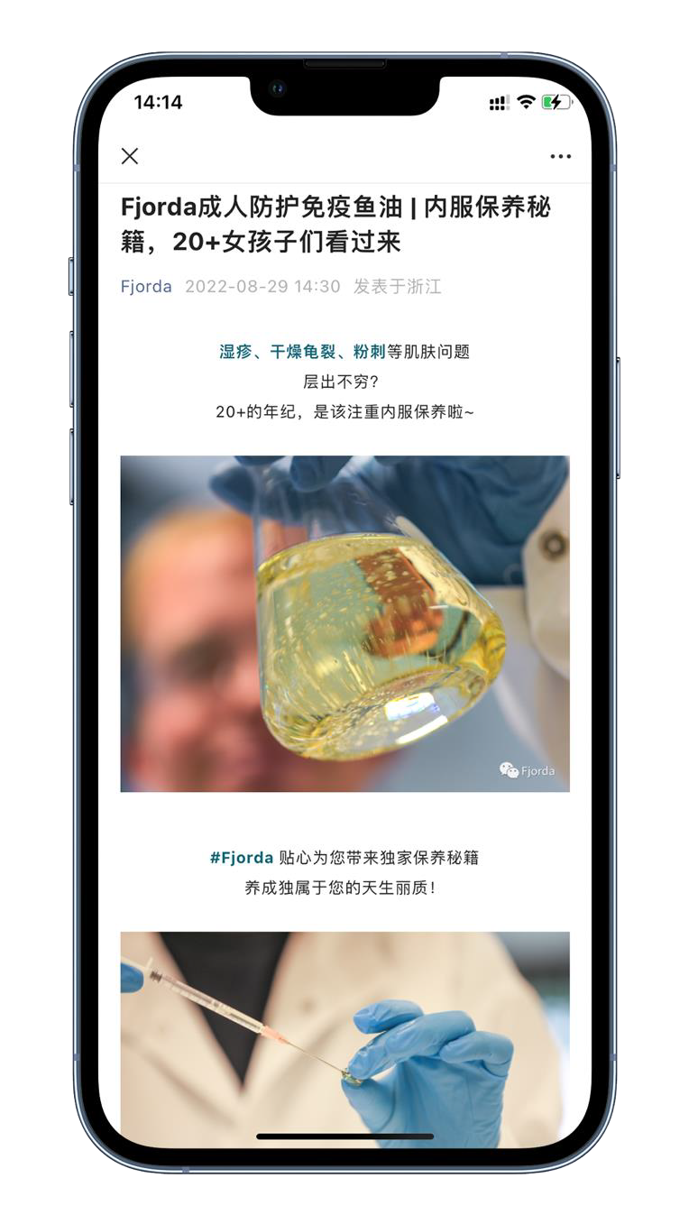
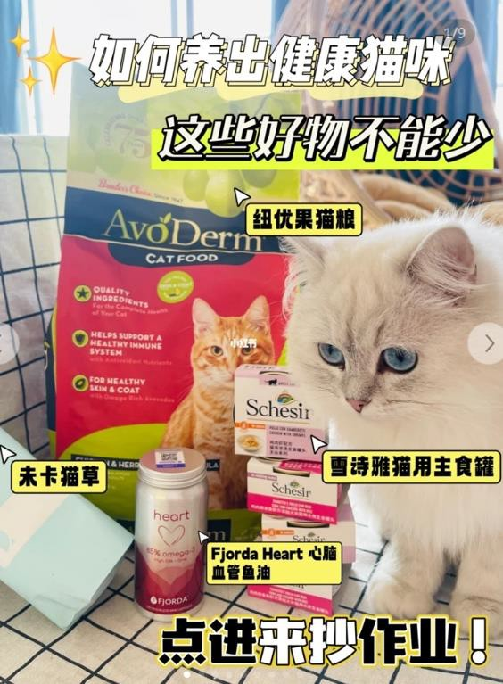

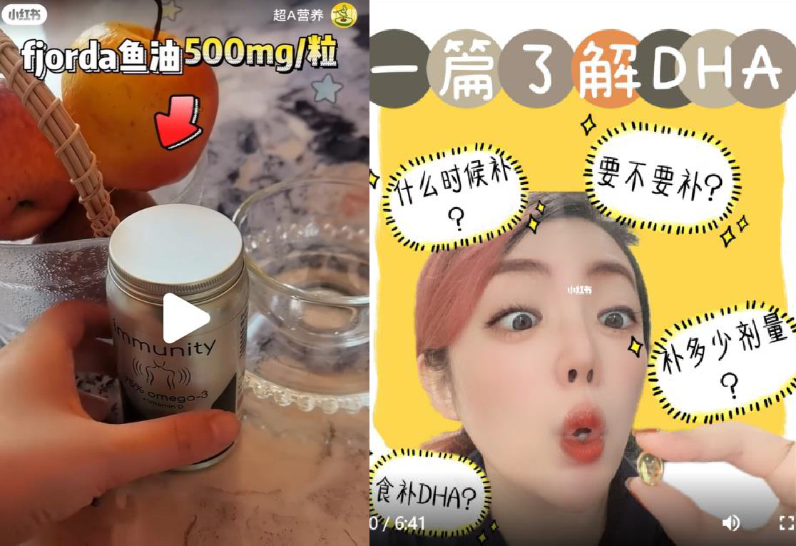
INFLUENCER COLLABORATIONS
WPIC partnered with top KOLs across niches for tailored exposure that effectively reached targeted audience segments.

Slide 23







Q&A
Peter McMath
peter.mcmath@wpic.co
Global: +1-506-476-4762

