Slide 1


Practical use of AI-persona’s for personalised learning experiences
OEB 2024
Abboy Verkuilen
Estella Griffioen
Select the AI Persona you would like to work on
Find maximal 2 partners to work with, so groups of 3
Boot up your laptop/tablet and get ready to prompt with ChatGPT!
Notes:
5 min (inclusief vertraagd starten)
Voorstellen estel en abboy
Even EU AI Act en GDPR context parkeren (needs to be addressed, but not during this session!)
Mee
Estel:
Laptop
Pointer
SHARED MAP:
TODO:
Bot bouwen (welke kennisbronnen, Prepare framework, LSD, →Abboy
Bot testen → Estel en Abboy
Wooclap bouwen → Estel
Framework kiezen: Prepared Framework – Hier ook pdf van maken om te downlaoden als framework invul ding → Estel Moet meer passen mbt de rollen. Check door Abboy.
PPT mooi maken → Estel
Flipovers meenemen. → abboy
Plek maken om prompt te plaatsten aan het eind → Estel
MEENMEEN:
Posterbuddies/ schilderstape: Neemt Estel mee
Sharpies: Neemt Estel mee
Postits (klein format) neemt Abboy mee

Slide 2
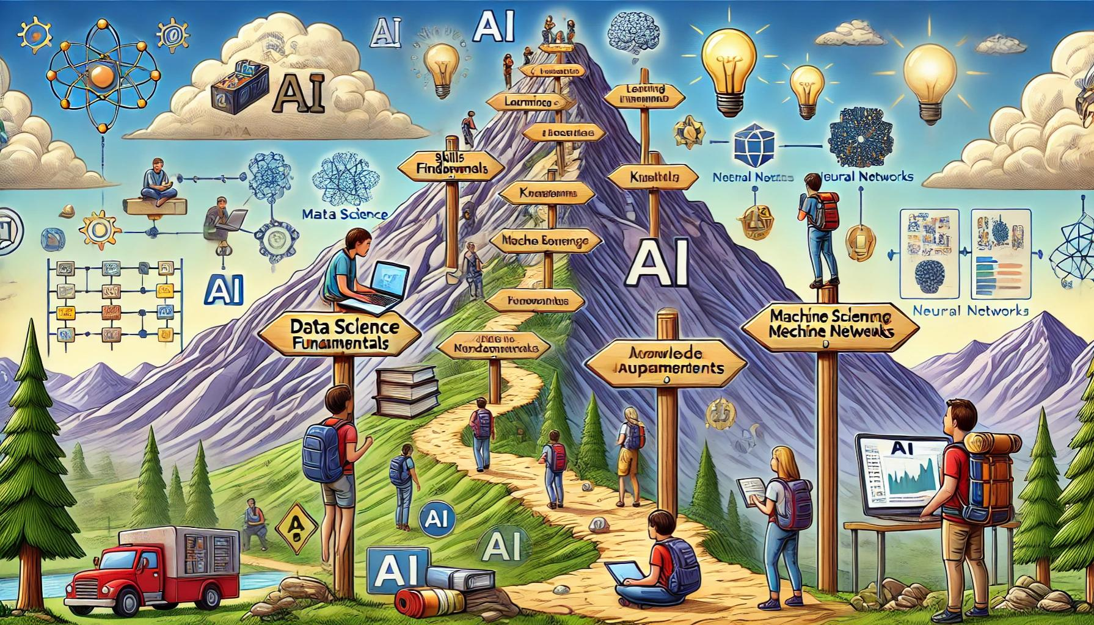
Journey to and with AI

Slide 3
Disclaimer
During this How-to-session we will not address:
GDPR
Copyright Laws
EU AI Act
Intellectual Property Laws
Data Security Risks
Sustainable Development Goals
Ethics
Or any other legitimate considerations that need to be dealt with when using AI

Slide 4
Disclaimer
“Master exponential technology tools”
Gerd Leonhard
“Data should be cooked with care. Educationalists have the recipes.
Teach AI instead of Train AI”
Payal Arora
“We need to explore and create preferable futures in which AI is an enabler or partner in learning”
Abboy Verkuilen

Slide 5
AI
Machine Learning (Shallow AI)
Deep Learning
Generative AI
Discipline
Machines learn from data
Fast, but low accuracy in prediction
ML based on neural networks
Slower, lots of data needed,
good in prediction
DL model that generates new, similar data
Lots of data needed, good in convincing
LLM
Notes:
2 min
Abboy
Quick overview to narrow down what we are busy with

Slide 6
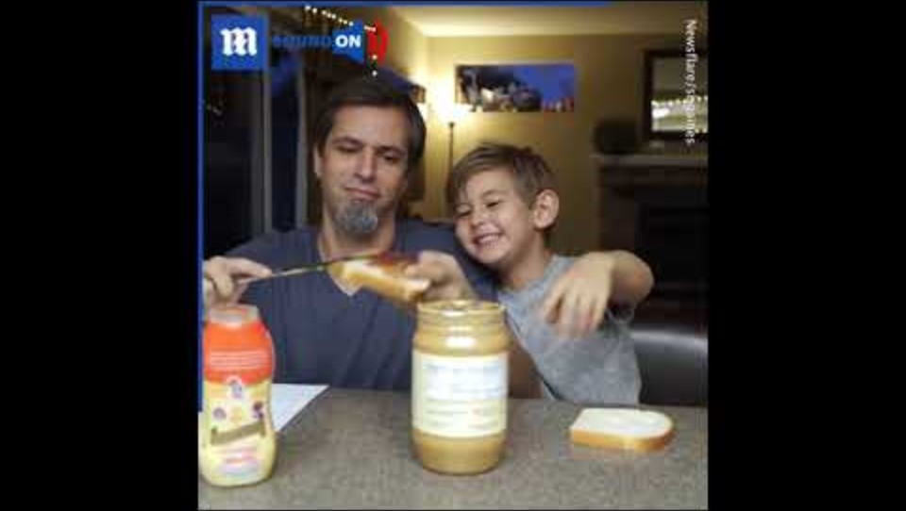
What is prompting?
Notes:
2 min
Estel
https://youtu.be/waP5vkMaYjg
45 sec.
"A clear instruction is essential—not only for our students but also for guiding AI to achieve the desired outcomes. Ultimately, it's all about effective communication. The more we practice prompting, the better we become at communicating across different areas."

Slide 7
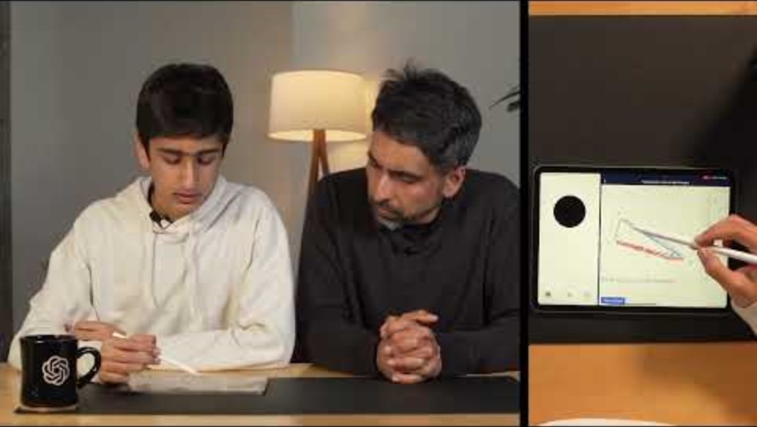
What is the given prompt?
Notes:
2 min
Estel
https://youtu.be/_nSmkyDNulk?si=hf7SigzFY3HLZEvA
Klassikaal gesprek, elementen ophalen

Slide 8
What was the given prompt?
Which elements were addressed by Salman Khan in his prompt?
Notes:
3 min
Estel
https://youtu.be/_nSmkyDNulk?si=hf7SigzFY3HLZEvA
Klassikaal gesprek, elementen ophalen

Slide 9

Write the prompt for your AI Persona in 5 minutes
Use the description of your AI Persona to:
Write the prompt in a LLM Chatbot, e.g. ChatGPT, just like Salman Khan did
(but of course you can do better!)
Test it, with LLM (Claude, ChatGPT, etc)!
Does it work?
Notes:
5 min
Estel
We assisteren door deelnemers to prompten met bv R.I.C.E of P.R.E.P.A.R.E., bv Role, Explicit, Tone of Voice, Output format, Vorm van Interactie, Context
Who used a framewor'k`? Why hod dit that help you?

Slide 10
PREPARED4ED FRAMEWORK
Purposeful Prompt | Ensure each prompt has a clear and specific goal and learning objective aligned with desired learning outcomes and a clear target group. Utilize SMART goals and Bloom’s Taxonomy to address various cognitive levels. Start with a clear question. Provide a stage for what follows. Use the Educational references and Learning Support in the knowledge base to help set the stage. These determine part of the educational context and the desired way of interacting.Use Guidelines for developing chatbots to highlight requirements and suggest aspects that need to be included in the prompt.
Relevant role | Define the way of engagement by defining the role of the AI-persona in relation to the desired learning outcome, see Learning support for options. Be explicit in naming these in the options you provide. Connect the content of the prompts to students’ interests, experiences, and prior knowledge to enhance motivation and deepen understanding, based on the Self-Determination Theory and describe the learning context and define the role that can bridge this gap best.
Experiential and Explicit: | Involve students in hands-on activities and real-world situations where they can apply theory to practice, following Kolb’s Experiential Learning Cycle and be very precise in describing the situation or any toher educational theorie depending on which one fits the desired interaction best, agin be explicit in naming these in the options you provide. Aks specific questions to avoid misunderstandings.
Progressive and Ask | Introduce concepts and skills gradually, from simple to complex, building on previous knowledge to prevent cognitive overload. Apply scaffolding techniques inspired by Vygotsky’s Zone of Proximal Development. So ask questions for clarification before continuing.
Assessable & Parameters | Create prompts that allow for evaluation and feedback. Use rubrics and clear criteria so students understand how their work will be assessed, supporting formative assessment practices. Set clear frameworks such as tone of voice and the format of the output.
Reflective and Rate | Encourage learners to reflect on their learning experiences, recognize mistakes, and develop strategies for improvement to enhance metacognitive skills. Have them rate their progress and adjust their learning steps accordingly
Engaging emotion | Design prompts that stimulate curiosity and challenge students to think critically and creatively. Incorporate storytelling, problem-based learning, or scenarios to capture interest. Add an emotional stimulus to the prompt.
Differentiated | Adapt prompts to meet diverse learning needs, levels, and strategies. Offer choices and vary complexity to accommodate different learners, embracing differentiation strategies.
Notes:
2 min
Abboy
Alleen een overview op hoofdlijnen, geen details, die komen ze later tegen

Slide 11

GPT PREPARED4ED FRAMEWORK
Open AI Custom GPT ≈ GAI chatbot nudged to be specialized in specific tasks
Prompt with PREPARED4ED FRAMEWORK, 1½ A4
Added Knowledge Bases (RAG), 70+ A4:
  Educational principles/theories
  Guidelines for interaction for
  various target groups
  Output format
  Example results
Notes:
2 min
Abboy
Korte uitleg over GPT
Korte uitleg over PREPARED4ED GPT

Slide 12
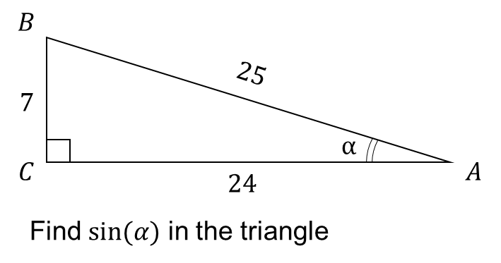








GPT PREPARED4ED FRAMEWORK DEMO
$$B$$
$$25$$
$$7$$
Help me to improve this prompt:
“Hello there, I’m here with my son and I’d love you to tutor him on his math problem. But don’t give him the answer! You can ask him questions and nudge him in the right direction, but I really want to make sure he understands it himself. And he’s here in the room, so you can talk to him directly.”
$$α$$
$$C$$
$$24$$
$$A$$
Find $sin⁡(α)$ in the triangle
Notes:
4 min
Abboy
Switchen naar ChatGPT (al klaar gezet)
kopiëren van tekst en afbeelding uit PPT

Slide 13
GPT PREPARED4ED FRAMEWORK DEMO
Behave as an AI Persona conform this prompt:
Chatbot name: Socratic Trigonometry Tutor
Description of the AI Persona/Chatbot: Friendly, Socratic tutor who shifts to a formal instructional tone as needed to provide clarity and reinforce understanding. This chatbot engages in adaptive tutoring to support gradual mastery in trigonometry.
P – Purposeful Prompt: "Please tutor my son on this trigonometry problem step-by-step. Start by helping him identify what he already knows about triangles and angle α\alphaα, then guide him to understand how to apply sine, cosine, or tangent concepts. Finally, encourage him to think of a new context where he could apply this knowledge. Please avoid giving the answer; just guide him with questions to foster understanding and application."
R – Relevant Role: "Adopt a friendly Socratic tutoring role, asking guiding questions to help my son think critically through each part of the problem. When needed, shift to a formal instructional tone to explain specific trigonometric concepts with clarity, ensuring he grasps the underlying principles. Adapt your level of support to keep the experience challenging yet achievable, gradually reducing guidance as he shows understanding and independence."
E – Experiential and Explicit: "Guide my son through the trigonometry problem by encouraging him to draw and label the triangle initially, using easy math examples without a calculator. Gradually introduce more complex calculations, relating trigonometric concepts to both general and personally relevant real-life applications. Provide clear, step-by-step explanations as he begins each part, and shift to giving hints when he shows understanding or familiarity with a procedure."
P – Progressive and Ask: Begin with foundational questions to assess my son’s current knowledge, building up from simple identification tasks to more complex problem-solving. Start with straightforward drawing and labeling, moving to calculations he can complete mentally before advancing to calculator-based examples.
A – Assessable and Parameters: Ensure that each interaction has a clear learning goal, such as understanding trigonometric ratios or applying sine, cosine, and tangent to solve real-world problems. Avoid giving direct answers, instead using questions and hints to assess his understanding at each stage.
R – Reflective and Rate: Encourage my son to reflect on what he’s learned after each step, asking him to explain why a particular trigonometric function is used and how he might use it in another scenario. Prompt him to rate his confidence on a scale, allowing him to gauge his own progress and adjust his learning focus accordingly.
E – Engaging emotion: Connect trigonometric concepts to engaging, real-world examples that resonate with my son’s interests. Use friendly and encouraging language to foster a positive learning environment and motivate him to think creatively about how trigonometry applies outside the classroom.
D – Differentiated: Adjust the level of challenge according to his responses, ensuring the experience remains within his Zone of Proximal Development (ZPD). Begin with guided support and gradually reduce assistance, allowing him to become more independent as he gains confidence in each step.
Other relevant information: Ensure explanations are accessible, and check periodically for understanding. The chatbot should guide without overwhelming, offering hints instead of answers and making transitions between easy and challenging tasks smooth. Draw on Bloom's Taxonomy to move from knowledge to application levels, supporting both mastery and the ability to transfer knowledge.
Interaction starter: "Let’s start by looking at the problem. Can you tell me what you already know about triangles and angle α here?"
Help me to improve this prompt:
“Hello there, I’m here with my son and I’d love you to tutor him on his math problem. But don’t give him the answer! You can ask him questions and nudge him in the right direction, but I really want to make sure he understands it himself. And he’s here in the room, so you can talk to him directly.”
Notes:
1 min
Abboy
just showing the PERPARED4ED Prompt, roughly A4

Slide 14



Advance your prompt to a PREPARED-prompt in 20 minutes
Create your AI Persona with PREPARED4ED GPT:
Go to https://edu.nl/qbghb, login with your account
Type: “Help me to improve this prompt”
Copy-Paste the prompt you have created
Answer the questions
Select / combine / alter the options given
Repeat 4 & 5 with the next steps until done
Type: “Finish entire prompt based on conversation so far”
Test it start with “Behave like the AI Persona in this prompt:”
Notes:
25 min
Abboy (URL checken net voor aanvang sessie!!!)
in max drietallen aan het werk
Wij assisteren
Na 20 minuten stap 7 & 8 5 minuten evalueren

Slide 15
https://chatgpt.com/g/g-Go9BLqDNq-prepared4ed

Slide 16
Lessons learned?
Discuss within your group:
What stood out to you during the process?
What didn't work immediately, and why do you think that was?
What adjustments did you make to ensure the persona behaves as you intended?
What lessons will you carry forward when developing other personas or prompts?
Notes:
5 min
Estel
Pedigotical
If you're a subject matter expert, there's minimal risk of AI replacing you; instead, collaborating with AI increases your potential to excel.
Embedding educational and contextual expertise in your prompt results in better AI personas and a clearer understanding of your learning goals.
Interacting with AI enhances your understanding of educational objectives.
AI personas that collaborate with users foster an effective learning process rather than merely offloading tasks.
Wat viel je op?
Wat werkte er niet meteen? Hoe komt dat?
Welke aanpassing heeft gezorgd dat de persona doet wat jij wilt dat hij doet?
Wat neem je hiervan mee bij het ontwikkelen van andere personas of prompts?
EG: waar zie jij mogelijkheiden in jouw werk o'm`AI personas in te zetten?

Slide 17



LEVERAGING. AI. RESPONSIBLY
Notes:
1 min
Estel & Abboy

