Slide 1
State Briefing: Pennsylvania
Leah Meredith
Victoria Moroney

Slide 2
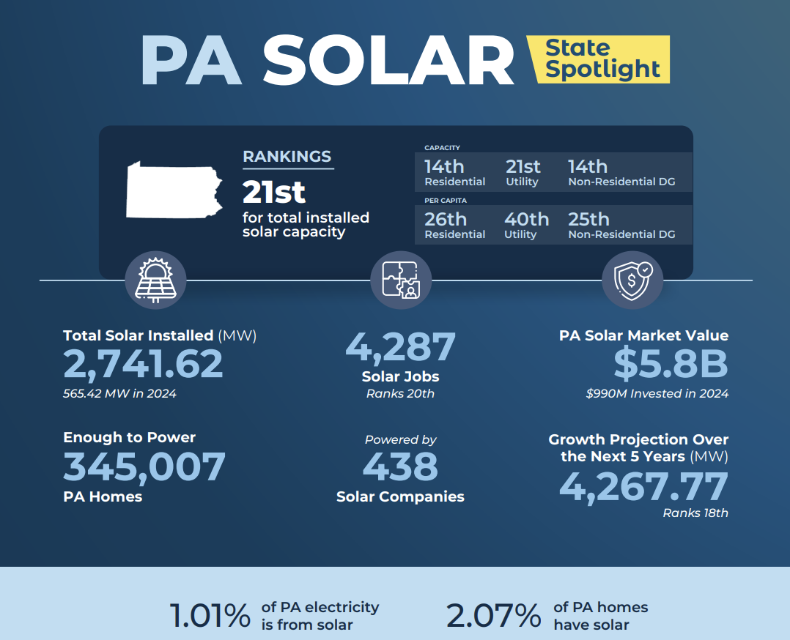
Pennsylvania Solar Market

Slide 3
Pennsylvania Policy Landscape
Gov. Shapiro (D) took office January 2023
  FERC complaint against PJM
Party control split between legislative chambers
  Senate Republican controlled (27-23)
  House Democratic controlled (102-101)
State budget statutory deadline of June 30
Nonpartisan PUC Commissioners
RGGI legal challenges
  Supreme Court decision expected fall of 2025
Notes:
Gov. Shapiro (D) took office January 2023
Ambitions for higher office
Party control split between legislative chambers
Senate Republican controlled (27-23)
House Democratic controlled (102-101)
Budget statutory deadline of June 30
RGGI Court Decision
PJM Capacity Auction
PUC

Slide 4

Pennsylvania Solar Market

Slide 5
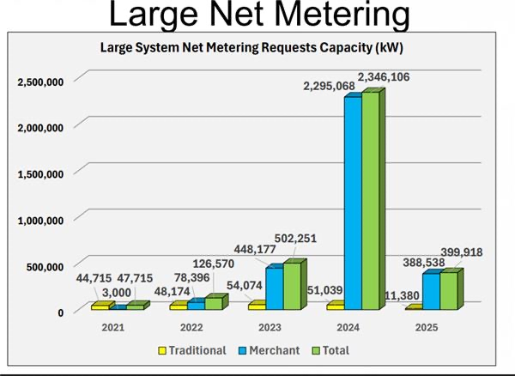
Merchant Generator Program
In 2021, the PA Supreme Court affirmed a Commonwealth Court decision that found the PUC had overreached its statutory authority by imposing a limit that net-metered systems could not exceed 110% of a customer’s annual electric consumption.
By 2023, the 3MWac merchant generator market started booming; today, over 3GW of projects sit in utility queues
Notes:
In 2022, PAPUC withdrew their policy limiting the size of net metered systems to 110% of a customer-generator's annual consumption
Some utilities took until 2023 to update their IX applications to reflect the court case
Because of lack of hosting capacity maps in PA, a significant portion of capacity in the queues is speculative and will not ever get developed
While not truly a 3GW+ program, the size of the merchant generator queues has caused alarm from the PUC and utilities, and has drawn the attention of legislators who are worried about unintended consequences
Because of the unique way in which the project was created (through the courts), the program lacks political champions (not from Republicans, not from Democrats) - widely viewed as a loophole program that the legislature will one day have to address
As the merchant generator market boomed, many saw it as a potential bargaining chip in the quest to get a more permanent FTM DG program in PA (e.g. horse trade the closure of the loophole for the opening of a new program) - some regulatory and political dynamics have made this trade more challenging – flow into Leah's next slide on the Lightning Plan and community energy

Slide 6
Governor Shapiro’s Energy Lightning Plan
HB504: Community Energy (Schweyer)
  SEIA supportive
  Community solar enabling legislation
HB500: EDGE Tax Credits (Inglis)
  SEIA supportive with amendments
  Tax credits for energy storage facility and utility-scale generators
HB501: PRESS (Friel Otten)
  SEIA supportive with amendments
  AEPS expansion
HB502: Getting Stuff Built with the RESET Board (Steele)
  SEIA supportive with amendments
  Establishes statewide siting board
HB503: Pennsylvania Climate Emissions Reduction Program (PACER) (Abney)
  SEIA not taking a position

Slide 7
Pennsylvania Legislative Updates
SB349: Solar Decommissioning (Yaw)
  SEIA supportive
  Passed Senate Passed House Environmental and Natural Resources Protection Committee
HB1272: Power Pennsylvania Act (Stambaugh)
  SEIA opposed
HB1239: Homeowners Associations Solar Access (Hanbidge)
  SEIA supportive
  Passed House Energy Committee
HB362: Authorizing a Pennsylvania Solar for All Program (Fiedler)
  SEIA supportive with amendments
  Passed House floor on second reader

Slide 8
Pennsylvania Regulatory Updates
PPL DER Management Pilot
UGI Utilities Default Service Plan
Wellsboro and Citizens’ Electric Rate Case
P-2024-3049343
PUC unanimously approved in February 2025; under appeal at Commonwealth Court
Creates a new concept, "Supply Peak Load Impact" (SPLI), arguing that a project that supplies 100 kW of supply to the grid has the same impact as a customer that consumes 100kW of peak load
All customers with a SPLI of 100kW+ are under GSR-2 tariff, which uses spot market pricing (PJM LMPs) to compensate customer-generators
R-2025-3054392 & R-2025-3054394
Rate cases filed in May 2025; interventions in process
Proposed new "Billing Demand" concept classifying customers based on use of the distribution system (the greater of gross generator rating or the customer's max demand)
Customer-generators with Billing Demands 400kW+ will be compensated at a weighted average LMP
P-2024-3049223
Goal of pilot to evaluate costs and benefits of monitoring DERs through utility owned management devices connected to inverters
Pilot plagued with implementation issues, SEIA intervened with “Joint Solar Parties” when PPL filed a request to make the pilot program permanent
Notes:
Citizens & Wellsboro: Utilities argue that without this change, costs that the utilities incur to provide distribution service to large generators for the purpose of exporting power will be shifted to residential and small commercial customers.
Impacts not just merchant generators but any customer-generator (existing or future) that has gone solar and has a SPLI/Billing Demand of 100kW+/400kW+ - this could bring in schools/businesses
Means we've lost legislative leverage – easier for Senate Rs to sit back and say they already got what they wanted thanks to back door PUC action

Slide 9
Questions?
Get in Touch
lmeredith@seia.org
vmoroney@forefrontpower.com

