Slide 1
Developing a Safety First Culture
HSJ Patient Safety Congress 2025
Tracey Thacker – National Deputy Director of Quality Governance
16 October 2025

Slide 2






Spire Healthcare
Britain’s largest independent healthcare company by turnover, operating across England, Wales and Scotland
What we do:
Treatment and surgery: from orthopaedics to cancer and complex care
Diagnostics
Primary care: nationwide network of independent GPs
Occupational health and employee assistance programmes
Physiotherapy, recovery and rehabilitation
NHS talking therapies and corporate and private mental health
38
Hospitals
3 Nations
40 ICBs
50+ Clinics, consulting rooms and medical centres
1.3m+
People cared for in 2024 – NHS, self-pay, insured, corporate
17,000+ Colleagues
230+
FTSU Guardians/
Ambassadors
98%
Good or Outstanding inspected locations (or equivalent)
Notes:
Thank you for inviting me to share how we have developed a Safety First Culture
Slide 1:
First, I would like to introduce you to Spire Healthcare by providing a quick overview of our organisation.
As you can see, Spire Healthcare is big, and it is complex, we have 38 hospitals spanning across 3 nations, with over 17,000 colleagues treating over 1.3m patients each year. Our hospitals are from Edinburgh to Portsmouth, and Wales to East Anglia. Good communication is vital.
I am going to talk to you today about some of the ways we have fostered a Safety First culture of openness, respect, collaboration and improvement.
This is spread across all of our teams, from a positive incident reporting culture, to our sector leading FTSU network and how we use the principles of a “Being Fair” culture” to manage medical professional standards.
We are aware that our patients have a choice – to use the NHS, to use us, or to go to another provider. We shape care around their needs to keep them safe and to give them the best experience possible.
Next slide

Slide 3





Quality Strategy
Patient Safety
Patient experience and engagement
Clinical Effectiveness and Outcomes
Quality Improvement
+
+
+
Delivering care focused on excellence in all areas of quality
Assurance
Notes:
Our expectations for developing a successful learning culture are set through leadership - in policy, data, and consistency across the organisation which we have built into our Quality Strategy.
This strategy reaffirms our dedication to continuous improvement, ensuring that patient safety, experience, and clinical outcomes remain our top priorities. It sets out clear objectives, supported by a robust ward-to-board governance framework, to monitor progress and drive meaningful change.
The strategy was launched in April 2025 and builds on our existing practices, aligning them under four key principles:
The first being - PATIENT SAFETY
This includes the implementation of PSIRF in April 2024. Now nearly 18 months post implementation this has proved a great opportunity for Spire to be at the forefront of change in patient safety and governance.
Our new PSIRF systems and processes have allowed for ‘A different conversation’ and is driving our safety-first culture to another level. Although PSIRF is only mandatory in England and when treating NHS patients, Spire decided to roll it out across its hospitals in England, Wales and Scotland for both NHS and private patients. Having a single framework in place for all patients provides consistency and equity. Really embracing it CAN actually change how your staff interact and learn. We have successfully recently run a national learning from Never Events campaign whereby we used SEIPS methodology to really focus on the reasons these types of events happen. This has proved extremely beneficial and resulted in lots of groupwide learning, feedback from local hospital teams, consultants and national teams involved in the reviews has been positive. PSIRF allows for richness of the learning, and the right learning.
The second is Patient Experience and Engagement
Our Patient Experience and Engagement Framework is purposefully built to the bespoke needs of our patients. We now measure these needs which allows us to ensure we can take action to deliver the very best experience to our patients.
Our teams are empowered to listen and act, and this is captured and celebrated.
We use Co-design Initiatives, actively engaging our patients and families in the design and evaluation of services to promote care that reflects their needs and preferences.
We value our patient feedback; we empower all colleagues to act, and we use this information to make a positive difference to people’s lives through outstanding personalised care.
This cultural ethos is spread across all our hospitals and is fundamental to our underlying beliefs and attitudes which influence daily practice.
Key principle number 3 is Clinical Effectiveness and Outcomes
Consistency across our clinical effectiveness and outcomes ensures care is evidence-based and outcome-driven.
We have developed and implemented a Clinical Effectiveness framework which enables our hospitals to measure themselves against key metrics including NICE guideline compliance, audit performance, and MDT engagement. The openness and transparency of our hospital teams in ensuring WHETHER they meet these standards contributes to our culture of learning and improvement.
And lastly Quality Improvement
We were very lucky in Spire as we already had a very highly regarded and developed QI programme in place prior to the implementation of PSIRF. National QI projects are reviewed annually and currently include reducing avoidable cancellations and overnight conversions and maintaining reduced length of stay for hips and knees which you may have heard about in Michele Millard’s talk yesterday. If you missed it you could always watch it again in your own time.
We have ensured that PSIRF links with Spire’s Quality Improvement work, and training interest and attendance has increased which is a testament to the engagement and group wide drive to improve. Using a combination of QI and PSIRF has actively given Spire a boost in our safety culture ambitions.
A culture of continuous improvement is essential for sustained excellence. Through data-driven interventions, cross-functional teamwork, and a commitment to sharing best practices, we will continuously refine our processes to enhance patient care.
To ensure our hospitals can provide assurance across all of these principles we have established a ward to board committee structure that oversees the execution of the strategy and ensures alignment with organisational goals.
Next slide

Slide 4
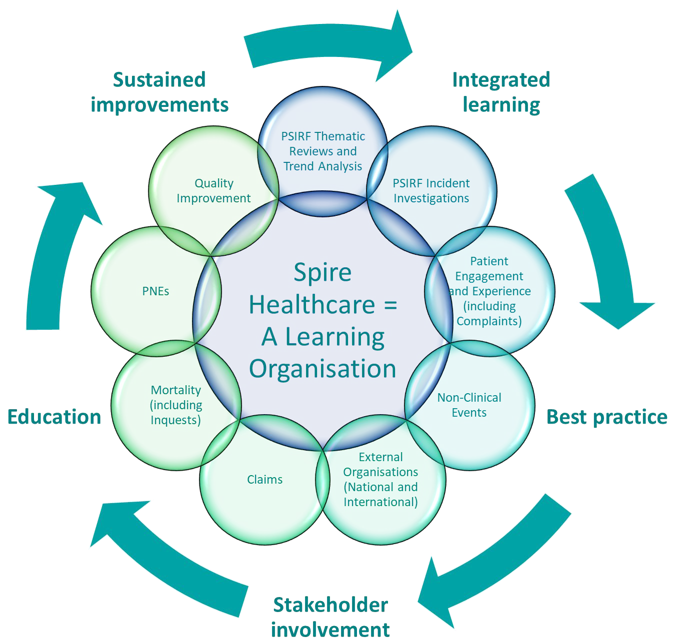
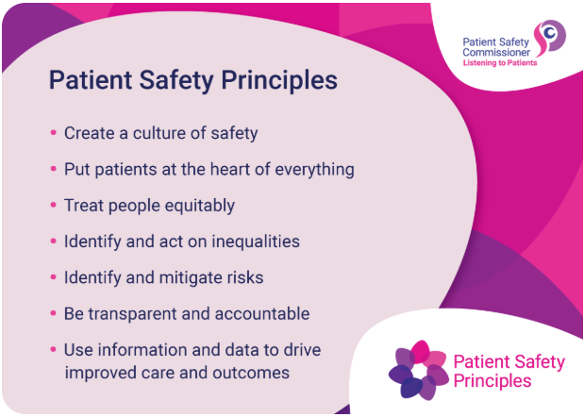
The Knowledge and Learning Framework
Notes:
In addition, we have developed and implemented the Knowledge and Learning Framework which aims to enhance Spire Healthcare as a learning organisation by building on existing mechanisms and guiding the next steps. It focuses on timely sharing of learning from SMART safety improvement plans, creating and evaluating shared learning aligned with strategic goals, and defining stakeholder needs to support sustained improvements. The framework provides best practice templates, clarifies the process for escalating learning to groupwide forums, drives embedded and sustained change, and ensures accessible and effective safety improvement plans for all colleagues from Board to Ward.
Both the strategy and the Knowledge and learning framework adopt the patient safety principles published by the National Patient Safety Commissioner and use them as we strive to deliver safe care.
Next slide

Slide 5

What contributes to a learning culture?
Encourage colleagues to engage with each other through PSIRF to learn when things go wrong, and celebrate when they go right
Be reflective, learn from past experiences
Change should not be top down – PSIRF brings together varied colleagues
Enable frontline-led change through QI
Encourage professional curiosity
Encourage, listen to and act on concerns
Manage them consistently and compassionately
Work collaboratively to find solutions
Be consistent so people repeat their behaviour and feel safe
“Our good culture allows good conversations – if we get culture right, we get safety right!
We need to learn when things go wrong, as well as when they go right” (Dr Cathy Cale – Group Medical Director)
Notes:
What we have achieved is relevant, is transferrable and could be replicated in other healthcare organisations, irrespective of whether it is the NHS or the independent sector.
Listed are some key points for applying the learning that I have shared today within your organisation. In addition I would add:
Building on the value of linking together different initiatives. PSIRF, Patient Experience and Quality Improvement, they really do enhance each other.
Share learning as far as possible throughout your networks so that we can all learn from each other.
We have achieved our safety-first culture with mass buy in, passion and leadership.
We know that Culture is king so if we get culture right, we will get safety right!
Next slide

Slide 6
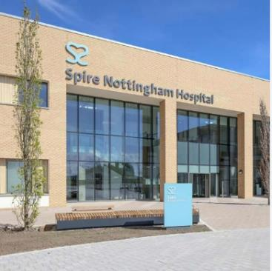
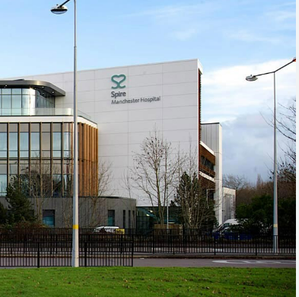



Thank you
Tracey Thacker – National Deputy Director of Quality Governance
Notes:
Thank you

