Slide 1
Seeing Safety
Bruno Chaves, Business Development Manager
Aerospace Tech Week 2025

Slide 2
Agenda
Introduction
Regulatory requirements for mixed-criticality
Display faults
System Partitioning:
  Memory partitioning
  Multicore vs singlecore
  Time partitioning
  Space partitioning
  Virtualization (dynamic CPU partitioning)
GPU Partitioning:
  Time partitioning (CoreAVI time partitioning for non-divisible GPU instances)
  Space partitioning (for GPU divisible instances)
  Virtualization (dynamic GPU partitioning)
Existing Solutions
  GPU Monitoring
  GPU HW Monitoring
  A new approach: Arm Mali G78AE GPU

Slide 3
Introduction
Since the introduction of Integrated Modular Avionics – IMA, it started becoming common to have applications performing different functions to run on the same HW system
  More efficient utilization of resources than a federated architectural approach where dedicated computing resources are allocated to each function.
This came as a way to improve SWaP – Size, Weight, and Power as avionics were predominantly federated systems – multiple separated control systems
A good example of IMA are the Airbus 380 and the Boeing 787
Memory
Application A
Application B
CPU
Notes:
* Transition to Integrate Modular Avionics (IMA) vs traditional federate approach where a dedicated computing resource is allocated for each specific function [Watkins, Christopher & Walter, Randy. (2007). Transitioning from federated avionics architectures to Integrated Modular Avionics. 2.A.1-1 . 10.1109/DASC.2007.4391842.]

Slide 4
Regulatory Requirements for Mixed Criticality
One option is to design the whole system to the highest assurance level required by the most critical function
To be able to assign different software design assurance levels to different software functions and components, they need to be partitioned
Partitioning: a technique to provide isolation between software components to contain and/or isolate faults (DO-178C)
Partitioning of resources can be achieved by:
  Space partitioning: Allocating unique hardware resources to each software component
  Time partitioning: Allowing multiple software components on the same hardware resources, allowing the partitioned software component to consume shared hardware resources only during its scheduled period of execution

Slide 5
Display faults
The main one would be no graphics – blank screen
  Cessna 182 29 December 2013
  EUROCOPTER EC135 14 February 2014
Frozen screen – less evident
  Aer Lingus – Serious incident - 29 February 2024: “Both pilots reported their display as appearing "frozen".”
  Aer Lingus: Plane had serious incident during Belfast landing - report - BBC News
Frozen screen elements – altitude gauges or others – misreporting of data
  Sensor problem
  Application problem
  Graphics driver issues/frozen rendering to window

Slide 6
System Partitioning

Slide 7
Memory Partitioning
The most common approach for memory partitioning is space partitioning: different portions of memory are allocated to different software components
  Memory partitioning can be static (fixed at system startup) or dynamic
  Memory partitioning can use paging and segmentation of memory for a more efficient use of memory
  Memory address virtualization can be used to support virtualization and enhance security
  Memory Management Units (MMU) or Memory Protection Units (MPU) are usually available to ensure that software components access only the allocated memory partition
The memory bandwidth allocation should also be considered
There might be instances where a solution with more than one memory controller might be required
MC1
SoC
Single memory Controller
MC1
MC2
SoC
Double memory Controller
Notes:
Memory Bandwidth partitioning:
Efficient Scheduling, Mapping and Memory Bandwidth Allocation for Safety-Critical Systems
Understanding how off-chip memory bandwidth partitioning in Chip Multiprocessors affects system performance | IEEE Conference Publication | IEEE Xplore
Hypart: a hybrid technique for practical memory bandwidth partitioning on commodity servers | Proceedings of the 27th International Conference on Parallel Architectures and Compilation Techniques

Slide 8
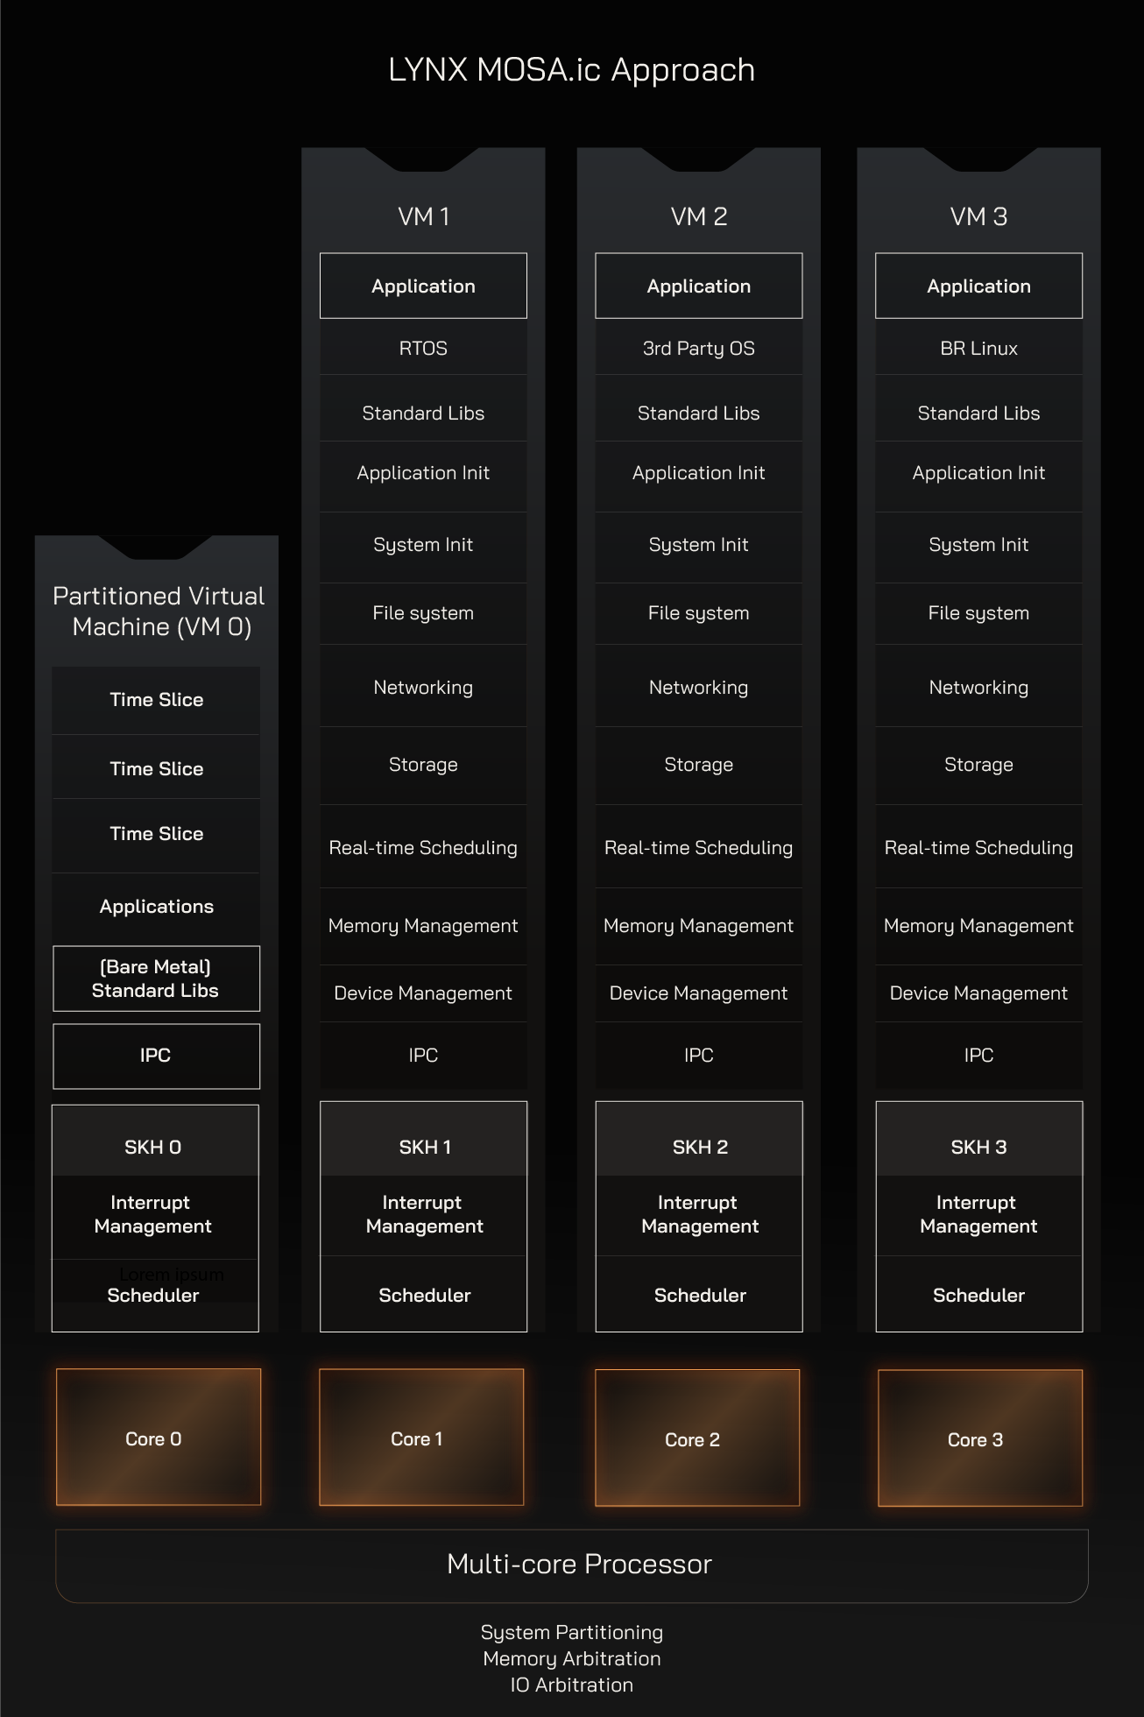
Multicore vs Single Core
With the introduction of IMA, and as systems become more complex:
  It is getting very difficult to buy single core systems except for specific ASICS/FPGAs which adds extra costs and certification complexities
  Functionality is split across cores to achieve timing/performance requirements
  If the application is heavy, it might be that a single core might not have enough cycles
The world has gone Multicore with a few exceptions.

Slide 9
CPU Partitioning: Time Partitioning
CPU resources are made available by the OS to the various processes in discrete time slots with an adequate scheduling algorithm to ensure that each task gets a guaranteed execution time (temporal isolation)
The appropriate scheduling algorithm depends on the criticality and the system function
  For RT systems, Earlier Deadline First (EDS) is optimal for single core CPU
  Preemption allows to interrupt the execution of a task, if a higher priority task needs to be executed
  ARINC 653 hierarchical scheduling: partitions and processes
Multicore processors: increased complexity
  Global scheduling: a single scheduler manages all the cores. Task are dynamically assigned to the available cores
  Partitioned scheduling: task are statically assigned to CPU cores. Each core runs its own scheduler

Slide 10
CPU Partitioning: Space Partitioning
Memory
Cache partitioning: CPU cache is divided in separate regions, allocated to different partitions (sometimes referred to as cache coloring, or cache allocation technology)
Multicore CPU
I/O Partitioning
  Virtual or Direct/passthrough IO mapping
OS
L3 Cache
L1 & L2 Cache
L1 & L2 Cache
CPU
Core0
Core1
Notes:
The debate of SMP/AMP is a subjective one, much is made of whether there is support for SMP or not
If an application uses it’s own RTOS, unless it is heavy application that requires more than what is available in one core then SMP is a requirement and an OS that takes 2 cores.
Or it can be split and run in 2 AMP cores.
It is a design choice, not really a technical issue.
Caching wise, since L2 is not split, it is easier to contain elements of an application. L3 is also manageable if the SoC is able to do cache coloring.

Slide 11
CPU Partitioning: Virtualization
Virtual Machines (VMs) are an abstraction of the actual HW
Each VM has its own OS and can be assigned to a partition
  One or more partitions can be assigned to a single core – AMP
  Multiple cores can be assigned to a partition - SMP
The Hypervisor manages the creation and execution of VMs
  HW usually provides specific virtualization for a more efficient and robust implementation
  Resources allocation is also managed by the hypervisor
VM 0
VM 1
Application A
Application B
OS0
OS1
CPU 0 (Virtual)
CPU 1 (Virtual)
Hypervisor
GPU
Notes:
Technologies to support Virtualization:
MMU
IOMMU
Second Level Address Translation (SLAT): aka System or second stage MMU
Single Root I/O Virtualization (SR-IOV): leverage PCIe. Doesn not apply for other buses used by ARM based SoC.
Cache Allocation Technology (CAT)
Virtual Advanced Programmable Interrupt Controller (VAPIC)

Slide 12
CPU Partitioning: Core Clusters
ARM SoC example
The hardware handles the physical separation
Each core cluster can have its own OS
It is still possible to use a hypervisor in a cluster
The L3 cache is shared per cluster, not the full SoC providing a separation barrier for single core per cluster usage
Core Cluster 1
Core Cluster 2
A53
A53
A53
A53
A53
A53
A72
A72

Slide 13
GPU Partitioning

Slide 14
GPU Partitioning: Time Partitioning
GPUs can provide time partitioning capabilities
  Identify task from different partitions
  Task Priority
  Tasks Isolation
  Tasks Preemption
CoreSuite™ 2.0 can provide time partitioning capabilities
  Task Throttling
  Task Preemption
If there is no spatial GPU resource partitioning, the whole GPU resources are available to a task during the allocated time slot
Memory
Application A
Application B
GPU Driver
GPU
Notes:
Assumption: one GPU driver per GPU instance (the case of multiple GPU drivers is considered under GPU Virtualization).
CoreSuite 2.0 supports multiple drivers (GPM) accessing the same GPU in a cooperative way: it is not considered suitable for mixed criticality cases.
If the driver provides the partitioning capability, it must be developed to the highest assurance level required by the applications.

Slide 15
GPU Partitioning: Space Partitioning
Memory
The GPU allows to assign GPU resources to different partitions
Resources allocated to different partitions are isolated
GPU Driver 0
GPU Driver 1
Cache
Cache
Core0
GPU
Core1

Slide 16
GPU Partitioning: Virtualization
Each partition is present with a full (virtual) GPU instance and can instantiate its own GPU driver
The partitioning is managed by the Hypervisor and/or the GPU HW
GPUs can provide time partitioning capabilities
  Identify task from different partitions
  Task Priority
  Tasks Isolation
  Tasks Preemption
GPU Virtualization offers high GPU utilization
Interferences need to be carefully considered
VM 0
VM 1
Memory
Application A
Application B
GPU Driver 0
GPU Driver 1
GPU 0 (Virtual)
GPU 1 (Virtual)
Hypervisor
GPU

Slide 17
Current Solutions

Slide 18
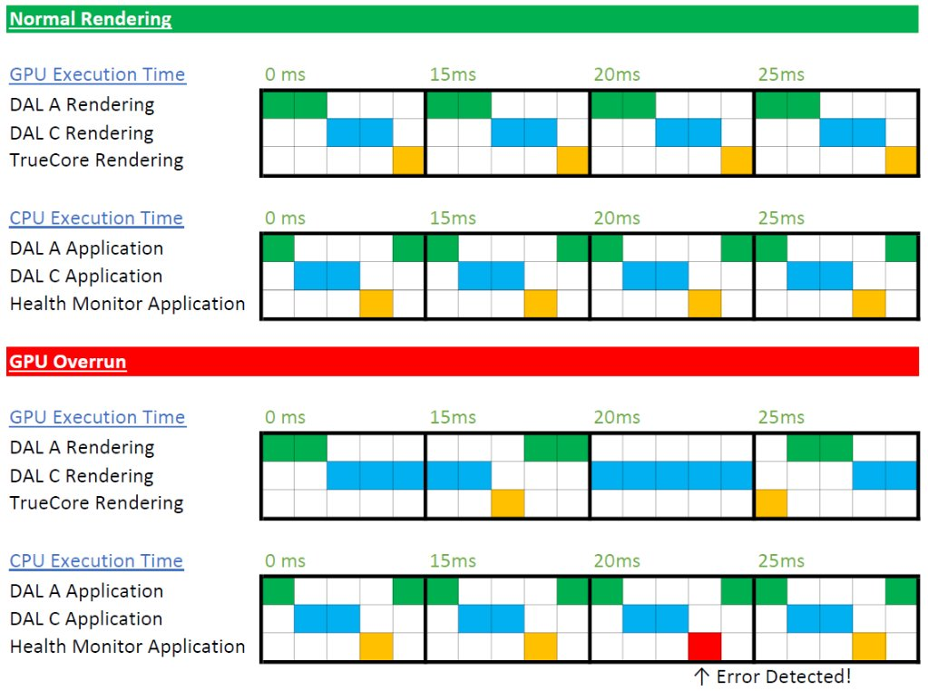
GPU monitoring
Example of problematic combinations:
  DAL A + Linux
  No stall is detected, GPU appears to be fine and running(health monitors)
  But it is just spinning as Linux locked it
  DAL A partition is now blocked
Time partitioning mitigation:
  Overrun detection
  Scheduled preemption (ignores status)
Enforcement:
  Restarting delayed application/partition
  Enforcing preemption of tasks

Slide 19
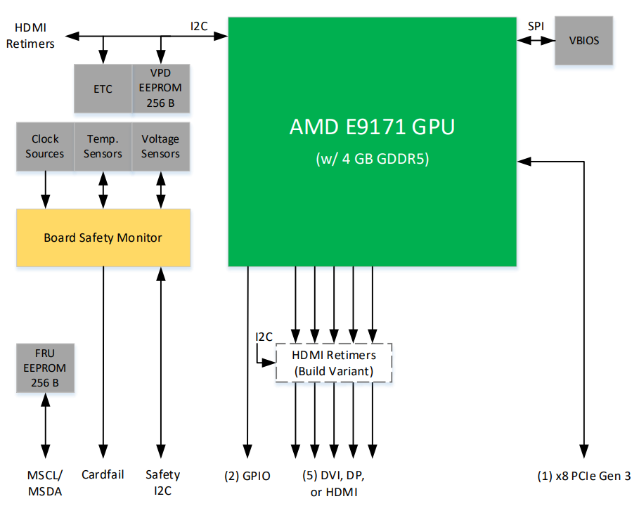
GPU HW monitoring
FPGA programmed to monitor the Display output of the graphics and other safety functions(example on the right)
  Costly
Display monitoring ASIC
  Cheaper, function specific, has to satisfy AC20-152A COTS-D objectives
Required for high DAL levels
Lynx GPMX002 XMC E9171 Graphics/Compute Processor block diagram

Slide 20
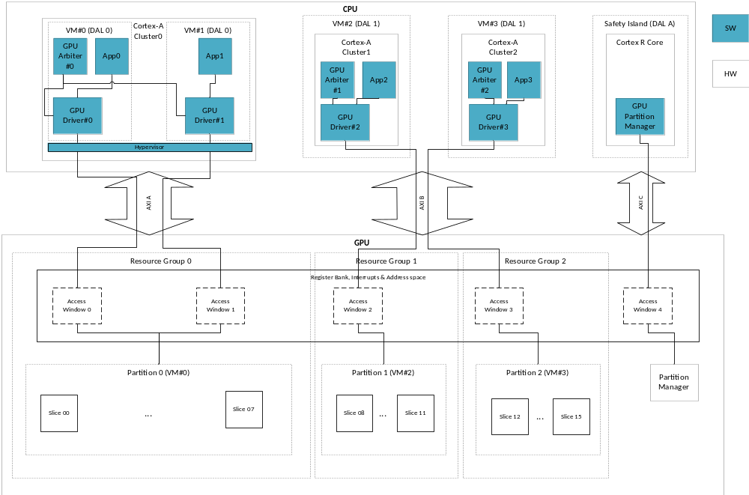
A New Approach: Arm Mali G78AE GPU
GPU with Hardware virtualization
Capable of partitions running heterogenous graphics stacks running independently and in isolation
Notes:
GPU Partition Manager (HW & SW): One per GPU, allocates GPU HW resources to resource groups.
GPU Arbiter (SW): one per Resource group, assigns slices to partitions dynamically.
Resource Group (up to 4):
AXI bus: There are 3 AXI Buses: each resource group is assigned to one AXI bus..
Access Windows (up to 16) [registers, interrupts, StreamID]
Each access window has can have a protected and a non-protected StreamID
Partitions (up to 4)
Slices (up to 16): the GPU arbiter can dynamically assign slices to partitions assigned to the resource group it controls.

Slide 21
Thank You!
edge@lynx.com
www.lynx.com

