Slide 1

Real-Time mission systems and advanced communications in avionics
Andre Odermatt
Principal Application Engineer, andre@rti.com

Slide 2
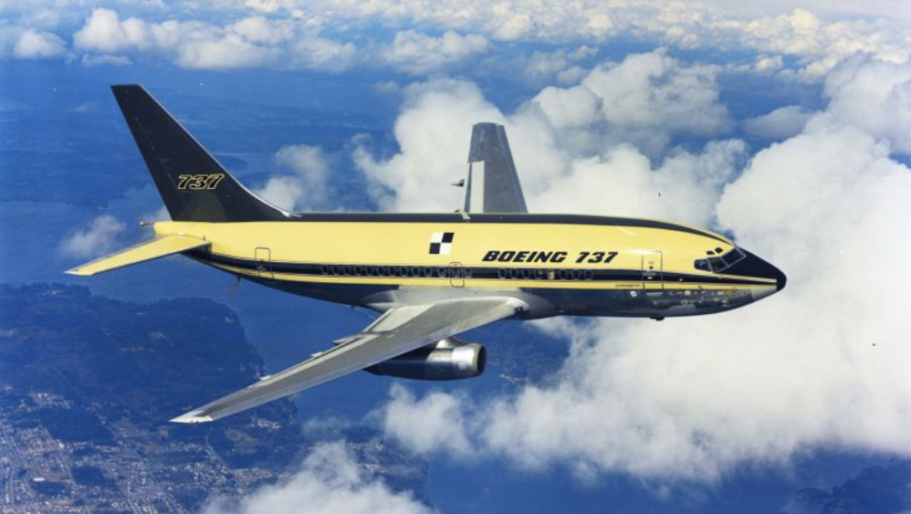
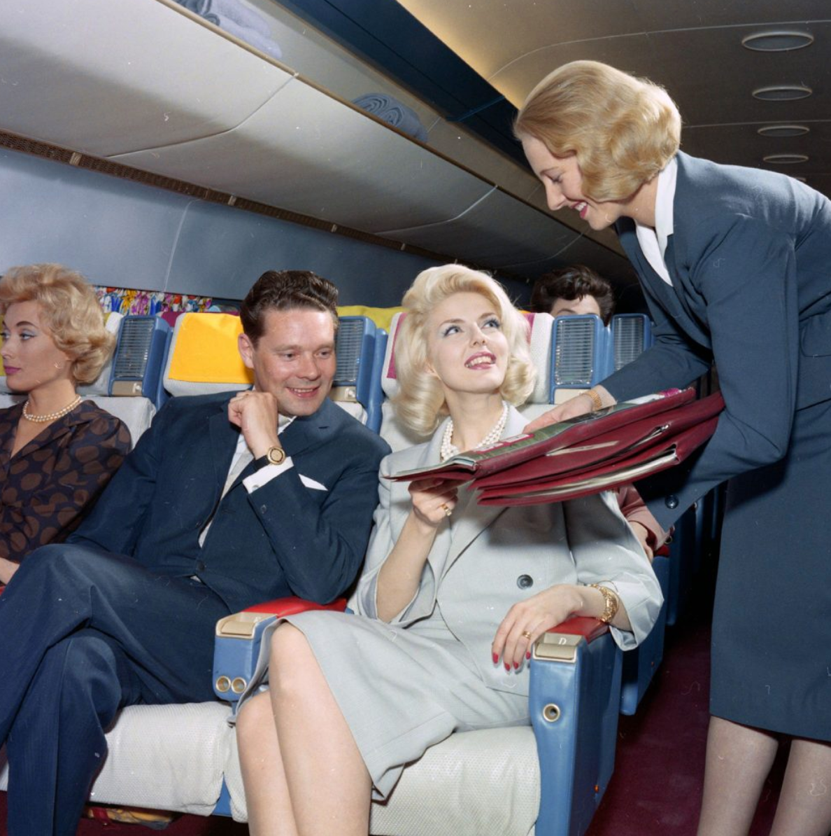
Air Travel in 1968
First Boeing 737 flight
Flying was a luxury experience
Manual controls, minimal automation
Pilots navigated with analog instruments
Isolated, mechanical systems

Slide 3

Car Travel in 1968
Navigation required paper maps
No GPS or digital assistance
Driving was fully manual
Vehicles had no onboard sensors or connectivity

Slide 4
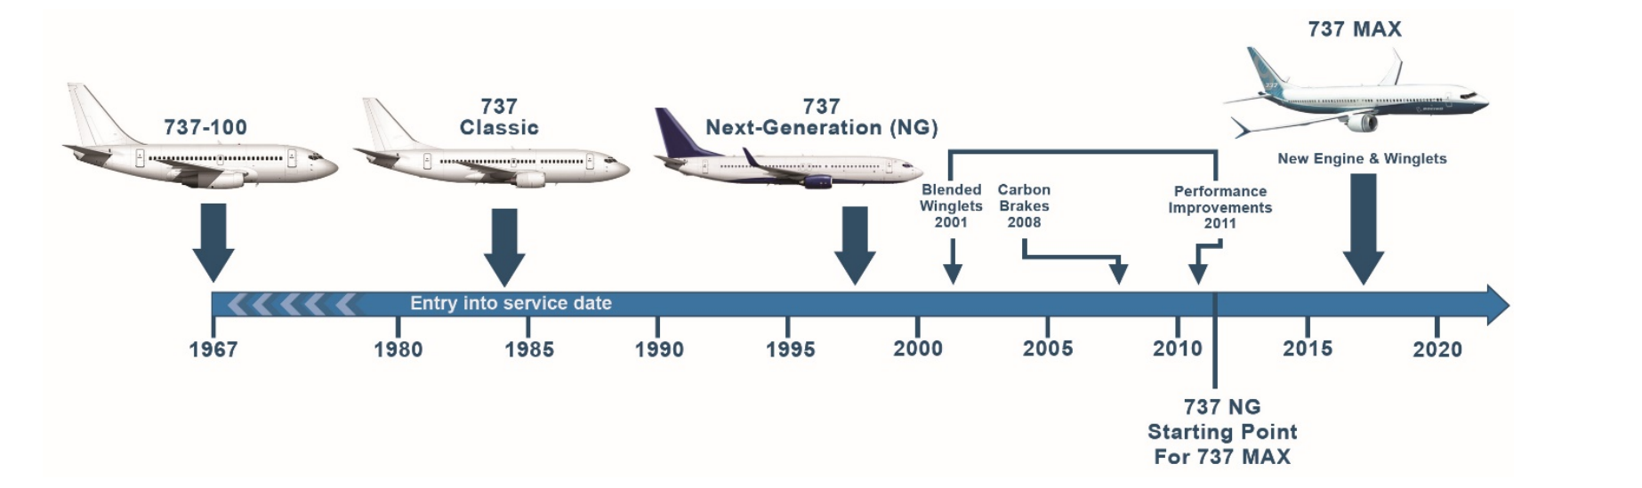

Evolution at Different Speeds
1967
2025
Airframe
P&W
JT8D
CFM56-3
CFM56-7B
CFM LEAP-1B
We
1968
1984
1997
1997
2017
2017
Hardware (Engines)

Slide 5
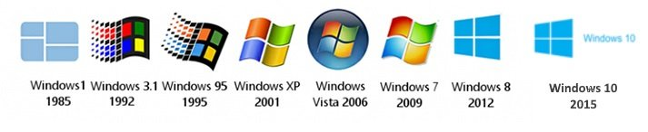
Example Of How Software Has Changed
29-Jul-15
10-Nov-15
2-Aug-16
5-Apr-17
17-Oct-17
30-Apr-18
13-Nov-18
21-May-19
12-Nov-19
27-May-20
18-May-21
16-Nov-21
18-Oct-22
1507
1511
1607
1703
1709
1803
1809
1903
1909
2004
21H1
20-Oct-20
20H2
21H2
22H2
Notes:
Version Build Release date
1507 10240 29-Jul-15
1511 10586 10-Nov-15
1607 14393 2-Aug-16
1703 15063 5-Apr-17
1709 16299 17-Oct-17
1803 17134 30-Apr-18
1809 17763 13-Nov-18
1903 18362 21-May-19
1909 18363 12-Nov-19
2004 19041 27-May-20
20H2 19042 20-Oct-20
21H1 19043 18-May-21
21H2 19044 16-Nov-21
22H2 19045 18-Oct-22

Slide 6
Where We Are Today
Evolution
Airframes last decades
Causation
Tech advances outpace platforms
Realization
Constant upgrades are now essential
Hardware evolves faster
Software evolves fastest
Warfare is changing
Rapid tech integration is critical

Slide 7
The Future is Distributed
Autonomy is growing
Software is taking over
Sensors are everywhere
Tomorrow’s systems must act as one.
Notes:
The future is autonomous
Software is taking over human tasks
The amount of software and sensors is increasing
=> A need for distributed systems
Future distributed systems need a real-time data centric communication framework which makes distributes systems working as one by getting the right data and the right place at the right time

Slide 8
How Do We Get There
Modular Design for Hardware and Software
Define Data Model
Data-Centric Design
Define Key Interfaces
Use of Open Standards
Data Centric Framework

Slide 9
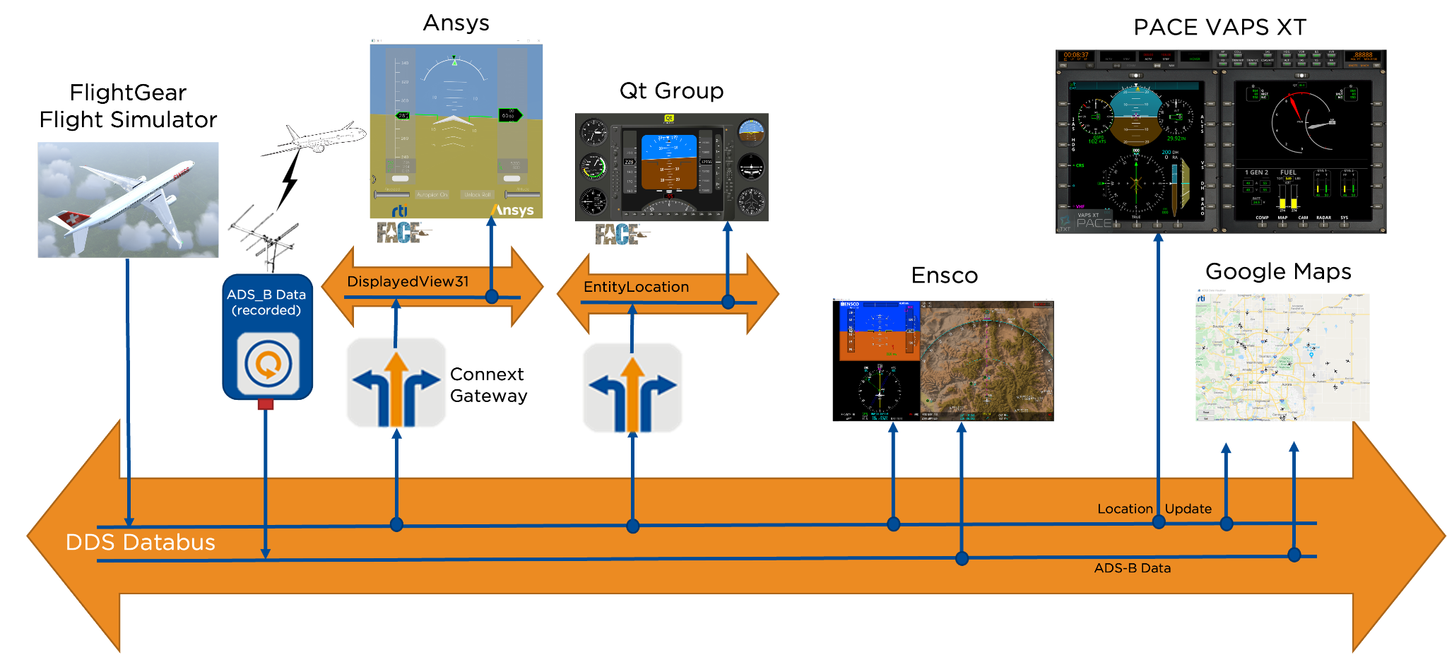
RTI Connext In Action

Slide 10

Data-Centric Framework
“Global Data Bus” generalizes Subject-Based Addressing
  Data objects addressed by Domain ID, Topic and Key
  Domains provide a level of isolation
  Topic groups homogeneous subjects (same data-type & meaning)
  Key is a generalization of subject
Data Writer
Domain
Data Reader
Data Reader
Data Writer
Topic
Data Reader
Key (subject)
Airline | Flight | Destination | Time
SWA | 023 | PDX | 14:05
UA | 119 | LAX | 14:40
Instance
Data Writer
Sensor | Value | Units | Location
4535 | 72 | Fahrenheit | Bldg. 405
5677 | 64 | Fahrenheit | Bldg., 201
Databus
Data Writer

Slide 11


Using QoS to Shape Data Flow
Collision
avoidance
application
Publisher
Radar Track
Topic
Reliable; 1 Hz;
get history
Subscriber
Publish reliably
10 Hz
600 sample history
Best effort; 0.2 HZ;
get history
Airline NOC
Subscriber
Nearby tracks with
altitude < 5000m
Airport ATC
Subscriber
Discovery matches publishers and subscribers of a topic
Topics tied to Data type, allowing smarter bus
Quality of Service describing application data needs must be compatible to communicate
Specifying and relying only on these data properties enables decoupled, resilient systems

Slide 12

DDS is the Foundation of Open Standards
DDS Standard defines
  API for application portability
  Data-Centric framework
  Wire protocol for interoperability
Multiple language bindings
  C, C++, Java, .NET, Ada, LabView, Matlab, Python, Lua
Multi platform support
  Windows, Linux, Unix, embedded OS
Cross-vendor portability
DDS API
Data-Centric Framework
Real-Time
Publish-Subscribe
Wire Protocol (RTPS)
Cross-vendor interoperability

Slide 13
DDS The Backbone of MOSA
Data Distribution Service (DDS) is the software connectivity foundation for over 20 cross-industry open standards, enabling the rapid integration of Open Systems Architectures (OSA) and deployment of Modular Open Systems Approach (MOSA) platforms
ALMAS
CMS Alerts
AUTOSAR
Automotive
CMOSS
Vehicular EW
CARACaS
Marine Robotics
CIGI
MS&T
FACE
Military Avionics
GCIA
Military Vehicle
GVA/NGVA
Military Vehicle
LOSA
Military Vehicle
MOCU
Robot Control
NOA
Naval Ship
OMS
Military Avionics
ROS2
Robotics
SOSA
Military Sensors
TMSC
Power Microgrids
UMAA
Maritime Robotics
UCS
UAS Control
EUROCAE
ED-247
Avionics Testing
DDS
Notes:
CMS = Combat Management System
MS&T = Modeling, Simulation, and Training
UAS = Unmanned/Uncrewed Air System
ALMAS -- ALert MAnagement Service in Combat Management Systems (CMS), consisting of a standard alerts data model, a model for an alert delivery and a lifecycle management service
https://www.omg.org/spec/ALMAS/1.1/About-ALMAS
AMSM -- Application Management and System Monitoring – Naval Combat Management System (CMS)
https://www.omg.org/spec/AMSM/
AUTOSAR Adaptive
Connext DDS supported as a network binding in the AUTOSAR Adaptive Platform beginning with the 18.03 release
https://www.autosar.org/standards/adaptive-platform
CMOSS -- C4ISR/Electronic Warfare Modular Open Suite of Standards (CMOSS) is a modular open systems architecture (MOSA) intended to converge select Army warfighting capabilities – such as mission command, movement and maneuver, and fires – into one system vs. integrating a multitude of separate capability “boxes” into vehicles.
https://www.army.mil/article/219848/armys_investments_for_the_future_yield_common_open_architecture
CARACaS -- Control Architecture for Robotic Agent Command and Sensing
Connext DDS is used as the connectivity framework in MOCU
https://ieeexplore.ieee.org/document/6107312
CIGI -- Common Image Generator Interface
CIGI Next will be built on DDS and Connext DDS as the interface
https://en.wikipedia.org/wiki/Common_Image_Generator_Interface
FACE -- Future Airborne Capability EnvironmentRTI is an Open Group FACE Consortium member and RTI Connext TSS was the world’s first certified conformant FACE Transport Services Segment (TSS) for both FACE Technical Standard 2.1 and FACE Technical Standard 3.1. RTI also offers commercial RTCA DO-178C DAL A certification evidence for Connext TSS 3.1
http://www.opengroup.org/face
GCIA -- Ground Combat Systems' Common Infrastructure Architecture integrates multiple systems and eliminates redundancies in fighting vehicles by using open architecture
https://www.army.mil/article/210117/reusable_and_refresh_able_open_systems_architecture_for_fighting_vehicles
GVA -- Generic Vehicle Architecture
The UK MoD GVA (DEF STAN 23-09) requires DDS
https://en.wikipedia.org/wiki/Generic_Vehicle_Architecture
LOSA -- Land Open Systems Architecture
The UK MoD GVA is part of LOSA and therefore requires the use of DDS
https://ui.adsabs.harvard.edu/abs/2013SPIE.8742E..0CP/abstract
MOCU -- Multi-Robot Operator Control Unit
Connext DDS is used as the connectivity framework in MOCU
https://apps.dtic.mil/sti/citations/ADA449450
NGVA -- NATO Generic Vehicle Architecture
The NATO version of the GVA (NGVA) standard (STANAG 4754) requires DDS
https://www.natogva.org/
NOA – Navy Open Architecture
https://www.usni.org/magazines/proceedings/2010/june/naval-systems-open-architecture-versatility-through-flexibility
OMS -- USAF Open Mission Systems
DDS is a supported publish/subscribe protocol in the Critical Abstraction Layer (CAL)
https://www.vdl.afrl.af.mil/programs/oam/oms.php
ROS2 -- Open Robotics Robotic Operation System V2 (ROS2 / ROS-Military)
ROS2 is built on top of DDS as a connectivity framework, with RTI Connext DDS as an option
ROS-Military (ROS-M) is built on top of ROS2
https://www.ros.org/
SOSA -- Sensor Open Systems Architecture
RTI is an Open Group SOSA DDS/RTPS is a SOSA Interaction Binding
https://www.opengroup.org/sosa
TMSC -- Tactical Microgrid Standards Consortium
TMSC requires DDS for communication
https://www.nationalacademies.org/documents/embed/link/LF2255DA3DD1C41C0A42D3BEF0989ACAECE3053A6A9B/file/D75F0F083ECEDF19C44CADF56755799FF6216E08625F?noSaveAs=1
UMAA -- Unmanned Maritime Autonomy Architecture
DDS is a supported transport protocol
https://www.dsp.dla.mil/Portals/26/Documents/Conference/2020-StateofDSPConf_Rothgeb.pdf?ver=lofexQym-3TE8qM4Tkqn6w%3D%3D
UCS -- Unmanned Systems (UxS) Control Segment Architecture
The UCS Architecture supports DDS. Most UCS implementations use DDS
https://www.sae.org/standards/content/as6512b/
More…

Slide 14

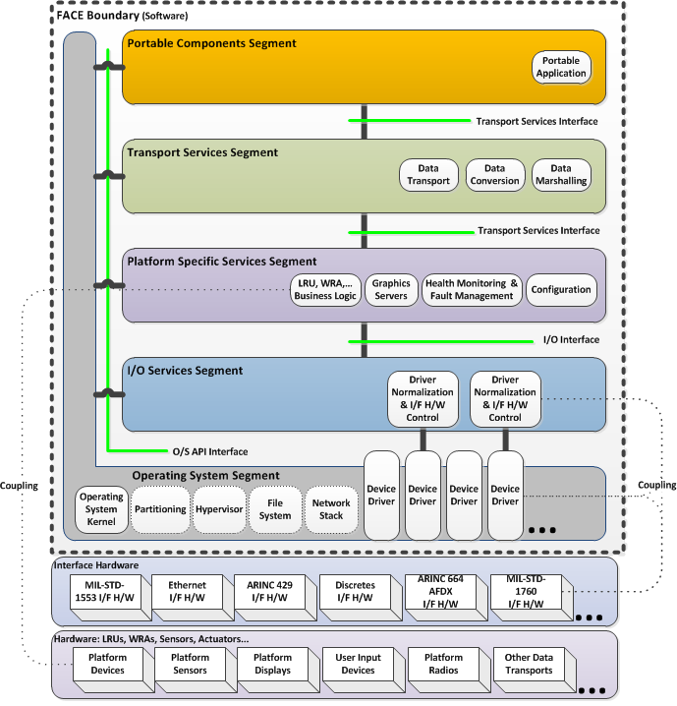
The Future Airborne Capability Environment (FACE®) Reference Architecture
FACE Portable Components Segment
Transport Services Segment
Platform Specific Services Segment
  Platform Device Services
  Platform Common Services
  Graphics Services
I/O Services Segment
Drivers
Operating System Segment
https://www.opengroup.org/face

Slide 15
The Transport Services Segment
PCS
PCS
PSSS
PSSS
RTI Connext
FACE Transport Services Segment (TSS) with RTI Connext

Slide 16
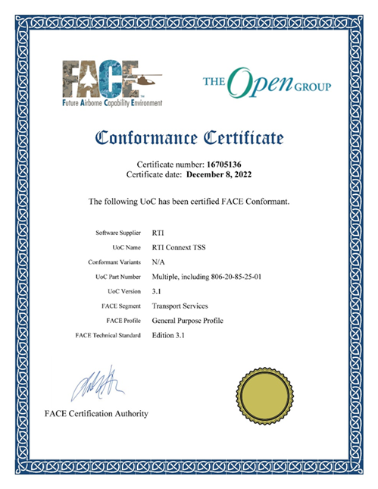
RTI Connext TSS
First TSS Conformant to the FACE Technical standard 2.1 and 3.1
Safety Base, Safety Extended, and general Purpose Profile
Publish / Subscribe Message Pattern
Debugging and Analysis tools
Available on a wide variety of operating systems and CPUs
Works with RTI Connext DDS (Professional, Micro, and Cert)
Interoperability with non FACE applications through DDS
DO-178 Artifacts

Slide 17
RTI Connext for Real-Time Communication
App 0
DAL ‘A’
App 1
DAL ‘C’
App N
DAL ‘B’
Connext TSS
Connext TSS
Connext TSS
Transport
OS
Transport
OS\
Transport
OS
653
653
653
POSIX
653
Socket
653
UDP
Partition OS 0
Partition OS 1
Partition OS N
On-Board Connext Databus
ARINC 653 Enabled Kernel (+ POSIX)
Processor Hardware
Global Connext Databus
Notes:
Clarify OS and transport differentiation when it comes to interfaces.
See if differences from VxWorks 653 2.x and 3.x are related to this vision:
2.x = MOS is the owner of the OS network stack
3.x Partition is the owner
From current AIRBUS work, a partition will be able to use up to the 3 available interfaces: ARINC 653, Intra and UDP

Slide 18



RTI Connext Enables Cross-Platform Interoperability
Avionics
Innovation
Avionics
Innovation
Avionics
Innovation
Avionics
Innovation
FACEE
ECOA
PYRAMID
Connext DDS
Connext DDS
Connext DDS
Connext DDS
RTI Connext DDS
OS / RTOS
OS / RTOS
OS / RTOS
OS / RTOS
Board Vendors
Board Vendors
Board Vendors
Board Vendors
Microprocessor
Microprocessor
Microprocessor
Microprocessor

Slide 19
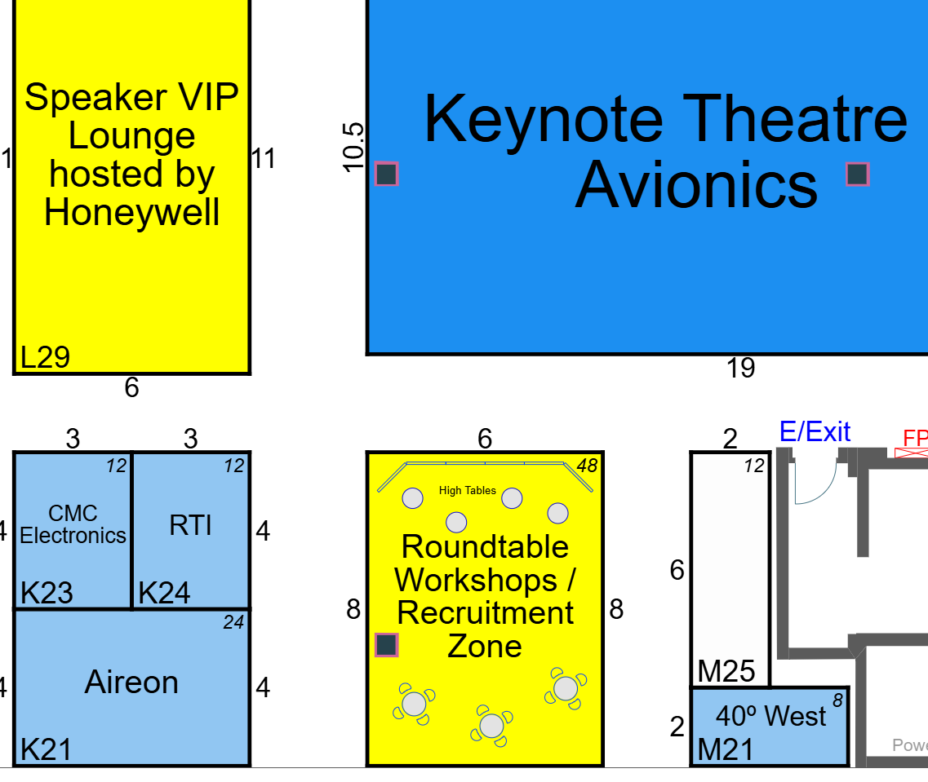
Visit us at booth #K24
Andre Odermatt
Principal Application Engineer
andre@rti.com

Slide 20






Stay Connected
rti.com
Free trial of Connext
rtisoftware
company/rti
rti.com/blog
@rti_software
rti.com/podcast

