Slide 1


Creating a culture of system learning
AAR to SAAR
Systems After Action Review
NHSE Accredited PSIRF Provider
Jessica Wadsworth
Co-director of Being Human in Healthcare Ltd
© 2025 Being Human in Healthcare Ltd

Slide 2
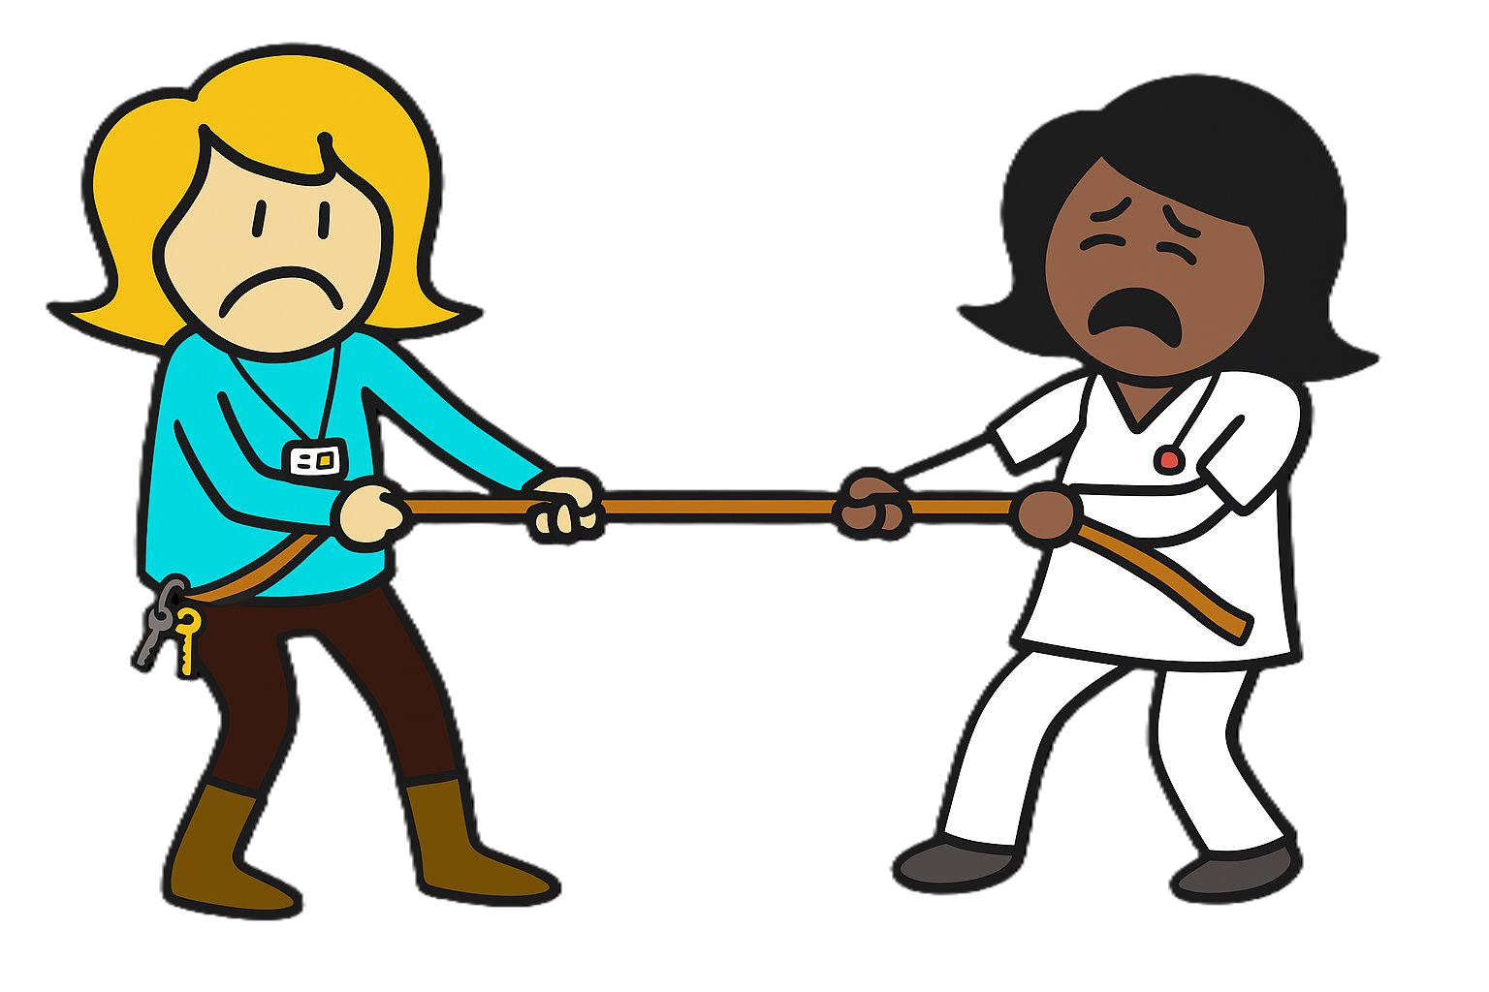
What can impact AAR learning?
Barriers
Catch–all tool
Multi-stage LR decision
Delay
Non-diverse involvement
Pre-AAR industry
Person-focused approach
Descriptive outputs
Lengthy AAR reports
Bureaucratic sign-off
Multiple tick-box actions
Facilitators
System-learning
Local LR decision
Timely
Diverse involvement
Minimal scoping activity
System-based approach
Relevant work system factors
Output supports analysis
Reduced bureaucracy
Co-ordinated improvement
Notes:
Tug of war between what

Slide 3

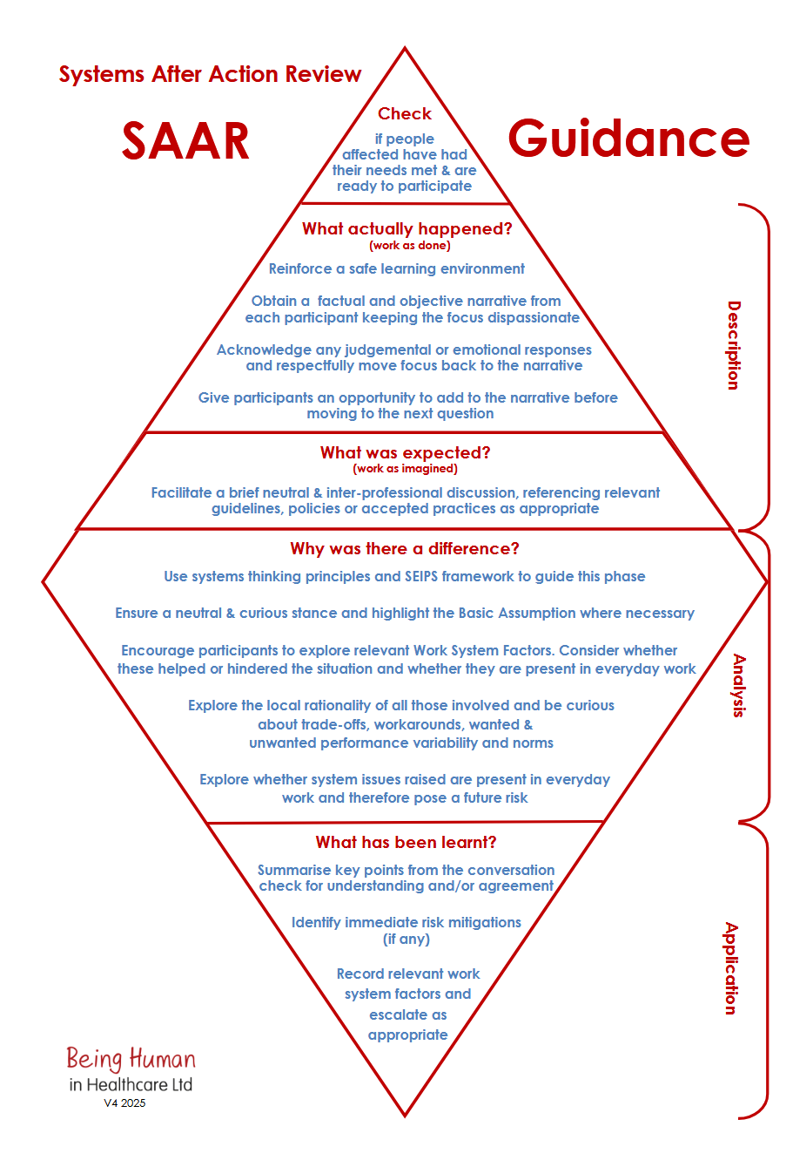
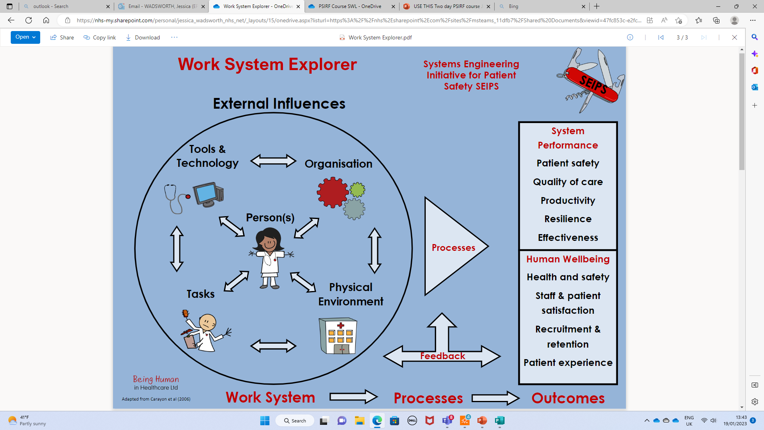
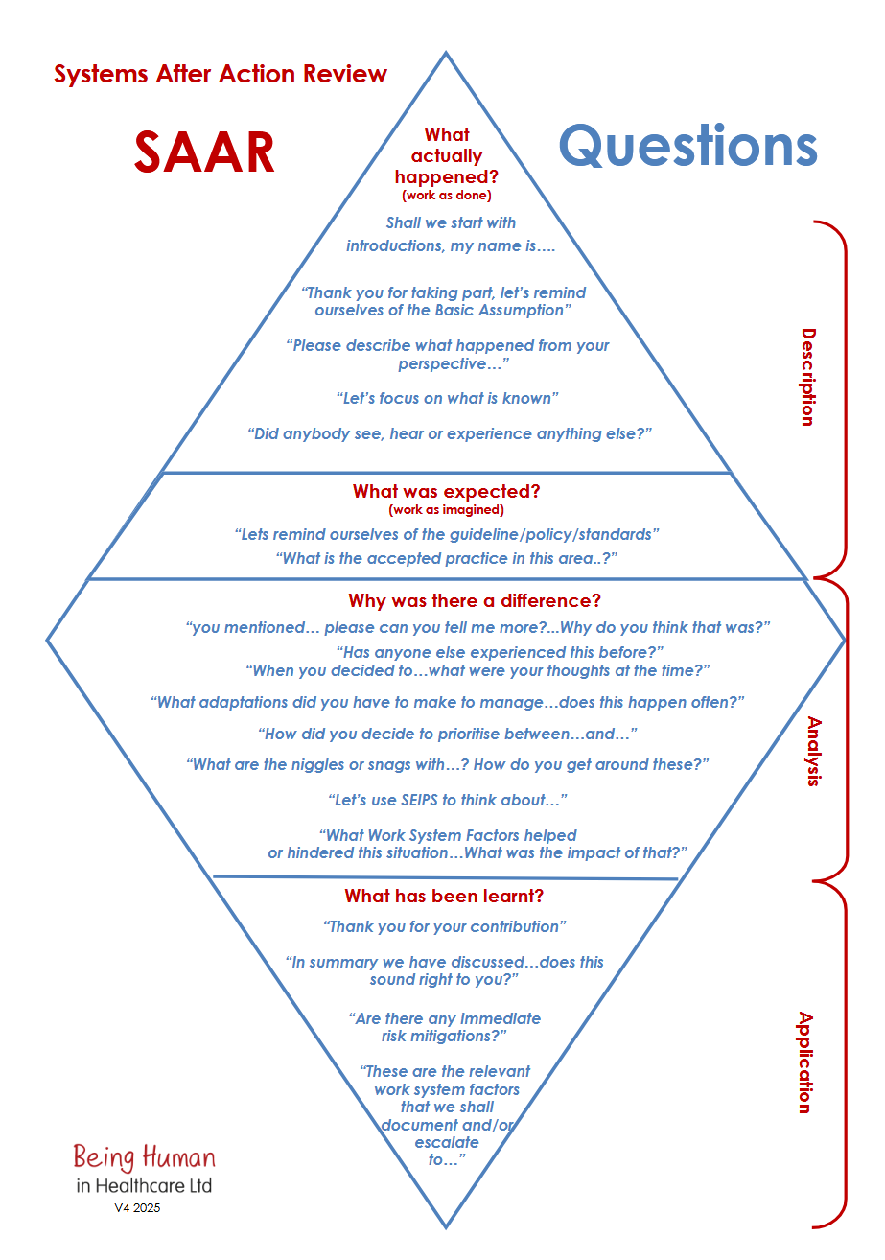
Benefits of the SAAR
What
actually
happened?
(WAD)
Move towards a debriefing culture
Enable system-based learning
for improvement
What did we expect to happen?
(WAI)
Why were there differences?
What did we
learn?
Notes:
Consider having the title here: Systems After Action Review: SAAR

Slide 4

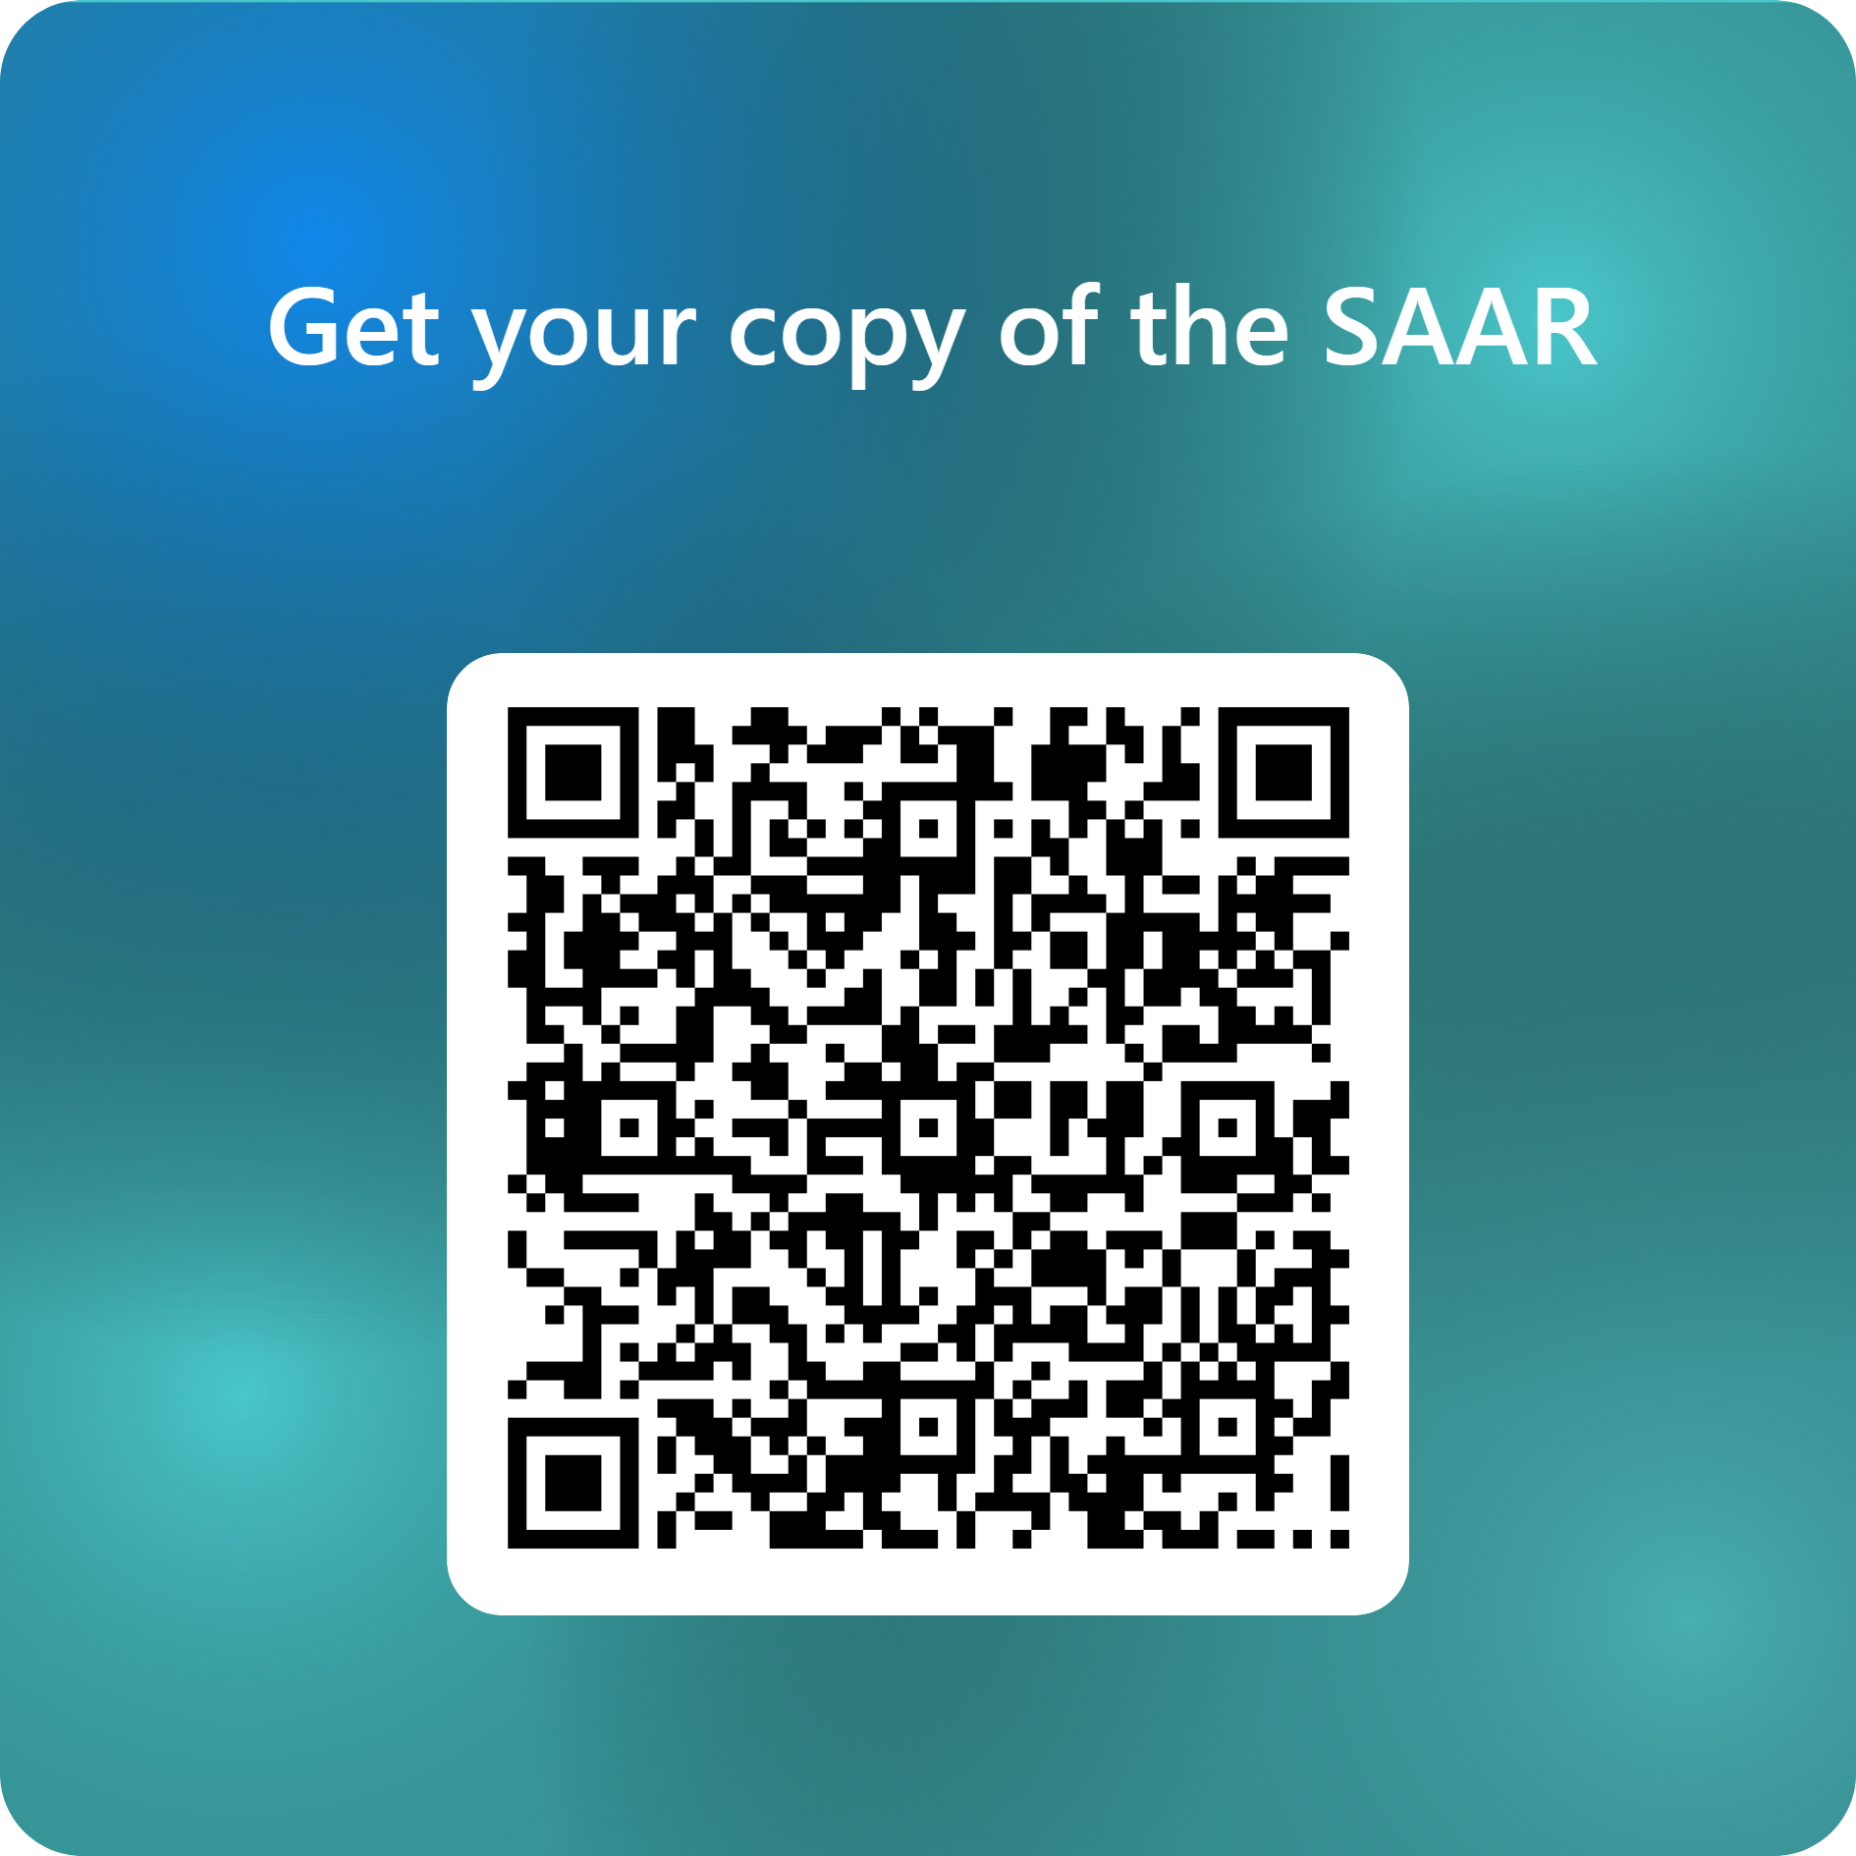

Thank You
© 2022 Being Human in Healthcare Ltd

