Slide 1
How to Read and Review Third-Party Risk Management Reports
April 15, 2026

Slide 2


Your Presenter
Alexis Kennedy
Partner, IT Advisory Services
Shelby Mathers
Director, Cybersecurity Consulting Services

Slide 3

What We Will Cover
Overview of TPRM
  Introduce the basics of Third-Party Risk Management and its importance in vendor oversight.
Vendor Assurance Reports
  Review common vendor assurance and assessment reports used in third-party risk evaluation.
Review Guidance
  Provide detailed guidance on how to analyze and interpret different report types effectively.
Defense-in-Depth Strategy
  Discuss strategies for combining reports to create a layered defense against risks.

Slide 4
What is Third-Party Risk Management (TPRM)?

Slide 5





Third-Party Risk Management (TPRM): Defined
Definition of TPRM
  TPRM involves identifying, assessing, and managing risks from external vendors and service providers.
Importance of TPRM
  TPRM is essential to manage risks related to security, compliance, business continuity, and data privacy.
Use of Assurance Reports
  Independent reports like SOC, ISO, PCI, penetration tests, and vulnerability scans ensure vendor controls and security.
Broader Organizational Benefits
  TPRM supports regulatory compliance, risk mitigation, and operational resilience for organizations.
Newsworthy Examples
..and so many more

Slide 6
Third Party Risk Management
Planning
Due Diligence
Contracting
Ongoing monitoring
Termination
Selection
Implementation of a vendor / third party risk management program can be a daunting, long-term project. Most organizations have established components of an overall program, but challenges can still exist with any organization.
Departmental silos create variable approaches to ongoing due diligence
Increased vendor reliance and significance to the organization may not be quickly identified
Information flow through the vendor life cycle can cause gaps in contracting / due diligence
Duplication of efforts across risk / procurement / business teams in oversight.

Slide 7
Risk Identification (Technology)
Risk Assessment and Treatment
Organizational Security
Security Policy
Asset and Information Management
Human Resources Security
Physical and Environment Security
Operations Management
Access Control
Application Security
Incident Event and Communication Management
Business Resiliency
Compliance
End User Device Security
Network Security
Privacy
Threat Management
Server Security
What is your own security posture and maturity?

Slide 8
TPRM: Common Report Types
Report Type | What It Covers
SOC 1 | ICFR - Related Controls
SOC 2 | Trust Services Criteria - Security, Availability, Confidentiality, Processing Integrity, and/or Privacy
ISO 27001 | Information Security Management System (ISMS)
ISO 42001 | Artificial Intelligence Management Systems (AIMS)
PCI DSS | Cardholder Data Protection
Penetration Testing | Exploitable Vulnerabilities – What can be broken into?
Vulnerability Scanning | Technical Weaknesses – What is potentially wrong?

Slide 9
SOC Reports

Slide 10

SOC Report
SOC = System & Organizational Control
A SOC Report is a method for how the vendor shares information about internal processes in support of the services that you depend on. The examination provides a high-level review of controls at the vendor.

Slide 11
SOC 1 vs. SOC 2
 | SOC 1 | SOC 2
Purpose | Evaluates vendor’s processes to support customer’s internal controls over financial reporting | Evaluates Trust Service Criteria – at least Security
Controls Tested | Business processes, IT processes | “Trust Principles” Security, Availability, Confidentiality, Processing Integrity, and/or Privacy
Differences | Organization defines control objectives and controls | Criteria is standard and organization defines controls

Slide 12
SOC Report Types
SOC 1 Type I / SOC 2 Type I
  Evaluates the design of the organization’s internal controls.
  As of a point in time (1 day)
  Sample of One tested for each control.
SOC 1 Type II / SOC 2 Type II
  Evaluates the design and effectiveness of the organization’s internal controls.
  For a period of time (at least 6 months)
Preferable to review Type II

Slide 13
Terms
Term | Description
User Entity | Client
Service Organization | Vendor; Who you’ve contracted services with
Service Auditor | The firm that is issuing an opinion
Subservice Organization | Subcontractors/subvendors
SOC Report | aka SSAE 21 (current standard) Sometimes referred to by the previous standard names: SAS 70; SSAE 16, SSAE 18

Slide 14
Sections of a SOC Report

Slide 15
Layout of SOC Report
Section I: Opinion Letter
Section II: Management’s Assertion
 | Section III: Management’s Description of the System
 | of Internal Controls
Section IV: Results
Section V: Unaudited Section

Slide 16
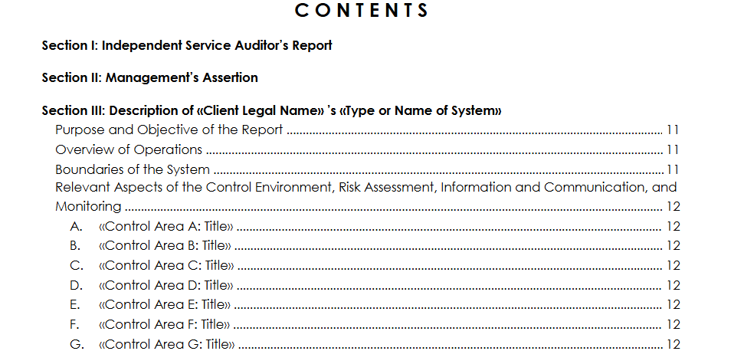
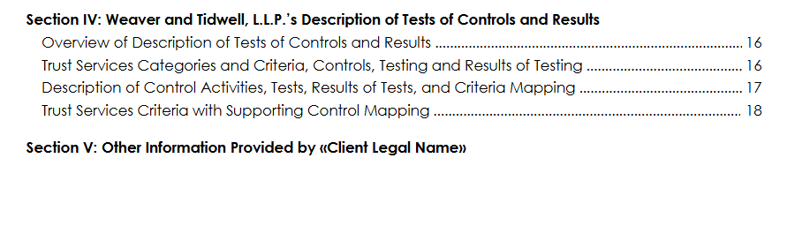
Example Table of Contents - SOC Report
Service Auditor’s Report /Opinion Letter
Management’s Assertions
Other information provided by the service organization
Information on what was tested, and testing results

Slide 17
SOC Report Review (1/3)
Section I – Opinion Letter
Standard format defined by AICPA, designed by auditors for auditors
Opinion Letter is the conclusion by the auditor over the processes and controls and description
If the auditor opinion is anything other than unqualified, the Opinion Letter expands on the reasons for the opinion
Opinion Type | Definition
Unqualified Opinion (clear) | Indicates that the objective or criteria tested as part of the report appears to be designed and/or operating effectively.
Adverse Opinion | Indicates that the users of the SOC report can not place any reliance on the service organization’s system.
Disclaimer of Opinion | Indicates the service auditor was unable to issue an opinion as they were limited by the service organization in the information they requested, or procedures performed
Qualified Opinion | Indicates that a objective and/or criteria was not designed and/or operating effectively.

Slide 18
The SOC Report has issues, now what?
Adverse Opinion and Qualified Opinion
Thoroughly review the Opinion Letter and the Results of Testing to understand the Basis for the Opinion
  For a Qualified Opinion, if the basis is not relevant to the client, then no additional step may be required
Review Management Responses (Section IV or V) where the service organization documents planned or actual remediation
  If not satisfied, request additional information from the vendor, such as an Internal Audit over the failed tests of controls
Consider whether the client needs to implement additional controls to supplement the service organization’s controls
Adverse Opinions are rare but very negative – the service organization does not have controls in place
  Execute a right-to-audit clause
  Request a new, accelerated SOC report (e.g. a six-month SOC report if the vendor typically issues a 12-month SOC report)
Unqualified Opinion (clean) but findings in controls considered key by the client
Review Management’s response
Consider whether the client needs to implement additional controls

Slide 19
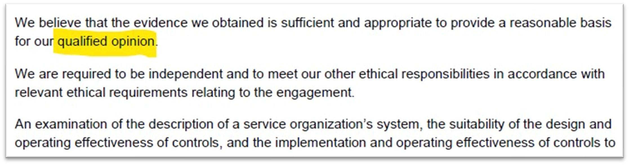
SOC Report Review (2/3)
Section I – Opinion Letter (cont’d)
Opinion Letter also includes the scope, the reporting period (dates of coverage - should cover the fiscal year), and the date the report was issued
Review the Opinion Letter to identify the auditor’s opinion, the reporting period, and scope
This sentence is the first evidence the opinion is qualified.
Section I – Opinion Letter (cont’d)
Service organization stating that the controls stated in the description were designed and/or operated effectively for the period

Slide 20
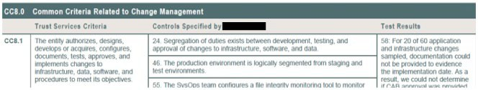
SOC Report Review (3/3)
Section III – Management’s Description of the System of Controls
  Description of the controls, usually with additional context to help understand the scope, objectives, and limitation of the controls
  Review the section for context around the controls that the client is expecting to see at the vendor
  Review of CUECs (Complementary User Entity Controls) should be performed
Section IV – Results
  List of all controls and the results of Service Auditor’s test of the controls
  Review the result of testing for the objectives/criteria and the specific controls that have been identified as key by the client – Negative results need to be analyzed further
Section V – Unaudited Section
  Contains service details that Service Organization provides but not audited
  May include management responses to the auditor’s findings or Disaster Recovery information
What is a CUEC? Complementary User Entity Controls, or CUECs, are the controls that the vendor wants their customer to have in place in for criteria to be achieved.

Slide 21
SOC Report Review Process

Slide 22
Establishing a SOC Report Review Process
Which SOC report to consider (if multiple reports are available)?
  Understanding of the services and controls
  Understanding of the client’s internal controls
Who is responsible to fill in the Review Template?
Who signs off on the Review Template?
When should the SOC report be reviewed?
How frequent does this review need to be done?

Slide 23
Inventory of Vendors
Service Organization | Report Type Available
Vendor 1 | SOC 1 Type 2
Vendor 2 | SOC 2 Type 2
Vendor 3 | SOC 1 Type 2 and SOC 2 Type 2
Vendor 4 | ISO 27001 and PCI
Vendor 5 | Penetration Testing Report
Vendor 6 | No Reporting Available
Prepared preliminary drafts of the template for management to utilize on an annual basis

Slide 24
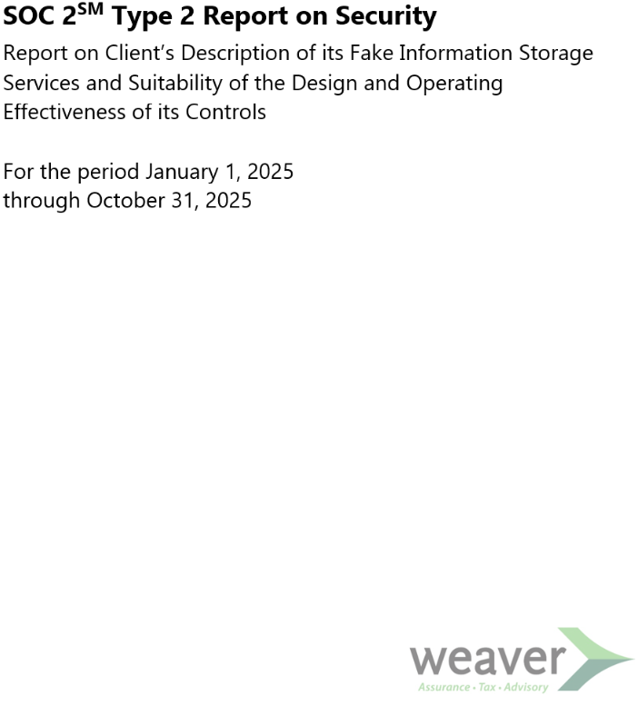
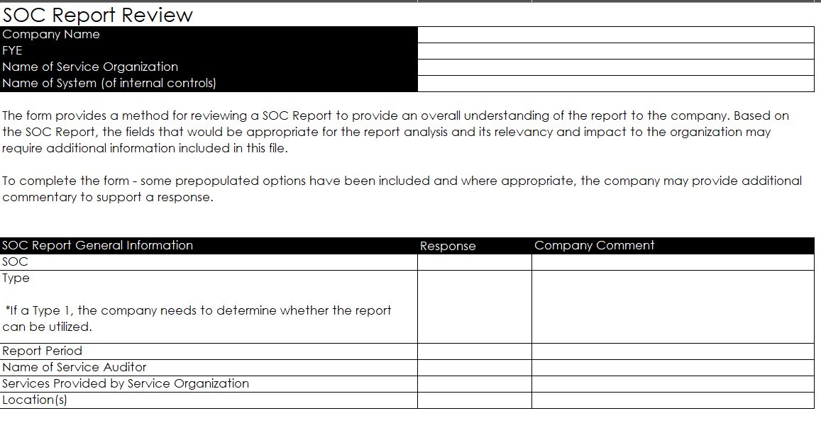
Overview Tab
General Information

Slide 25
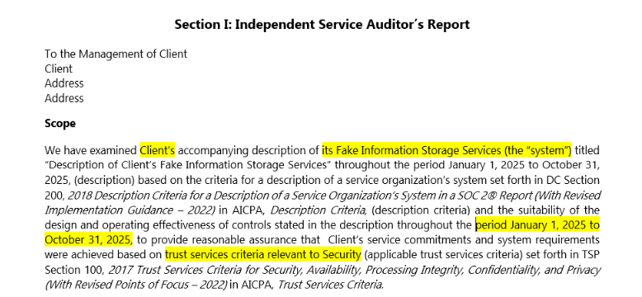
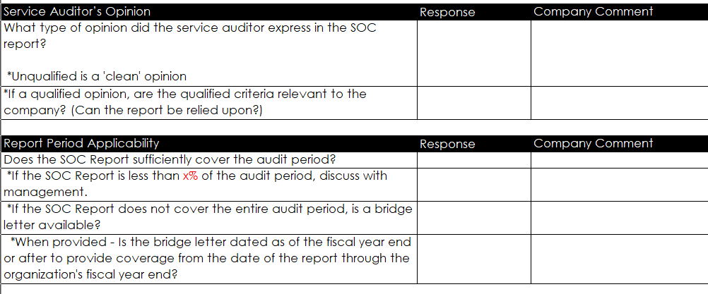
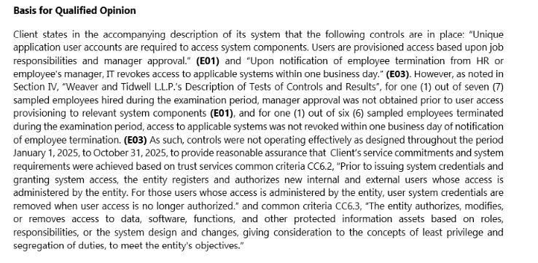
Overview Tab, cont.
Opinion and Period
SOC Report – Section 1
Auditor’s opinion (Note that unqualified is a ‘clean option’.)
Who did the Audit? Reputable firm? In good standing with Peer Review Board?

Slide 26
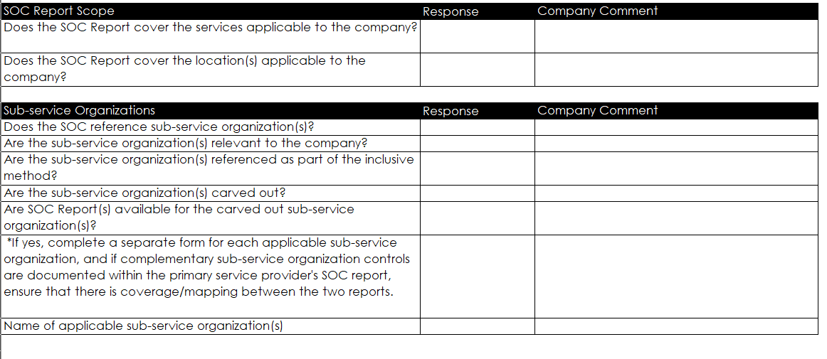
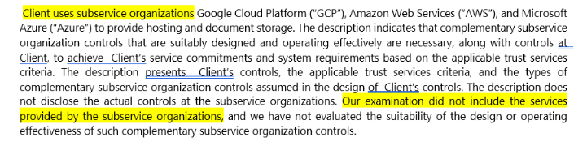
Overview Tab, cont.
Scope and SSOs
SOC Report – Section 1

Slide 27
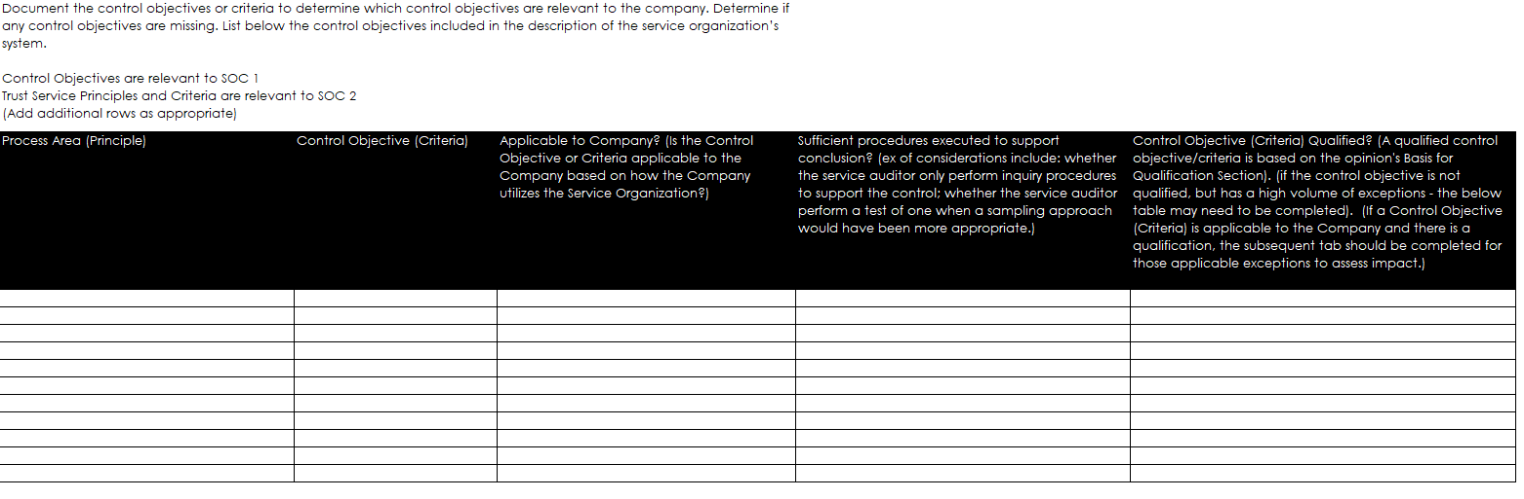
Control Objectives or Criteria Tab
SOC Report - Section IV

Slide 28
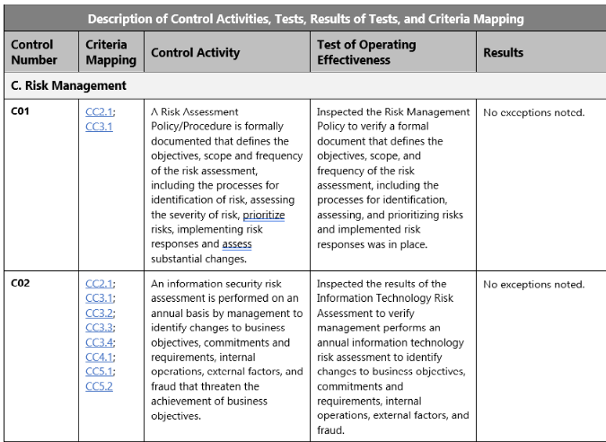
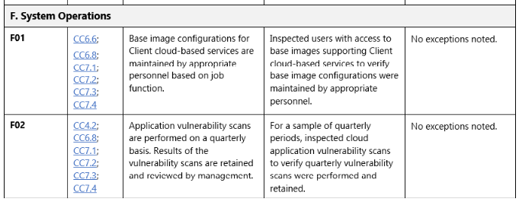
Control Objectives or Criteria Tab
SOC Report - Section IV

Slide 29
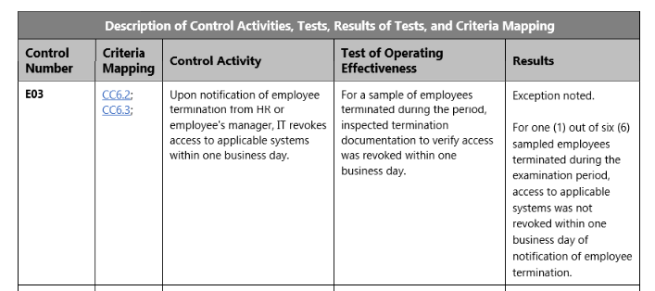
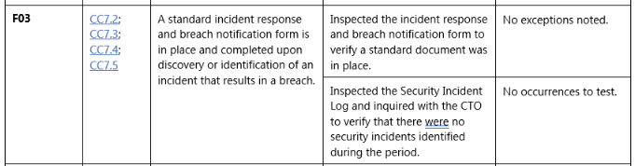
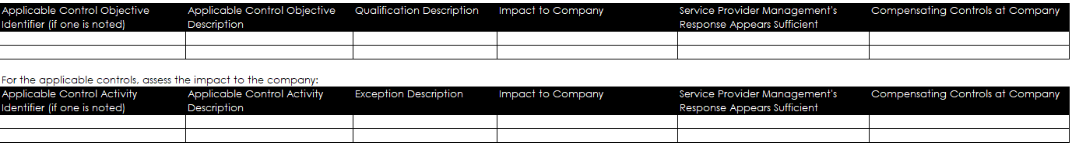
Exception Analysis

Slide 30
Exception Analysis
Qualification
Exception
Opinion Letter
  Large break down
  Controls in aggregate did not operate to meet the objective or criteria.
Examples
  Logical access failed because:
    Term testing failed
    UAR incomplete
    Provisioning access without approvals
Section 4 Only
  Did not meet the auditor materiality threshold to qualify the objective or opinion
  Needs to be evaluated to ensure no impact to you, the user.

Slide 31
Exception Analysis
Red Flags
Exception
Opinion Letter
  Large break down
  Controls in aggregate did not operate to meet the objective or criteria.
Examples
  Logical access failed because:
    Term testing failed
    UAR incomplete
    Provisioning access without approvals
Section 4 Only
  Did not meet the auditor materiality threshold to qualify the objective or opinion
  Needs to be evaluated to ensure no impact to you, the user.

Slide 32
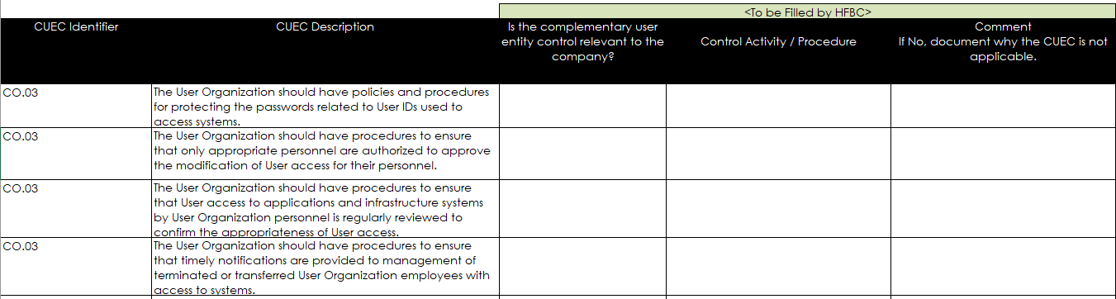
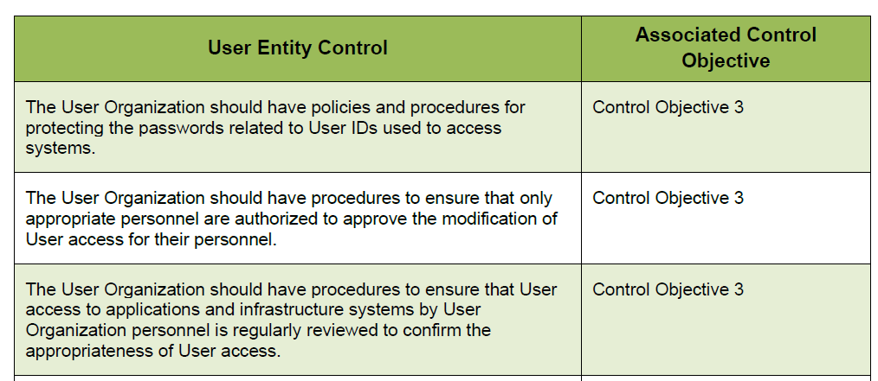
CUEC Tab
This is a key aspect of the SOC Report Review
Section III (Complementary User Entity Controls)

Slide 33
CSOC
Complementary Subservice Organization Controls
What subservice organizations are doing to support the services delivered?
Were you aware of the outsourced providers?
Are you comfortable with the level of outsourcing?
Do you need to collect those SOC reports as well to get the full picture.

Slide 34
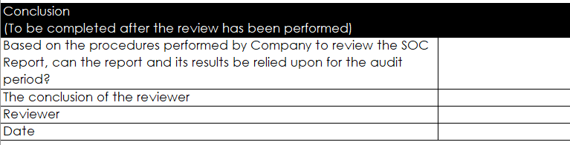
Overview Tab, cont.
Conclusion
Review should be performed by appropriate personnel with adequate knowledge over the client’s environment and compliance needs

Slide 35
Reviewing ISO 27001 Reports
ISO 27001 Key Attributes
Compared to SOC 2?
Certification Validation
  Verify the legitimacy of the certification body and the certificate’s validity period when reviewing ISO 27001 reports.
Statement of Applicability
  The SoA outlines in-scope and excluded controls, clarifying the boundaries of the Information Security Management System.
Review Exclusions and Limitations
  Carefully assess exclusions to ensure they do not affect critical services you depend on.
Beyond Certification
  ISO 27001 confirms a management system presence but does not guarantee control effectiveness; supplement with other reports.
ISO 27001 Certificate | SOC 2 Report
One-page certificate | 50–100+ page report
Pass/fail certification | Opinion-based attestation
Valid for 3 years | Point-in-time or period-of-time
Public-facing | Usually NDA-restricted
Based on ISMS | Based on controls & testing

Slide 36
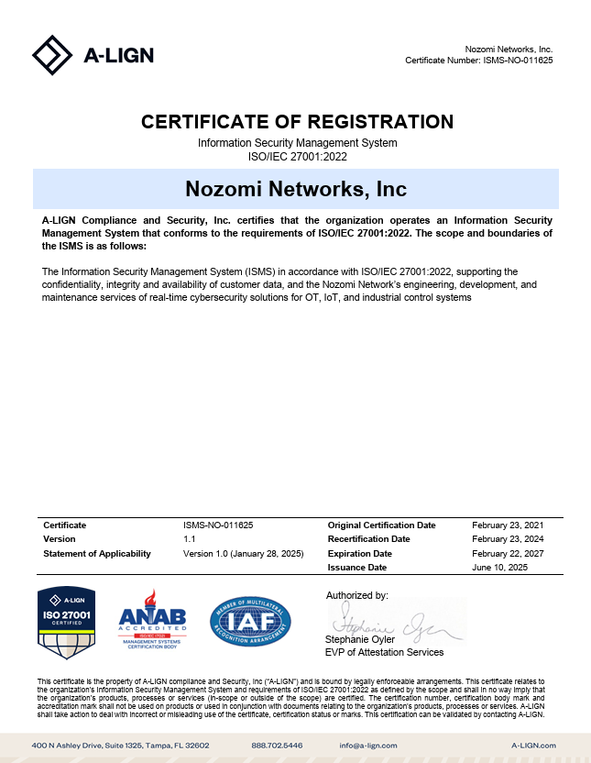
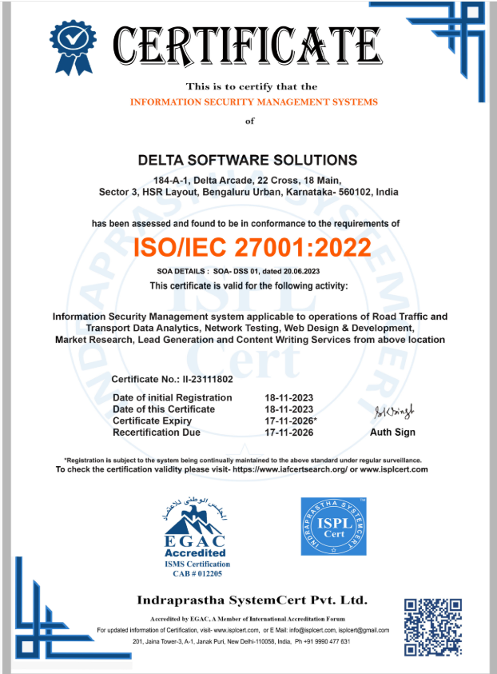
Example Certification Reports: ISO 27001

Slide 37
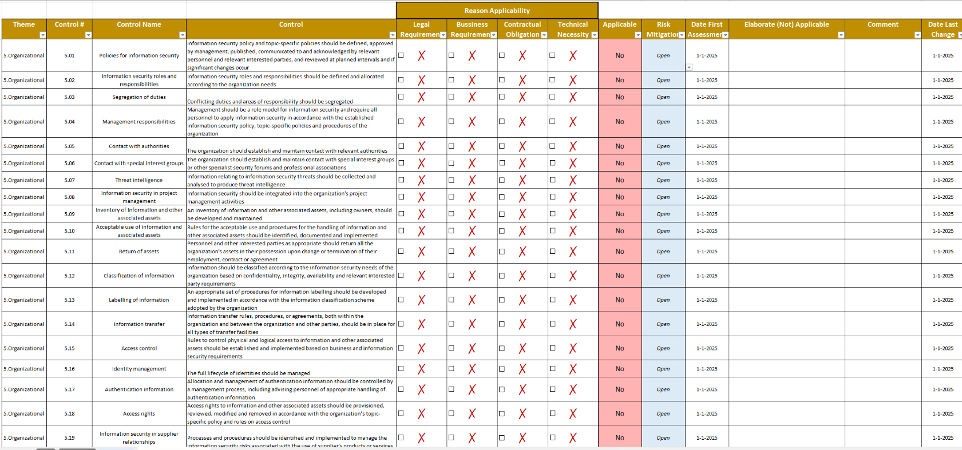
Example Statement of Applicability: ISO 27001

Slide 38
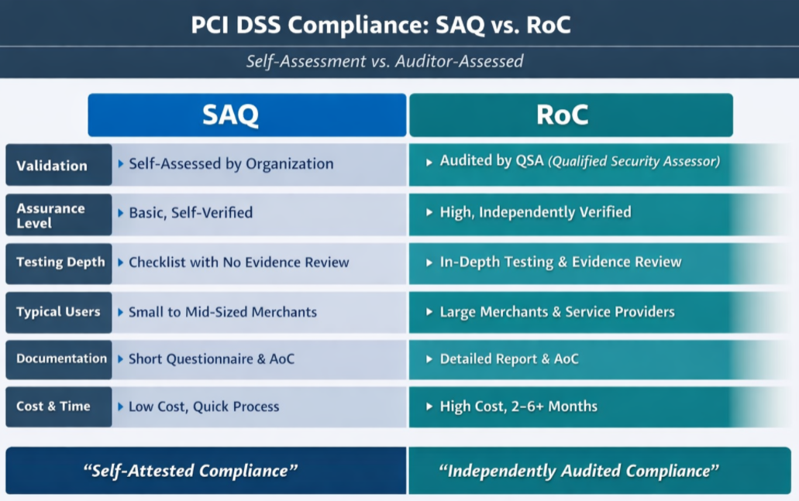
Reviewing Other Reports: Key Items
Types of PCI DSS Reports
Notes:
PCI DSS reports are required for vendors handling payment card data. The two main report types are the Report on Compliance (ROC) and the Attestation of Compliance (AOC). When reviewing PCI DSS reports, identify which type is provided and confirm that the scope aligns with the services you use. Compensating controls should be reviewed to understand how the vendor addresses requirements that cannot be met directly. It is also important to determine whether the vendor is classified as a service provider or merchant, as this affects their compliance obligations. PCI DSS reports provide high assurance for payment data protection but should be integrated with other evidence for a complete risk assessment.

Slide 39
Other Reporting Key Items
Vulnerability scan does not equal penetration test
PCI has two main forms of reports
  SAQ. Could be third party validated or not
  ROC. Fully validated by a QSA
  AOC. Can come with an SAQ and a ROC
ISO 42001 – will look similar to ISO 27001
HIPAA Security – does NOT have a certification body

Slide 40
Things to Keep in Mind
TPRM reports should be obtained and reviewed by the client at least once in a year
  If no report, ask why?
  Identify what procedures you are willing to live with to gain assurance over the services provided to you by that vendor.
Bridge Letters (SOC Reports)
  Depending on the report period, a bridge letter is provided by the service organization on the operation of the controls since the report period through the date of the letter
Subservice Organizations
  If a service organization is utilizing a subservice organization that is significant to the client’s operations, the subservice organization’s SOC Report should be considered for review by the client

Slide 41
Takeaways

Slide 42
Third Party Risk Management Implementation Roadmap
Phase I - Getting Started
Phase II – Communication/Design
Phase III - Implementation
Determine organizational priorities for project based on resources, time, risk tolerances, and desired maturity model for overall Program
Conduct current state assessment of each stage of vendor lifecycle
Identify any gaps in controls / information / processes / systems
Conduct vendor analysis using financial and operational reliance metrics
Leverage existing structures or systems in procurement / finance / risk / security
Identify risk tier categories* relevant to organization / vendor assessment
Identify any new technology requirements
Communication of organizational priorities across all branches / business units
Establish any necessary controls / processes in selection / contracting / monitoring
Conduct vendor risk assessment to classify into tiers
Evaluate contracts for high-risk vendors for any gaps / impact
Communicate with vendors any new due diligence requirements
Build out templates (questionnaires, required documentation, etc.) for vendor due diligence assessments to be used by business units
Identify technology solutions
Assess, score, and tier all vendors
Establish ownership across each stage of the process
Establish risk tiered timelines for ongoing monitoring
Implement data analytics that support overall vendor program
Implementation of any new technology
Reassess the program on a periodic basis against the lifecycle
Implement and report on KPI / KRIs across vendors and overall Program
Work with Risk / Compliance / Audit on collaborative assurance model for ongoing sustainability of the Program
Financial exposure
Risk management
Information Security
Reliance on Sub-contractors
Transition experience
Business Maturity
Operational Resilience
Conflicting arrangements
Incident reporting
Physical Security
Human resources management
Insurance
Strategies and Goals
Financial Condition
Fee structure & incentives
Qualifications
Company management
Legal & Regulatory
* Preliminary Risk Tier Categories

Slide 43
Roadmap Summarized (Getting Started)
Inventory Vendors (Criticality Tiers)
Define Cross-Functional Teams
Establish Risk Thresholds
Repeatable Risk Analysis Sources (e.g., Questionnaires, Trust & Assurance Reports, Monitoring Services)
Continuous Monitoring
Maintain Documentation

Slide 44
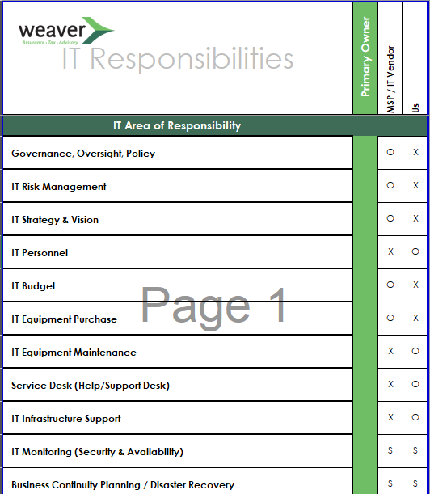
Inventory Your Vendors (Third and Fourth Party)
The biggest challenge to developing a vendor profile for risk identification is that most organizations simply don’t have the data needed to do so. In most cases, a process will have to be created to obtain it.
“Technology Vendors”
Get a clear understanding of your third (and fourth) party relationships.
  What do they do?
  What do they have access to?
  What data do they maintain?
  What are the contractual agreements?
  Who are their providers (your fourth party inventory)?
Centralize your vendor records.
  Contracts
  Contacts
  SLAs
  Responsible Party
Categorize the vendors and evaluate risk.
  Quantitative (Annual Spend, Transaction Volume, Etc.)
  Sensitivity (Access to people, facilities, and data)
  Qualitative (Risks)

Slide 45
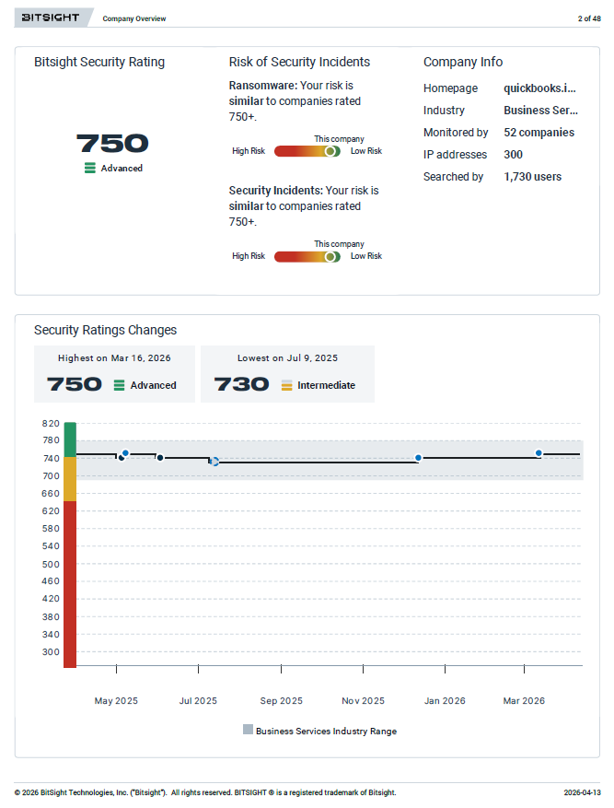
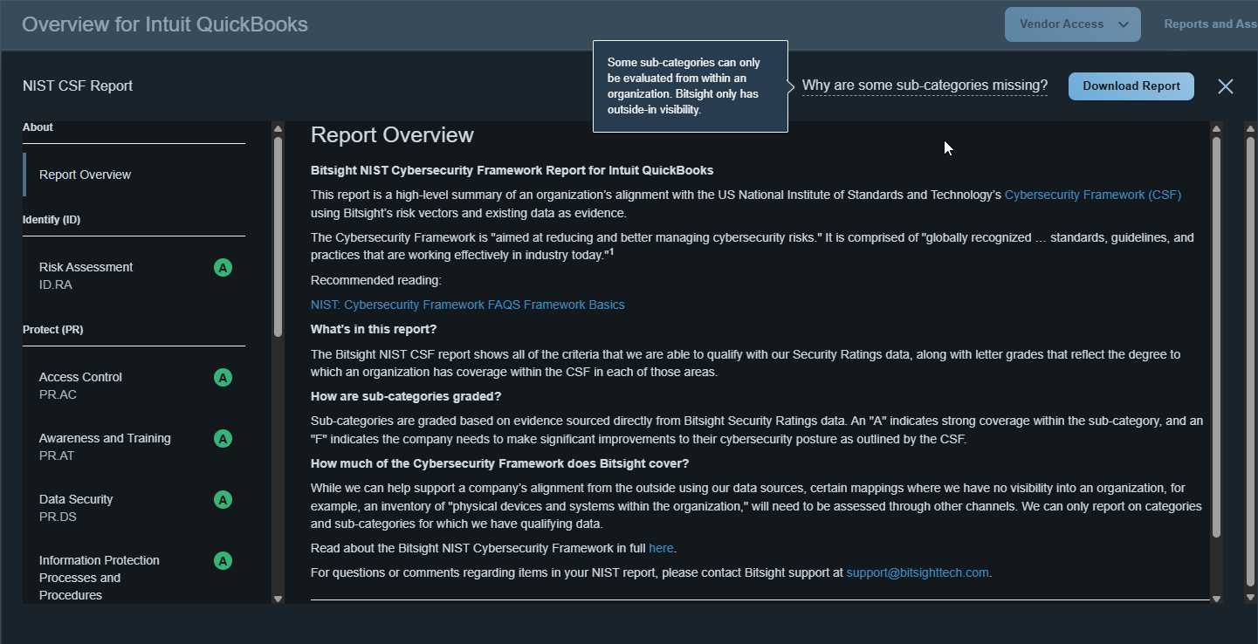
Maintain Healthy Skepticism
Working Assumptions on Input Sources

Slide 46
Scalability
AI Prompts
Initial Review
  Review this SOC 2 Type II report and summarize: (1) the audit period, (2) the trust service criteria covered, (3) any qualified opinions, and (4) the top 5 control deficiencies or exceptions noted.
Exception Deep-Dive
  List every control exception in this SOC report. For each one, tell me: the control description, the nature of the exception, the vendor's management response, and my residual risk level (High/Medium/Low).
Complementary User Entity Controls (CUECs)
  Extract all Complementary User Entity Controls from this SOC report. For each CUEC, tell me what my organization must do to satisfy it and flag any that are commonly missed.
Subservice Organizations
  Identify all subservice organizations listed in this SOC report. For each one, note whether they're carved out or inclusive, what services they provide, and whether I need to obtain their SOC reports separately.

Slide 47
Scalability
AI Prompts
Gap Analysis
  Compare this vendor's SOC 2 report against our internal control requirements [paste requirements]. Identify any gaps where their controls don't meet our standards.
Year-Over-Year Comparison
  Compare these two SOC reports from the same vendor (prior year and current year). Highlight any new exceptions, removed controls, changes in scope, or audit opinion changes.
Risk Memo
  Draft a one-page Third Party Risk Assessment memo for [vendor name] based on this SOC report. Include: vendor overview, scope of services, audit opinion, key exceptions, CUECs, subservice orgs, and a recommended risk rating.
Board/Stakeholder Summary
  Summarize this SOC 2 report in plain English for a non-technical stakeholder. Focus on what risks it does and doesn't address, and whether we should be comfortable proceeding with this vendor.

Slide 48
Appendix

Slide 49
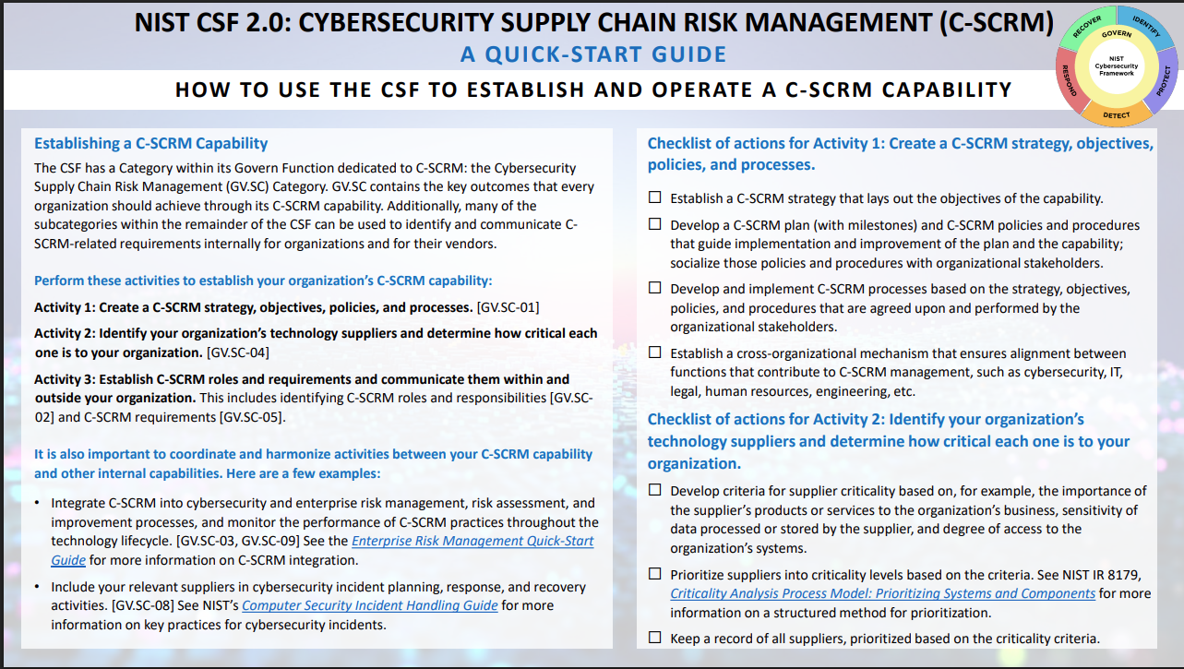
Resources
Supply Chain Risk Management Quick Start Guide (National Institute of Standards and Technology Cybersecurity Framework 2.0)
  Link: https://nvlpubs.nist.gov/nistpubs/SpecialPublications/NIST.SP.1305.pdf

Slide 50
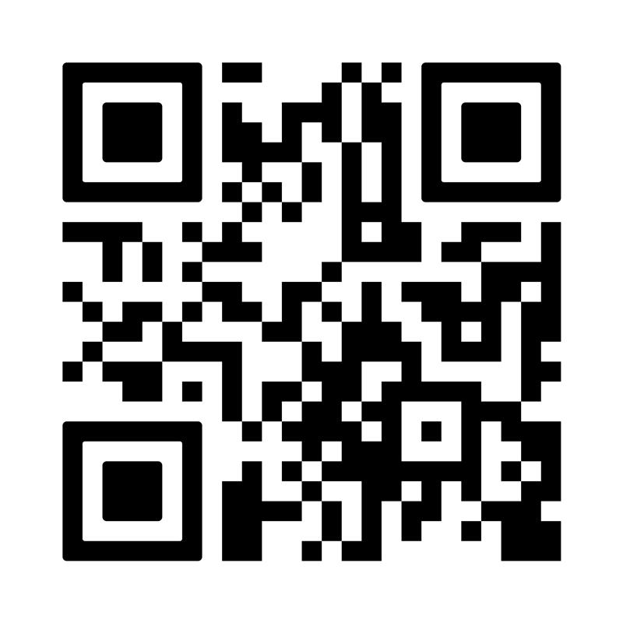
SOC Report Template
SCAN ME For Report Review Template

Slide 51
Alexis Kennedy
Partner, IT Advisory Services
817.882.7348
alexis.kennedy@weaver.com
Shelby Mathers
Director, Cybersecurity Consulting Services
682.291.9487
shelby.mathers@weaver.com

