Slide 1
Technical Innovations Advancing the Patient Safety Agenda
16 September 2025
Mark Linggood – Product Director

Slide 2
Technical Innovation Enabling Cultural Improvements

Slide 3
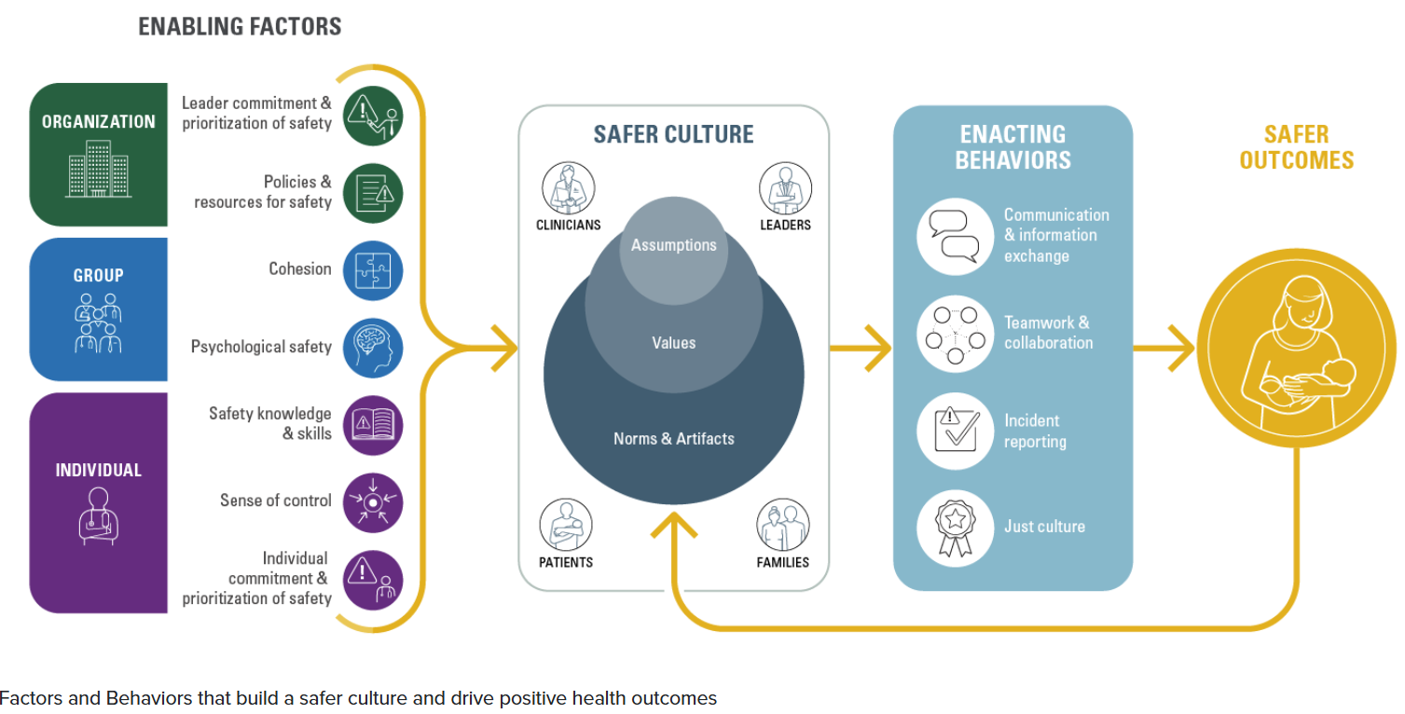
Phycological Safety is an Enabling Factor of a Safer Culture and Safer Patient Outcomes.
Bisbey et al. (2019)

Slide 4


Using AI to Detect Instances of Blame in Incident Data to Help Improve the Psychological Safety of our Workforce
10100010101010001010010100101000100101001010100101010010010100101001010101010100101010101010101010000100100100010010010101001010100101010000101001010100101010100101010010..……....…..01010101001010101010101010100101010101001101010010101010..………………..0001010100101010101000010101111100101001000101010001010……………………1010101010101010010101010000100101010101010010101010………………………0101010100101010101010101010010101010100110101001010..…………………..1010101001010101010000101011111001010010001010100010101………………..0100101010100001001010101010100101010101000000001111010100…………0100101010010010010100101001010101001010100101010101010010101010..0010101010101001010101010100110101010001010111010011001010101111100…..010010101010001010100101010

Slide 5
Automating Safety Process to Leverage New Safety Insights and Productivity Gains

Slide 6
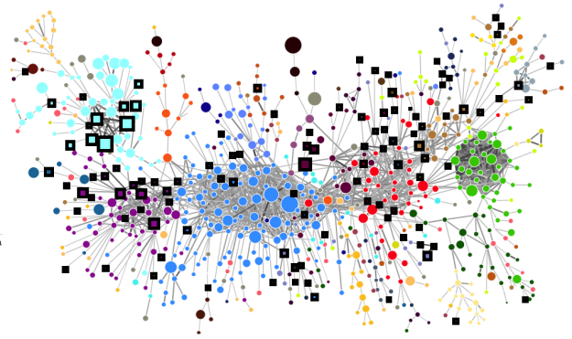
Increasing the Productivity of Key Safety Activity Using AI

Slide 7



The RLDatix Enabling Healthcare Organisations' to Unlock Productivity and Insights Through AI Solutions
Mortality Reviews
Policy management
Job planning
Collaborative Bank
Investigations
Complaints & Feedback
Incident
Management
Audits & Assurance
Rostering
Rota’s
Payroll
Claims management
Quality Improvement
Risk management
Standards & Compliance
Activity Management
Contingent Staffing
Safe Staffing
7

Slide 8

Using LLM’s for Automating Time-consuming Administrative Safety Tasks
Mortality Reviews
Policy management
Job planning
Collaborative Bank
Investigations
Complaints & Feedback
Incident
Management
Audits & Assurance
Rostering
Rota’s
Payroll
Claims management
Quality Improvement
Risk management
Standards & Compliance
Activity Management
Contingent Staffing
Safe Staffing
8

Slide 9
Moving Towards Predictive Models of Patient Safety

Slide 10
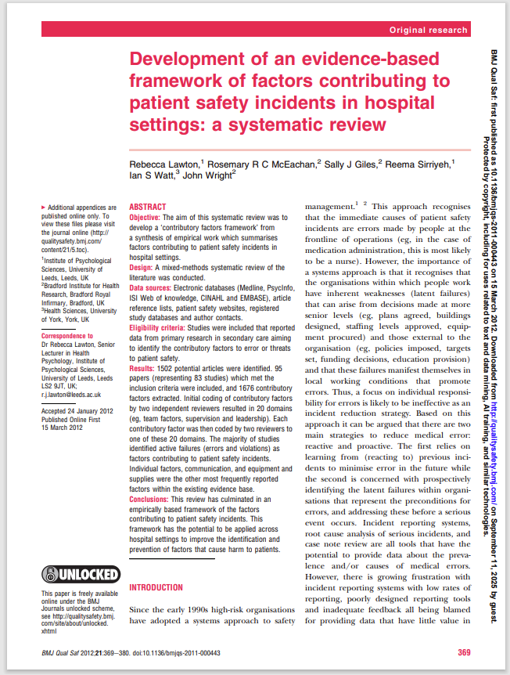
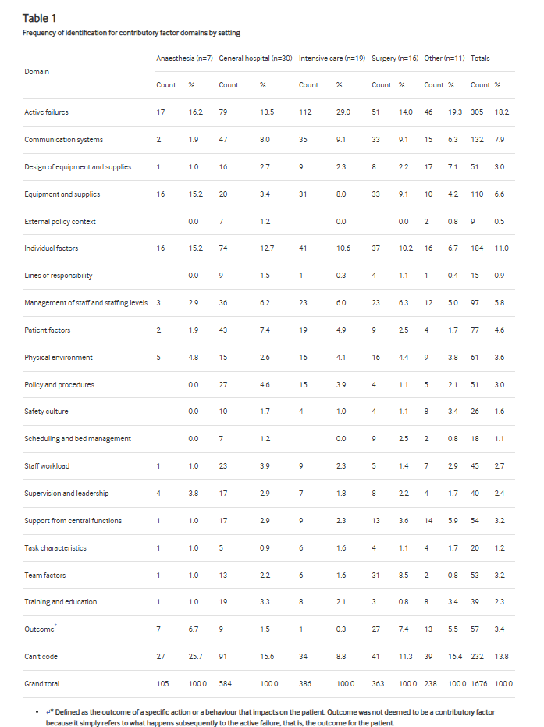
Workforce Factors are Contributing Towards the Vast Majority of Patient Safety Incidents Occurring (47%)
Most common contributory factors:-
18.2% Staff Active failures (slips, lapses, mistakes, deviations)
11% Individual staff factors (Fatigue)
5.8% Management of staff and staffing levels
2.7% Staff workload
2.4% Supervision and management
3.2% Team factors
2.3% Staff Training and education
0.9% Lines of responsibility
4.6% Total Patient factors
47% Total Staff factors

Slide 11
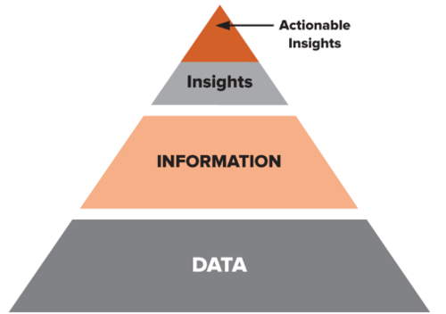
Identification of Non-Spurious Correlations Between Workforce and Safety Data Creates New Opportunities for Actionable Insights
Bank &
Agency
Leadership
Staff Skills
Working Patterns

Slide 12
Thank you

