Slide 1
Dr Annie Hunningher
Group Patient Safety Lead, Consultant in Anaesthesia
Barts Health NHS Trust
Panel G3
Creating a Culture of Learning
7 mins talk

Slide 2
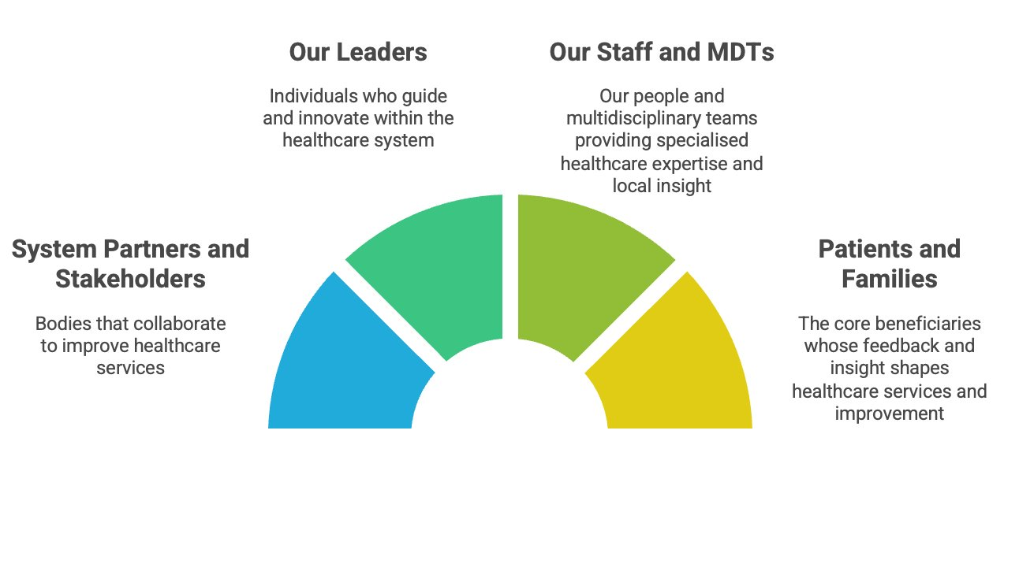
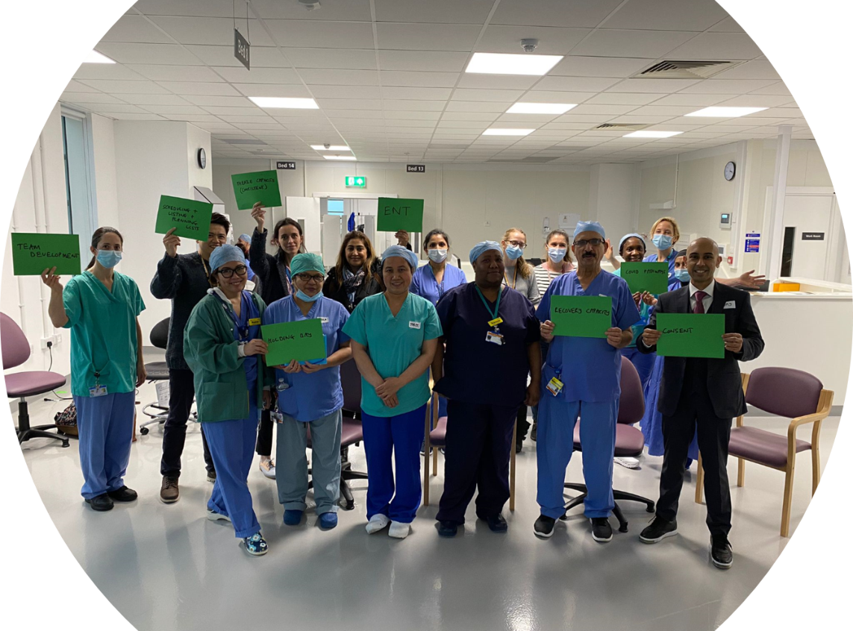
WHO? Creates a Culture of Learning
Notes:
We have a moral obligation to our patients and families to learn to restor them and we know that their insight will help us truly learn
Our staff and MDT on the shop floor have expertise and local insight...also need restoration ...we need to involve and listen to them
Our leaders need to understand this and be generative and facilitative to innovate and guide this culture
System partners and stakeholders set the scene of expectation , metrics and around true learning

Slide 3
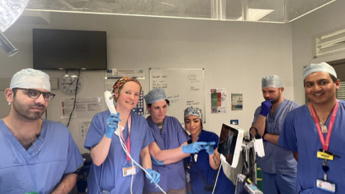

Slide 4
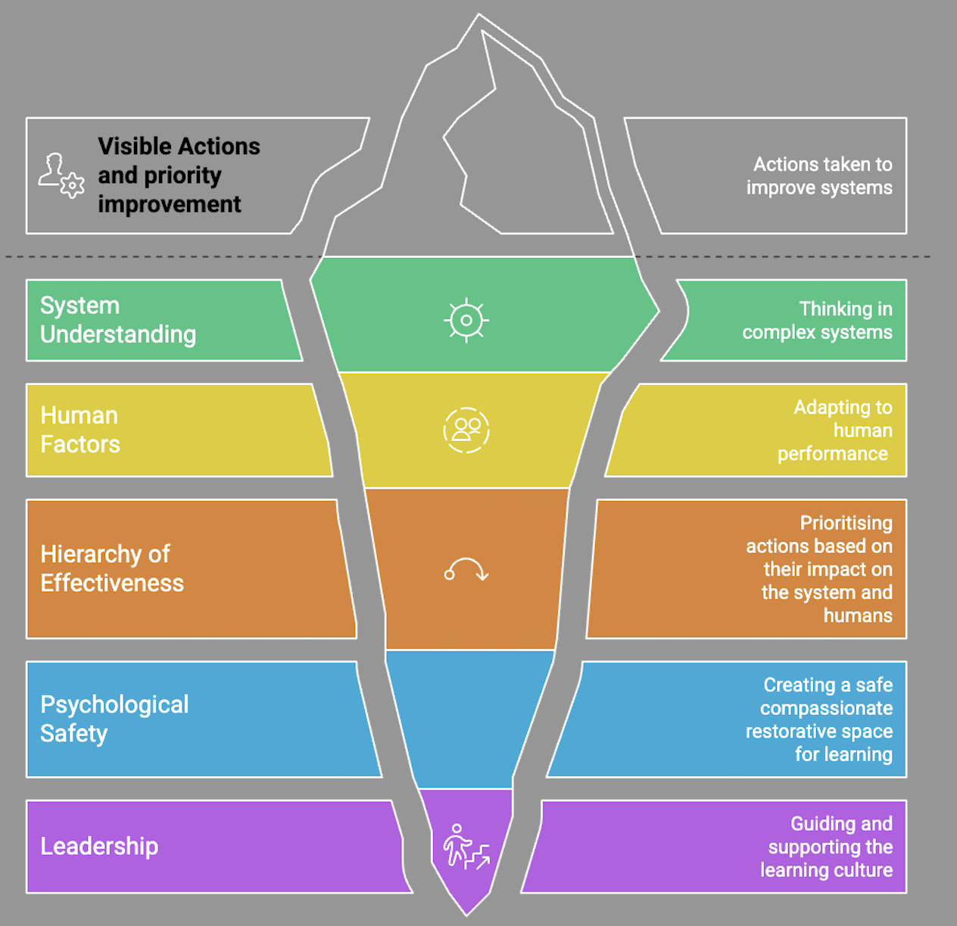
WHAT?
Creates a Culture of Learning
Notes:
I get annoyed with platitudes of Sharing the Learning without visible actions and actual improvement ..beware of feeding the bureaucratic monster
We know that to achieve this we need these elements of system understanding, human factors, the hiearchy of effectiveness of what works in a safe space of civility and psychological safety with generative leadership behind it.

Slide 5
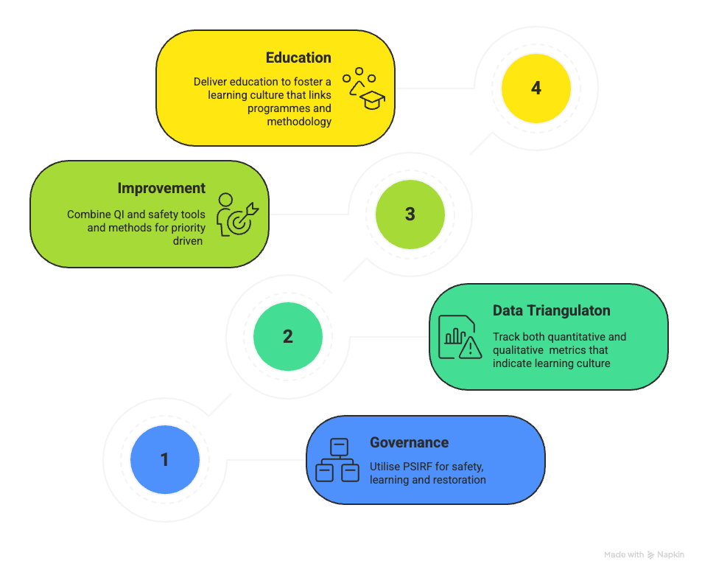
HOW?
Create a Culture of Learning
Notes:
Yes culture is difficult to measure but with PSIRF tools, data triangulation, actual improvement and education in all of the above …..we are digging into the complexity

Slide 6
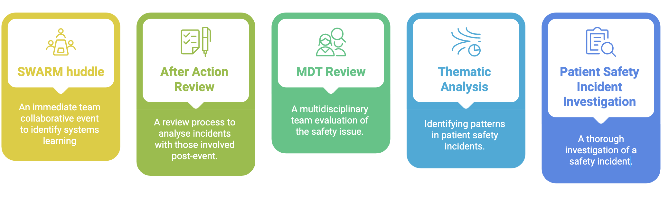
Responses

Slide 7
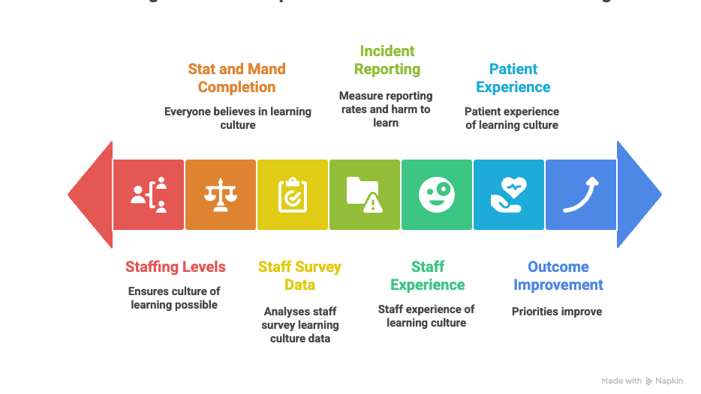
Notes:
Creating the relationships between data sets to show us that the hearts and minds really both matter

Slide 8
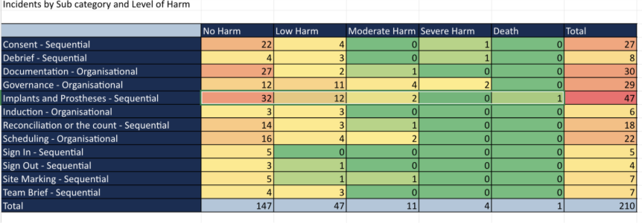
New insights: Beyond Never Events

Slide 9
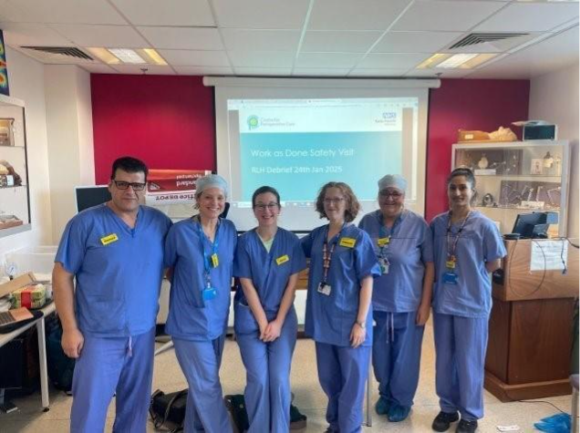
Work as Done visits

Slide 10








SEIPS for a Culture of Learning
Tasks
  Improvement in PSIRP priorities
  Quality management system
  Professionalisation of safety
  Safety communications
  Quality assessment of PSIIs
Organisation
  Policies and Procedures
  Clear PSIRPs with improvement evidence
  Board oversight and knowledge
  PSIRF metrics – Structure, Process and Outcome
  Outcome includes priority metrics and safety culture
  Group benchmarking
  Defined roles for delivery
Desired Outcome
A Culture of Learning
Tools & Technology
  QI approach
  Safety toolbox
  Linking training and QI
  Safety dashboards
  Intranet storage of PSIRF tools
  Systems that track change and learning culture
Person
  Just restorative culture
  Involved patients
  Involved staff
  Psychological safety
  Safety training and opportunity – ward to board
  PSPs and PSSs
External Environment
  Culture of openness and transparency
  LFPSEs and incident reporting
  Insight data/dashboard
  CQC inspections
  Coroner support
  ICB oversight
Internal Environment
  HF design consideration
Notes:
We should be using the SEIPS tool to create a culture of learning and thinking in a way that allows us not to do what we have always done but move forward to better

Slide 11
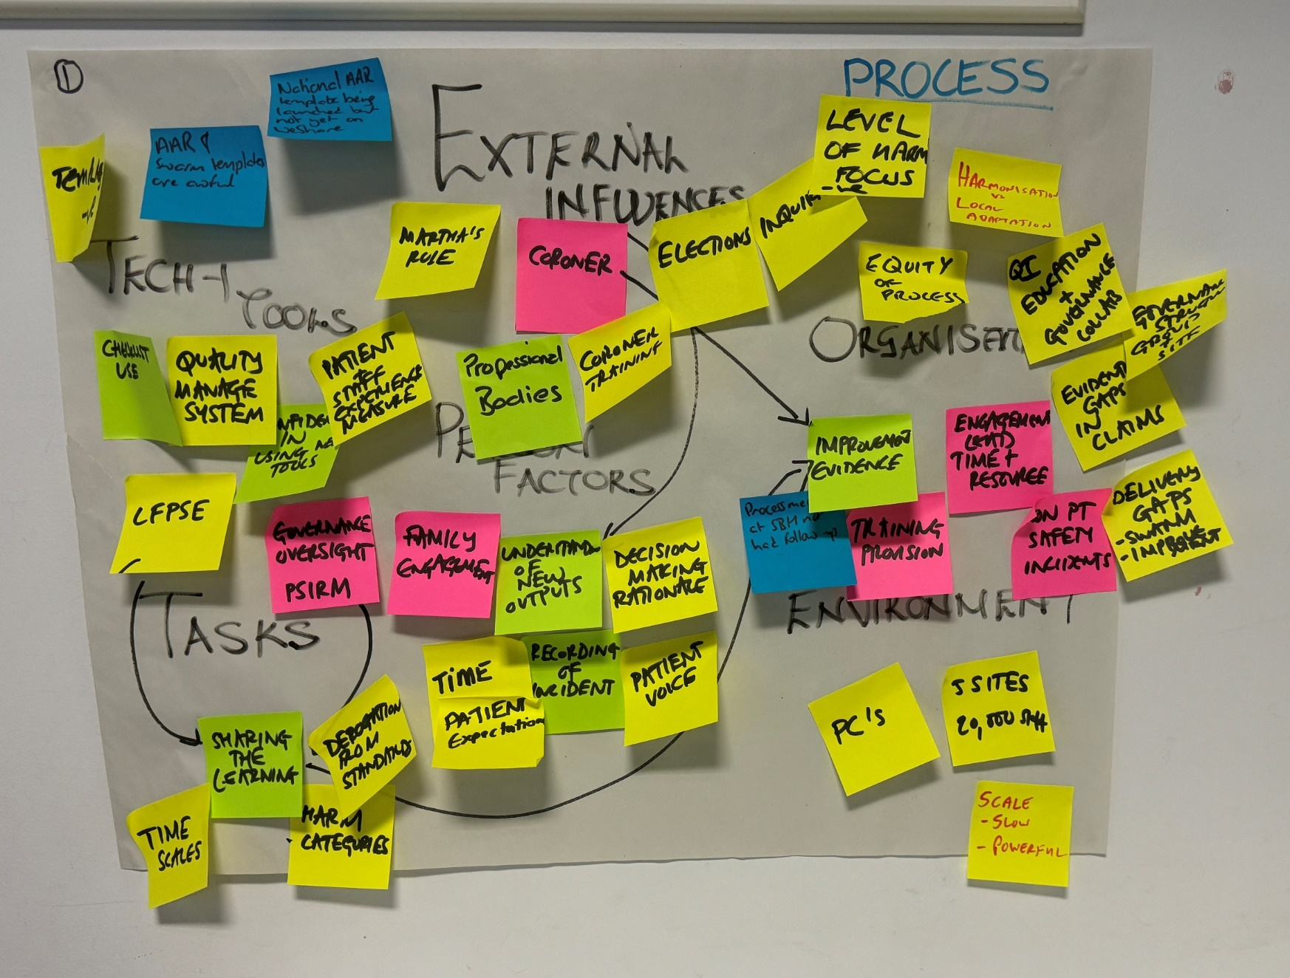

My Key Take Away
It's complex!
Creating a culture of safety requires 3/4D insight that links relationships in the system and drives outcome improvement

