Slide 1
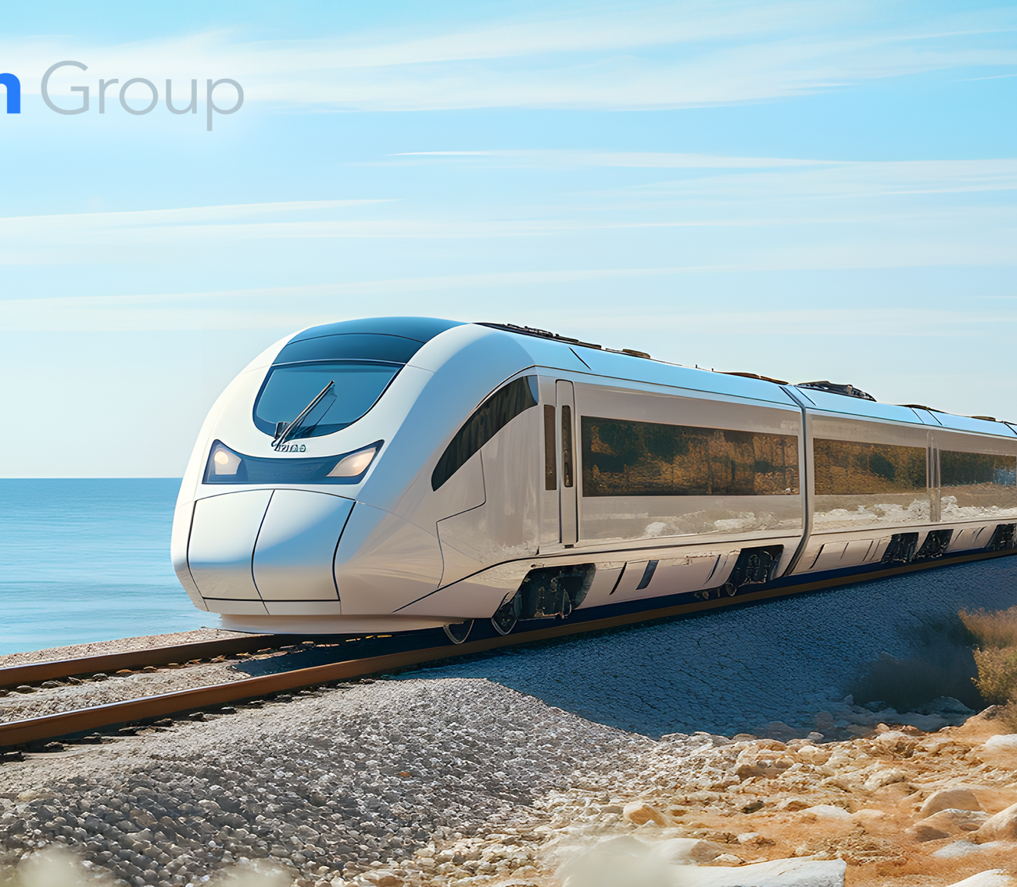


Train Ticketing Business Group
From Local to Global:
Trip.com’s Growth Agenda
in the Open Train Ticketing Sector

Slide 2

Agenda
Who are we?
Trip.com’s network
Impact of rail liberalization for ticketing retailers
The journey of Trip.com
Current supply chain
Growth in the UK and EU
A glimpse in the future
Challenges and opportunities
Conclusions and future outlook

Slide 3












A Leading travel service provider
Customer services
Approximately
Airlines
10,000
Over 510 global airlines, Covering over 3,400 airports in over 220 countries and region
customer service staff
Providing
Hotels
24/7
Over 1.1 million global accommodation listings
customer service
7
Tours
customer service centers worldwide
Over 400,000 package tours
Post transaction service automation rate
Train
Cover 36 countries and regions, 1000+ cities
＞70%
06

Slide 4

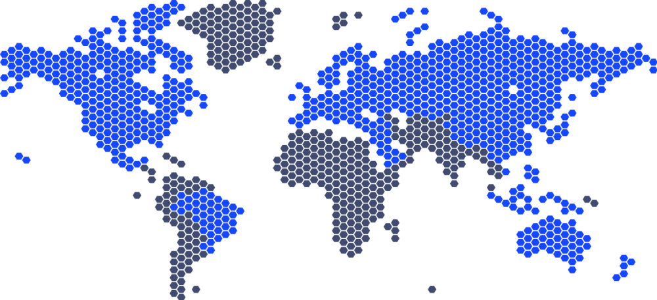




Providing services to hundreds of millions of members in 24 languages across 39 countries and regions
24
Languages
39
Countries and regions
1.1 million
Hotels in 200+ countries and regions
United States
Brazil
Canada
510 airlines
France
Finland
Spain
Italy
Austria
Germany
Sweden
Greece
Poland
Russia
Turkey
United Arab Emirates
Israel
Saudi Arabia
Thailand
Vietnam
Malaysia
Portugal
United Kingdom
Ireland
Netherlands
Belgium
Switzerland
Denmark
Hong Kong
Philippines
Indonesia
Mainland China
Mexico
Singapore
Covering 3,400 airports in over 220 countries and regions
05

Slide 5




























Our Platforms
Our Partners
Trip.com
Ctrip
Trainpal
Qunar
Zhixing
Tieyou

Slide 6













Global Train Partners and Distribution Channels
Trip.com offers train tickets for Mainland China, France, Germany, Hong Kong, Italy, South Korea, Spain, Taiwan, United Kingdom. It also supports railway inquiries across Japan and plans to add other Asia and EU countries in the near future.
China (Incl.TW & HK)
France
Trip.com
Global
Germany
Trainpal
UK and EU.
Italy
Japan
South Korea
Ctrip & Qunar
China outbound.
Skyscanner
Global
Spain
United Kingdom

Slide 7
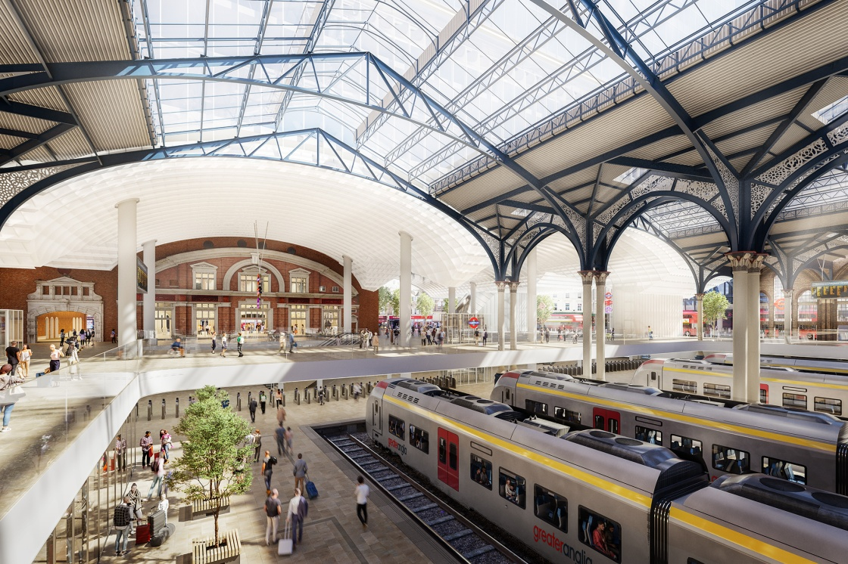
Impact of Rail Liberalization in Europe for
Ticketing Retailers

Slide 8

Impact of Rail Liberalization in Europe for Ticketing Retailers
Opportunities
Challenges
Increased Competition
More ticket retailers can potentially enter the market, offering diverse booking platforms and services.
Potential for Increased Sales
Competition could drive more customers to compare prices and book tickets, potentially increasing overall sales volume. For example, the rail market revenue pool doubled in the last seven years.
Need for Innovation
Retailers will need to adapt and differentiate themselves to attract customers, potentially through:
Seamless Multi-Operator Booking
Offering tickets across various operators on a single platform.
Value-Added Services
Bundling tickets with hotels, tours, or other travel products.
Specialization
Focusing on specific customer segments or niche markets.

Slide 9
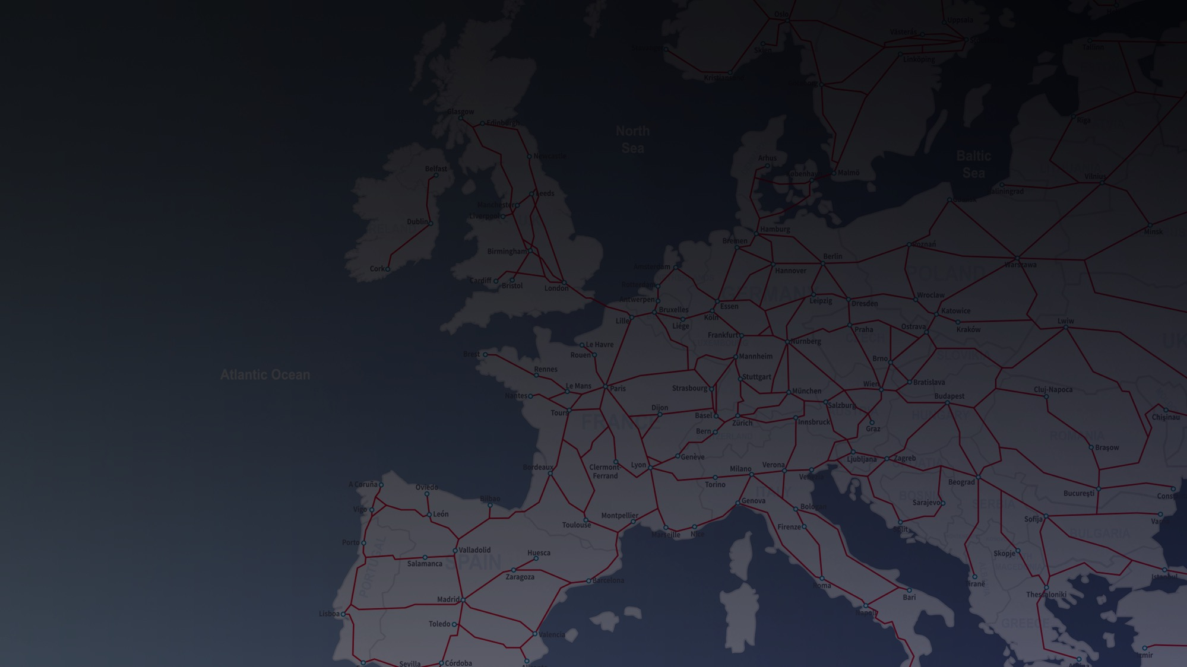
Impact of Rail Liberalization in Europe for Ticketing Retailers
Considerations & Outlook
Technical Integration: Connecting to different operators' booking systems and ensuring smooth data exchange.
Marketing Strategies: Reaching customers effectively in a more competitive landscape.
Long-Term Potential: As rail liberalization matures, ticketing retailers will play a crucial role in simplifying travel planning and boosting the overall rail market.
An increase of 69% in pax x km has been seen in Italy in the first seven years of market liberalisation and an increase of 47% in the revenue pool.
Both prices and service quality have moved in the favour of the travellers.*
* Source: McKinsey & Company “The liberalization of the EU passenger rail market”

Slide 10
The journey of Trip.com

Slide 11




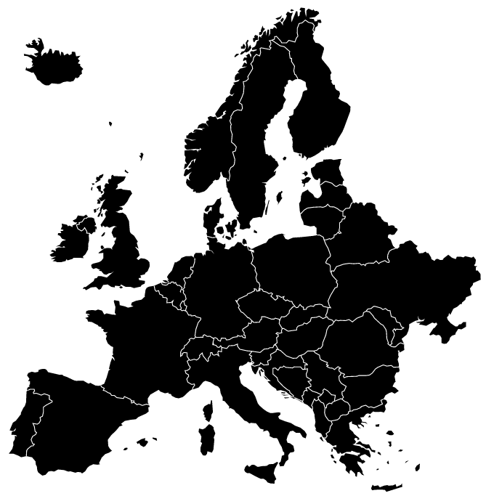
















Netherlands
UK
Germany
France
Austria
Switzerland
Spain
Italy

Slide 12

UK Ticket Volume
2023 vs 2022
+ 100 %
2023 vs 2019
+798%
* Train data of Trip.com Group

Slide 13

Europe Ticket Volume (excluding UK)
2023 vs 2022
+ 909 %
2023 vs 2019
+335%
* Train data of Trip.com Group

Slide 14







Norway
Poland
Sweden
Czech Republic
Hungary
Portugal
Belgium

Slide 15

Industry Challenges
Access to data is necessary in each step of the process and stands at the base of creating a good customer experience, and therefore achieving an overall growth at an industry level.
Important points in where collaboration and data exchange is necessary:
- Trip planning
- Booking
- Payment
- Pre-departure
- On-train information
- Aftersales

Slide 16
Conclusion and future outlook
Partnership-driven growth: Trip.com’s expansion is fueled by strategic alliances.
Industry-wide benefits: Collaborations and market openness enhance the entire train ticketing sector.
Forward together: Unity and cooperation are key to advancing travel technology.

Slide 17
Train Ticketing Business Group
Thank you!
Alvaro Ungurean
Commercial Director Europe
International Train

