Slide 1

The Value of Digital Identity
Enhancing Security, Efficiency, and Customer Experience
EMPOWERING USERS WITH IDENTITY – NAVIGATING TO DECENTRALIZED IDENTITY
Notes:
For those unfamiliar with the concept, think of digital identity as the beating heart of any consumer-facing business. It’s the essential mechanism that proves who you are online and enables your customers to access your digital services securely and seamlessly.
Today’s customers expect instant access to your services from anywhere in the world, all at the click of a button. Meeting these expectations while maintaining robust security is critical, particularly with how prominent fraud is right now, and that isn’t going to change anytime soon either.

Slide 2
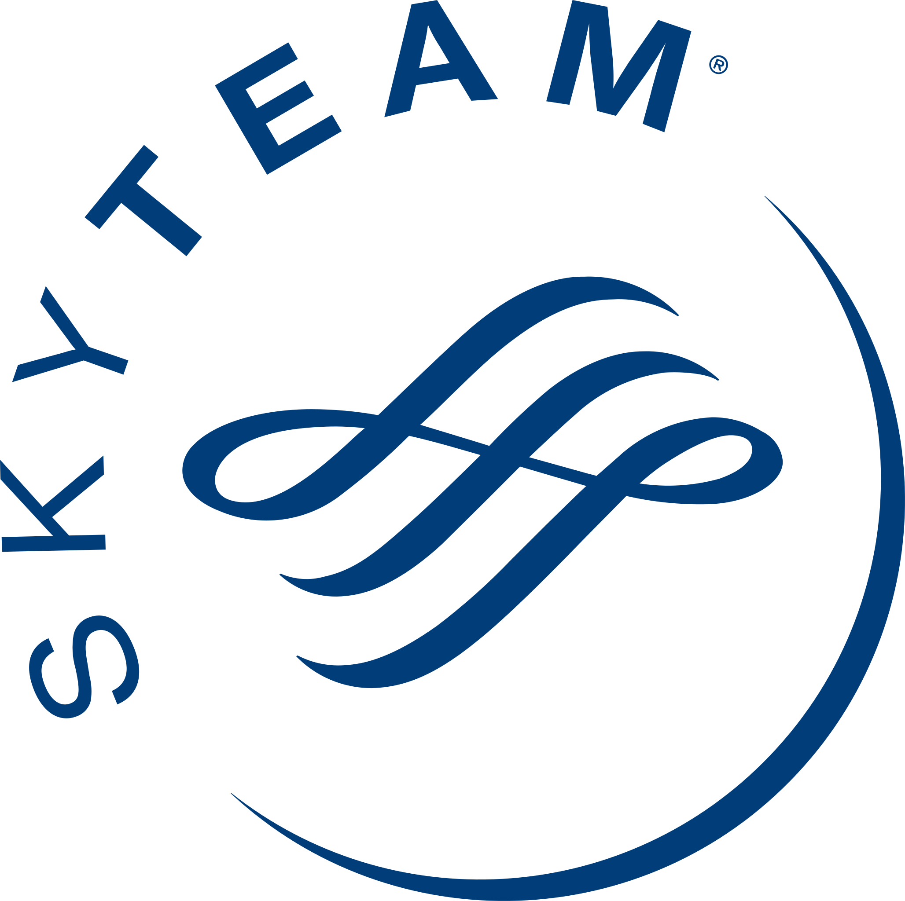

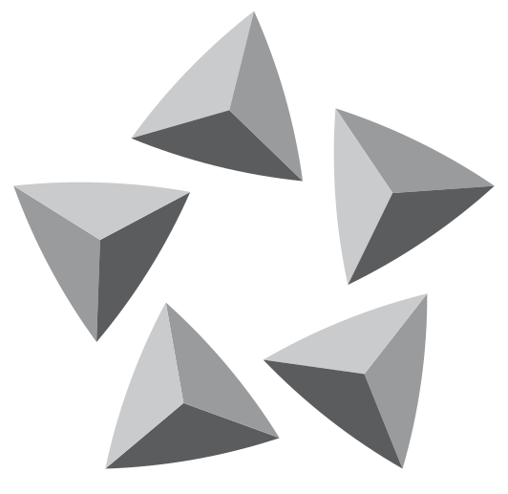





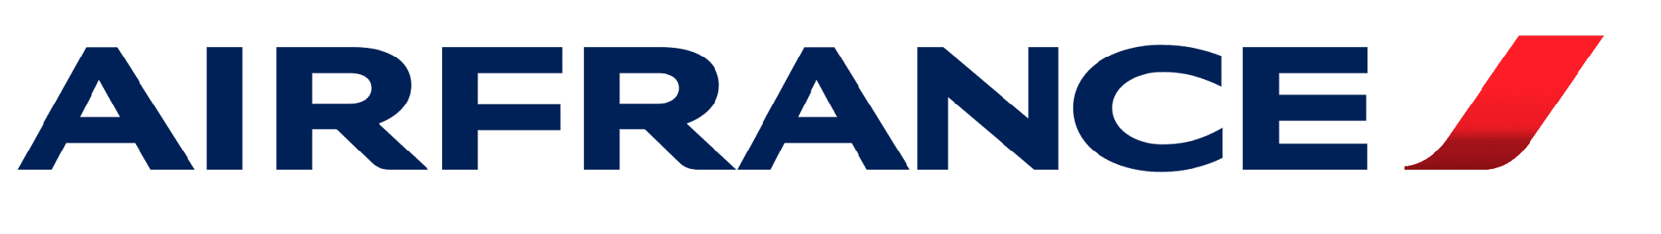
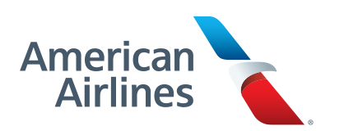

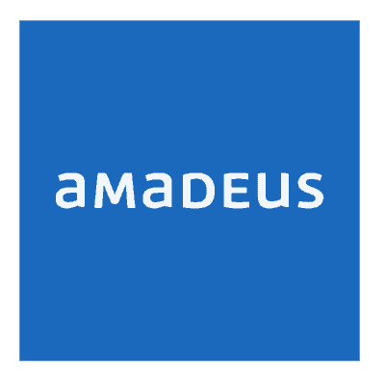

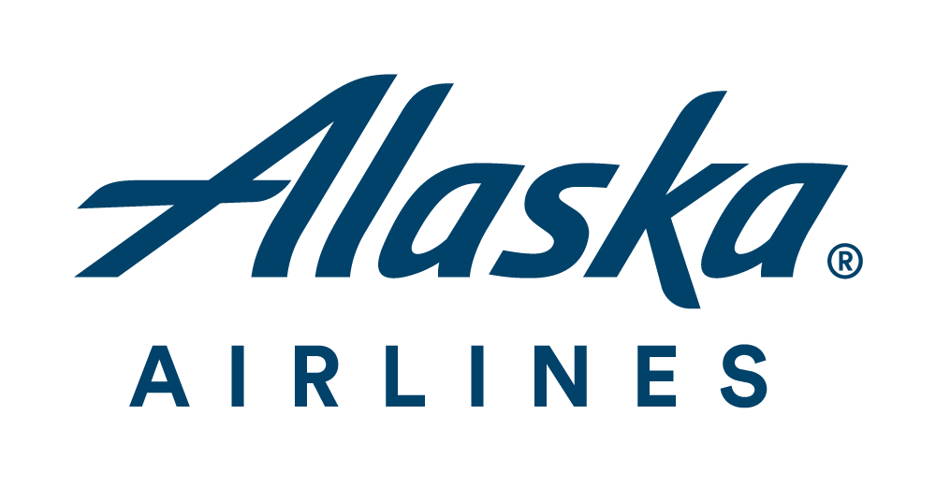

The undisputed IDENTITY LEADER IN AVIATION
Notes:
We work with 70% of the world’s largest commercial airlines to ensure that every customer interaction is optimised for both convenience and security.
I will be sharing insights and lessons learned from our work with these airlines, showing you how to enhance your customer experience without compromising on security and safety.

Slide 3

“
Customers expect both security and experience, it’s no longer a choice.
©2024, Ping Identity Co., All rights reserved
Notes:
Today, customers across all industries are demanding both ultimate convenience and unwavering security. This expectation has shifted from being an exception to the new norm.
While we may be aware of this trend, meeting these demands poses significant challenges. It impacts every aspect of a business, driving change that isn’t always welcomed, and fundamentally reshaping how we operate.
That’s why today, I will focus on three key areas that our partner airlines have identified as essential for their ongoing growth. Together, we’ll explore how prioritising identity can transform your operations and drive success.

Slide 4
80%
54%
Customers will not return after a breach
Customers switched brands as a result of bad customer experience
Notes:
To highlight the importance of security, consider this: 80% of individuals who experience a data breach are unlikely to return.
What this means is that even a single breach can lead to substantial revenue loss across all customer interactions. Regaining trust and restoring your reputation is no small feat.
Did you know that over half of consumers have stopped using an online service because they became frustrated with the customer experience?
By balancing security with customer experience through more advanced identity capabilities, one customer saw a 14 point increase in their NPOS.

Slide 5

Notes:
The first of the three core areas I mentioned a moment ago is brand loyalty.
The market has never been more competitive, and one of our customers in North America (United Airlines) faced significant challenges with its outdated login process for loyalty program members. This led to customer frustration, reduced retention, high cart abandonment rates, and increased security risks.
Moreover, the airline struggled with software management and lacked persistent user sessions. With Ping's integrated technology, we streamlined the authentication process, making it both simpler and more secure. This transformation resulted in an enhanced user experience and a reduction in fraud.
Additionally, Ping's low-code orchestration and cloud-based infrastructure eliminated the need for extensive developer resources and on-premises maintenance, ultimately boosting productivity and agility.

Slide 6
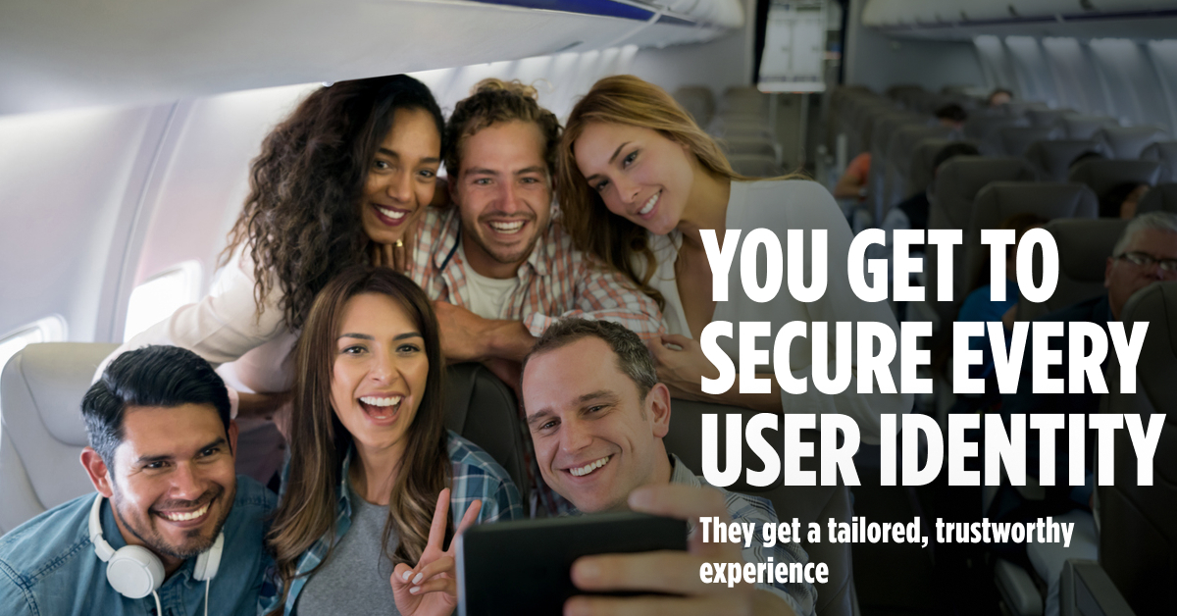
Notes:
The second desire, is delivering secure experiences every time.
the largest domestic air carrier in the U.S. (Southwest), faced critical challenges with its legacy workforce technology, which resulted in poor reliability, with employees logging in up to 100 times daily, and a costly, inefficient infrastructure that caused significant disruptions, including an outage that led to $80M in flight delays.
In response, Southwest partnered with Ping Identity providing reliable, centralised authentication for 60,000 employees. This high-availability infrastructure ensures that pilots and flight attendants can access essential applications efficiently, reducing login occurrences from 50 to just one.
Next, Southwest plans to expand into CIAM, enhancing the login experience for over 60 million customers and unlocking new revenue opportunities by unifying user profiles across platforms.

Slide 7

Notes:
American Airlines, a long-time Ping customer, faced significant budget cuts and workforce reductions due to the COVID-19 pandemic. As part of their digital transformation, they needed to modernise their IAM infrastructure to reduce costs and complexity. With their legacy technology nearing end-of-life, the rising support costs made continuing with their incumbent providers unsustainable.
Our solution will reduce total cost of ownership during challenging times and provide a standardised, easier-to-manage IAM system.
—
Add slide - Cross function * add latest story intel: Easyjet needed to simplify it’s user self service registration to increase customer base while securely storing and retrieving identity data to prevent fraudulent access and comply with regulatory demands. They wanted to see and manage all identities in one place, mitigating silos and then deliver a low friction experience where users could access all of their products and services in one single view.

Slide 9













UTOPIAN TRAVEL EXPERIENCES Seamless & Secure
c
v
BOOK-TO-TRAVEL
Browse destinations
Book travel
Sign up for loyalty program
AIRPORT & FLIGHT
Check-in
Baggage drop
Security
Border control
In-flight services
Baggage claim
Lost luggage
Contact helpdesk
ANCILLARY SERVICES
Travel insurance
Book a hotel
Rent a car
Make an excursion
Notes:
Your customers now expect a seamless, full-service experience from the moment they book their trip to the time they return home. This includes everything from renting a car and booking a hotel to planning their entire journey.
They want that simple, one-stop sign-on experience similar to what they get from platforms like Amazon and Apple. This expectation spans all aspects of their travel experience.
Meeting these demands is essential to staying competitive in today’s market.
One uninterrupted seamless experience

Slide 10
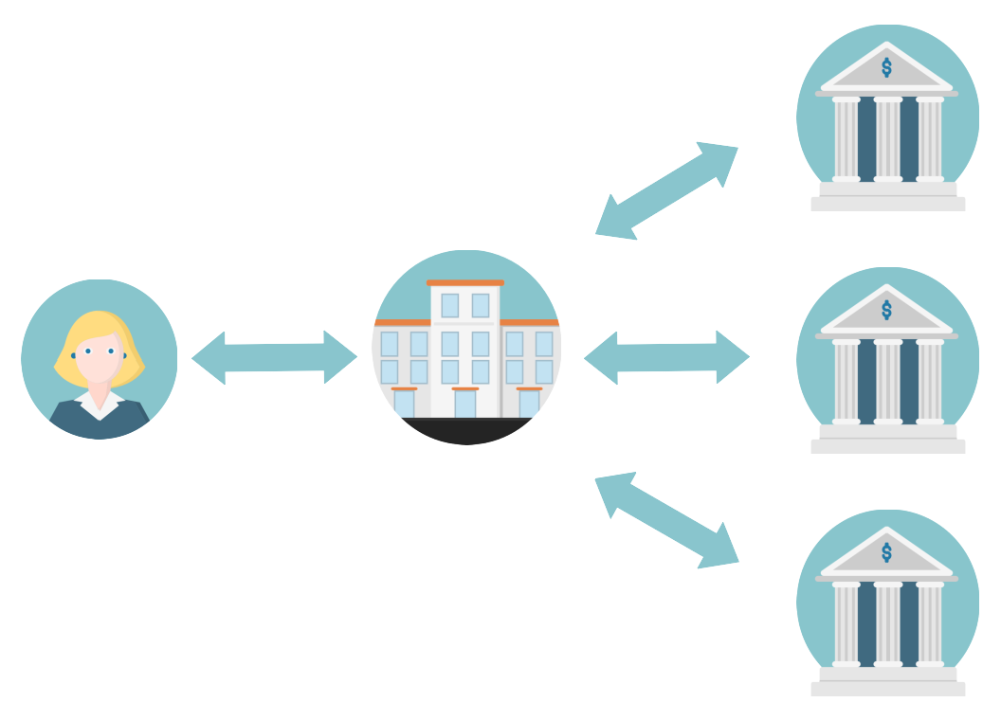
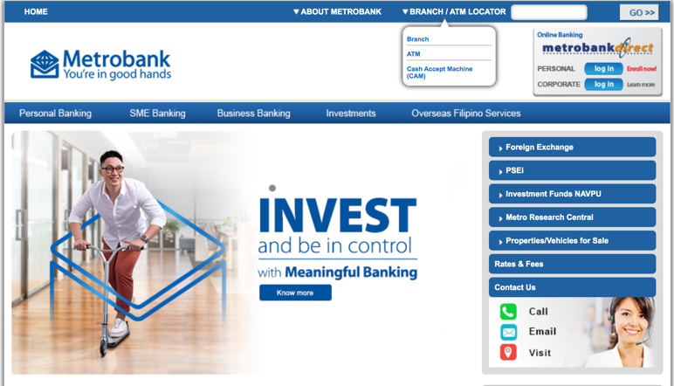


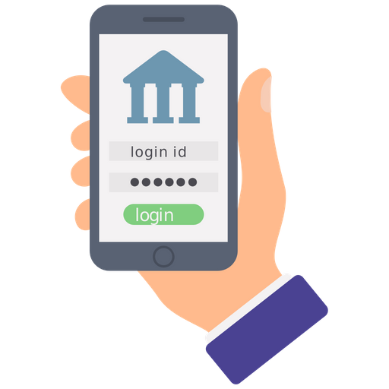
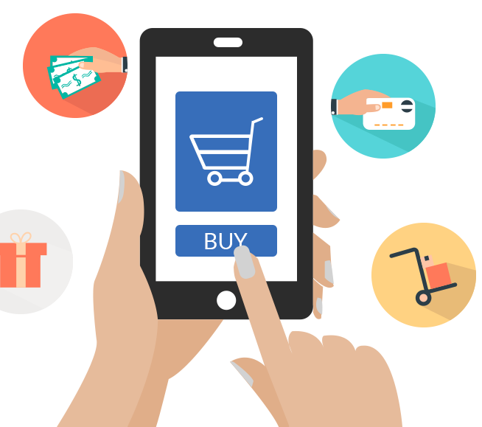
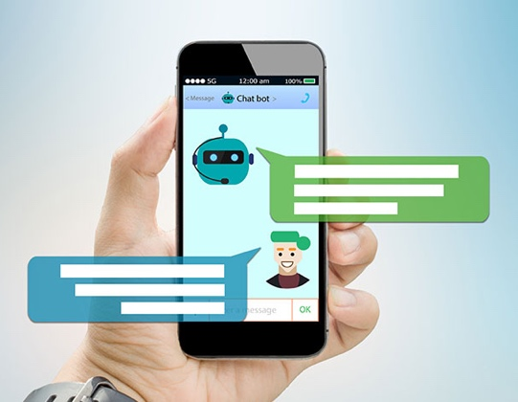




Securing Digital Interactions for Omnichannel Access
Airlines
B2B / B2B2C
Frequent Flyer
Channels
…
Online Web Apps / Portals
Mobile Apps
Transaction Auth.
API Security
Virtual Assistant
Securing Digital Channels with Trusted Customer Digital Identity
Customers
Biz Partners
User Journey
Retail | Corporate
B2B Services
CIAM
Verify
Protect
Manage
1
Identity Fraud
Protection
Customer
Sign-up
Passwordless
Login & MFA
3
Transaction
Authorization
Secure
Self-Service
Privacy &
Consent
2
4
5
6
++

Slide 11




VERIFIED CIAM OUTCOMES
INCREASE REVENUE
COST EFFICIENCIES
CLV up by
NPS up by
App development cycles reduced by
Increased agility
$293
2 pts
6
$3.1M
months
Customer Lifetime Value increase per customer
Increased Net Promoter Score
Faster time-to-market
in annual savings by cloud-delivered AuthN
Notes:
A major North American airline (Delta Airlines) faced challenges with storing user profiles in a costly legacy database, resulting in complex authentication, limited scalability, and inconsistent user experiences. This led to high abandonment rates and increased technical debt, with the airline struggling to handle traffic spikes during events like weather cancellations.
We supported their cloud-first strategy by shifting operations to the cloud, which provided a scalable, secure profile management system that also enhanced user experiences across all digital channels.
The solution is expected to accelerate time to market, improve customer retention, and save $3.1 million annually, while laying the foundation for future capabilities and revenue growth.

Slide 12
The undisputed IDENTITY LEADER IN AVIATION
Notes:
We work with 70% of the world’s largest commercial airlines to ensure that every customer interaction is optimised for both convenience and security.
I will be sharing insights and lessons learned from our work with these airlines, showing you how to enhance your customer experience without compromising on security and safety.

Slide 13
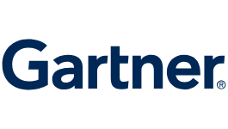


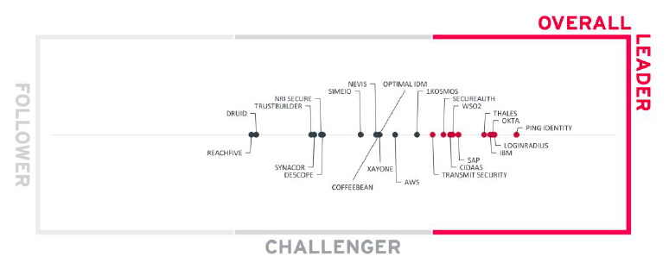
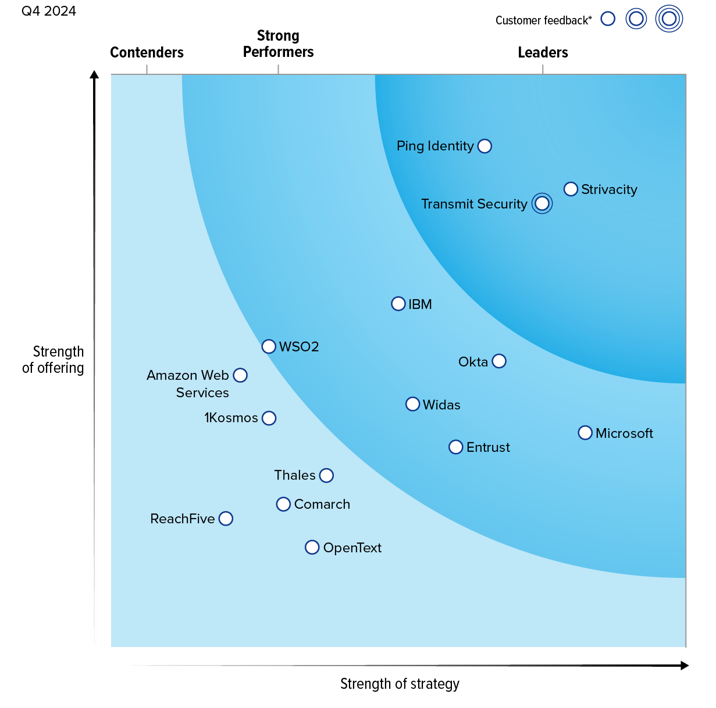
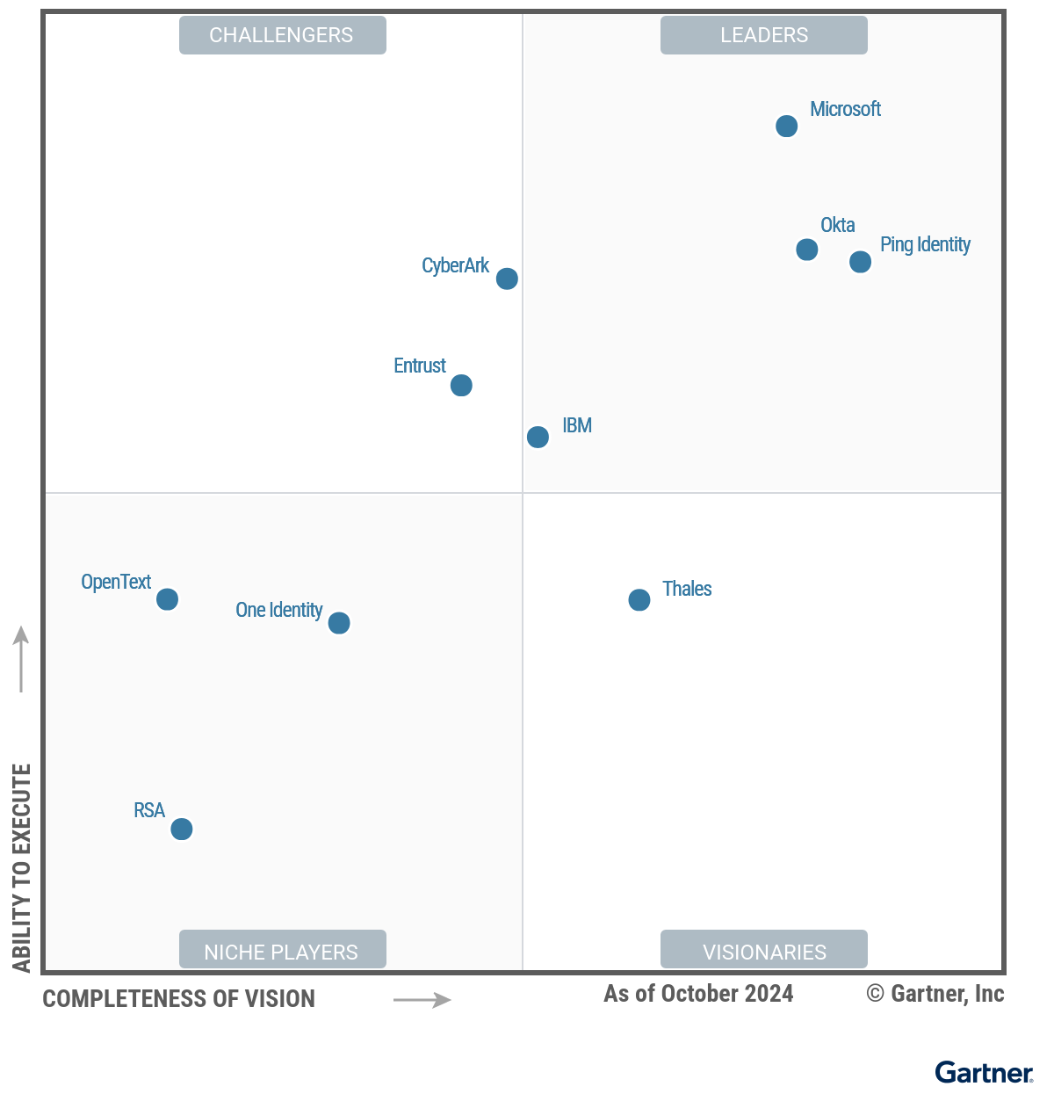
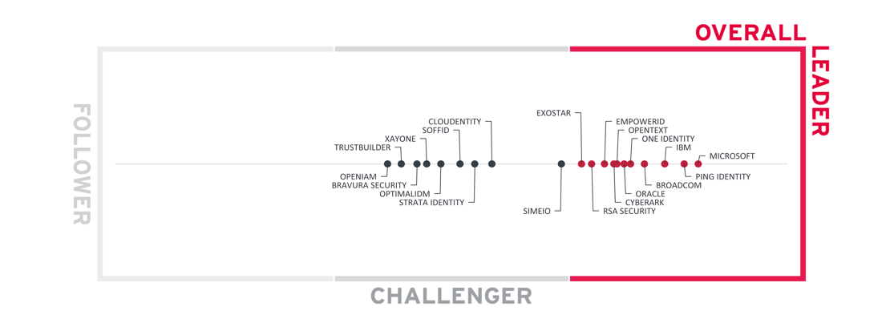
MARKET LEADERSHIP
Leader for 8 Years (2017-2024)
Gartner MQ for Access Management
2024 Leader
in CIAM Leadership Compass
2024 Leader
in the Forrester CIAM Wave
2024 Leader
in Identity Fabrics Leadership Compass
Notes:
A LEADER WHO IS NOW ONLY STRONGER THAN EVER BEFORE
WE ARE A MARKET FORCE
Gartner MQ: https://www.pingidentity.com/en/resources/content-library/analyst-reports/gartner-iam-magic-quadrant.html
KuppingerCole Access Management: https://www.pingidentity.com/en/resources/content-library/analyst-reports/3745-kuppingercole-leadership-compass-access-management.html
KuppingerCole Identity Fabrics: https://www.pingidentity.com/en/resources/content-library/analyst-reports/3993-kuppingercole-leadership-compass-identity-fabrics.html
Forrester CIAM Wave: https://www.pingidentity.com/en/resources/content-library/analyst-reports/3702-2022-forrester-wave-ciam.html

Slide 14
Thank you.
Let’s chat at Stand C06
Notes:
Update CTA

