Slide 1



On the Right Track
Winning Corporate Travelers in the Rail Industry
World Passenger Festival

Slide 2

Today’s agenda
Who we are
The corporate traveller opportunity
What rail operators can do to attract more corporate travellers
The biggest driver of growth in the rail industry in the next 5 years
Snowfall solutions

Slide 3
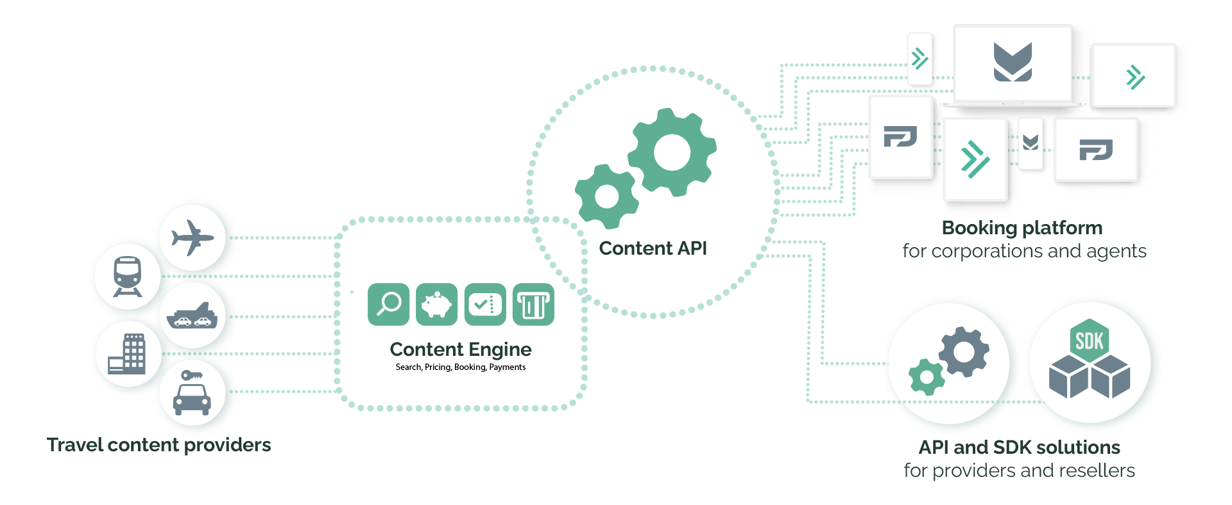
We are Snowfall: Next Generation Tools and Technologies that simplify the world of travel
Notes:
Anthony?

Slide 4
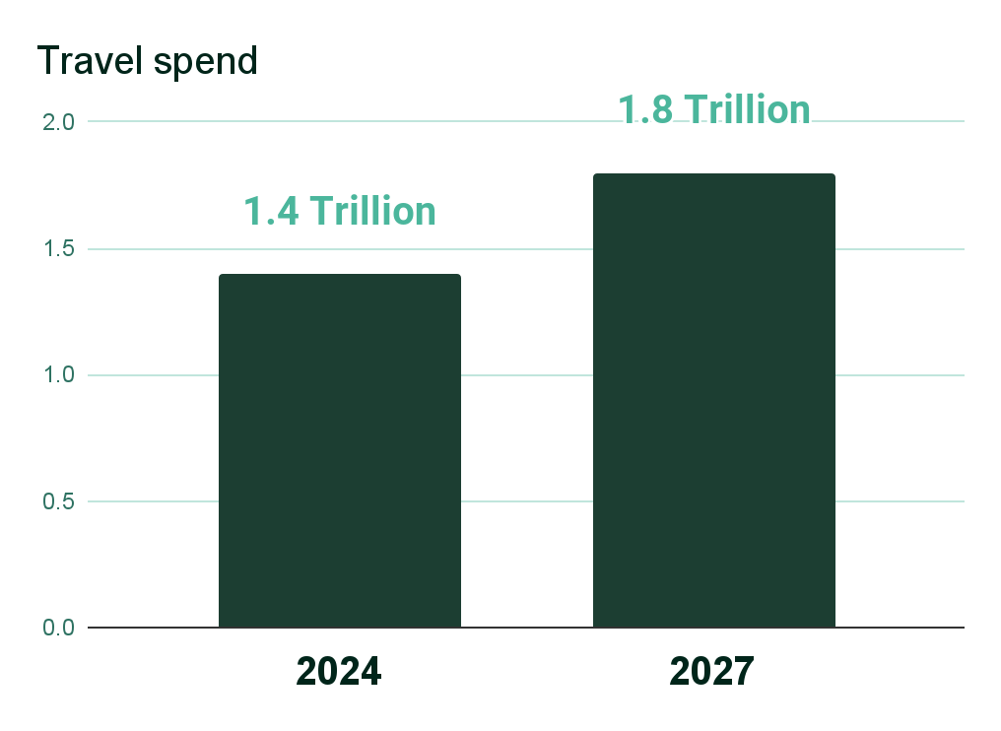
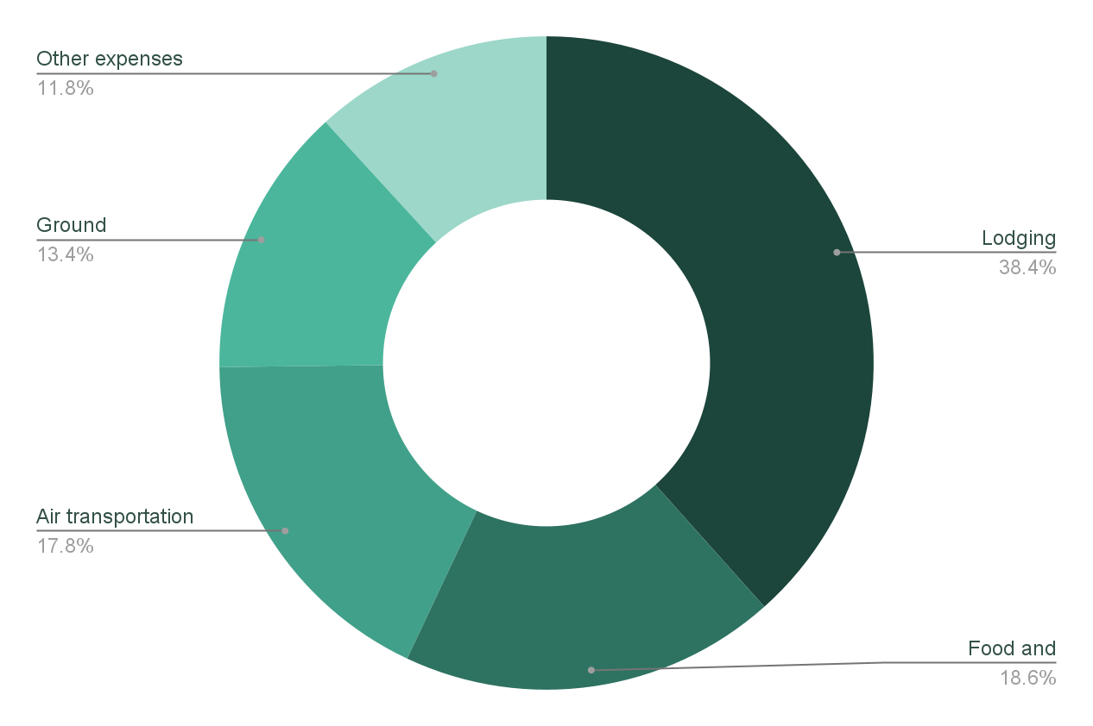

The Corporate traveller opportunity
Source: GBTA Global Business Travel Industry Forecast

Slide 5
The survey
What rail operators can do to attract more corporate travellers?
What Travel Management Platforms can do to bring more customers toward rails?
What will be the biggest driver of growth in the rail industry in the next 5 years?

Slide 6

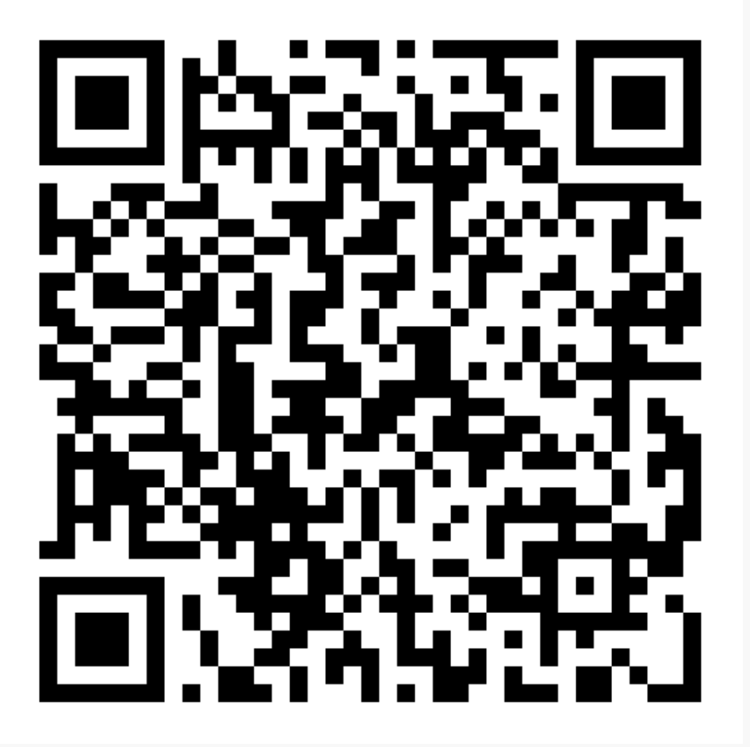
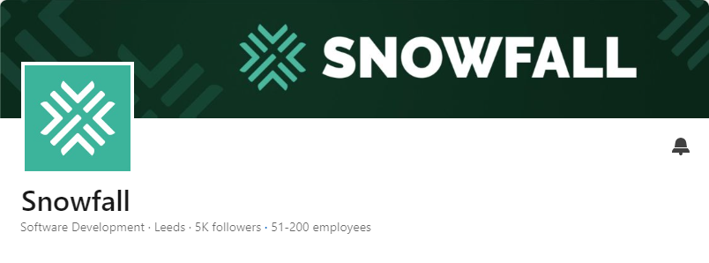

Do you want to see the overall research? We will publish it on LinkedIn

Slide 7
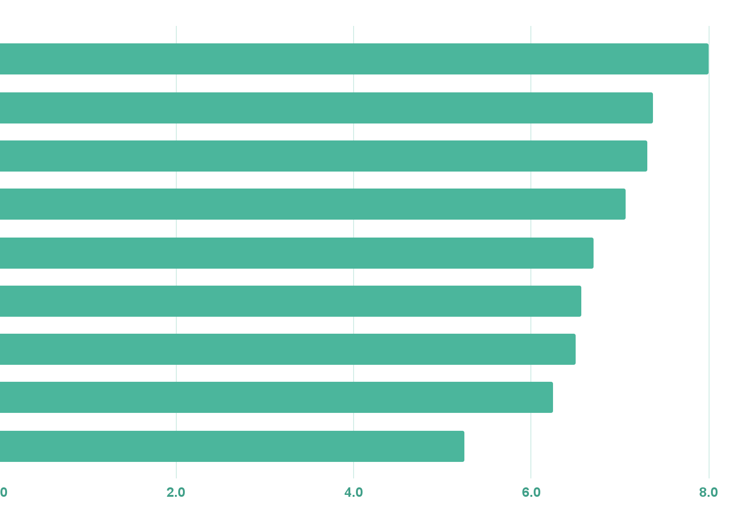
What rail operators can do to attract more corporate travel customers?
Source: Snowfall survey to rail operators, May 2024
Integration with corporate travel platforms
Reliable Wi-Fi and workspaces
Direct routes to key business hubs
Emphasise environmental benefits
Flexibility
Loyalty programs
Exclusive corporate rates
Enhance business class offerings
Dedicated corporate travel portals

Slide 8
How well do you currently integrate with Travel Management platforms?
Source: Snowfall survey to rail operators, May 2024

Slide 9
What Travel Management Platforms can do to bring more customers toward rails?
Source: Snowfall survey to rail operators, May 2024
Corporate rates
Environmental benefit
Booking experience
Digital support
Better Integrations
Rail into air platforms
Travel packages
OSDM standards
Promotion and awareness

Slide 10






What will be the biggest drivers of growth in the rail industry in the next 5 years?
Source: Snowfall survey to rail operators, May 2024
Sustainability and Co2 policies
Booking process improvements
Content distribution
Offer expansions, fastest connections and new routes
Multimodality
Price

Slide 11
Features we have been asked for to address these challenges
Buying policy for corporations
Approval process
Multimodality search
Co2 decision making

