Slide 1
Introduction
Sarah Vilms
Vice President,
Strategic Growth Initiatives
T
RE+ Industry Trends Theater
September 11

Slide 2
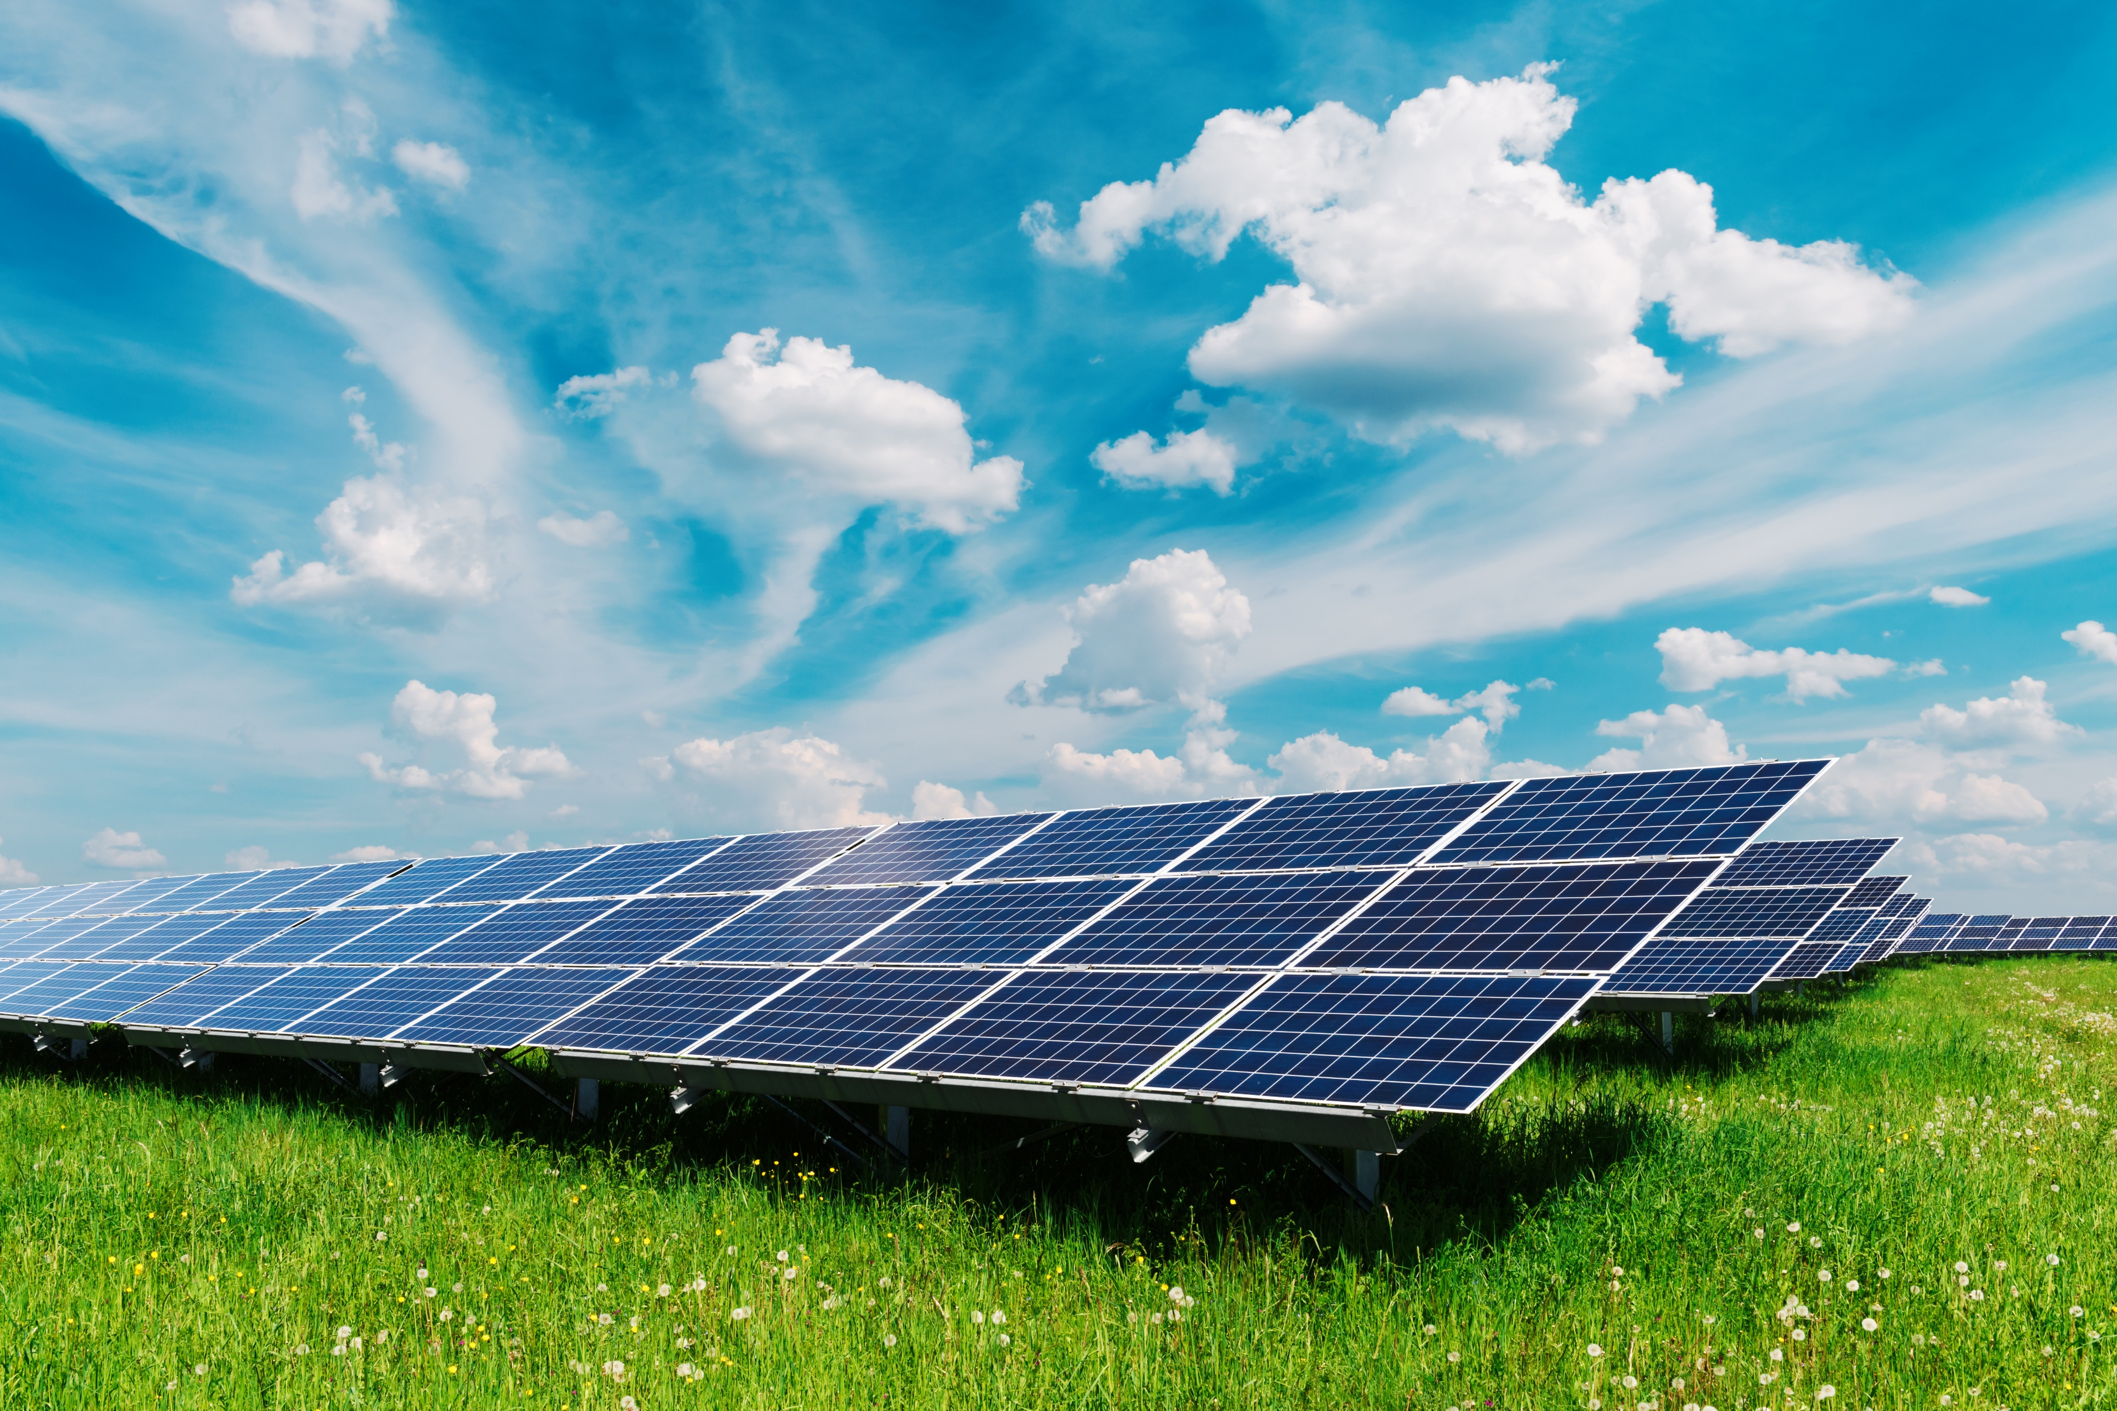
Federal and State Funding Portal
What is the Opportunity?
Availability of Funding
One-Stop-Shop
Tailored
You Don’t Have to Hunt and Peck
Live
Knowledge vs. Applying
Why Should We Care?
Success to Date
Next Steps

Slide 3
Example of Grant Opportunities
  Fiscal Year 2025 Solar Module and Solar Hardware (SMASH) Incubator
  Battery Materials Processing and Battery Manufacturing and Recycling Grant Program
  State of Kansas – Solar for Community Buildings
  State of Minnesota – Solar on Public Buildings Program
  State of Maryland - Commercial Energy Storage Grant Program
Notes:
update with most recent content

Slide 4
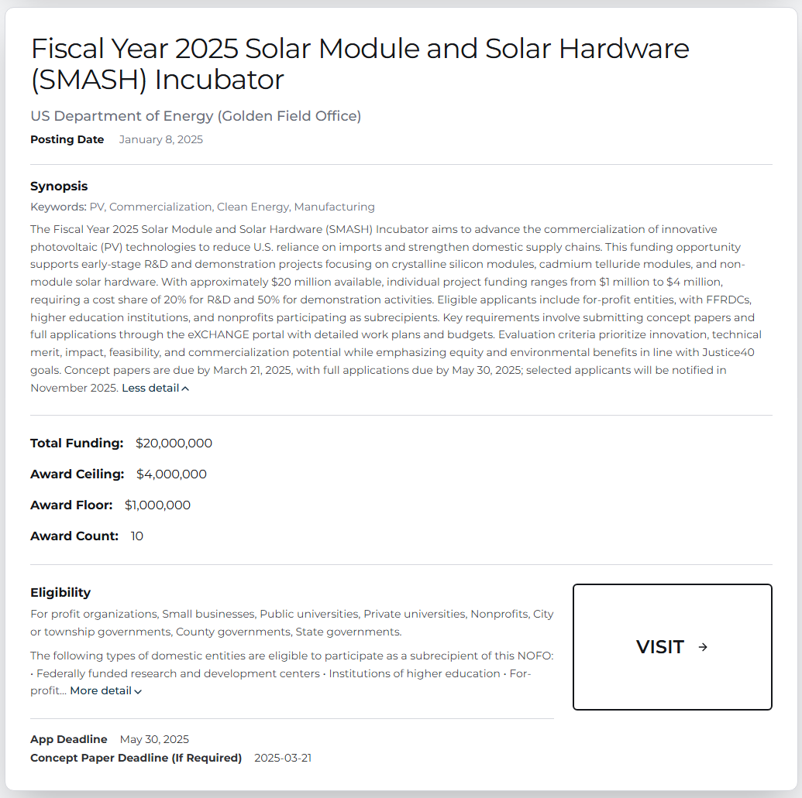
Notes:
Added 8/4

Slide 5
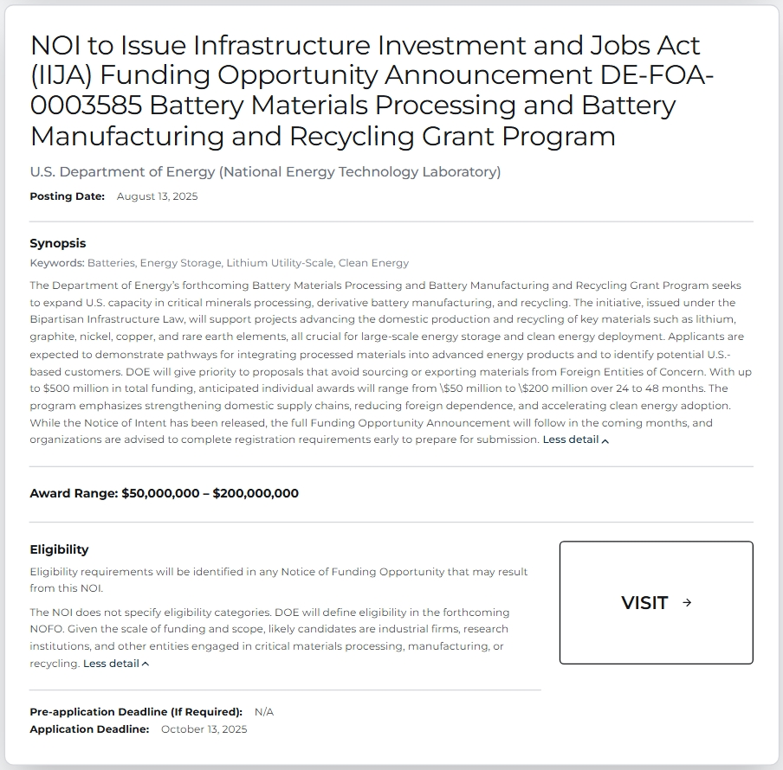

Slide 6
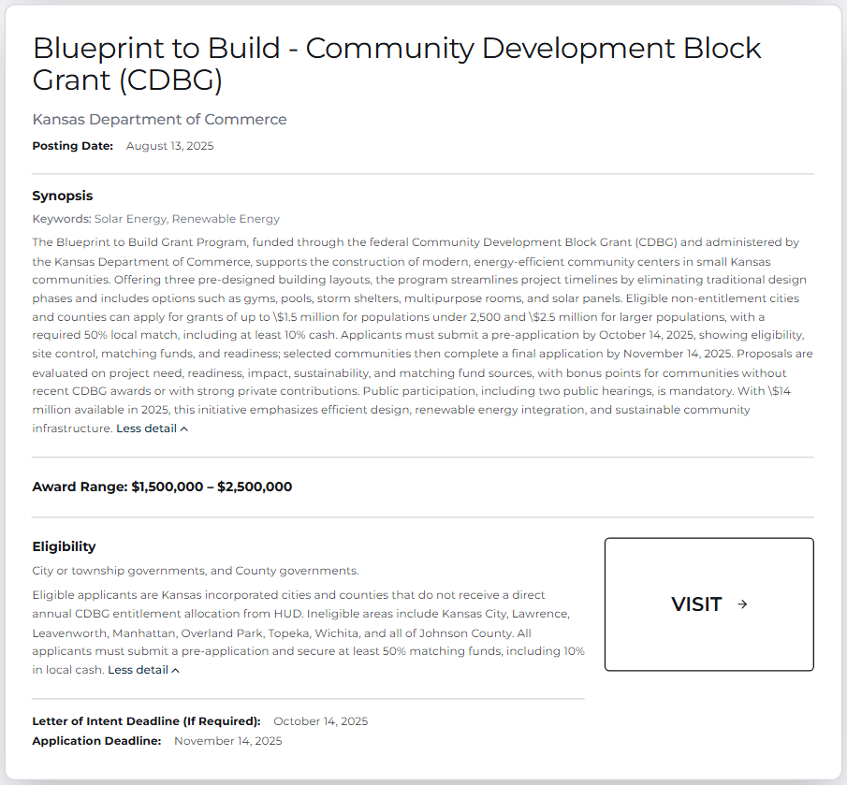
Notes:
Place new MN slide and two newest state grants Added 8/18

Slide 7
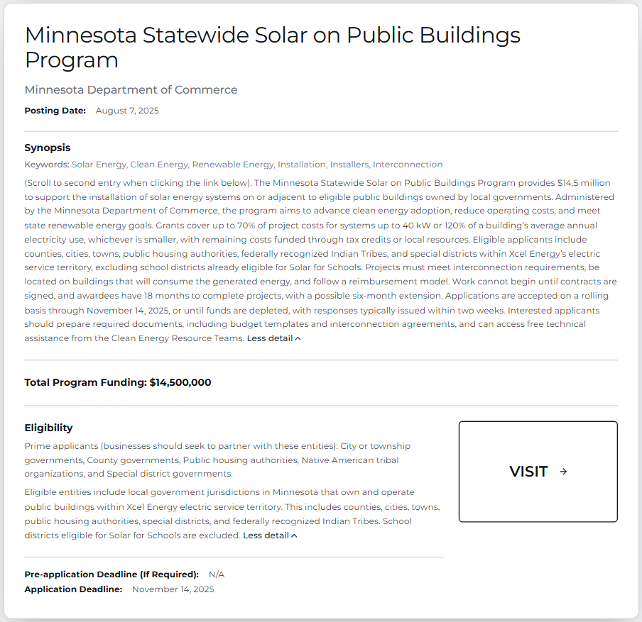
Notes:
Place new MN slide and two newest state grants Added 8/18

Slide 8
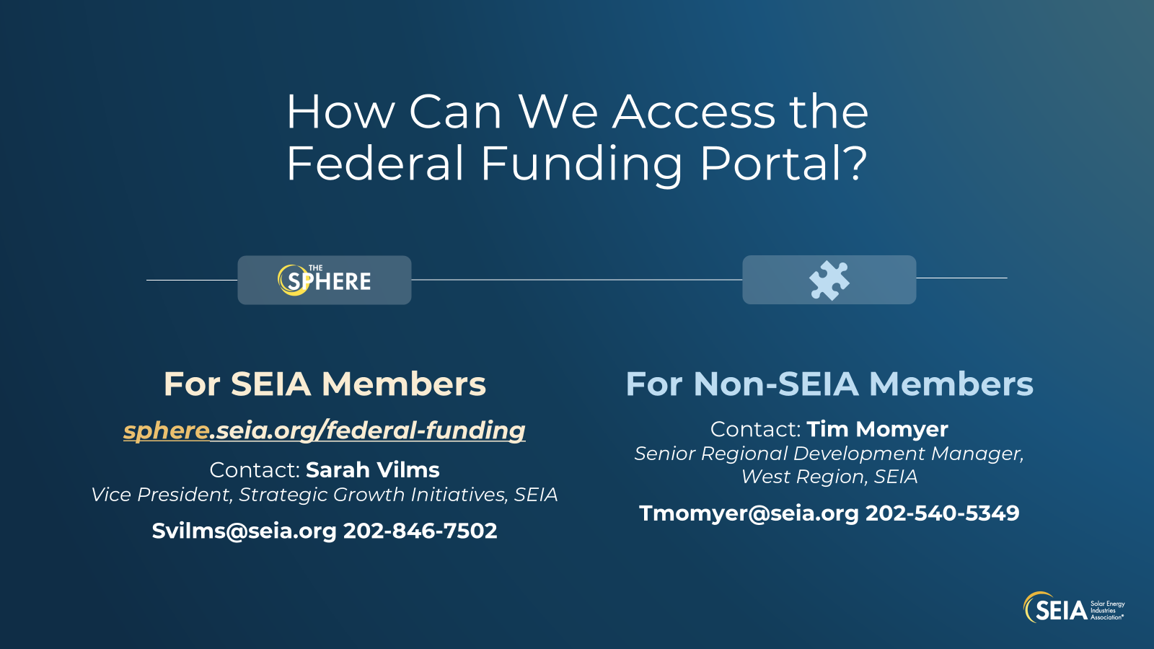
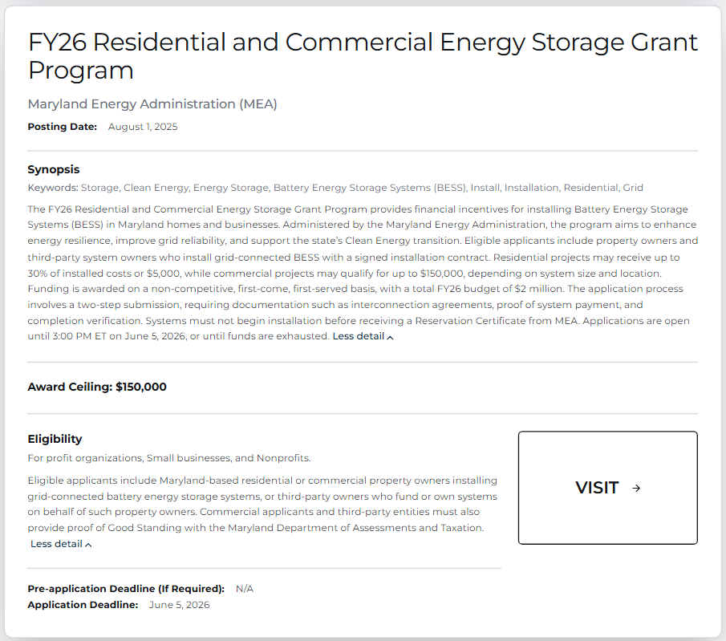
Notes:
Place new MN slide and two newest state grants Added 8/18

