Slide 1


SCOTTISH BORDERS COUNCIL
Delivering care, closer to home through digital transformation in home care
Chris Myers, Director of Adult Social Work and Care

Slide 2





Scottish Borders
4,732 km²​
3,058 km of roads​
116,900 people​
Growth of 30% in 75+ age group between 2018-2028
21.5% > 70yrs​ compared to 13.5% UK
55% of the population live in rural areas compared to 17% UK
Dependency ratio of 0.71 compared to 0.58 UK ​
300 Home Care Staff​
700,000 Home care visits a year

Slide 3


The problem
High unmet need for home care services
  Impacts on experience and outcomes
  Impacts on health and social care system
Increase in demand across health and social care
High ‘dependency ratio’ with vacancies across providers
High travel times across a large rural area
High administrative burden for staff
Isolated working for staff
Variability in provision
Challenges providing seamless communication
Poor data infrastructure

Slide 4
What we aimed to do
Implement transformation across home care
Better support and empower staff
Improve home care service capacity and continuity
Better support service users
Improve data quality, business intelligence/ analytics and monitor outcomes
Improve communications with service users and across health and social care
Demonstrate value
Ensure sustainability
Put people at the heart of everything we do

Slide 5


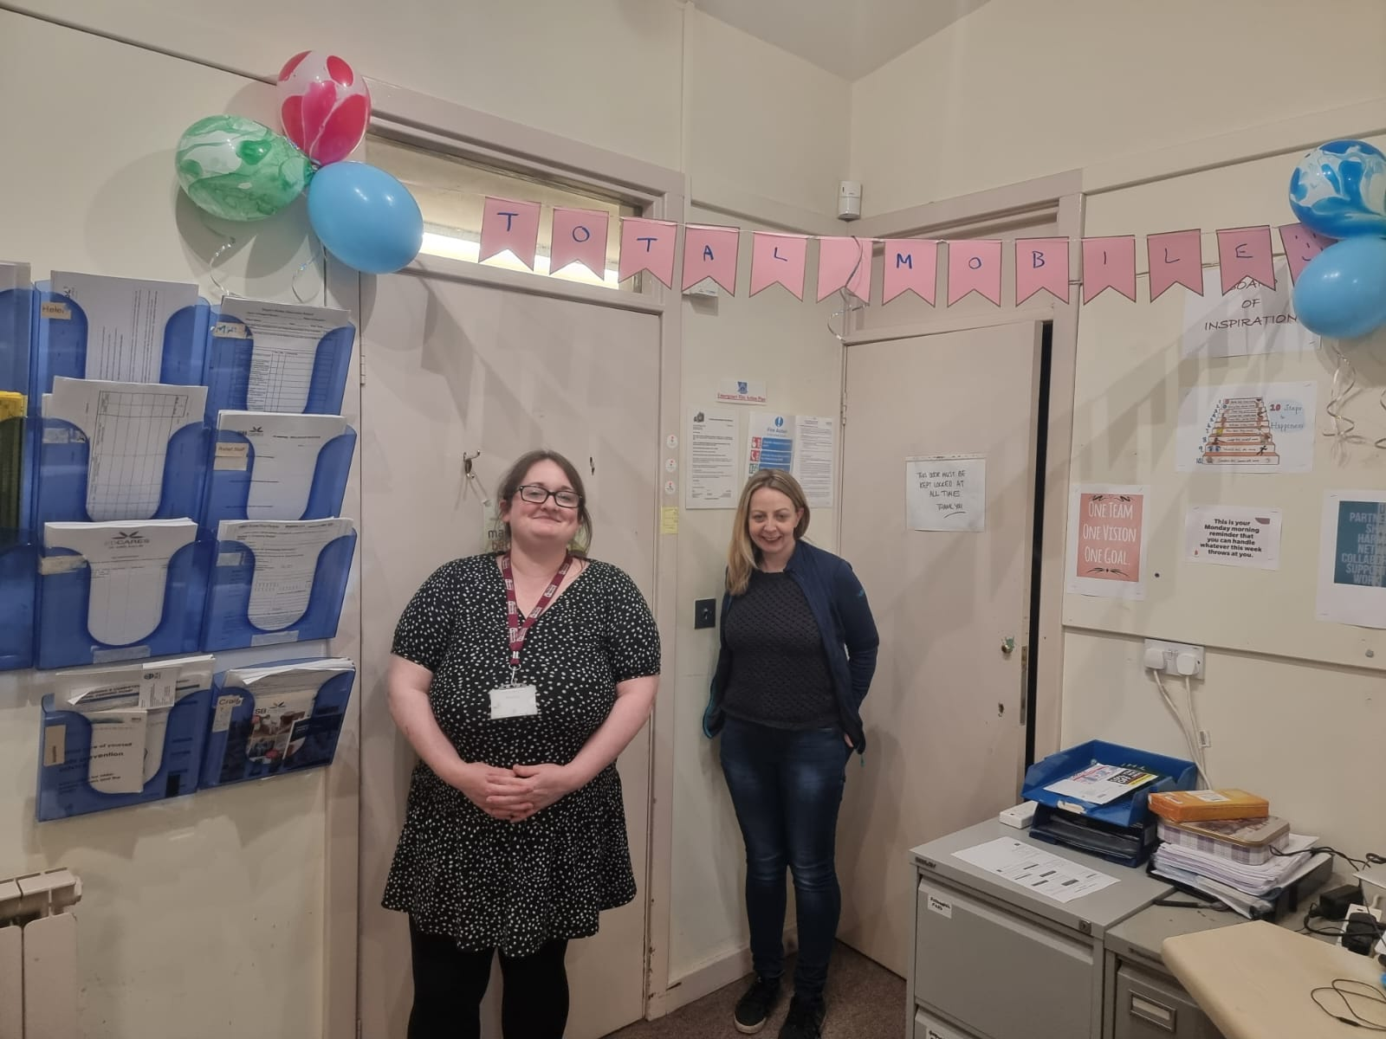
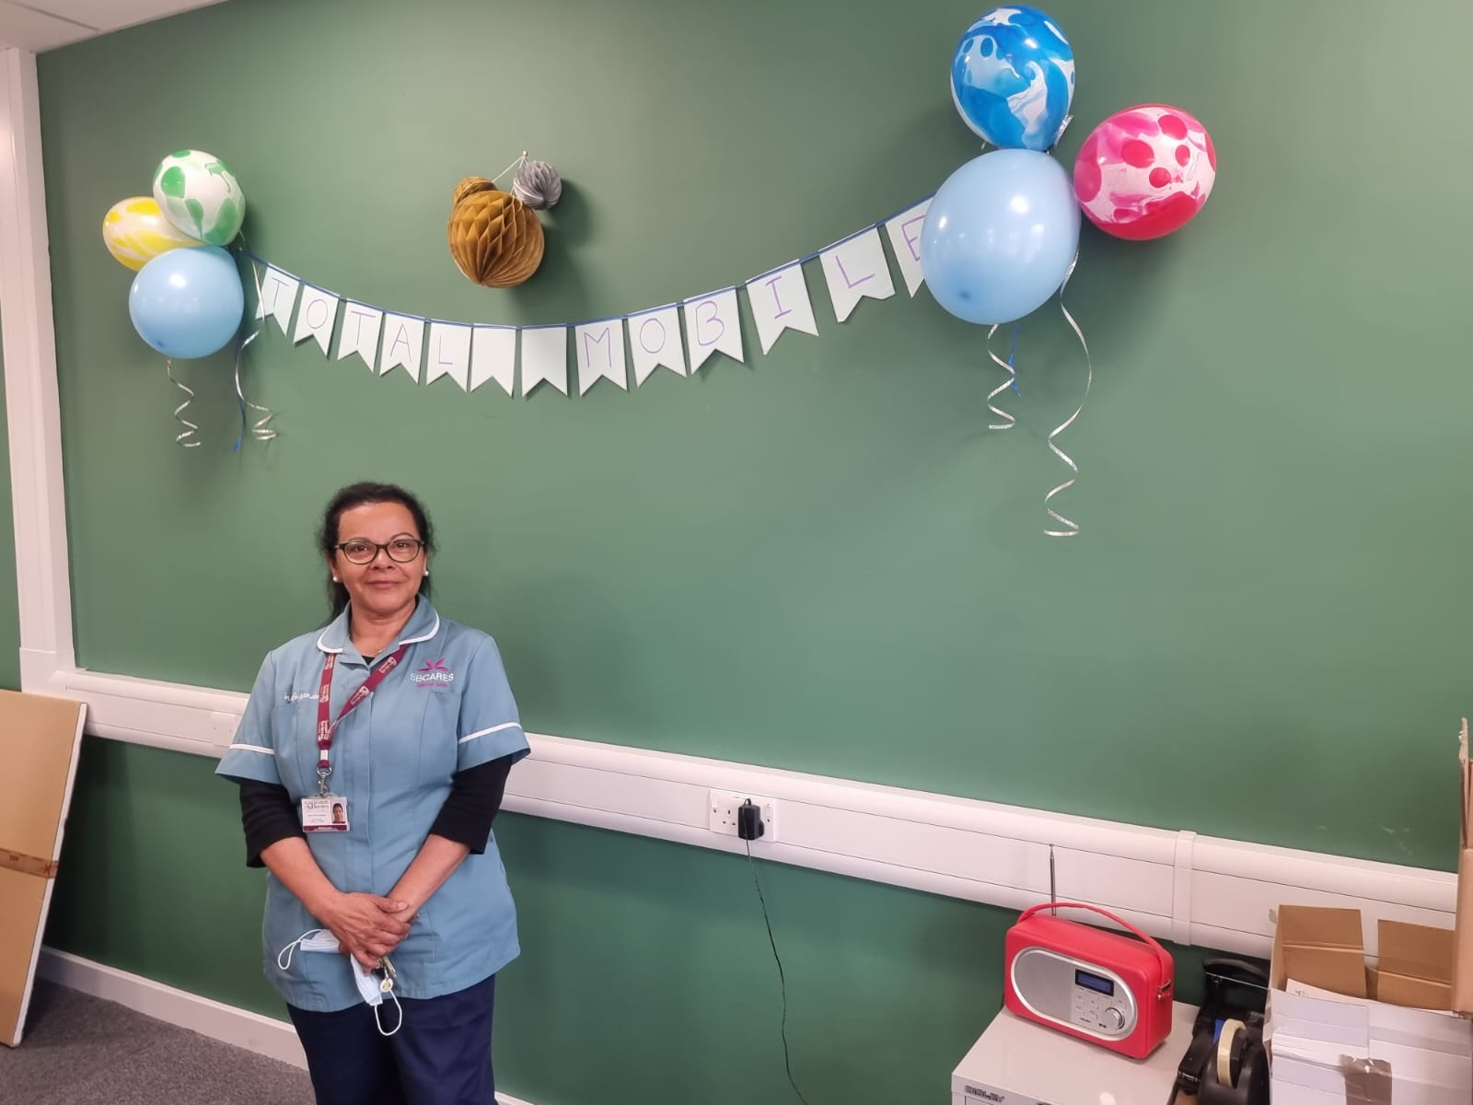
What made the change a success
Clear vision - Recognised the need for change
Staff championing the agenda and local competition
Council’s transformation funding and programme. Digital support from CGI
Localism and community stewardship from all with service users at the heart
Clear success criteria and change management
Tailoring the IT around the service, and taking an agile approach
The package
Organisation and staff able to take risks
Notes:
Deployment of iPhones, TM, Protect App to front line staff, App for service users and families to keep them up to date, work arounds for rural network coverage

Slide 6
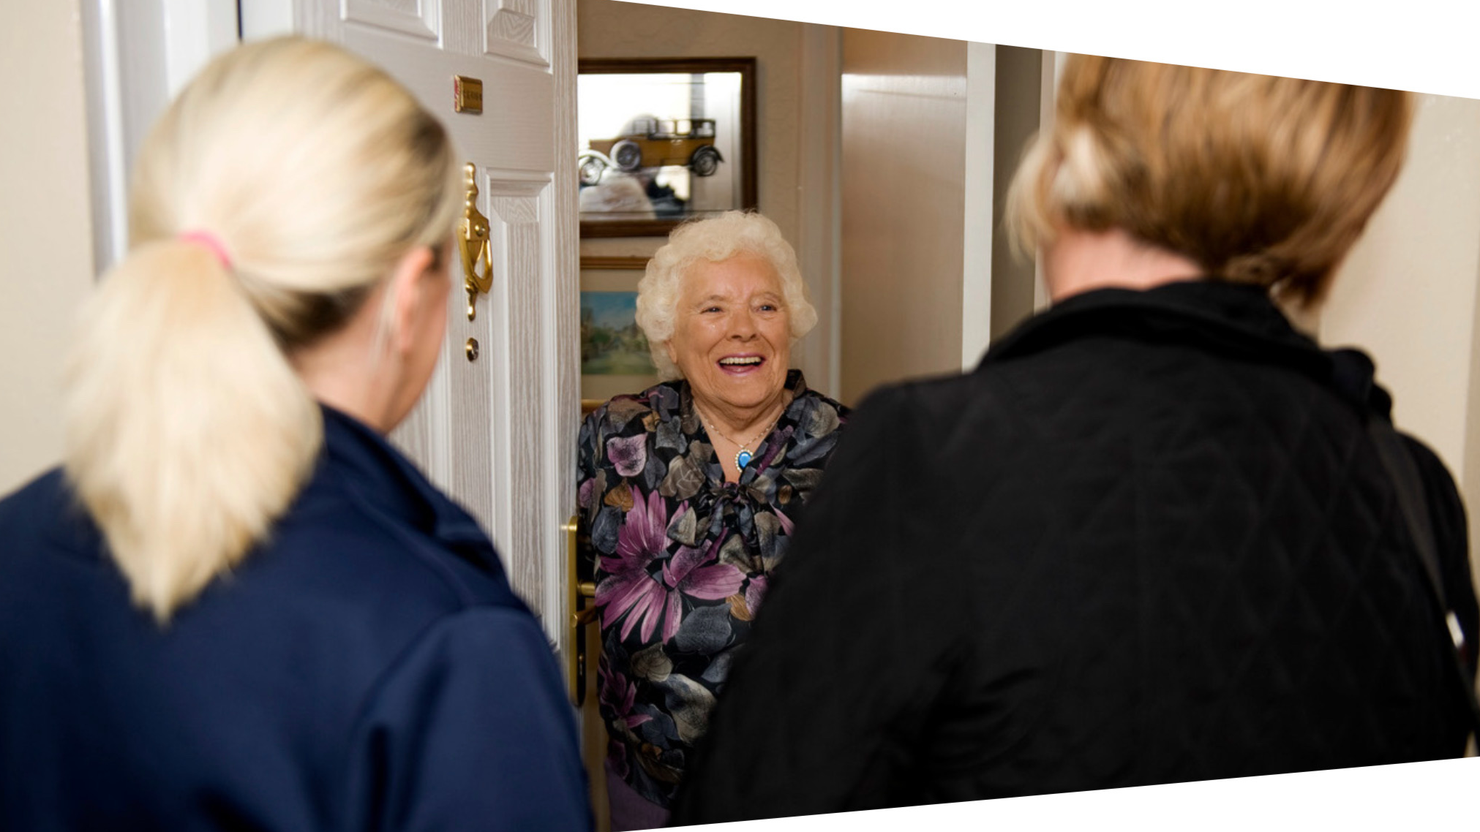
Outcomes
“People who had previously been anxious as to who would be arriving could now be more confident and settled knowing who would be visiting” Care Inspectorate (2024)
“…improvements to the scheduling system, which had resulted in visiting times being more punctual and more familiar staff visiting people” Care Inspectorate (2024)
703,000 care visits per annum (+19%)​
Reduced unmet need​
Improved continuity of care​
95% of care visits scheduled dynamically​
Reduced admin for staff​
More efficient travel​
Reduction of CO₂ by 21-42 tonnes per annum​
Support of more seamless care
Positive staff feedback​
£620k per annum savings​
Service users are better informed and know who is visiting them​
Improved Business Intelligence

Slide 7
Take aways and prompts
1. Change is possible! (and necessary)
2. Delivering care closer to home has significant benefits for population health and wellbeing in line with the ‘triple aim’ of health and social care
3. Similar productivity benefits are likely across scheduled Community Health services where staff travel is involved
Q. Does your organisation and team have the culture and conditions to support transformation to deliver more care closer to home?
Q. How can you play your part in driving transformation locally to support the delivery of care closer to home?
Better outcomes
Better experience
Care closer to home
Better value

Slide 8





Thank you
scotlandstartshere.com

