Slide 1

RAMS & ILS: The tale of a real workflow
November 26th, 2025

Slide 2



Before we start… a quick roundtable!
  Cédric PATERNOSTRE
    Head of International development
  Charles BACCIOCHINI
    ILS Manager – Velizy
  Andrés GONZALEZ
    Country Manager Spain

Slide 3


LGM quick overview
01
Figures, key facts and forecast

Slide 4
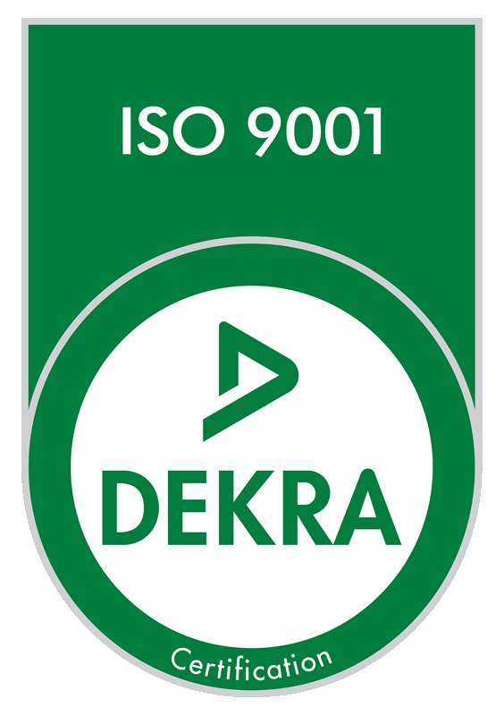
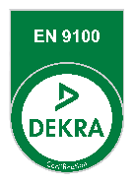

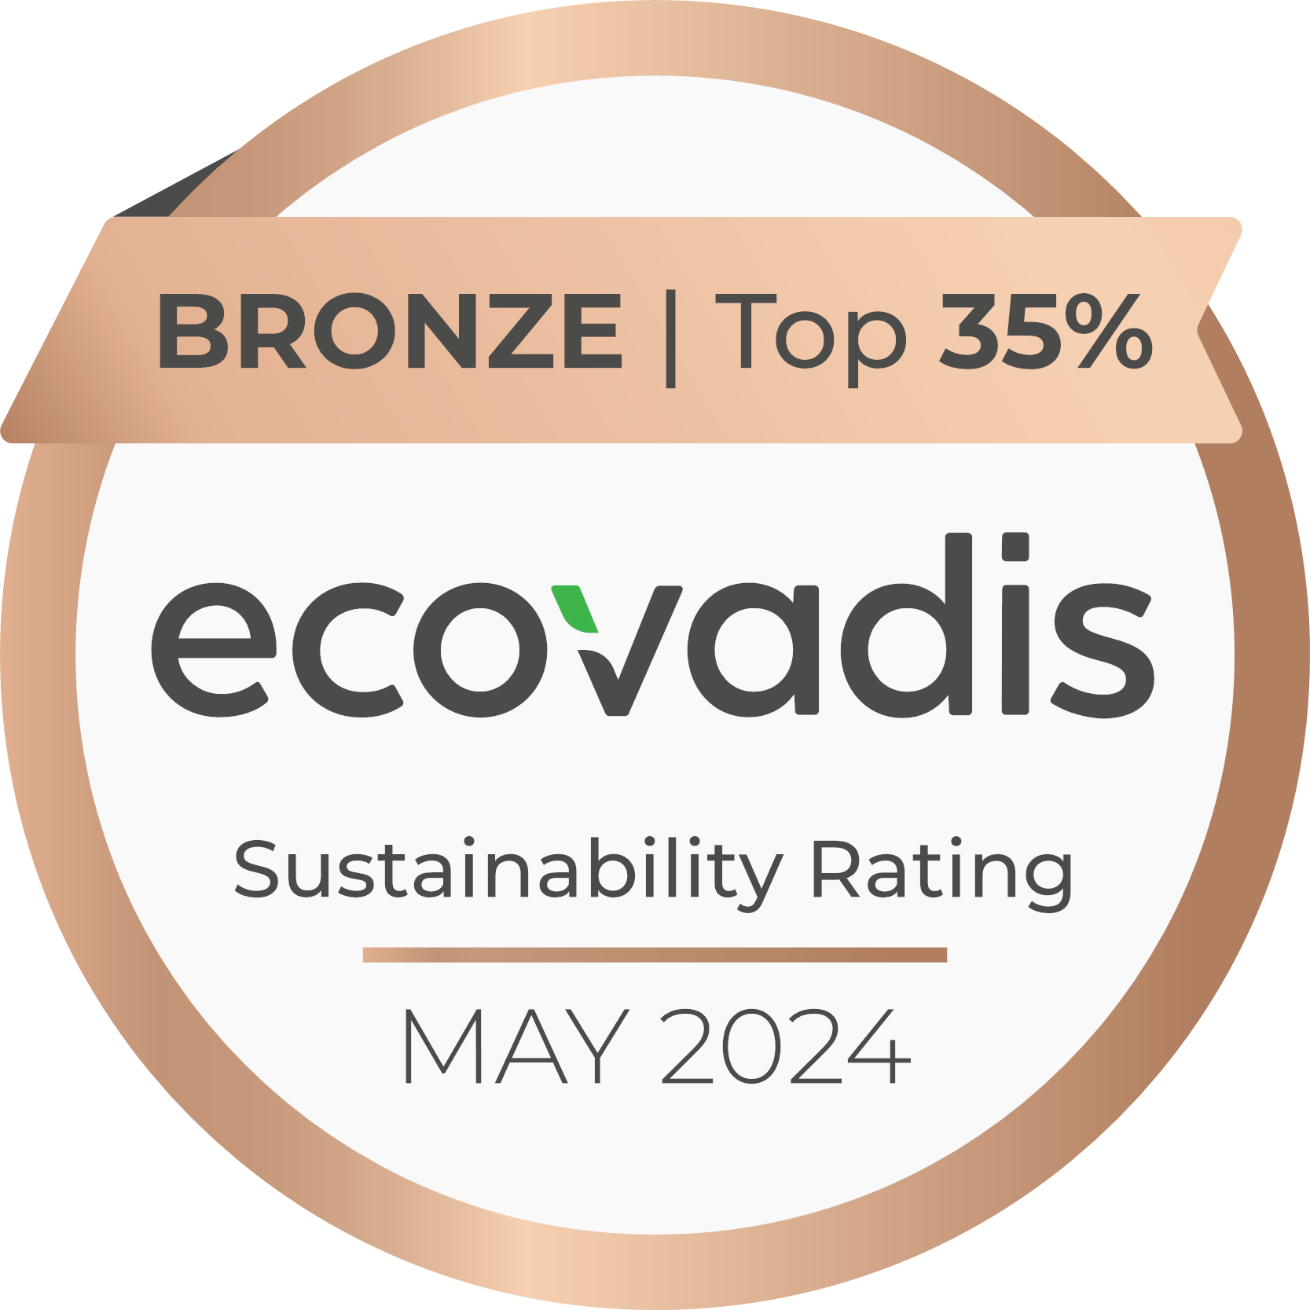





















Partnering with you for sustainable engineering solutions
We help you overcome the technological, security and environmental challenges of Industry and Infrastructures.
Driven by our passion for innovation and commitment to sustainable engineering, we are shaping the future.
Certifications
EN 9100 for aeronautical activities at our Vélizy-Villacoublay, Aix-En-Provence, Toulouse, Marville and Saint-Aubin plants as defined per our certificate.
LGM academy
Training for key professions of engineering
TRAINING ORGANIZATION: 11 78 83574 78
Driving progress on large, complex projects and critical industrial assets.
Supporting strategic and operational transformations in specialised engineering businesses.
Network
Delivery modes (% sales)
23%
technical assistance
20%
service center
15%
consulting & training
42%
package & products

Slide 5









A multisectoral group with an international dimension
Business Sectors
Footprint
165 M€
  Aeronautics
France
Sales
More than 20 national agencies
(Paris, Aix-en-Provence, Lyon, Bordeaux, Nantes, Villeneuve d’Ascq, Toulouse, etc.)
A presence in French overseas (Guyane)
  Railways
1 600
  Defence
europe
Employees
  Energy
Germany: Aachen, Donauwörth, Munich
Belgium: Charleroi
Spain: Madrid
Italy: Milan
England: Crawley
Sweden: Stockholm
Organization
The LGM group in France:
these are 3 leading companies in their respective fields.
  Naval
LGM SAS
Consulting and development activities in technological, digital, and software engineering.
LGM Ingénierie SAS
& ARELIS SAS
Design and production activities in advanced electronics.
  Space
OVERSEAS
Canada: Montreal, Toronto
India: Bangalore, Pune
Morocco: Casablanca
  Automotive

Slide 6


RAMS & ILS
02
The tale of a real workflow

Slide 7
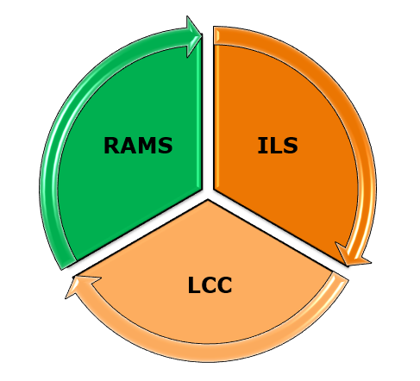

RAMS & ILS context
Reliability
Availability
Maintainability
Safety
Integrated
Logistic
Support
Life
Cycle
Cost
Performance
Consistency
Operation Efficiency
Safety
…
Maximize availability
Re-used products
Maintenance Efficiency
Minimize costs
…
WORKFLOW
Connecting these disciplines offers a systematic approach that ensures full lifecycle performance coverage and, more importantly, makes the workflow continuous, feedback-driven, and linked.
AI generated

Slide 8
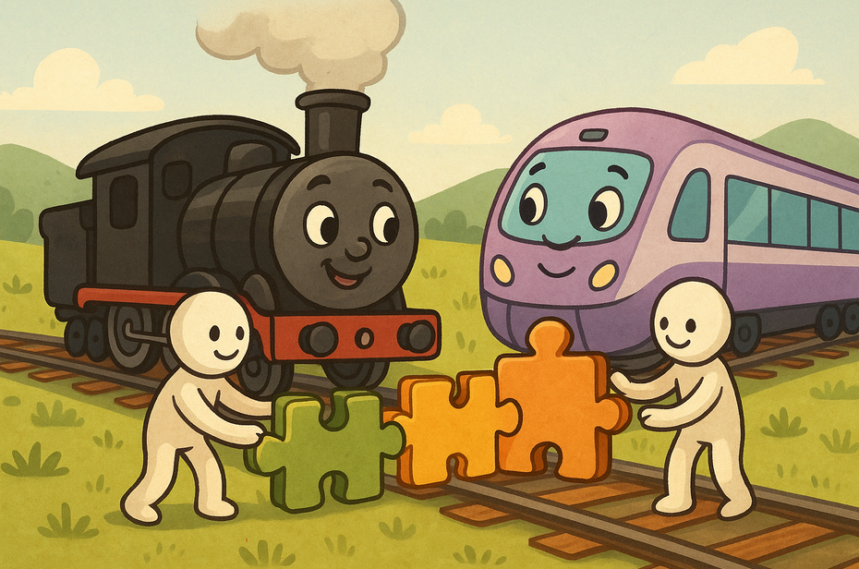
RAMS & ILS context
WHY a Tale?
Keep a childlike mindset to enjoy the journey, yet remain focused on the professional scope and its inherent topics to understand the past, the present, and the future of the railway. A tale give us story continuity until the end.
Once upon a time, two extraordinary trains — one bold in black, the other glowing in violet — traveled across distant lands. Though they ran on different tracks, their stories were meant to meet…
AI generated

Slide 9


RAMS & ILS: The tale of a real workflow
Coming back to the real world and to the issues that matter to adults, we can now introduce the two protagonists of our story.
Black Train
Violet Train
AI generated

Slide 10
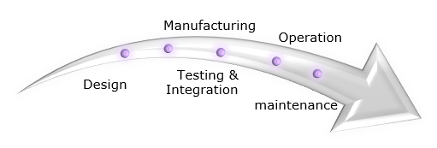
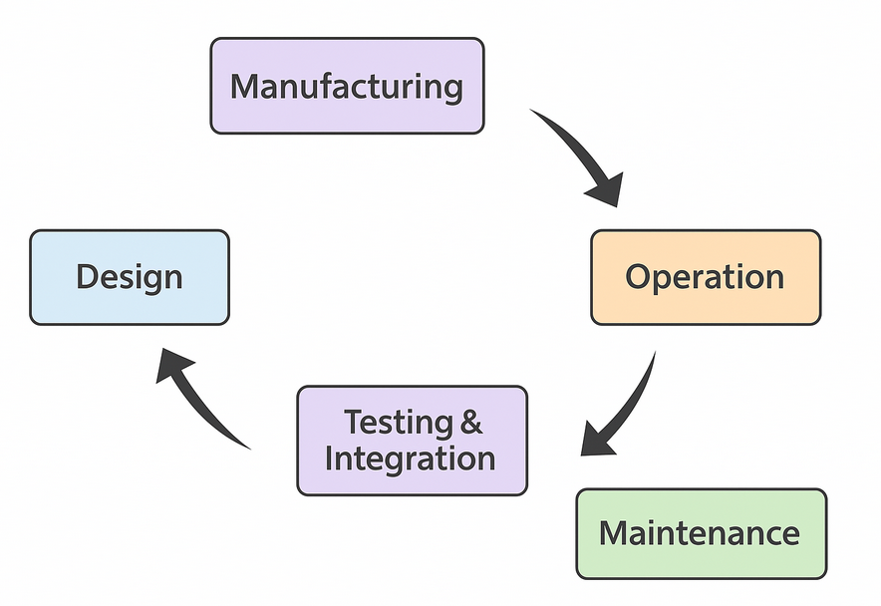
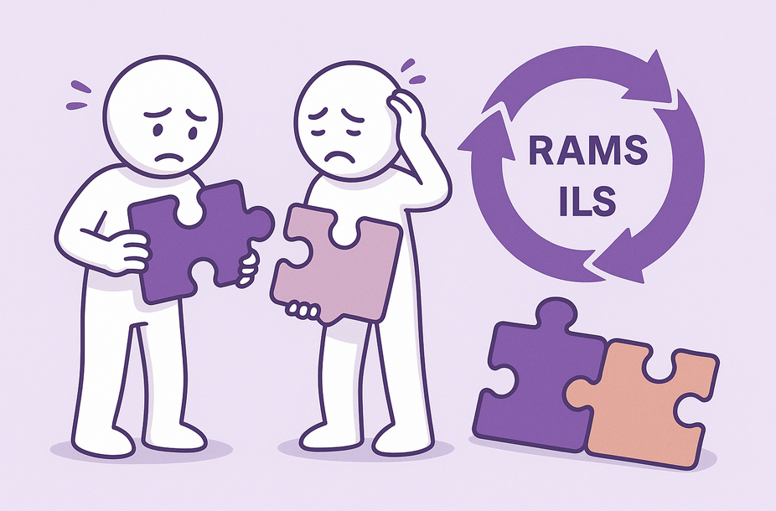

RAMS & ILS: The tale of a real workflow
Black Train
Well-defined RAMS & ILS process workflow.
Good MTBF estimation.
Accurate RAM inputs.
Application of RAMS & ILS in the entire lyfecycle.
Trusted tools and techniques.
Conservative estimations and hypothesis.
Violet Train
Poor definition of RAMS & ILS-LCC process.
Focused only on customer requirements and Project milestones.
Only focused on instant profitability of product
Engineers have been addressed analysis using poor inputs, optimistic hypotheses and non-trusted techniques.
Optimistic approaches.
Workflow
AI generated

Slide 11
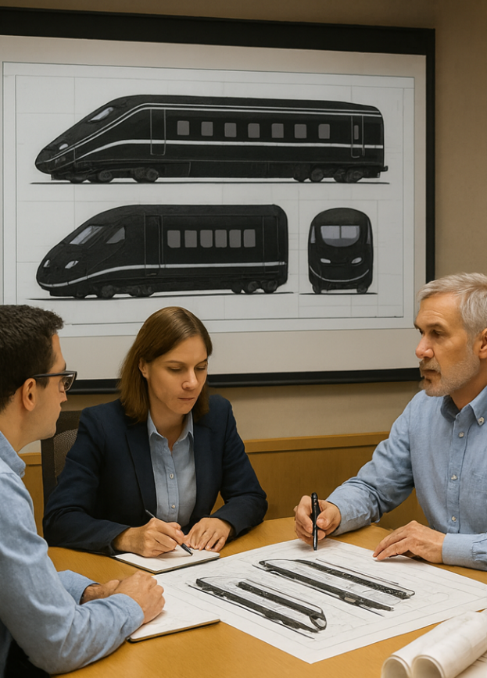
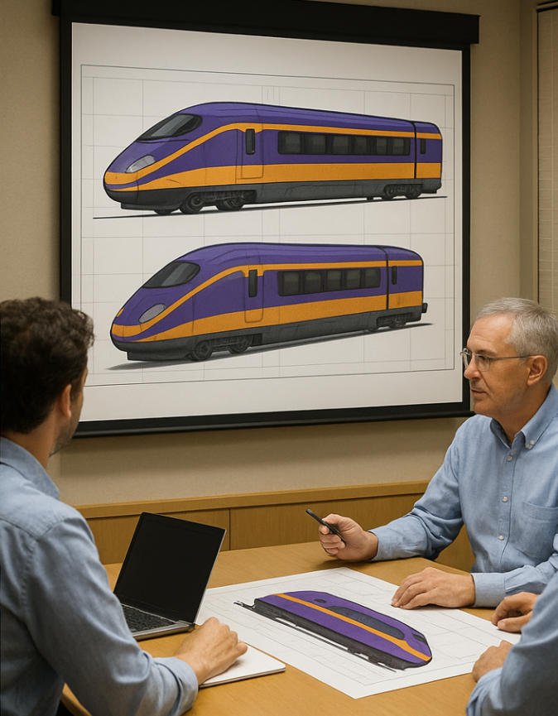
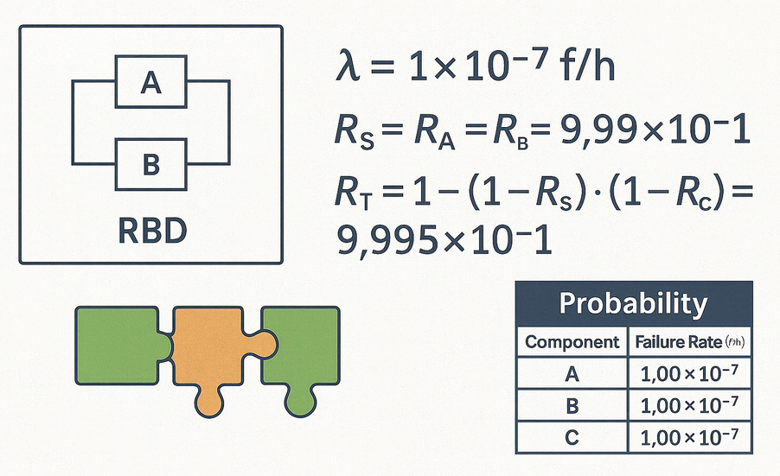
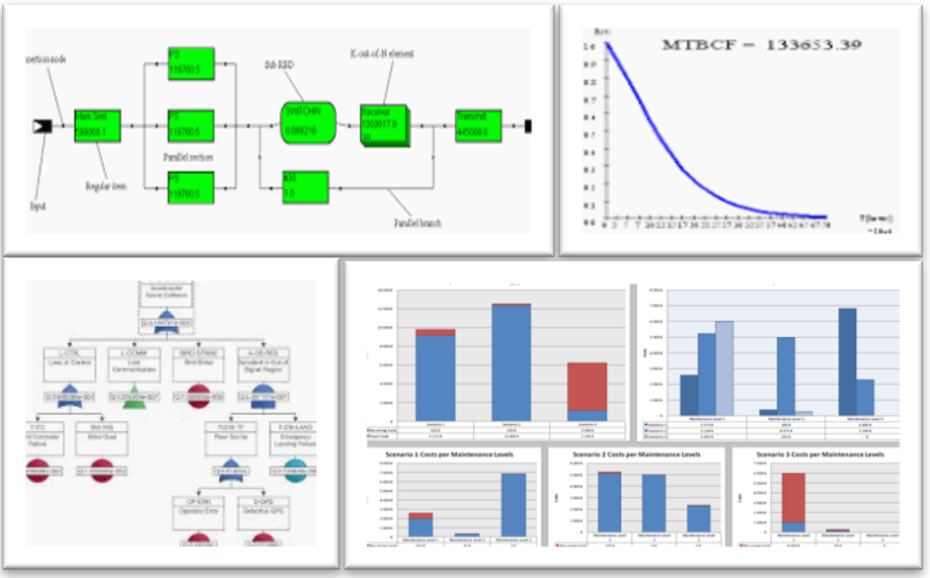
RAMS & ILS: Design phase
Black Train
Project management is guiding and supporting RAMS & ILS activities during the early concept design phase, taking into account the outcomes of the RAMS & ILS analysis.
Violet Train
Project management considers RAMS & ILS to be mere deliverables and begins the concept design without paying attention to these disciplines.
AI generated

Slide 12
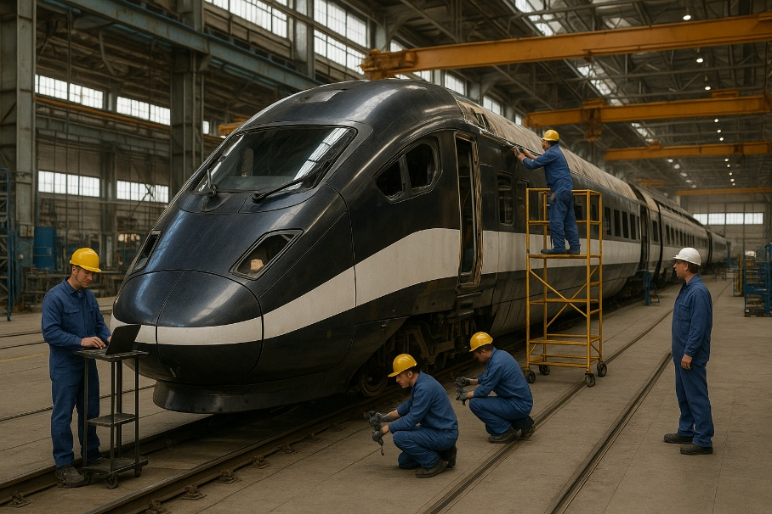
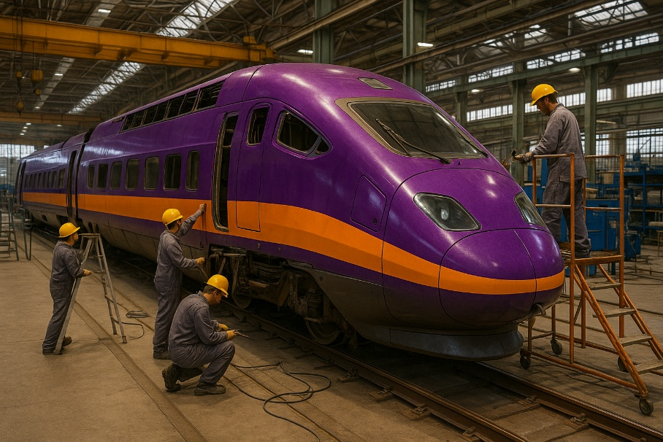
RAMS & ILS: Manufacturing phase
Black Train
Manufacturing is progressing properly, using products, components, architecture and subsytems already validated by RAMS and ILS, although this sometimes increases the Project’s preliminary costs.
Violet Train
Manufacturing is progressing properly, using products, components, architecture, and subsystems already employed in other similar projects, thereby reducing production costs at this stage.
AI generated

Slide 13
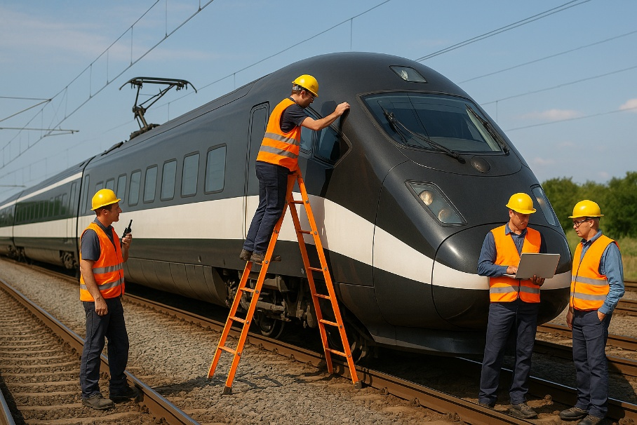
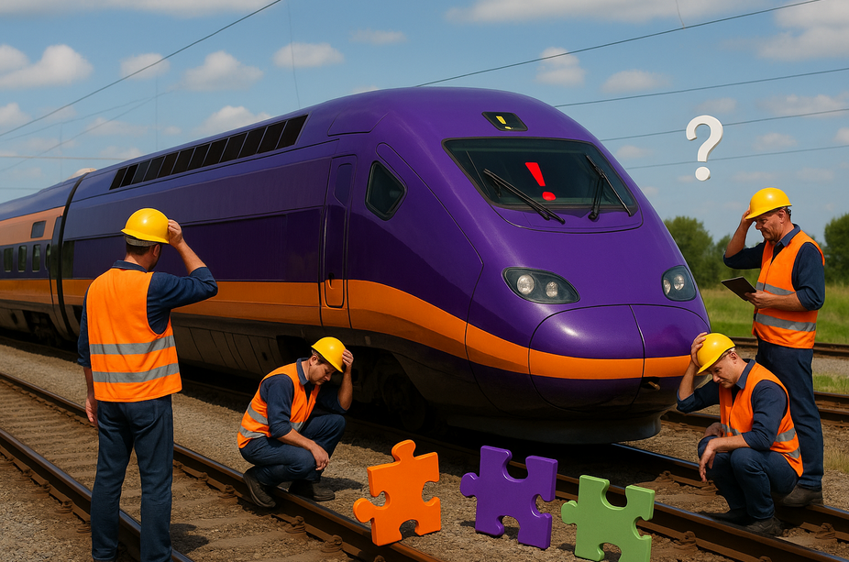
RAMS & ILS: Integration & Testing phase
Black Train
Integration and testing are progressing properly, using products, components, architecture, and subsystems already validated by RAMS and ILS, and the expected results are meeting the project milestones.
Violet Train
Integration and testing are progressing with issues due to unexpected behavior of functions, subsystems, and products. The validation campaign is delayed, and the project is incurring additional costs and jeopardizing milestones.
AI generated

Slide 14

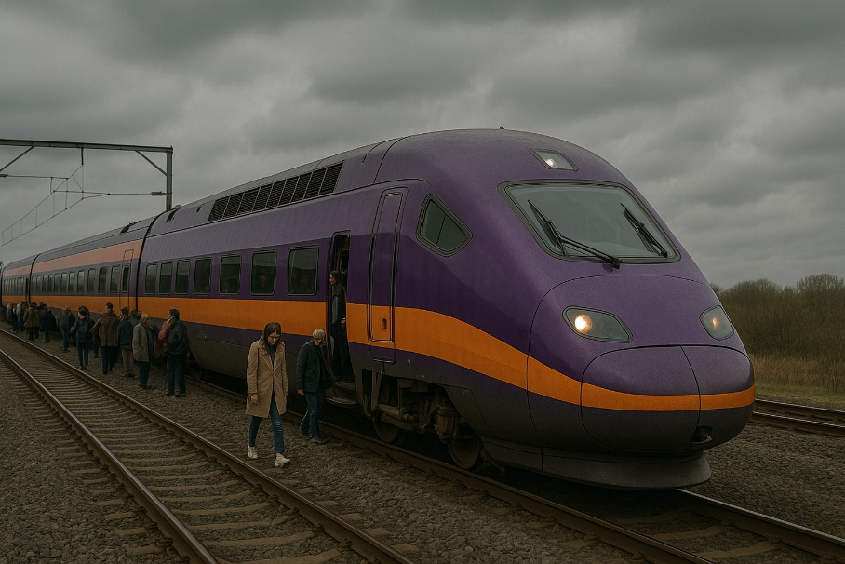
RAMS & ILS: Operation phase (I)
Black Train
Operation is successful according to the project requirements, ensuring performance, line capacity, permitted speed, fulfillment of customer needs, and positive feedback from users.
Violet Train
Operation faces availability issues due to poor forecasting of RAMS & ILS parameters. The train’s operation is resulting in increased costs, customer penalties, and a negative reputation among users.
AI generated

Slide 15


RAMS & ILS: Operation phase (II)
Black Train
Operation is ensuring passenger safety, on-time arrival, improved mobility across countries, and a better quality of life for users.
Violet Train
Operation, without an accurate RAMS & ILS workflow, could sometimes lead to catastrophic scenarios that must be absolutely avoided.
AI generated

Slide 16
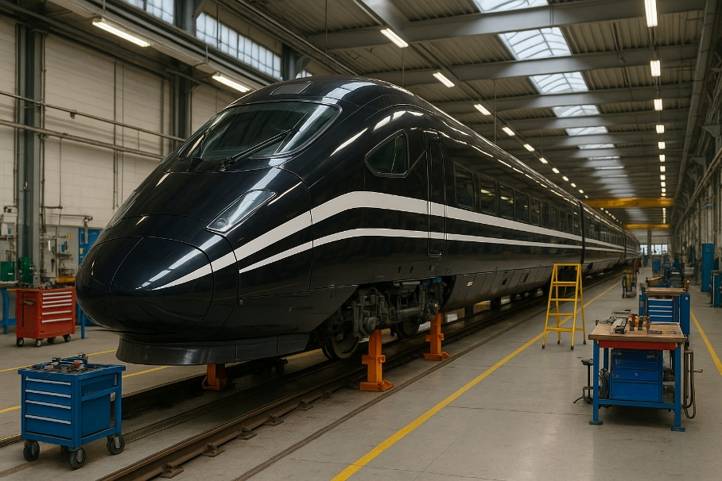
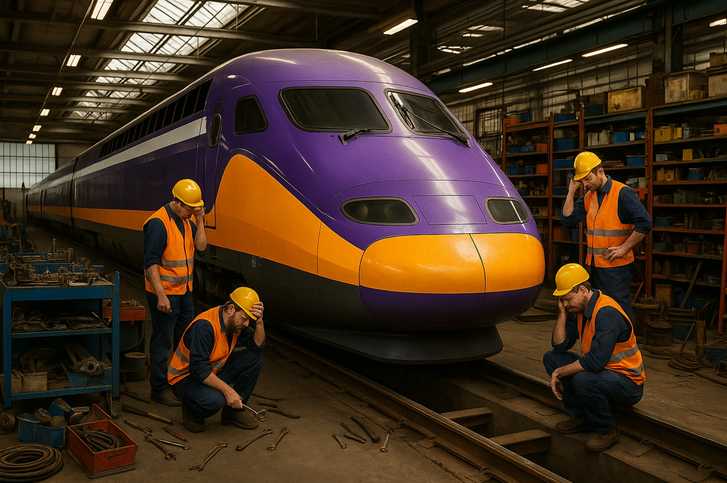
RAMS & ILS: Maintenance phase
Black Train
Maintenance policy ensures clear task definitions, less complex activities, and safe procedures for technicians. Furthermore, field operation guarantees that operational data is fed back into RAMS, contributing to a better definition of the design concept and improved LRU stock management.
Violet Train
Maintenance policy is often improvised, risky for technicians, and affected by poor stock control, impacting the train’s availability for operation and resulting in additional costs and penalties.
AI generated

Slide 17
RAMS & ILS
03
Conclusions

Slide 18
Conclusions / Key concepts
The black and violet trains are only analogies of the concept that, as RAMS & ILS experts, LGM want to convey.
The tale has been intended to be a different, funny and dynamic way to understand the importance of RAMS and ILS in the railway industry.
A correct application of the RAMS and ILS workflow ensures:
  Better performance during all the engineering project phases.
  Proved better performance during operation phase of the project/product due to accurate RAM figures and reliable MTBF estimation.
  Better approach for guarantee period ensuring contract requirements.
  Maintenance policy and tasks continuously improved.
  Field data acquisition within the cycle of the workflow improves inputs for RAMS.
  Reduce and saving costs at all levels.
An incorrect application of the RAMS and ILS workflow:
  Risk of jeopardizing engineering project milestones.
  Risk of bad performance during operation phase of the project/product.
  Potential penalties during guarantee period.
  Maintenance policy and tasks worsened.
  Field data acquisition missing.
  Increase of costs.

Slide 19


Conclusions / Key concepts
Moral of the tale:
Black Train won against its competitors, but later on, the other trains also wanted to be part of the RAMS & ILS workflow process.
Applying the RAMS & ILS workflow in the railway industry has proven to be an effective solution to prevent accidents, availability issues, and loss of quality of life for citizens using rail transport.
By sustaining the spirit we had as children—like when we listened to a tale—we keep our natural curiosity alive and discover clearer ways to face adult challenges with rigor, critical judgment, and true maturity.”
ILS
LCC
RAMS

Slide 20



Conclusions / Key concepts
MUCHAS GRACIAS POR VUESTRA ASISTENCIA
THANK YOU VERY MUCH FOR YOUR ATTENDANCE
NOUS VOUS REMERCIONS VIVEMENT POUR VOTRE PRÉSENCE

Slide 21

Andrés González
Charles Bacciochini
Cédric Paternostre
Country Manager Spain
+34 615 08 05 63
ILS Manager Vélizy
+33 685 884 483
Head of International development Vélizy
+33 661 72 86 90

