Slide 1
East Coast Digital Programme Update
Jon Hayes – Head of Programme Engineering and Systems Management

Slide 2
The Digital Signalling Masterplan
The Pilots – Foundational technical development
2007+
2020-2025
The Pathfinder – Delivery and commercial model development
2018-2030
The Pioneer – To migrate tens of organisations to operate with digital signalling
The Portfolio – Building the industry capability for multiple route-based deployment
2024-2034
The Paradigm – Multiple progressive route base digital signalling renewal
2030s+

Slide 3
Summary of the ECDP strategic narrative
Two thirds of signalling assets along ECML South are now life expired.
What is the problem with conventional signalling?
1
Replacing the assets conventionally is not a feasible option in terms of affordability,
asset sustainability or supply chain capacity.
The future of signalling is digital, which is a systemic shift away from ‘civil works’
conventional signalling, towards a cheaper, safer and more sustainable system.
Why digital signalling?
2
Digital signalling will transform how the railway operates and provide greater flexibility,
enabling better performance and system capability for passenger and freight services.
There is a once in a generation opportunity now to unlock the benefits of digital signalling
by leveraging the necessary signal renewals and new fitted trains.
Why now?
Implementation on ECML South will be the catalyst for digital signalling along the Route and
the wider UK rail network, making future schemes cheaper, better and faster.
3
Notes:
Two thirds of signalling assets along ECML South are now life-expired. These assets are safety critical and further life extension is not possible.
Replacing these assets is not a feasible option. Conventional signalling presents significant problems in terms of affordability, asset sustainability, disruption to the network and supply chain capacity. The cost of conventional renewals is increasing, and is expected to be c. £40m more than available funding for the next five years.
The future of signalling is digital, which will provide a systemic shift away from conventional signalling, requiring extensive civil engineering works. Digital signalling is significantly cheaper to build, renew and maintain, reducing costs by £xm over the next decade. It is a significantly safer system, protecting the lives of trackside workers and providing a safer system for in-train crew and passengers. It is significantly more sustainable with a much lower carbon footprint, supporting the UK’s Net Zero agenda.
Digital signalling will transform how the railway operates and provide greater flexibility and enable better performance and system capability for passenger and freight services. It will also unlock a range of wider socio-economic benefits, including investment in high skilled jobs and strengthened supply chain capability. This will modernise the rail sector in line with the rest of the world, attract major suppliers and support the UK’s ambition to become an innovative world leader and exporter.
This presents a once in a generation opportunity now to unlock the benefits of digital signalling by leveraging the necessary signal renewals on ECML South and significant investment in new fitted trains. Once deployed, digital signals will represent only 2.6% of the UK rail network but will have covered the investment for c. 35% of overall passenger fleet fitment.
Implementation on ECML South will be the catalyst for digital signalling along the rest of the Route and the wider UK rail network for generations to come, making future schemes cheaper, better and faster. By starting here, fitting all the trains and training all the drivers and making digital signalling operations real, it unlocks one of the vital arteries that stretch the country.

Slide 4
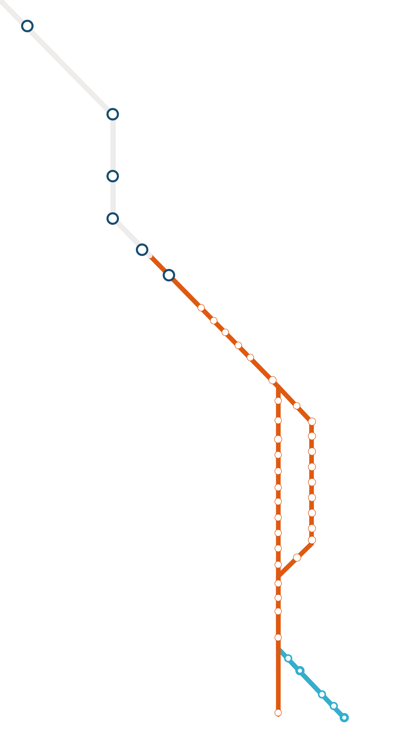
About the ECDP
1 Programme
5 Tranches
12 Incremental Steps
27 Duty Holders
64 projects
678 vehicles
736 signals removed
c2,750 drivers
5,982 staff impacted
Hitchin
ECML-S
OMO
ECDP
NCL
HIGHBURY & ISLINGTON

Slide 5
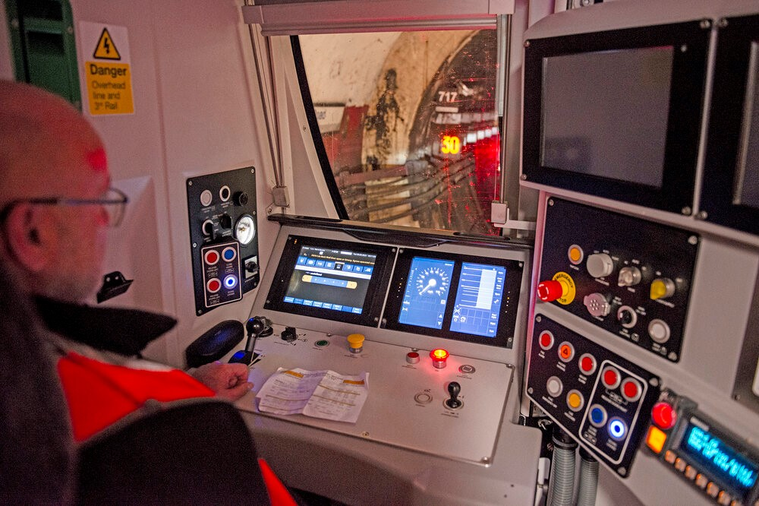
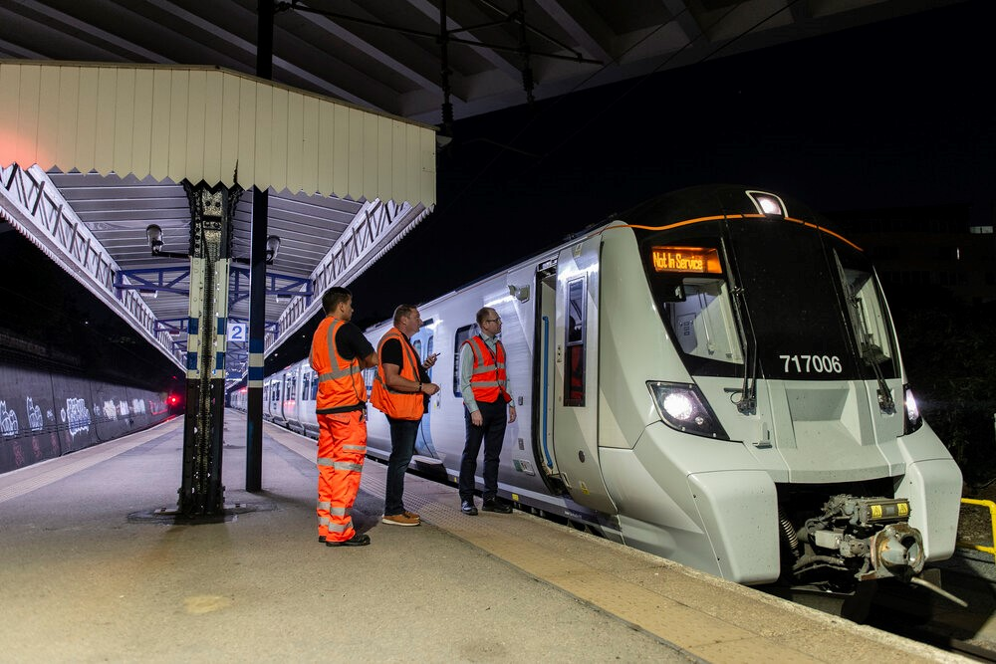
Northern City Line - NCL
Majority of drivers trained
100% operation in ETCS Level 2
One train class/operator 717
Lessons/learnings
GSM-R cell capacity
  Circuit switched
  ‘Unexpected’ non-termination
Start of Mission
Support/data for fast fault diagnosis

Slide 6
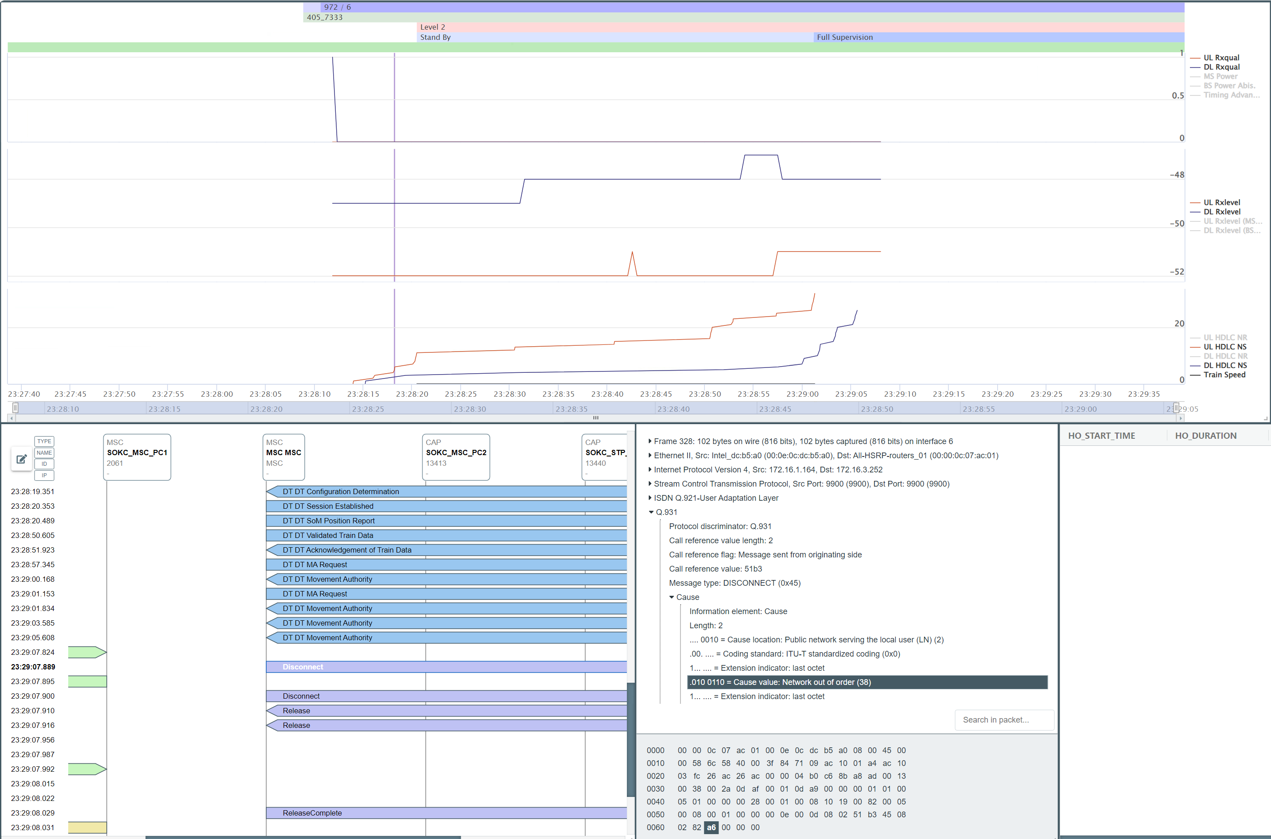
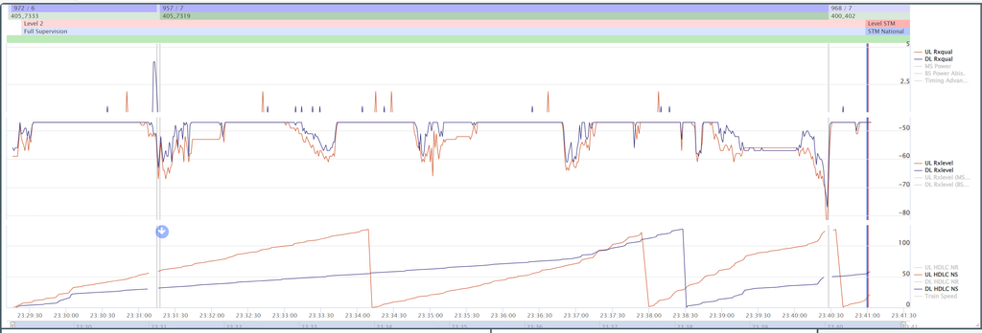
NCL – Support Team
Dedicated support team in York ROC
Data easily available
  RBC
  Interlocking
  ‘QATS’

Slide 7
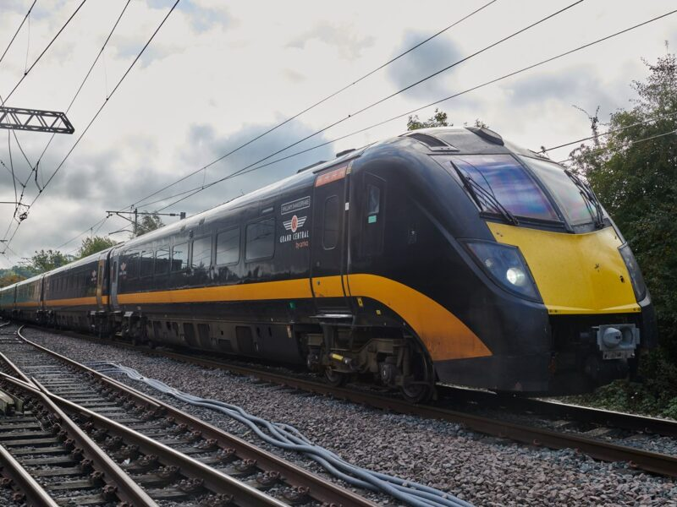
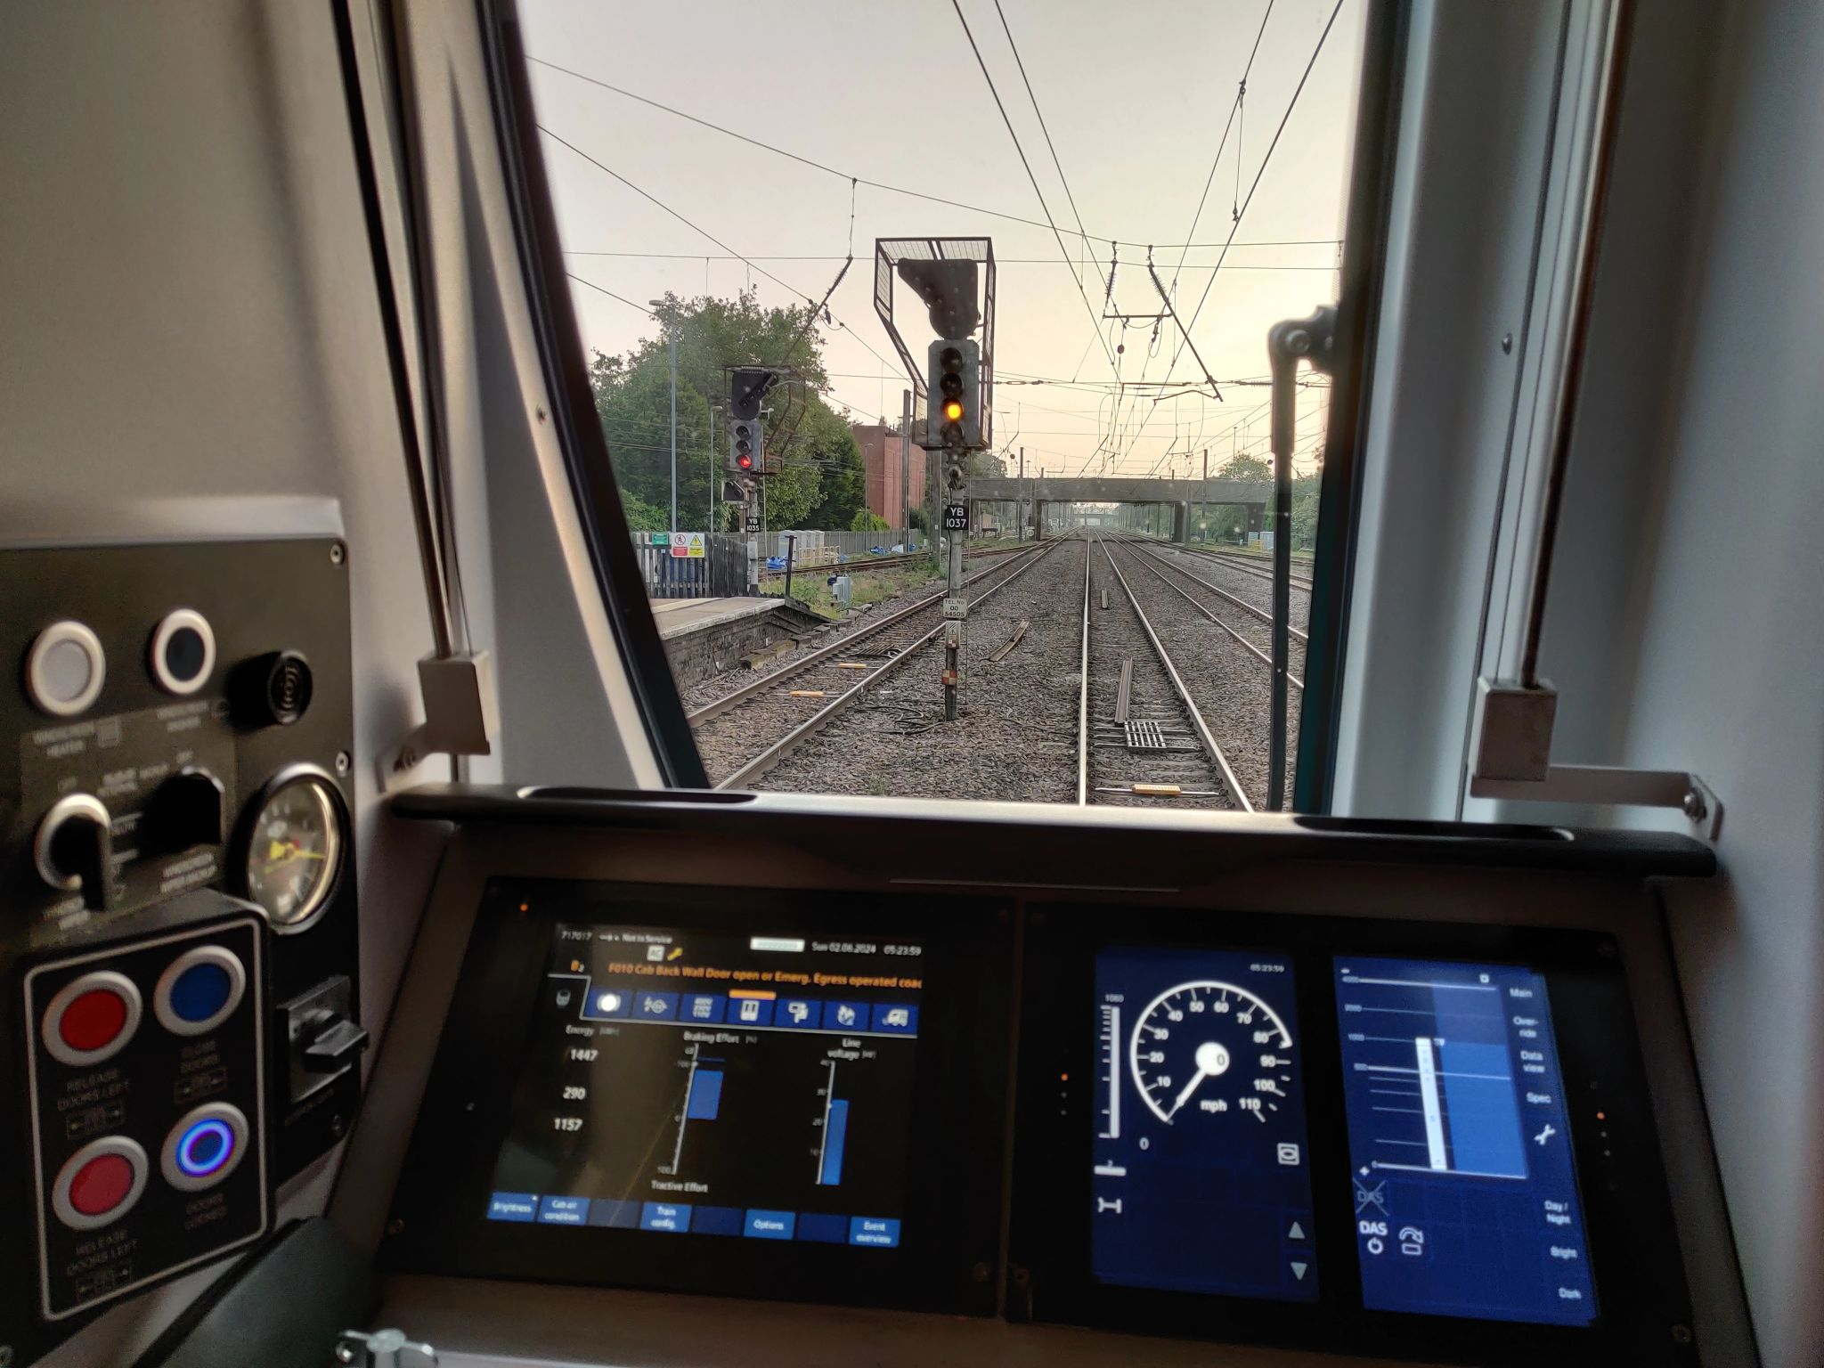
Operational Migration Overlay (OMO)
Welwyn to Hitchin
  L2 Overlay
  RBC/RBC Handover
  125mph (200km/h) operation
Baseline 3 Release 2 (SV2.1)
Initial testing circuit switch
Moving to packet switching
  Onboard dependent

Slide 8
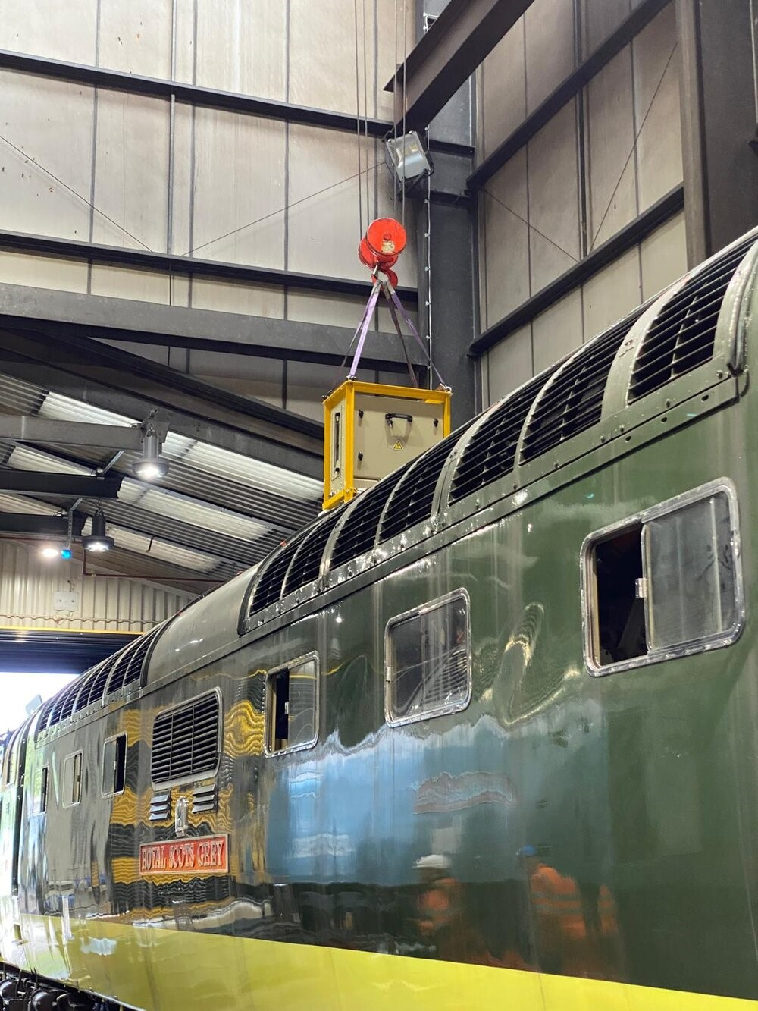
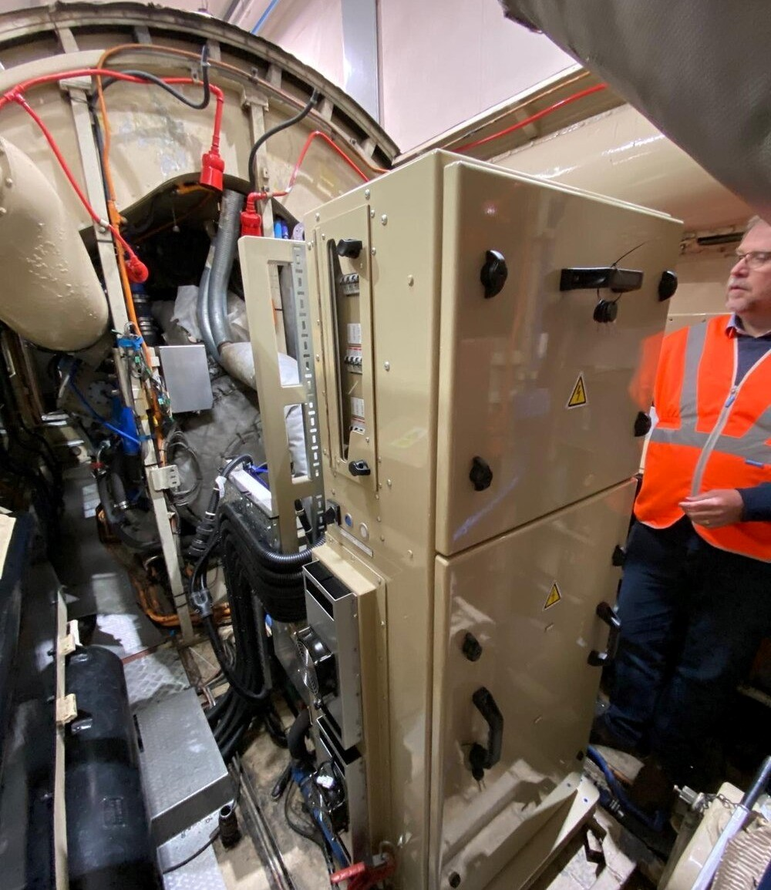
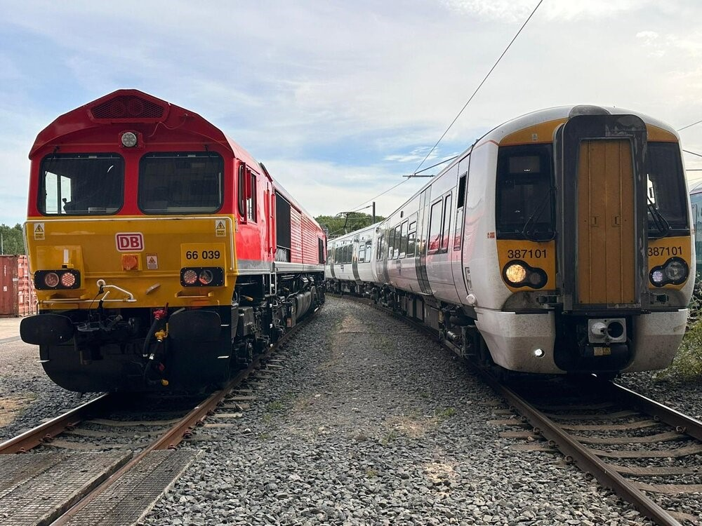

Train Fitment/Updates

Slide 9
Enabling Projects/activities
National ERTMS Test Lab (NETL)
ECDP SoS Lab
  Integration with onboards in a lab environment
On-line Key Management System (OKMS)
  Successfully demonstrated
    National ERTMS Test Lab (NETL)
    ECDP SoS Lab
4500 existing standards reviewed for impact by ETCS
‘Updates’ to GB Reference Design

Slide 10
Next steps
Commence roll-out of upgrades to existing fleets (Class 700/717)
Continue FiCs and fitment
NCL – ‘signals away’ – mid 2025
OMO – commence operational transition – end 2025

Slide 11
Reflections for the Industry
SV2.1 Product maturity
  2016 TSI
  Only now seeing first products for ‘debugging’.
ESC/RSC checks
  Finalising/publishing checks before system built/tested.
Driver Training / competence retention
  Simulator vs operational railway

Slide 12
Questions?

