Slide 1

CPHI Frankfurt
Exhibitor Webinar

Slide 2

Welcome
Tara Dougal
Event Director

Slide 3

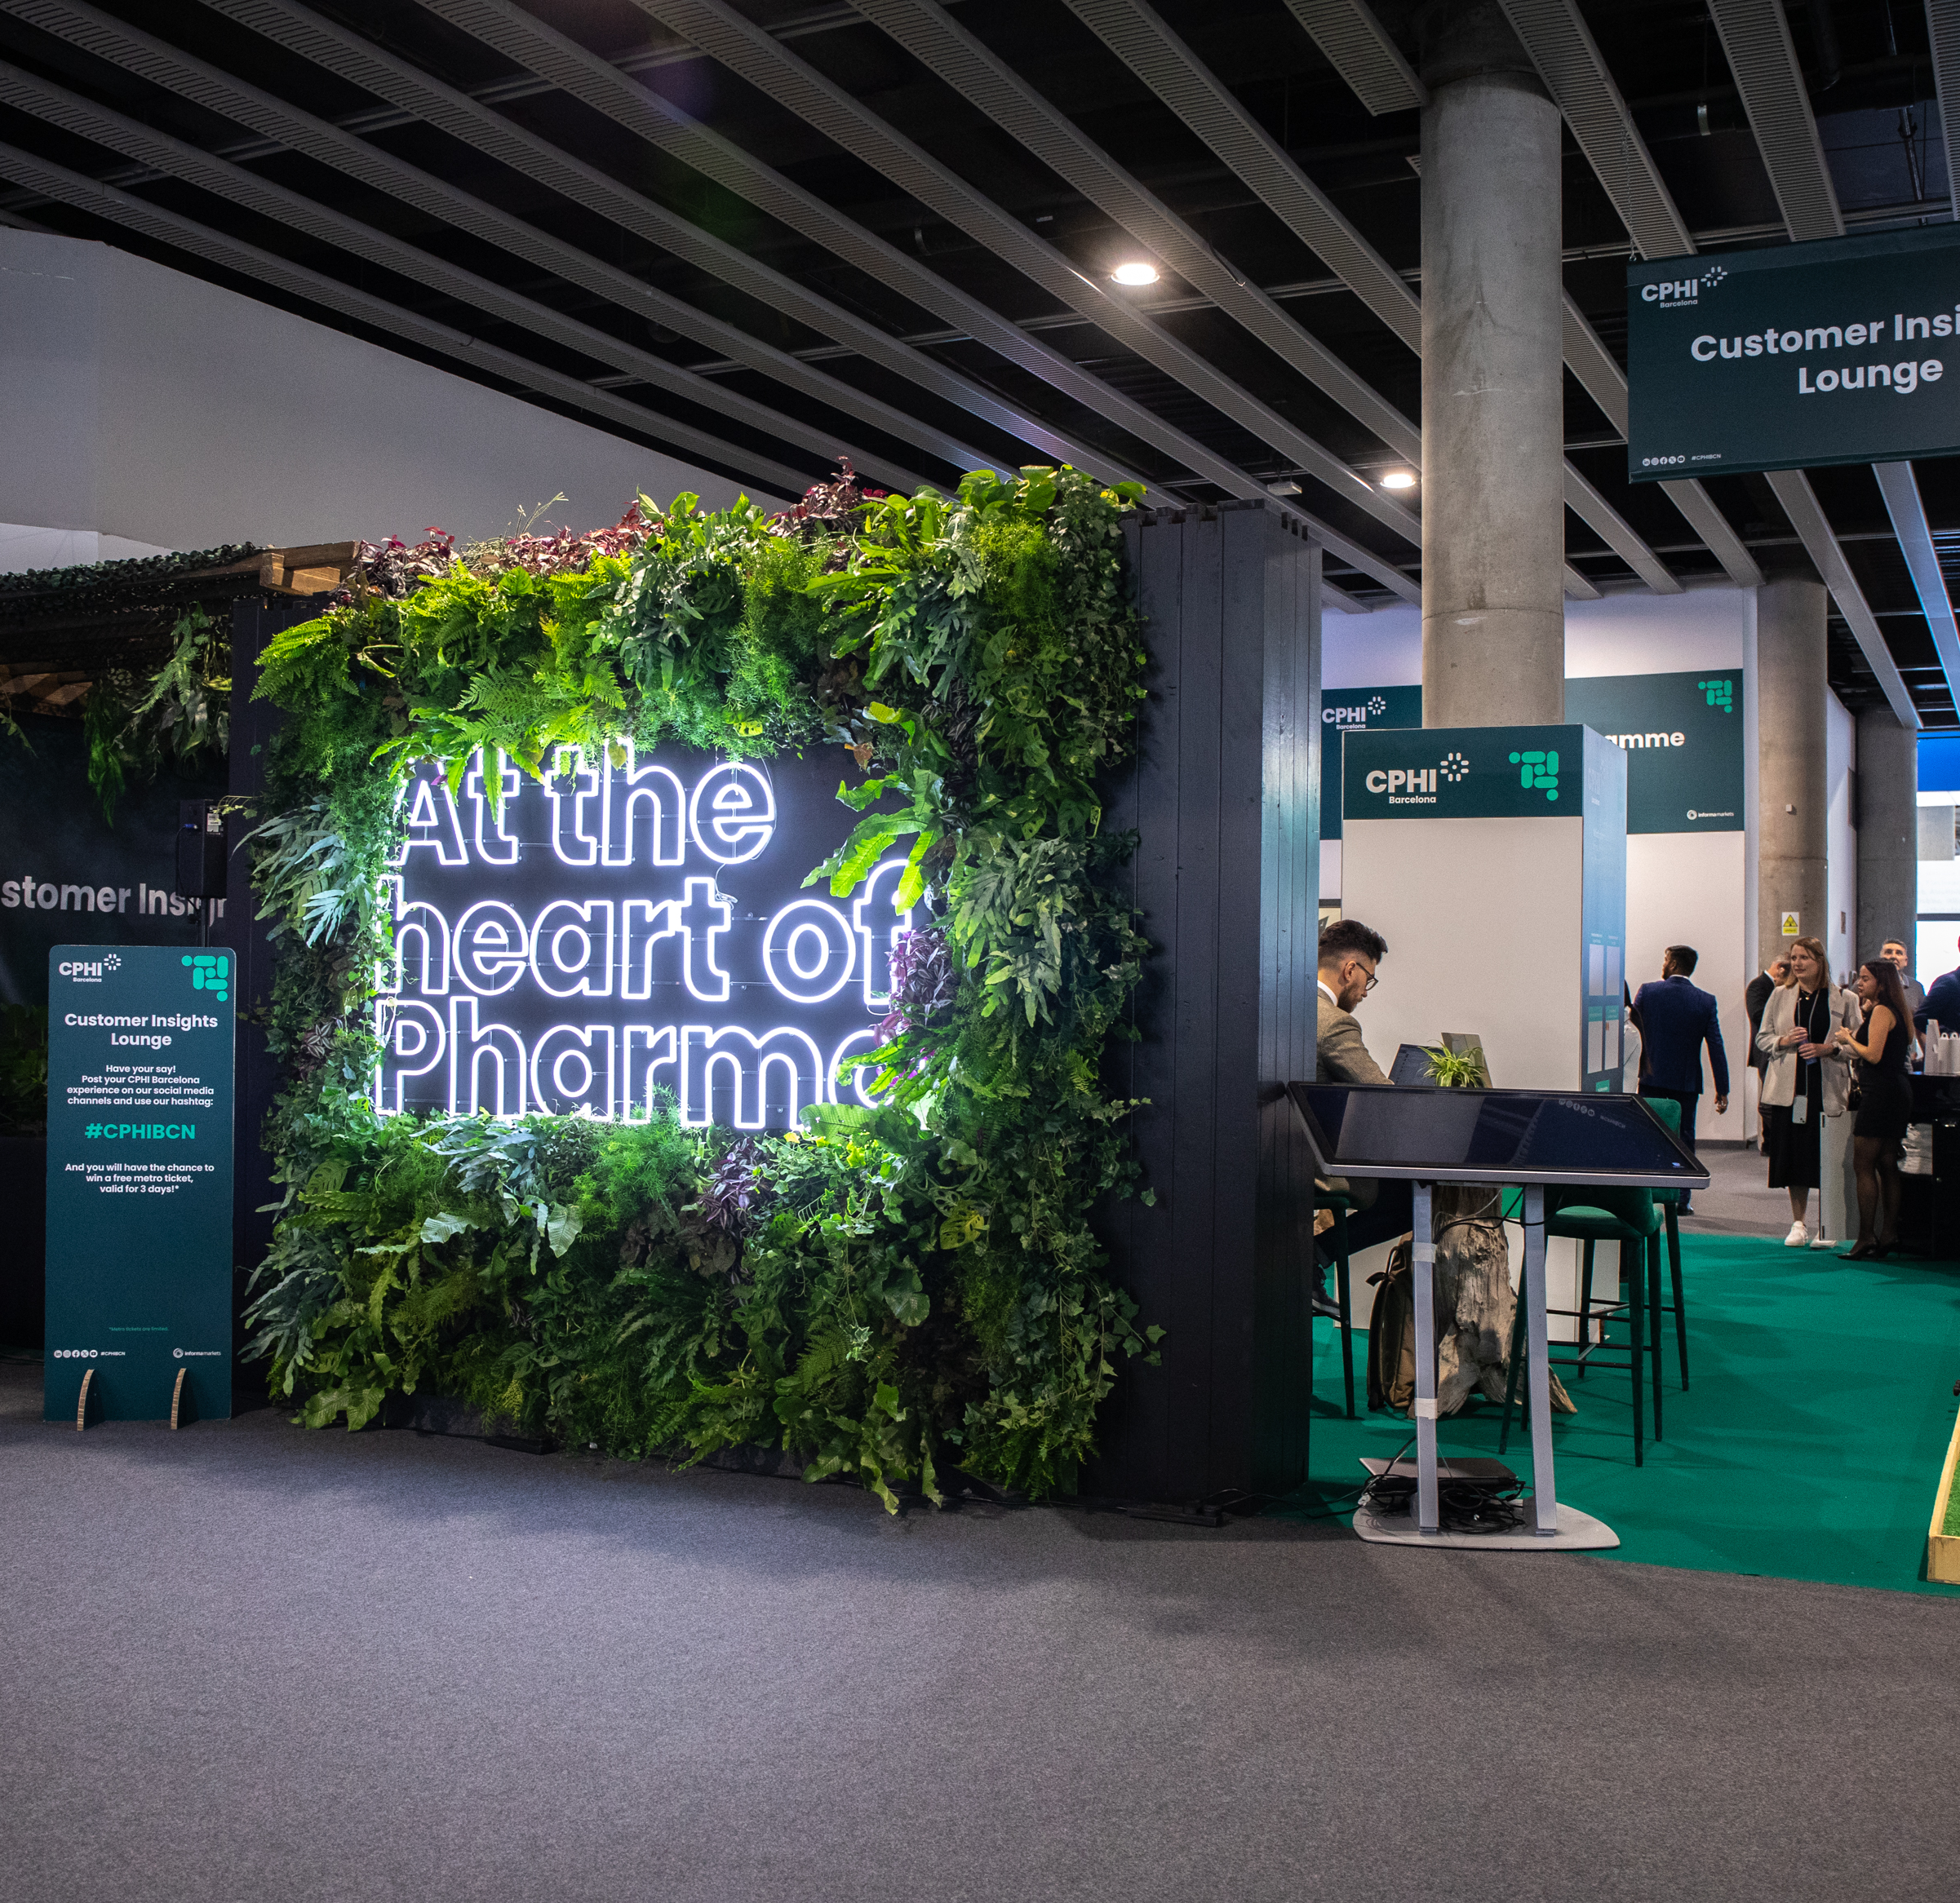
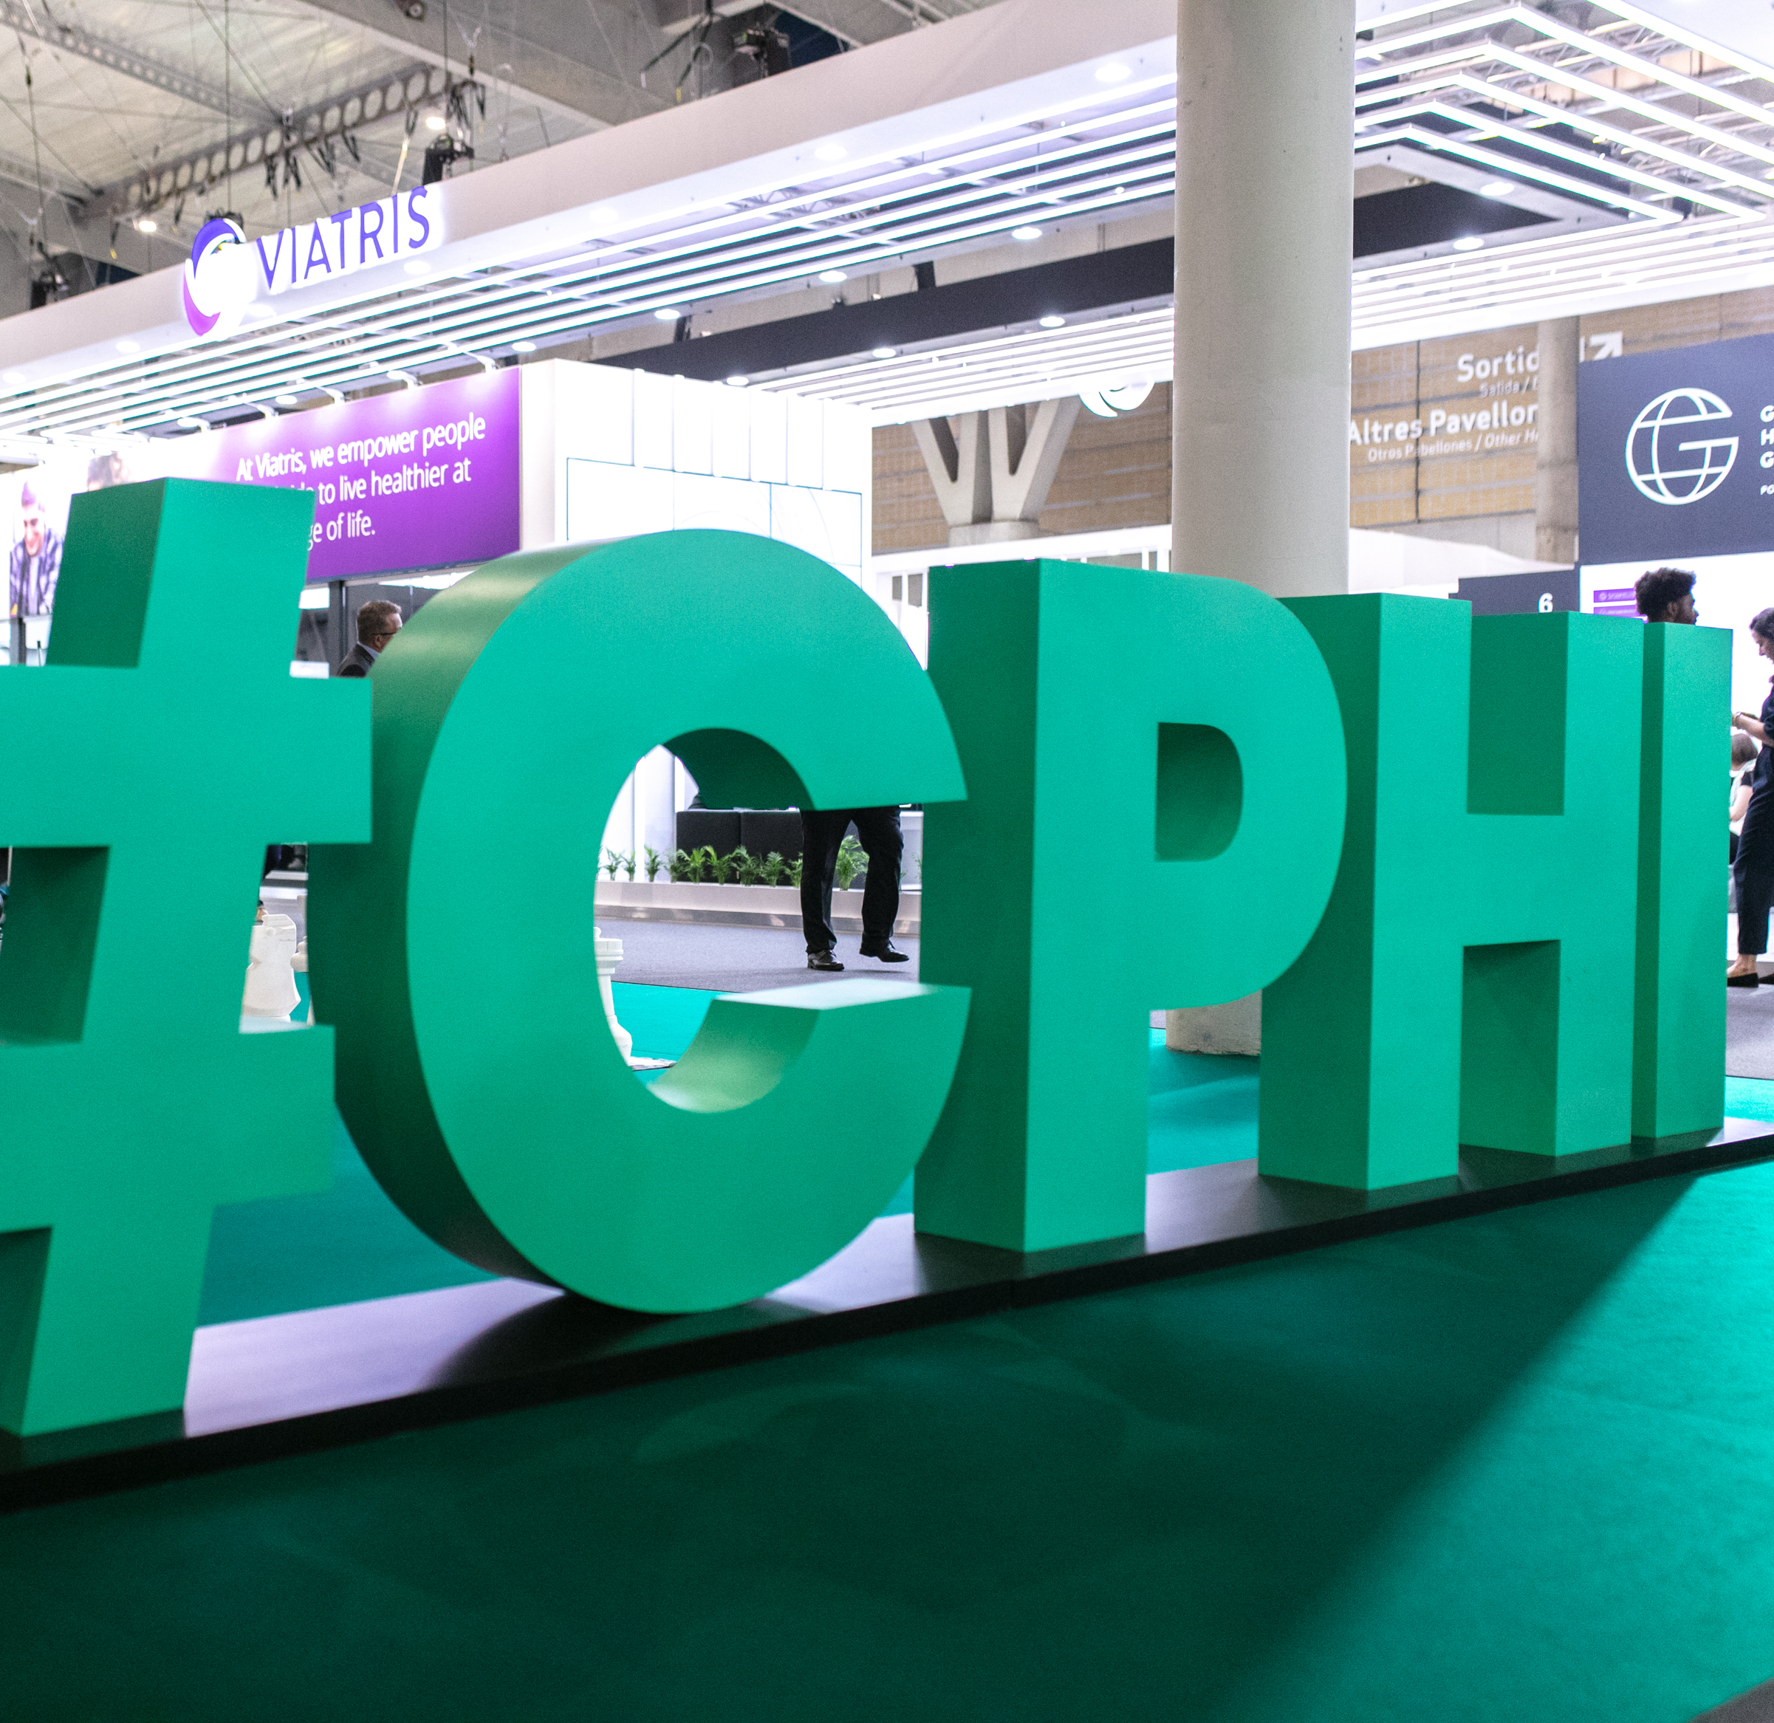
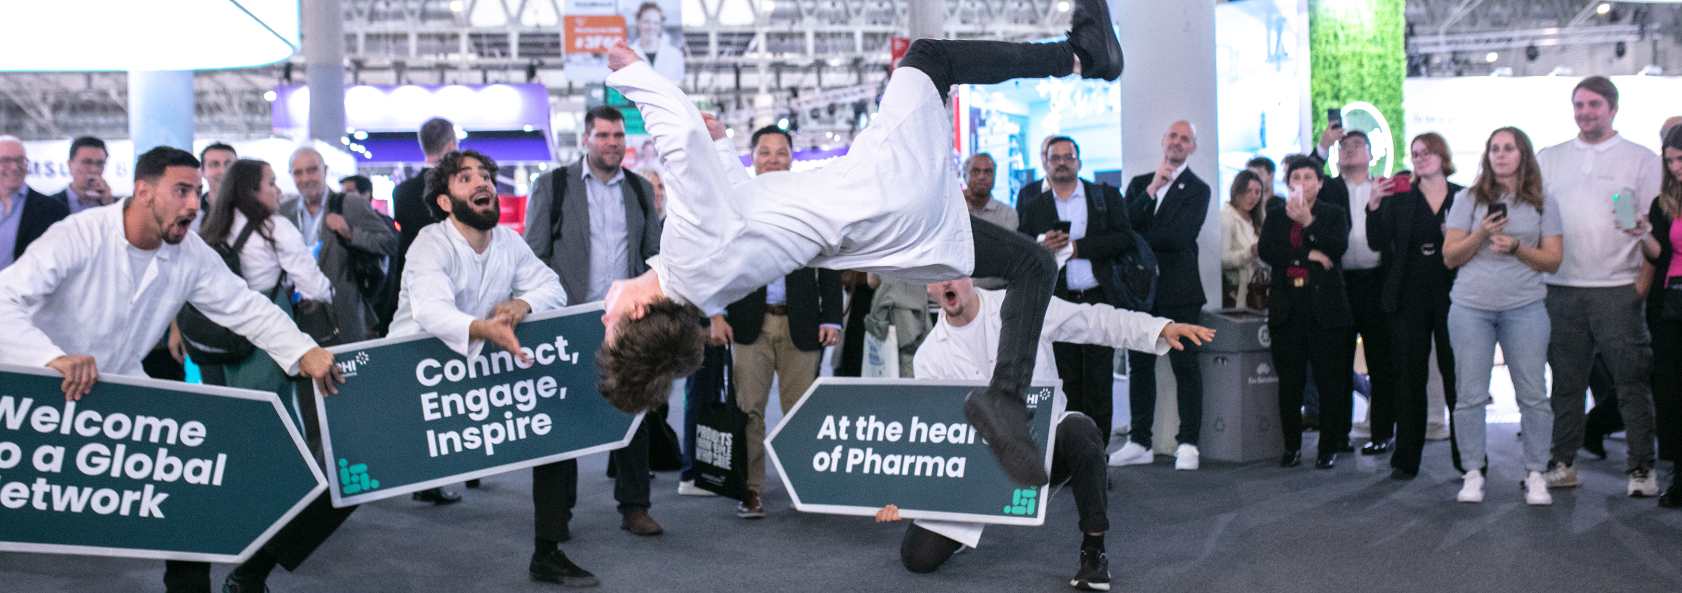
Welcome to
CPHI Frankfurt
Uniting the global pharma supply chain
6
63,000 visitors
2,400 exhibitors
Opening hours
Exhibitors 8:00 – 18:30
Leaders 8:30-18:30
Explorers 9:00 – 18:30
Standard: 10:00 – 18:30
Notes:
CPHI is the world’s leading pharmaceutical exhibition, connecting buyers and sellers of products and solutions from across the global supply chain.
36 year old brand, started in Frankfurt, will find it’s long term home there again from 2027 onwards
Covering the end to end supply chain, bringing together buyers and sellers of products, ingredients and solutions

Slide 4
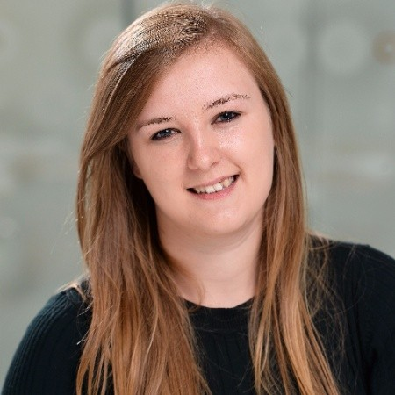
Operations
Victoria Ryder
Senior Operations Manager

Slide 5
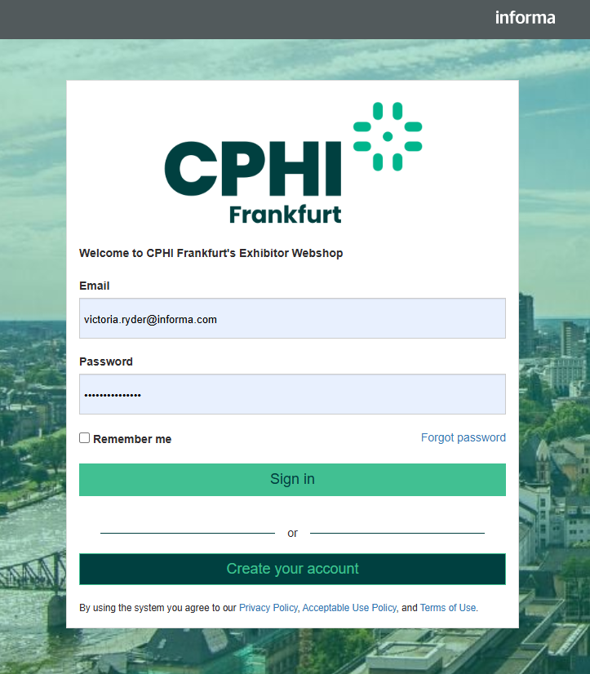
Finalise your preparations
Refresh your memory on the key information
Confirm all mandatory forms are completed
Place final orders for your stand.
Register your team members
Need help?
Customer Service
WhatsApp: +31 (0) 20 245 5355
Hotline Telephone number: +31 (0) 20 245 5355
Email: cphicustomerservice@informa.com
Notes:
Now is a great time to log back in to your exhibitor manual and Confirm all mandatory forms are completed, you manual also contains all the key information you need for exhibiting including hall opening hours, stand package inclusions and links to all the order forms for additional services. You can also find information about sustainability and better stands as all Space only exhibitors will again be audited against our 10 point check list this year.
this year we introduced a new e-commerce platform presenting products from A-booth. Adexpo, Fullvision and DB Pixelouse, theres still time to log in and place orders for your stand, hi-vis vests can also be ordered in the platform for collection onsite and for space only stand holders, you can purchase a stand number to be printed and delivered to your stand, please note these are mandatory for health and safety reasons and will not be provided this year by us as the organizer. If you have not already done so, you can complete the payment for stand parties in this platform too. Please note, parties are only permitted on Wednesday 29th October and require organizer approval, exhibitors hosting unauthorized stand parties will be subject to penalties as detailed in your exhibitor manual. If you are a space only stand, there’s still time for your contractor to order early access and late working, the details of how to do both are available in your exhibitor manual and for Modular stand holders you can complete all upgrades directly with a-booth. This platform will also be available for limited orders onsite but we do advise you place orders as soon as possible to avoid the higher onsite prices. Please also make sure you have checked the waste section of the Exhibitor manual and made the appropriate order, all exhibitors are responsible for the waste left on their stands, including unused promotional materials and penalties are in place to cover the cost of the waste removal.
Register your team members in advance to make your arrival at the venue as smooth as possible, printed badges are mandatory for all attendees this year so print your badge and bring it with you to Frankfurt.
If you need any help or have any questions about your final preparations our customer services team are here to help, their contact details are on screen now, you can also find a full list of official suppliers and their contact details within your exhibitor manual

Slide 6
Arriving at Messe Frankfurt
Build up
Exhibitor access is on Monday 27th October 8am – 6pm
This is a clean works day
PPE is mandatory
You will need a badge to enter
Badge printing will be available at Torhaus and Congress 3pm – 5pm.
Operations
Show Open
Exhibitor Access is from 8am
Arrive at the entrance closest to your stand
Prepare for security check
Print your badge in advance
Use the shuttle bus to transfer between halls quicker
Schedule your first meetings after opening times
Victoria Ryder
Senior Operations Manager
Notes:
Exhibitor access is on Monday 27th October 8am – 6pm, space only exhibitors wishing to arrive prior to the 27th to monitor the build of your stand will need a contractor pass, for shell scheme, Modular stand build or any other type of exhibitor access is not possible before the 27th october
This is a clean works day, no building works or painting are permitted to allow us to continue preparations for the laying of carpet and opening CPHI Frankfurt, Exhibitors or their contractors who break this rule will be subject to penalties. The details of these are available within your exhibitor manual.
PPE is mandatory, this means a hi-vis vest and safety boots or appropriate footwear, sandals, heels etc are not appropriate
You will need a badge to enter, please make sure you have your Exhibitor badge with you for entry on Monday 27th October, for Tuesday 28th October all attendees will need a printed badge before access is permitted, please print your badge before arriving in Frankfurt if possible. Lanyards and badge holders will be available at all registration areas on Tuesday 28th October.
If you need to Badge your badge onsite there will be a badge printing window on Monday 27th October from 3-5pm in Torhaus and Congress
Show Open
Arrive at the entrance closest to your stand, there are 5 entrances at Messe Frankfurt, it’s best to plan your arrival so that you don’t have far to walk once inside the venue.
Prepare for security check, all attendees will have to pass through a security check on entry to the venue, random bag checks will be in place, we will be using new machinery to make these checks as efficient as possible but please take exhibiting materials to your stand on Monday 27th October wherever possible to avoid delays with your entry.
Print your badge in advance and bring it with you, if you do not have a printed badge you will need to use the self print badge desks onsite to get one before accessing the event, this may delay you entry and arrival time at your stand.
Use the shuttle bus to transfer between halls quicker, if you need to arrive at City entrance but your stand is in hall 8,9,11,12 there will be an express shuttle bus to drop you closer to your hall, following the opening of the show there will be a dedicated hall shuttle with a stop a most halls to help you move across the venue quicker
We advise that you schedule your first meetings after opening times by 15 minutes or so to allow for attendees to travel from the entrance to your stand, access for Leaders is from 8:30am, access for explorers is from 9am and standard attendee access is 10am. Attendees will not be able to enter the venue until after their access time, please also advise attendees of the closest entrance to your stand and hall if they are visiting you for an early meeting.

Slide 7
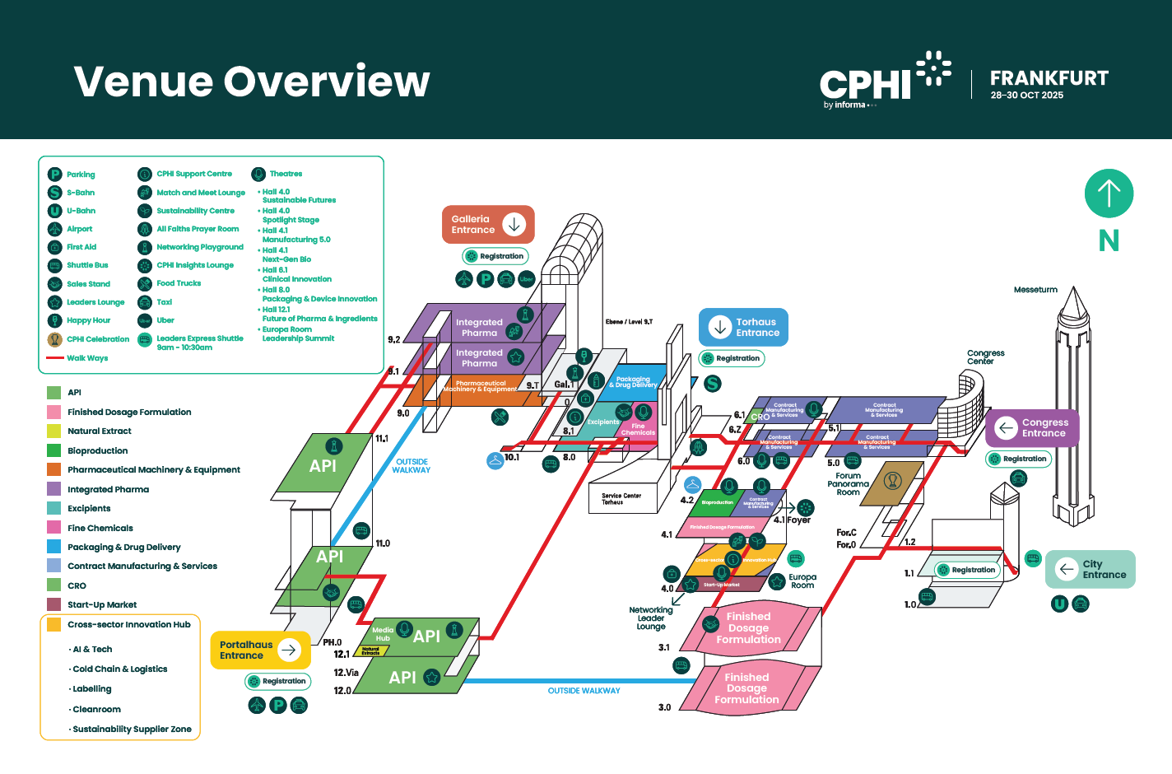
Notes:
CPHI Frankfurt spreads across the whole of Messe Frankfurt, with 16 halls and 5 entrances, City, Congress, Galleria, Torhaus, Portalhaus. This year we have given each entrance a colour to help make it easier for all attendees, so you will see both the entrance name and colour on all signage across the venue, if you need to check in a coat or luggage there a are matching colour coded cloakrooms at all entrances apart from Torhaus where if you are in halls 3-6 the cloakroom is located at hall 4.2 and if you are in halls 8-12 the cloakroom is in 10.1. If you are planning to arrive at Torhaus, please arrive before 9am when we expect the entrance to become busy with attendees, if you are arriving by a private coach, the drop off point is Portalhaus.
A few more key locations to be aware of and please also include this in the briefings you will do for your teams
First aid if needed is located at hall 8.0 in Galleria and at Hall 4.0, the all faiths prayer room is located at Torhaus and a lactation room is available at hall 8.0. We also have two CPHI Support Centres where you will be able to find the informa customer services team and representatives from all our official suppliers here, support centres are located at at Hall 4 level C and hall 8.0. We will also have a pop up desk at Portalhaus outside hall 11.0.
There will also be a free to attend happy hour in Galleria from 6pm on Tuesday 28th and Wednesday 29th October and the CPHI Celebration is taking place in Forum Panarama on Tuesday 28th October.

Slide 8
Digital Operations
Adya Verma

Slide 9
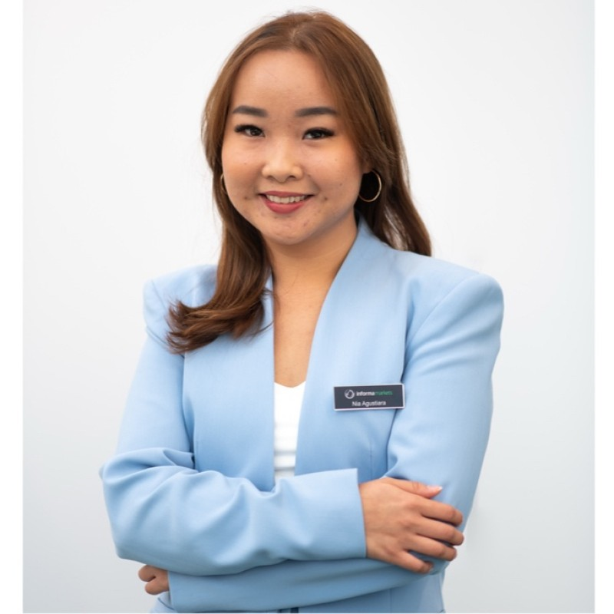
Your Stand at CPHI Milan 2026
Nia Agustiara
Senior Project Specialist - Rebook
Notes:
Hello everyone, and welcome. My name is Nia Agustiara, I’m a Senior Project Specialist in the sales team.
Thank you for joining today’s quick session.

Slide 10

Rebook now for CPHI Milan
Benefits of rebooking Pre-show
Modular Stand Design Package
Rebooking process
Notes:
In the next ten minutes, I’ll cover three things:
first, benefits of rebook pre-show and why acting early is so important, ,
second,how our Modular Stand Design Package can help you stand out at CPHI Milan
and finally, how you can easily rebook your stand in our platform

Slide 11
Why Rebook Early?
Booking demand is very high for CPHI Milan – 80% space booked
Prime locations are filling up quickly
Secure stand with the best available rate
Notes:
Let’s start with rebooking. Every year, CPHI attracts a huge number of exhibitors, and prime locations go very quickly. At this moment 80% space booked
By rebooking early, you not only secure your preferred spot, but you also avoid the risk of being left with limited choices. It’s a simple step that saves you stress later.
Finally, when you rebook early, you will secure stand with the best available rate as price increased based on the occupancy rate.

Slide 12
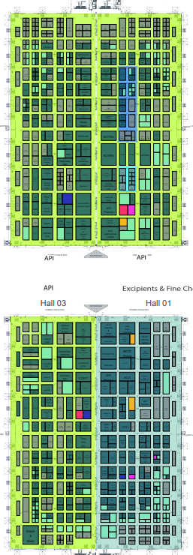
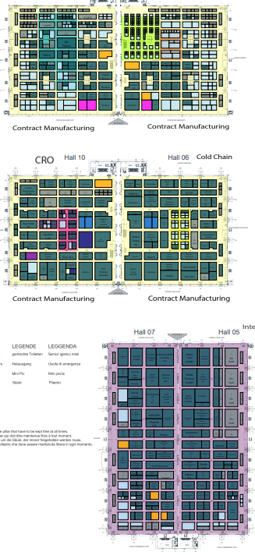
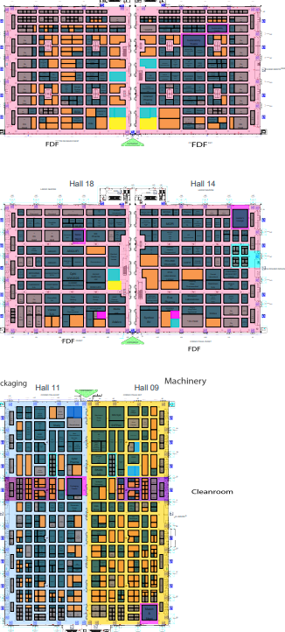
CPHI Milan 2026 floorplans
Floorplan 1: API, Excipients & Fine Chemicals, Natural Extract
Floorplan 2: CDMO, CRO, Bio, AI & Tech, Coldchain, Integrated Pharma
Floorplan 3: FDF, Machinery, Cleanroom, Packaging, Labelling
Notes:
Here’s the current floor plan. This year we divided the floorplan into 3 floorplans : floorplan1,2,3
You can see in dark green the stands that are already confirmed, and in other colour still available.
As you can tell, the halls are already filling up quickly, and the remaining spaces are becoming limited.
This is why we encourage you to rebook now—because once the floor is full, it’s full.
Rebooking today ensures you’re in the location that best supports your business objectives.

Slide 13
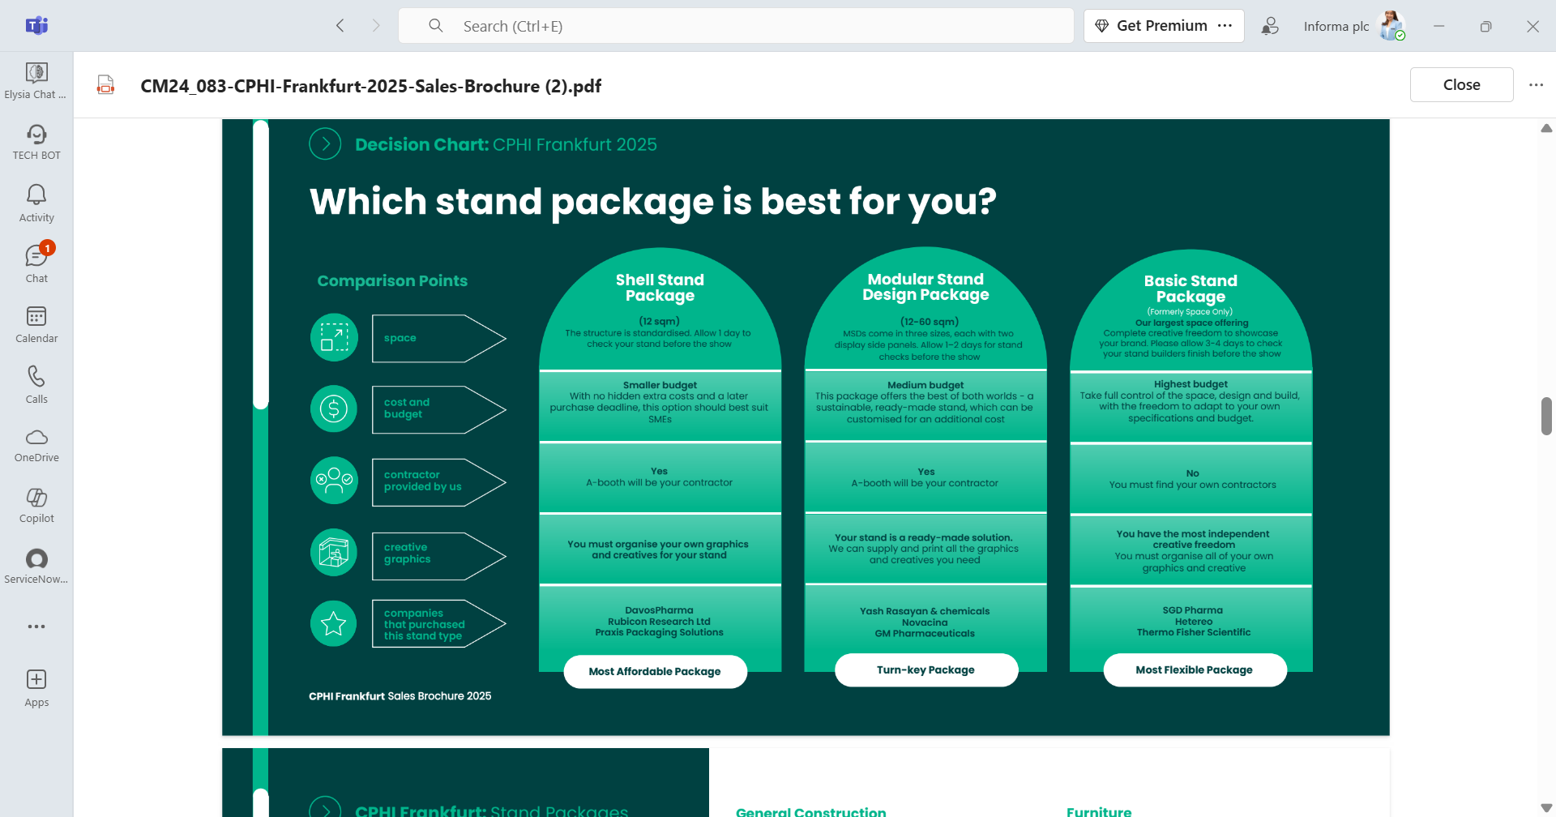
Choosing the best stand for your needs
Securing your location
Choosing the right stand package
Best Balance
Notes:
Securing your location is only half the story.
Once you have your space, the next step is making sure you stand out.
And that’s where our Modular Stand Design Package comes in.
The Modular Stand Design Package is our turn-key solution for exhibitors who want impact without the cost and complexity of a full custom build.
With MSDP, you get a professional look that’s scalable and customizable, but at a medium budget.
The best part? Everything is handled by our contractors, so you don’t have to worry about logistics.
It’s about giving you peace of mind, while still standing out on the show floor.

Slide 14
Booking instructions
Notes:
Now let me quickly show you how easy it is to rebook in the exhibitor platform.
Step one, log in to your portal—this is the same login you used for your previous booking.
Step two, click on the ‘Rebook’ option next to your existing stand.
Step three, confirm your stand selection, choose your package, and finalize the booking.
That’s it—just three steps.
It’s a straightforward process designed to save you time and secure your space immediately.
And remember—rebooking early also means you can consider upgrading your stand package.

Slide 15
Thank you!
Nia Agustiara
pharmaobp@informa.com
Notes:
Finally, Rebooking through the platform is simple and fast.
And by upgrading to the Modular Stand Design Package, you’ll maximize your presence at CPHI Milan without overspending.
I encourage you to rebook today and speak with our team about upgrading to MSDP.
That way, you’ll secure your location and ensure your stand makes the impact it deserves.
Thank you for your time today—let’s make CPHI Milan a great success for your company.

Slide 16
Boost on-site visibility
Notes:
So let’s recap:
The floor plan is filling up quickly.
Rebooking through the platform is simple and fast.
And by upgrading to the Modular Stand Design Package, you’ll maximize your presence at CPHI Milan without overspending.
I encourage you to rebook today and speak with our team about upgrading to MSDP.
That way, you’ll secure your location and ensure your stand makes the impact it deserves.
Thank you for your time today—let’s make CPHI Milan a great success for your company.

Slide 17
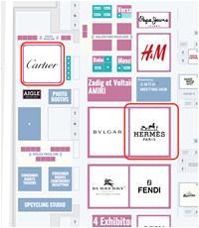
Stand out on-site with our Online Floor Plan Logo
Logo Placement on the Online Floor Plan – €2,000
Make your stand impossible to miss! Add your company logo to your stand on the CPHI Europe Online Floor Plan, visible to all attendees via the official mobile app.
Logo displayed on your stand location
Visible on the mobile app and online
Exhibitors with logos receive 267% more exposure on average
🔒 Limited availability per hall, contact your Account Manager now for details!

Slide 18
Q&A
Notes:
So let’s recap:
The floor plan is filling up quickly.
Rebooking through the platform is simple and fast.
And by upgrading to the Modular Stand Design Package, you’ll maximize your presence at CPHI Milan without overspending.
I encourage you to rebook today and speak with our team about upgrading to MSDP.
That way, you’ll secure your location and ensure your stand makes the impact it deserves.
Thank you for your time today—let’s make CPHI Milan a great success for your company.

